Slide 1
On the reported TDCF change when the OMC Whitening Electronics Chassis Configuration Changed
J. Kissel for the Calibration Team

Slide 2
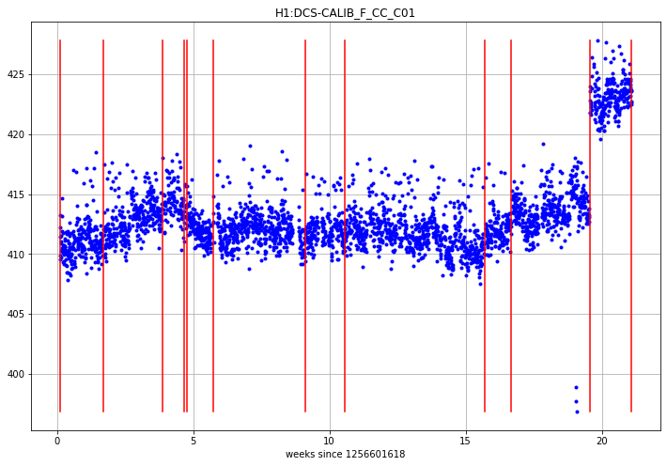
What’re we going to do tonight, Brain?
Trying to solve yet another mystery of O3B Chunk 2…
As a part of the O3B Chunk 2 review, G2001206, Alan asks “why did the reported cavity pole change when the OMC Whitening Chassis Configuration changed?”
From Alan’s Sanity Checks, calCheck_plots.html
TDCF for Cavity Pole Frequency [Hz]
Whitening change on Mar 16 2020
Time [weeks since Nov 1 2019]

Slide 3
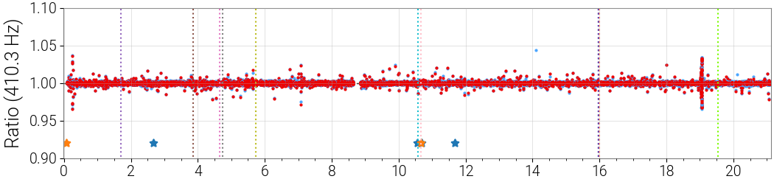
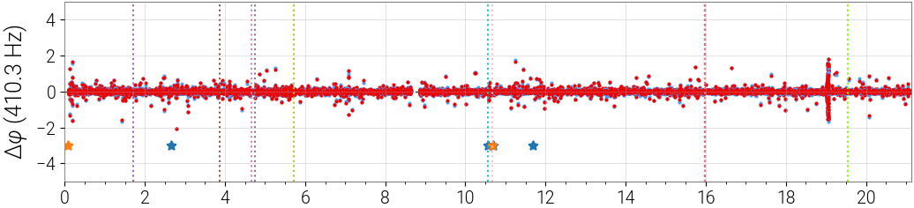
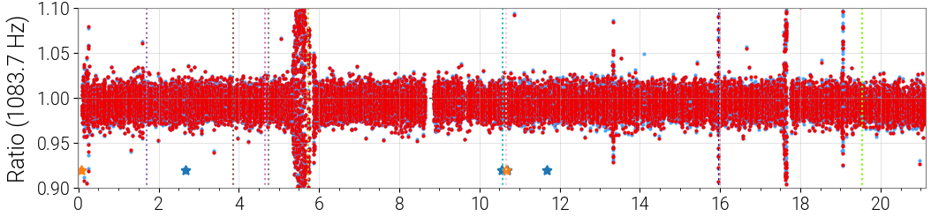
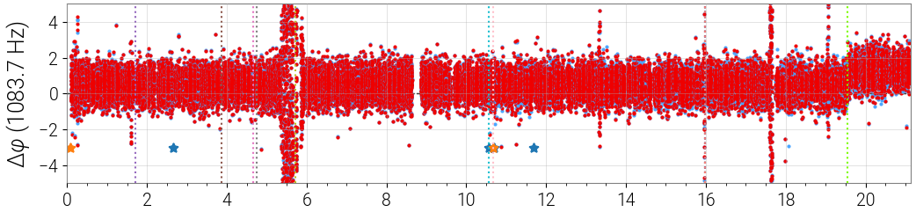
First, let’s check the DCS / PCAL Trend
If the cavity pole really changed, and the DCS model is now wrong, then we should see an impact in both the 410 Hz and 1083 Hz lines after the change.
Magnitude
O3B C01 Cummary Pages
Phase
Magnitude
Time [weeks since Nov 1 2019]
OK, maybe there’s something here.
A ~1 deg change…
Phase
Time [weeks since Nov 1 2019]

Slide 4
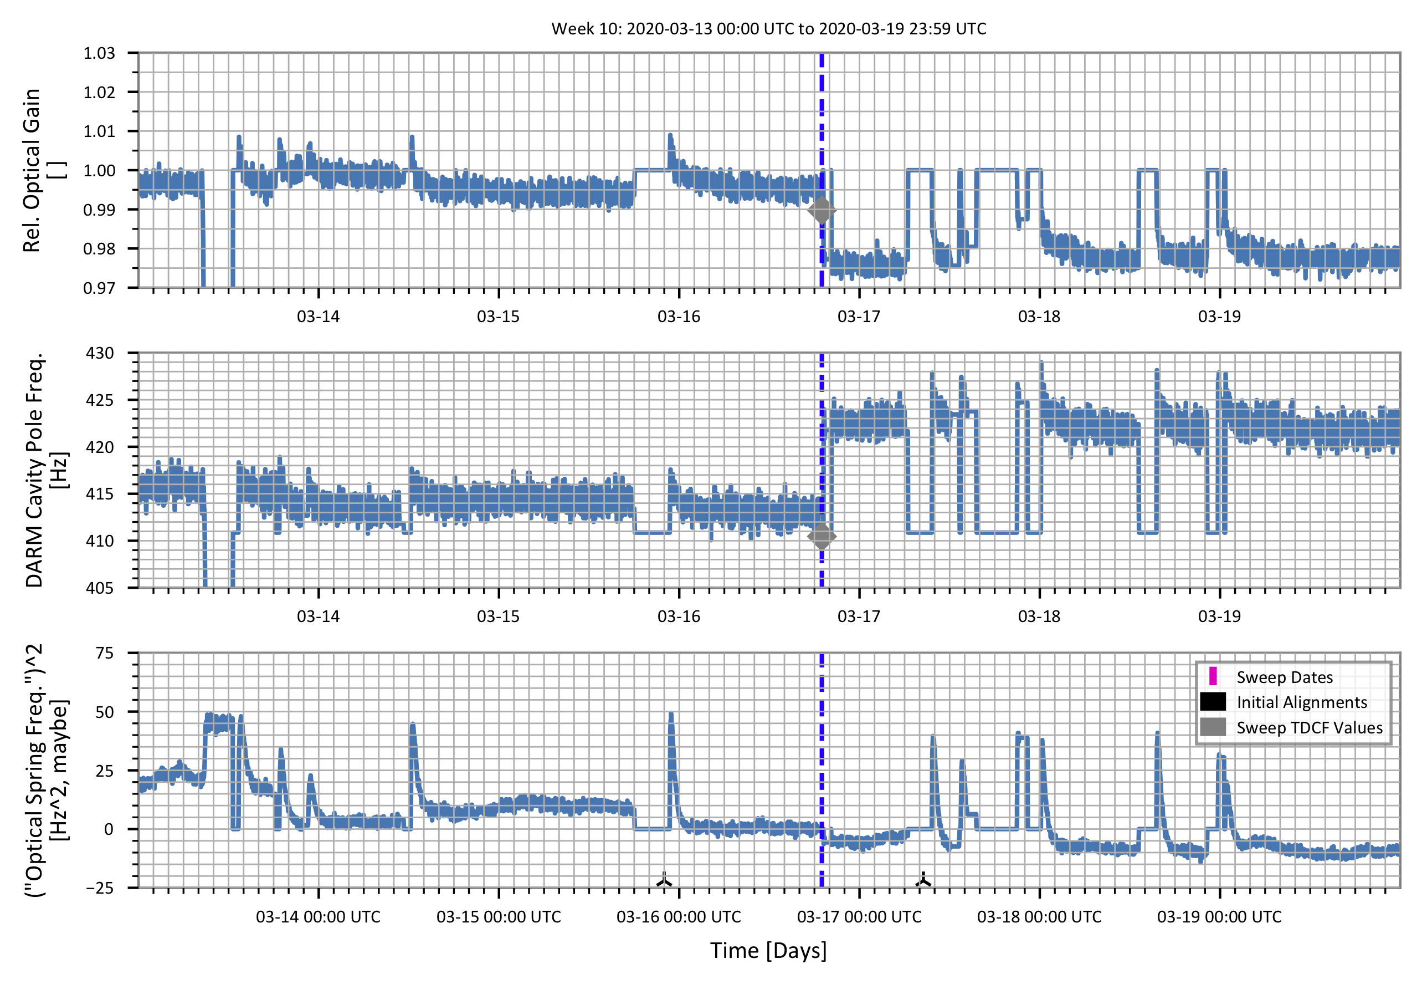
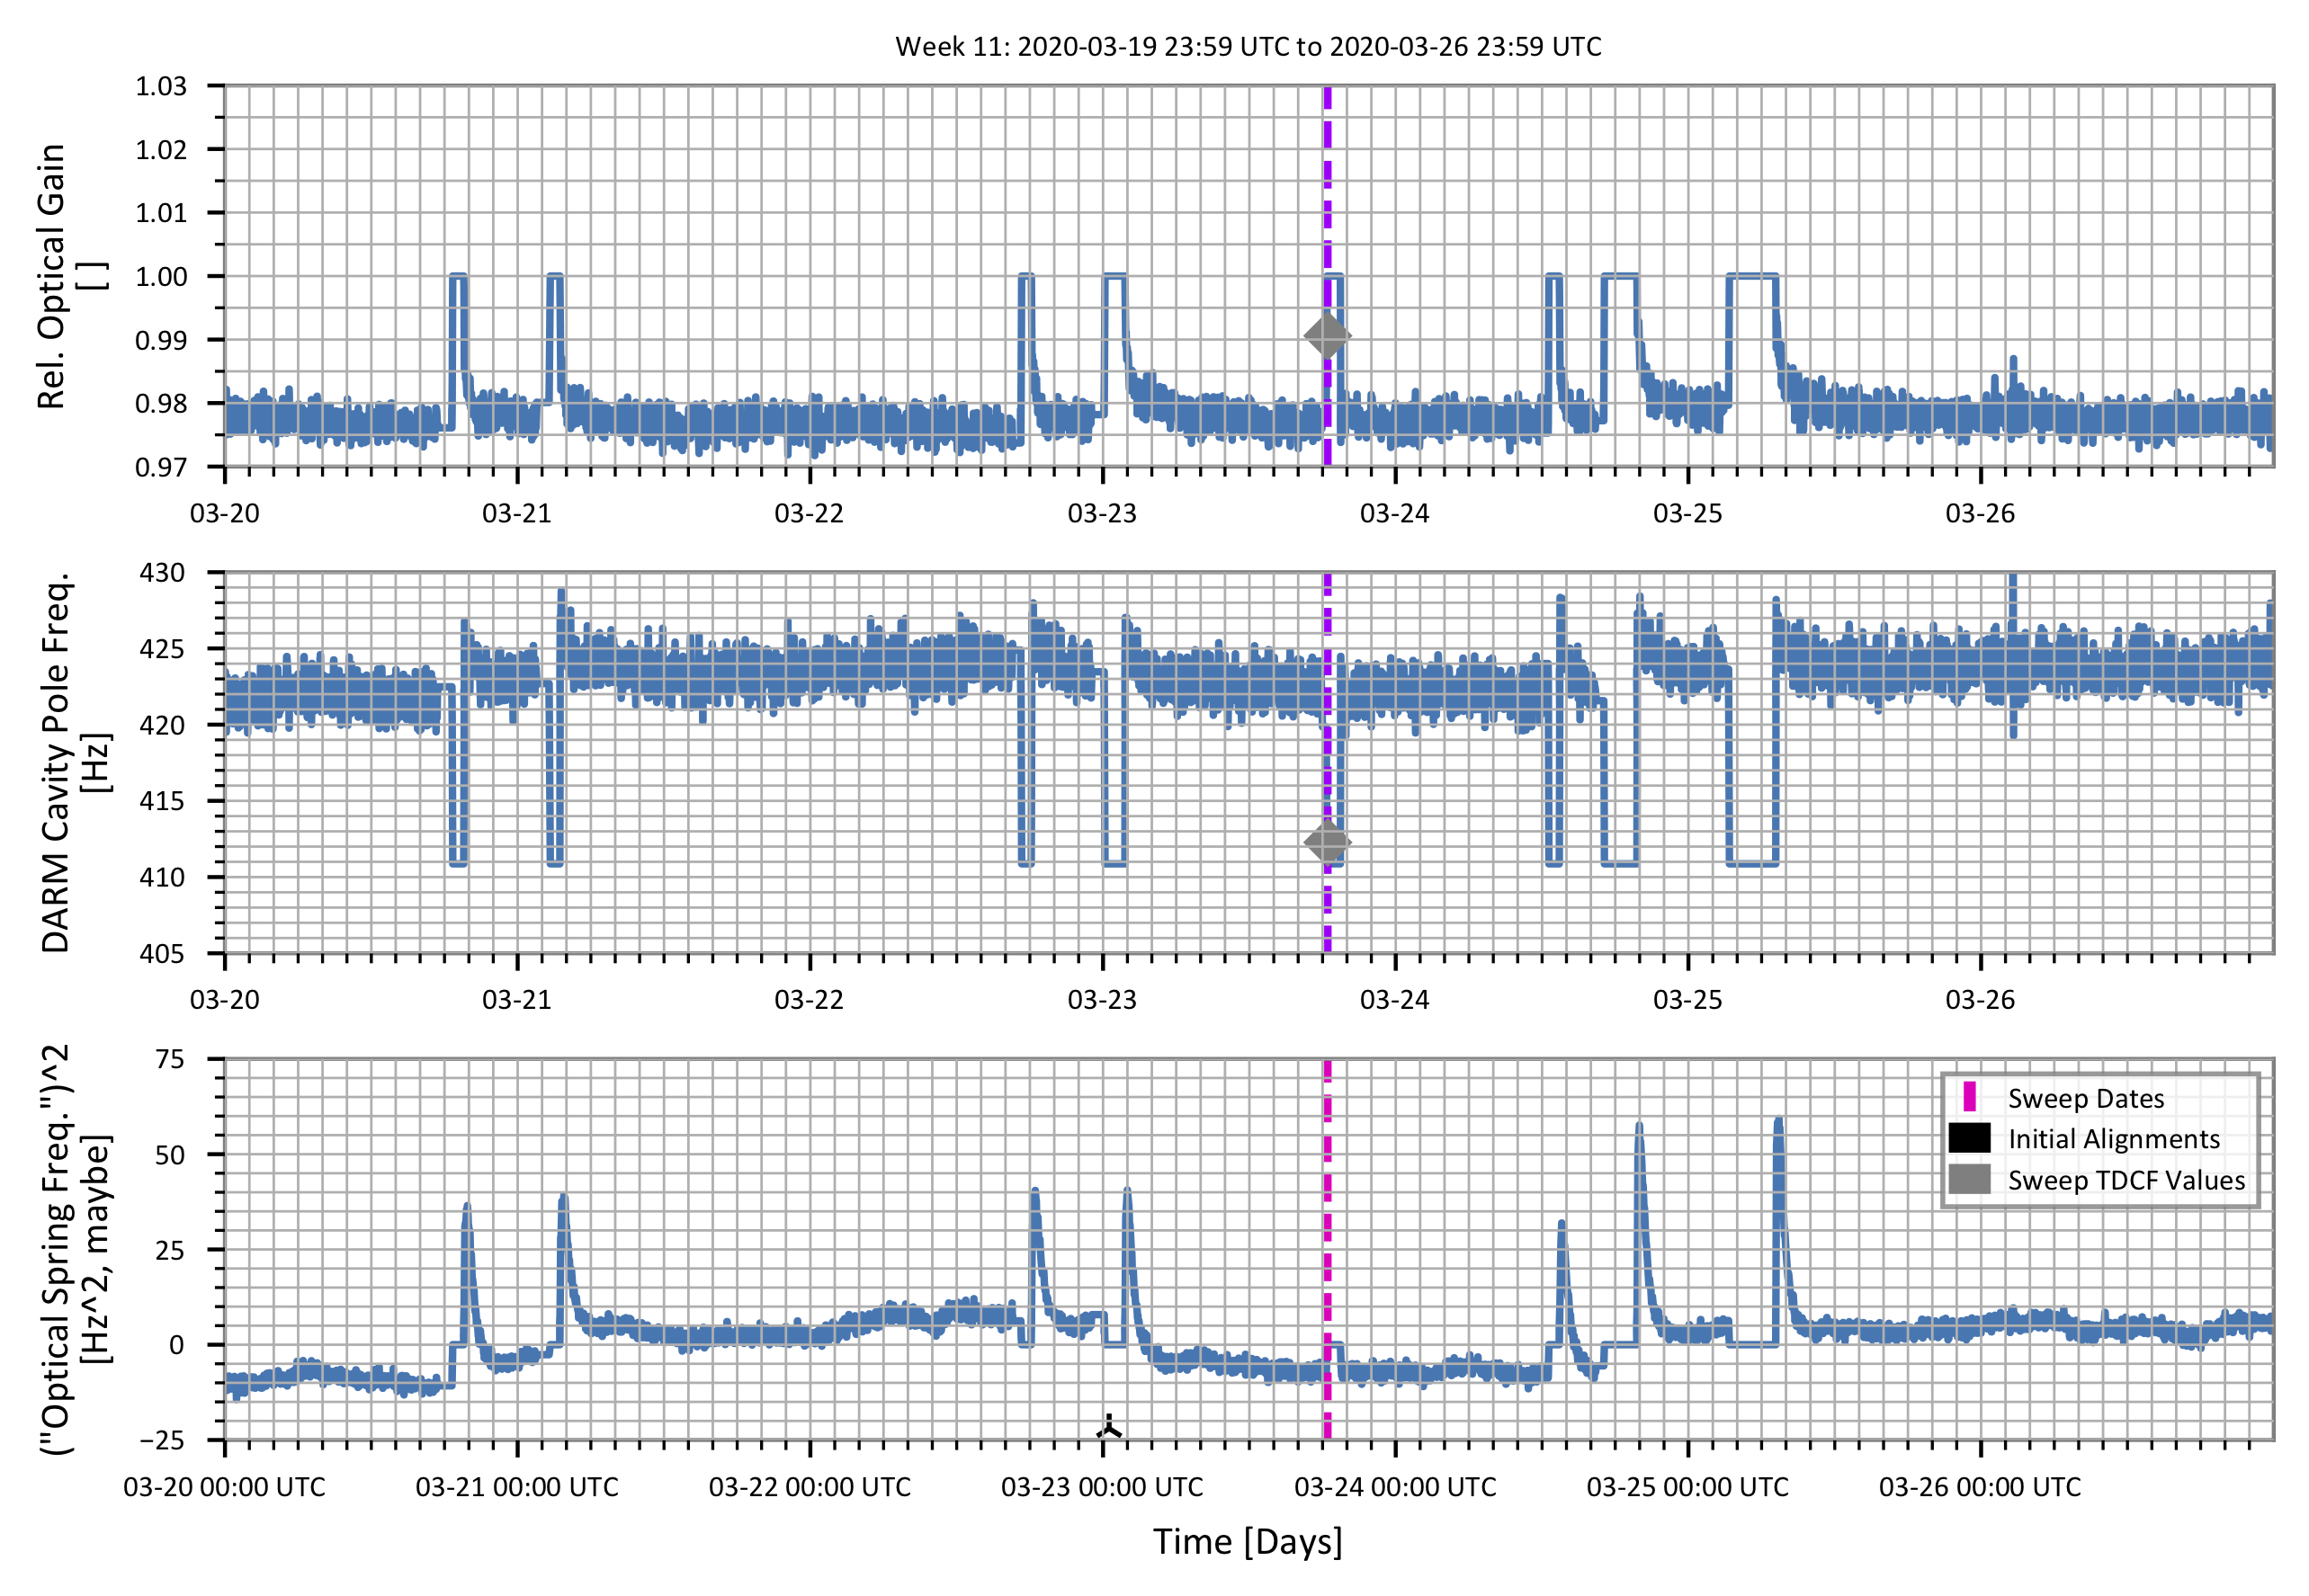
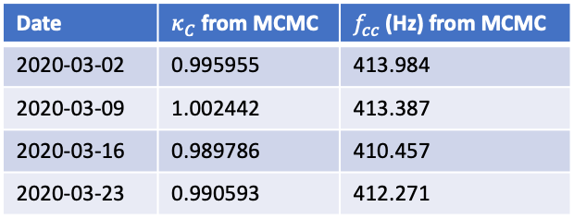
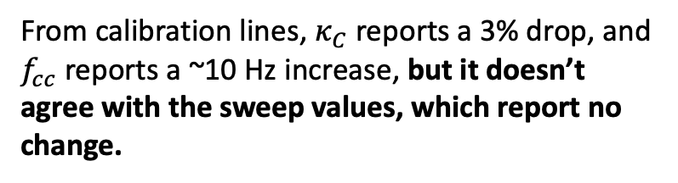
What do the TDCFs Report?
Zooming in on the last two weeks of the Run, I show
  the actual minute trends of the sensing function TDCF channels from the DCS frames, and
  the MCMC fit values for the two sensing function sweeps
Plots produced by plot_H1_DCS_TDCF_MinuteTrends_O3BChunk2_Jan14-Mar27_20200803.py
From calibration lines, $κ_{C}$ reports a 3% drop, and $f_{cc}$ reports a ~10 Hz increase, but it doesn’t agree with the sweep values, which report no change.
Date | $κ_{C}$ from MCMC | $f_{cc}$ (Hz) from MCMC
2020-03-02 | 0.995955 | 413.984
2020-03-09 | 1.002442 | 413.387
2020-03-16 | 0.989786 | 410.457
2020-03-23 | 0.990593 | 412.271

Slide 5
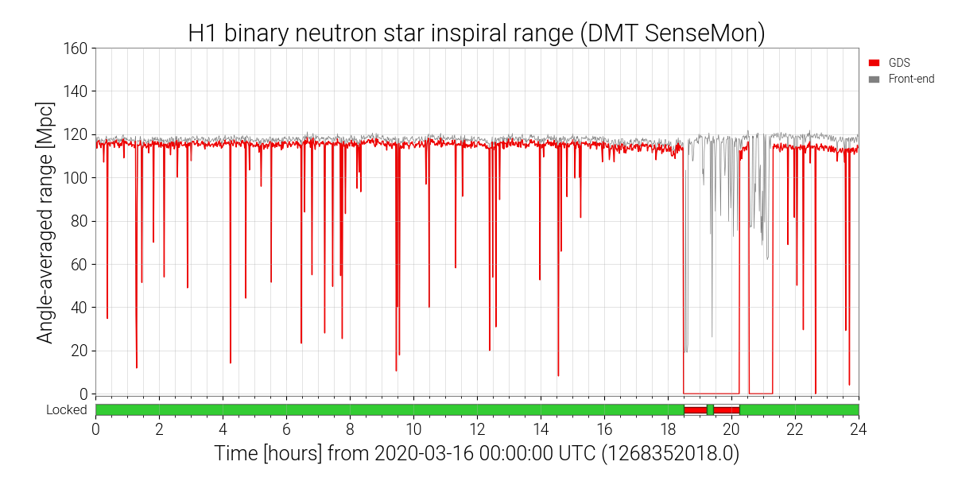
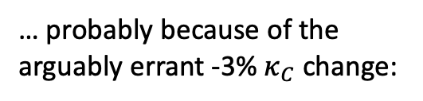
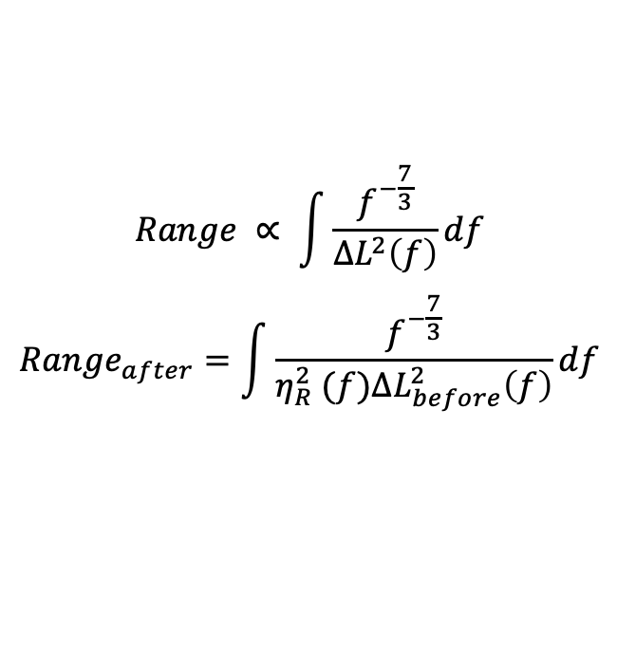

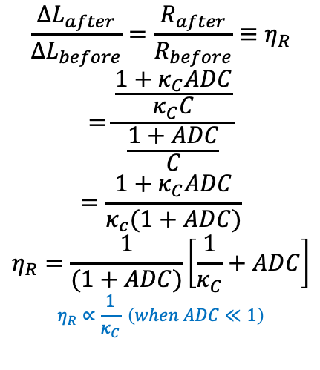
Note, the Range Dropped…
… probably because of the arguably errant -3% $κ_{C}$ change:
~120 Mpc
~116 Mpc
$$\frac{{∆L}_{after}}{{∆L}_{before}}=\frac{R_{after}}{R_{before}}≡η_{R}$$
$$=\frac{\frac{1+κ_{C}ADC}{κ_{C}C}}{\frac{1+ADC}{C}}$$
$$=\frac{1+κ_{C}ADC}{κ_{c}(1+ADC)}$$
$$η_{R}=\frac{1}{(1+ADC)}\left[\frac{1}{κ_{C}}+ADC\right]$$
$$η_{R}∝\frac{1}{κ_{C}} \left(when ADC≪1\right)$$
$$Range ∝ \int{\frac{f^{−\frac{7}{3}}}{{∆L}^{2}\left(f\right)}df}$$
$${Range}_{after}=\int{\frac{f^{−\frac{7}{3}}}{η_{R}^{2} (f){∆L}_{before}^{2}\left(f\right)}df}$$
$${Range}_{after}∝κ_{C}^{2} (when ADC≪1)$$

Slide 6
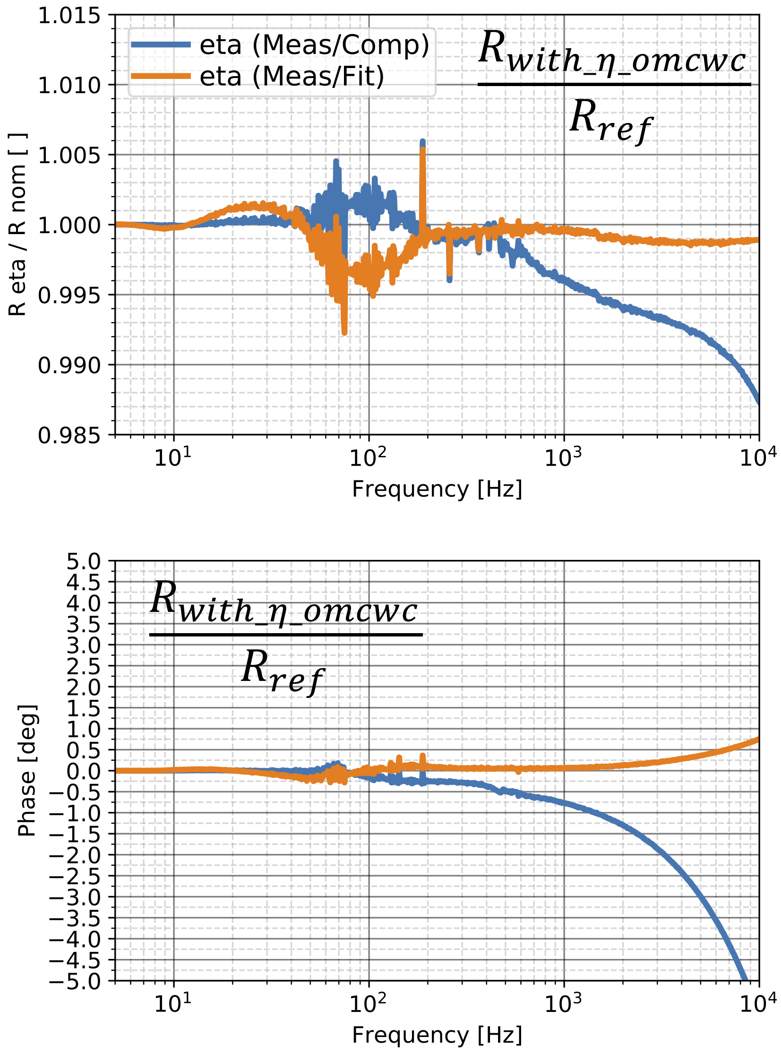
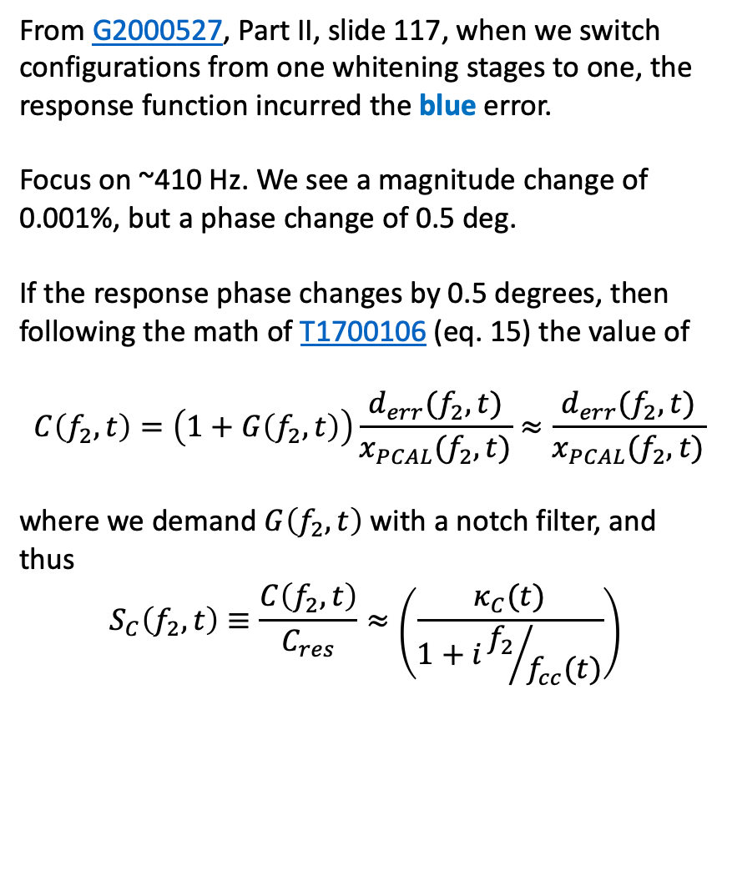
But let’s get back to f_cc
What happens when the response function changes at calibration line frequency?
From G2000527, Part II, slide 117, when we switch configurations from one whitening stages to one, the response function incurred the blue error.
Focus on ~410 Hz. We see a magnitude change of 0.001%, but a phase change of 0.5 deg.
If the response phase changes by 0.5 degrees, then following the math of T1700106 (eq. 15) the value of
$$C\left(f_{2},t\right)=\left(1+G\left(f_{2},t\right)\right)\frac{d_{err}(f_{2},t)}{x_{PCAL}(f_{2},t)}≈\frac{d_{err}(f_{2},t)}{x_{PCAL}(f_{2},t)}$$
where we demand $G\left(f_{2},t\right)$ with a notch filter, and thus
$$S_{C}\left(f_{2},t\right)≡\frac{C\left(f_{2},t\right)}{C_{res}}≈\left(\frac{κ_{C}(t)}{1+i{f_{2}}/{f_{cc}(t)}}\right)$$

Slide 7




Just in case you need proof $G(f_{2})≪1$
Produced by the O3B, 2020-01-03 Model
Here’s $f_{2}=410.3$ Hz
$$|G\left(f_{2}\right)|≈{10}^{−4}≪1$$

Slide 8
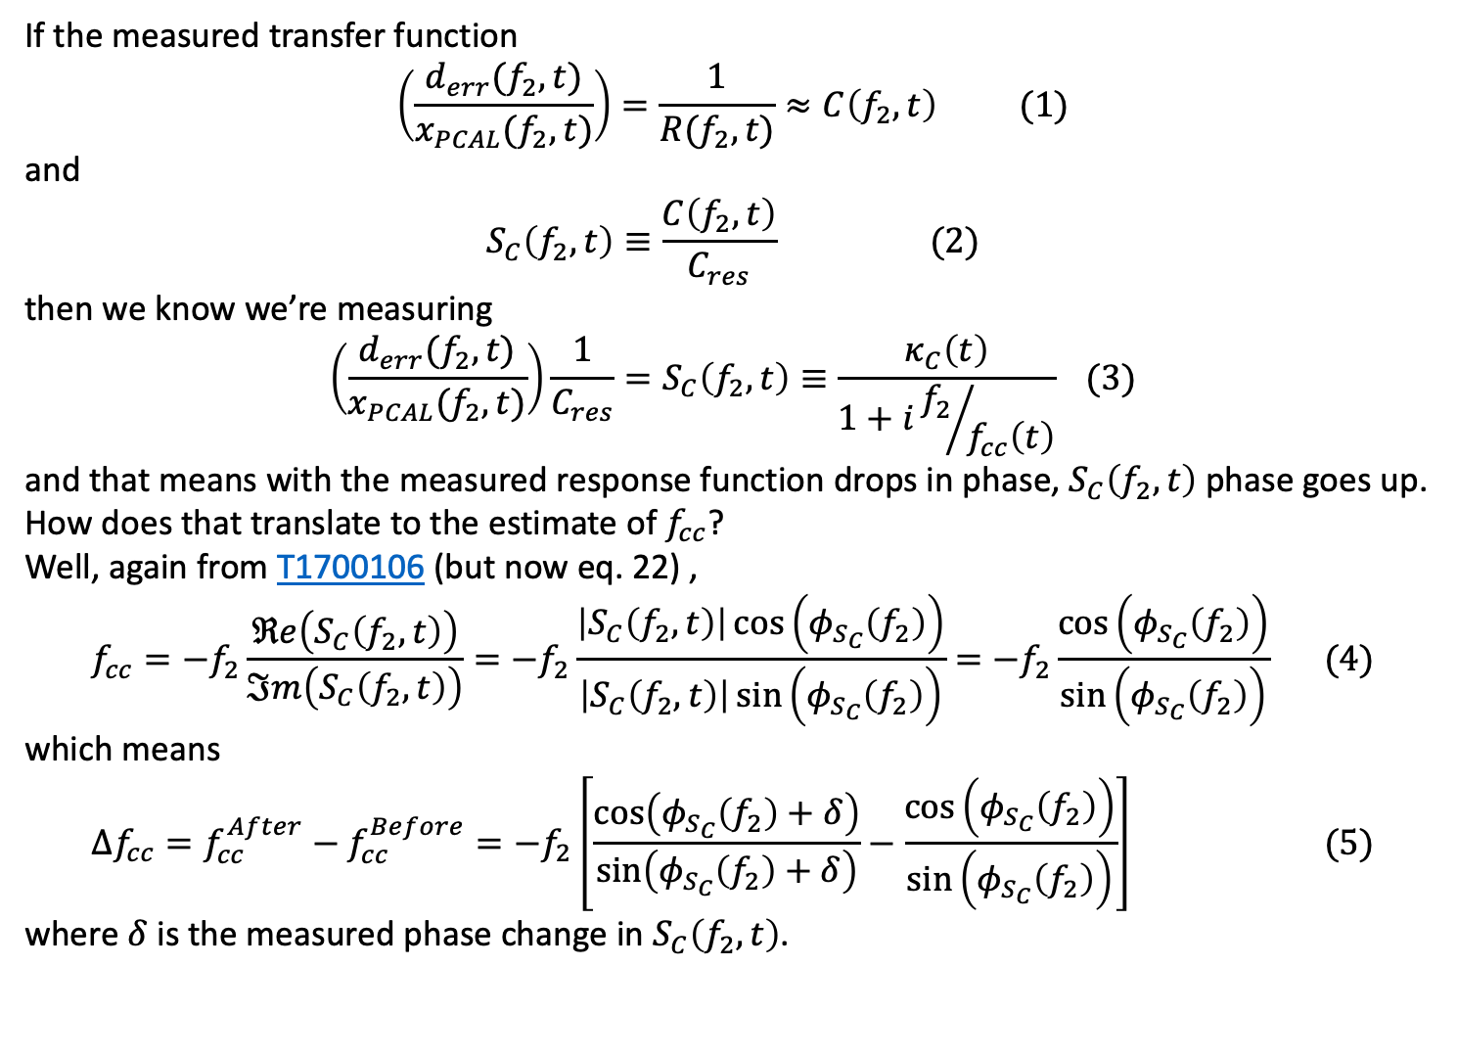
OK, so let’s reconcile some math
If the measured transfer function
$$\left(\frac{d_{err}(f_{2},t)}{x_{PCAL}(f_{2},t)}\right)=\frac{1}{R(f_{2},t)}≈C\left(f_{2},t\right) (1)$$
and
$$S_{C}\left(f_{2},t\right)≡\frac{C\left(f_{2},t\right)}{C_{res}} (2)$$
then we know we’re measuring
$$\left(\frac{d_{err}(f_{2},t)}{x_{PCAL}(f_{2},t)}\right)\frac{1}{C_{res}}=S_{C}\left(f_{2},t\right)≡\frac{κ_{C}\left(t\right)}{1+i{f_{2}}/{f_{cc}\left(t\right)}} (3)$$
and that means with the measured response function drops in phase, $S_{C}\left(f_{2},t\right)$ phase goes up.
How does that translate to the estimate of $f_{cc}$?
Well, again from T1700106 (but now eq. 22) ,
$$f_{cc}=−f_{2}\frac{ℜe\left(S_{C}\left(f_{2},t\right)\right)}{ℑm\left(S_{C}\left(f_{2},t\right)\right)}=−f_{2}\frac{\left|S_{C}\left(f_{2},t\right)\right|\cos\left(φ_{S_{C}}\left(f_{2}\right)\right)}{\left|S_{C}\left(f_{2},t\right)\right|\sin\left(φ_{S_{C}}\left(f_{2}\right)\right)}=−f_{2}\frac{\cos\left(φ_{S_{C}}\left(f_{2}\right)\right)}{\sin\left(φ_{S_{C}}\left(f_{2}\right)\right)} (4)$$
which means
$$∆f_{cc}=f_{cc}^{After}−f_{cc}^{Before}=−f_{2}\left[\frac{\cos\left(φ_{S_{C}}\left(f_{2}\right)+δ\right)}{\sin\left(φ_{S_{C}}\left(f_{2}\right)+δ\right)}−\frac{\cos\left(φ_{S_{C}}\left(f_{2}\right)\right)}{\sin\left(φ_{S_{C}}\left(f_{2}\right)\right)}\right] (5)$$
where $δ$is the measured phase change in $S_{C}\left(f_{2},t\right)$.

Slide 9

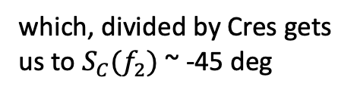

In case you need proof $1/R$=$C$ at 410.3 Hz,
Produced by the O3B, 2020-01-03 Model
Here’s $f_{2}=410.3$ Hz and magnitudes are equal…
…and phase is ~ -65 deg
which, divided by Cres gets us to $S_{C}(f_{2})$ ~ -45 deg

Slide 10
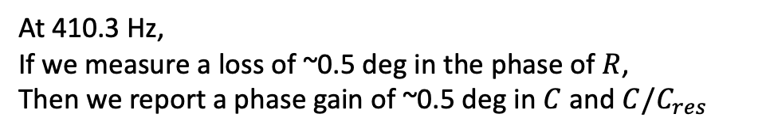

Which gets us here.
At 410.3 Hz,
If we measure a loss of ~0.5 deg in the phase of $R$,
Then we report a phase gain of ~0.5 deg in $C$ and $C/C_{res}$
and thus, we report an $f_{cc}$ change of ~7 Hz

Slide 11

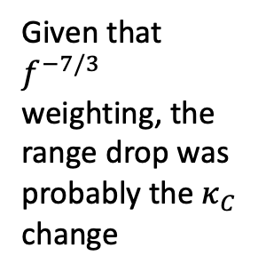
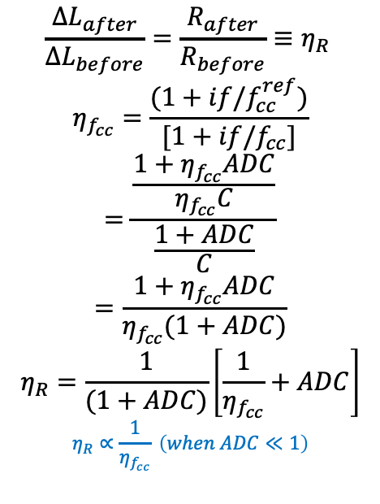

How does a change f_cc impact R?
$$\frac{{∆L}_{after}}{{∆L}_{before}}=\frac{R_{after}}{R_{before}}≡η_{R}$$
$$η_{f_{cc}}=\frac{(1+if/f_{cc}^{ref})}{[1+if/f_{cc}]}$$
$$=\frac{\frac{1+η_{f_{cc}}ADC}{η_{f_{cc}}C}}{\frac{1+ADC}{C}}$$
$$=\frac{1+η_{f_{cc}}ADC}{η_{f_{cc}}(1+ADC)}$$
$$η_{R}=\frac{1}{(1+ADC)}\left[\frac{1}{η_{f_{cc}}}+ADC\right]$$
$$η_{R}∝\frac{1}{η_{f_{cc}}} \left(when ADC≪1\right)$$
Given that $f^{−7/3}$ weighting, the range drop was probably the $κ_{C}$ change
425
$$Range ∝ \int{\frac{f^{−\frac{7}{3}}}{{∆L}^{2}\left(f\right)}df}$$
$${Range}_{after}=\int{\frac{f^{−\frac{7}{3}}}{η_{R}^{2} (f){∆L}_{before}^{2}\left(f\right)}df}$$
420
415
$f_{cc}$ [Hz]
410
405
400
Time [weeks]
$${Range}_{after}∝η_{f_{cc}}^{2} (when ADC≪1)$$

Slide 12
Which is what I think happened here.
Causes this…
TDCF for Cavity Pole Frequency [Hz]
This…
Time [weeks since Nov 1 2019]
Here we see a shift of ~415 to ~423 Hz, which is a change of 8 Hz.
Is this bad?
Do I think we need to do anything about it?

Slide 13
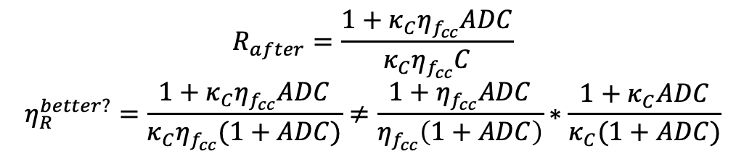
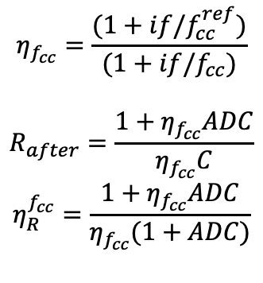
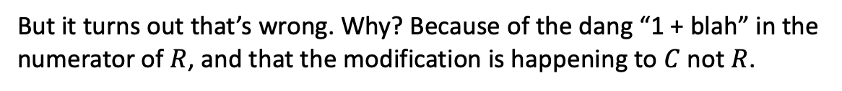
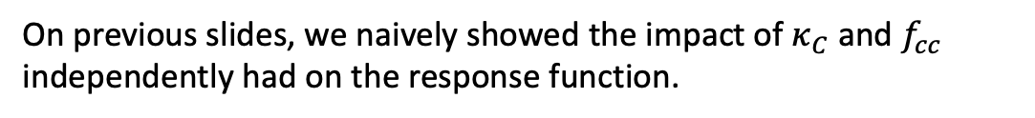

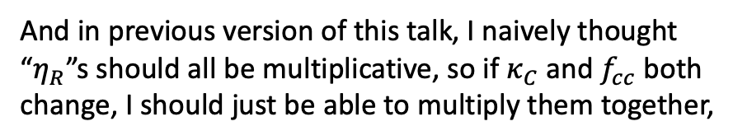
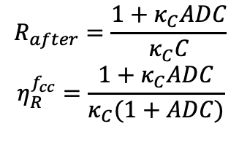
(Ha! Math. Pff.) (But … Math?) (Oh wait – Maaaaath. )
On previous slides, we naively showed the impact of $κ_{C}$ and $f_{cc}$ independently had on the response function.
$$η_{f_{cc}}=\frac{(1+if/f_{cc}^{ref})}{(1+if/f_{cc})}$$
$$R_{after}=\frac{1+η_{f_{cc}}ADC}{η_{f_{cc}}C}$$
$$η_{R}^{f_{cc}}=\frac{1+η_{f_{cc}}ADC}{η_{f_{cc}}(1+ADC)}$$
$$R_{after}=\frac{1+κ_{C}ADC}{κ_{C}C}$$
$$η_{R}^{f_{cc}}=\frac{1+κ_{C}ADC}{κ_{C}(1+ADC)}$$
And in previous version of this talk, I naively thought “$η_{R}$”s should all be multiplicative, so if $κ_{C}$ and $f_{cc}$ both change, I should just be able to multiply them together,
$$η_{R}^{naive}=η_{R}^{f_{cc}} η_{R}^{f_{cc}}$$
(Ha! Math. Pff.)
But it turns out that’s wrong. Why? Because of the dang “1 + blah” in the numerator of $R$, and that the modification is happening to $C$ not $R$.
$$R_{after}=\frac{1+κ_{C}η_{f_{cc}}ADC}{{κ_{C}η}_{f_{cc}}C}$$
$$η_{R}^{better?}=\frac{1+κ_{C}η_{f_{cc}}ADC}{{κ_{C}η}_{f_{cc}}(1+ADC)}≠\frac{1+η_{f_{cc}}ADC}{η_{f_{cc}}\left(1+ADC\right)}∗\frac{1+κ_{C}ADC}{κ_{C}(1+ADC)}$$
(But … Math?)

Slide 14
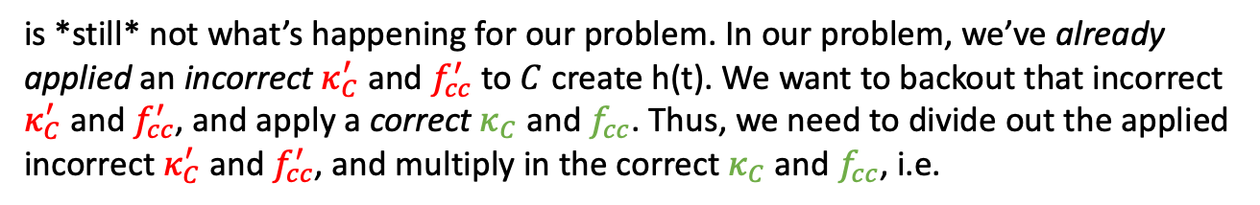
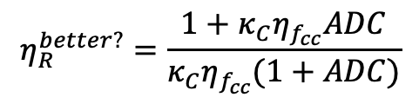
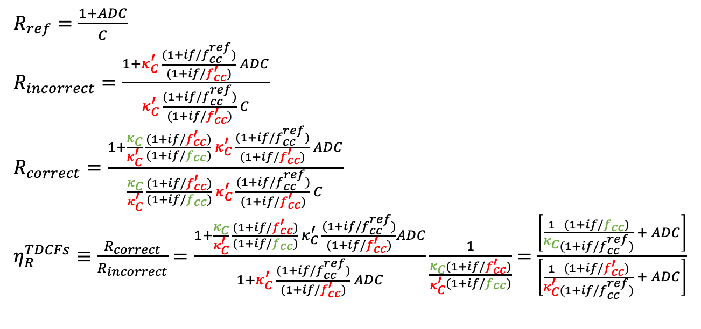
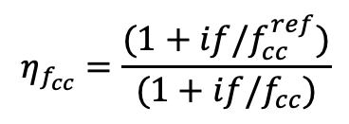
(Ha! Math. Pff.) (But … Math?) (Oh wait – Maaaaath. )
But even *this*,
$$η_{R}^{better?}=\frac{1+κ_{C}η_{f_{cc}}ADC}{{κ_{C}η}_{f_{cc}}(1+ADC)}$$
$$η_{f_{cc}}=\frac{(1+if/f_{cc}^{ref})}{(1+if/f_{cc})}$$
is *still* not what’s happening for our problem. In our problem, we’ve already applied an incorrect $κ_{C}^{′}$ and $f_{cc}^{′}$ to $C$ create h(t). We want to backout that incorrect $κ_{C}^{′}$ and $f_{cc}^{′}$, and apply a correct $κ_{C}$ and $f_{cc}$. Thus, we need to divide out the applied incorrect $κ_{C}^{′}$ and $f_{cc}^{′}$, and multiply in the correct $κ_{C}$ and $f_{cc}$, i.e.
$R_{ref}=\frac{1+ADC}{C}$
$R_{incorrect}=\frac{1+κ_{C}^{′} \frac{(1+if/f_{cc}^{ref})}{(1+if/f_{cc}^{′})} ADC}{κ_{C}^{′} \frac{(1+if/f_{cc}^{ref})}{(1+if/f_{cc}^{′})} C}$
$R_{correct}=\frac{1+\frac{κ_{C}}{κ_{C}^{′}} \frac{(1+if/f_{cc}^{′})}{(1+if/f_{cc})} κ_{C}^{′} \frac{(1+if/f_{cc}^{ref})}{(1+if/f_{cc}^{′})} ADC}{\frac{κ_{C}}{κ_{C}^{′}} \frac{(1+if/f_{cc}^{′})}{(1+if/f_{cc})} κ_{C}^{′} \frac{(1+if/f_{cc}^{ref})}{(1+if/f_{cc}^{′})} C}$
$η_{R}^{TDCFs}≡\frac{R_{correct}}{R_{incorrect}}=\frac{1+\frac{κ_{C}}{κ_{C}^{′}} \frac{(1+if/f_{cc}^{′})}{(1+if/f_{cc})} κ_{C}^{′} \frac{(1+if/f_{cc}^{ref})}{(1+if/f_{cc}^{′})}ADC}{1+κ_{C}^{′} \frac{(1+if/f_{cc}^{ref})}{(1+if/f_{cc}^{′})} ADC}\frac{1}{\frac{κ_{C}}{κ_{C}^{′}}\frac{(1+if/f_{cc}^{′})}{(1+if/f_{cc})}}=\frac{\left[\frac{1}{κ_{C}}\frac{(1+if/f_{cc})}{(1+if/f_{cc}^{ref})} + ADC\right]}{\left[\frac{1}{κ_{C}^{′}}\frac{(1+if/f_{cc}^{′})}{(1+if/f_{cc}^{ref})} + ADC\right]}$
(Oh wait – Maaaaath. )

Slide 15

Comparison between Naïve, Better? and Correct versions of $η_{R}$
(Ha! Math. Pff.)
(But … Math?)
(Oh wait – Maaaaath. )

Slide 16

OK, so what values of $κ_{C}^{′}$, $f_{cc}^{′}$, $κ_{C}$, and $f_{cc}$?
meas_kappaC = 0.995
meas_kappaCprime = 0.9825
meas_fcc = 413
meas_fccprime = 423
These are the numbers I gathered with an eye-ball average of the above trend plots we saw on slide 4.
The prime values taken *after* the whitening change.
The presumed correct values taken *before* the whitening change.

Slide 17
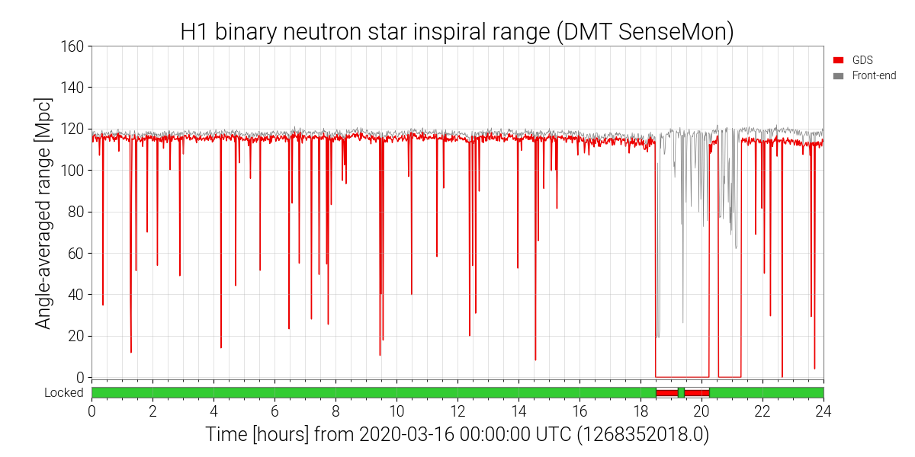
And just one more thing…
Before we verify our predicted systematic error budget,
Let’s review what before vs. after broadband injection data is available (slide from G2000527)
DMT_ANALYSIS_READY end
BB Measurement
Brief NLN, but not DMT_ANALYSIS_READY
DMT_ANALYSIS_READY
resumes
Detector was locked and happy for ~19 hours. Went out of OBS_READY at Mar 16 2020 18:29:59 UTC, switched whitening config, and measured broadband 30 seconds afterword.
Pre
  2020-03-02_H1_PCALY2DARMTF_BB_3min.xml: 2020-03-02 19:00:32 UTC
  2020-03-09_H1_PCALY2DARMTF_BB_3min.xml: 2020-03-09 18:00:33 UTC
Post
  2020-03-16_H1_PCALY2DARMTF_BB_3min.xml: 2020-03-16 18:30:31 UTC
  2020-03-23_H1_PCALY2DARMTF_BB_3min.xml: 2020-03-23 18:01:20 UTC

Slide 18
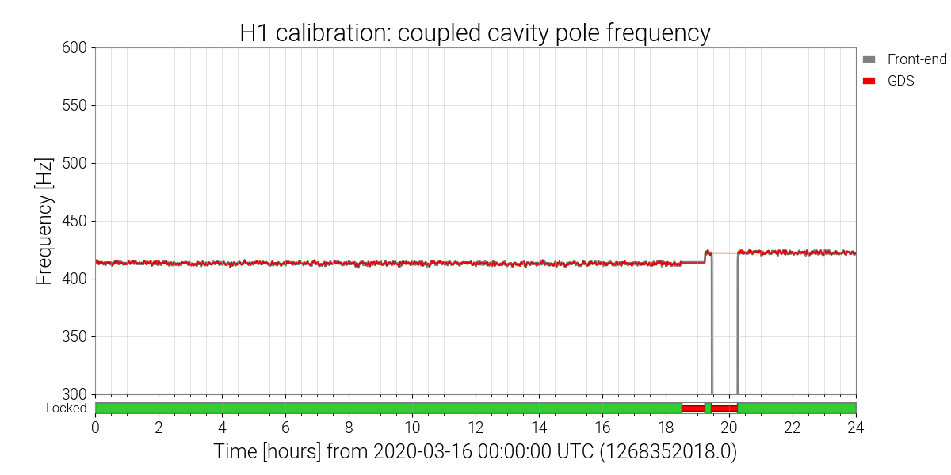
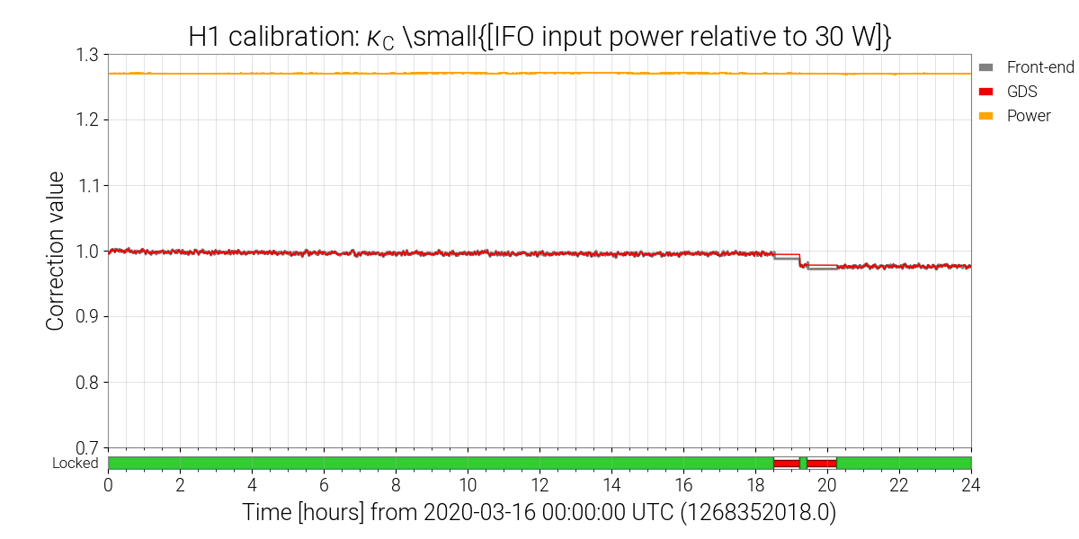


And just one more thing.
But remember, that once we go out of observation ready mode and turn off the calibration lines, there’re no TDCFs being measured. So, Aaron processes the BB injections with the DCS TDCFs from the observation ready stretch *right before* the BB injection.
$f_{cc}$ on 2020-03-16
Why do I bring it up?
Because that means 2020-03-16 BB injection has the (small) whitening chassis error, but it does *not* have the error from the TDCFs
This is why the 2020-03-23 BB injection looks so different from the 2020-03-16 injection.
The 2020-03-23 measurement shows *both* the (small) whitening chassis error AND the error from applying incorrect TDCFS.
$κ_{C}$ on 2020-03-16

Slide 19
I think we got it…
2020-03-09, no OMC WC error
2020-03-16, OMC WC error, but no TDCF error
2020-03-23, OMC WC error & TDCF error
Systematic error and uncertainty, before including OMC or TDCF error
Systematic error and uncertainty, after including TDCF error
TDCF error

Slide 20
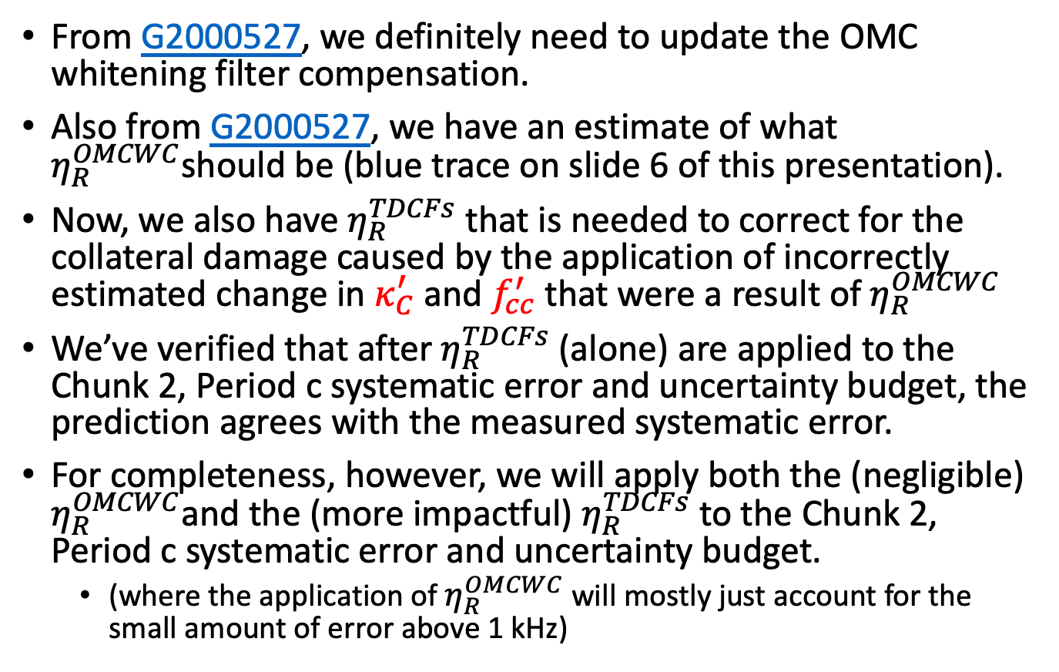
In conclusion!
From G2000527, we definitely need to update the OMC whitening filter compensation.
Also from G2000527, we have an estimate of what $η_{R}^{OMCWC}$should be (blue trace on slide 6 of this presentation).
Now, we also have $η_{R}^{TDCFs}$ that is needed to correct for the collateral damage caused by the application of incorrectly estimated change in $κ_{C}^{′}$ and $f_{cc}^{′}$ that were a result of $η_{R}^{OMCWC}$
We’ve verified that after $η_{R}^{TDCFs}$ (alone) are applied to the Chunk 2, Period c systematic error and uncertainty budget, the prediction agrees with the measured systematic error.
For completeness, however, we will apply both the (negligible) $η_{R}^{OMCWC}$and the (more impactful) $η_{R}^{TDCFs}$ to the Chunk 2, Period c systematic error and uncertainty budget.
  (where the application of $η_{R}^{OMCWC}$ will mostly just account for the small amount of error above 1 kHz)

