Slide 1
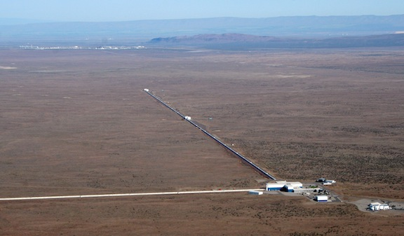
Status of LIGO Hanford Observatory
Zzzz
GWANW
29 June 2020

Slide 2
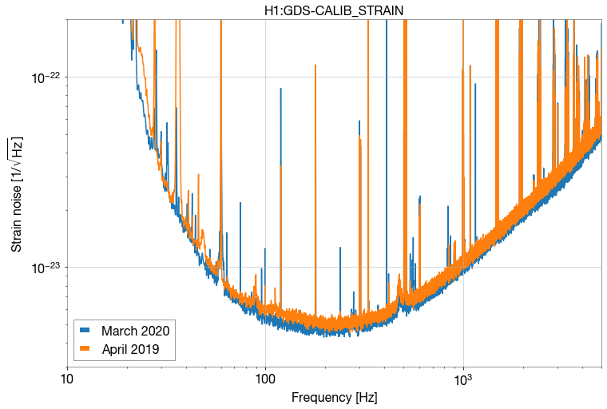
Sensitivity Improvement in O3
Early O3a
Late O3b
Noise subtraction not yet done for O3b

Slide 3
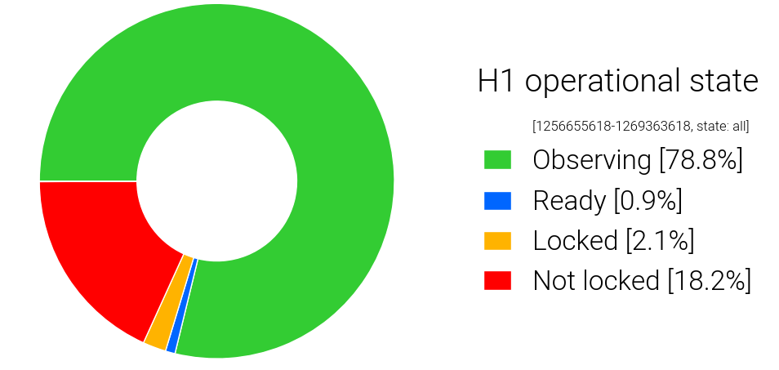
Improvements During O3
Automated running – no overnight shifts
Eliminate 48 Hz peak (52184)
Using 2 photodiodes for CARM to reduce shot noise (48762)
Testing Newtonian Calibrator (53819)
Squeezer fiber fixed – more squeezing (52675)
Frequency dependence of squeezing (56068)
Power Recycling Cavity Length Feedforward (51553)
Change DARM offset (55264)
Decoupling Length/Angle (51717)
Wind fence (53871, 55971)
R0 tracking (54556)
Earthquake mode auto transition (56170, 55347)
(71% Observing in O3a)
CPS diff for robustness (53390)
SR3 heater tuning – mode matching (48406)

Slide 4
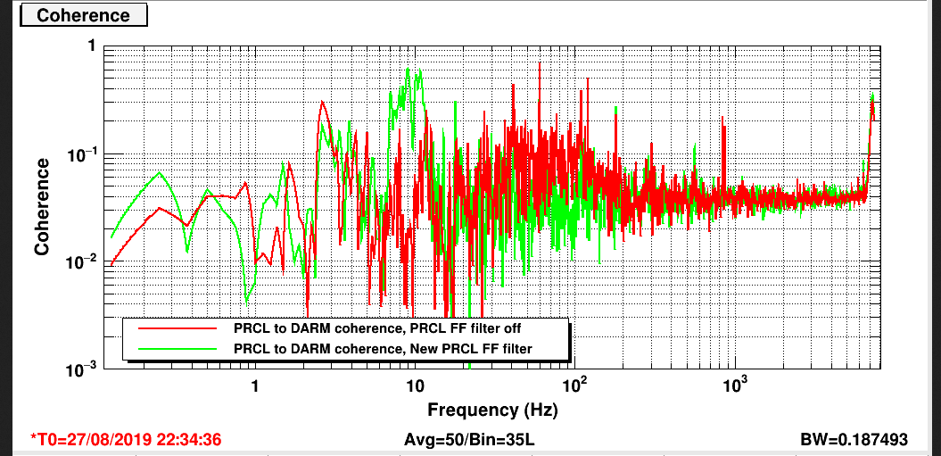
PRCL Feedforward
Alog 51553
Coherence reduced in GW band when PRCL FF engaged
Does make noise slightly worse around 10 Hz, but that is out of GW band

Slide 5
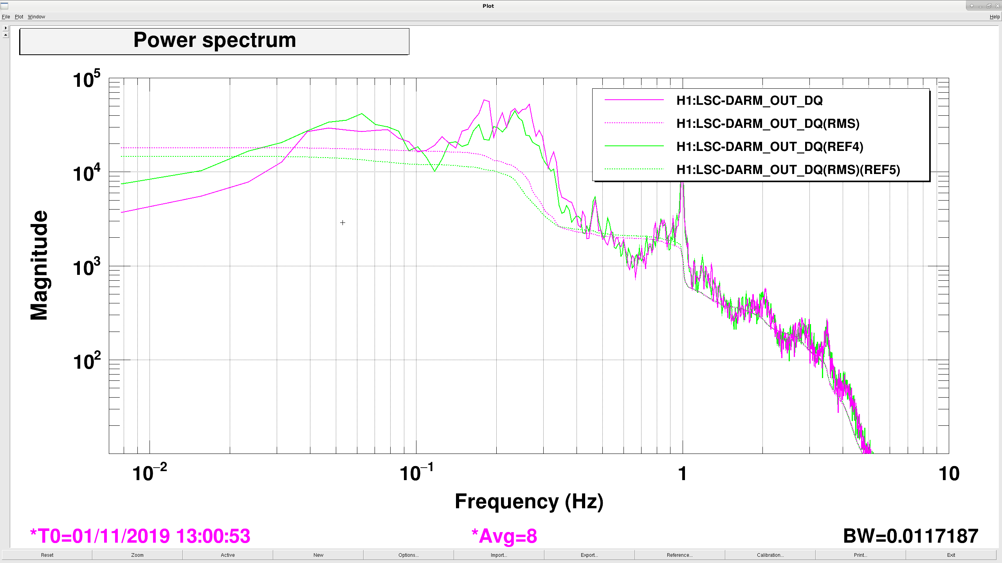
Differential Seismic
Alog 53390
Pink on, green off
Lower DARM with “CPS DIFF” engaged
Should give improvement to robustness, esp to earthquakes and wind
May be leading to excess glitches (ongoing study, ex. 56080)

Slide 6
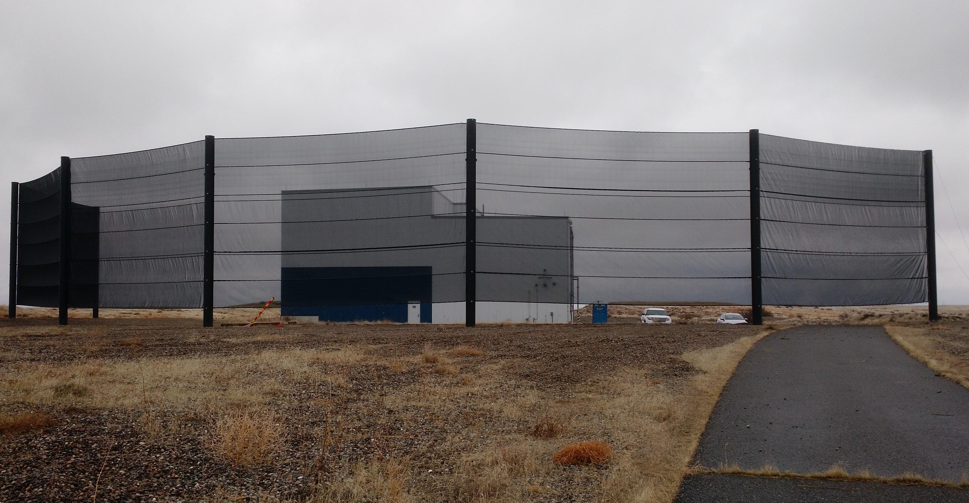
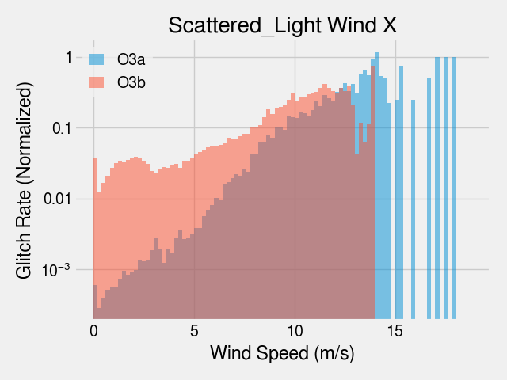
Wind Fence
Alog 53871
Reduce wind speed at end buildings
Improve robustness, duty cycle
Some improvement in glitches
Alog 55971

Slide 7
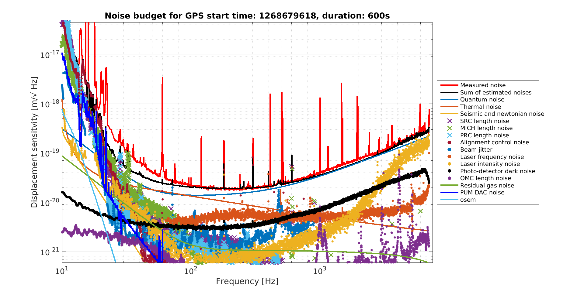
LHO Noise Budget O3b
Alog 56195

Slide 8
From Unlocked to Observing
Video by Kai Staats

Slide 9
Toward O4
Relock H1 after hibernation, check sensitivity esp. after nearby earthquake (6.5 in Idaho)
Swap last test mass at LHO – reduce imbalances between arms
Frequency dependent squeezing (filter cavity)
Lower loss output Faraday isolator
New higher power laser
Even more stray light control baffles (eg. Suspended transmission benches, LHO output Faraday)
- May be deferred due to time constraints

Slide 10
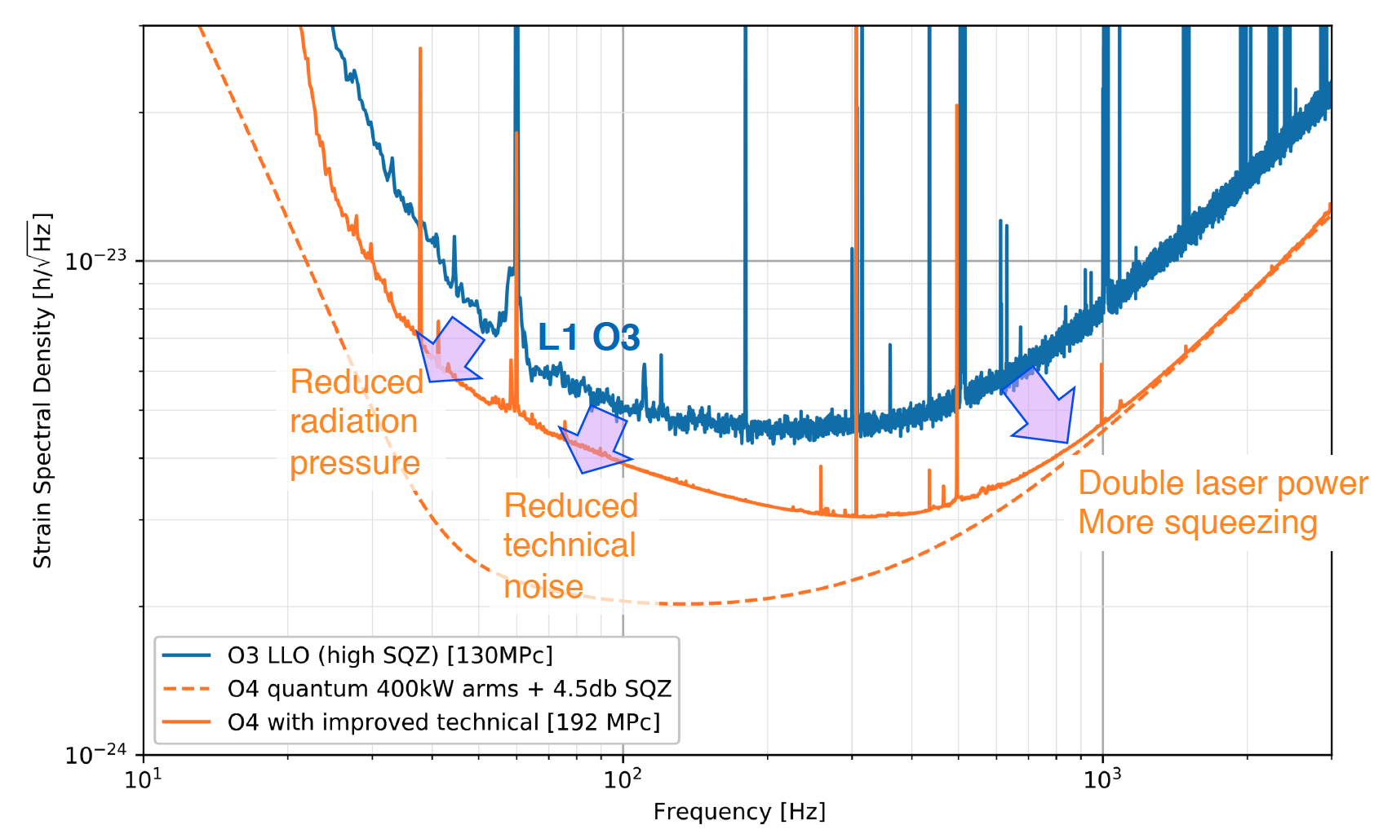
Anticipated Sensitivity for O4
From G2000903

