Slide 1
Effects of Different Data Quality Veto Methods in the PyCBC Search for Compact Binary Coalescences
Brina Martinez
University of Texas Rio Grande Valley
Mentor: Dr. Derek Davis
LIGO Laboratory, California Institute of Technology
LIGO SURF 2020
August 21, 2020

Slide 2
Overview
Goals of the project
PyCBC search pipeline
Data quality vetoes
Current veto methods
New methods
Results
Potential extension for project

Slide 3
Goals
We want to confidently mitigate noise in the detector’s data and finely tune our pipeline to prevent a decrease in search sensitivity and detect more signals!
What can cause a decrease in search sensitivity?
Loud glitches
Removing too much data (time)
Using ineffective flags

Slide 4
PyCBC search pipeline
The PyCBC pipeline is used in the search for Gravitational Waves from a Compact Binary Coalescence
Compact Binary Coalescences are when two compact objects such as black holes or neutron stars coalesce and experience an inspiral, merger, and ringdown.
PyCBC shows us the signal-to-noise ratio and ranking statistics for triggers and signals in data when correlated with expected waveforms
PyCBC uses matched filtering to match signals to gravitational wave templates
PyCBC uses a chi-squared consistency test to downrank triggers in the data that are due to glitches and increase the significance of real GW signals. The SNRs of triggers are weighted along this consistency test and outputs a new ranking statistic or re-weighted SNR

Slide 5
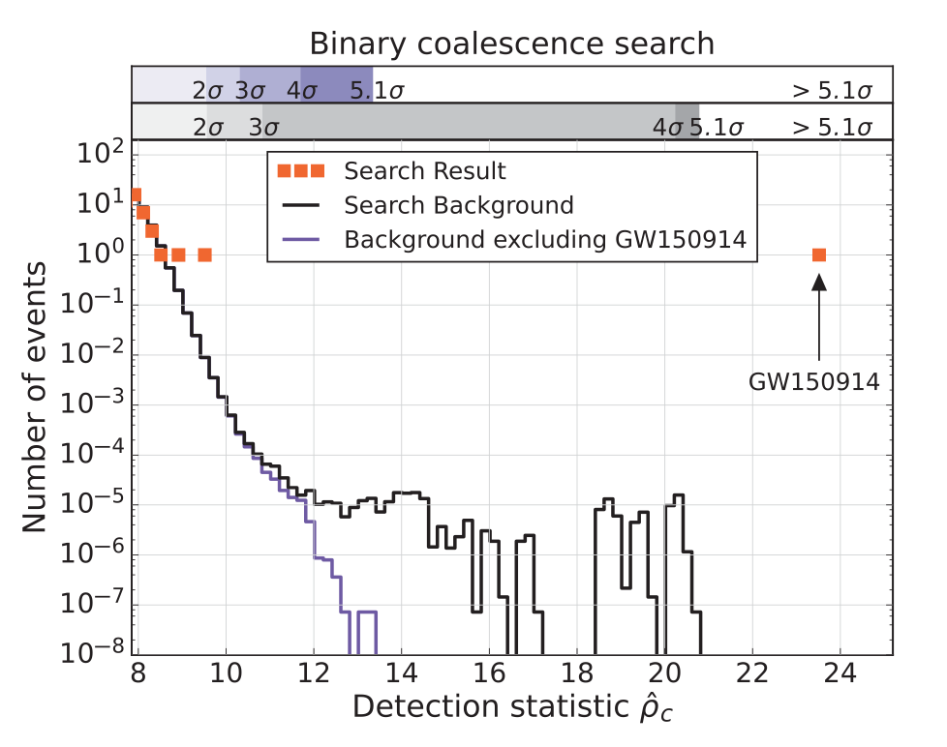
PyCBC search pipeline
B.P. Abbott et al. Phys. Rev. Lett. 116 061102 (2016)

Slide 6
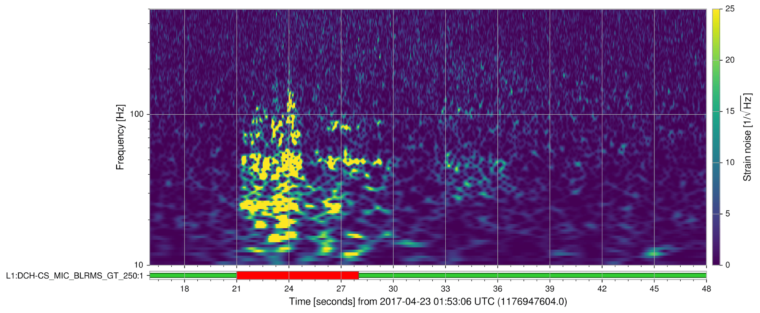
Data quality vetoes
Vetoes are generated from flags which identify transient noise in data where glitches or noise make it difficult to run analysis on signals.
In order for a flag to identify these transient noises they need to be correlated with some disturbance in or around the detector
These are referred to as “CAT2 Flags”
Vetoes remove flagged segments to improve the analysis pipeline’s search for signals

Slide 7
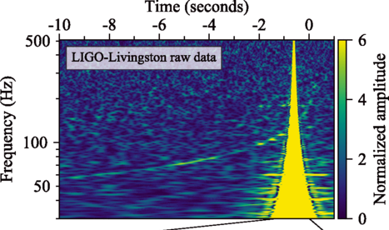
Current Method vs Improved Method
Current Method
Removes glitches and flagged times completely
If flags are not as efficient, they do not highlight enough glitches, decreasing search sensitivity
Uses chi-square consistency test to analyze glitches and downrank
Improved Method
Our method shows an effective glitch veto that increases the significance of signals and the overall number of detectable signals without removing data.
Keeps glitches that are flagged, removing no data
Uses chi-square consistency test and re-ranking of the glitch statistic
How is this done?
Uses CAT2 data quality vetoes
Uses Likelihood ratio of trigger rate for vetoed time vs all time to re-rank data against original background
glitch
signal
B. P. Abbott et al. Phys. Rev. Lett. 119, 161101

Slide 8
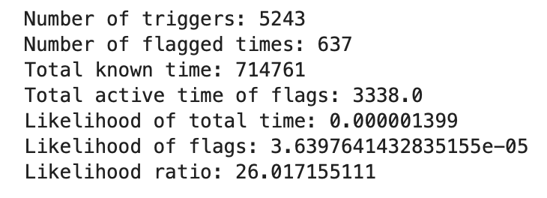
Likelihood in the Improved Method
How much more likely is a trigger to show up during a flag vs all time?

Slide 9
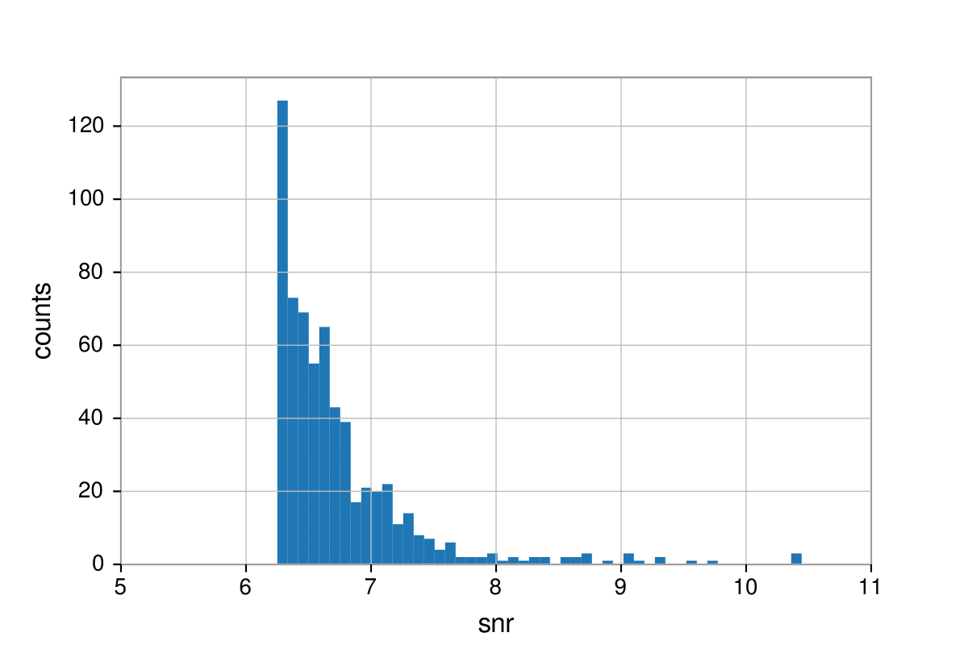
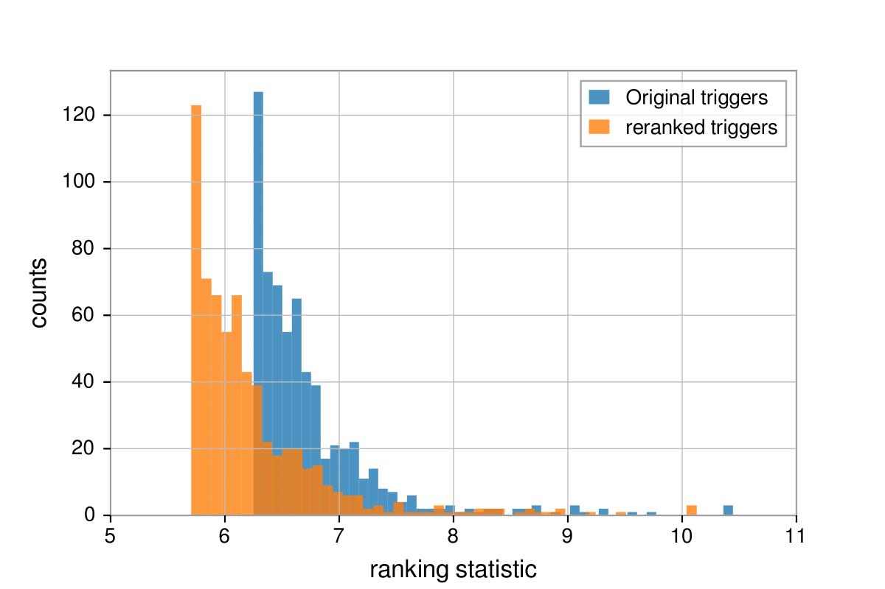
Ranking in Improved Method
Re-ranking triggers
Likelihood ratio of data quality flag
New ranking statistic
Original ranking statistic
Ranking statistic of triggers during vetoed times are updated using the likelihood ratio

Slide 10
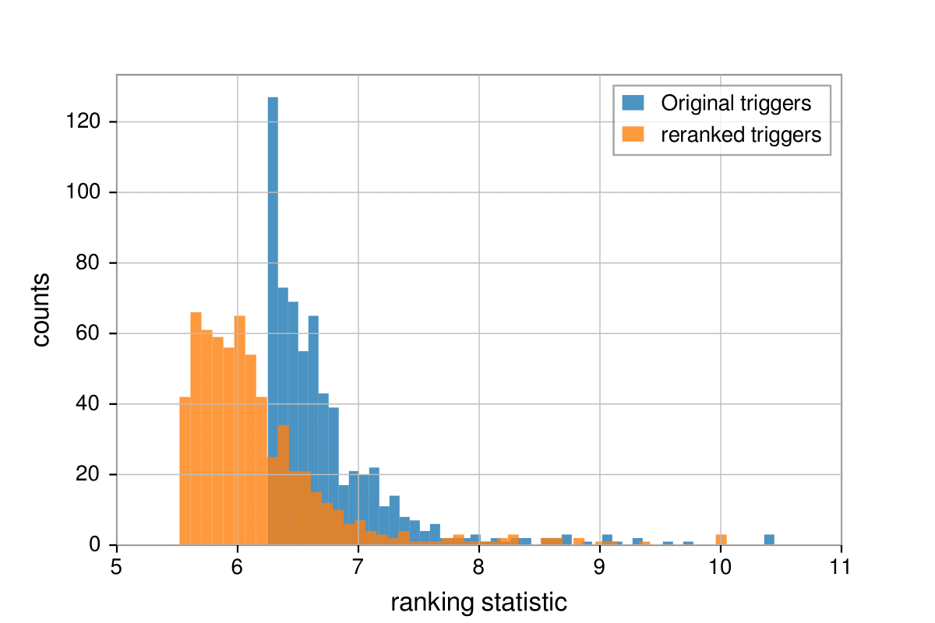
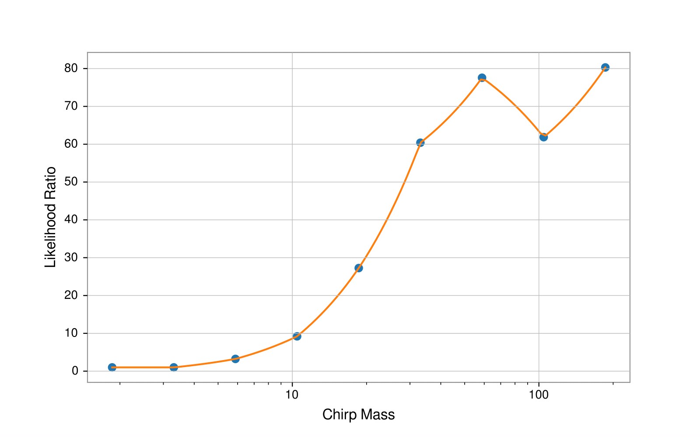
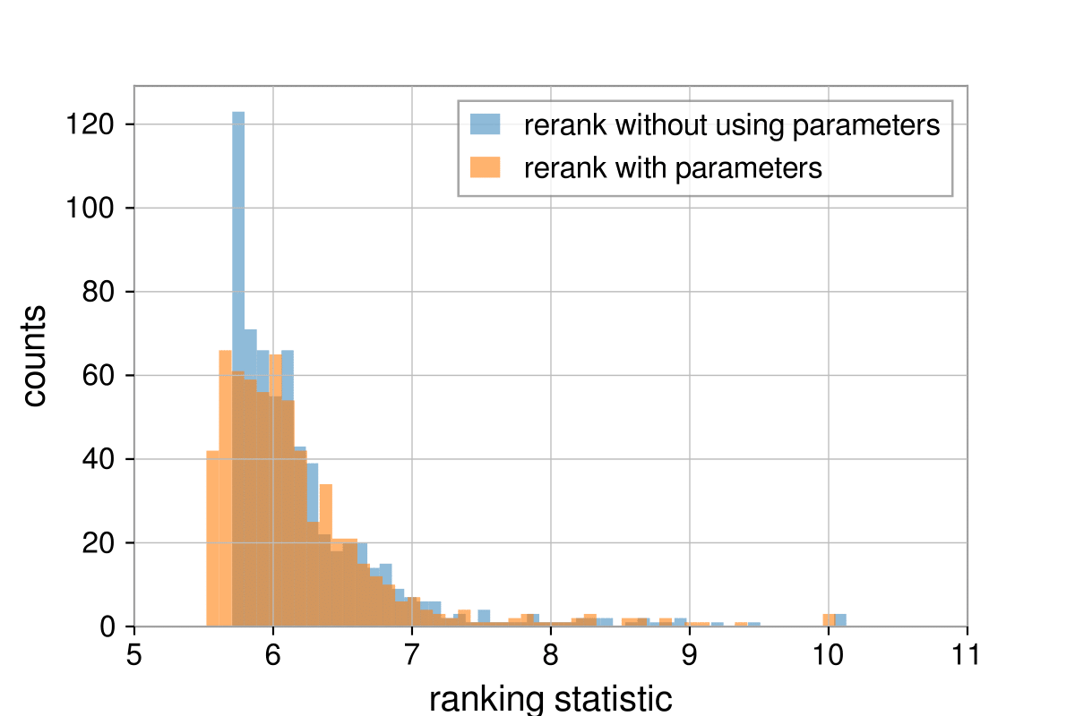
Using different parameters to calculate
likelihood
We calculated the likelihood ratio for different chirp masses
Other template parameters we could use
Mass ratio
Template duration

Slide 11
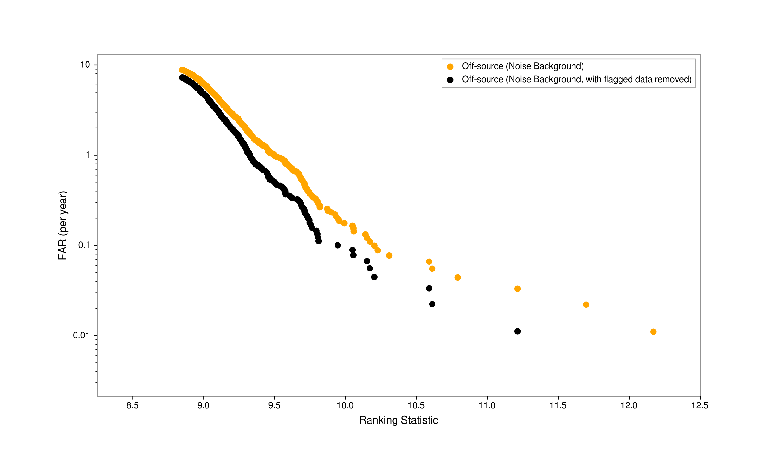
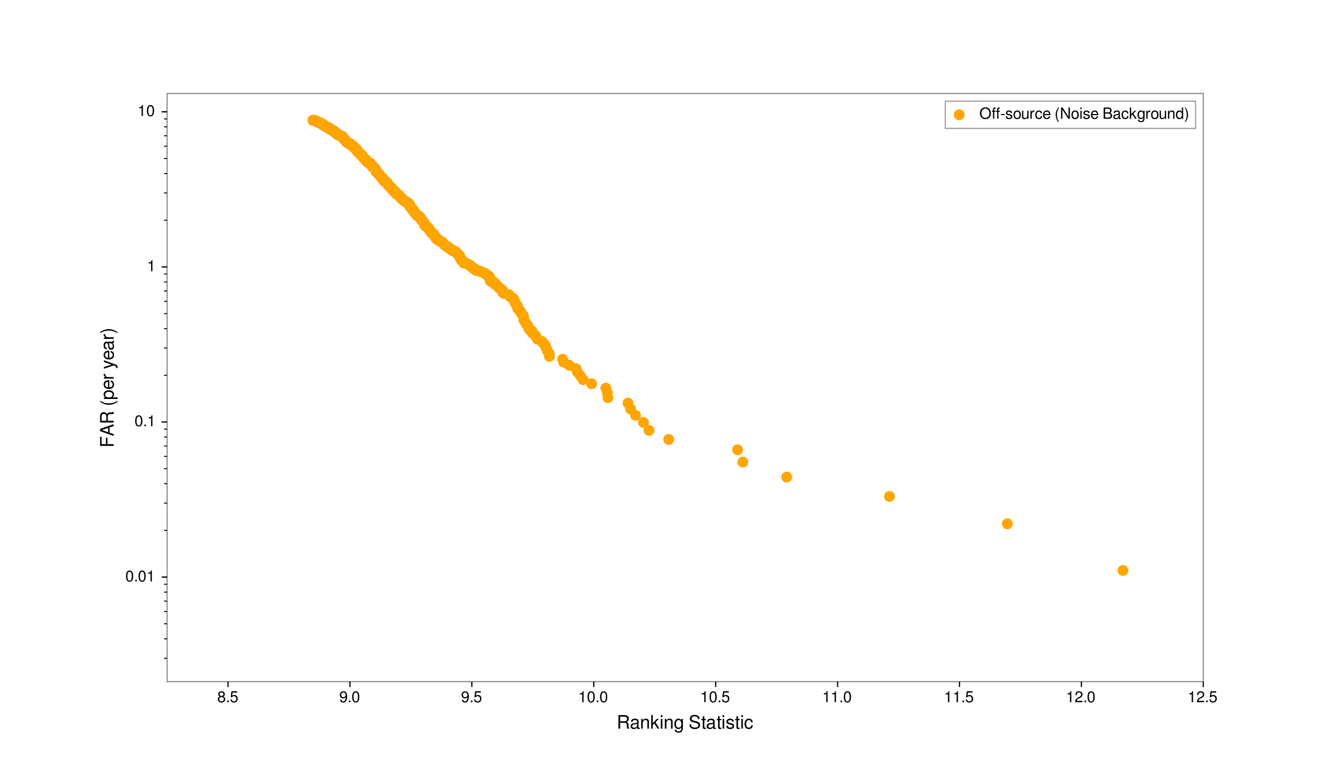
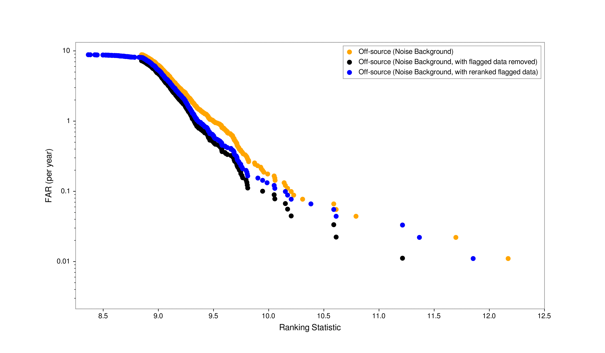
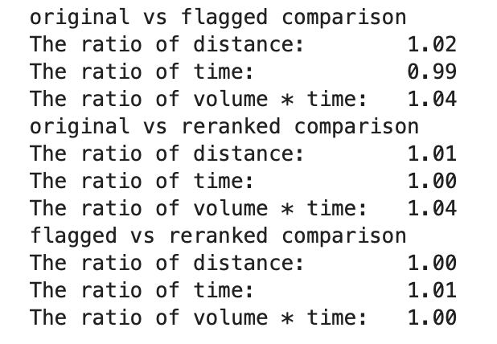
Results

Slide 12
Conclusions
Improved veto method vs. Current veto method:
Re-ranks flagged data instead of removing flagged data completely
Increases the significance of signals
Reduces the time lost due to flags
Increases the overall number of detectable signals

Slide 13
Future Investigations:
Expand amount of flags applied
Expand to different DQ products (e.g. iDQ, Gravity Spy)
Expand to updated PyCBC ranking statistic

Slide 14
Thank you! Questions?
I would like to give a special thank you to Derek for being an amazing mentor, Dr. Weinstein for endless support and enthusiasm, the National Science Foundation, the Caltech LIGO SURF Program, and LIGO Laboratory.
Computing support for this project was provided by the LDAS computing cluster at the California Institute of Technology. LIGO was constructed by the California Institute of Technology and Massachusetts Institute of Technology with funding from the National Science Foundation, and operates under cooperative agreement PHY-0757058. The LIGO SURF Program is supported by NSF award PHY-1852081.

Slide 15
References
This project uses PyCBC to investigate impacts of different veto methods on search sensitivity
B. Allen, W. G. Anderson, P. R. Brady, D. A. Brown, and J. D. E. Creighton. FINDCHIRP: An algorithm for detection of gravitational waves from inspiraling compact binaries. Phys. Rev. D, 85:122006, 2012.
Bruce Allen. A chi**2 time-frequency discriminator for gravitational wave detection.Phys.Rev. D, 71:062001, 2005.
Alexander H. Nitz, Thomas Dent, Tito Dal Canton, Stephen Fairhurst, and Duncan A. Brown. Detecting binary compact-object mergers with gravitational waves: Understanding and Improving the sensitivity of the PyCBC search. Astrophys. J., 849(2):118, 2017.
Tito Dal Canton et al. Implementing a search for aligned-spin neutron star-black hole systems with advanced ground based gravitational wave detectors. Phys. Rev. D, 90(8):082004, 2014.
Samantha A. Usman et al. The PyCBC search for gravitational waves from compact binary coalescence. Class. Quant. Grav. , 33(21):215004, 2016.
Alexander H. Nitz, Tito Dal Canton, Derek Davis, and Steven Reyes. Rapid detection of gravitational waves from compact binary mergers with PyCBC Live. Phys. Rev. D, 98(2):024050, 2018
Additional sources
B P Abbott et al. Effects of data quality vetoes on a search for compact binary coalescences in Advanced LIGO’s first observing run. Class. Quant. Grav., 35(6):065010, 2018.
Godwin et al. Incorporation of Statistical Data Quality Information into the GstLAL Search Analysis. LIGO Document number P2000117
B P Abbott et al Characterization of transient noise in Advanced LIGO relevant to gravitational wave signal GW150914. 2016 Class. Quantum Grav. 33 134001

Slide 16
Extra slides

Slide 17
Math!
Noise distribution
Ranking statistic
Signal distribution
Single-IFO noise model
Single-IFO ranking statistic
Template duration
Total noise rate
Distribution steepness
Threshold ranking statistic
Equations from O2 stat paper:
Nitz et al. Astrophys.J. 849 (2017) no.2, 118
DQ timeseries

Slide 18
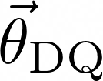
= iDQ
= iDQ streams + DQ flag(s)
Input data is iDQ timeseries
Lambda calculated using iDQ likelihood vs cumulative trigger counts
Similar implementation to Godwin et al. (P2000117)
Input data is multiple semi-independent data streams
Lambda calculated for each input data stream independently
“Final” lambda is maximized for each individual trigger

