Slide 1
Seismic Radiometer
Sanika Khadkikar
2020 Caltech SURF Program
Mentors: Rana Adhikari, Koji Arai, Tega Edo

Slide 2
Outline
Motivation & Objectives
Experimental Setup
Source Localization & Heatmap making
Conclusions
Future Work
Acknowledgements

Slide 3
Motivation and Objectives
What is seismic noise?
Effect of seismic noise on instrument sensitivity for ground based detectors
Noise of the compensation apparatus used to reduce the seismic noise

Slide 4
Motivation and Objectives
Coupling of seismic noise in the gravitational wave data output
Why is a heatmap necessary?
Heatmap creation

Slide 5
Experimental Setup
N
40m Lab
3 seismometers of 3(X,Y,Z) channels being used.
The Y arm is aligned with the east-west direction
The X arm is aligned with the north-south direction
Array baseline of 40m
BS
EY
EX
Millikan Library

Slide 6
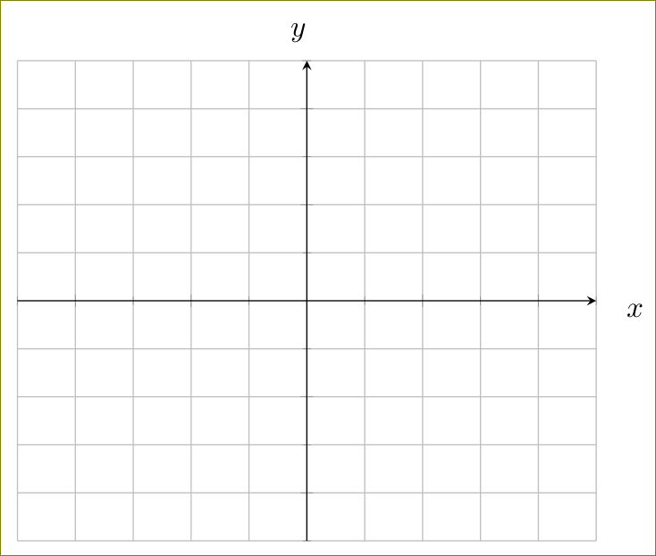
Source localization
Frequency- Wave number analysis
Plane wave approximation
Inability to determine the distance of the source determination
Different time delays at each seismometer
Source 1
BS
EY
EX

Slide 7
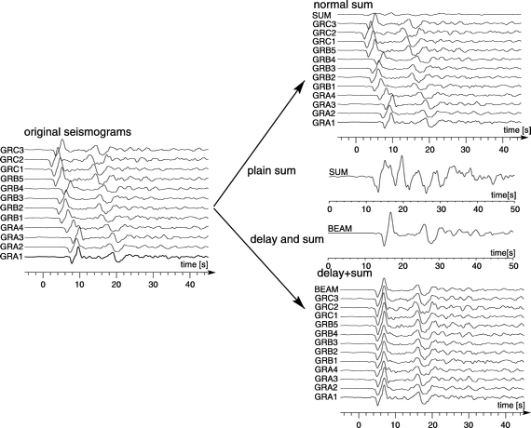
Source localization
Frequency- Wave number analysis
Alignment/Stacking of the signals
Calculation of the RMS of the stacked signal
Frequency domain transfer for faster calculation

Slide 8
Source localization
Frequency- Wave number analysis
Under plane wave approximation :
where,
and source direction is,

Slide 9
Source localization
Choosing an estimate velocity vector of the source [Vx,Vy]
Calculating the time delay array such that the signals are stacked
The velocity combination where the signals are stacked will provide the power available at every velocity guess.
Source direction determination using Vx and Vy
Velocity in y direction
Source (Vx,Vy))
BS
EY
40m/Vs
Velocity in x direction
EX

Slide 10
Data Acquisition
Choosing the right seismic data for targetted analysis :
Microseismic domain : 0.1-1Hz
Millikan shaking region: ~1 Hz
Anthropogenic domain: 1-10 Hz
Setting the area in which the source field can be calculated :
Constraints due to the baseline length

Slide 11
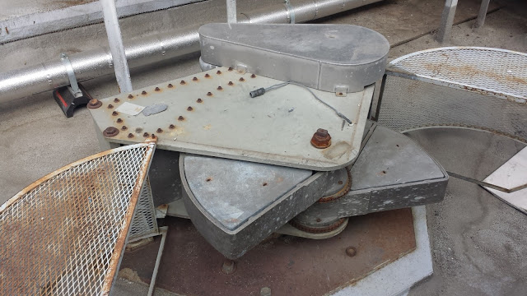
Creation of the Heatmap
The Millikan Library Shaking Event
Shaken sinusoidally with the natural frequency of the building ~1.2 Hz
Building is shaken from the top

Slide 12
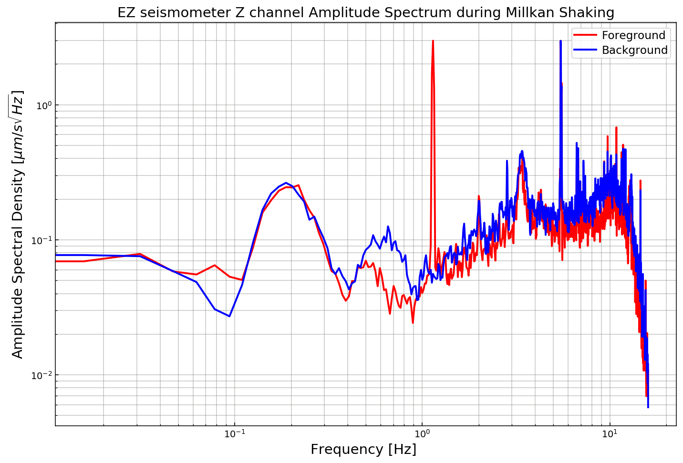
Creation of the Heatmap
Millikan shaking event ASD

Slide 13
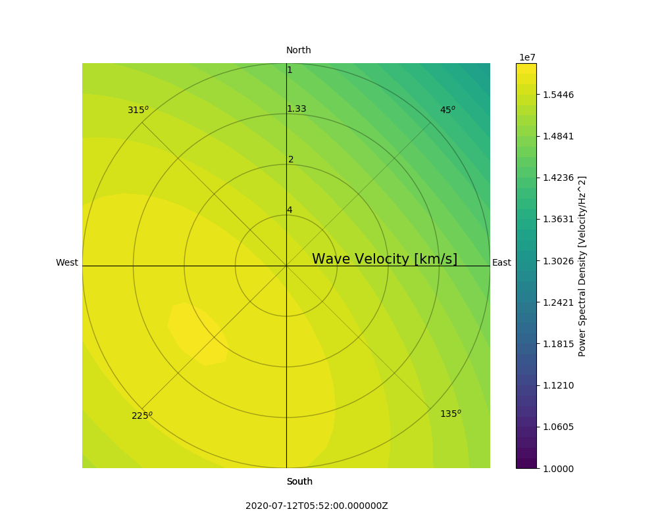
Creation of the Heatmap
Millikan shaking event source localization

Slide 14
Creation of the Heatmap
Millikan shaking : 40 minute simulation
Start time : 5:20:00 UTC End Time : 6:00:00 UTC
Date : 12-07-2020
Millikan shaking : 40 minute simulation
Start time : 5:20:00 UTC End Time : 6:00:00 UTC
Date : 12-07-2020
Millikan shaking event

Slide 15
Conclusions
Successes of the method :
Determination of source direction and velocity
Multiple source localization possible over a given length of time.
Source frequency resolution achieved : 0.01 Hz (specific to Milikan shaking)
Shortcomings of the method :
Due to only 3 seismometers being available which is the least number needed to determine the location, the accuracy of source detection is lesser than any seismic array.
The short baseline limits the area in which we can perform the source localization.

Slide 16
Future Work
Using time delays to determine the source distance with a known error cap.
Using actual waveforms instead of plane wave approximations.
Correlation analysis of different channels of the seismometer to determine the exact set of waves being received at the seismometer.
Significant improvement can be made by using the 4km LIGO baselines and the various seismometers (>3) present at the LIGO sites.
LIGO-T1900364-v5

Slide 17
Acknowledgements
I would like to thank all the following individuals for their immense contribution to the project :
All of my mentors : Koji Arai, Rana Adhikari, Tega Edo
My SURF team mates
Thank you for hearing me out patiently!
LIGO-T1900364-v5

Slide 18
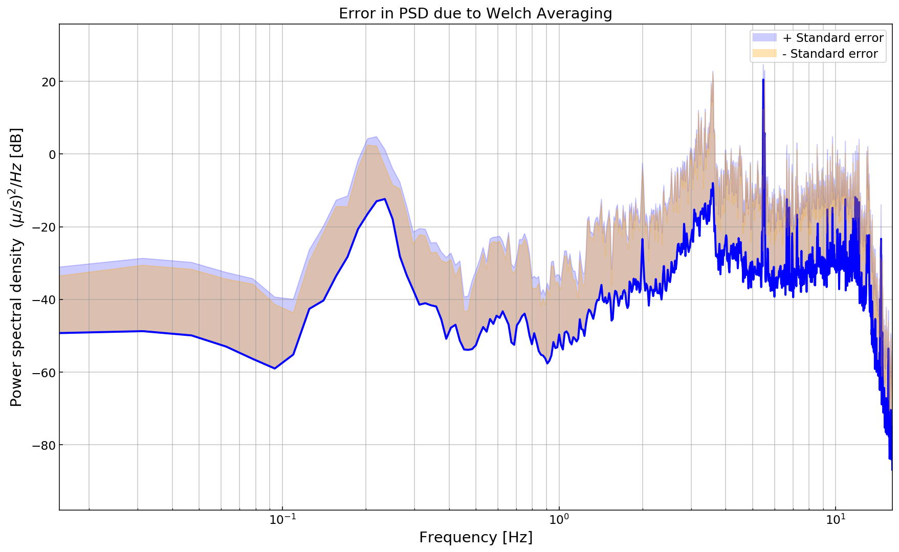
Data Analysis
Sanity Checks :
Decalibration of the seismometers
Presence of a DC offset
How precise is the Welch function in calculating the Power?

