Slide 1
Neural Network Control for Seismometer Temperature Stabilization
Ella Buehner Gattis
Supervised by Rana Adhikari, Koji Arai, Tega Edo

Slide 2
Introduction
Building on linear temperature control with PID to develop nonlinear control using a neural network
Real systems are nonlinear, so this will be better suited to adapt to nonlinearities such as radiative losses
Ability to deal with slow time variations and unpredictable parameters
Decrease overshoot and undershoot

Slide 3
Motivation
Increase overall performance of controller
Nonlinear control has better disturbance rejection, faster set point convergence
Training a neural network controller for temperature stabilization will then be applicable across many other stabilization problems in LIGO
Mirrors, pendulum stabilization, etc
Sets premise for nonlinear controllers throughout LIGO

Slide 4
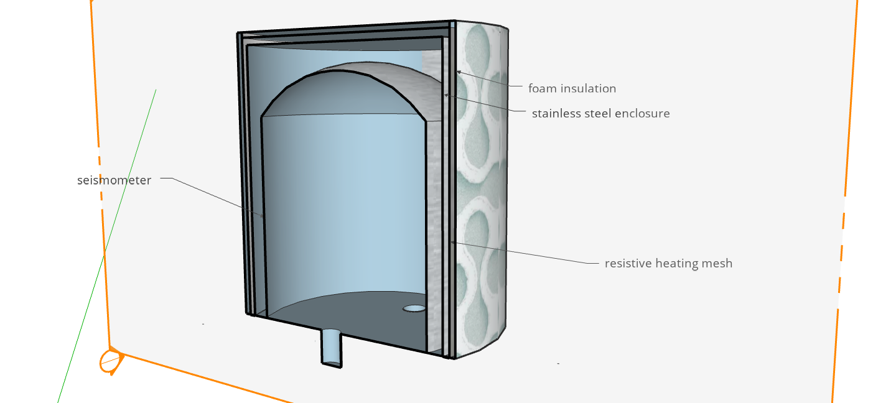
Objectives
Design feedback system to keep temperature constant within seismometer enclosure
Non-linear control for
better accuracy
Neural Network control
has ability for self-learning
and may also reduce
control energy
foam insulation
stainless steel enclosure
seismometer
resistive heating mesh

Slide 5
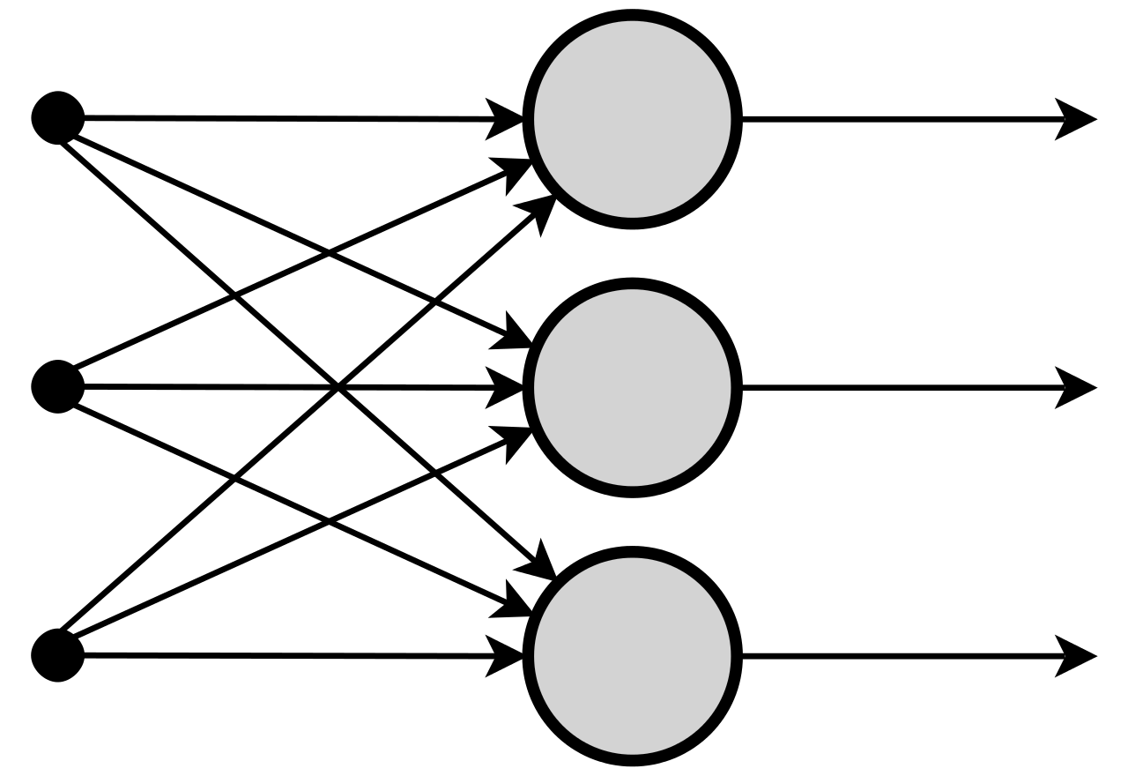
How a Neural Network Works
Many individual neurons connected in dense network
Each neuron receives inputs multiplied by a weight
Layers are made of rows of neurons

Slide 6
How a Neural Network Works
Neuron outputs sum of values received multiplied by their respective weights
Connections initially have randomly assigned weights and biases, which are adjusted in process of training
$$x_{1}$$
$$w_{1}$$
$$\sum_{i=1}^{m}{wix_{i}}$$
$$x_{2}$$
$$w_{2}$$
$$y$$
$$w_{3}$$
$$x_{3}$$

Slide 7
How a Neural Network Works
Network iterates over training set, adjusting weights until desired output is received for a particular input
Maps inputs to outputs
Train by supervised learning or reinforcement learning

Slide 8
Supervised Learning
input training data
neural network
adjust weights
output
difference
ideal output training data

Slide 9
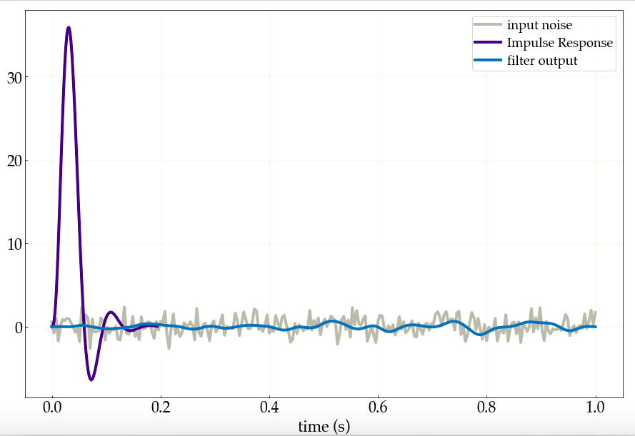
Initial Neural Network
To better understand the concept, first built a simple Convolutional Neural Network to imitate the output of a digital filter
Supervised learning
Tensorflow, Keras
Digital filter applied to random noise using second order sections
Grey noisy signal is input of network
Blue smoothed signal is the target output of network

Slide 10
Initial Neural Network
Labelled set of input (random noise) and output (filtered signal)
As network goes through more training iterations, the weights and biases are adjusted to achieve the desired output
Input shape matters!
(1, data shape, 1)
(batch size, number of steps, channels)

Slide 11
Convolutional Network Structure
Convolutional network adapts to broader pattern across data set
Convolution layer searches for features across a particular “window”, acts like a filter
Takes element-wise product of filter and input
Also need a convolutional neural network for optimum temperature control

Slide 12
Convolutional Network Structure
window size 3
input
time
extracted features
dot prod w/ weights
output

Slide 13
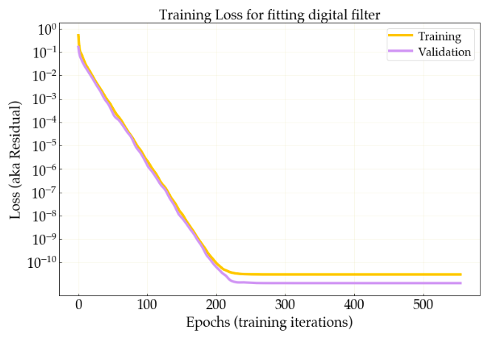
Simple neural network
loss is defined here by mean squared error
able to achieve very high accuracy after around 220 training epochs

Slide 14
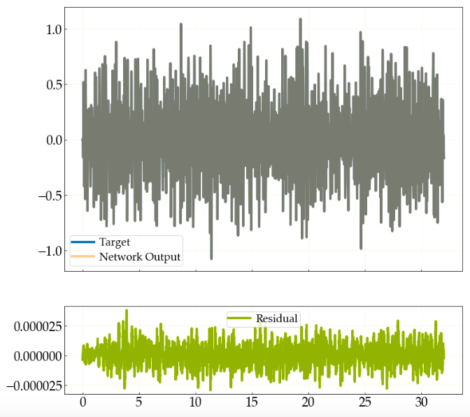
Target and real network output almost completely overlap
Notes:
LABEL THE AXES

Slide 15
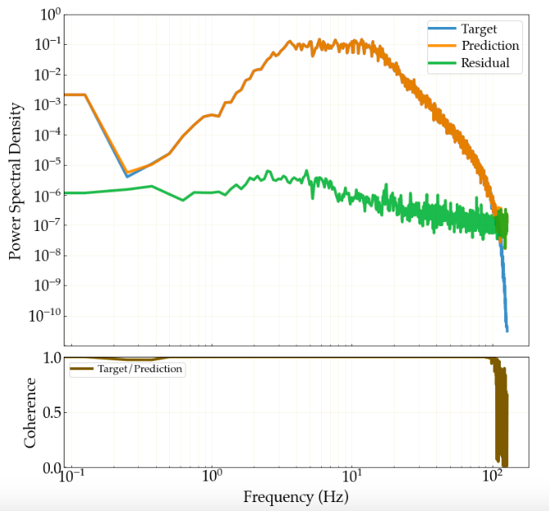
PSD of neural network output and target output

Slide 16
Supervised Learning vs Reinforcement Learning
input training data
agent
neural network
reward
state
action
adjust weights
environment
output
difference
ideal output training data

Slide 17
Temperature control neural network
Also use convolutional neural network
Control: interacts directly with environment- need to use reinforcement learning
Whereas supervised learning uses a labelled data set of input and desired output to train, reinforcement learning generates its own labels – the “reward”
Need continuous action space (output will be continuous – power supplied to heater)
Actor critic most suitable

Slide 18
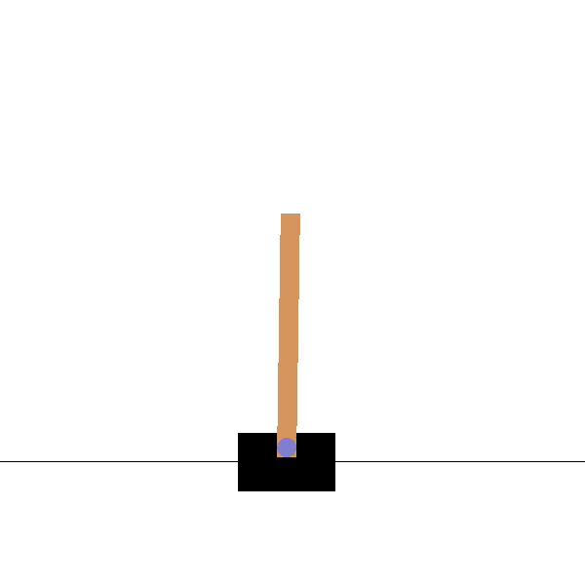
Reinforcement learning: OpenAI gym
Several different environments available to train networks with game-like scenarios
In our case want to train network for temperature stabilization
Built custom environment for this based on pendulum example (both are stabilization problems)
stabilizing an inverted pendulum

Slide 19
Actor Critic Network
“actor” selects best action based on the current state
“critic” estimates the value function of the action
observation
observation
actor
action
critic
Q-value
action

Slide 20
Actor Critic Network
take a single step, for which a reward and the next state are obtained
as more steps are taken both the actor and the critic improve at their respective roles
actor is policy-based, critic is value-based

Slide 21
Actor Critic Network
the policy maps states to actions
the value function finds expected reward for a state - judges which actions were good or not
attempt to merge concepts of policy-based (better in continuous action spaces) and value-based algorithms
idea is for the overall network to outperform the actor and critic separately

Slide 22
Summary
Neural network for nonlinear control will reach temperature set point more quickly, with less over/under-shoot
Built a simple convolutional neural network to fit frequency response of filter
Aiming to train a convolutional neural network for control
Built gym environment for temp control – no ambient temperature fluctuation
Control with DQN converged on set point very slowly
Setting up Actor Critic as training algorithm

Slide 23
Going forward
Get actor critic network up and running in the gym environment
Increase the complexity of both the environment and the network
Add ambient temperature fluctuation to training
Fine tune the network, e.g. adjust hyperparameters for best performance
Run network control in simulation to evaluate efficacy
Apply neural network controller to other scenarios in LIGO

Slide 24
Acknowledgements
Thank you to Rana, Koji and Tega for your supervision & all your help throughout
Thank you also to Sanika and Rushabha, it’s been really fun working with you guys!

