Slide 1
Optimal Temperature Control of the Seismometer
Rushabha B
CalTech LIGO SURF 2020
Mentors: Rana Adhikari, Koji Arai, Tega Edo
Notes:
Change a title

Slide 2
Overview
Why does LIGO require seismometers and why do these seismometers require temperature stabilisation ?
Modelling the temperature control system
Developing and optimising the linear PID Controller
Designing the Heater Circuit
Testing the optimised control system

Slide 3
Introduction
Low frequency region dominated by seismic noise
To characterize this seismic noise we can use seismometers.
Need to make sure noise in the seismometer data is really low !!

Slide 4
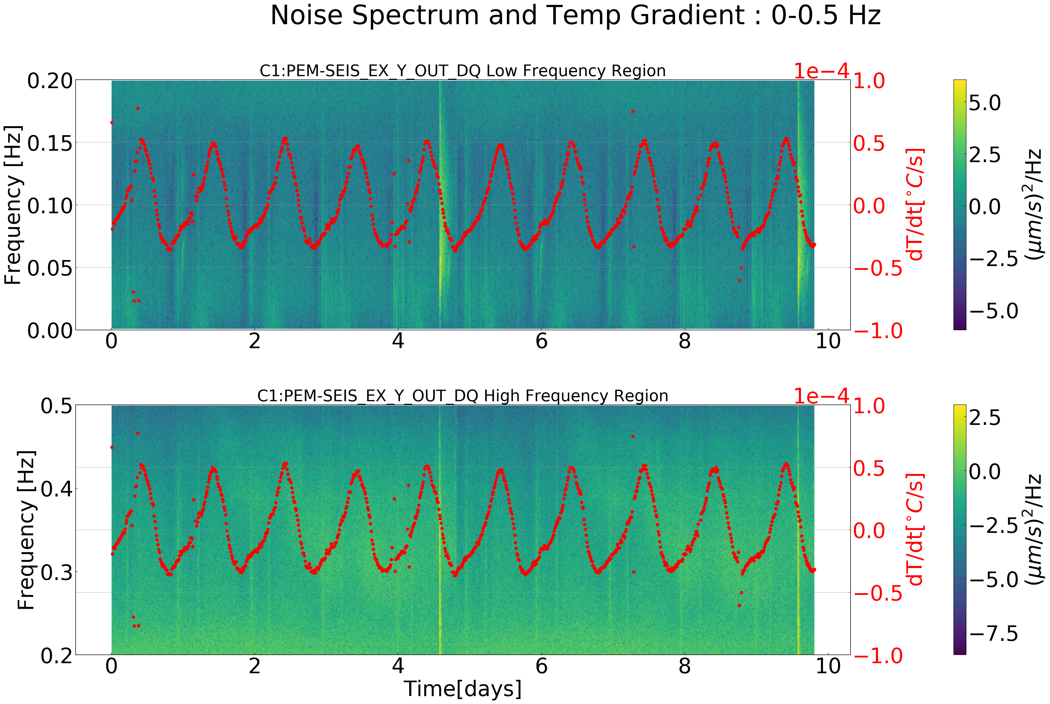
Seismic data noise and temperature
Noise floor of the seismometer in the background
The temperature gradient variation is shown in the foreground
To reduce the noise we need to make sure the temperature of seismometer is as stable as possible !!

Slide 5
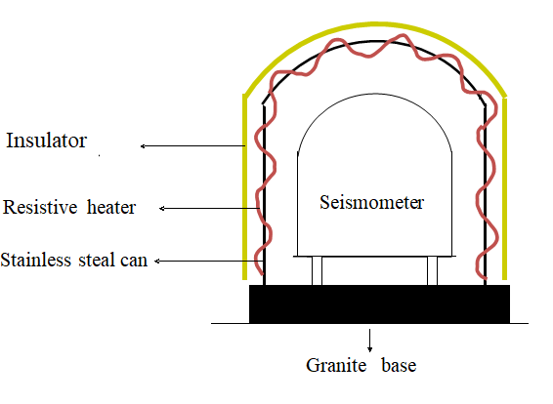
The Control System
Physical Setup
VS
Model

Slide 6
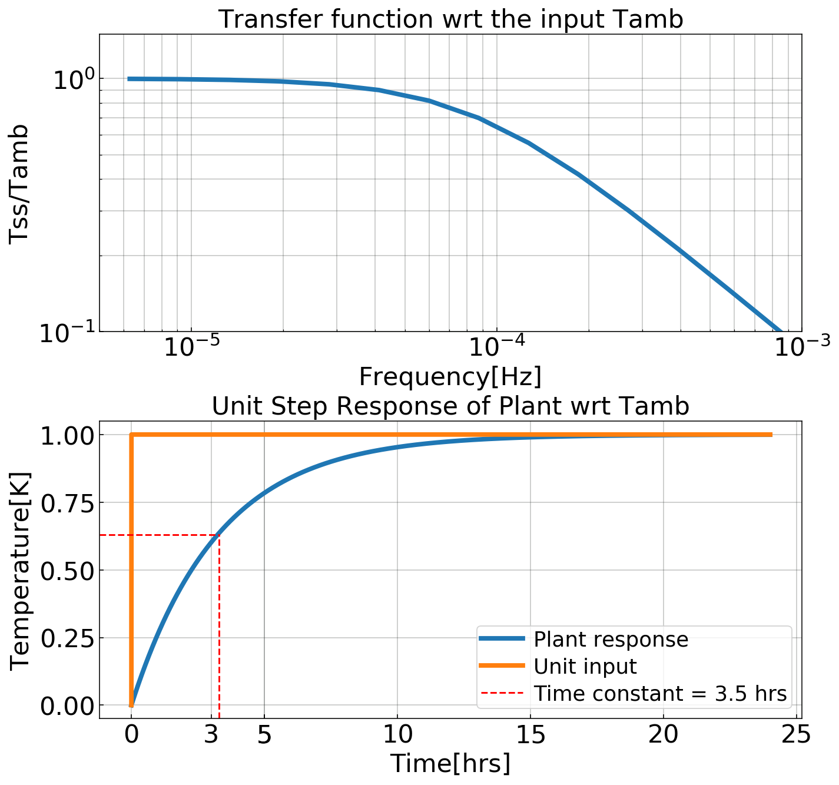
Modelling of the plant
$$P_{in}=Increase in temp of the can+conductive loss$$
$${P_{in}=M}_{SS}C_{SS}\frac{dT_{ss}}{dt}+\frac{K_{f}A_{f}}{h_{f}} \left(T_{ss}−T_{amb}\right)$$
Natural Response of the system :
$${0 =M}_{SS}C_{SS}\frac{dT_{ss}}{dt}+\frac{K_{f}A_{f}}{h_{f}} \left(T_{ss}−T_{amb}\right)$$
The time constant for the system was =3.5hrs

Slide 7
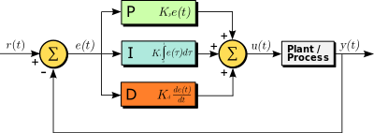
Modelling of the Controller : PID
Proportional Integral and Derivative controller :
$PID= K_{p}e\left(t\right)+K_{I}\int{e\left(t\right)dt+ K_{D}\frac{de}{dt}}$
$H_{1}(s)$=$K_{p }+{\frac{K_{I}}{s}+K}_{D}s$
This is a linear controller. We would like to see how well this linear controller, minimizes the steady state error for our system model.
Acts as a performance benchmark for the non-linear controller i.e. the neural network controller.

Slide 8
Ambient Temperature Model
Data was noisy hence for offline analysis and simulation curve fit function was necessary
Interpolation function was developed to generate the data as shown.
Notes:
Why not BH

Slide 9
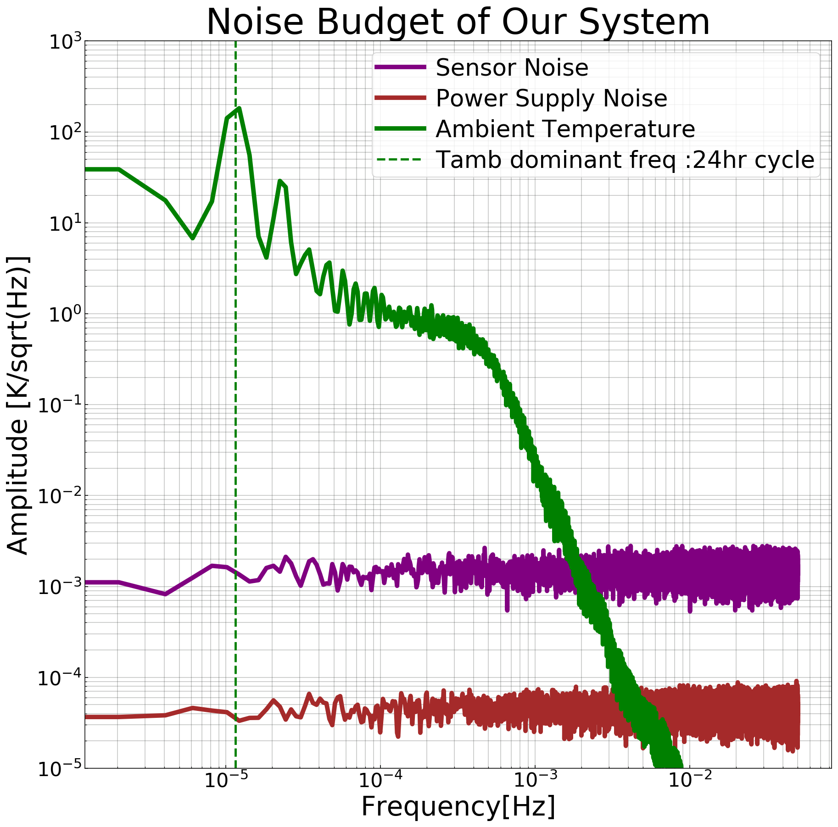
Noise Budget
The total noise and disturbances to our system and the points of injection is shown.

Slide 10
Steady State Error Analysis
The noise and disturbances to our system aim to upset our set point of our temperature.
The frequency distribution of this error is shown in the plot.
The affect of the daily fluctuation of the room temperature can be seen here.

Slide 11
Optimal Control
Some examples of commonly used optimal control on linear systems :
Linear Quadratic Regulator (LQR) : Formulates the controller which minimizes the energy spent by the control system
H infinity : Formulates the cost function with the disturbances taken as one of the parameters to be minimized with controller gain provided as a constraint.
$${Cost=x}^{T}Qx+u^{T}Ru$$

Slide 12
Cost Function or The metric
The total disturbance at the output is the sum of each noise and disturbance source weighted by their transfer function.
The cost function was designed to be the integral of this disturbance over the frequency band of our choice which was from 0-1 Hz.
$Δ {T_{ss}}^{2}\left(s\right)={\left(Y_{amb}(s\right)∗ΔT_{amb}(s))}^{2}+{\left(Y_{PS}\left(s\right)∗Δ {PS}_{noise}(s)\right)}^{2}$ ${+ (Y_{Sensor}(s)∗Δ S_{noise}(s)) }^{2}$
$$Cost Function= \int_{f1}^{f2}{Δ {T_{ss}}^{2}\left(f\right)df+max⁡(Phase Margin of Open Loop System)}$$
Notes:
Black hole, define BH ECO

Slide 13
Optimization of the PID coefficients
Due to complicated nature of the cost function iterative algorithm was used .
The two options which were explored were :
Particle Swarm Optimisation (PSO)
Genetic Algorithm (GA)
PSO was favoured due to the natural minimisation algorithm it uses and is much faster than GA.
Notes:
换成Teukolsky master eq(全slide唯一一个公式)

Slide 14
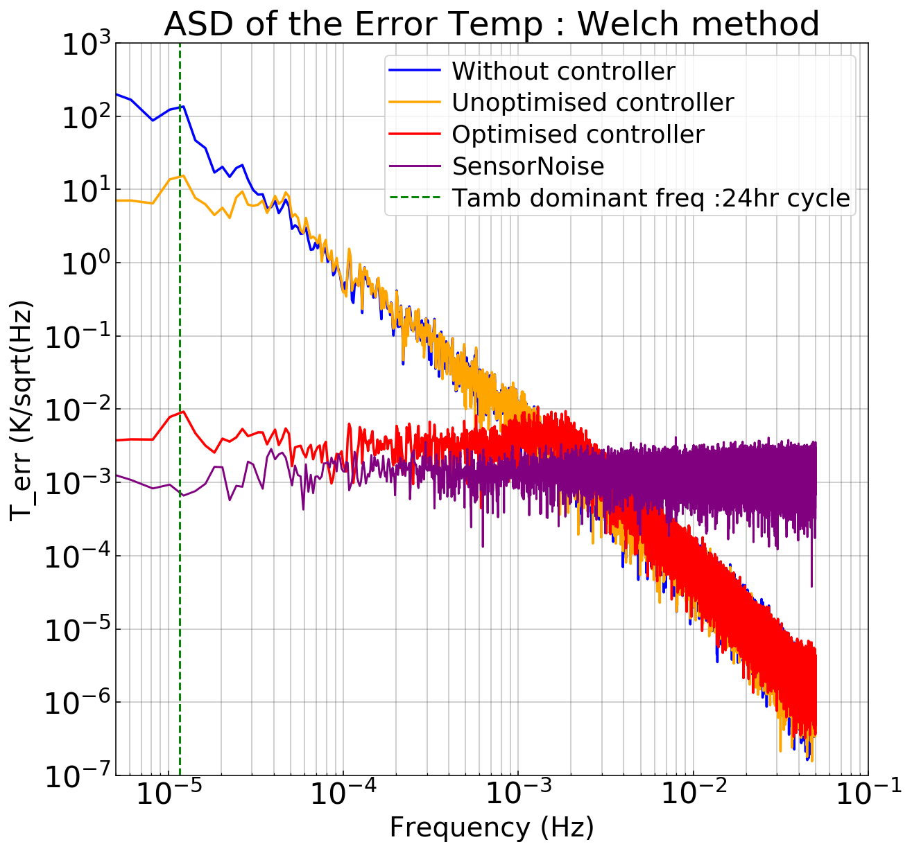
Results of the optimization
With the correct PID coefficients the reduction in error is significant !!
Notes:
Complete figure

Slide 15
Results of the Optimisation
The optimised PID coefficients also ensured that the system was stable.
The loop gain transfer function tells about this stability by looking at its phase margin.

Slide 16
Testing of our control system
Physical testing of our simulated optimised control system

Slide 17
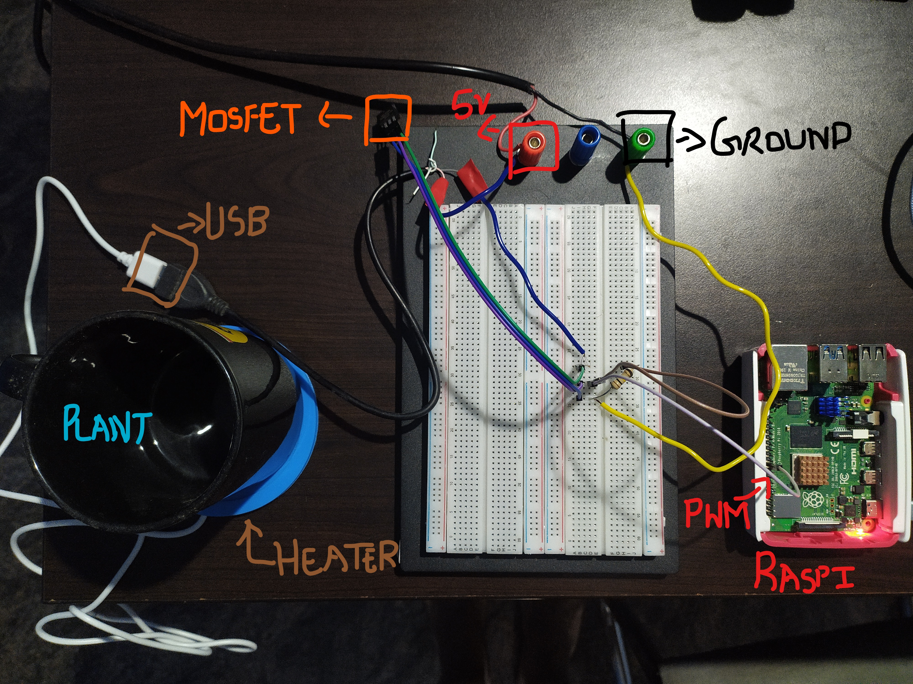
Breadboard Circuit

Slide 18
Summary
Seismometer and the disturbances to this system was modelled and simulated on python.
The linear PID controller was developed and was optimised using the PSO algorithm to get the least steady state error.
Testing of this model on the remote home setup is being carried out.

Slide 19
Future Work
Short Term :
Closing the feedback loop of the remote setup using the ADC
Designing a more powerful driver circuit to provide higher power to the heater.
Replacing the PID controller with a neural network
Testing the neural network on the physical remote setup
Long term :
Physical testing of the optimised system on the seismometers in the actual lab environment

Slide 20
Acknowledgement
I would like to thank Rana Adhikari, Koji Arai and Tega Edo for their guidance and mentorship throughout the project.
I would like to thank my SURF teammates for all their help.
Finally I would like to thank Prof.Alan Weinstein, LIGO laboratory and the NSF foundation for conducting and coordinating all the LIGO and REU related talks which made the internship experience really enriching.

Slide 21
Thanks for listening!

