Slide 1
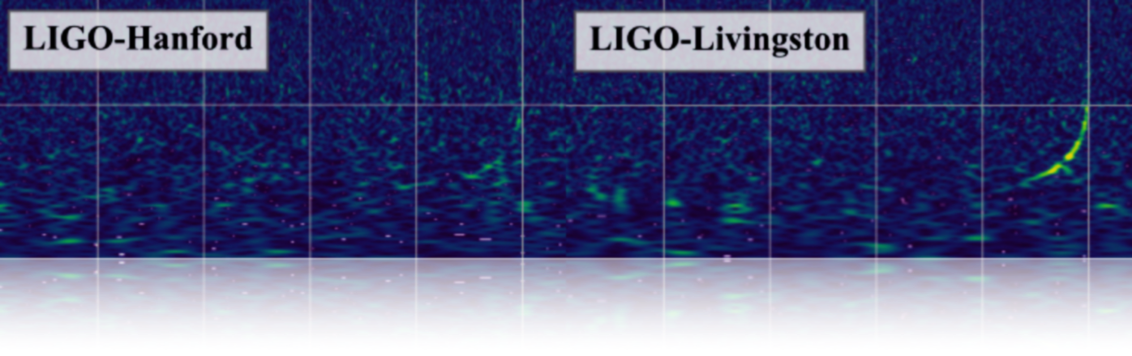
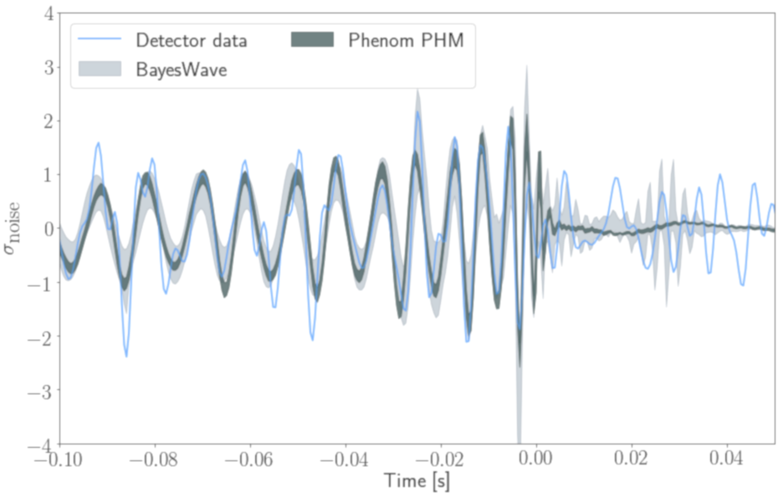
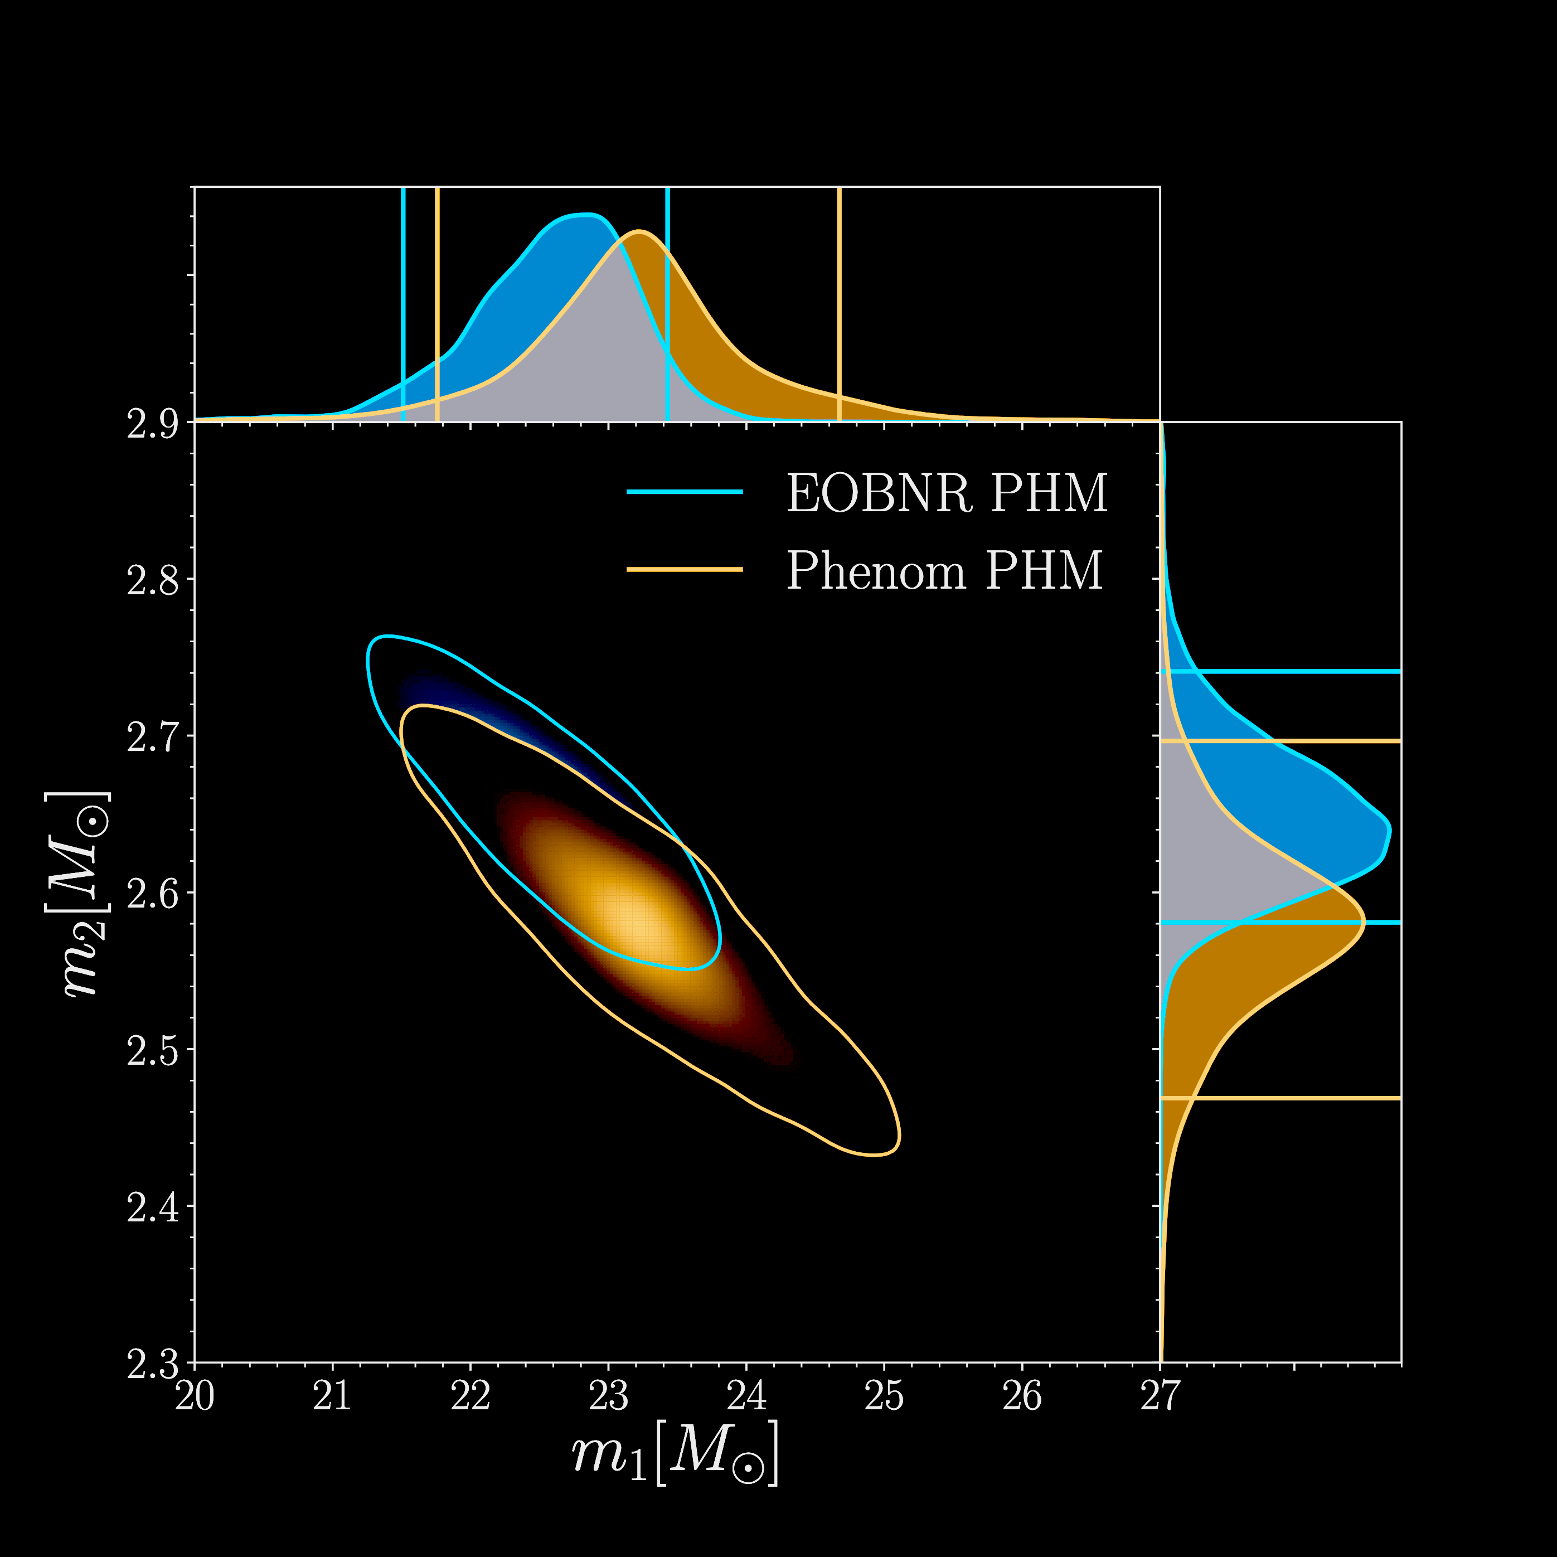
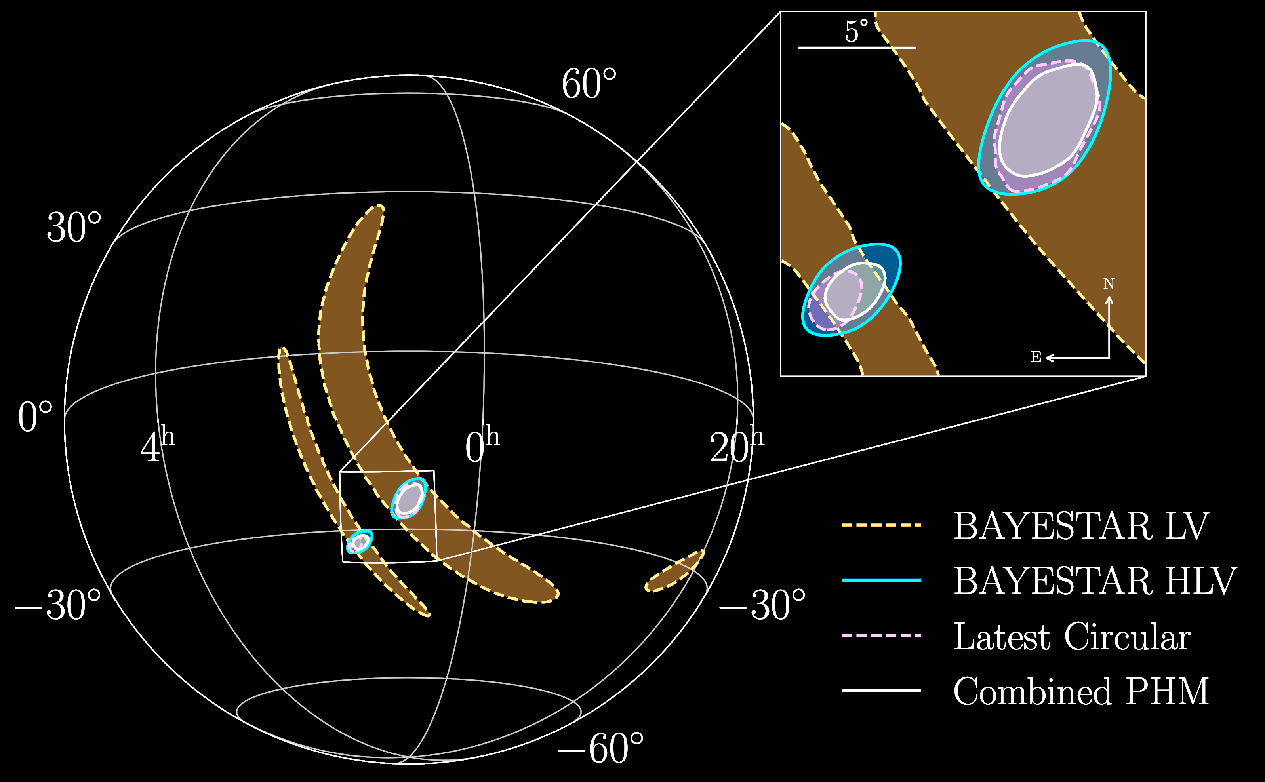
GW190814 Factsheet
Lowest mass ratio event to date
Strongest evidence of higher order modes
Observed by: | LIGO Hanford, LIGO Livingston and Virgo detectors
Source type: | BH and compact object
Date: | August 14th 2019
Time of merger: | 21:10:39 UTC
Network SNR: | 25
Distance: | 196 – 282 Mpc
Redshift: | 0.05
Chirp Mass: | 6.1 M⨀
Primary Mass: | 23.2 M⨀
Secondary Mass: | 2.6 M⨀
Mass ratio: | 0.11
Final Mass: | 25.6 M⨀
Model 1
Model 2
Spin Perpendicular to Orbital Plane: | 0.0
Spin Parallel to Orbital Plane: | 0.0
Spin of Final BH: | 0.28
SNR in Octupole Mode: | 5.2 – 7.9
# GW cycles (above 20Hz) | 300 cycles
Sky Area: | 18 deg²
Merger Rate: | 1 – 23 Gpc⁻³ yr⁻¹
Initial Public Alert Delay: | 20 min
R. Ewing*, R. Huxford*, D. Singh*
* The Pennsylvania State University

