Slide 1
Thermal Noise in GW detectors and everywhere
LIGO-G2000770
Koji Arai – LIGO Laboratory / Caltech

Slide 2
Laser interferometer GW detectors and noises
Who am I: Koji Arai
LIGO Scientist - Interferometer Sensing & Control
My view of a laser interferometer GW detector
Optical
noise
Displacement
noise
Optics
Mechanics
Electronics
Electrical noise

Slide 3
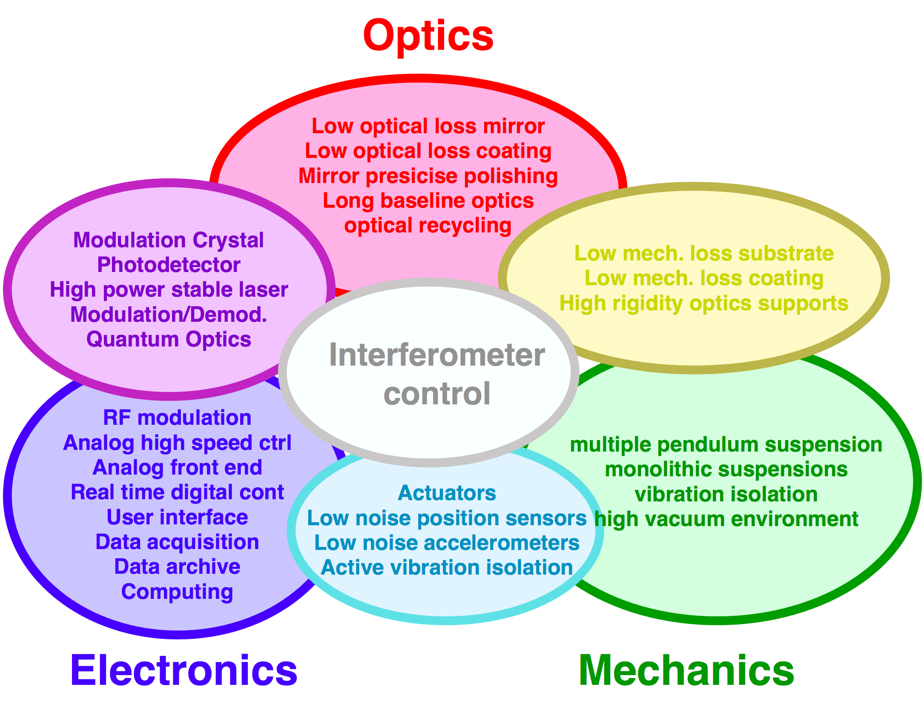


Laser interferometer GW detectors and noises
Who am I: Koji Arai
LIGO Scientist - Interferometer Sensing & Control
My view of a laser interferometer GW detector
Thermal noise
Optical
noise
Displacement
noise
Optics
Mechanics
Electronics
Electrical noise

Slide 4
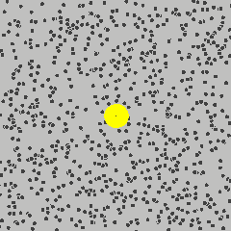


Thermal Noise
Examples 1
Brownian Motion - A. Einstein (1905)
μ: mobility
(∝ 1/η <-viscosity)
By Lookang Author of computer model: Francisco Esquembre, Fu-Kwun and lookang - Own work, CC BY-SA 3.0, https://commons.wikimedia.org/w/index.php?curid=19140345

Slide 5



Thermal Noise
Examples 2
Johnson-Nyquist Noise of a resistor (R)
V
R

Slide 6
Thermal Noise
Examples 3
Mechanical system (harmonic oscillator) with damping
Thermal excitation: kB T/2 for K.E. and P.E.
(equipartition of energy)
𝛾
k
x

Slide 7
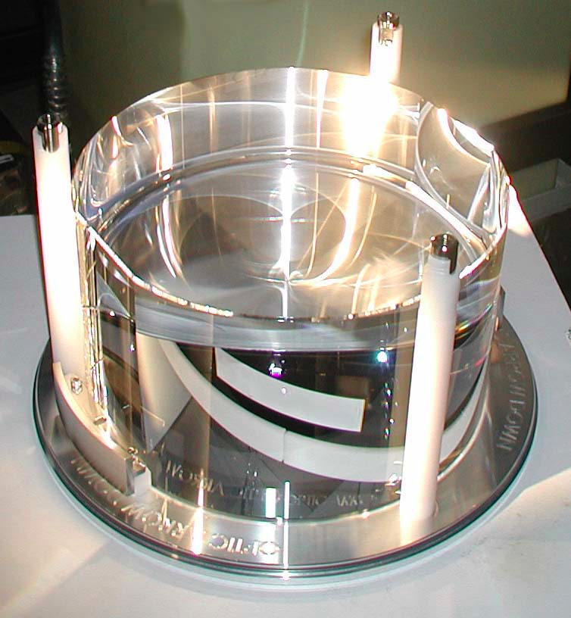
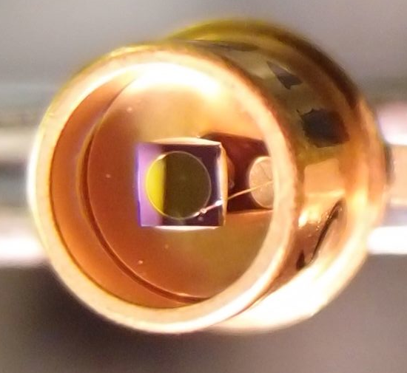
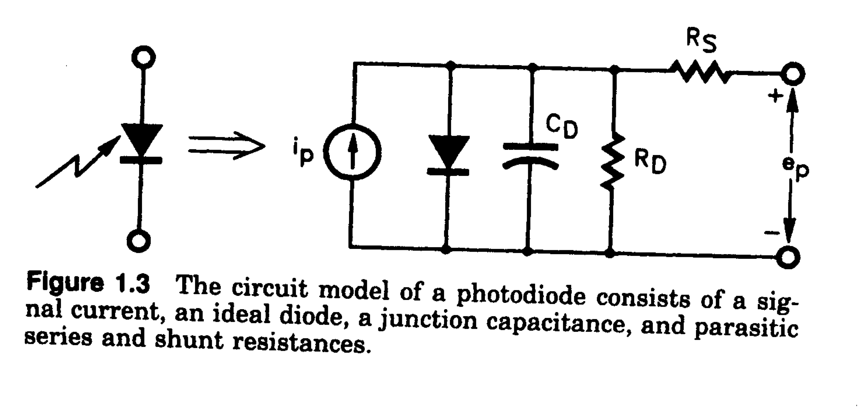


Thermal Noise
Mirror substrate T.N.
Coating T.N.
Thermo-optic noise
Suspension T.N.
Thermal noise in electrical systems
Thermal noise in optical sensors
photodiode

Slide 8
Thermal Noise
There is a single principle behind them:
  “Fluctuation Dissipation Theorem”
Our goal here is to become able to:
- quantify the amount of thermal noise
- know how to reduce / isolate the noise
To know your dissipation
-> To know how much the fluctuation

Slide 9

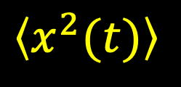




Noise
Time series x(t)
$$x$$
RMS
$$t$$
mean
$$\left\langle x\left(t\right)\right\rangle$$
mean
$$\left\langle x_{ }^{2}(t)\right\rangle$$
mean square
$$\sqrt{\left\langle x^{2}(t)\right\rangle }$$
root mean square (RMS)

Slide 10
Introduction ~ Noise?
Frequency Domain
Power Spectral Density (PSD)
Double sided PSD (-Infinity < f < Infinity)
Single sided PSD (0 <= f < Infinity)
[x_{unit}² / Hz]
Linearized PSD (Amplitude Spectral Density):
[x_{unit}/ sqrtHz]

Slide 11

Introduction ~ Noise?
Parseval’s Theorem for signal RMS and PSD
Notes:
\langle x^2(t)\rangle = \int_0^\infty S_x(f) {\rm d} f

Slide 12





Fluctuation Dissipation Theorem
  Excited system: Energy dissipation to the heat bath
Same coupling
  Thermal equilibrium: Thermal excitation by the heat bath
Energy
dissipation
heat
bath
=
Thermal
excitation

Slide 13
Approaches
1) Inject known amount of fluctuation
-> Calculate the transmission to the target motion
2) Calculate/measure the frequency response of the target object
-> Calculate the thermal noise spectrum
3) Calculate the energy loss rate of the forced oscillation
Fluctuation is gaussian stochastic noise
=> better to use freqeuncy domain

Slide 14


Method 1: Fluctuation injection
Equation of Motion
Dissipation and fluctuation have a relationship
Add fluctuation force whose PSD is proportional to R
deterministic

Slide 15






Method 1: Fluctuation injection
Most suitable example: Circuit noise analysis
RC circuit:

Slide 16







Method 1: Fluctuation injection
Voltage noise <-> Current noise

Slide 17





Method 2: Transfer Function Approach
For a complicated system: e.g.
  Multiple losses / Multiple masses
Transfer function approach
Displacement x caused by Force F
Notes:
H(\omega) = \frac{\tilde{x}(\omega)}{\tilde{F}(\omega)}\,\,\,\left(=\frac{\tilde{Q}(\omega)}{\tilde{V}(\omega)}\right)
Z(\omega) = \frac{\tilde{F}(\omega)}{\tilde{v}(\omega)} \,\,\,\left(= \frac{\tilde{V}(\omega)}{\tilde{I}(\omega)}\right)
S_x(\omega) = - \frac{4 k_{\rm B} T\,{\rm Im}[H(\omega)]}{\omega}
= \frac{4 k_{\rm B} T\,{\rm Re}[1/Z(\omega)]}{\omega^2}
Y(\omega) = \frac{1}{Z(\omega)}

Slide 18
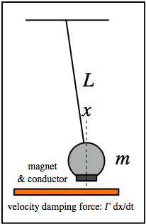
Method 2: Transfer Function Approach
Example: Velocity damping of a pendulum
Notes:
m \ddot{x} + \Gamma \dot{x} + m \omega_0^2 x = f
-m \omega^2 \tilde{x} + i \omega \Gamma \tilde{x}+m \omega_0^2 \tilde{x} = \tilde{f}
H(\omega) = \frac{\tilde{x}}{\tilde{f}} = \frac{1}{m(\omega_0^2-\omega^2) + i \omega \Gamma}
= \frac{4 k_{\rm B} T \Gamma}{m^2 (\omega_0^2-\omega^2)^2 + (\omega \Gamma)^2}
H(\omega) = \frac{\tilde{x}}{\tilde{f}} =
\frac{1}{m(\omega_0^2-\omega^2) + i \omega \Gamma}
S_x(\omega) = -\frac{4 k_{\rm B} T}{\omega} {\rm Im}[\frac{1}{m(\omega_0^2-\omega^2) + i \omega \Gamma}]
= \frac{4 k_{\rm B} T\,\Gamma}{m^2 (\omega_0^2-\omega^2)^2 + (\omega \Gamma)^2}

Slide 19

Method 2: Transfer Function Approach
- Velocity damping of a pendulum
- Structure damping
loss angle: 0 < 𝜙₀ ≪ 1
What happens if the loss has
an arbitrary frequency dependence 𝜙(ω) ?
Notes:
m \ddot{x} + m \omega_0^2 (1+{\rm i} \phi_0) x = f
m \ddot{x} + m \omega_0^2 [1+{\rm i} \phi(\omega)] x = f

Slide 20


Method 2: Transfer Function Approach
arbitrary 𝜙(ω)
Check equipartition of energy
Notes:
H(\omega) = \frac{1}{m(\omega_0^2-\omega^2) + {\rm i} m \omega_0^2 \phi(\omega)}
{\color[rgb]{0.131345,0.999677,0.023624}H_R(\omega) = \frac{2}{\pi} \mathcal{P} \int_{0}^{\infty} {\frac {\omega' H_I(\omega')} {{\omega'}^2 - \omega^2}} \, d\omega'
}
\frac{1}{2} k \langle x^2 \rangle & = \frac{m \omega_0^2}{2}\times\frac{1}{2 \pi}\int_0^{\infty} - \frac{4 k_{\rm B} T}{\omega} {\rm Im}[H(\omega)] {\rm d} \omega \\
& = - \frac{m \omega_0^2 k_{\rm B} T}{\pi} \int_0^{\infty} \frac{1}{\omega} {\rm Im}[H(\omega)] {\rm d} \omega \\
& = \frac{m \omega_0^2 k_{\rm B} T}{\pi} \frac{\pi}{2} {\rm Re}[H(0)] \\
& = \frac{k_{\rm B} T}{2}
\frac{1}{2} k \langle x^2 \rangle & = \frac{m \omega_0^2}{2}\times\frac{1}{2 \pi}\int_0^{\infty} - \frac{4 k_{\rm B} T}{\omega} {\rm Im}[H(\omega)] {\rm d} \omega \\
& = - \frac{m \omega_0^2 k_{\rm B} T}{\pi} \int_0^{\infty} \frac{1}{\omega} {\rm Im}[H(\omega)] {\rm d} \omega \\
& = \frac{m \omega_0^2 k_{\rm B} T}{\pi} \frac{\pi}{2} {\rm Re}[H(0)] \\
& = \frac{k_{\rm B} T}{2}

Slide 21
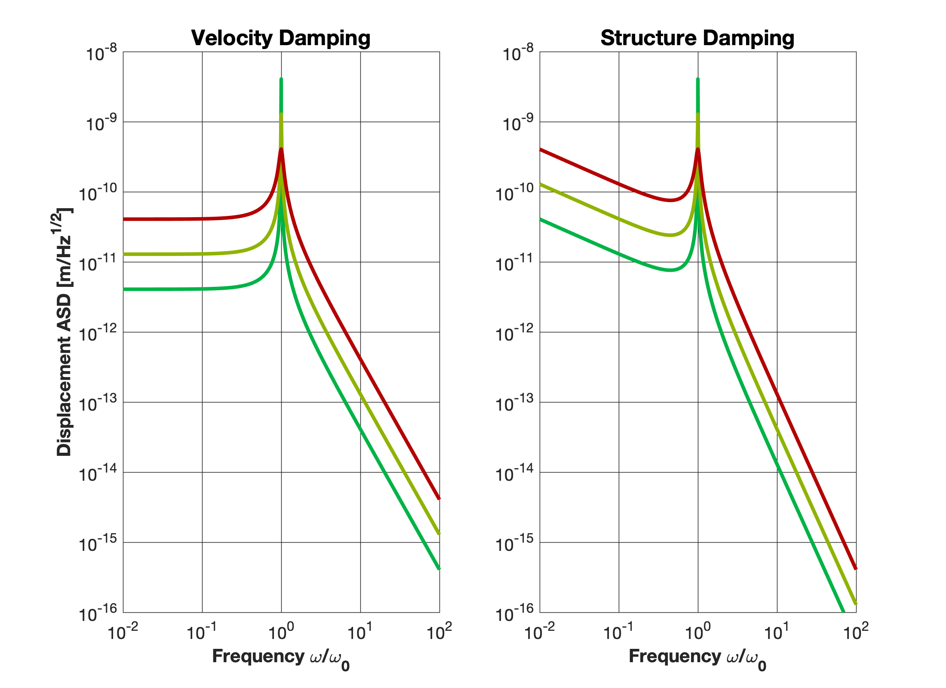

Method 2: Transfer Function Approach
Thermal noise displacement of a harmonic oscillator

Slide 22

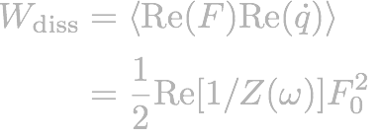
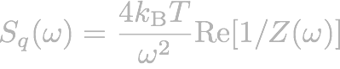
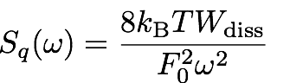
Method 3: “Direct” Approach
Another approach for a complicated system:
Energy loss rate for a forced oscillation
-> Calculate the fluctuation
Systems response (impedance) at a certain freq:
Average rate of energy dissipation
We don’t need to
know Z(ω)!

Slide 23
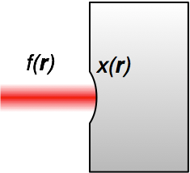


Method 3: “Direct” Approach
Sensing of the mirror surface deformation with a laser beam (with intensity profile of f(r))
Apply periodic pressure with profile of f(r)
This induces deformation of x(r) which is different
from our sensing profile of f(r), but that’s OK
Calculate the rate of dissipation Wdiss
analytically, using FEA, or etc
Put this into the following formula
We don’t need to
know Z(w)!
Y. Levin PRD 57, 659-663 (1998)

Slide 24

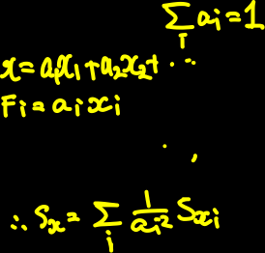
Method 3: “Direct” Approach
Simple case

Slide 25
Method 3: “Direct” Approach
Different loss process -> different thermal noise
We don’t need to
know Z(w)!

Slide 26
Blank

Slide 27
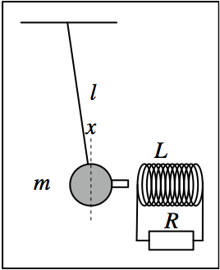
Pendulum with Coil Magnet
Question
  Induced current damping (electro-mechanical system)
  1. How does the Q factor of the system depend on R?
  2. How much is the thermal noise displacement of the mass?
  3. How does the thermal noise of the resistor shakes the mass?
  4. How are the above questions with a capacitive coupling
  instead of the coil?
  Cold damping
  1. If the resistor is cooled, how does
  the thermal noise motion change?
  2. Is the pendulum actually cooled?
  Down to what temperature?
  3. How fast the pendulum recovers the
  original temperature once R is returned
  to the room temp.?
We don’t need to
know Z(w)!

Slide 28
Blank

Slide 29
Approach 1: Fluctuation injection
Example: Brownian motion

Slide 30
Approach 1: Fluctuation injection
Example: Brownian motion

Slide 31





Approach 1: Fluctuation injection
RC circuit:
Dissipation anPSD) of the fluctuation force

Slide 32

Approach 1: Fluctuation injection
Example: harmonic oscillator with loss
Viscous damping: friction proportional to the velocity

Slide 33





Method 2: Transfer Function Approach
Question:
- Velocity damping of a pendulum

Slide 34
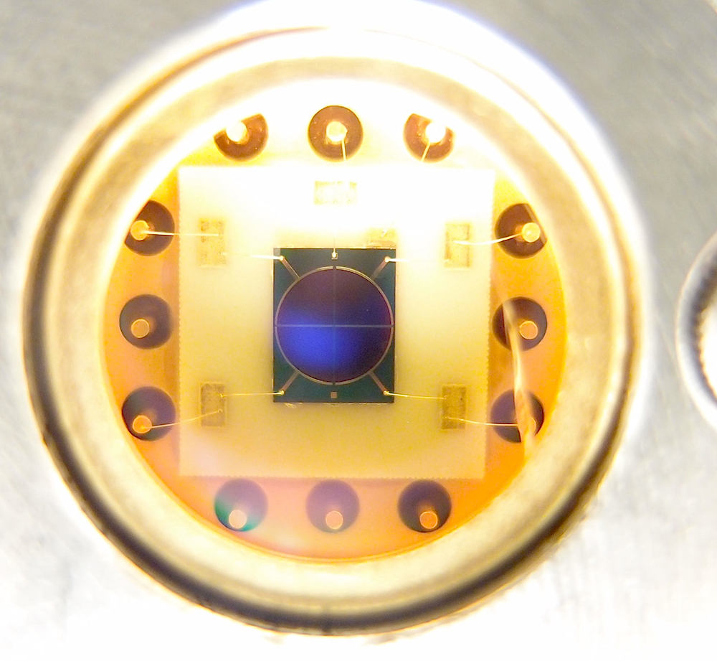
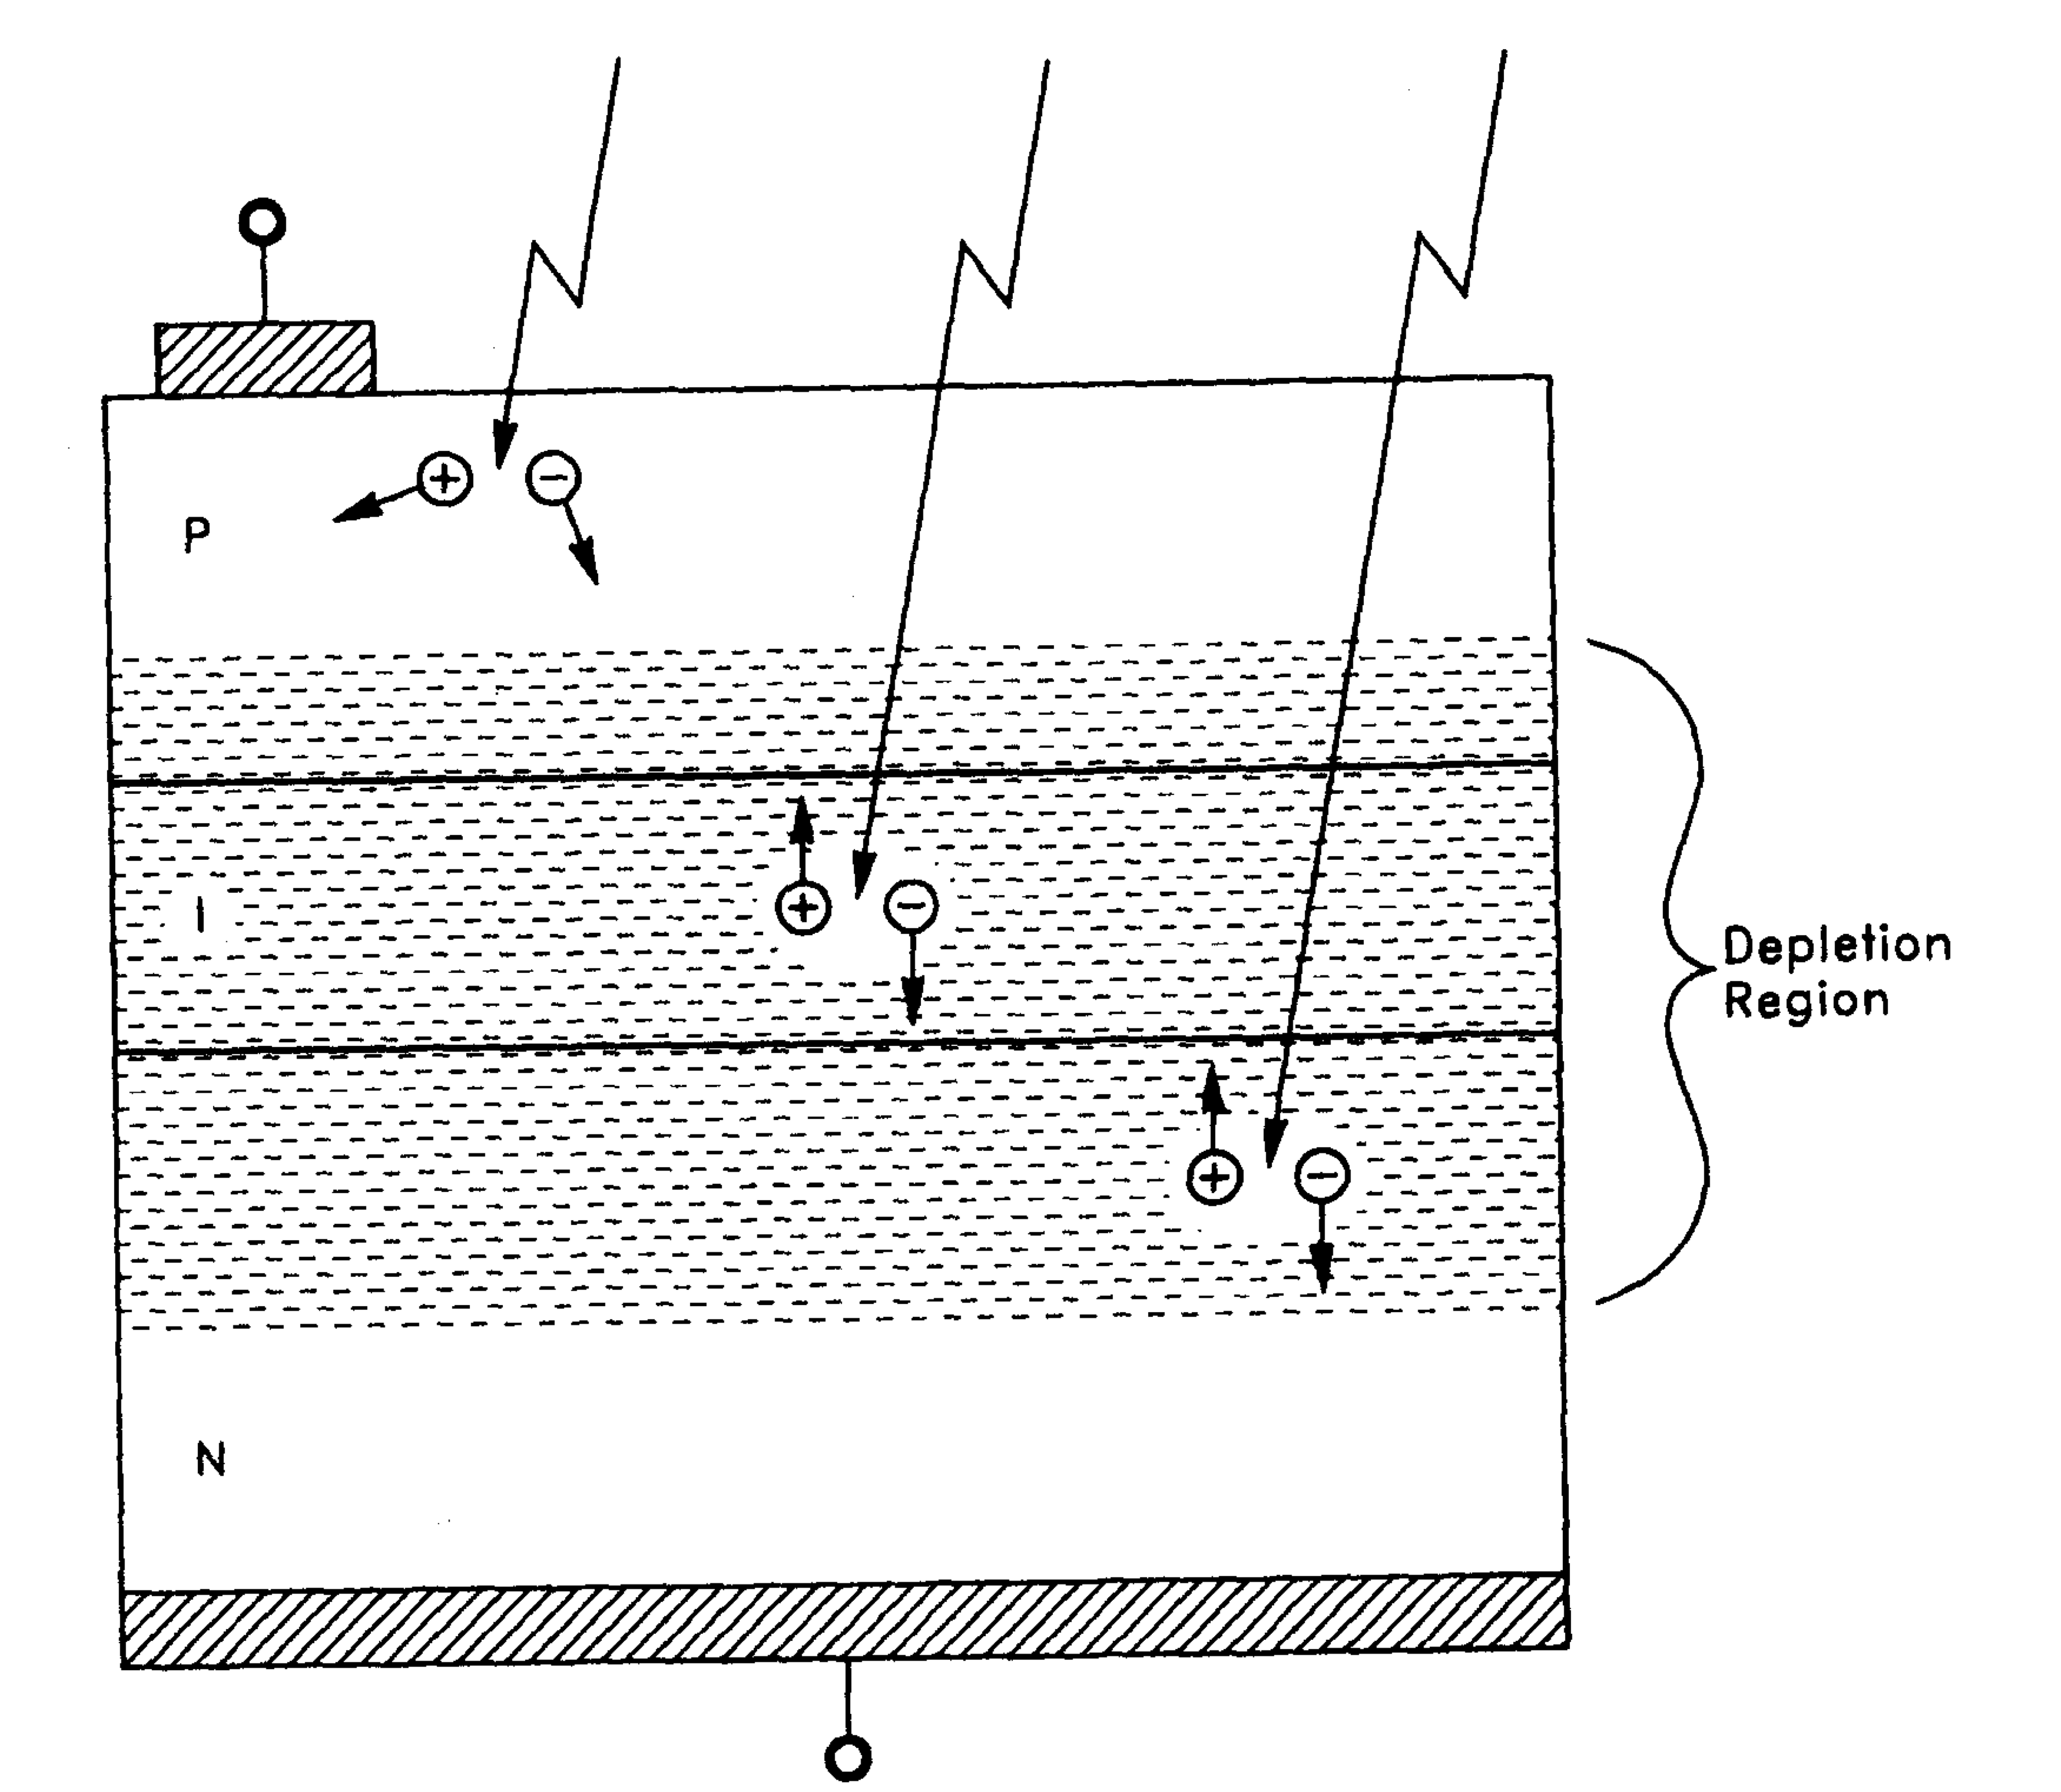
Noise in photodetectors
Photodiodes
  PIN photodiodes
  (InGaAs for near IR, Si for visible)
    Good linearity
    Low noise
    High Quantum Efficiency (>90%)
InGaAs Quadrant PD
(𝜙3mm)
Anode
InGaAs PD (𝜙1mm)
P-layer
I-layer
N-layer
Photocurrent
Cathode
“Photodiode Amplifiers”, J. Graeme (McGrawHill 1995)

Slide 35
Noise in photodetectors
Noise in photodiodes
  Photodiode equivalent circuit
    Shunt Capacitance R_{D} (~100MΩ) Usually not a problem
    Junction Capacitance C_{D} (1pF~1nF)
    Series Resistance R_{S} (1Ω~100Ω)
input referred noise current
  The diode aperture size needs to be ~mm => Cd tends to be big.
  2mm InGaAs PD: Rs~10Ω, Cd~100pF
  => i_Rs = 20 pA/sqrtHz @100MHz
  (equivalent to the shot noise of 1mA light ~ 1.3mW@1064nm)

