Slide 1
Understanding H1's O3 B Electronics Compensation Systematic Error
J. Kissel for the Calibration Group

Slide 2
Outline
Two Parts, each quite long. *sigh*
PART I: The ETMX UIM Driver, from Nov 27 to Dec 03 2019
  Why do you care about the UIM?
  Review where we were before we started
  Review of the Circuit
  The Measurement
  Other models of the circuit
  The Fit and Each Coil Result
  Converting fit results in to systematic error in A_{UIM}
  Converting sys error in A_{UIM} to sys error in R and Conclusions
PART II: The OMC Whitening Chassis, from Mar 16 to 27 2020
  Review of the Circuit
  Fit Results for each channel
  Converting fit results in to systematic error in C
  Converting sys error in C to sys error in R

Slide 3
But -- your time is valuable
This is 126 page slide show. Here are the answers, in case you don’t have time to be educated as to how I came to each conclusion, with the confusing details and the lessons learned that got me to it. I hope at least some folks read it.
PART I: The ETMX UIM Driver, from Nov 27 to Dec 03 2019
Executive summary: non-Jeff’s everywhere whom guessed the answer ahead of time are vindicated in that the UIM electronics error -- either from differences in compensation between states, or poor compensation in general – doesn’t substantially contribute to the response function systematic error. (See slide 70 for quantitative answer)
We may safely proceed with O3B chunk 1 uncertainty budget development without including this systematic error.
  Note that this would have *not* been “covered” by the GPR even it it were non-negligible.
PART II: The OMC Whitening Chassis, from Mar 16 to 27 2020
Executive summary: While I can predict the systematic error from the configuration switch, it also doesn’t substantially contribute to the response function systematic error (see slide 124 for quantitative answer).
We can probably proceed with O3B chunk 2 uncertainty development without including this systematic error.
We need to remeasure and recompensate the OMC Whitening Chassis.
We need to find out what happened on / around 2020-03-23 instead.
We need to use different measurements we have to make the best guess for the systematic error…

Slide 4
PART I:
The ETMX UIM Driver, from Nov 27 to Dec 03 2019

Slide 5
Outline
Two Parts, each quite long. *sigh*
PART I: The ETMX UIM Driver, from Nov 27 to Dec 03 2019
  Why do you care about the UIM?
  Review where we were before we started
  Review of the Circuit
  The Measurement
  Other models of the circuit
  The Fit and Each Coil Result
  Converting fit results in to systematic error in A_{UIM}
  Converting sys error in A_{UIM} to sys error in R and Conclusions
PART II: The OMC Whitening Chassis, from Mar 16 to 27 2020

Slide 6
I.1 Why do you care about the UIM?
The UIM always gets pushed to ”low priority” because “we should be rolling off its authority fast enough that it doesn’t matter in the detection band.”
That means: we ignore it, assuming anything we do above 10 Hz to the UIM doesn’t matter, and don’t stress about the consequences when we change something until it’s too late.
We’ve already identified one systematic error in the UIM that has bit us ‘cause we ignored it: the nasty bending response of the UIM Blade + Non-magnetic Blade Dampers.
This amplifies the contribution of the UIM to the response function at 150 Hz, making *all* UIM systematic error important, right in the bucket. (This is true only for H1, which doesn’t roll off their UIM fast enough. L1 should be safe.)
But also: this is the era of the 1%. Even when we fix the UIM contribution by rolling it off faster, this study emphasizes that we must question everything and *confirm* *quantitatively* that something is “negligible.”
This didactic presentation is good practice, and by presenting in great detail, I aim to train the next generation, lest the art of understanding analog electronics analysis dies.

Slide 7
I.1 Why do you care about the UIM?
H1 O3
(1/C) / R
UIM Contributes at the ~10% level out to ~25 Hz
(D*A_{p}) / R
(D*A_{T})/ R
Vertical Blade Spring Twisting / Bending in L direction causes UIM contribution to spike back in to play at 150 Hz
(D*A_{u}) / R
Figure 4
from P1900245

Slide 8
Outline
Two Parts, each quite long. *sigh*
PART I: The ETMX UIM Driver, from Nov 27 to Dec 03 2019
  Why do you care about the UIM?
  Review where we were before we started
  Review of the Circuit
  The Measurement
  Other models of the circuit
  The Fit and Each Coil Result
  Converting fit results in to systematic error in A_{UIM}
  Converting sys error in A_{UIM} to sys error in R and Conclusions
PART II: The OMC Whitening Chassis, from Mar 16 to 27 2020

Slide 9
I.2 Review of where we were before starting
During O1 and O2, we were using all ETMY stages for the DARM actuators, the UIM included.
We updated the low-pass compensation filters on ETMY based on fit to measurements [LHO:21283], but we only used the “DTT measurements with the coil driver monitor circuits” technique, which are insensitive to the 85:300 zero:pole pair which results from the output impedance network [LHO:21142], and we ran out of time (remember GW150914?), so we didn’t update the antiAcq filter.
We ran in ETMY, UIM, State 1 for all of O1 and O2, so the updates didn’t actually matter (Sorry Darkhan!).
In Jan 2019, 4 months before O3, we made the switch to using all ETMX stages for the DARM actuator.
The UIM electronics were fully measured in analog on Feb 03 2019 (yes, a Sunday!), by Rich Abbott and Jeff Kissel. Rich was unconvinced that we needed the differential driver full setup as described in D1900027, so we did some sort of single-ended, direct via clip-leads measurement [LHO:46927] (this becomes important later).
Lilli tried to fit the State 1 data, but they didn’t make any sense to us at the time [LHO:47195].
We did take the DTT data on Feb 07 2019 to update the low pass compensation, but never got to processing it.
Because of confusion about the results in the State 1 measurements, and because the UIM was low priority, we just chose not to update anything: [LHO:47167]. (Remember ER14 and how there was systematic error everywhere [LHO:47378] ?)
Flash-forward to Nov 27 2019, we got suspicious of DAC quantization noise [LHO:53376], and switched the ETMX UIM driver to State 2 [LHO:53528], forgetting the terrible state of the compensation, and assuming “the UIM doesn’t matter.”
Only 6 days later on Dec 03 2019 (and thus in between regular calibration sweeps), we reverted back to State 1 [LHO:53652].
The switch happened between two regular actuator sweeps (taken on 2019-11-11 and 2019-12-04), so there for we must model what the systematic error with the measurements we have (namely, the Feb 03 2019 data) for this 6 day period, in which -- of course – there lies GW191129.

Slide 10
Outline
Two Parts, each quite long. *sigh*
PART I: The ETMX UIM Driver, from Nov 27 to Dec 03 2019
  Why do you care about the UIM?
  Review where we were before we started
  Review of the Circuit
  The Measurement
  Other models of the circuit
  The Fit and Each Coil Result
  Converting fit results in to systematic error in A_{UIM}
  Converting sys error in A_{UIM} to sys error in R and Conclusions
PART II: The OMC Whitening Chassis, from Mar 16 to 27 2020

Slide 11
I.3 Review of the Circuit: Forest through the Trees
To understand the 2019-02-03 data, we need to understand the circuit and the measurement.
Let’s start with the circuit: D070481, specifically, the UIMCircuit_v5.pdf
It looks intimidating, so I’ll start with the parts, and break it down to the parts that are important to our story.
The BOSEM Coil Connected across P and N legs
Voltage Monitor Circuit Pickoff
Input buffering
/ Impedance matching
with AI
G_{LP1}
G_{inbuff} ≈1
AI Chassis
Connection
[…]
Z_{coil}
V_{in}
V_{LP1}
V_{out}
V_{coil}
Z_{sw}
I_{coil}
[…]
Z_{out}
Z_{cab}
G_{LPbuff} ≈1
G_{amp}
Low Pass 1
Output Impedance Network
test/coil enable switch circuit
Identical Low Passes 2 and 3 not shown
Output
Current
Driver

Slide 12
I.3 Review of the Circuit: Simplified, Differential
Here’s the circuit Simplified.
V_{in}
V_{LP1}
V_{out}
V_{coil}
I_{coil}
Z_{coil}
Z_{cable}
G_{LP1}
Z_{out}
G_{amp}
All parts of the circuit that have gain, but no frequency dependence, we just ignore. We’ll scale the gain of all models to the measurement in the end. We’re looking for poles and zeros
The low pass, the output impedance network, and the coil will define the ”important” poles and zeros (below 1 kHz). (I wonder if the output current amplifier is important later)
In the end, the “transfer function” we want the transconductance of the driver / coil system: I_{coil} / V_{in}

Slide 13
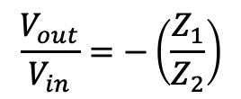
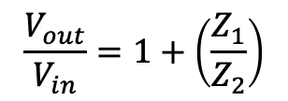
I.3 Review of the Circuit: Trust the Basics
Here’s a friendly reminder of the tools in the circuit analysis toolbox:
Converting to Impedance:
Ohm’s Law:
Voltage Divider:
Series Impedance:
Non-inverting Op-Amp
$$\frac{V_{out}}{V_{in}}=1+\left(\frac{Z_{1}}{Z_{2}}\right)$$
Parallel Impedance:
Inverting Op-Amp
$$\frac{V_{out}}{V_{in}}=−\left(\frac{Z_{1}}{Z_{2}}\right)$$

Slide 14
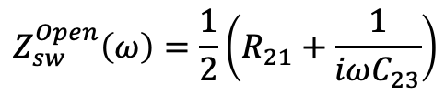
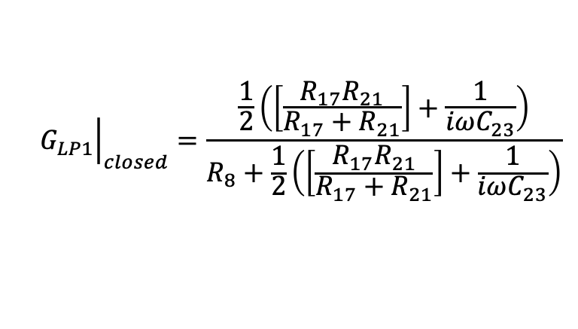
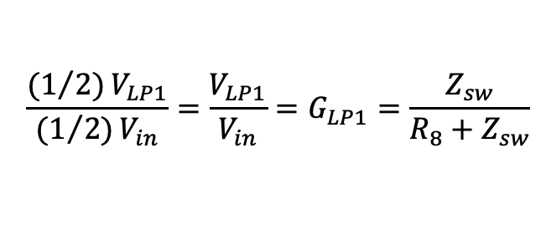
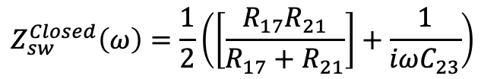
I.3 Review of the Circuit: Simplified, Single-Ended
G_{LP1}
1
1
Z_{out}
V_{in}
V_{LP1}
G_{amp}
2
2
Z_{sw}
I_{coil}
Z_{coil} / 2
One trick for differential circuit analysis: consider only one leg, and divide everything that “crosses between legs” by two -- voltage, impedance, etc, -- and reference everything to ground (0V). The transfer functions are the same, and the analysis is equivalent.
$$Z_{sw}^{Open}\left(ω\right)=\frac{1}{2}\left(R_{21}+\frac{1}{iωC_{23}}\right)$$
With the switch closed, that means,
$${\left.G_{LP1}\right|}_{closed}=\frac{\frac{1}{2}\left(\left[\frac{R_{17}R_{21}}{R_{17}+R_{21}}\right]+\frac{1}{iωC_{23}}\right)}{R_{8}+\frac{1}{2}\left(\left[\frac{R_{17}R_{21}}{R_{17}+R_{21}}\right]+\frac{1}{iωC_{23}}\right)}$$
$$Z_{sw}^{Closed}\left(ω\right)=\frac{1}{2}\left(\left[\frac{R_{17}R_{21}}{R_{17}+R_{21}}\right]+\frac{1}{iωC_{23}}\right)$$
$$\frac{{{(1}/{2)}V}_{LP1}}{{{(1}/{2)}V}_{in}}=\frac{V_{LP1}}{V_{in}}=G_{LP1}=\frac{Z_{sw}}{R_{8}+Z_{sw}}$$
which is enough to plot the transfer function, but we can re-arrange to show the analytic computation of the poles and zeros of this TF…

Slide 15
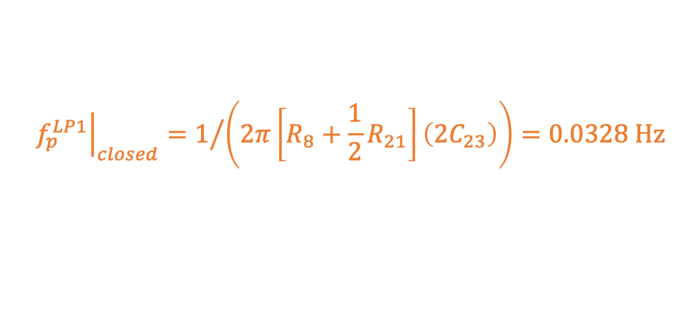
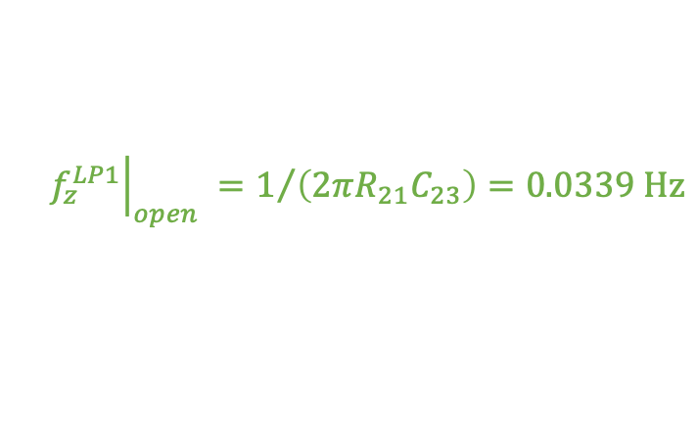
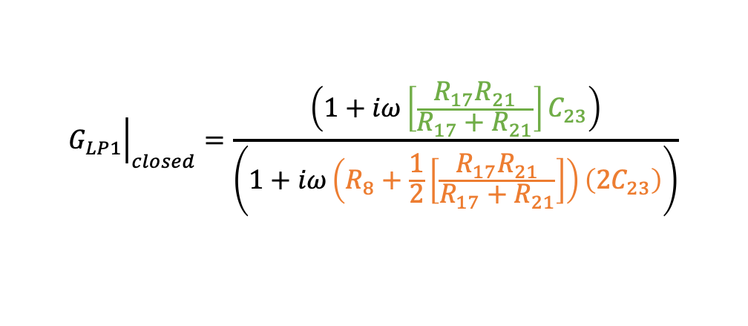
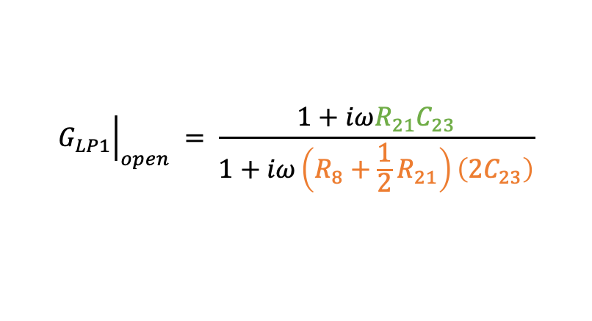
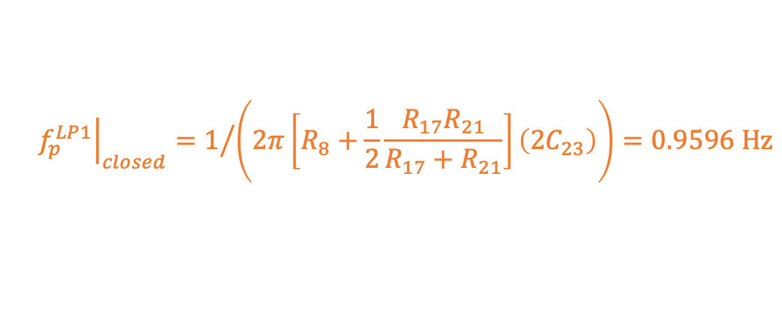
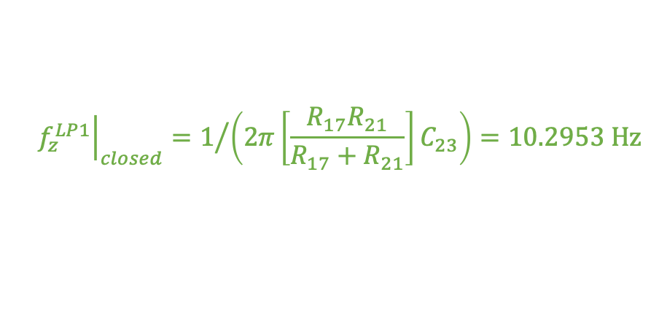
I.3 Review of the Circuit: The Low Pass
$${\left.G_{LP1}\right|}_{closed}=\frac{\left(1+iω{\left[\frac{R_{17}R_{21}}{R_{17}+R_{21}}\right]C}_{23}\right)}{\left(1+iω\left(R_{8}+\frac{1}{2}\left[\frac{R_{17}R_{21}}{R_{17}+R_{21}}\right]\right)\left(2C_{23}\right)\right)}$$
G_{LP1}
That means
1
1
V_{LP1}
$${\left.f_{z}^{LP1}\right|}_{closed}=1/{\left(2π\left[\frac{R_{17}R_{21}}{R_{17}+R_{21}}\right]C_{23}\right)}=10.2953 Hz$$
V_{in}
2
2
$${\left.f_{p}^{LP1}\right|}_{closed}=1/{\left(2π\left[R_{8}+\frac{1}{2}\frac{R_{17}R_{21}}{R_{17}+R_{21}}\right]\left(2C_{23}\right)\right)}=0.9596 Hz$$
Consistent with the expected low pass z:p = (10.5 : 1.0) Hz.
With the switch open, Rpara reduces to R17, leaving,
$${\left.G_{LP1}\right|}_{open} = \frac{1+iωR_{21}C_{23}}{1+iω\left(R_{8}+\frac{1}{2}R_{21}\right)\left(2C_{23}\right)}$$
R8 = 16e3 # Ohms
R17 = 3.3e3 # Ohms
R21 = 1e6 # Ohms
C23 = 4.7e-6 # Farads
$${\left.f_{z}^{LP1}\right|}_{open} =1/{\left(2πR_{21}C_{23}\right)}=0.0339 Hz$$
$${\left.f_{p}^{LP1}\right|}_{closed}=1/{\left(2π\left[R_{8}+\frac{1}{2}R_{21}\right]\left(2C_{23}\right)\right)}=0.0328 Hz$$

Slide 16
I.3 Review of the Circuit: The Low Pass
G_{LP1}
V_{in}
V_{LP1}
Another analysis trick:
the suppression of the low pass (i.e. the asymptotic gain at high frequency) is the ratio of f_{p} / f_{z}
Also, with the switch open, the pole and zero nearly cancel.
When the switch is open, each LP stage – above 0.1 Hz – has gain of 0.969 V/V ≈ 1 V/V.
Where we’re concerned – above 1 Hz – we can treat this as “just” a part of the overall gain to be measured later, and uninteresting in terms of the frequency response
Thus: For State 1 (with no low passes on, all switches open), we can ignore the response of all three low passes.

Slide 17
I.3 Review of the Circuit: The Output
On to the response of the amplifier gain and impedance network.
These are important for State 1.
Z_{out}
Z_{cable}
1
1
V_{out}
1
V_{in}
V_{coil}
Z_{coil} / 2
2
G_{amp}
2
2
V_{out}
V_{in}
Z_{out}
Sometimes, just redrawing the circuit makes things a lot more clear.
From the AD8671 Data Sheet!
Z_{load}
This complicated network can be treated as “just” a non-inverting amplifier, with capacitive load, that has been “in-loop compensated.” More in-loop compensation here.
But, with a “duct tape and bubble gum” story …
Z_{cable}
& Z_{coil} / 2

Slide 18



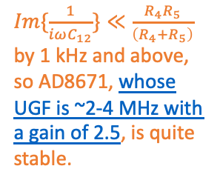
I.3 Review of the Circuit:
R_{S} = R104 = 10 # Ohm
R_{F} = R3 = 3.3e3 # Ohm
R_{G} = R10 = 2.2e3 # Ohm
C_{F} = C100 = 0.22e-9 # Farad
C_{L} = C_{cable} = 1.0e-9 # Farad
R4 = 750.0 # Ohm
“R_{L}” = R5 = 2.0e3 # Ohm
C12 = 0.68e-6 # Farad
Use the AD8671, it’s a nice, low noise op amp.
“OK, I’ll use the data-sheet-recommended configuration, because the cable run will be pretty long – probably 3 nF of parasitic capacitance. Same component values should be fine.”
Right, but be conscious of the current noise, so make sure R_{L} stays big (the BOSEM, Z_{coil} , should be connected after it), and DAC noise from upstream.
“OK, cool, a big series resistor *in the driver circuit*, prior to the cable load with R5 = 4k and increase R_{F}/R_{G} from 1 to 0.33.”
Mmm... but that reduces the actuator range. Can you give me more gain?
“Sure –let’s put in an RC bypass around R_{L} to amplify the range at 100 Hz.”
That reduces the protection against current noise, but should still be OK. And also… sorry… we still need more range.
“OK, dropping R₅ to 2k, and bumping R_{F}/R_{G} up to 0.5.”
But wait… the circuit isn’t really ever capacitively loaded any more… so the this design doesn’t make sense with this silly R_{S} that makes the circuit confusing to analyze!
RC bypass
$Im\{\frac{1}{iωC_{12}}\}≪\frac{R_{4}R_{5}}{\left(R_{4}+R_{5}\right)}$ by 1 kHz and above, so AD8671, whose UGF is ~2-4 MHz with a gain of 2.5, is quite stable.
MOAR gain
Original non-inverting opamp circuit, in-loop compensated with R104
MOAR gain
Big series resistor
Original cable load that motivated the in-loop compensation design

Slide 19
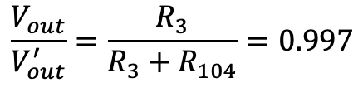
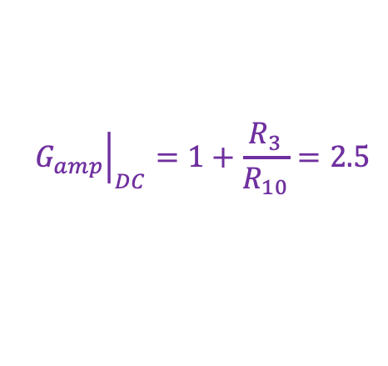
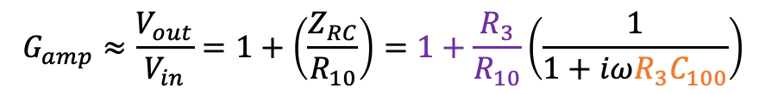
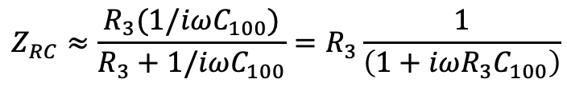
I.3 Review of the Circuit: Op-Amp = Just a Gain
So can we just ignore R_{S} = R104 = 10 Ohms?
R3 = 3.3e3 # Ohm
R10 = 2.2e3 # Ohm
R104 = 10 # Ohm
C100 = 220e-12 # Farad
$$\frac{V_{out}}{V_{out}^{′}}=\frac{R_{3}}{R_{3}+R_{104}}=0.997$$
1
V_{in}
2
1
‘
1
V_{out}
V_{out}
YES. R10 is just a tiny voltage drop between Vout and Vout’.
2
2
G_{amp}
Now, “just” a non-inverting amplifier.
What’s the pole frequency?
‘
≈ V_{out}
V_{in}
V_{out}
$$Z_{RC}≈\frac{R_{3}(1/iωC_{100})}{R_{3}+1/iωC_{100}}=R_{3}\frac{1}{\left(1+iωR_{3}C_{100}\right)}$$
219 kHz is sufficiently high frequency that we can ignore this pole too.
So, YES, ignore R104 and C100.
G_{amp} for us is just 2.5.
This won’t be a part of the State 1 response either
$$G_{amp}≈\frac{V_{out}}{V_{in}}=1+\left(\frac{Z_{RC}}{R_{10}}\right)=1+\frac{R_{3}}{R_{10}}\left(\frac{1}{1+iωR_{3}C_{100}}\right)$$
$${\left.G_{amp}\right|}_{DC}=1+\frac{R_{3}}{R_{10}}=2.5$$
$$f_{p}^{RC}=1/\left(2πR_{3}C_{100}\right)=219.2 kHz$$

Slide 20
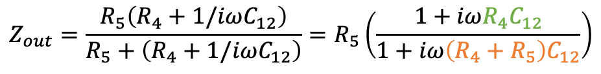


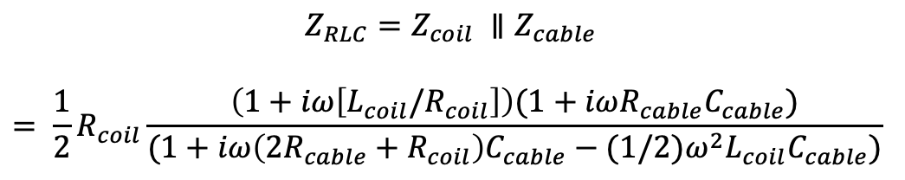
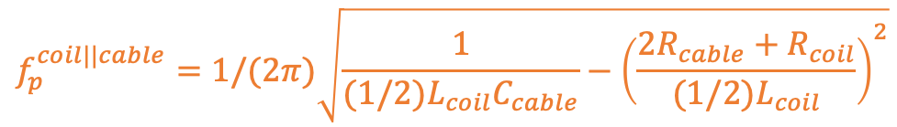
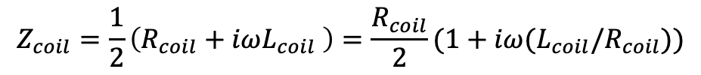
I.3 Review of the Circuit: Output Zs: Rs, Ls, and Cs
Let’s look at the load impedance.
We’ll find out here’s from were *all* the response from State 1 comes.
1
V_{out}
2
$$Z_{out}=\frac{R_{5}\left(R_{4}+1/iωC_{12}\right)}{R_{5}+\left(R_{4}+1/iωC_{12}\right)}=R_{5}\left(\frac{1+iωR_{4}C_{12}}{1+iω\left(R_{4}+R_{5}\right)C_{12}}\right)$$
$$f_{z}^{out}=1/\left(2πR_{4}C_{12}\right)=312.069 Hz$$
Z_{out}
$$f_{p}^{out}=1/\left(2π{(R}_{4}+R_{5})C_{12}\right)=85. 110 Hz$$
$$Z_{coil}=\frac{1}{2}\left(R_{coil}+iωL_{coil} \right)=\frac{R_{coil}}{2}(1+iω(L_{coil}/R_{coil}))$$
1
V_{coil}
$$f_{z}^{coil}=1/\left(2πL_{coil}/R_{coil}\right)=571.085 Hz$$
2
$${Z_{RLC}=Z_{coil} ∥Z}_{cable}$$
$$= \frac{1}{2}R_{coil}\frac{\left(1+iω\left[L_{coil}/R_{coil}\right]\right)(1+iωR_{cable}C_{cable})}{(1+iω\left({2R_{cable}+R}_{coil}\right)C_{cable}−{(1/2)ω}^{2}L_{coil}C_{cable})}$$
I_{coil}
$$f_{z}^{coil}=1/\left(2πL_{coil}/R_{coil}\right)=571.085 Hz$$
Z_{cable}
Z_{coil}
$$f_{z}^{cable}=1/(2πR_{cable}C_{cable})=2.27 MHz$$
$$f_{p}^{coil||cable}=1/(2π)\sqrt{\frac{1}{(1/2{)L}_{coil}C_{cable}}−{\left(\frac{2R_{cable}+R_{coil}}{(1/2)L_{coil}}\right)}^{2}}$$
$$=65.063 kHz$$

Slide 21
I.3 Review of the Circuit: Z total: poles and zeros
Also, note for later how much larger Zout is than Zcoil at most frequencies
This 312:85 Hz z:p pair will define the response of State 1
These will make our measurement confusing…
Just to drive it home that G_{amp} design is confusing:
Here we see reactance never gets larger than Resistance below 10 kHz >> The load is *not* capacitive

Slide 22
I.3 Review of the Circuit: OK, Let’s Review
OK, now that we know what kind of response to expect from everything, we can head back to the differential picture and summarize.
V_{in}
V_{LP1}
V_{out}
V_{coil}
I_{coil}
Z_{sw}
fixed z at 571 Hz
Z_{coil}
G_{LP1}
Z_{cable}
Open: “Just” a gain of ~1 z:p
Closed: z:p pair at 0.960:10.3 Hz
Z_{out}
Unimportant … maybe?
G_{amp}
fixed z:p pair at 312:85 Hz
Well, that was a fun exercise.
But what do we really want?
The response of the current created across the coil, I_{coil} to V_{in}.
So let’s talk about how to measure it.
“Just” a gain of 2.5.

Slide 23
Outline
Two Parts, each quite long. *sigh*
PART I: The ETMX UIM Driver, from Nov 27 to Dec 03 2019
  Why do you care about the UIM?
  Review where we were before we started
  Review of the Circuit
  The Measurement
  Other models of the circuit
  The Fit and Each Coil Result
  Converting fit results in to systematic error in A_{UIM}
  Converting sys error in A_{UIM} to sys error in R and Conclusions
PART II: The OMC Whitening Chassis, from Mar 16 to 27 2020

Slide 24
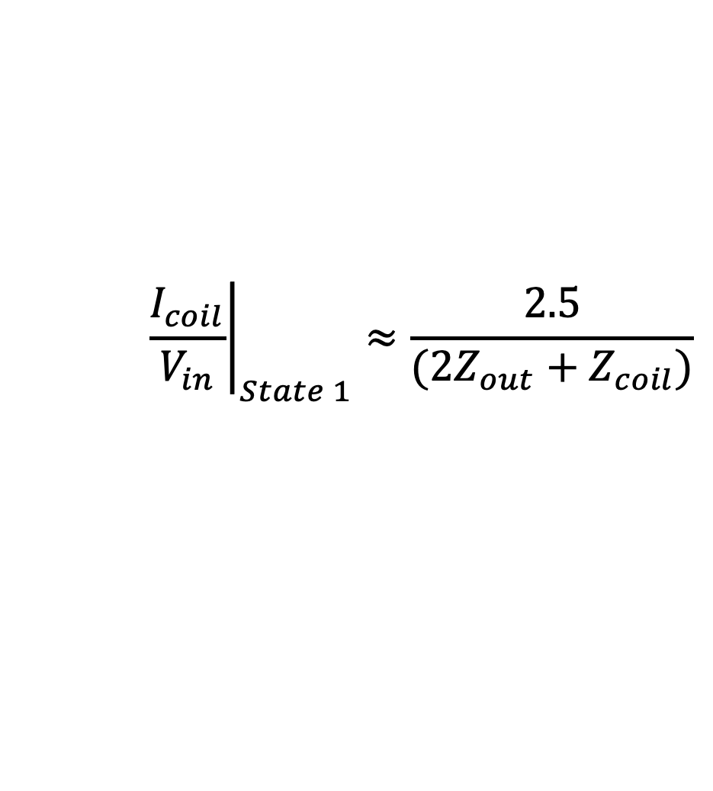
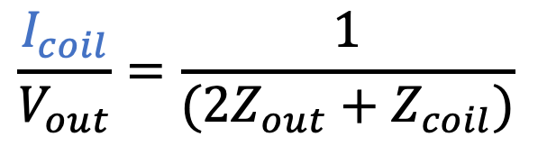
I.4 The Measurement: Coil Current/Vout
We calculated that whatever the values of Rcable and Ccable are, they’re not going to matter until several 10s of kHz. So let’s make it easy to think about.
In State 1, we already know, Vout/Vin is “just a gain” at ~2.5. So the current, held fixed by the G_{amp} opamps, will just obey Ohms Law as it heads out to the coil and back across the differential connection to the coil:
V_{out}
V_{coil}
I_{coil}
Z_{out}
Z_{coil}
$$V_{out}={I_{coil} Z}_{total}=I_{coil}(2Z_{out}+Z_{coil})$$
$$\frac{I_{coil}}{V_{out}}=\frac{1}{(2Z_{out}+Z_{coil})}$$
And, we know for State 1, that means,
$${\left.\frac{I_{coil}}{V_{in}}\right|}_{State 1}≈\frac{2.5}{(2Z_{out}+Z_{coil})}$$
So let’s look at that response, with our basic analytic model.

Slide 25
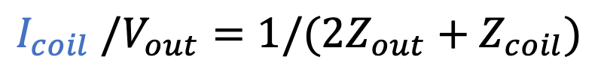
I.4 The Measurement: Coil Current / Vout
$$I_{coil} /V_{out}=1/(2Z_{out}+Z_{coil})$$
Ah – OK, since
abs(2 Z_{out} )>> abs(Z_{coil} )
(from slide 17)
then it’s Z_{out} that dominates this transfer function out to a few kHz
Note that the z:p have flipped to 85:312 Hz, because they’re in the denominator
The phase loss from excluding the coil and cable is only a ~few degrees above 1 kHz

Slide 26
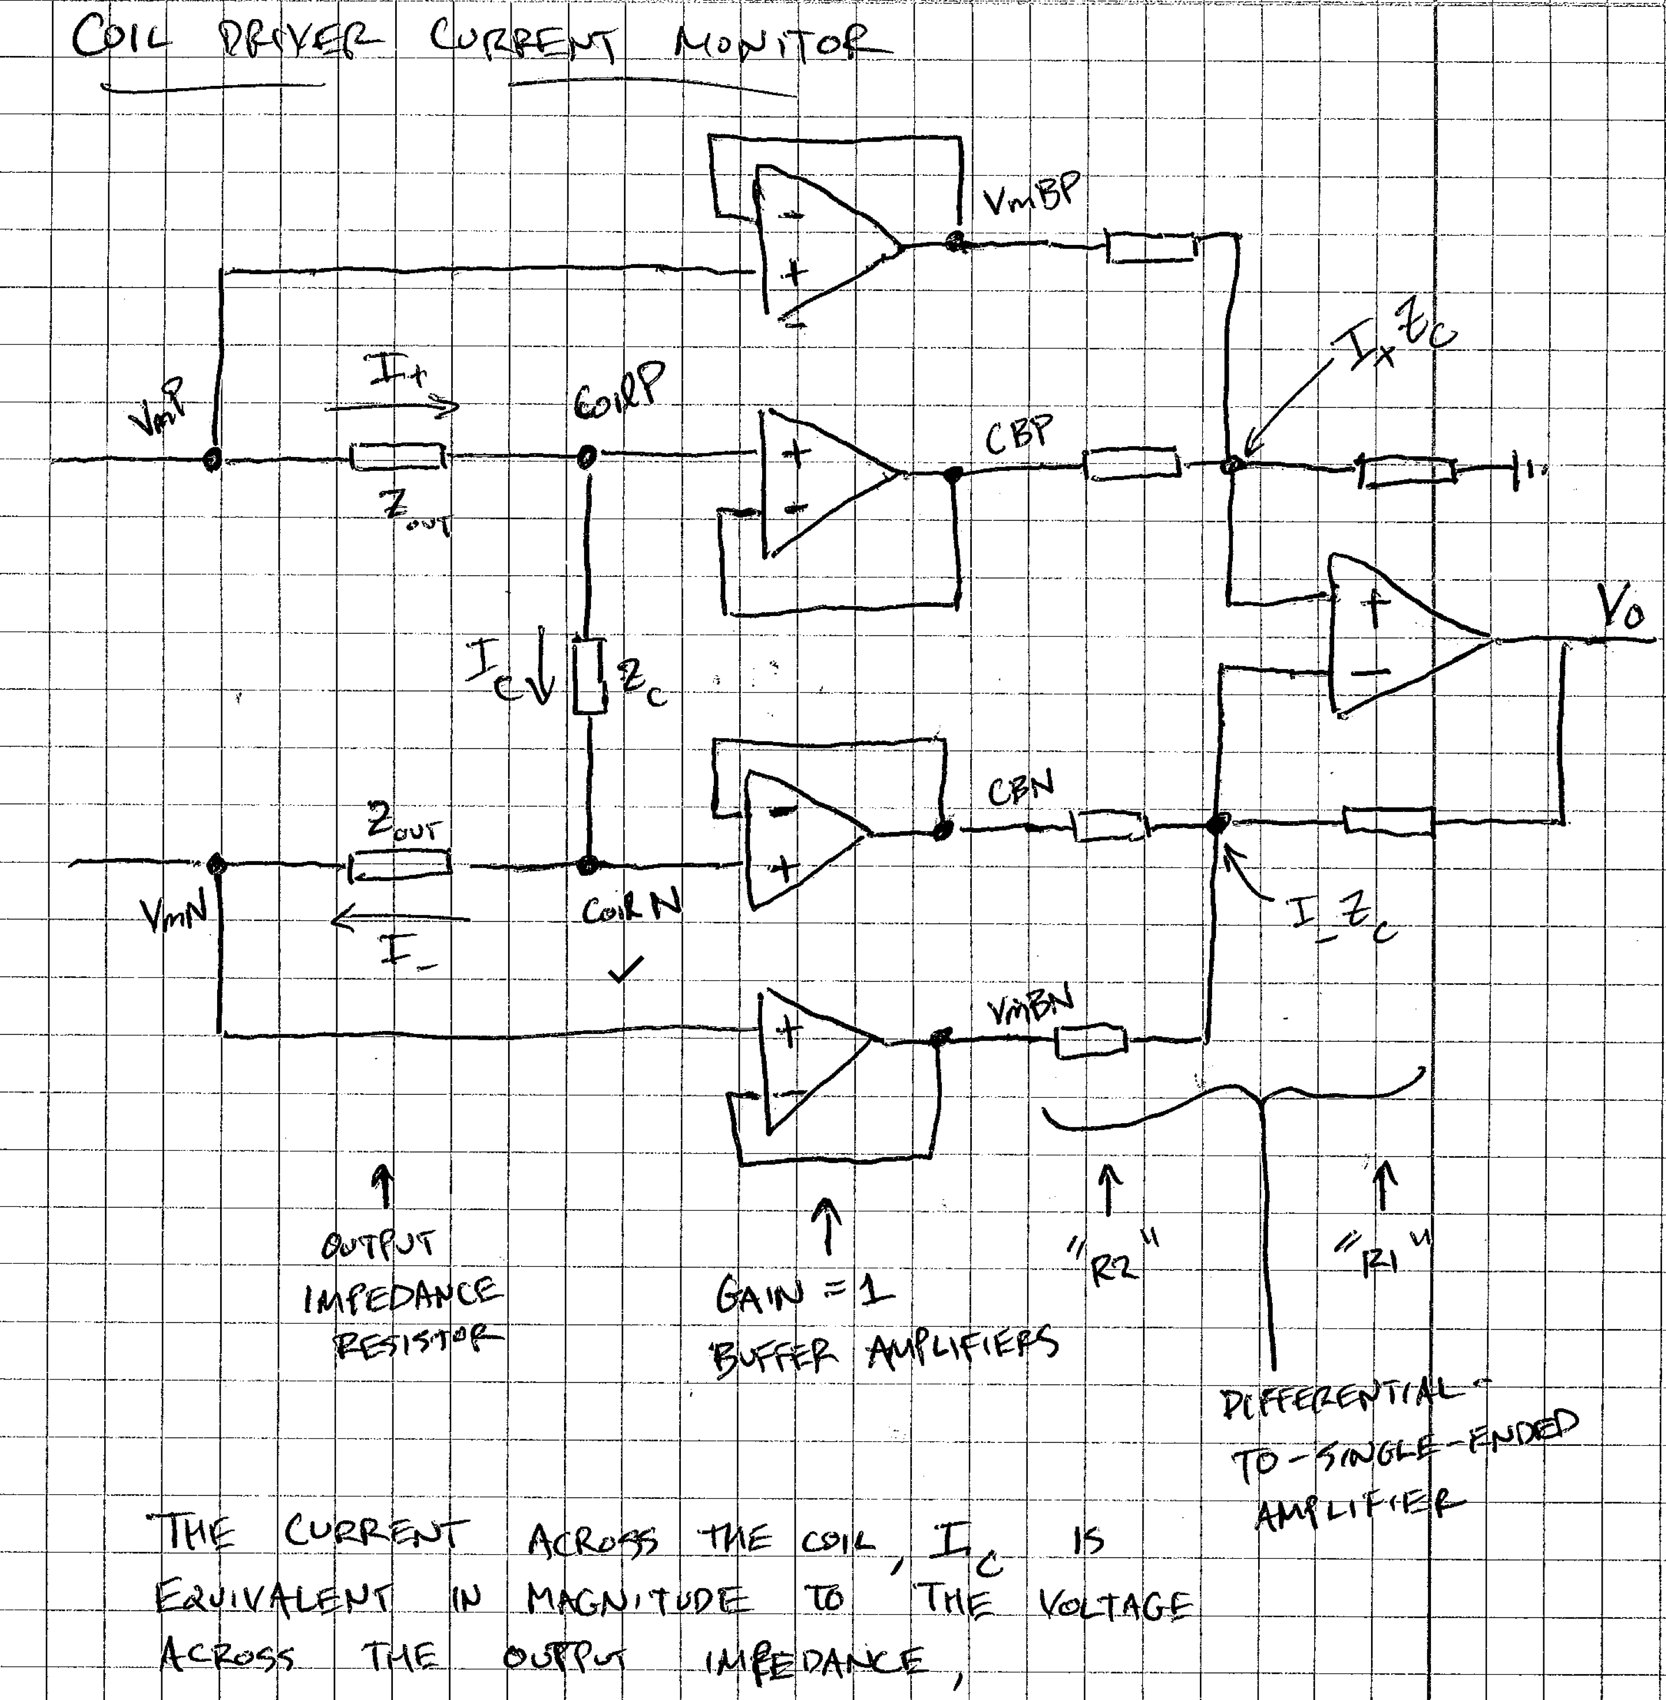
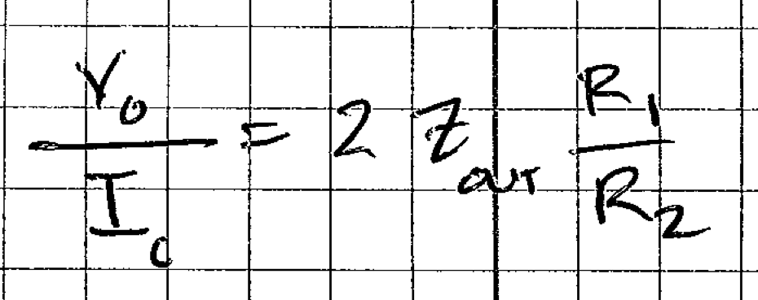
I.4 The Measurement: Fast Current Monitor?
Why do we have to physically measure the transfer function in analog? Why not use the fast current monitor?
from D070480
The answer does include the output impedance network for this driver (contrary to popular belief, started by 2014 Jeff)
BUT -- the fast current monitor board itself may contribute some frequency dependence, and there’s an AA chassis between the analog IMON signal and where it’s read in by the DAQ. These responses will confuse fitting routines and/or your interpretation of the results.
It works well for *ratios* of measurements, namely to get poles and zeros from things that *change* between states (i.e. the low pass filters), but it does not help you characterize State 1.
We typically operate in state 1, and at least the AA chassis has appreciable response in frequency bands of interest to us, so …
Analog measurement it is.

Slide 27
I.4 The Measurement: Should / Would / Could…
OK Great! Gung-ho Jeff will go out there, he’ll take some clip leads, a differential driver, and breakout boards, to measure at the output of the driver – but leaving output connected to the OSEM as normal, “because you need the current to go across the output legs” – the op-amps need to be loaded with *something,* so might as well make it “as accurate as possible.”
V_{coil}
V_{in}
V_{coil}
V_{in}
I_{coil}

Slide 28


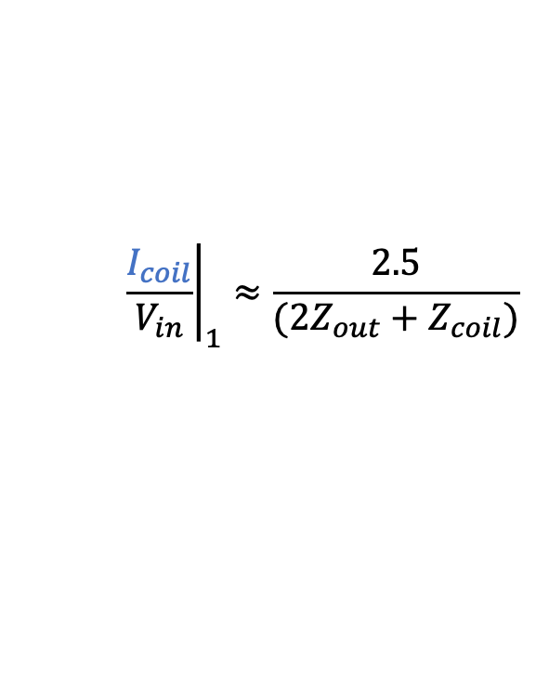
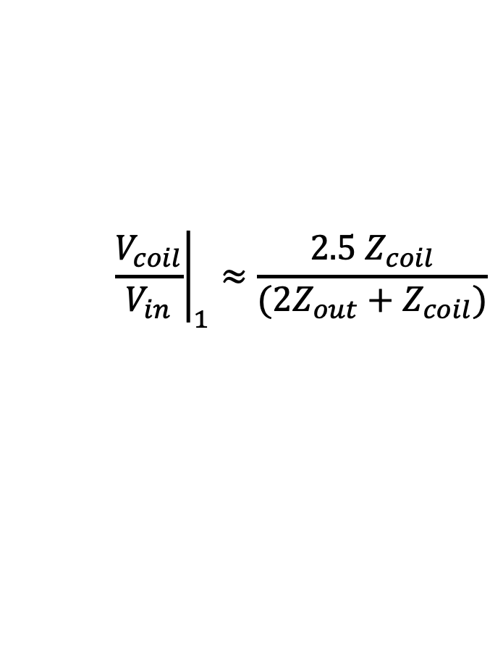
I.4 The Measurement: Facepalm!
But wait – if you’ve left the coil connect “as normal” then you’re not going to measure…
$${\left.\frac{I_{coil}}{V_{in}}\right|}_{1}≈\frac{2.5}{(2Z_{out}+Z_{coil})}$$
V_{coil}
V_{in}
But instead…
I_{coil}
$$V_{coil}=I_{coil}Z_{coil}$$
$${\left.\frac{V_{coil}}{V_{in}}\right|}_{1}≈\frac{{2.5 Z}_{coil}}{(2Z_{out}+Z_{coil})}$$
$$f_{z}^{coil}=1/\left(2πL_{coil}/R_{coil}\right)=571.085 Hz$$
$$f_{p}^{out}=1/\left(2πR_{4}C_{12}\right)=312.069 Hz$$
flipped because Zout is in the denominator
$$f_{z}^{out}=1/\left(2π{(R}_{4}+R_{5})C_{12}\right)=85. 110 Hz$$
Which means you’re going to be confused for months – YEARS – by your results, until you write this presentation!

Slide 29

I.4 The Measurement: “missing” pole, really solved.
$$V_{coil}/V_{in} ≈Z_{coil}/(2Z_{out}+Z_{coil})$$
”Why don’t I see the ~312 Hz pole??”
Well, Gung-Ho Jeff. It’s because
(a) You didn’t measure I_{coil}/V_{in}, you measured V_{coil}/V_{in}, and
(b) you’ve loaded the circuit with the coil.
So the coil’s 570Hz zero almost cancels the 1/Zout 312 Hz pole.
Also, you didn’t consider cable impedance, so you got confused by that too.
This is still the basic analytic model *of* the measurement, not the measurement itself. I wanted you to understand why I was confused when I saw the data.
What does the REAL data look like?

Slide 30
I.4 The Measurement: What we really did…
But wait … it gets worse. To quote [LHO:46927]:
“This time (unlike the 2016 attempt; with measurement as shown on the last slide, as in [LHO:24725]) we tried to cut corners by only driving the coil drivers with single-ended input directly from the SR785 -- so we can avoid having to characterize the details of the differential driver box that has been used previously. This failed, causing (what we believe to be saturations) of the coil driver electronics and wonky unphysical*** transfer functions.”
The joys of that Sunday measurement you think will work to save you time…
But V_{coil} is measured differentially…
Notice, that only one leg of V_{in} is being driven by the SR785…

Slide 31
I.4 The Measurement: *** wonky, unphysical TFs
UL
UR
Evan plotted the results 2019-02-03 results the next day (see [LHO:46773]).
Evan apologizes for the lack of tick marks.
Sure, it looks like there’s “there’s no 300 Hz pole,” but we now understand that.
Further, it looks like, for at least State 2, the z:p = 10.5:0.95 Hz low pass shows up, good…
But look at how the magnitude gets distorted at (let’s say 500 Hz) and above in States 3 and 4...
LL
LR
But … this is the data we have. Maybe we can salvage the data for States 1 and 2?
^/trunk/Common/Electronics/H1/Data/SUSElectronics/ETMX/UIM/2019-02-03/2019-02-03_UIMdriver_measurementnotes.txt

Slide 32
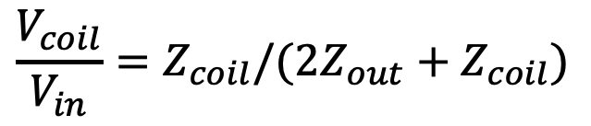
I.4 The Measurement: Finally, The Data.
ETMX UIM UL State 1, Analytic Model vs. Data
$$\frac{V_{coil}}{V_{in}}=Z_{coil}/(2Z_{out}+Z_{coil})$$
But… this doesn’t look like the high Q cable impedance RLC resonance we expected…
Yeah, magnitude looks OK … on a loglog plot…
The phase gets bad by ~300-400 Hz.
Even for the UIM, that’s no bueno, since we expect UIM contributions to “flare up” around blade bending resonances between 50 - 200 Hz
Is it a result of the bad measurement technique, or is this real??

Slide 33
Outline
Two Parts, each quite long. *sigh*
PART I: The ETMX UIM Driver, from Nov 27 to Dec 03 2019
  Why do you care about the UIM?
  Review where we were before we started
  Review of the Circuit
  The Measurement
  Other models of the circuit
  The Fit and Each Coil Result
  Converting fit results in to systematic error in A_{UIM}
  Converting sys error in A_{UIM} to sys error in R and Conclusions
PART II: The OMC Whitening Chassis, from Mar 16 to 27 2020

Slide 34
I.5 Other Models of the Circuit
What if we use a more sophisticated model? Can we predict this deviation? There are lots of more sophisticated modelling tools for circuits out there, LISO, Spice, Altium, etc.
Chris Wipf put together a LISO model of the UIM circuit in the Noise Budget SVN,
  https://svn.ligo.caltech.edu/svn/aligonoisebudget/trunk/Dev/SusElectronics/LISO/QUAD/UIM
  Note that, unfortunately, the LISO models Chris ran didn’t export poles and zeros, we so don’t have them (we’ll find later that re-running to get them won’t be worth it)
It will be instructive to show that model too, especially because
  More models = more understanding
  More poles and zeros will appear from the fit than we predict from the analytic model,
  The LISO model doesn’t make approximations for clarity, and
  The parameters of the cable and coil load are (apparently) quite uncertain
But, also, let’s just fit the data.

Slide 35
Outline
Two Parts, each quite long. *sigh*
PART I: The ETMX UIM Driver, from Nov 27 to Dec 03 2019
  Why do you care about the UIM?
  Review where we were before we started
  Review of the Circuit
  The Measurement
  Other models of the circuit
  The Fit and Each Coil Result
  Converting fit results in to systematic error in A_{UIM}
  Converting sys error in A_{UIM} to sys error in R and Conclusions
PART II: The OMC Whitening Chassis, from Mar 16 to 27 2020
This parts a four-sub-part doooosey

Slide 36
I.6.1 The Fit: IIR Rational is Awesome
Most transfer function software is unruly: if you don’t understand what your data is, or the quality of the data, you’re going to have a tough time tailoring the tool to suit your needs, and/or understanding the results.
A 2016 call to action, G1601173, inspired Lee McCuller to develop IIRrationalv2. I’ve found it to work excellently, with minimal input.
The script to run the fit lives here:
^/trunk/Common/Electronics/H1/Scripts/fit_ETMX_UIM_driver_20190203_IIRrational_20200401.py
Here’s my environment that I used to get it to work (determined using ^/trunk/Common/Misc/Scripts/versioncheck.py the output of which is quoted here):
This is Python version:
3.7.4 (default, Aug 13 2019, 15:17:50)
[Clang 4.0.1 (tags/RELEASE_401/final)]
If you import the following packages, you will get the versions listed below:
matplotlib.__version__ = 3.1.1
numpy.__version__ = 1.17.2
scipy.__version__ = 1.3.1
sklearn.__version__ = 0.21.3
gwpy.__version__ = 1.0.1
nds2.__version__ = 0.16.5
IIRrational.__version__ = 2.0.11
h5py.__version__ = 2.9.0
emcee.__version__ = 3.0.2
corner.__version__ = 2.0.1

Slide 37

I.6.1 The Fit Results Per Coil: Intro to Plot
|Data/Fit|
|Model/Fit|
ETMX UIM UL State 1
Note the different scales of L and R axes!!
Phase(Model/Fit) [deg]
Phase(Model/Fit) [deg]
$$\frac{V_{coil}}{V_{in}}=Z_{coil}/(2Z_{out}+Z_{coil})$$
The basic analytic model is as bad as we know from slide 27 (residual shown in dotted green)
The LISO model seems to miss the basic RC and Coil pole and zero frequencies, resulting in magnitude error of ~15% by 300 Hz, and also bad in phase (residual, in dashed green, is 10 deg by 1 kHz).
The IIRrational fit is excellent, all the way out to 10 kHz. But … let’s look at all the poles and zeros it returns …

Slide 38
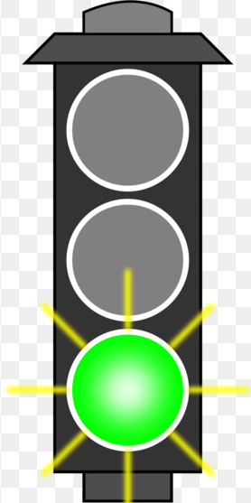
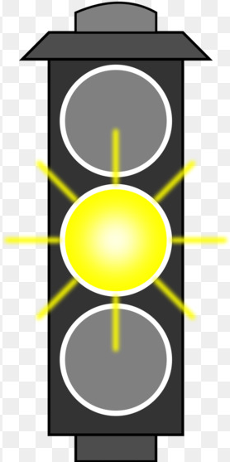
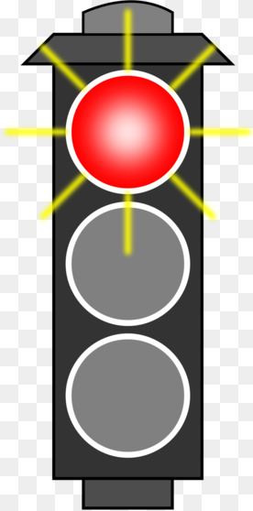

I.6.1 Fit per Coil: State 1 Results Interpretation
Again, understand the fit results is an important part of the game:
Do zeros and poles make sense?
Are there more than you expect?
Are results consistent across several coils?
Can we ignore any?
Take UL for example:
ETMX UIM UL State 1
$$\frac{V_{coil}}{V_{in}}=Z_{coil}/(2Z_{out}+Z_{coil})$$
Circuit Feature Assignment | UL Fit Zeros | UL Fit Poles
Coil Impedance | 696.5942 Hz
RC Network | 87.0329 Hz | 431.3965 Hz
SW Closed LP | 0.0325 Hz | 0.0293 Hz
????? | 2246.0201 Hz | 1592.0174
Cable impedance? |  | pair(22092.54 Hz, 59.37 deg)
f_{z} or f_{p} , or combo is right about where we expect. Or the fz:fp is close enough to “canceling” to ignore
f_{z} or f_{p} is probably from feature X, but is pretty far off from expected, or maybe high frequency enough to not matter
WUT

Slide 39


I.6.1 Fit per Coil: State 1 Results Summary
Circuit Feature Assignment | UL Fit Zeros | UL Fit Poles
Coil Impedance | 696.5942 Hz
RC Network | 87.0329 Hz | 431.3965 Hz
SW Closed LP | 0.0325 Hz | 0.0293 Hz
???? | 2246.0201 Hz | 1592.0174
Cable impedance? |  | pair(22092.54 Hz, 59.37 deg)
Circuit Feature Assignment | UR Fit Zeros | UR Fit Poles
Coil Impedance | 671.7041 Hz
RC Network | 85.9533 Hz | 422.2943 Hz
SW Closed LP | No fit? | No fit?
???? | 2337.1901 Hz | 5132.4934 Hz
???? | pair(12262.2781 Hz, 15.218 deg) pair(12822.8952 Hz, 21.5666) | pair(11037.6219 Hz, 61.3485 deg)
???? | 19443.5355
Cable impedance? |  | pair(21731.503 Hz, 73.7415 deg)
$$f_{z}^{coil}=1/\left(2πL_{coil}/R_{coil}\right)=571.085 Hz$$
$$f_{p}^{out}=1/\left(2πR_{4}C_{12}\right)=312.069 Hz$$
$$f_{z}^{out}=1/\left(2π{(R}_{4}+R_{5})C_{12}\right)=85. 110 Hz$$
Circuit Feature Assignment | LL Fit Zeros | LL Fit Poles
Coil Impedance | 699.0254 Hz
RC Network | 86.5228 Hz | 427.0135 Hz
SW Closed LP | No fit? | No fit?
???? | 2315.2727, 5247.6252 Hz | 1623.5029, pair(5943.6595, 10.6624 deg)
Cable impedance? |  | pair(21390.090 Hz, 58.138 deg)
Circuit Feature Assignment | LR Fit Zeros | LR Fit Poles
Coil Impedance | 570.3 Hz
RC Network | 86.019 Hz | 380.235 Hz
SW Closed LP | 0.036 Hz | 0.032 Hz
???? | 160.731 Hz | 1104.104 Hz
Nearly canceling | pair(3998.485 Hz, 64.2946 deg) | pair(3991.249Hz, 63.6625 deg)
???? | pair(12280.307 Hz, 4.400 deg) | 6807.508, 11411.143
Cable impedance? |  | pair(21818.686 Hz, 59.566 deg)
$f_{p}^{coil||cable}=$ $65.063 kHz$

Slide 40
I.6.1 Fit per Coil: State 1 Results LR
Circuit Feature Assignment | LR Fit Zeros | LR Fit Poles
Coil Impedance | 570.3 Hz
RC Network | 86.019 Hz | 380.235 Hz
SW Closed LP | 0.036 Hz | 0.032 Hz
??? | 160.731 Hz | 1104.104 Hz
Nearly canceling | pair(3998.485 Hz, 64.2946 deg) | pair(3991.249Hz, 63.6625 deg)
??? | pair(12280.307 Hz, 4.400 deg) | 6807.508, 11411.143
Cable impedance? |  | pair(21818.686 Hz, 59.566 deg)
Just to show that the data, the fit, or the fit residuals for the LR “poster child” don’t look any different, but the fit has poles and zeros right where we expect, AND some ones that we don’t expect at all.

Slide 41
I.6.1 The Fit per Coil: State 1 Results Discussion
Why is LR the poster child, with f_{z}:f_{p} = (86, 570: 380) Hz, where the other three are consistently f_{z}:f_{p} = (86, 690: 430)?
  Let’s assume that, for whatever reason, the three coils – though not as expected, are fit at real values. 430 vs. 380 Hz means R4, C12 values are in question, and 690 vs. 570 Hz means R_{coil} or L_{coil} are in question.
  Let’s assume we know the resistances well at (R4, R_{coil}) = (750,42.7) Ohm. That means (C12,L_{coil}) are actually ~(0.49e-6 F, 9.8 mH) instead of the drawing/cannon values of (0.68e-6 F, 11.9 mH).
  Plausible…
What are all of these mid- kHz poles and zeros? Can we get by with ignoring the fit results above 1 kHz?
  Is this a manifestation of the bad measurement / saturation?
Why is the cable impedance so low in frequency and so low in Q?
  Is *this* a manifestation of the bad measurement / saturation?

Slide 42
I.6.1 The Fit per Coil: What’s next?
You feel I’m in the weeds. I know. *I* feel I’m in the weeds. How can we come back up for air? Look at some more weeds.
We can blindly assume that the fit is perfect for all coils. If so, we’d use the value of the coil f_{z}, divide it out of the V_{coil} / V_{in} data, and look at the I_{coil} / V_{in} transfer function. Does it make sense? Should we bother (re)fitting *that* data?
Look at the ratio of State 2 to State 1. Is getting the low pass f_{z}:f_{p} pair from that is as easy as we expect?
Look (and fit) at state 2 by itself. Does the data match the State 1 fit * (State 2 / State 1) fit?

Slide 43
I.6.2 Fit per Coil: State 1 I_{coil} / V_{out}, taking out “knowns”
What does Icoil/Vout look like, if we assume good fit for coil f_{z} and the RC network’s f_{z}:f_{p}?
Divide out RC f_{z}:f_{p}
Divide out coil f_{z}
What is this ~1 kHz feature that remains in every coil??
Probably the cable impedance, don’t really care

Slide 44
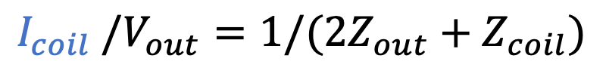
I.6.2 Fit per Coil: State 1 remember our expectations?
Green Solid on previous slide should look like Purple dashed here
Coil Impedance was supposed to be much more sharp, and higher in frequency
No 1 kHz feature
$$I_{coil} /V_{out}=1/(2Z_{out}+Z_{coil})$$

Slide 45
I.6.2 Fit per Coil: State 1 How bad would it be?
… then foton has the UIM TF
wrong by 10% / 5 deg at 300 Hz …
If
The fit is correct for coil and RC, and
this ~1 kHz feature is real…
… And if we update foton to use *only* the fit RC, then magnitude is better, but phase is worse

Slide 46
I.6.1 The Fit per Coil: What’s next?
You feel I’m in the weeds. I know. *I* feel I’m in the weeds. How can we come back up for air? Look at some more weeds.
We can blindly assume that the fit is perfect for all coils. If so, we’d use the value of the coil f_{z}, divide it out of the V_{coil} / V_{in} data, and look at the I_{coil} / V_{in} transfer function. Does it make sense? Should we bother (re)fitting *that* data?
Look at the ratio of State 2 to State 1. Is getting the low pass f_{z}:f_{p} pair from that is as easy as we expect?
Look (and fit) at state 2 by itself. Does the data match the State 1 fit * (State 2 / State 1) fit?
Conclude: There’s really something weird with this data, manifesting at 1-2 kHz

Slide 47
I.6.3 Fit per Coil: State 2/State 1: the LP1 zs and ps
OK. Need some air. Does the analog data we have make any sense? It does. Look at the ratio between state 2 and state 1.
Residual if only ~10.5:1.0 Hz f_{z}:f_{p} pair is used
Data, matches the fit, matches the expectation. Only minor improvement if updated.
Residual if full fit is used
Surprisingly, many reported fit poles and zeros, but they’re all roughly cancelling.
Foton values, not shown, but they’re all (f_{z}:f_{p}) = (10.5:1.0) Hz

Slide 48
I.6.3 Fit per Coil: State 2/State 1: Results Summary
UL | Fit Zeros | Fit Poles
Nearly cancelling | 2.89952 Hz | 2.75042 Hz
Nearly canceling | 4.76888 Hz | 5.05923 Hz
SW Closed LP | 10.5814 Hz | 0.99443 Hz
Nearly canceling | 145.8720 Hz | 143.2566 Hz
Nearly canceling | 1113.0777 Hz | 1128.0047 Hz
???? | Pair(5367.8369 Hz, 32.3526 deg) | Pair(7623.7668 Hz, 36.2003 deg)
???? | Pair(9452.2185 Hz, 52.8143 deg) | Pair(11133.7022 Hz, 9.6965 deg)
???? | Pair(21080.1439 Hz, 54.1226 deg) | Pair(14240.3312 Hz, 31.3564 deg)
UR | Fit Zeros | Fit Poles
SW Closed LP | 10.3314 Hz | 0.98556 Hz
Nearly canceling | 52.4826 Hz | 51.6746 Hz
Nearly canceling | 344.4865 Hz | 341.47236 Hz
Nearly canceling | 2137.9732 Hz | 2163.3018 Hz
???? | 3211.9846 Hz | 5833.4346 Hz
???? | pair(4802.2480 Hz, 32.800 deg) | 4409.4475 Hz, 5019.2094 Hz
???? | pair(11329.7897 Hz, 52.0737 deg | Pair(14962.1253 Hz, 39.2143 deg)
???? | pair(24347.3447 Hz, 57.547 deg | 15509.4456 Hz, 17175.5778 Hz
LL | Fit Zeros | Fit Poles
SW Closed LP | 10.3830 Hz | 0.9820 Hz
Nearly canceling | 61.3351 Hz | 60.2293 Hz
Nearly canceling | 282.9903 Hz | 291.4153 Hz
Nearly canceling | Pair(643.6467 Hz, 11.4552 deg) | 630.7973 Hz, 654.7394 Hz
???? | Pair(5512.6344 Hz, 39.6531 deg) | Pair(6718.1860 Hz, 65.2573 deg)
???? | Pair(7085.8327 Hz, 66.5343 deg) | 10061.4559 Hz, 10891.6712 Hz
Nearly canceling | Pair(13638.8270 Hz, 63.1878 deg) | Pair(13419.9763 Hz, 26.1267 deg)
???? | Pair(24657.6748 Hz, 61.7029 deg) | Pair(15566.9234 Hz, 55.0929 deg)
LR | Fit Zeros | Fit Poles
Nearly cancelling | 0.05932 Hz | 0.06045 Hz
SW Closed LP | 10.4728 Hz | 0.98792 Hz
Nearly canceling | 93.0036 Hz | 91.4280 Hz
Nearly canceling | 1522.7636 Hz | 1579.1637 Hz
???? | Pair(4255.9612 Hz, 29.7771 deg) Pair(8332.2720 Hz, 54.3682 deg) | 5443.8019 Hz, 8077.0312 Hz, Pair(11032.6047 Hz, 39.2195 deg)
Nearly canceling | Pair(13237.5898 Hz, 61.0969 deg) | Pair(13752.7035 Hz, 39.9270 deg)
???? | Pair(25155.6858 Hz, 59.6633 deg) | Pair(13801.8767 Hz, 29.9008 deg)

Slide 49
I.6.3 Fit per Coil: State 2 / State 1 Oddball -- UR
Only UR is of concern with the residual of “if we ignore everything but the fit fz:fp that closely matches the expected low pass frequencies” exceeding 1% in magnitude above 100 Hz…
UR | Zeros | Poles
SW Closed LP | 10.3314 Hz | 0.98556 Hz
Nearly canceling | 52.4826 Hz | 51.6746 Hz
Nearly canceling | 344.4865 Hz | 341.47236 Hz
Nearly canceling | 2137.9732 Hz | 2163.3018 Hz
???? | 3211.9846 Hz | 5833.4346 Hz
???? | pair(4802.2480 Hz, 32.800 deg) | 4409.4475 Hz, 5019.2094 Hz
???? | pair(11329.7897 Hz, 52.0737 deg | Pair(14962.1253 Hz, 39.2143 deg)
???? | pair(24347.3447 Hz, 57.547 deg | 15509.4456 Hz, 17175.5778 Hz
But … as you’ll see (and what is often said with details of these studies): we’ve got bigger fish to fry…

Slide 50
I.6.1 The Fit per Coil: What’s next?
You feel I’m in the weeds. I know. *I* feel I’m in the weeds. How can we come back up for air? Look at some more weeds.
We can blindly assume that the fit is perfect for all coils. If so, we’d use the value of the coil f_{z}, divide it out of the V_{coil} / V_{in} data, and look at the I_{coil} / V_{in} transfer function. Does it make sense? Should we bother (re)fitting *that* data?
Look at the ratio of State 2 to State 1. Is getting the low pass f_{z}:f_{p} pair from that is as easy as we expect?
Look (and fit) at state 2 by itself. Does the data match the State 1 fit * (State 2 / State 1) fit?
Conclusion: There’s really something weird with this data, manifesting at 1-2 kHz
Conclusion: Yes, we can safely extract the fit low pass f_{z}:f_{p} pair.

Slide 51
I.6.4 Fit per Coil: State 2 vs State (1) and (2/1) Fits
ETMX UIM LL State 1
ETMX UIM LL State 2
Since the ratio behaved so much like expected, State 2 by itself is probably going to look like the product of the State 1 results and the State2/State1, and it does.

Slide 52
I.6.4 Fit per Coil: State 2 I_{coil} / V_{in} Residuals
ETMX UIM LL State 2
Data is divided by Z_{coil} from State 1 fit

Slide 53
I.6.4 Fit per Coil: Remember State 1…
ETMX UIM LL State 1

Slide 54
I.6.4 Fit per Coil: Fit answer Comparison: UL and LL
State 2 fit results
State 1 fit and State 2/1 fit results
Circuit Feature Assignment | UL Fit Zeros | UL Fit Poles
Nearly canceling | 0.028847 Hz | 0.026747 Hz
Coil Impedance | 842.2736 Hz
RC Network | 89.2645 Hz | 472.0885 Hz
SW Closed LP | 10.3110 Hz | 0.97697 Hz
????? | 4401.5227 Hz | 2798.8233 Hz
Cable impedance? |  | pair(21118.6667 Hz, 42.1804 deg)
Circuit Feature Assignment | UL Fit Zeros | UL Fit Poles
Coil Impedance | 696.5942 Hz
RC Network | 87.0329 Hz | 431.3965 Hz
SW Closed LP | 10.5814 Hz | 0.99443 Hz
????? | 2246.0201 Hz | 1592.0174
Cable impedance? |  | pair(22092.54 Hz, 59.37 deg)
Hrmm… State 2 fit f_{z}:f_{p} numbers are pretty different from State 1 fit and State 2/1 fit, except for LP1 values
Circuit Feature Assignment | LL Fit Zeros | LL Fit Poles
Nearly canceling | 0.37481 | 0.36443
Nearly canceling | 6.43273 | 6.36145
Nearly canceling | 183.9139 | 200.7849
Coil Impedance | 549.8213
RC Network | 89.9268 | 346.3705
SW Closed LP | 10.2956 | 0.9999998
???? | 1632.2068 | 1177.1166 Hz,
???? | pair(15713.5244 Hz, 42.2756 deg) 15762.0667 Hz | 3750.3363 Hz, pair(7843.1654 Hz, 52.3709 deg),
Cable impedance? | pair(20052.8982Hz, 26.0454 deg) 21877.4091 Hz, 22594.0678 Hz | pair(13919.8163 Hz, 69.7893 deg) pair(22669.5375 Hz, 77.5484 deg)
Circuit Feature Assignment | LL Fit Zeros | LL Fit Poles
Coil Impedance | 699.0254 Hz
RC Network | 86.5228 Hz | 427.0135 Hz
SW Closed LP | 10.3830 Hz | 0.9820 Hz
????? | 2315.2727, 5247.6252 Hz | 1623.5029, pair(5943.6595, 10.6624 deg)
Cable impedance? |  | pair(21390.090 Hz, 58.138 deg)

Slide 55
I.6.4 Fit per Coil: Fit answer Comparison: UR and LR
Circuit Feature Assignment | UR Fit Zeros | UR Fit Poles
Nearly canceling | 40.5700 Hz | 39.1471 Hz
Nearly canceling | 112.8337 Hz | 101.2331 Hz
Coil Impedance | 767.4099 Hz
RC Network | 77.2791 Hz | 455.1022 Hz
SW Closed LP | 10.2308 Hz | 0.97447
????? | pair(5414.0903 Hz, 57.7074 deg) pair(8543.0235 Hz, 31.6995 deg) pair(12415.6958 Hz, 20.2785 deg) | 2200.0659 Hz pair(4588.0341 Hz, 51.4882 deg) pair(6168.5520 Hz, 63.2901 deg)
Nearly canceling | pair(11209.1738 Hz, 2.010 deg) | pair(11298.7088 Hz, 65.2882 deg)
Cable impedance? |  | pair(21411.5152 Hz, 71.3476 deg)
Circuit Feature Assignment | UR Fit Zeros | UR Fit Poles
Coil Impedance | 671.7041 Hz
RC Network | 85.9533 Hz | 422.2943 Hz
SW Closed LP | 10.3314 Hz | 0.98556 Hz
???? | 2337.1901 Hz pair(12262.2781 Hz, 15.218 deg) pair(12822.8952 Hz, 21.5666) | 5132.4934 Hz pair(11037.6219 Hz, 61.3485 deg)
???? | 19443.5355
Cable impedance? |  | pair(21731.503 Hz, 73.7415 deg)
Circuit Feature Assignment | LR Fit Zeros | LR Fit Poles
Coil Impedance | 280.6193 Hz
RC Network | 82.0951 | 243.1757 Hz
SW Closed LP | 13.8309 | 0.97606 Hz,
Nearly canceling | 7.66634 Hz | 8.58653 Hz
Nearly canceling | 34.3607 Hz, | 31.5980 Hz
????? | 14.8359 Hz 1030.2985 pair(12506.8258 Hz, 72.7462 deg) pair(13751.5651 Hz, 28.6342 deg) pair(14315.4683 Hz, 41.2455 deg) pair(15283.4931 Hz, 37.1055 deg) | 18.6402 Hz 596.1594 3794.1125 Hz pair(13081.7578 Hz, 74.9549 deg) pair(10071.4374 Hz, 53.4518 deg) pair(11402.8925 Hz, 53.3173 deg)
Cable impedance? |  | pair(22102.4149 Hz, 72.6274 deg)
Circuit Feature Assignment | LR Fit Zeros | LR Fit Poles
Coil Impedance | 570.3 Hz
RC Network | 86.019 Hz | 380.235 Hz
SW Closed LP | 10.4728 Hz | 0.98792 Hz
???? | 160.731 Hz | 1104.104 Hz
Nearly canceling | pair(3998.485 Hz, 64.2946 deg) | pair(3991.249Hz, 63.6625 deg)
???? | pair(12280.307 Hz, 4.400 deg) | 6807.508, 11411.143
Cable impedance? |  | pair(21818.686 Hz, 59.566 deg)

Slide 56
I.6.1 The Fit per Coil: What’s next?
You feel I’m in the weeds. I know. *I* feel I’m in the weeds. How can we come back up for air? Look at some more weeds.
We can blindly assume that the fit is perfect for all coils. If so, we’d use the value of the coil f_{z}, divide it out of the V_{coil} / V_{in} data, and look at the I_{coil} / V_{in} transfer function. Does it make sense? Should we bother (re)fitting *that* data?
Look at the ratio of State 2 to State 1. Is getting the low pass f_{z}:f_{p} pair from that is as easy as we expect?
Look (and fit) at state 2 by itself. Does the data match the State 1 fit * (State 2 / State 1) fit?
Conclusion: There’s really something weird with this data, manifesting at 1-2 kHz
Conclusion: Yes, we can safely extract the fit low pass f_{z}:f_{p} pair.
Conclusions: Sort of. The residuals have same mysterious 1-2 KHz features from State 1, but the poles and zeros are astoundingly different, some more like expected, some just wrong, with no general trends as each coil is different.

Slide 57
I.6 Fit per Coil: Grand Conclusions
We definitely, definitely, definitely need to get good measurements.
  We should always drive the drivers, and measure the response differentially.
Unfortunately, we can’t assume each coil channel is going to be even roughly the same, and we may get conflicting answers between what should be the same answers when switching between states.
  e.g. State 2 / State 1 for for LP1 is not the same as State 2 alone
  So we should be prepare to the “two clocks” situation, where don’t know which to choose.
Make the data going in to the fitter as simple as possible, when it makes physical sense to do so.
  Never, ever, ever take measurements with the coil as a part of the measurement. Just put a no-capacitance, 40 Ohm dummy OSEM “across the back” of the driver as the “coil” “load” impedance.
  That also means that we can’t use the FAST_I_MONs measurements either --not because “they don’t measure the output network” -- but because they include the coil impedance which drastically confuses the even the best fitting routines
  We should perform the same analytical analysis on PUM driver vs. the AOSEM to confirm Zcoil << Zout…. another day.

Slide 58
Outline
Two Parts, each quite long. *sigh*
PART I: The ETMX UIM Driver, from Nov 27 to Dec 03 2019
  Why do you care about the UIM?
  Review where we were before we started
  Review of the Circuit
  The Measurement
  Other models of the circuit
  The Fit and Each Coil Result
  Converting fit results in to systematic error in A_{UIM}
  Converting sys error in A_{UIM} to sys error in R and Conclusions
PART II: The OMC Whitening Chassis, from Mar 16 to 27 2020

Slide 59
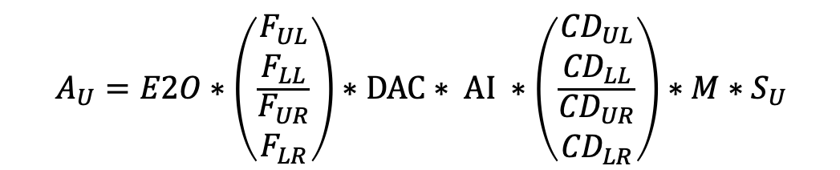
I.7 Converting Individual Coil Fit Results in to Systematic Error in A_{UIM}
Let’s assume we understood and we’re happy with everything from section I.6.
  Remember: we’re not, but let’s move on anyways, because this is the data we have.
The individual coil results must be used retroactively to predict what error was caused in the *total* longitudinal actuation strength in the UIM.
  You can think of it like this:
$$A_{U}=E2O∗\left(\frac{\begin{matrix}F_{UL} \\ F_{LL}\end{matrix}}{\begin{matrix}F_{UR} \\ F_{LR}\end{matrix}}\right)∗DAC∗ AI ∗\left(\frac{\begin{matrix}{CD}_{UL} \\ {CD}_{LL}\end{matrix}}{\begin{matrix}{CD}_{UR} \\ {CD}_{LR}\end{matrix}}\right)∗M{∗S}_{U}$$

Slide 60
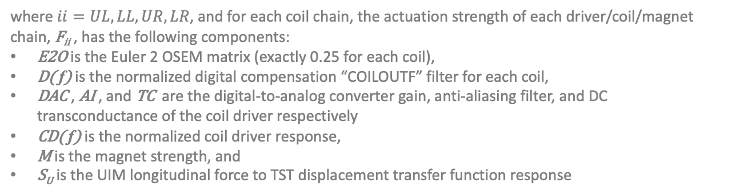
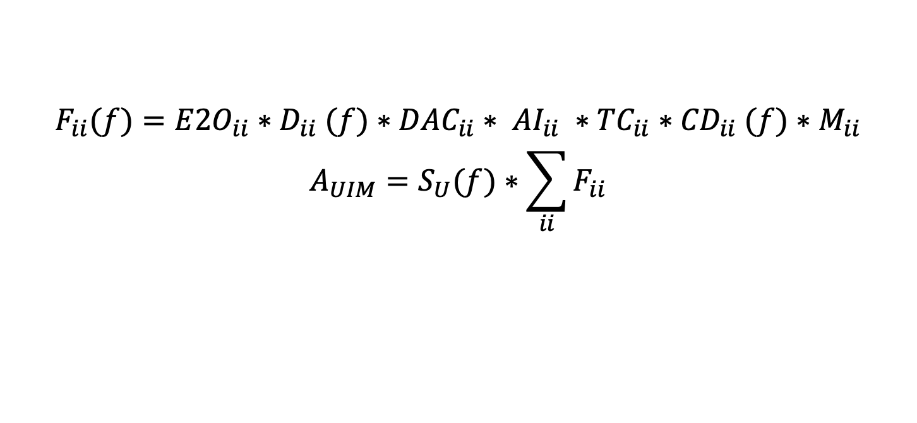
I.7 Fit per Coil >> Error in A_{UIM}: Reality
  Or like this:
$$F_{ii}(f)={E2O}_{ii}{∗D}_{ii}(f)∗{DAC}_{ii}∗ {AI}_{ii} ∗{TC}_{ii}{∗CD}_{ii}(f)∗M_{ii}$$
$$A_{UIM}=S_{U}(f)∗\sum_{ii}{F_{ii}}$$
where $ii=UL,LL,UR,LR$, and for each coil chain, the actuation strength of each driver/coil/magnet chain, F_{ii} , has the following components:
E2O is the Euler 2 OSEM matrix (exactly 0.25 for each coil),
D( f) is the normalized digital compensation “COILOUTF” filter for each coil,
DAC , AI , and TC are the digital-to-analog converter gain, anti-aliasing filter, and DC transconductance of the coil driver respectively
CD( f) is the normalized coil driver response,
M is the magnet strength, and
S_{U} is the UIM longitudinal force to TST displacement transfer function response
Ideally, D_{ii}(f) would be the perfect inverse of CD_{ii}(f) for every coil, they would cancel to a unity transfer function and we can exclude it from any model.
That’s what we’ve done for the UIM in the calibration group’s DARM loop model.
However, the frequency dependent systematic error in A_{UIM} arises when D_{ii}(f) doesn’t perfectly invert CD_{ii}(f), and the fact that the frequency dependent error from each stage is *summed* means that error is not easily intuitable from the individual chain error.

Slide 61
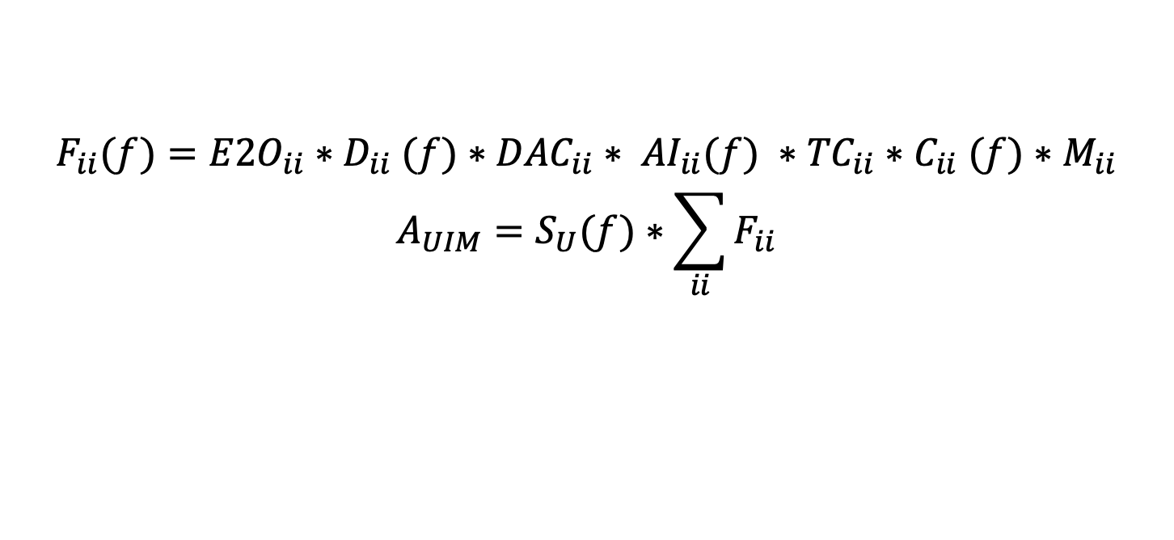
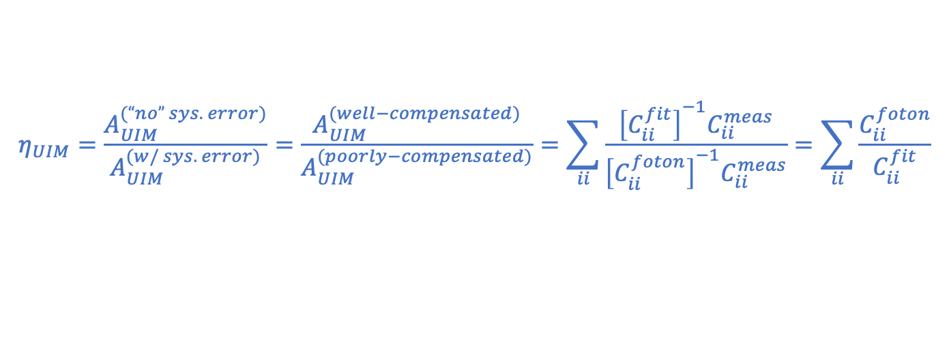
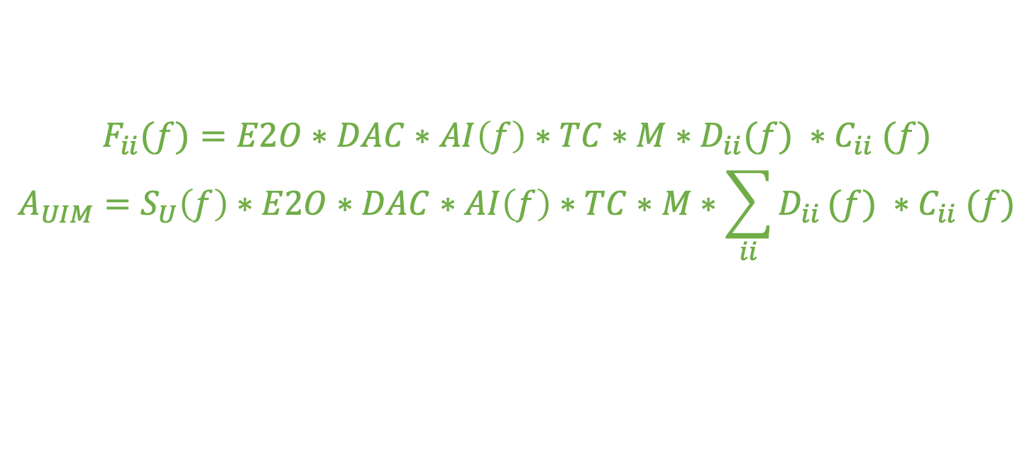
I.7 Fit per Coil >> Error in A_{UIM}: Model
$$F_{ii}(f)={E2O}_{ii}{∗D}_{ii}(f)∗{DAC}_{ii}∗ {AI}_{ii}(f) ∗{TC}_{ii}{∗C}_{ii}(f)∗M_{ii}$$
$$A_{UIM}=S_{U}(f)∗\sum_{ii}{F_{ii}}$$
So we need to construct a model with these terms explicitly included.
Let’s take the above, and assume everything in between D_{ii} and C_{ii} for each chain (namely DAC_{ii}, AI_{ii}(f), and TC_{ii}) is only a common gain to all four chains. This is an OK assumption because
  we take some effort (eg LHO:42740) to ”balance” the gain of each path to minimize length to angle coupling.
  the AI filter response, AI( f), which is a 16kHz elliptic lowpass, in general doesn’t start to deviate from “just a gain” until several kHz, and each channel would only have a small difference at that. Including the measured differences is an exercise for some other day.
$$F_{ii}(f)=E2O∗DAC∗AI\left(f\right)∗TC∗M∗D_{ii}(f) {∗C}_{ii}(f)$$
$$A_{UIM}=S_{U}\left(f\right)∗E2O∗DAC∗AI\left(f\right)∗TC∗M∗\sum_{ii}{D_{ii}}(f) {∗C}_{ii}(f)$$
Under this assumption, the systematic error, $η_{UIM}$, can be computed using only what we already have!
$$η_{UIM}=\frac{A_{UIM}^{(“no” sys. error)}}{A_{UIM}^{(w/ sys. error)}}=\frac{A_{UIM}^{(well−compensated)}}{A_{UIM}^{(poorly−compensated)}}=\sum_{ii}{\frac{{\left[C_{ii}^{fit}\right]}^{−1}C_{ii}^{meas}}{{\left[C_{ii}^{foton}\right]}^{−1}C_{ii}^{meas}}}=\sum_{ii}{\frac{C_{ii}^{foton}}{C_{ii}^{fit}}}$$

Slide 62
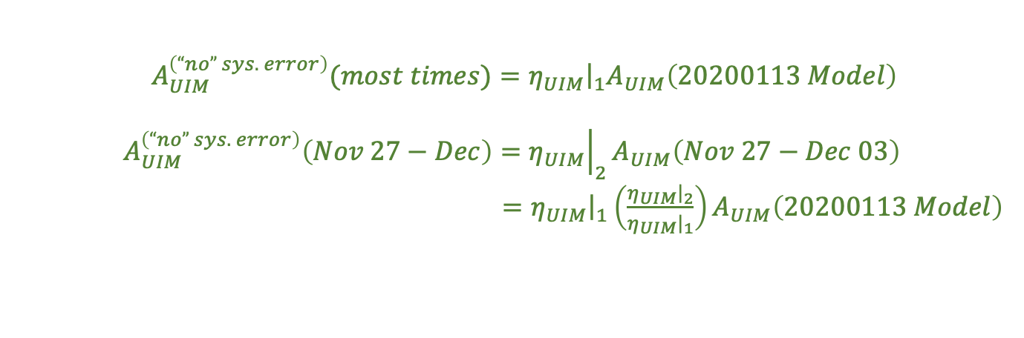
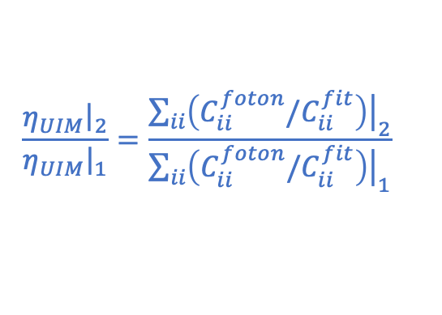
I.7 Fit per Coil >> Error in A_{UIM}: Model
But wait! Remember the whole reason we got in to this game was to find out what error was caused by *switching* from State 1 to State 2,
So we should also compute
such that we’ll know, not only the systematic error under “normal” operation (i.e. in state 1), but also during this Nov 27 – Dec 03 2019 time period.
$$\frac{{\left.η_{UIM}\right|}_{2}}{{\left.η_{UIM}\right|}_{1}}=\frac{{\left.\sum_{ii}{\left(C_{ii}^{foton}/C_{ii}^{fit}\right)}\right|}_{2}}{{\left.\sum_{ii}{\left(C_{ii}^{foton}/C_{ii}^{fit}\right)}\right|}_{1}}$$
$A_{UIM}^{\left(“no” sys. error\right)}(most times)={\left.η_{UIM}\right|}_{1}A_{UIM}\left(20200113 Model\right)$
$$A_{UIM}^{\left(“no” sys. error\right)}\left(Nov 27−Dec\right)={\left.η_{UIM}\right|}_{2}A_{UIM}\left(Nov 27−Dec 03\right)$$
$={\left.η_{UIM}\right|}_{1}{\left(\frac{{\left.η_{UIM}\right|}_{2}}{{\left.η_{UIM}\right|}_{1}}\right)A}_{UIM}\left(20200113 Model\right)$

Slide 63
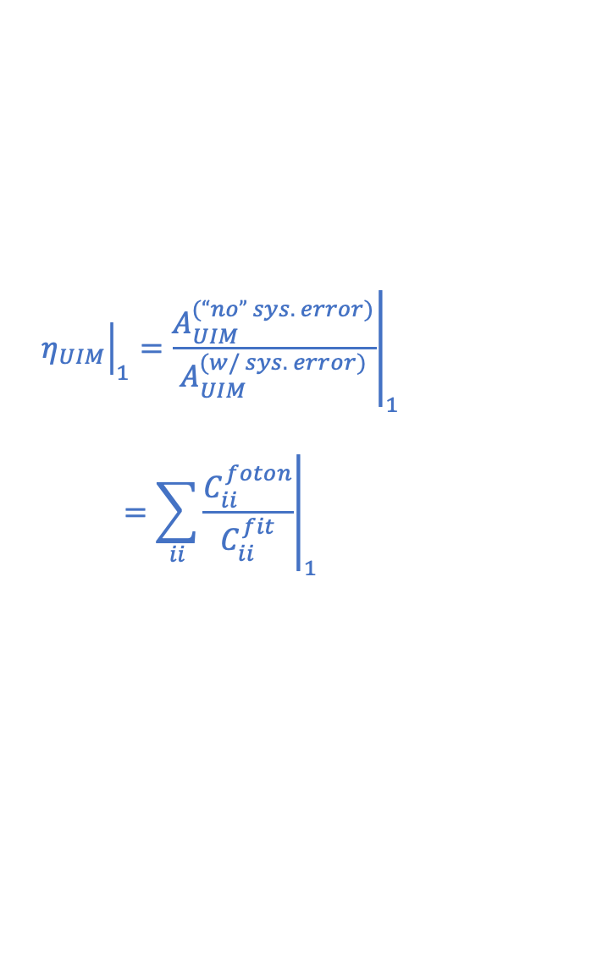
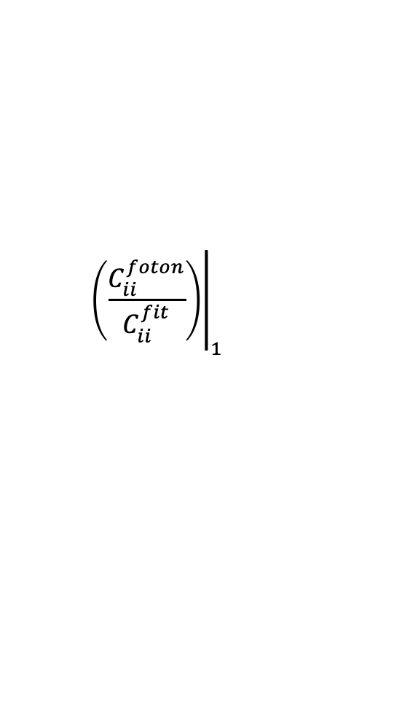
I.7 Fit per Coil >> Error in A_{UIM}: State 1 Results
$${\left.\left(\frac{C_{ii}^{foton}}{C_{ii}^{fit}}\right)\right|}_{1}$$
$${\left.η_{UIM}\right|}_{1}={\left.\frac{A_{UIM}^{(“no” sys. error)}}{A_{UIM}^{(w/ sys. error)}}\right|}_{1}$$
$$={\left.\sum_{ii}{\frac{C_{ii}^{foton}}{C_{ii}^{fit}}}\right|}_{1}$$

Slide 64
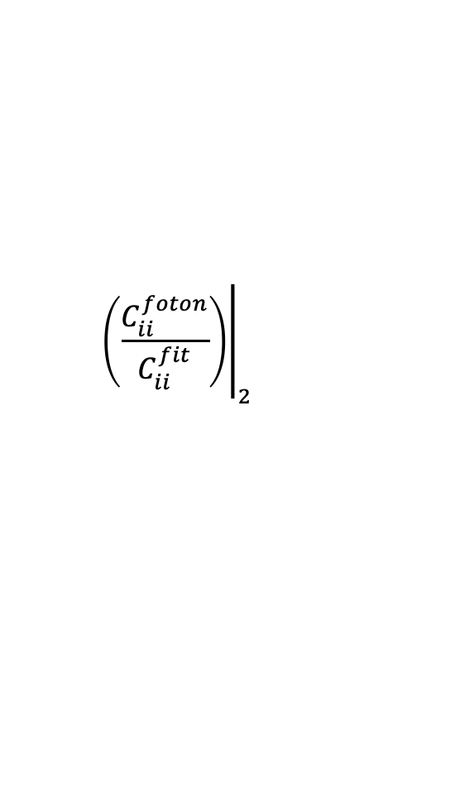
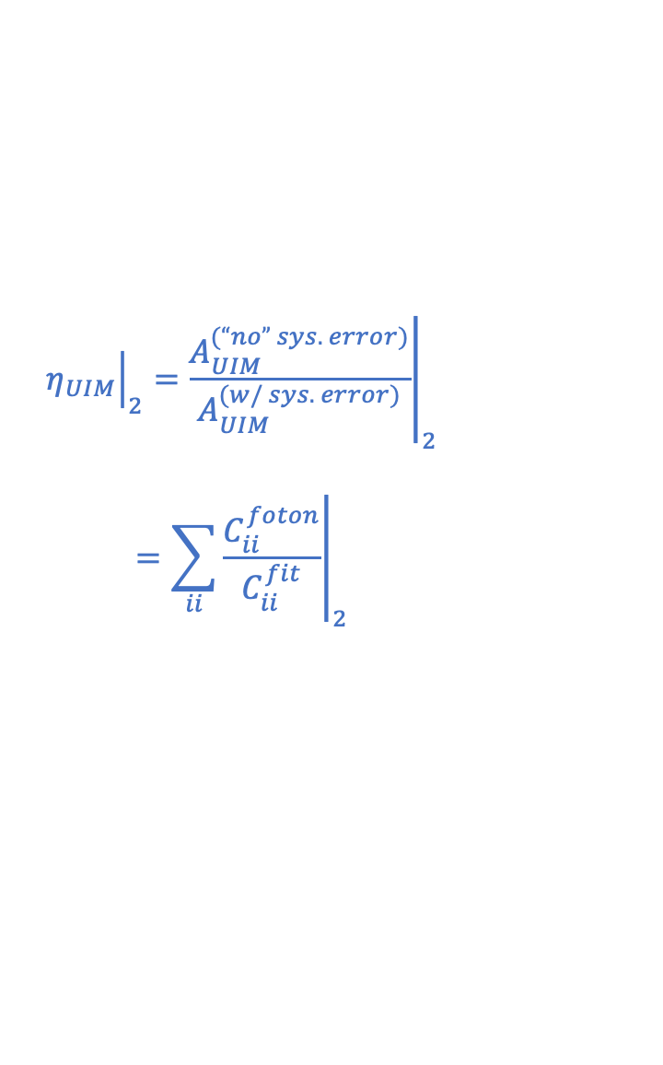
I.7 Fit per Coil >> Error in A_{UIM}: State 2 Results
$${\left.\left(\frac{C_{ii}^{foton}}{C_{ii}^{fit}}\right)\right|}_{2}$$
$${\left.η_{UIM}\right|}_{2}={\left.\frac{A_{UIM}^{(“no” sys. error)}}{A_{UIM}^{(w/ sys. error)}}\right|}_{2}$$
$$={\left.\sum_{ii}{\frac{C_{ii}^{foton}}{C_{ii}^{fit}}}\right|}_{2}$$

Slide 65
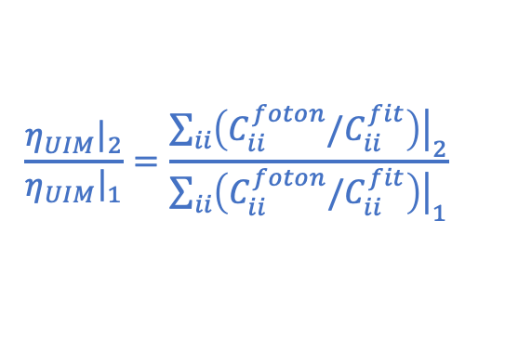
I.7 Fit per Coil >> Error in A_{UIM}: Results Compared
$$\frac{{\left.η_{UIM}\right|}_{2}}{{\left.η_{UIM}\right|}_{1}}=\frac{{\left.\sum_{ii}{\left(C_{ii}^{foton}/C_{ii}^{fit}\right)}\right|}_{2}}{{\left.\sum_{ii}{\left(C_{ii}^{foton}/C_{ii}^{fit}\right)}\right|}_{1}}$$

Slide 66
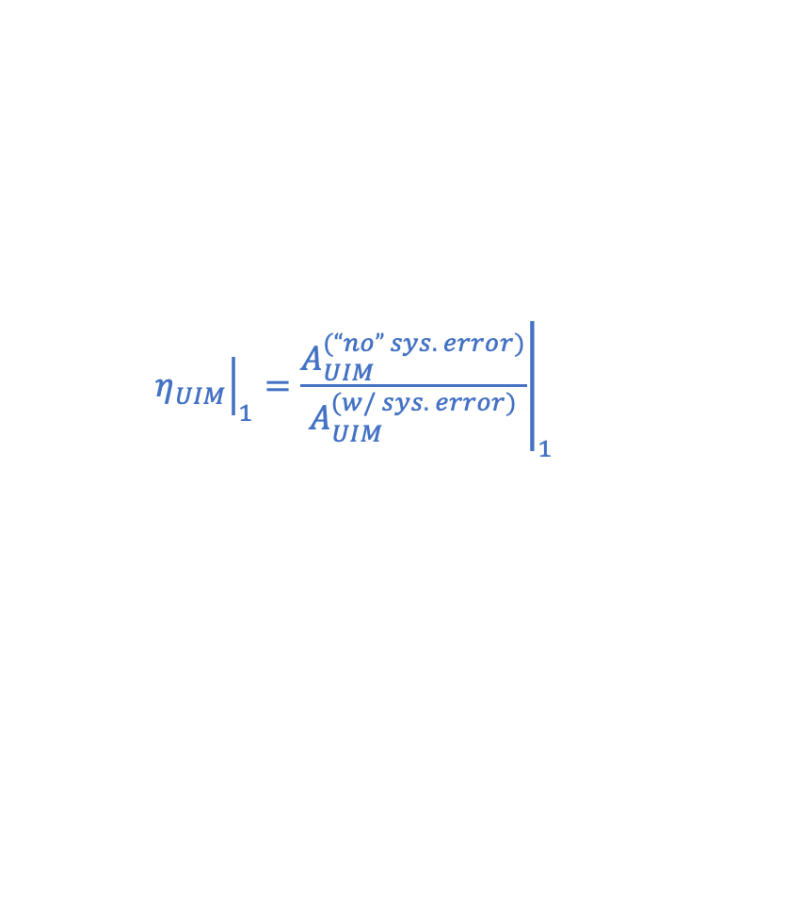
I.7 Fit per Coil >> Error in A_{UIM}: Discussion
$${\left.η_{UIM}\right|}_{1}={\left.\frac{A_{UIM}^{(“no” sys. error)}}{A_{UIM}^{(w/ sys. error)}}\right|}_{1}$$
Huh! So – it looks like the error in State 1 compensation is really of much more concern that the switch between State 1 and State 2 for a short time period.
That’s pretty much it. At least all of this careful study was worth it for some reason.
On to showing how this manifests in the response function!
But also – do remember that this is based on fits of data that doesn’t make sense. So hold these truths to be full of salt grains until we get a better measurement.

Slide 67
I.7 Sys. Err in A_{UIM} Recap
But, if we believe the measurement, is this error big w.r.t. other errors in the UIM?
Yeah – it kinda is!
Namely – the blade spring bending nonsense completely fools the GPR above 50 Hz. So this kind of smoothly varying function just would not be found in / “accounted for with” the GPR. So, we’re stuck having to model it all and estimate the impact on the Response Function systematic error.

Slide 68
Outline
Two Parts, each quite long. *sigh*
PART I: The ETMX UIM Driver, from Nov 27 to Dec 03 2019
  Why do you care about the UIM?
  Review where we were before we started
  Review of the Circuit
  The Measurement
  Other models of the circuit
  The Fit and Each Coil Result
  Converting fit results in to systematic error in A_{UIM}
  Converting sys error in A_{UIM} to sys error in R and Conclusions
PART II: The OMC Whitening Chassis, from Mar 16 to 27 2020

Slide 69
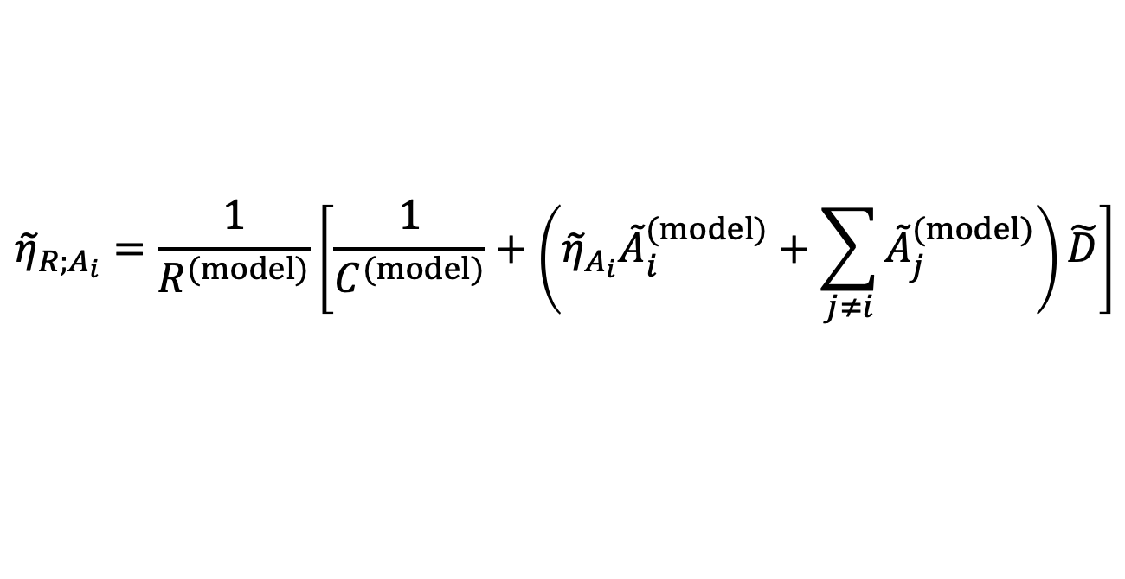
I.8 Converting Sys. Err in A_{UIM} to that in R
Hey! We wrote a paper on this! Check out Eq. 11 in P1900245:
$${\tilde{η}}_{R;A_{i}}=\frac{1}{R^{(model)}}\left[\frac{1}{C^{(model)}}+\left({\tilde{η}}_{A_{i}}{\tilde{A}}_{i}^{(model)}+\sum_{j≠i}{{\tilde{A}}_{j}^{(model)}}\right)\tilde{D}\right]$$
H1 O3
Error contributions to the response function recapped from Slide 6
Vertical Blade Spring Twisting / Bending in L direction causes UIM contribution to spike back in to play at 150 Hz
(D*A_{u}) / R
UIM Contributes at the ~10% level out to ~25 Hz

Slide 70
I.8 Sys. Error R as a result of A_{UIM} Error
*Sigh*. Well, the contribution is quite small.
+0.1%
-0.15%
+0.09 deg
-0.03 deg
And the error caused by switching *between* the states is even smaller.

Slide 71
I.8 UIM Electronics Error Conclusions
The executive summary: non-Jeff’s everywhere whom guessed the answer ahead of time are vindicated in that the UIM electronics error -- either from differences in compensation between states, or poor compensation in general – doesn’t substantially contribute to the response function systematic error.
We may safely proceed with O3B chunk 1 uncertainty budget development without including this systematic error.
  Note that this would have *not* been “covered” by the GPR even it it were non-negligible.
BUT: we’ve now learned many valuable lessons about:
  How to take the right measurement of a coil driver
  How to make sense of a fit to data using rough analytic expectations from converting a circuit diagram in to a collective transfer function
  How bad the compensation is for the UIM driver response
  How to propagate electronics errors to the response function

Slide 72
PART II:
The OMC Whitening Chassis,
from Mar 16 to 27 2020

Slide 73
Outline
Two Parts, each quite long. *sigh*
PART I: The ETMX UIM Driver, from Nov 27 to Dec 03 2019
PART II: The OMC Whitening Chassis, from Mar 16 to 27 2020
  What’s the issue?
  Game Plan / Review of the Original Data
  Review of the Circuit
  Review of the Existing Compensation Scheme
  Fitting and Predicting the Response Function Systematic Error
  Comparison against measured Response Function Error
  Collateral Damage on TDCFs
  Final Answer
  Conclusions

Slide 74
Outline
Two Parts, each quite long. *sigh*
PART I: The ETMX UIM Driver, from Nov 27 to Dec 03 2019
PART II: The OMC Whitening Chassis, from Mar 16 to 27 2020
  What’s the issue?
  Game Plan / Review of the Original Data
  Review of the Circuit
  Review of the Existing Compensation Scheme
  Fitting and Predicting the Response Function Systematic Error
  Comparison against measured Response Function Error
  Collateral Damage on TDCFs
  Final Answer
  Conclusions

Slide 75
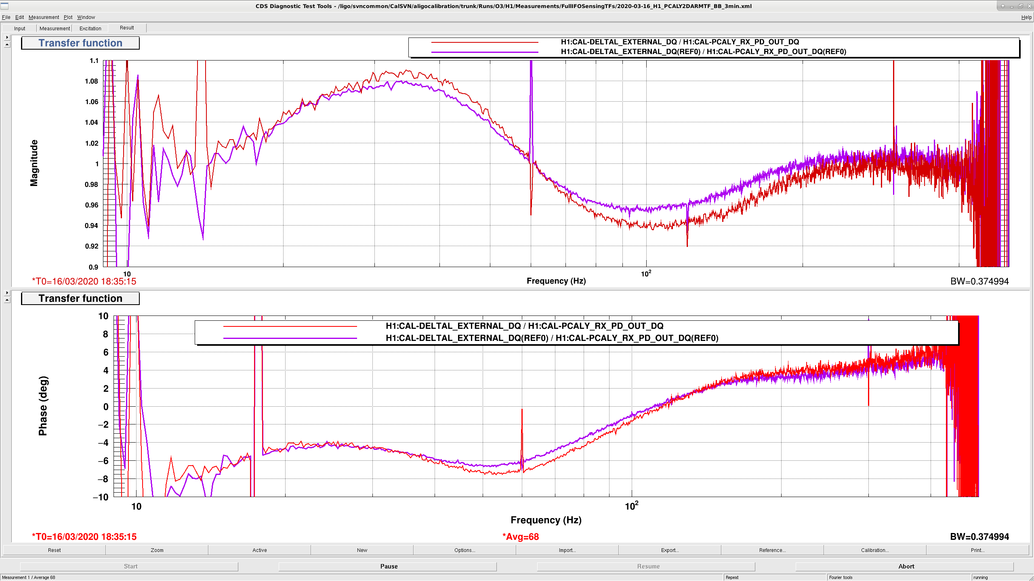
II.1 What’s the issue?
LHO:55620
IIET:14567
Monday Afternoon, Time of first observation ready segment after change is
Mar 16 2020 14:18:54 PDT
Mar 16 2020 21:18:54 UTC
GPS 1268428752
Reduced the amount of OMC analog whitening from all 3 stages (2 whitening stages and one low pass) to just 1 stage of whitening. Results in 1-1.5% systematic error change.
Could have modelled sooner and created a new pyDARM parameter file, but ran out of time, so now we must predict the systematic error to be included in the uncertainty budget.
Live trace is Mar 16 2020 18:00:33 UTC, 30 seconds after change.
Reference is Feb 24 2020 19:00:39 UTC

Slide 76
Outline
Two Parts, each quite long. *sigh*
PART I: The ETMX UIM Driver, from Nov 27 to Dec 03 2019
PART II: The OMC Whitening Chassis, from Mar 16 to 27 2020
  What’s the issue?
  Game Plan / Review of the Original Data
  Review of the Circuit
  Review of the Existing Compensation Scheme
  Fitting and Predicting the Response Function Systematic Error
  Comparison against measured Response Function Error
  Collateral Damage on TDCFs
  Final Answer
  Conclusions

Slide 77
II.2 Game Plan
Revisit the Stefan / Lilli aLOG, find the fitting script, make sure we can reproduce the results.
  Will need fit-from-measured zpks’s of each stage of both channels. Do we even have the right data to do this?
  Find that data, if it’s not used in Lilli’s fitting script already.
  If need be replot / innovate Lilli’s script.
Find the right Foton Filter File, get all the z’s p’s and k’s for each filter module.
Make a prediction of
  All three stages ON and compensated, vs.
  Only one stage ON and compensated
Once DCS frames become available, re-process broadband injections before vs. after change.
  Maybe Maddie has processed them already? check email.
  Compare against prediction above.
Build the ability to include that frequency-dependent systematic error in to RRNom.

Slide 78
II.2 Review of the Data: Measurement Setup
D1900027
Open questions (now that we’ve learned such a valuable lesson in Part I and in LHO:48358 about paying attention to electrical grounds): Should we have floated the shields? Does it matter that we’re “connected to the AA chassis as normal?”

Slide 79
II.2 Review of the Data: Lots of renaming…
Rich measured the chassis, zipped up the files, and gave them to Stefan as .78d files: LHO:47418
Stefan converted the .78d files to useable .asc data, and wrote a script to build the compensation filters: LHO:47257
The script and data were renamed and moved by Jeff to CalSVN: LHO:47290
Lilli renamed the files (LHO:47358) that based on Rich’s configuration map (from LHO:47418)
Here “F1”, “F2” (Rich) or “FM1,” “FM2” (Lilli) is for “filter module,” [as in the corresponding compensation filter] but really means “whitening stage” [as in the corresponding analog filter stage].
All of these newly renamed files were processed with
fit_OMCDCPDWhiteningChassis_20190304.py
and for the record, used a former measurement of the coil driver test box that was used from the 2019-03-07 measurement of S1900070.
Rich’s Measurement configuration | DCPD A (Chan 4) SR785 File Name | DCPD A (Chan 4) Lill’s File Name | DCPD B (Chan 5) SR785 File Name | DCPD B (Chan 5) Lilli’s File Name
All three stages ON | srs0020.78d | PDA_FM1FM2FM3_mag.asc | srs0036.78d | PDB_FM1FM2FM3_mag.asc
no DC voltage offset | srs0021.78d | PDA_FM1FM2FM3_pha.asc | srs0037.78d | PDB_FM1FM2FM3_pha.asc
First two stages ON | srs0024.78d | PDA_FM1FM2_mag.asc | srs0034.78d | PDB_FM1FM2_mag.asc
no DC voltage offset | srs0025.78d | PDA_FM1FM2_pha.asc | srs0035.78d | PDB_FM1FM2_pha.asc
First stage ON | srs0026.78d | PDA_FM1_mag.asc | srs0032.78d | PDB_FM1_mag.asc
no DC voltage offset | srs0027.78d | PDA_FM1_pha.asc | srs0033.78d | PDB_FM1_pha.asc
All stages OFF | srs0028.78d | PDA_noFM_mag.asc | srs0030.78d | PDB_noFM_mag.asc
no DC voltage offset | srs0029.78d | PDA_noFM_pha.asc | srs0031.78d | PDB_noFM_pha.asc
Measurement was taken *after* all ECRs (including fixing sensitivity to DC offset) were implemented
So Lilli using “no DC offset” data is OK, even though DCPDs during NLN have ~50 mA = ~5V running through the chassis

Slide 80
II.2 Review of the Data: Welp, I need to refit the data
I need to understand with what raw data I’m working, so I can understand how to work with it.
Stefan’s metric for success in LHO:47257 was “A / B”, but the DCPDs are *added*, so we need something like “A + B”
Although the fit looks pretty fantastic in LHO:47358, Lilli just fit each measurement straight up, and didn’t compute any ratios of transfer functions to isolate poles and zeros from each stage, so hard to verify which poles are coming from which stage (and if say, FM1’s fit changes when it’s a part of FM1, FM2, and FM3).
When computing the residual contribution to R in LHO:47453, Lilli plotted (A+B)/2, instead of (b_A*A+b_B*B), where b_A and b_B are the balance matrix values,
  (no need for the “divide by two” part of the “average” since it’s an over all gain, and captured in H_C)
I think there’s a bug in fit_OMCDCPDWhiteningChassis_20190304-compareTF.py, fit_OMCDCPDWhiteningChassis_20190304-compareRes.py, and fit_OMCDCPDWhiteningChassis_20190304-compareRes-writeTXT.py, which all mis-represent the poles and zeros installed in foton; we should just import the design from the real foton file, H1OMC_1239468752.txt
IIRrational has improved, and should now need a lot less input, so we can make the code cleaner.
ALSO, Again, Open Question: As discussed in LHO:48358 (learned, unfortunately, a month later), the DUT and coil driver test box *must* be properly referenced to ground, or one may get distortions in the frequency response at high frequency. The data for S1900070 clearly shows a gain of 2.002, confirming that at least the test box measurement was done with an errant “floating” ground. Nothing we can do about it now, but the OMC whitening chassis might behave like the AA chassis, where the high-frequency response gets distorted without measurement shields properly referenced to ground.

Slide 81
Outline
Two Parts, each quite long. *sigh*
PART I: The ETMX UIM Driver, from Nov 27 to Dec 03 2019
PART II: The OMC Whitening Chassis, from Mar 16 to 27 2020
  What’s the issue?
  Game Plan / Review of the Original Data
  Review of the Circuit
  Review of the Existing Compensation Scheme
  Fitting and Predicting the Response Function Systematic Error
  Comparison against measured Response Function Error
  Collateral Damage on TDCFs
  Final Answer
  Conclusions

Slide 82

II.3 Review of the Circuit: Squad goals
I’m gunna do the same thing I did for the UIM driver and break down the circuit into manageable pieces (I’ll go a little faster, assuming you’re used to the methods now having gone through Part I).
Again, this is (a) to teach you, the next generation, and (b) so can be sure we know what to expect when fitting, as well as verifying that we’re modelling it correctly.
As before, we’ll be focusing on finding frequency response, since the over all gain of the OMC DCPD chain is measured as a whole. You’ll find that the super-Nyquist high-frequency poles are especially interesting…

Slide 83
II.3 Review of the Circuit: Forest through the Trees
The (LHO) DCPD Chain from D1300502
The complex chain internal to the whitening chassis alone from pg 1 D1001530-v7
Differential Input from interface board
(b) Four adjustable gain stages
(d) Filter Stage Modified into a Low Pass
Differential Output to AA Chassis
(c) Two remaining Whitening stages
(f) Single-ended to Differential Driver
(a) Differential to single-ended driver
(e) Output buffer
Bold things we’ll find to have interesting frequency response

Slide 84




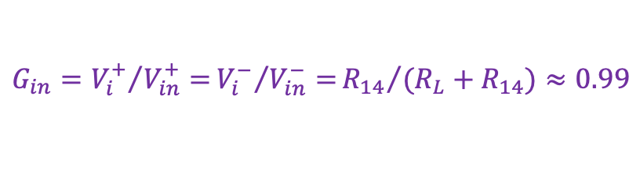



II.3 Review of the Circuit: (a) Diff.-to-S.E. Driver
From pg 2 of D1001530-v7
To analyze, let’s break in to three parts
The voltage divider
some passive input low pass filter
the *actual* differential-to-single-ended driver
$$V_{ii}^{+}$$
$$V_{i}^{+}$$
$$V_{in}^{+}$$
$$V_{o}$$
$$V_{in}^{−}$$
$$V_{i}^{−}$$
$$V_{ii}^{−}$$
For (a), it’s our typical LIGO input voltage divider, aka load termination, for the long cable run from in vacuum. That means we have to understand to what this board is connected (guh). So, we go upstream to the interface board, D1300520-v3 (see no impedance), then further to the head D1300369-v1 (see no impedance), then finally to the in-vac preamp D060572-v1, to see an impedance of 1k (plus whatever small resistance from the cable run). *This* time, unlike the UIM, I think we can ignore parasitic cable capacitance, so this is just a gain “drop” of
$${G_{in}=V_{i}^{+}}/{V_{in}^{+}=}{V_{i}^{−}}/{V_{in}^{−}=}{R_{14}}/{(R_{L}+R_{14})≈0.99}$$

Slide 85














II.3 Review of the Circuit: (a) Diff.-to-S.E. Driver
$$V_{ii}^{+}$$
$$V_{i}^{+}$$
$$V_{in}^{+}$$
$$V_{o}$$
$$V_{in}^{−}$$
$$V_{i}^{−}$$
$$V_{ii}^{−}$$
For (ii), the passive low-pass filter, we can do the usual trick of splitting the different circuit in half, and dividing the impedance of components that span the legs in two. In this case just a capacitor, so
$${\left.\frac{\left(V_{ii}^{+}−V_{ii}^{−}\right)}{\left(V_{i}^{+}−V_{i}^{−}\right)}\right|}_{C_{38}}={\left.\frac{V_{ii}^{+}}{V_{i}^{+}}\right|}_{{2C}_{38}}=\frac{1/{iω2C_{38}}}{(R_{32}+1/iω2C_{38})}=\frac{1}{(1+iω\left(2R_{32}C_{38}\right))}$$
$$f_{p}^{LP}=1/{\left(2π\left(2R_{32}C_{38}\right)\right)}=28.42 kHz$$
For (iii), the actual differential driver, you can see that I’ve re-drawn it to better match the traditional analysis for of an instrumentation amplifier, make it easier to agree that the transfer function takes the form
because, as expected, the circuit is symmetric (e.g. R17=R19, R15=R21, etc.). Since R17 = 0 Ω, and R18 has been omitted, i.e. R18 = ∞ Ω, the first term reduces to 1.0. With
then
$$G_{ia}=\frac{V_{o}}{\left(V_{ii}^{+}−V_{ii}^{−}\right)}=\left(1+\frac{{2R}_{17}}{R_{18}}\right)\frac{Z_{RC}}{R_{15}}$$
$${\left.G_{ia}\right|}_{DC}=\frac{R_{16}}{R_{15}}=0.498$$
$$Z_{RC}={R_{16}}/{\left(1+iωR_{16}C_{37}\right)}$$
$$G_{ia}=\frac{R_{16}}{R_{15}}\frac{1}{\left(1+iωR_{16}C_{37}\right)}$$
$$f_{p}^{ia}=1/{\left(2πR_{16}C_{37}\right)}$$
$$=18.95 kHz$$

Slide 86

II.3 Review of the Circuit: (b) Adjustable Gain Stages
From pg 3 of D1001530-v7…
… and back to pg 1 of D1001530-v7 to get values…
… and then look through ECR E1900064…
To remember that *all* of the switchable gain stages have been disabled / bypassed in O3:
the removal of each R11 in the last three stages makes an infinite resistance to ground, so there’s no longer any input, and further (though no where so explicitly stated) the switches are bypassed with a jumper so the output of the opamp is no longer connected.
R11 in the first stage remains, but is increased to 1k. Because it’s connected to the ZRC network of the ”Diff. Rec.” aka “Differential to Single Ended Driver” aka ”Instrument Amplifier,” and the real part of ZRC is dominated by R20 = 1.5 kΩ, which means the only remaining, fixed gain is
$$G= {R_{11}}/{\left(R_{20}+R_{11}\right)=1500/(1000+1500)=0.4}$$

Slide 87









II.3 Review of the Circuit: (c) Whitening Stages
From pg 4 of D1001530-v7…
These can be redrawn as a non-inverting amplifier…
$$V_{Fin}$$
$$V_{Fout}$$
$$Z_{2}$$
$$Z_{1}$$
$$Z_{1}=\frac{R_{1}(1+1/iωC_{4})}{(R_{1}+1/iωC_{4})}=\frac{R_{1}}{(1+iωR_{1}C_{4})}$$
$$Z_{2}=R_{2}+1/iωC_{5}=\frac{(1+iωR_{2}C_{5})}{iωC_{5}}$$
$$\frac{V_{Fout}}{V_{Fin}}=1+ \frac{Z_{1}}{Z_{2}}=1+ \frac{\frac{R_{1}}{(1+iωR_{1}C_{4})}}{\frac{(1+iωR_{2}C_{5})}{iωC_{5}}}=\frac{1+iω\left(R_{1}C_{5}+R_{1}C_{4}+R_{2}C_{5}\right)−ω^{2}(R_{1}R_{2})(C_{4}C_{5})}{(1+iωR_{2}C_{5})(1+iωR_{1}C_{4}) }$$
$$f_{z}^{F}=1/{\left(2π\left(R_{1}C_{5}+R_{1}C_{4}+R_{2}C_{5}\right)\right)}=0. 960 Hz$$
$$f_{z}^{F}=1/{\left[{\left(2π\right)}^{2}\left(R_{1}R_{2}C_{4}C_{5}\right)\right]}=1.069 MHz$$
$$f_{p}^{F}=1/{\left(2π\left(2R_{2}C_{5}\right)\right)}=10.073 Hz$$
$$f_{p}^{F}=1/{\left(2π\left(2R_{1}C_{4}\right)\right)}=106.103 kHz$$

Slide 88
II.3 Review of the Circuit: (c) Whitening Stages
The z:p pair we really want at 0.96:10.07 Hz i.e. the “1:10” whitening as expected.
But... there is the z:p pair at 1.06:0.103 MHz that causes 0.5 deg phase loss at 1 kHz if we exclude it.
Two-take-aways:
This 1.06 : 0.103 MHz response is a part of each filter stage, so it comes and goes, depending on whether you’re using the stage (you need a “high-frequency pole” for each stage you use)
Very important lesson for measurement taking and fitting: know where the zeros and poles are ahead of time, so you don’t end up fitting for them with data that doesn’t sufficiently cover their frequency region (fitting for zeros or poles outside of data frequency region = BAD, prone to errors)

Slide 89



II.3 Review of the Circuit: (d) The New Low Pass
Another documentation doozy… images from E1600252
Seriously: While I chide Rich Abbott for his documentation, this change is indicative of his true engineering brilliance, and artistic mastery of circuits.
He’s a busy man, just getting the job *done*.
It’s *literally* only us who care at this level.
$$V_{Fin}$$
$$V_{Fout}$$
Redlines
re-drawn

Slide 90







II.3 Review of the Circuit: (d) The New Low Pass
Redlines re-drawn again, shown with functionally equivalent design intent as an inverting op-amp.
Now “easy” to analyze:
$$V_{Fin}$$
$$V_{Fout}$$
$$Z_{1}=\frac{R_{1}\left(R_{n}+1/iωC_{4}\right)}{\left(\left(R_{1}+R_{n}\right)+1/iωC_{4}\right)}=R_{1}\frac{\left(1+iωR_{n}C_{4}\right)}{(1+iω\left(R_{1}+R_{n}\right)C_{4})}$$
$$\frac{V_{Fout}}{V_{Fin}}=−\frac{Z_{1}}{Z_{2}}=−\frac{R_{1}}{R_{2}}\frac{\left(1+iωR_{n}C_{4}\right)}{(1+iω\left(R_{1}+R_{n}\right)C_{4})}$$
$${\left.G_{ia}\right|}_{DC}=−\frac{R_{1}}{R_{2}}=−1.0$$
OK, cool. No sneaky high frequency poles here…
$$f_{z}^{F}=1/{\left(2πR_{n}C_{4}\right)}=503.655 Hz$$
$$f_{p}^{F}=1/{\left(2π\left(R_{1}+R_{n}\right)C_{5}\right)}=49.954 Hz$$

Slide 91







II.3 Review of the Circuit: (e) and (f) buff and SE-D amp
$$V_{out}^{+}$$
$$V_{Bin}$$
$$V_{Bout}$$
$$V_{Bout}$$
$$V_{out}^{−}$$
(e) is a standard gain buffer,
(f) is response-free single-ended to differential amplifier
$$G_{B}=\frac{V_{Bout}}{V_{Bin}}=1+\frac{R_{5}}{∞}=1.0$$
$$G_{oa}=\frac{\left(V_{out}^{+}−V_{out}^{−}\right)}{V_{Bout}}$$
$$=\frac{V_{out}^{+}}{V_{Bout}}−\frac{V_{out}^{−}}{V_{Bout}}$$
$$=\frac{R_{25}}{R_{24}}−\left(−\frac{R_{28}}{R_{27}}\right)$$
$$G_{oa}=2.0$$

Slide 92









II.3 Review of the Circuit: Conclusions
Differential Input from interface board
(b) Four adjustable gain stages
(d) Filter Stage Modified into a Low Pass
Differential Output to AA Chassis
(c) Two remaining Whitening stages
(f) Single-ended to Differential Driver
(a) Differential to single-ended driver
(e) Output buffer
(a)
$$G_{in}≈0.99$$
(c)
Two whitening stages available,
Per stage you get:
$${\left.G_{ia}\right|}_{DC}=0.498$$
$$f_{z}^{F}:f_{p}^{F}=0. 960:10.073 Hz$$
$$f_{z}^{F}:f_{p}^{F}≈1.069:0.106 MHz$$
$$f_{p}^{ia}=18.95 kHz$$
(b)
$$G=0.4$$
(d)
One low-pass available:
$$f_{z}^{F}:f_{p}^{F}=503.655:49.954 Hz$$
(e)
$$G_{B}=1.0$$
(f)
The overall gain (differential in, differential out) is therefore
$$G_{oa}=2.0$$
$$G_{overall}=G_{in}{\left.G_{ia}\right|}_{DC}G{ G}_{B}{ G}_{oa}≈0.4$$

Slide 93
Outline
Two Parts, each quite long. *sigh*
PART I: The ETMX UIM Driver, from Nov 27 to Dec 03 2019
PART II: The OMC Whitening Chassis, from Mar 16 to 27 2020
  What’s the issue?
  Game Plan / Review of the Original Data
  Review of the Circuit
  Review of the Existing Compensation Scheme
  Fitting and Predicting the Response Function Systematic Error
  Comparison against measured Response Function Error
  Collateral Damage on TDCFs
  Final Answer
  Conclusions

Slide 94



II.4 Compensation Scheme: Context
Using a zoom in on the relevant corner of the Subway Map G1501518, each channel’s zeros and poles of OMC whitening chassis response is represented as the white “W_A Resp.” and “W_B Resp.” boxes
For the low frequency zeros and poles, i.e.
we “compensate” (multiply) the raw ADC signal with (by) digital filters “in loop,” with digital IIR filters in the front-end shown as black boxes with the same name
The Balance Matrix digitally adds the two paths together, with coefficients that are *close* to 1.0 (not 0.5!)
These take care of the *differential* gain between the channels
$$f_{z}^{F}:f_{p}^{F}=0. 960:10.073 Hz$$
$$f_{z}^{F}:f_{p}^{F}=503.655:49.954 Hz$$
$$f_{z}^{F}:f_{p}^{F}=0. 960:10.073 Hz$$

Slide 95



II.4 Compensation Scheme: Context
DCPD SUM
that will be fed to quadratic normalize-ation
DCPD A Compensation filter bank
Balance Matrix
Raw ADC Signals
DCPD B Compensation filter bank

Slide 96
II. 4 Compensation Scheme: The switchable response
Here’s a new state machine diagram to show what’s is done to compensate the switchable filter response.
Notice, that the fixed 19 kHz pole and the 1 MHz:100 kHz zero:pole portion of the switchable response is not compensated.
These are the filters that Stefan updated quickly, and documented in LHO:47257.
(There are other filters in here to compensate for the switchable trans-impedance and other gain-only compensation, but not relevant to this discussion.)

Slide 97



II.4 Compensation Scheme
For all the high-frequency response values,
the front-end code isn’t running fast enough
  clock cycle is 61 usec,
  i.e. a rate of 16.384 kHz,
  thus a Nyquist frequency of 8.192 kHz,
  but with IIR filter warping, practically that means zeros and poles can’t be accurately represented above ~5 kHz
Therefore we must rely on the acausal GDS (or DCS) pipelines to compensate these poles.
We do so assuming a *single* path, that uses the average of the measured pole frequencies from each channel.
$$f_{p}^{F}=0.106 MHz$$
(Notice the 1 MHz zero is dropped from the discussion, since it is assumed to have negligible impact in the response below 1 kHz)
$$f_{p}^{ia}=18.95 kHz$$
$$f_{p}^{F}=0.106 MHz$$
pyDARM creates this filter, informed by the model parameter files …
Now you know what we’ll be comparing our *new* fit against, and you’ve got a good handle on how things fit in to the bigger compensation picture.
So let’s get to fitting, and estimating the systematic error.

Slide 98
Outline
Two Parts, each quite long. *sigh*
PART I: The ETMX UIM Driver, from Nov 27 to Dec 03 2019
PART II: The OMC Whitening Chassis, from Mar 16 to 27 2020
  What’s the issue?
  Game Plan / Review of the Original Data
  Review of the Circuit
  Review of the Existing Compensation Scheme
  Fitting and Predicting the Response Function Systematic Error
  Comparison against measured Response Function Error
  Collateral Damage on TDCFs
  Final Answer
  Conclusions

Slide 99
II.5 Fitting and Predicting Systematic Error
Order of operations for fitting and predicting the error:
  For each of the two DCPD Channels:
    Import measurement (which are of cascaded application of filtering), divide by test box
    Take ratios of measurements to obtain individual stage response
    Fit individual stages, obtain expected zeros and poles
    Stack fit zeros:poles to re-create cascading application of filtering, compare against measurement to create residuals
    Reconstruct residuals of compensation we actually used (both in front-end for LF and GDS for HF)
  Then, for each filter state
    Sum each paths residuals (use “balance matrix” for compensation version, and apply HF poles)
    Create a residual (both with existing compensation, and with fit)
    Take the ratio of State 1 (one Whitening Stage – i.e. configuration after Mar 10), and State 3 (both whitening stages and the low pass – i.e. what we had for all prior times in O3)
  Finally, estimate response function error
    Use ratio of State 1 to State 3 as “η_{OMCWC}” for C
    Compute reference R from 20200103 model, then a modified R using C* η_{OMCWC}
    FINAL ANSWER ESTIMATE Take ratio of R_η_{OMCWC} / R_reference

Slide 100
II.5 Fitting and Predicting Systematic Error
    A.i. Import measurement (which are of cascaded application of filtering), divide by test box
State 0
State 1
State 2
State 3
This (the right panels) is the data that Lilli fit in LHO:47358. In fact, we really only took the results from the green curve (i.e. State 3). One can see how a fitting program might get confused, having to fit for the poles and zeros of all *four* states simultaneously… and note the frequency vector only spans 5 Hz to 100 kHz.

Slide 101




II.5 Fitting and Predicting Systematic Error
    A.ii. Take ratios of measurements to obtain individual stage response
$$f_{p}^{F}≈0.106 MHz$$
$$f_{z}^{F}:f_{p}^{F}=0. 960:10.073 Hz$$
$$f_{p}^{ia}=18.95 kHz$$
No Filters
1st Whitening
Low pass
2nd Whitening
$$f_{z}^{F}:f_{p}^{F}=503.655:49.954 Hz$$
Ah, that’s reassuringly simple. BUT – we see much more clearly that the data only goes down to 5 Hz and up to 100 kHz, so fitting for the 1 Hz zero and 0.1 MHz pole will be error prone.
So again, we need better data, but we’ll proceed with what we have…

Slide 102









II.5 Fitting and Predicting Systematic Error
    A.iii. Fit individual stages, obtain expected zeros and poles
2nd Whitening Stage, PDB
Expected:
$$f_{z}^{F}:f_{p}^{F}=0. 960:10.073 Hz$$
$$f_{p}^{F}≈0.106 MHz$$
Previous Results:
$$f_{z}^{F}:f_{p}^{F}=1.000:10.467 Hz$$
$$f_{p}^{F}=0.0328 MHz$$
Seed (PDB):
$$G=0.9973$$
$$f_{z}^{F}:f_{p}^{F}=1.0 :10.0 Hz$$
$$f_{p}^{F}=0.032 MHz$$
New Results (PDB):
$$f_{z}^{F}:f_{p}^{F}=0. 985:10.455 Hz$$
$$f_{p}^{F}=0.868 MHz$$
Fits are now much more simple – but the fit for the two whitening stages are limited because they’re trying to fit for zeros or poles outside the data’s frequency region.
At the low end, given incomplete data for the 1 Hz, the fitter yields a residual with ~0.25% error in magnitude.
I think this is why Stefan felt the need to add a little gain modifiers to each compensation filter as reported and installed in LHO:47257.

Slide 103
II.5 Fitting and Predicting Systematic Error
    A.iii. Fit individual stages, obtain expected zeros and poles
PDA | New Result Zeros | Old Result Zeros | New Result Poles | Old Result Poles | Old Result Gain
Fixed Response | 0.2057 |  | 0.0489, 13612.7, 17873.2 | 11346
1st Whitening Stage | 0.9894 | 0.969 | 10.4215, 98277.1 | 10.440, 32875.3 | G = 0.9734
Low Pass | 501.119 | 497.5 | 49.7277 | 49.63 | G = -0.9995
2nd Whitening Stage | 0.9677 | 0.9865 | 10.3377, 86258.7 | 10.372, 32875.3 | G = 1.0020
PDB | New Result Zeros | Old Result Zeros | New Result Poles | Old Result Poles | Old Result Gain
Fixed Response | 0.2067 |  | 0.0505, 13707.1, 18046.0 | 11521
1st Whitening Stage | 0.979 | 0.966 | 10.1639, 98413.7 | 10.160, 32863 | G = 0.975458
Low Pass | 501.790 | 497.7 | 49.8120 | 49.72 | G = -1.0004
2nd Whitening Stage | 0.9845 | 1.000 | 10.4551, 86788.8 | 10.467, 32683 | G = 0.9973

Slide 104
II.5 Fitting and Predicting Systematic Error
    A.iii. Fit individual stages, obtain expected zeros and poles
Most low frequency zeros and poles are very similar,
BUT new fit takes out DC gain from State 0 with nearly cancelling zero:pole pair at ~0.20:0.05 Hz; old fit did it with a gain on each of the State 1, 2, and 3 fits.
  Which is better? Dunno. Seems like new fit might be conceptually better, but here’s where we’d need data down to (past) 1 Hz.
  Preferably, get data down to 0.5, 0.2, 0.1… for whatever patience allows, and fit again.
New fit does a *much* better job at fitting for the 0.1 MHz pole
  (though the State 3 fit still reports ~20 kHz too low)
  Would be nice to get data out to 200 kHz, or to see if “ratio of State 3 / State 2” data we used agrees with a new measurement of “only State 3 on” but probably not worth chasing
Both old and new fit for State 0 have a high frequency pole at 11 or 13 kHz, respectively, where there shouldn’t be
  What’s going on here? Should it be included? Dunno…

Slide 105
II.5 Fitting and Predicting Systematic Error
    A.iii. Fit individual stages, obtain expected zeros and poles
Here’s the residuals between each stage and the fit for that stage.
Notice that the fits are pretty dang awesome – but the 1:10 Hz whitening stages have low-frequency gain issues. Again: this is the result of incomplete data.
PDA
No Filters
1st Whitening
Low pass
2nd Whitening
PDB
No Filters
1st Whitening
Low pass
2nd Whitening
But alas. We move on with the plan, ‘cause maybe “perfect is the enemy of good enough.”

Slide 106
II.5 Fitting and Predicting Systematic Error
    A.iv. Stack fit zeros:poles to re-create cascading application of filtering, compare against measurement to create residuals
Take the poles and zeros from the fit each stage, collect them, successively adding them to a new model filter of each state, and divide that cascaded model against the original data
We see how the lack of low frequency data for the whitening stages impacts this residual – especially for state 3, which has the error from both the 1st and 2nd whitening stage
PDA
State 0
State 1
State 2
State 3
PDB
State 0
State 1
State 2
State 3
… but the magnitude residual is still only at most 0.0025 away from unity at 10 Hz, and closer than that for most frequencies until 5 kHz.
So now we have a good model of the measurement.
Is it better than the old model that Stefan and Lilli created and installed?

Slide 107
II.5 Fitting and Predicting Systematic Error
    A.v. Reconstruct residuals of compensation we actually used (both in front-end for LF and GDS for HF)
This pulls the LF zeros and poles from Stefan’s work.
It does *not* yet include HF poles
The residual is each individual stage’s measured response / compensation FM response
No Filters
1st Whitening
Low pass
2nd Whitening
PDA
No Filters
1st Whitening
Low pass
2nd Whitening
PDB
NOTE THE YLIM SCALE CHANGE
PDA has a 3% gain error in it’s 1st whitening stage compensation, see rabbit hole
”No filters” response is clearly missing the 19 kHz pole, fine – we compensate that later. Fine.
2nd stage compensation is < 0.1% away from unity magnitude. Interesting.

Slide 108
II.5 Fitting and Predicting Systematic Error
    A.v. Reconstruct residuals of compensation we actually used (both in front-end for LF and GDS for HF)
Here’s the “stacked” version…
One can see the “DC Gain” error is stacking up – especially, strangely the 1st whitening stage of PDA
*but* the magnitude response is still “flat” up to ~1kHz
State 0
State 1
State 2
State 3
State 0
State 1
State 2
State 3
Phase is rolling off quickly, but that’s the missing compensation for 19 kHz pole.
This gets applied when I create the sum (because that’s how it’s done in the current calibration scheme)

Slide 109
II.5 Fitting and Predicting Systematic Error
    B.i. For each (stacked) filtering stage, sum each paths residuals (use “balance matrix” for compensation version and apply average HF poles)
Dude – you don’t think the rabbit hole is deep enough yet???
Let’s talk about the balance matrix and how the A and B paths are matched.
DCPD SUM
that will be fed to quadratic normalization
DCPD A Compensation filter bank
Balance Matrix
Raw ADC Signals
DCPD B Compensation filter bank

Slide 110
II.5 Fitting and Predicting Systematic Error
    B.i. For each (stacked) filtering stage, sum each paths residuals (use “balance matrix” for compensation version and apply average HF poles)
Wednesday, Dec 2018, Stefan develops methodology to populate the balance matrix: LHO:45734
Friday, Mar 01 2019, Stefan updates and augments his methodology documentation (nice!): LHO:47217
Mar 01 2019, (same Friday) Stefan updates the balance matrix and turns on FM10 = gain of 0.977
  2019-03-01 22:08 UTC FM10 turned on (Friday at 2pm)
Saturday, Mar 02 2019 Craig & Stefan discover that the balance is (ah!) DCPD light level dependent! LHO:47247
Sunday Mar 03 2019, Rich and Peter debug and fix the OMC Whitening Chassis, LHO:47254
2019-03-04 02:35 UTC FM10 is turned off and never used again (Sunday at 5:30 pm).
Monday Mar 04, Stefan aLOGs that he’s updated the compensation after Rich/Peter chassis fix: LHO:47257, but says:
  “Finally, we still will have to re-match the photo diode light levels in lock (alog 47217).”
…. but I don’t think this “re-match” to the photodiode light level -- i.e. re-compensate for the DCPDA channel 0.977 errant gain was ever done – or maybe it was encorporated in to the first FMs?!
The perils of the Expert Visiting Scientist…

Slide 111




II.5 Fitting and Predicting Systematic Error
    B.i. For each (stacked) filtering stage, sum each paths residuals (use “balance matrix” for compensation version and apply average HF poles)
So, in conclusion, what the compensation scheme really should be is:
$${Sum}_{real}=G_{overall}^{A}∗{meas}_{LF}^{A}∗{meas}_{HF}^{A}∗{comp}_{LF}^{A}∗{comp}_{HF}^{A}{ G}_{bal}^{A}$$
$+{ G}_{overall}^{B}∗{meas}_{LF}^{B}∗{meas}_{HF}^{B}∗{comp}_{LF}^{B}∗{comp}_{HF}^{B}{ G}_{bal}^{B}$
But what we’ve modelled in O3 assumes that in the above equation,
$$G_{bal}^{A}=G_{bal}^{B}=1/2$$
Bad assumption
$${G_{overall}^{A}=G_{overall}^{B}=G}_{overall}=G_{meas}$$
Pulled out / Folded in to $H_{ C}$
$${meas}_{LF}^{A}∗{comp}_{LF}^{A} ={meas}_{LF}^{B}∗{comp}_{LF}^{B}=1$$
Bad assumption
$${{{comp}_{LF}^{A}={comp}_{LF}^{B}=comp}_{HF}=(meas}_{HF}^{A}+{meas}_{HF}^{B})/2$$
Bad assumption
$${Sum}_{model}={comp}_{HF}$$
(without allowing for
switchable response)
Bad assumption
So let’s review the *values* for the existing compensation, so we can compare it against the fit.

Slide 112






II.5 Fitting and Predicting Systematic Error
    B.i. For each (stacked) filtering stage, sum each paths residuals (use “balance matrix” for compensation version and apply average HF poles)
# DCPD SUM Balance Matrix Elements
# LHO aLOG 47228
# https://alog.ligo-wa.caltech.edu/aLOG/index.php?callRep=47228
# PDA PDB
balance = [1.01039,0.98961]
FM1
$$f_{z}^{F}:f_{p}^{F}=0. 960:10.073 Hz$$
# Existing compensation:
# Low frequency --
# From LHO aLOG 47257
# and cross checked to be present in
# ^/trunk/Common/H1CalFilterArchive/h1omc/
# v H1OMC_1254266332.txt
# "FM0" FM1 FM2 FM3
compOMCzeros_whitening = [[ 1.0, 10.440, 49.63, 10.372], #PDA
[ 1.0, 10.160, 49.72, 10.467]] #PDB
compOMCpoles_whitening = [[ 1.0, 0.966, 497.5, 0.9865], #PDA
[ 1.0, 0.969, 497.7, 1.0000]] #PDB
compOMCgain_whitening = [[ 1.0, 0.973400, -0.9995, 1.0020], #PDA
[ 1.0, 0.975458, -1.0004, 0.9973]] #PDB
1st Whitening
Low pass
2nd Whitening
FM2
$$f_{z}^{F}:f_{p}^{F}=503.655:49.954 Hz$$
FM3
$$f_{z}^{F}:f_{p}^{F}=0. 960:10.073 Hz$$
# From LHO aLOG 47377
# which has been copied to, e.g. modelparams_H1_20200103.py
# PDA PDB
uncompOMCpoles_whitening = np.array([(11.346e3 + 11.521e3)/2,
(32.875e3 + 32.863e3)/2,
(32.875e3 + 32.863e3)/2])
$$f_{p}^{ia}=18.95 kHz$$
$$f_{p}^{F}≈0.106 MHz$$
$$f_{p}^{F}≈0.106 MHz$$

Slide 113
II.5 Fitting and Predicting Systematic Error
    B.ii. For Each State create a stacked summed residual (both with existing compensation, and with fit)
So here’s where we were throughout most of O3: State 3, All three filter stages on, the correct number of HF poles, a *gain* flaw, but again is absorbed in $G_{meas}$ (i.e. $H_{C}$)
Here’s the new fit – better gain, but honestly, about the same level of wiggle
Bad HF compensation actually does OK
Stacked gain error of (1.01*0.97*0.97 + 0.98*0.97) ≃ 1.91
No Filters
balance
No Filters
balance
1st Whitening
LF phase error from (stacked) poor fit of 1 Hz poles in the whitening stages
Bad HF compensation actually does OK

Slide 114
II.5 Fitting and Predicting Systematic Error
    B.ii. For Each State create a stacked summed residual (both with existing compensation, and with fit)
So here’s where we ended O3: State 1, only one low-pass on
But now, existing 3 HF poles from pyDARM *over* compensates for state 1, which should only have 2 HF poles
Same story at low frequency
However, still neglible effect below 1 kHz…

Slide 115


II.5 Fitting and Predicting Systematic Error
    B.ii. Take the ratio of State 1 (one Whitening Stage – i.e. configuration after Mar 10), and State 3 (both whitening stages and the low pass – i.e. what we had for all prior times in O3)
$$η_{C}^{OMCWC}$$
OK, now we *might* be on to something.
The *ratio* State 1 / State 3 shows the bad HF compensation
But, it also shows that the new fit isn’t perfect (because of the lack of LF data)
This is our compensation and fit “η_{OMCWC}”s
$η_{C}^{OMCWC}$ will become important later, place a mental bookmark!

Slide 116
II.5 Fitting and Predicting Systematic Error
    C.i. Use ratio of State 1 to State 3 as “η_{OMCWC}” for C

Slide 117



II.5 Fitting and Predicting Systematic Error
    C.ii. Compute reference R from 20200103 model, then a modified R using C* η_{OMCWC}
$$\frac{R_{with_η_omcwc}}{R_{ref}}$$
$$η_{R}^{OMCWC}$$
$$\frac{R_{with_η_omcwc}}{R_{ref}}$$

Slide 118

II.5 Fitting and Predicting Systematic Error
    C.ii. Compute reference R from 20200103 model, then a modified R using C* η_{OMCWC}
$$η_{R}^{OMCWC}$$
This is the same as the right two panels on the previous page, but zoomed to the same frequency range and ylims as typical BB injections.
In short: all this work, and the predicted error isn’t big enough to explain what was seen on that fateful day in Mar 2020…

Slide 119
Outline
Two Parts, each quite long. *sigh*
PART I: The ETMX UIM Driver, from Nov 27 to Dec 03 2019
PART II: The OMC Whitening Chassis, from Mar 16 to 27 2020
  What’s the issue?
  Game Plan / Review of the Original Data
  Review of the Circuit
  Review of the Existing Compensation Scheme
  Fitting and Predicting the Response Function Systematic Error
  Comparison against measured Response Function Error
  Collateral Damage on TDCFs
  Final Answer
  Conclusions

Slide 120

II.6 Compare Against Measurement
Let’s review what before vs. after broadband injection data is available.
DMT_ANALYSIS_READY end
BB Measurement
Brief NLN, but not DMT_ANALYSIS_READY
DMT_ANALYSIS_READY
resumes
Detector was locked and happy for ~19 hours. Went out of OBS_READY at Mar 16 2020 18:29:59 UTC, switched whitening config, and measured broadband 30 seconds afterword.
Pre
  2020-03-02_H1_PCALY2DARMTF_BB_3min.xml: 2020-03-02 19:00:32 UTC
  2020-03-09_H1_PCALY2DARMTF_BB_3min.xml: 2020-03-09 18:00:33 UTC
Post
  2020-03-16_H1_PCALY2DARMTF_BB_3min.xml: 2020-03-16 18:30:31 UTC
  2020-03-23_H1_PCALY2DARMTF_BB_3min.xml: 2020-03-23 18:01:20 UTC

Slide 121
II.6 Compare Against Measurement
But somethings already fishy here…
If the whitening configuration changed *before* the 2020-03-16 measurement, shouldn’t there be a difference?
Ok – maybe if you squint… you can see a change between 2020-03-09 and 2020-03-16… but what the heck is going on with 2020-03-23?

Slide 122
II.6 Compare Against Measurement
Maybe we can make sushi out of the fish?
OK, so… there is *some* quantifiable difference (ratio) between the “before” and “after” the change

Slide 123








II.6 Compare Against Measurement
Now, before we compare slide 122 with 118 this is *always* super duper confusing, let’s make sure we plot the right thing, and compare apples to apples instead of apples to (1/apples).
On page 115, we’ve defined the systematic error in C as
$$η_{omcwc}≡\frac{C_{state 1}}{C_{state 3}}=\frac{C_{after}}{C_{before}}$$
Then, on page 117 and 118 we show
$$R_{reference}= \frac{1}{C_{before}}+AD$$
$$R_{with_η_omcwc}=\frac{1}{C_{after}}+AD=\frac{1}{C_{before}∗η_{omcwc}}+AD$$
$$η_{R}= \frac{R_{with_η_omcwc}}{R_{reference}}$$
For the measurements on page 121 and 121, remember from T1900169
$$\frac{ΔL}{PCAL}=\frac{R_{DCS}}{R_{PCAL}}$$
DCS response function isn’t changing – the PCAL excitation is measuring the change,
Which means
$${\left.\frac{ΔL}{PCAL}\right|}_{2020−03−09}=\frac{R_{DCS}}{R_{reference}}$$
$$\frac{{\left.ΔL/PCAL\right|}_{200316}}{{\left.ΔL/PCAL\right|}_{200309}}$$
$$= \frac{R_{reference}}{R_{with_η_omcwc}}=\frac{1}{η_{R}}$$
$${\left.\frac{ΔL}{PCAL}\right|}_{2020−03−16}=\frac{R_{DCS}}{R_{with_η_omcwc}}$$

Slide 124
II.6 Compare Against Measurement
Sushi go!
HaHA! Vindication! The new fit does a good job at predicting the *miniscule* change in the response function. Great!
So… what the heck is going on with the 2020-03-23 measurement??

Slide 125
Outline
Two Parts, each quite long. *sigh*
PART I: The ETMX UIM Driver, from Nov 27 to Dec 03 2019
PART II: The OMC Whitening Chassis, from Mar 16 to 27 2020
  What’s the issue?
  Game Plan / Review of the Original Data
  Review of the Circuit
  Review of the Existing Compensation Scheme
  Fitting and Predicting the Response Function Systematic Error
  Comparison against measured Response Function Error
  Collateral Damage on TDCFs
  Final Answer
  Conclusions

Slide 126

II.7 Collateral Damage on/from TDCFs
G2001293 started out as an unrelated investigation in to why the cavity pole changed by 7 Hz after the OMC whitening chassis change.
However, the result of that investigation concludes that the OMC whitening chassis error (predicted in this talk) at 410.3 Hz actually causes the sensing function TDCFs to falsely report a change in the optical gain and cavity pole.
These poorly informed TDCFs were then applied to h(t), and thus create a self-inflicted systematic error. In G2001293, we show that accounting for this error almost entirely accounts for the change between the 2020-03-16 measurement and 2020-03-23 measurement. Mystery solved!
But, one last thing (picking up after the conclusion of G2001293): to completely account for impact, we will apply both the (negligible) $η_{C}^{OMCWC}$and the (more impactful) $η_{C}^{TDCFs}$ to the Chunk 2, Period c systematic error and uncertainty budget.
  (where the application of $η_{C}^{OMCWC}$ will mostly just account for the small amount of error above 1 kHz)

Slide 127





II.7 Collateral Damage on/from TDCFs
The maaaaaath covered on page 14 of G2001293 reminds us that, because of the “1+” part of the response function, the modification to C is not so straightforwardly propagated to a modification in R. So let’s pick up where we left off, but include $η_{C}^{OMCWC}$ as well as $η_{C}^{TDCFs}$.
$$η_{C}^{total}≡η_{C}^{OMCWC}η_{C}^{inc≫cor}η_{C}^{ref≫inc}$$
$R_{ref}=\frac{1+ADC}{C}$
$R_{incorrect}=\frac{1+κ_{C}^{′} \frac{(1+if/f_{cc}^{ref})}{(1+if/f_{cc}^{′})} ADC}{κ_{C}^{′} \frac{(1+if/f_{cc}^{ref})}{(1+if/f_{cc}^{′})} C}=\frac{1+ η_{C}^{ref≫inc}ADC}{η_{C}^{ref≫inc}C}$
$R_{correct}=\frac{1+η_{C}^{OMCWC}\frac{κ_{C}}{κ_{C}^{′}} \frac{(1+if/f_{cc}^{′})}{(1+if/f_{cc})} κ_{C}^{′} \frac{(1+if/f_{cc}^{ref})}{(1+if/f_{cc}^{′})} ADC}{η_{C}^{OMCWC}\frac{κ_{C}}{κ_{C}^{′}} \frac{(1+if/f_{cc}^{′})}{(1+if/f_{cc})} κ_{C}^{′} \frac{(1+if/f_{cc}^{ref})}{(1+if/f_{cc}^{′})} C}=\frac{1+η_{C}^{OMCWC}η_{C}^{inc≫cor}η_{C}^{ref≫inc}ADC}{η_{C}^{OMCWC}η_{C}^{inc≫cor}η_{C}^{ref≫inc}C}$
$η_{R}^{final}≡\frac{R_{correct}}{R_{incorrect}}=\frac{1+η_{C}^{OMCWC}η_{C}^{inc≫cor}η_{C}^{ref≫inc}ADC}{1+η_{C}^{ref≫inc}ADC}\frac{1}{η_{C}^{OMCWC}η_{C}^{inc≫cor}}$
$$η_{R}^{ref≫inc}≡\frac{R_{incorrect}}{R_{ref}}$$
$$η_{R}^{ref≫cor}≡\frac{R_{correct}}{R_{ref}}$$

Slide 128




II.7 Collateral Damage on/from TDCFs
$$η_{C}^{OMCWC}$$
$$η_{C}^{inc≫cor}$$
$$η_{C}^{ref≫inc}$$
$$η_{C}^{total}$$
meas_kappaC = 0.995
meas_kappaCprime = 0.9825
meas_fcc = 413
meas_fccprime = 423
f2 = 410.3

Slide 129

II.7 Collateral Damage on/from TDCFs
2020-01-03 Model Component Contribution to R
Even though $η_{C}^{total}$ is small, it gets amplified from 30 Hz to 250 Hz by a factor of ~2 because of the DARM loop shaping of C in both the numerator and denominator of $η_{R}^{final}$

Slide 130
Outline
Two Parts, each quite long. *sigh*
PART I: The ETMX UIM Driver, from Nov 27 to Dec 03 2019
PART II: The OMC Whitening Chassis, from Mar 16 to 27 2020
  What’s the issue?
  Game Plan / Review of the Original Data
  Review of the Circuit
  Review of the Existing Compensation Scheme
  Fitting and Predicting the Response Function Systematic Error
  Comparison against measured Response Function Error
  Collateral Damage on TDCFs
  Final Answer
  Conclusions

Slide 131




II.8 Final Answer: The construction of $η_{R}^{final}$
$$η_{R}^{ref≫cor}≡\frac{R_{correct}}{R_{ref}}$$
$$η_{R}^{ref≫inc}≡\frac{R_{incorrect}}{R_{ref}}$$
$η_{R}^{final}≡\frac{R_{correct}}{R_{incorrect}}=\frac{1+η_{C}^{OMCWC}η_{C}^{inc≫cor}η_{C}^{ref≫inc}ADC}{1+η_{C}^{ref≫inc}ADC}\frac{1}{η_{C}^{OMCWC}η_{C}^{inc≫cor}}$

Slide 132
II.8 Final Answer: succession of BB vs. Modified Percentile for Period c

Slide 133
II.8 Final Answer: Predicted Impact across the Entire Band

Slide 134

II.8 Final Answer
$η_{C}^{OMCWC}$ and the bulk of the fitting/modeling plots was produced by
/ligo/svncommon/CalSVN/aligocalibration/trunk/Common/Electronics/H1/Scripts/
fit_OMCDCPDWhiteningChassis_20190304_forG2000527.py
and exported to
/ligo/svncommon/CalSVN/aligocalibration/trunk/Runs/O3/H1/Results/Uncertainty/
2020-08-25_measDate2019-03-04_H1OMC_WhiteningChassisTFs_eta_C_omcwc.txt
$η_{C}^{inc≫cor}η_{C}^{ref≫inc}$ and the work presented in G2001293 was produced by
/ligo/svncommon/CalSVN/aligocalibration/trunk/Common/Documents/G2001293_O3BChunk2Periodc_OMCWhitening_and_TDCF_SysError/
showimpact_omcwhiteningchassiserror_on_sensingTDCFs_and_R.py
$η_{C}^{OMCWC}$, $η_{C}^{inc≫cor}$, and $η_{C}^{ref≫inc}$ were all combined as described on page 127 by
/ligo/svncommon/CalSVN/aligocalibration/trunk/Runs/O3/H1/Scripts/Uncertainty/
combine_OMCWC_and_BadSensingTDCF_syserror_H1O3BChunk2Periodc_20200316-20200327.py
The resulting $η_{R}^{final}$ produce by that script was exported as
/ligo/svncommon/CalSVN/aligocalibration/trunk/Runs/O3/H1/Results/Uncertainty/
2020-08-25_H1O3BChunk2Periodc_ResponseFunctionSysError_OMCWC_and_BadTDCFs_eta_R_omcwc_badtdcfs.hdf5
RRNom was modified in rev 11150

Slide 135
II.8 Final Answer
LHO aLOG 56582 details this, the 2020-03-23 broadband injection against the official, RRNom produced budget

Slide 136
Outline
Two Parts, each quite long. *sigh*
PART I: The ETMX UIM Driver, from Nov 27 to Dec 03 2019
PART II: The OMC Whitening Chassis, from Mar 16 to 27 2020
  What’s the issue?
  Game Plan / Review of the Original Data
  Review of the Circuit
  Review of the Existing Compensation Scheme
  Fitting and Predicting the Response Function Systematic Error
  Comparison against measured Response Function Error
  Collateral Damage on TDCFs
  Final Answer
  Conclusions

Slide 137
II.8 Conclusions
Lessons learned:
  We really need to take the time to get to know all of the circuits that matter, and understand how to best measure them
  Yes, we can predict the frequency-dependent change caused by electronics errors in the sensing function.
  We should take a new measurement of the OMC Whitening Chassis,
    be sure to get data down to at least 0.25 Hz (and if patience allows 0.1 Hz), and update the compensation filters.
    be sure to take both cascading response and single filter response measurements.
We’ve found some insidious collateral damage of the OMC whitening chassis configuration change itself
  the sensing function TDCFs were impacted by this, incorrectly reporting plant change, and cause *much worse* systematic error
  Discovered and reviewed in G2001293
Final answer (where we include OMC error itself *and* the correction for bad TDCFs) agrees nicely with 2020-03-23 measurement.
FIN

