Slide 1
O3 LIGO-Virgo-KAGRA update from the Sites, April 2020
Nicolas Arnaud, Joseph Betzwieser, Anamaria Effler, Keita Kawabe, Nicolas Leroy,
Shinji Miyoki, Brian O’Reilly, Alessio Rocchi, David Shoemaker, Matteo Tacca

Slide 2
We’re suspending O3 due to COVID-19
(with a possibility of not resuming O3)
Stopped Observation Mode operation at 1700 UTC on March 27 2020 at all sites.
All LIGO and Virgo detectors were shut down after O3b close-out measurements.
  Only essential observatory operations are allowed to maintain the integrity of the detector and the observatory facilities.
We don’t know when we will restart observation with the instruments.
  O3c or direct transition to O4 prep? We don’t know at this point either.

Slide 3
O3 Summary from the Sites’ Perspective
O3 up to this point was a great success.
  Started to send public alerts in low latency, sent 56 public alerts (not retracted) in ~11 months.
  Just as important: Great responses from many EM and neutrino observers. We thank you for the success of O3.
O3b improved upon O3a
  Better noise for H1 and V1, better stability and duty factor for all despite winter (which is always environmentally harsher).
  Somewhat (but measurably) better BNS volume-time coverage in shorter time.
    We’re already better off now than we’d have been had we ran for 12 months without spending time for improvements.
    1 month for commissioning break as well as spending time for characterization and improvements at the cost of apparent loss of observing time already paid off.

Slide 4
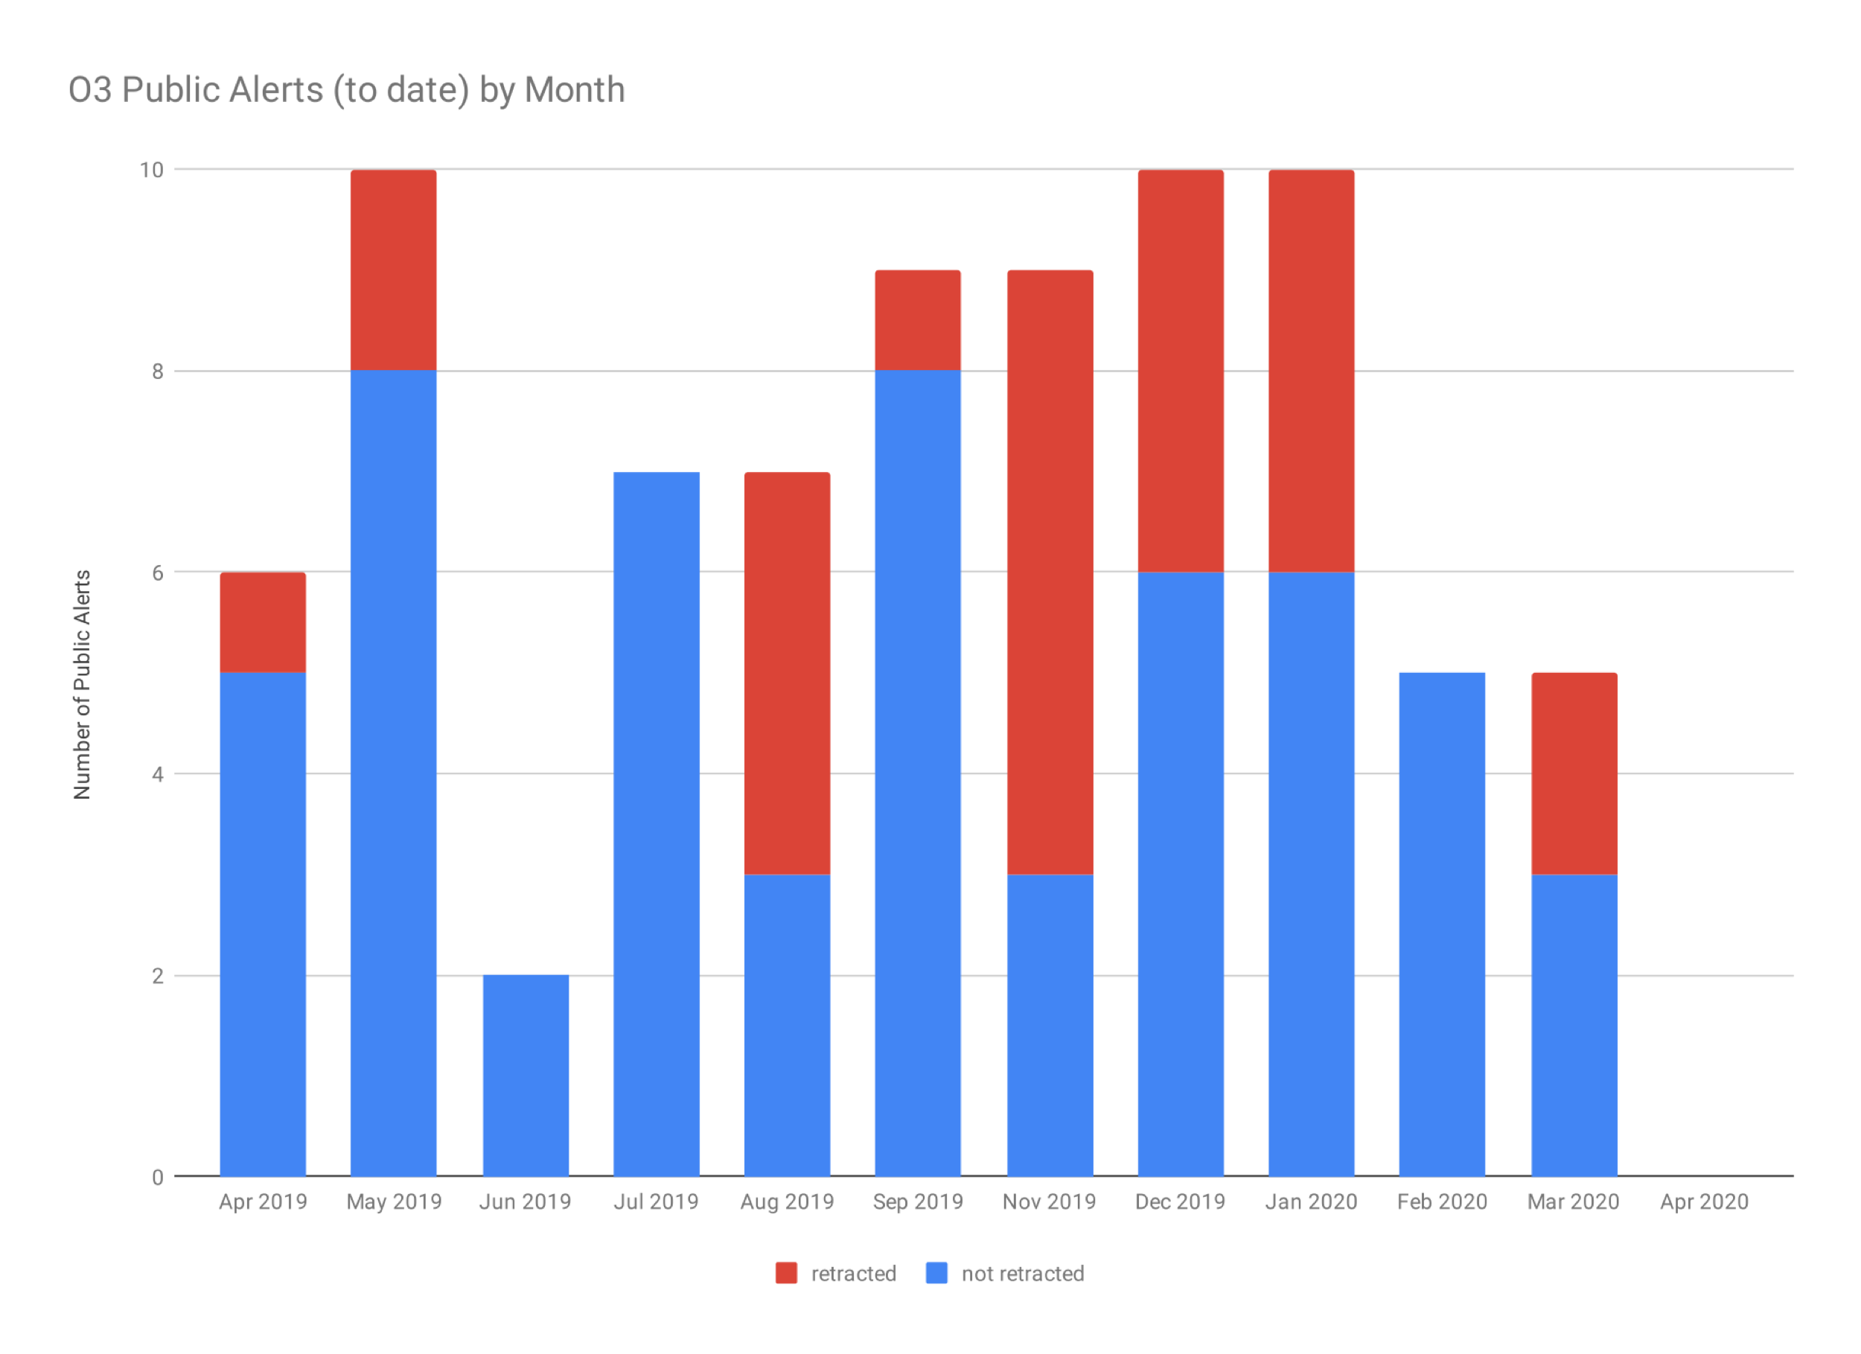
56 alerts that weren’t retracted in 11 months. 7 alerts including 2 retractions since the last OpenLVEM telecon on Feb/20/2020.
https://dcc.ligo.org/LIGO-G1901322/public

Slide 5
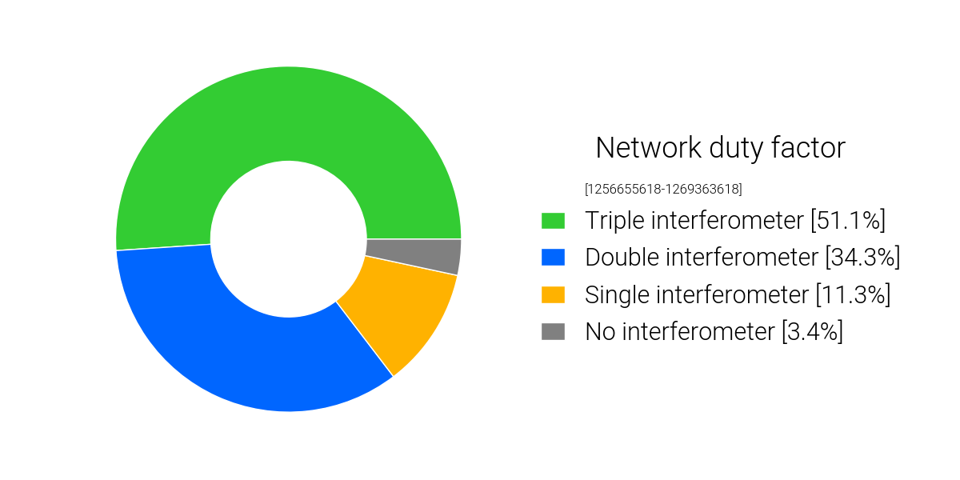
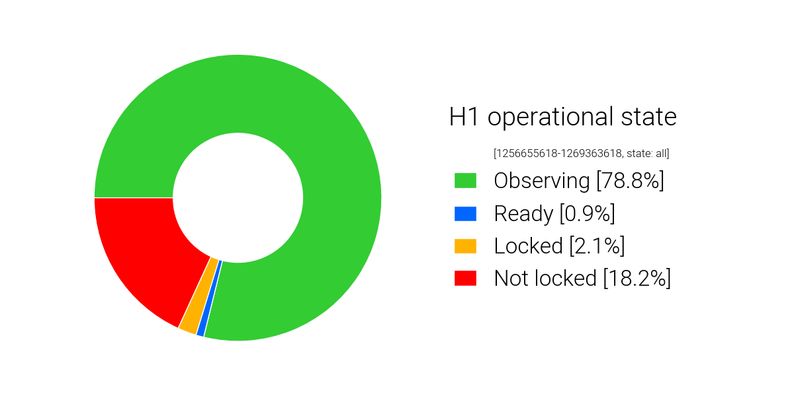
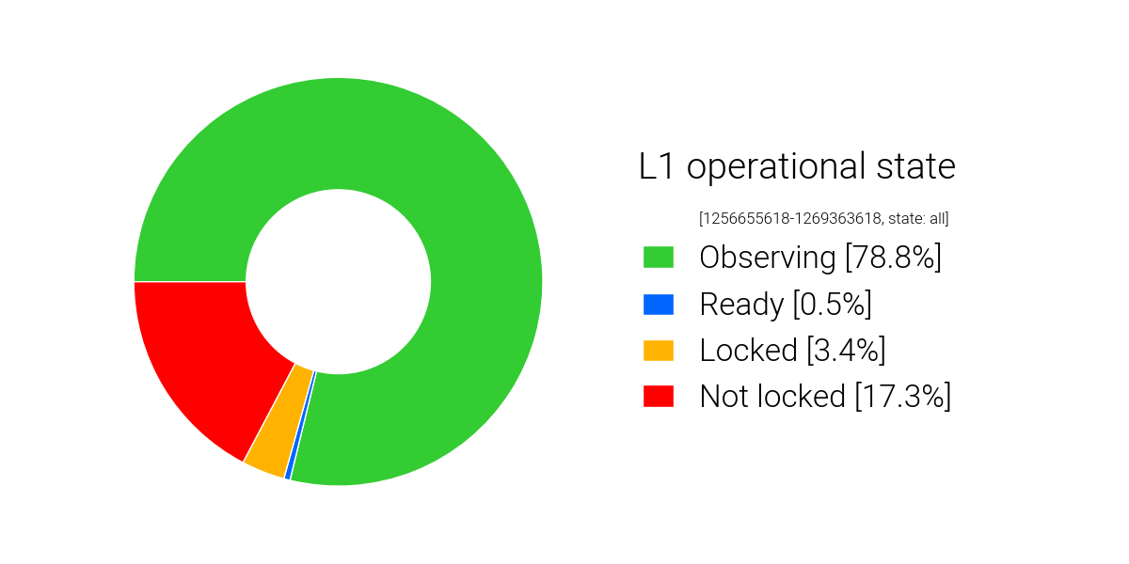
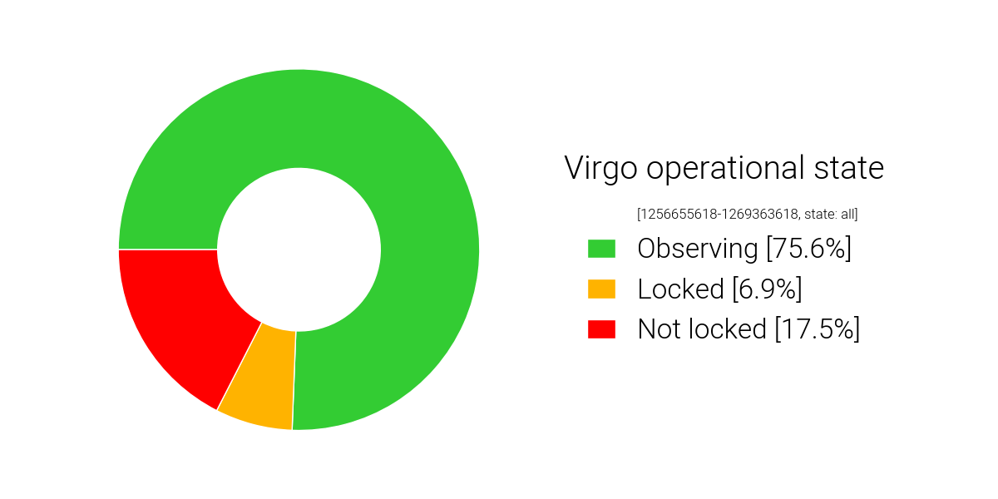
All in all, O3b was a substantial improvement over O3a.
51.1% Triple IFOs (VS 44.5% in O3a)
85.4% Double or Triple (VS 81.9%)
3.4% zero IFO (VS 3.2%)
(Downtime includes everything including but not limited to maintenance)
78.8% VS 71.2 in O3a
78.8% VS 75.8
75.6% VS 76.3

Slide 6
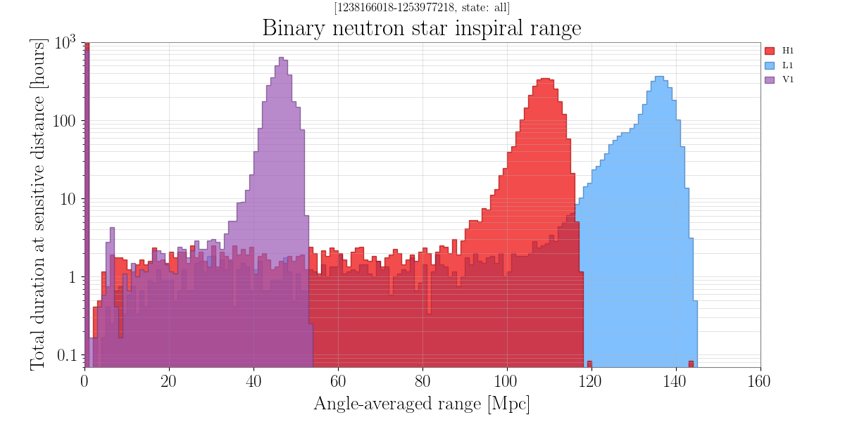
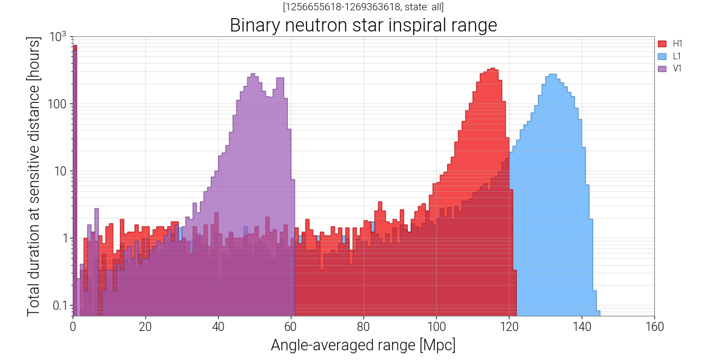
O3a
O3b

Slide 7
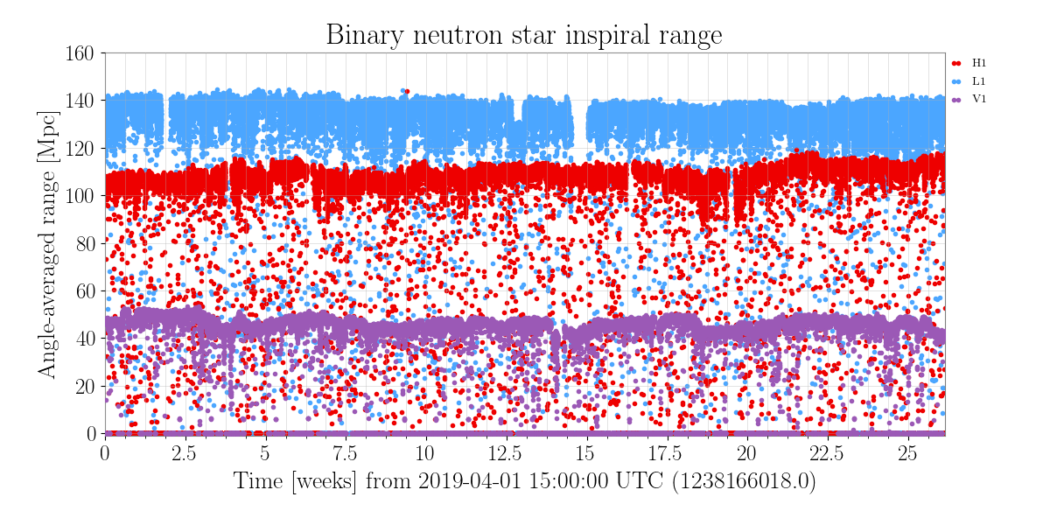
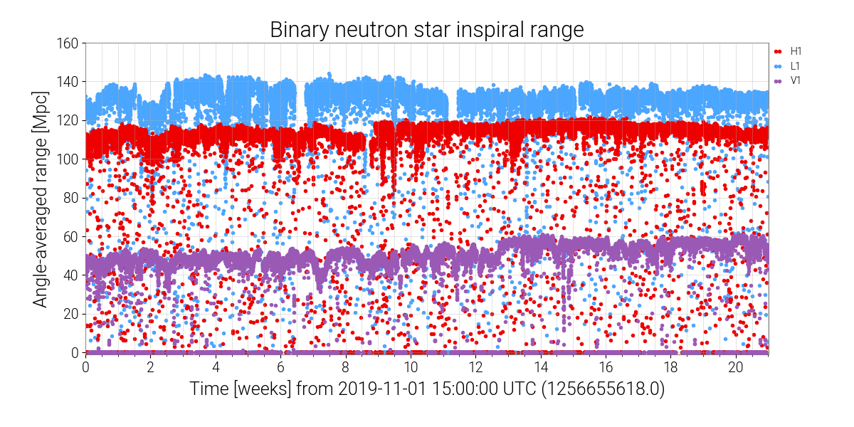
O3a
O3b

Slide 8
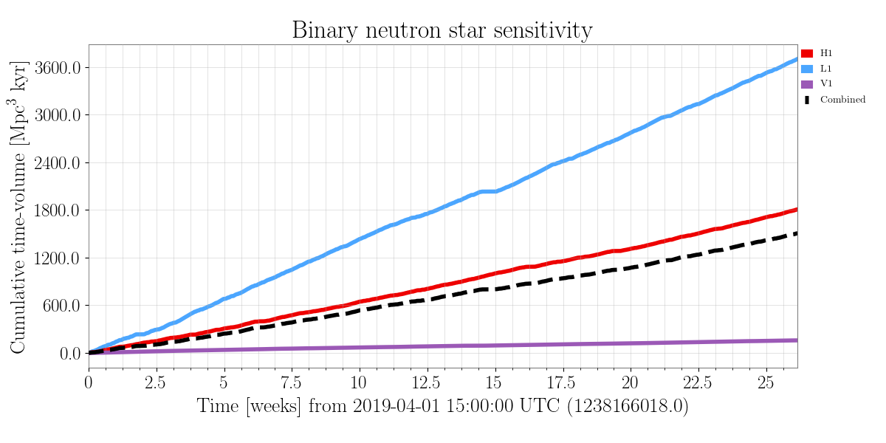
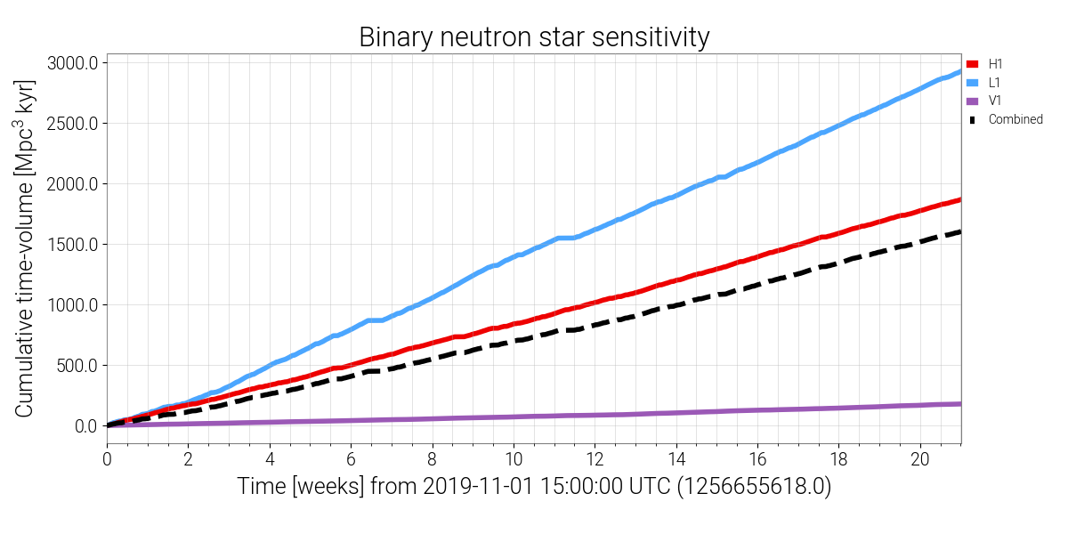
More BNS volume-time coverage in less than 5 months (148.08 days) than in 6 months (183 days) despite winter.
O3a
O3b

Slide 9
KAGRA
Conducted observation run Feb 25 – Mar 9 2020.
  BNS range ~700kpc.
Commissioning break started on Mar 10, still ongoing.
  Mar/12 earthquake, ~1 week was spent for recovery.
  Best BNS range ~970kpc (!!), strongly dependent on alignment.
  Current focus is the stability of the instrument.
Unfortunately O3 was suspended but KAGRA plans to conduct another round of observation from Apr. 7 2020 for ~2 weeks.

Slide 10
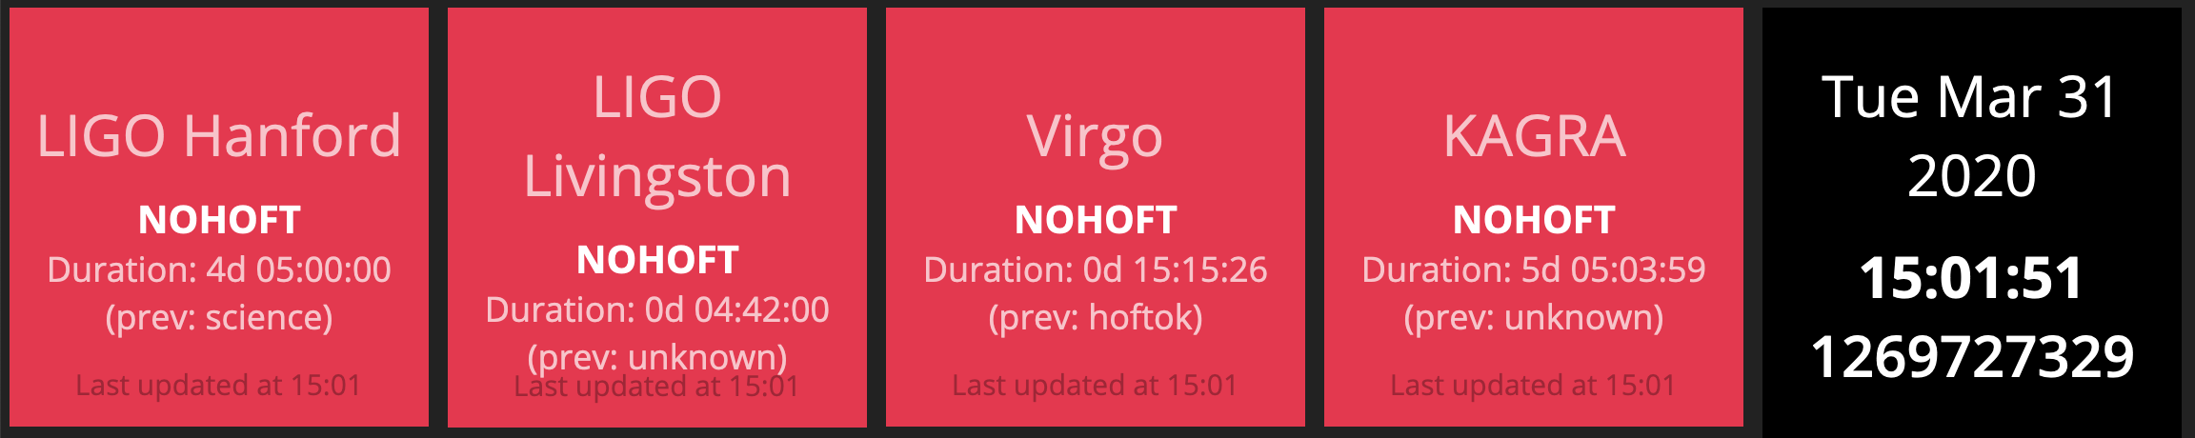
Thank you very much for being with us for a very productive 12 months.
O3c or O4, we don’t know which and when, but one way or the other we’ll come back online.
  We will keep you up to date with our plans.
Hopefully next time it will be a joint LIGO-Virgo-KAGRA observation.

Slide 11
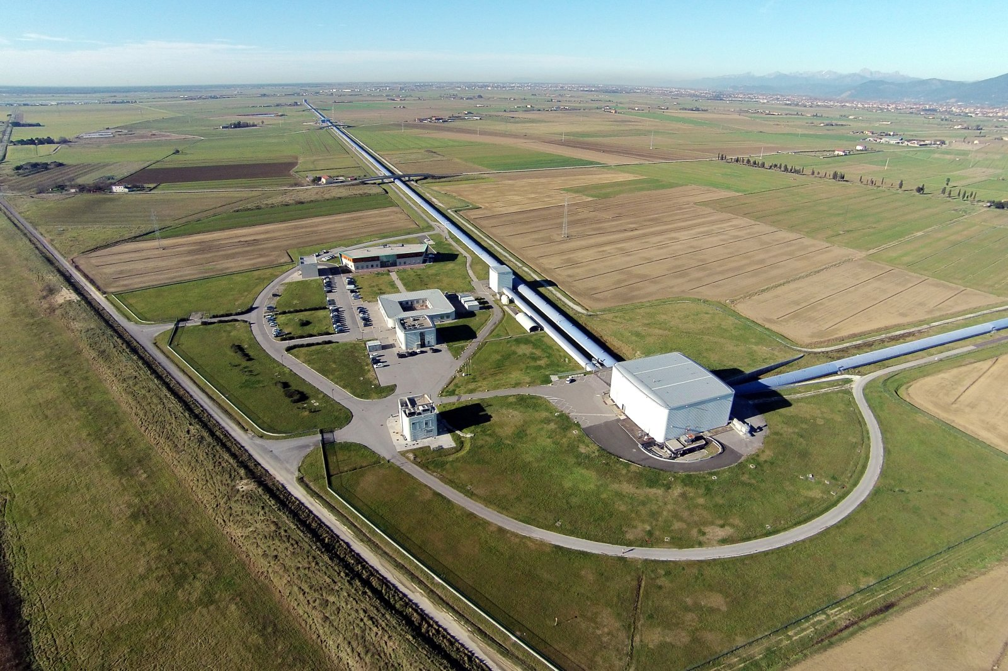
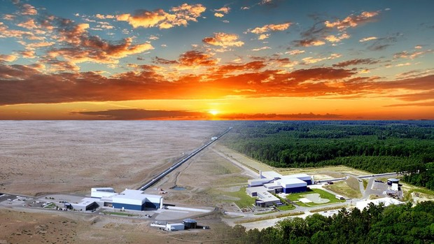
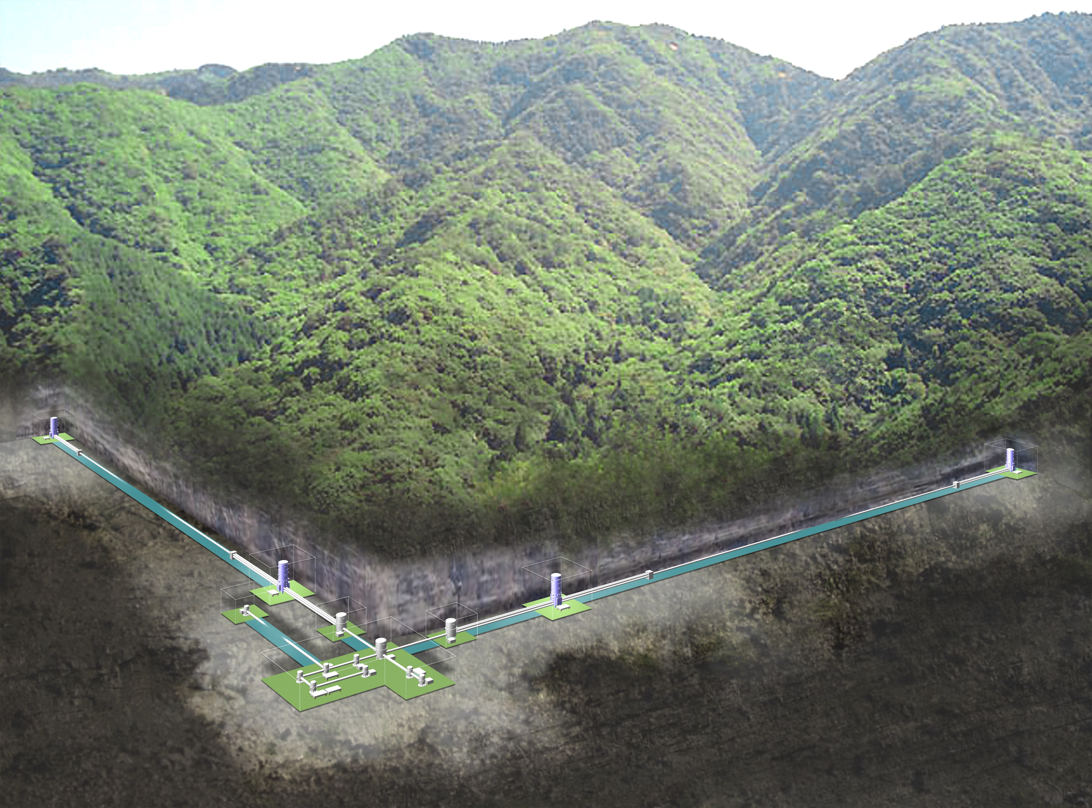
Stay safe everybody!
Virgo
LHO
LLO
KAGRA
Wind also means overabundance of tumbleweed at LHO.
Pitchforking etc. continues.
KAGRA OMC

