Slide 1
Cause and effect of point absorbers on test masses
Mirror
  Point absorption on mirror surface causes thermal distortion of the surface and substrate
  Many HOMs are induced on reflection
FP cavity
  aLIGO arm is close to resonance of TEMnm, n+m=7, and this mode is amplified in the cavity,
  HOM has long power tail and induces large RTL
  Mirror coating aberration reduces HOM, and reduces excess RTL by PA
aLIGO IFO, DRFPM
  Large RTL reduces PRG
  Curvature mismatch of fields
  from two arms reduces PRG
(A)
(A)
(B)
(B)
(C)
(C)
LG₃₁:29%
LG₀₀:48ppm

Slide 2
Mirror reflection induces all HOMs
FP cavity picks up 7th mode
Fig.1 Modes of induced fields
Fig.2 Modes of resonating field in FP

Slide 3
PRG = CC(sum of arm losses) one or two point absorbers (RoC unaffected)

Slide 4
Effect of the phasemap non-uniformity on the loss by the point absorber

Slide 5
Effects of clipping loss and effective RoC change
RoC change
Clipping effect

Slide 6
Phasemap vs
HOM&RTL in FP cavity
Reduction of loss due to 7th mode

Slide 7
Effect of fall off on PRG with ETM15
No fall off at the edge
As built with fall off
Double fall off at the edge

Slide 8
Test mass phasemaps reduces excess RTL by PA
50mW w/o map
50mW w/o map
X

Slide 9
Extra

Slide 10
Absorber location dependence first peak of LG(3,1) is at 2cm

Slide 11
PRG vs CD same sets as RTL vs PRG

Slide 12
PRG vs HOM same sets as RTL vs PRG

Slide 13
PRG vs 7th mode same sets as RTL vs PRG

Slide 14
RTL vs HG7 fraction same sets as RTL vs PRG

Slide 15
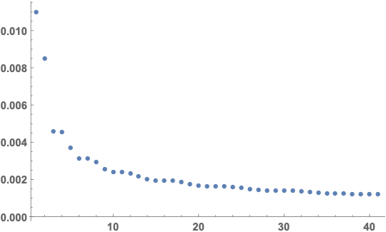
Effect of the difference of clipping losses on ITM and ETM
Power loss by clipping and conversion to other modes
Explicit calculation for LG00 input
Extra loss -
∑LG(n) power

Slide 16
dE = E-TEM00 on ITM&ETM
dRTL = RTL – RTL0, RTL0 = RTL(without map and absorber) = 48ppm
dEE
±3cm
one absorber 10mW
at x=2cm, y=0
No mirror maps
dRTL=10ppm
one absorber 10mW
at x=2cm, y=0
L1 x arm maps
dRTL= 17ppm
two absorbers 10mW
at 2cm & -2cm
L1 x arm maps
dRTL= 11ppm
dEI
±20cm

Slide 17
How 1W input is lost
BS→ITM→BS
PRM3→BS→ITMs
PRM2→PRM3→BS
reflection
PN
LN

