Slide 1
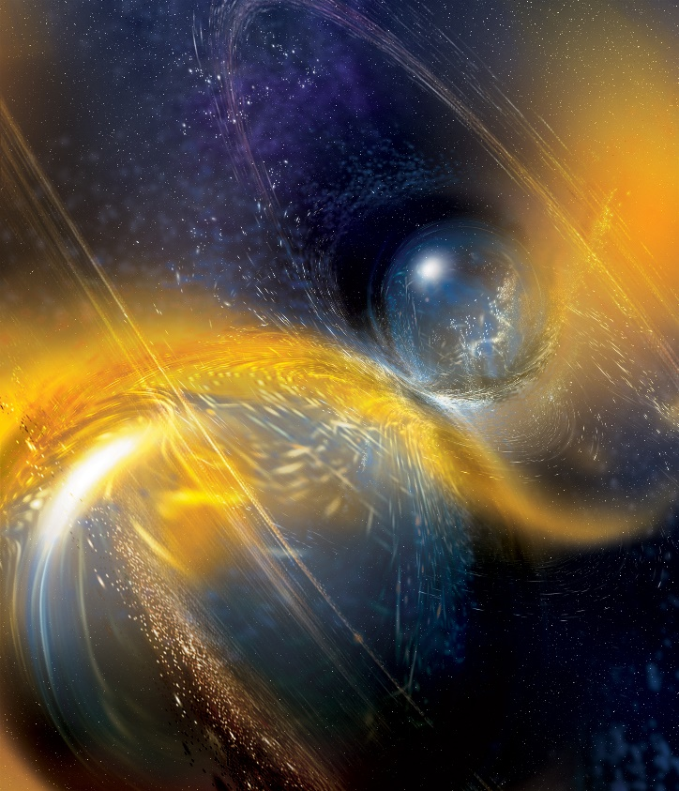

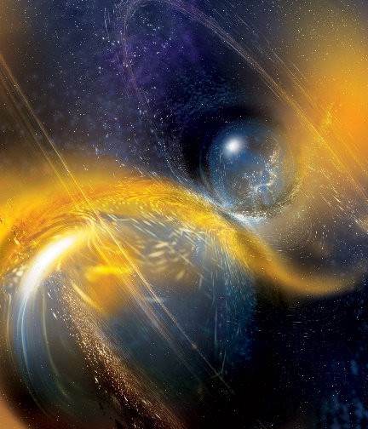







LIGO: The Current Observation Run and Future Upgrades
Daniel Sigg
LIGO Hanford
Observatory
California Institute
of Technology
February 2020
For the LIGO Scientific Collaboration and the Virgo Collaboration
LIGO-G2000229-v2
Credit: National Science Foundation/LIGO/Sonoma State University/A. Simonnet.

Slide 2



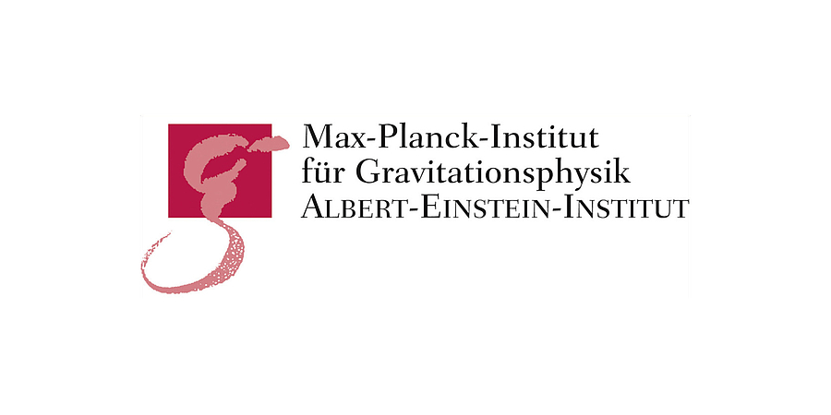



























































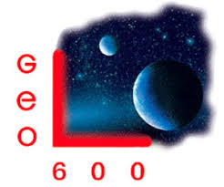


























































LIGO Scientific Collaboration
Albert-Einstein-Institut
American University
Andrews University
Bar-Ilan University
Bard College
Bellevue College
California Institute of Technology
California State Univ., Fullerton
California State Univ., Los Angeles
Carleton College
Chinese University of Hong Kong
Christopher Newport University
Colorado State University
Columbia U. in the City of New York
Concordia University, Wisconsin
Cornell University
Embry-Riddle Aeronautical Univ.
Eötvös Loránd University
Georgia Institute of Technology
Goddard Space Flight Center
GW-INPE, Sao Jose Brasil
Haverford College
Hillsdale College
Hobart & William Smith Colleges
IAP – Nizhny Novogorod
IIP-UFRN
Kenyon College
Louisiana State University
Maastricht University
Marquette University
Marshall Space Flight Center
Missouri University of Science
& Technology
Montana State University
Montclair State University
Moscow State University
National Tsing Hua University
NCSARG – Univ. of Illinois,
Urbana-Champaign
Northwestern University
Penn State University
Rochester Institute of Technology
Sonoma State University
Southern University
Stanford University
Stony Brook / CCA
Syracuse University
Texas Tech University
Tsinghua University
U. Montreal / Polytechnique
University of Arizona
University of Brussels
University of California, Berkeley
University of Chicago
University of Florida
University of Maryland
University of Michigan
University of Minnesota
University of Oregon
University of Rhode Island
University of Sannio
University of Santiago de Compostela
University of Szeged
University of Texas at Austin
University of Texas Rio Grande Valley
University of the Balearic Islands
University of Tokyo
University of Utah
University of Washington
University of Washington Bothell
University of Wisconsin – Milwaukee
USC – Information Sciences Institute
Villanova University
West Virginia University
LIGO Laboratory: California Institute of Technology; Massachusetts Institute of Technology; LIGO Hanford Observatory; LIGO Livingston Observatory
ARC Centre of Excellence For Gravitational Wave Discovery (OzGrav):
Australian National University; Charles Sturt University; Monash University; Swinburne University of Technology; University of Adelaide; The University of Melbourne; University of Western Australia
German/British Collaboration for the Detection of Gravitational Waves (GEO600):
Albert-Einstein-Institut, Hannover; Cardiff University; King's College, University of London; Lancaster University, Leibniz Universität, Hannover; Rutherford Appleton Laboratory; University of Birmingham; University of Cambridge;
University of Glasgow; University of Hamburg; University of Portsmouth; The University of Sheffield; University of Southampton; University of Strathclyde; University of the West of Scotland; University of Zurich
Korean Gravitational Wave Group (KGWG)
Ewha Womans University; Hanyang University; Inje University; Korea Astronomy and Space Science Institute; Korea Institute of Science and Technology Information;
National Institute for Mathematical Sciences; Pusan National University; Seoul National University; Ulsan National Institute of Science and Technology
LIGO India Scientific Collaboration (LISC)
Chennai Mathematical Institute; DCSEM, Mumbai; IISER-Kolkata; IISER-Pune; IIT-Bombay; IIT-Gandhinagar; IIT-Hyderabad; IIT-Madras; IPR-Gandhinagar; ICTS-TIFR, Bengaluru; IUCAA, Pune; RRCAT, Indore; TIFR, Mumbai

Slide 3
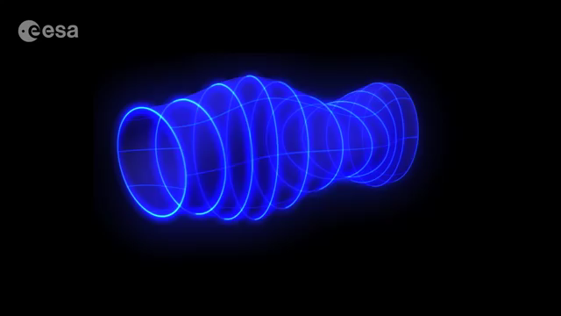
Direction of wave travel

Slide 4




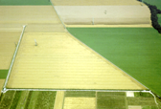




GEO-HF
LIGO Hanford
600 m
4 km
3 km
3 km
4 km
The Growing Network
4 km
LIGO Livingston
Virgo
3 separate collaborations working together

Slide 5
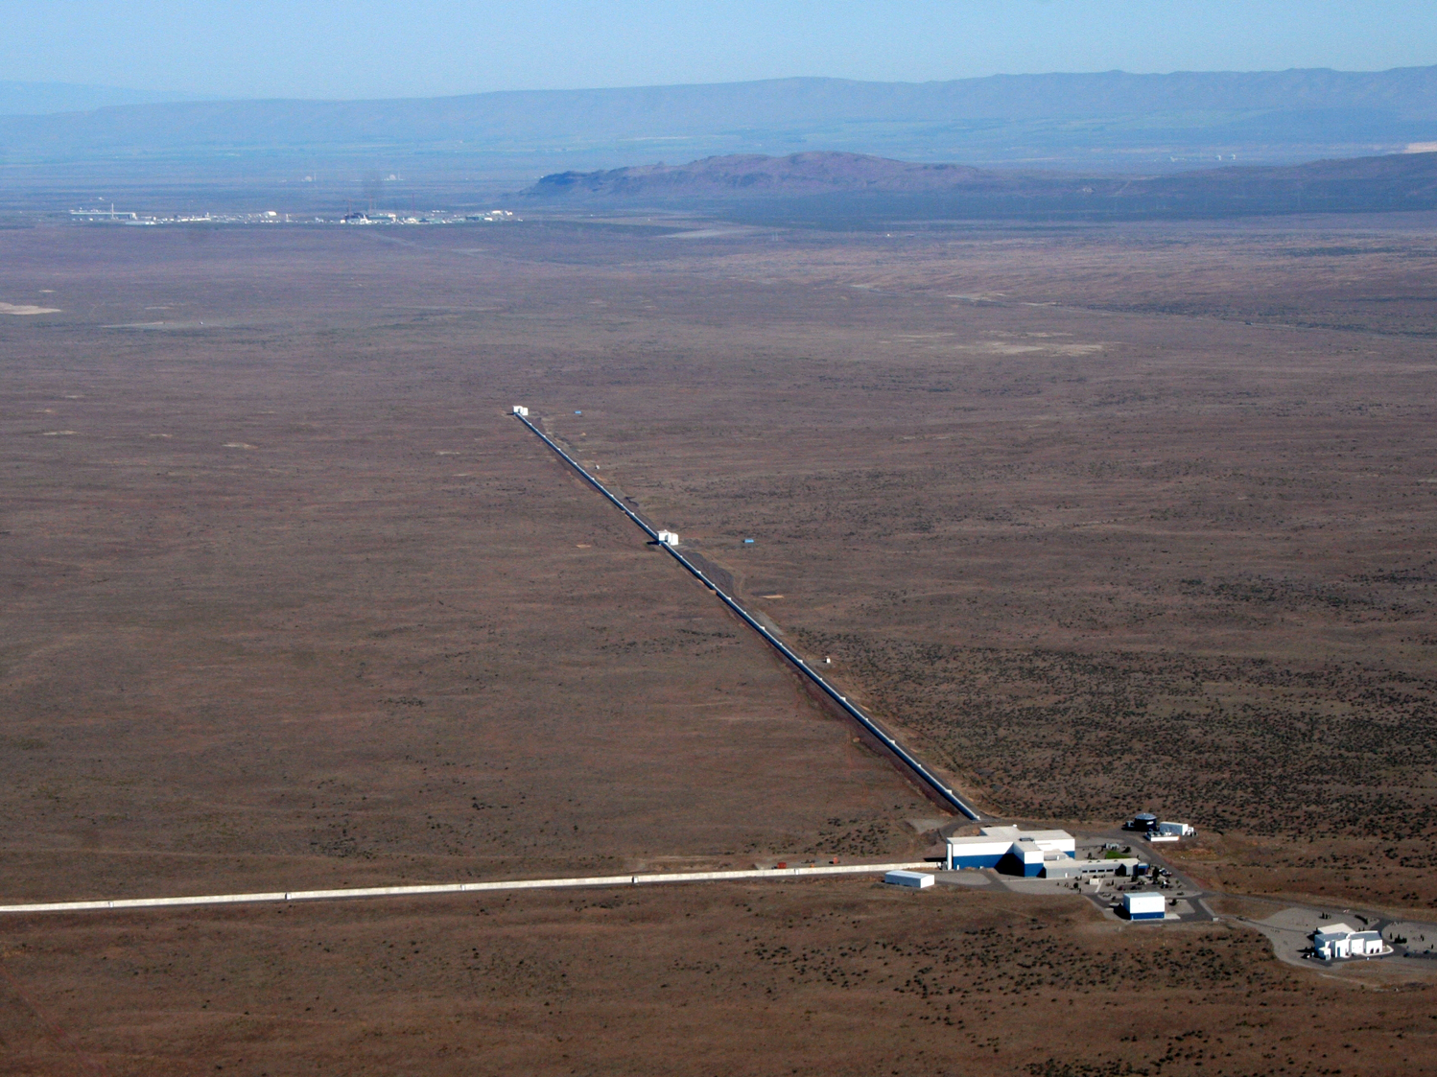
Hanford Observatory

Slide 6
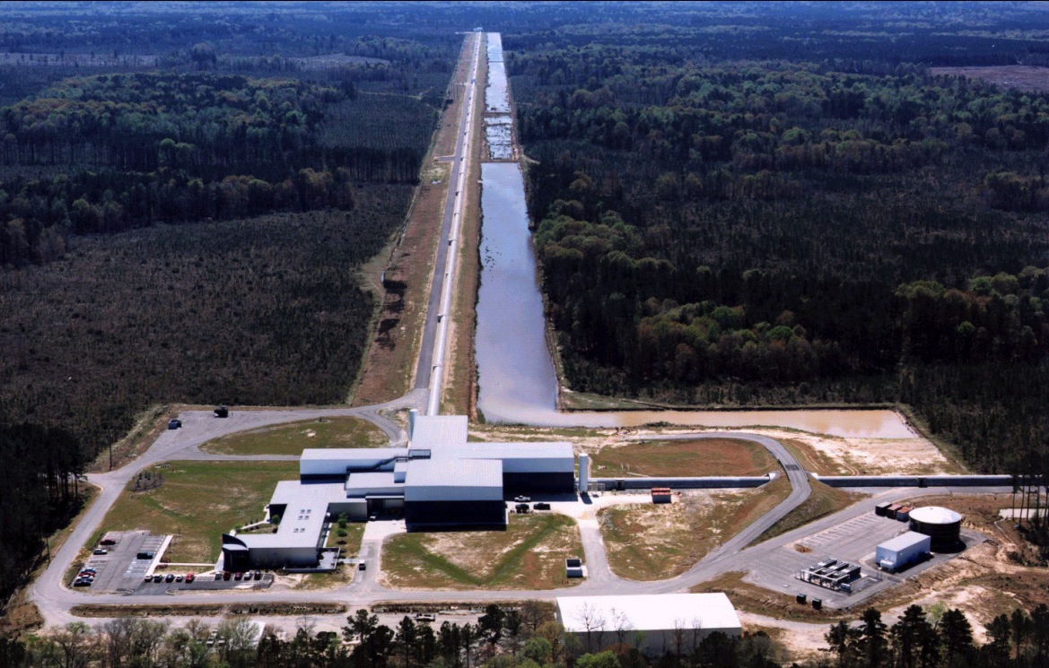
Livingston Observatory

Slide 7
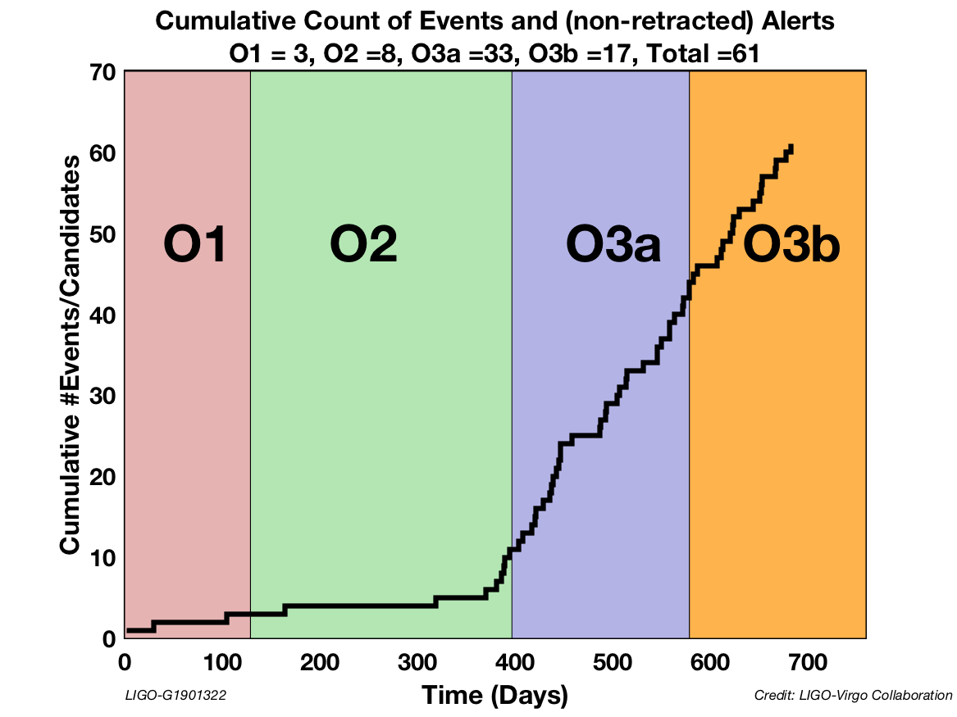
Events: 61 / O3: 50
Sharp increase of event rate in O3 due to sensitivity improvements
gracedb.ligo.org
Events / Public Alerts
Initial
LIGO
O1 / O2
O3

Slide 8
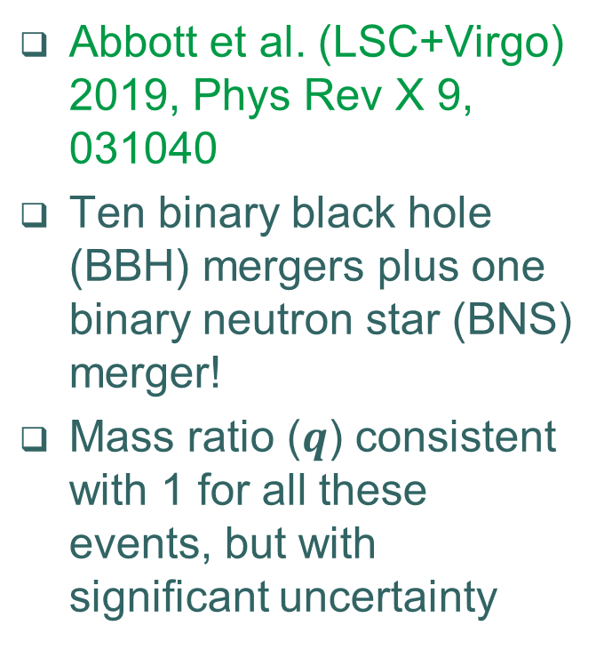
Events confidently detected in O1+O2: the GWTC-1 catalog
Abbott et al. (LSC+Virgo) 2019, Phys Rev X 9, 031040
Ten binary black hole (BBH) mergers plus one binary neutron star (BNS) merger!
Mass ratio ($q$) consistent with 1 for all these events, but with significant uncertainty

Slide 9
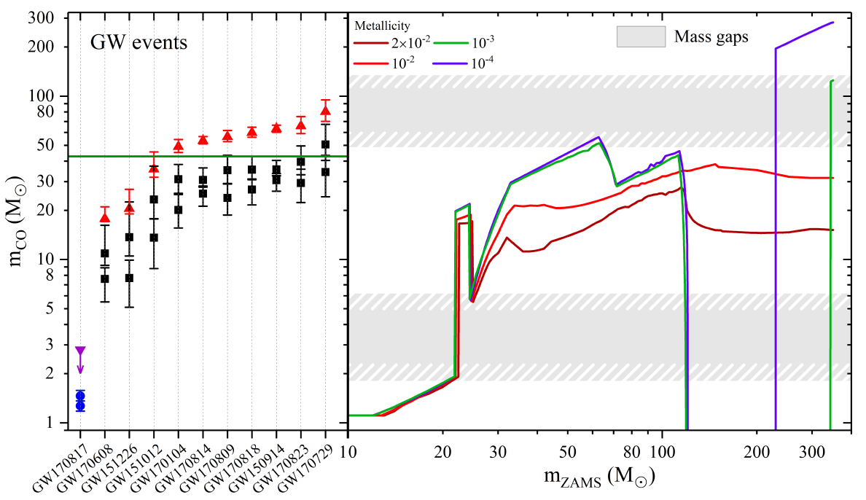

Slide 10
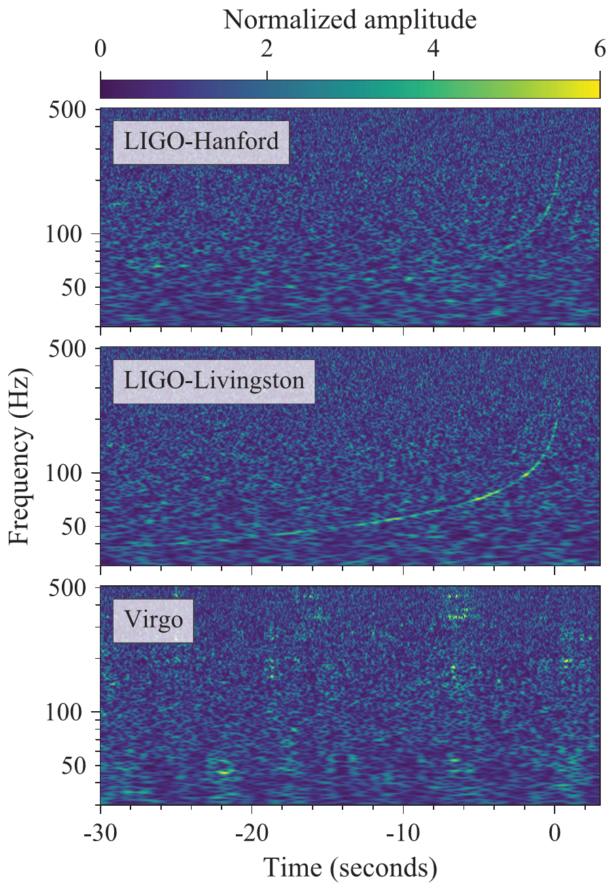

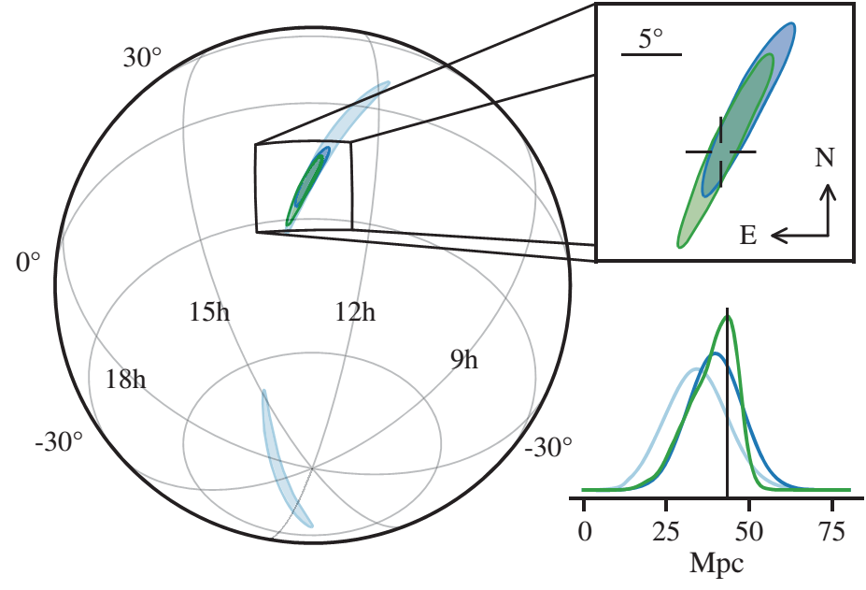
Binary Neutron Star Merger
  Initially found using a template with typical neutron star masses
  And coincident (within ~2 sec) with a
  short GRB!
Visible in LIGO spectrograms!
We localized it pretty well in the sky
  Initially to an area of ~31 deg,
  ultimately to ~16 deg²
GW170817
[Abbott et al. 2017, PRL 119, 161101]

Slide 11
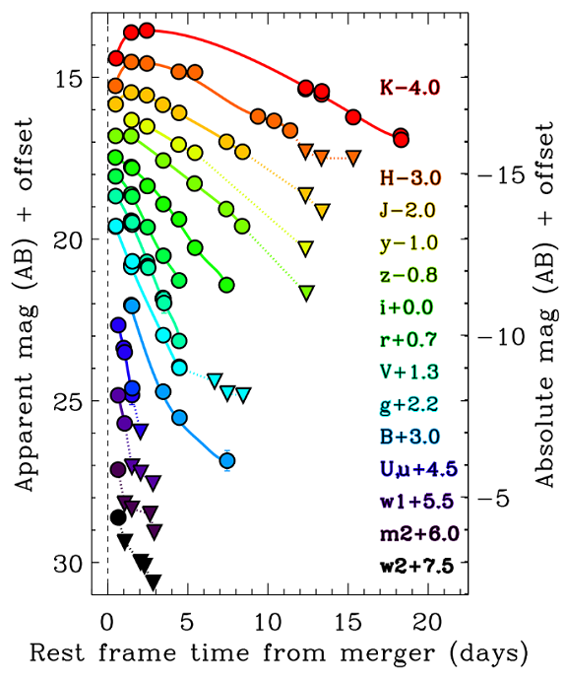
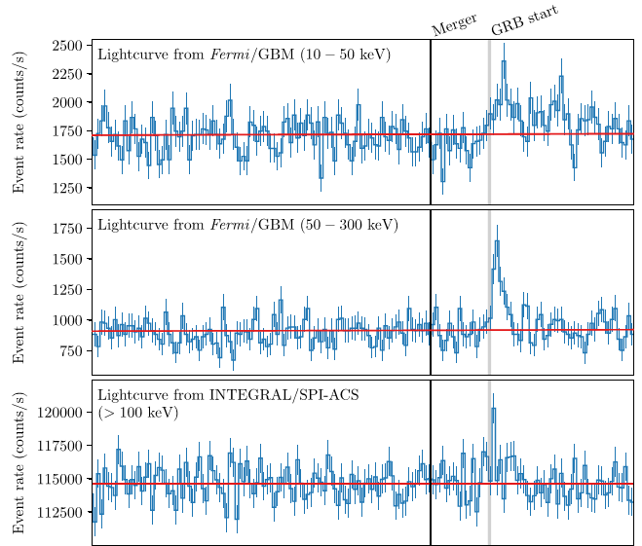

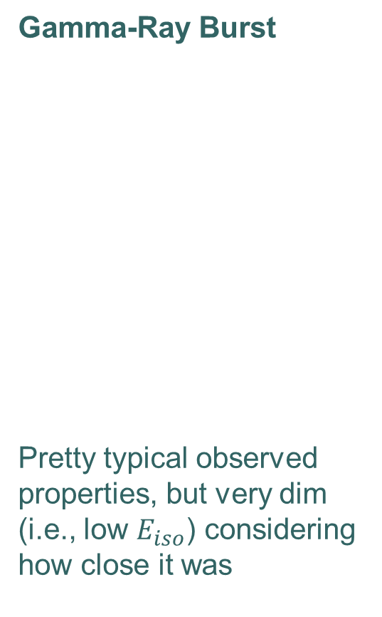
GRB 170817A / AT2017gfo Electromagnetic Signatures
Gamma-Ray Burst
Pretty typical observed properties, but very dim (i.e., low $E_{iso}$) considering how close it was
Kilonova
Thermal emission from ejected material,
heated by decay of r-process elements formed in event
[Price/Rosswog/Press]
[LSC, Fermi-GBM and INTEGRAL 2017, ApJL 848, L13]
[Drout et al. 2017, Science 10.1126/science.aaq0049]

Slide 12
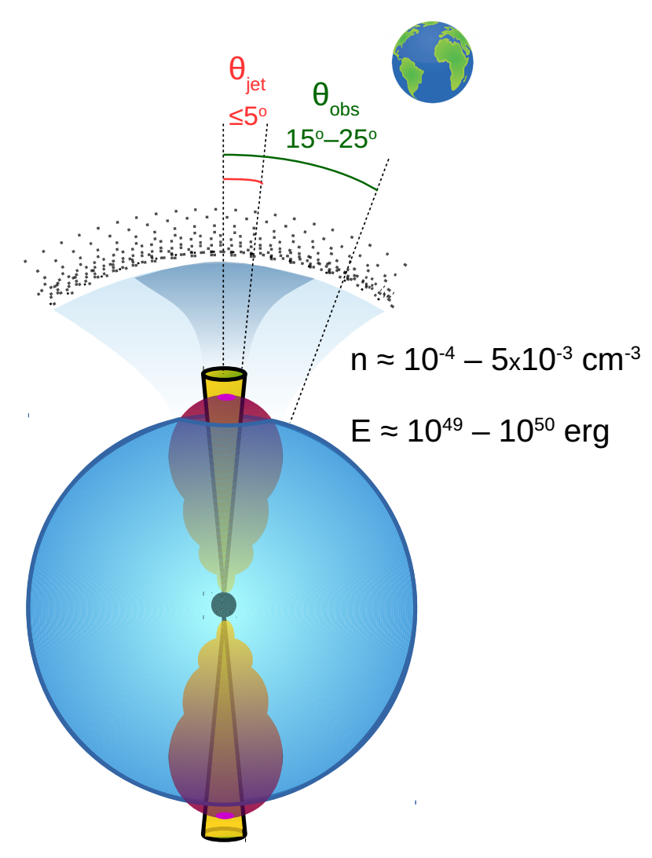
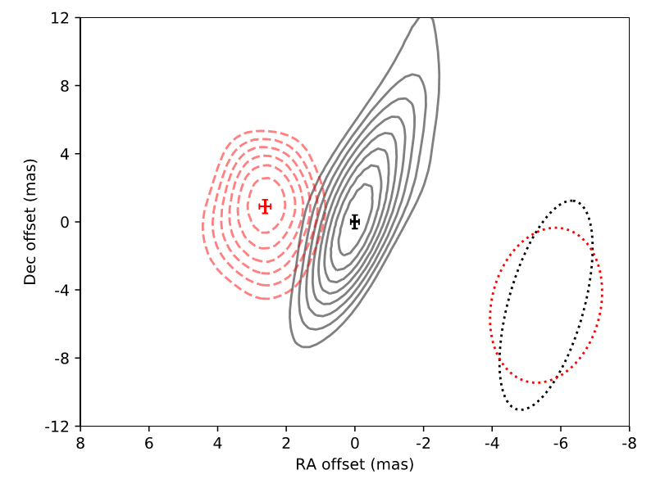
GRB 170817A / AT2017gfo Electromagnetic Signatures
[Troja et al. 2019, MNRAS 489, 1919]
X-ray and radio signals appeared after several days, then brightened for months before fading!
Very-high-resolution radio imaging of the remnant saw the expanding jet!
[Mooley et al., arXiv:1806.09693]
  From 75 to 230 days after merger,
  position shifted ~2.7 milli-arcseconds
Afterglow
Consistent with a relativistic jet viewed ~20 degrees off-axis

Slide 13
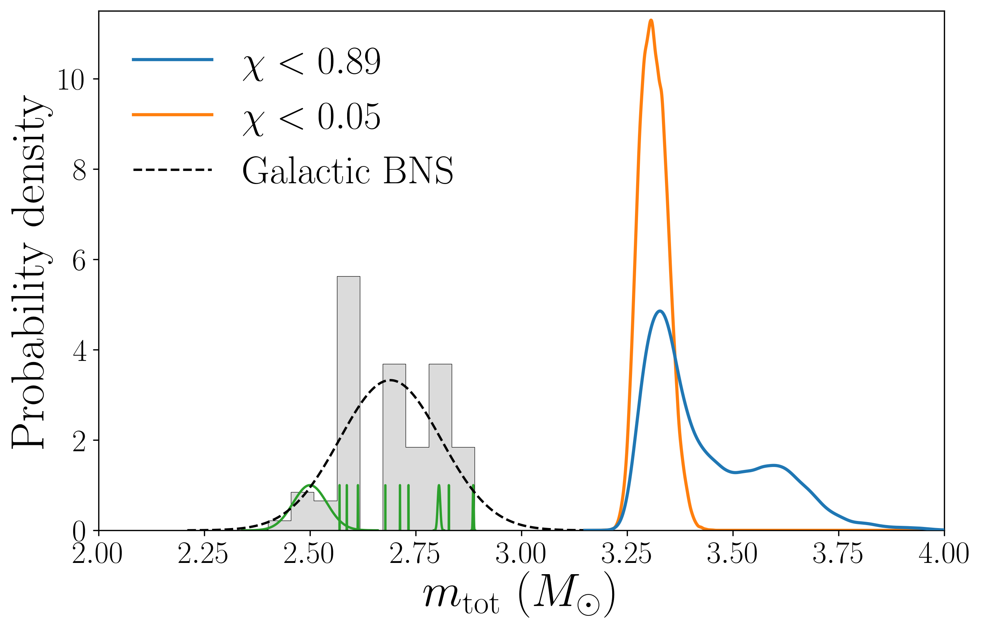
First published
O3 event
2nd Binary Neutron Star Merger
Distinguished
from galactic
distribution
Overall heavier
No EM counterpart
observed
Black hole?
arXiv:2001.01761
GW190425

Slide 14
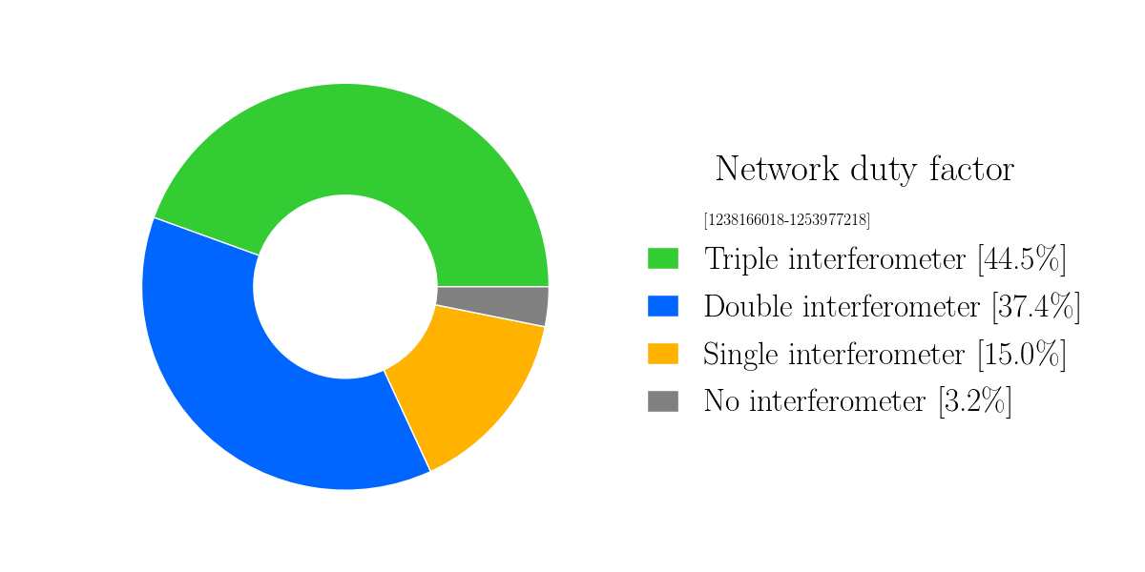
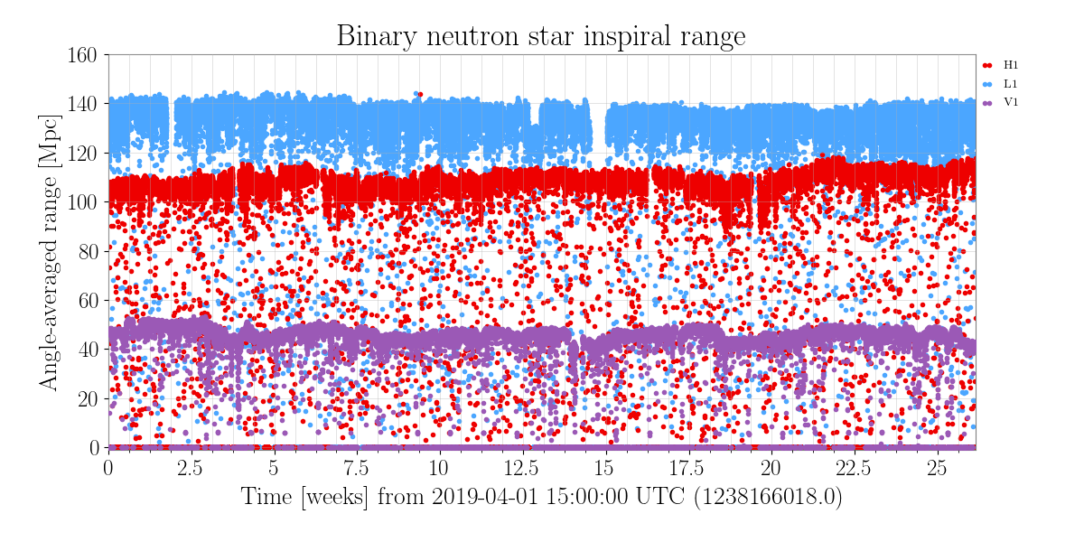
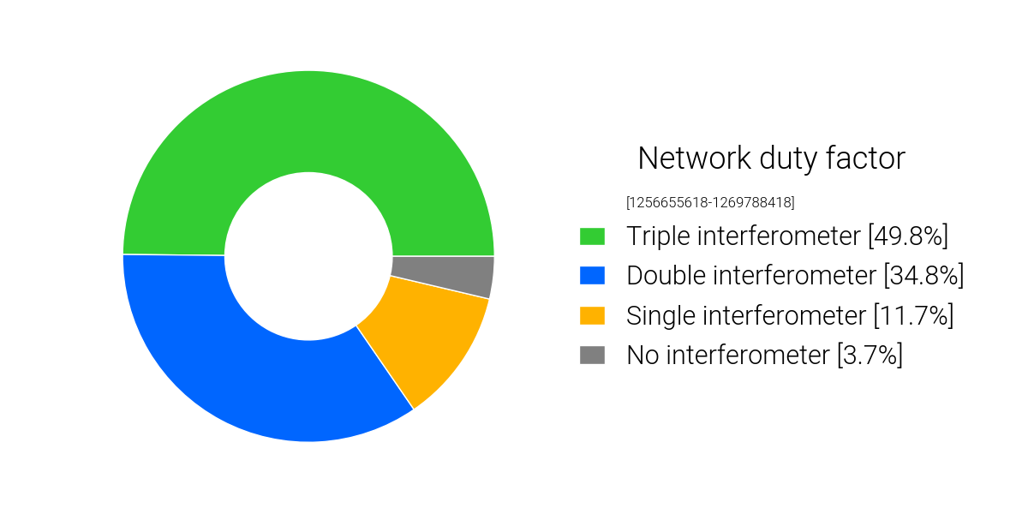
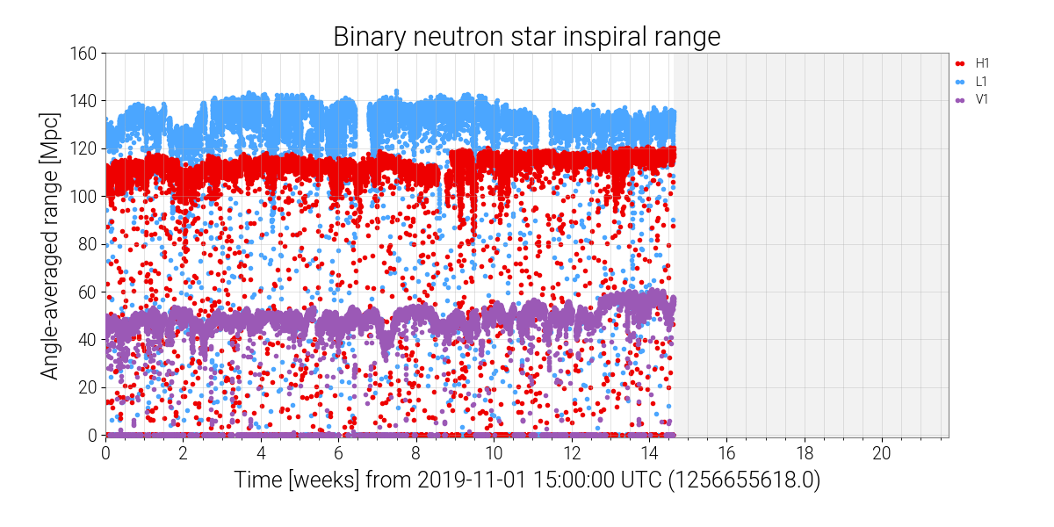
O3a
O3b

Slide 15
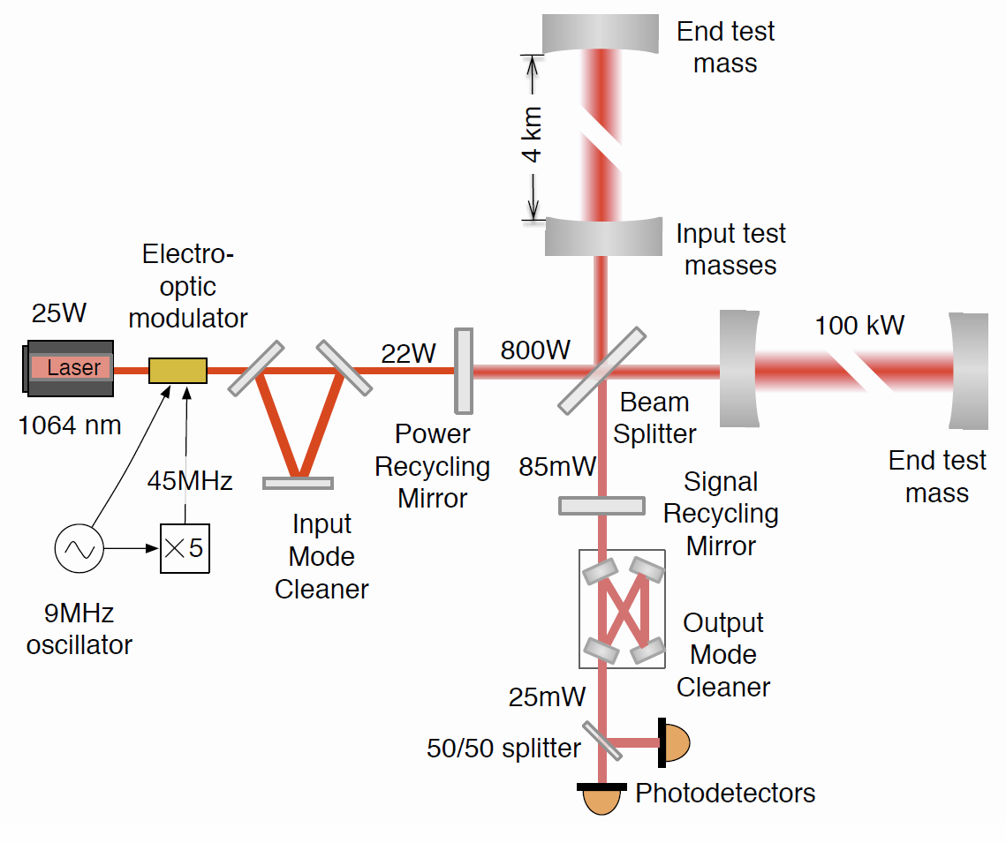

Slide 16
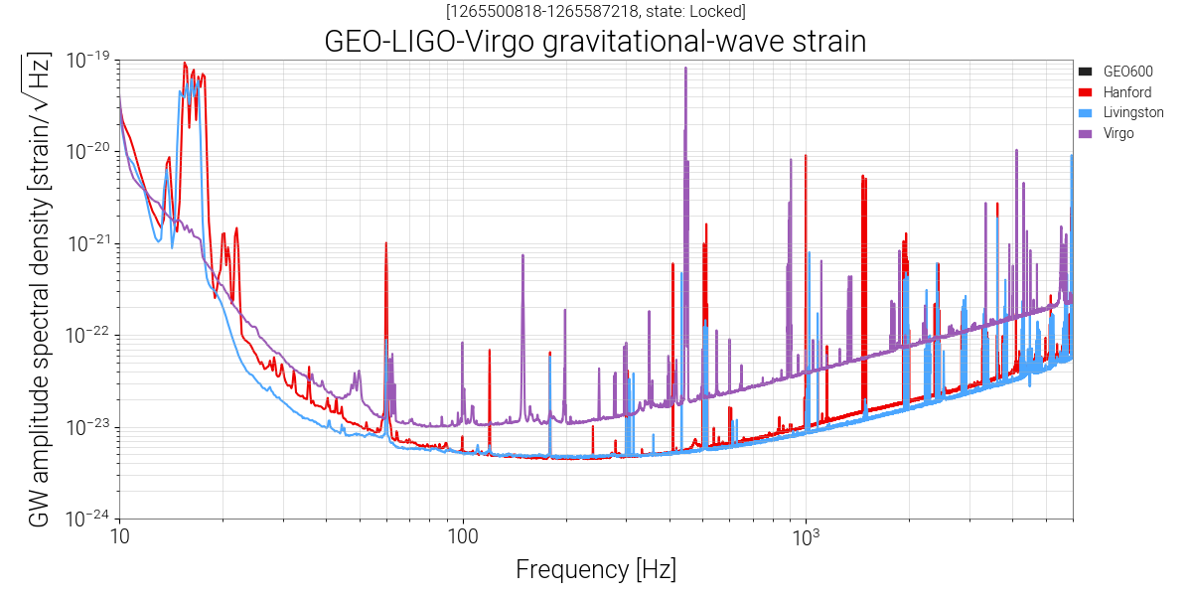
All detectors are running with a squeezed light source
Radiation Pressure
Shot Noise
Thermal Noise

Slide 17
The A+ Upgrade
Goal:
  Projected inspiral range: 325 Mpc (almost doubling of Advanced LIGO design)
First stage: May 2020 to end of 2021
  Add frequency depended squeezing to suppress both shot and radiation pressure noise
  300 m filter cavity to rotate squeezer phase
  Low loss Faraday isolator
  Active wavefront control to improve mode matching
Second state: after O4
  New mirror coatings with 4 times lower thermal noise (2x improvement in displacement)
  Add a balanced homodyne detector to improve sensing and reduce noise couplings
  Larger beamsplitter to reduce losses

Slide 18
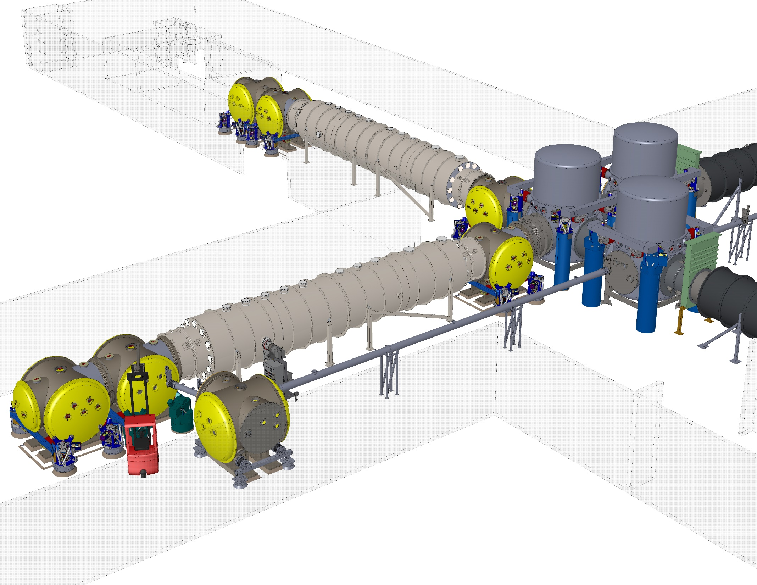
Large beamsplitter
Balanced
homodyne
detector
Low loss
Faraday isolator
A+ Layout
New test mass
coatings
Filter cavity beam tube
Squeezed light source
Active mode matching

Slide 19
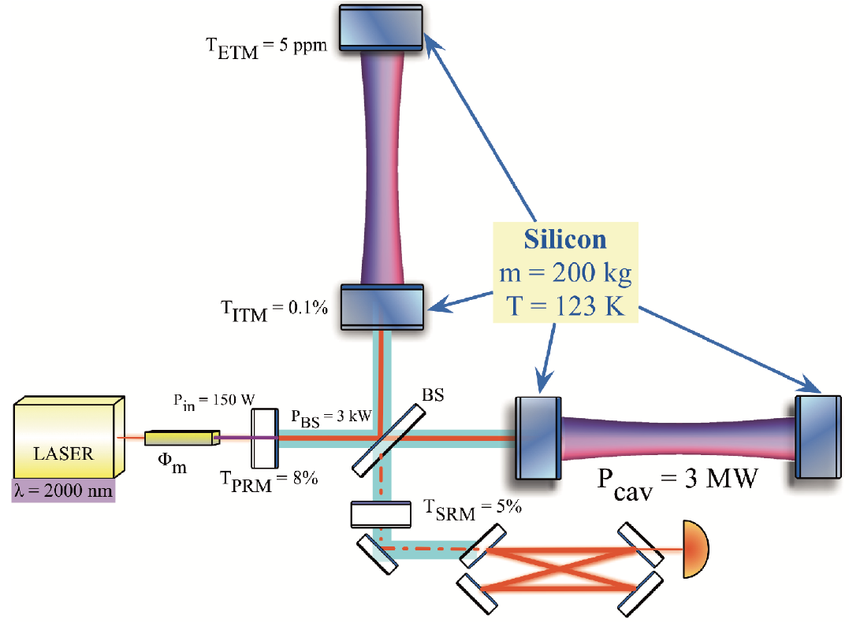
Ultimate detector in current facilities
New Technology!
Silicon test masses
Cryogenic 123K
2µm laser
}
α(t)=0
Voyager

Slide 20
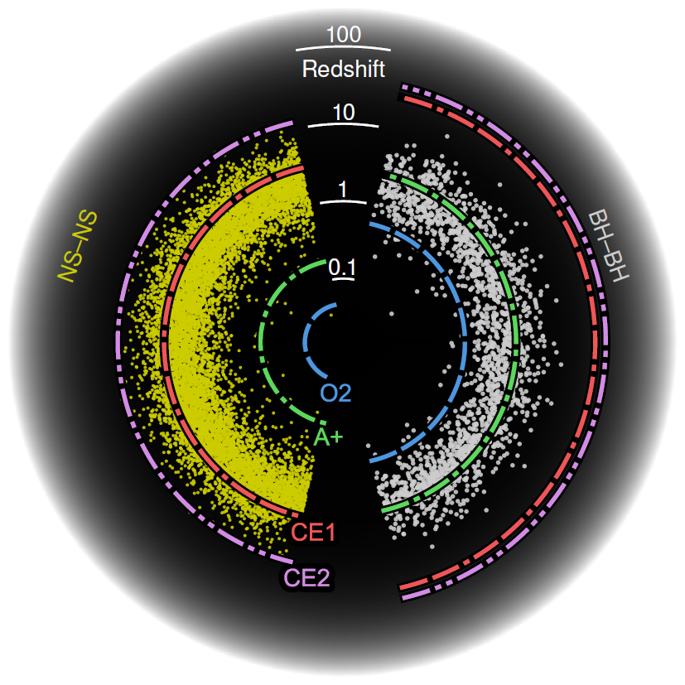
Einstein Telescope
10 km triangular shape
Underground
Xylophone
Cryogenic
Cosmic Explorer
40 km L-shape
Above ground
CE1: Fused silica,
room temperature
CE2: Silicon @ 120K
Need a network of 3+ detectors for triangulation/source direction
O(100 000) events per year
3rd Generation Detectors
Credit: Evan Hall

Slide 21
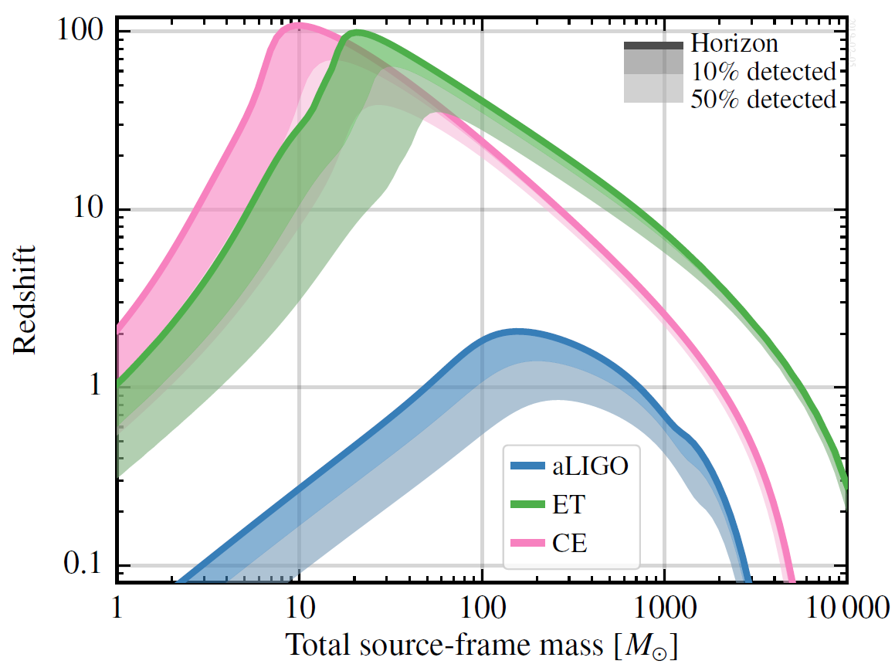
Enormously increase the number of compact binary mergers detected
Provide samples of “loud” signals measured with very high fidelity
Greatly improve tests of cosmology and fundamental physics
Trace the cosmic evolution
of compact binary mergers, inferring their origins and evolution
Search more deeply for signals other than binary mergers —
such as spinning neutron stars,
core-collapse supernovae, and the stochastic GW background
PBH?
First Stars Formed
High SNR Signals!
3rd Generation Detectors
BNS
BBH
Credit: Evan Hall

Slide 22
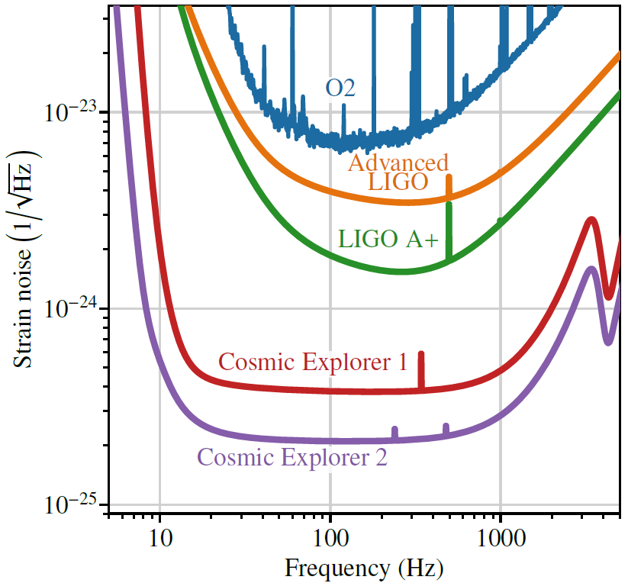
Determining the Nature of the Densest Matter in the Universe
Quark matter, equation of state, strange quark stars, radius vs. mass
Magnetic fields, pulsar glitches
Multi-messenger Observations of Binary Systems
Dynamics of the collision, Jet formation
Heavy element production
Localize sources prior to merger!
Seeing Black Holes Merge throughout
Cosmic Time
First stars, star formation rate,
galaxy evolution
Probing the Evolution of the Universe
Expansion of the Universe,
Hubble constant, dark energy density
Key Science Goals

Slide 23
Exploring the Nature of Gravity and Compact Objects
High-fidelity observations, GR tests
Multi-band: Observation with LISA
Rare objects: high spin, neutron star/IMBH, black hole with matter, etc.
The Life and Death of Massive Stars
Evolution of massive stars throughout cosmic history
Core collapse/ magnetar glitches in the Milky Way or Magellanic Clouds
Sources at the Frontier of Observations
Potential for discoveries beyond neutron stars and black holes
Dark and exotic matter including axionic and other dark matter fields around black holes or in the cores of neutron stars,
Mergers of primordial black holes formed in the early Universe
Gravitational-wave emission from cosmic (super)strings.
Key Science Goals
https://gwic.ligo.org/3Gsubcomm/

Slide 24
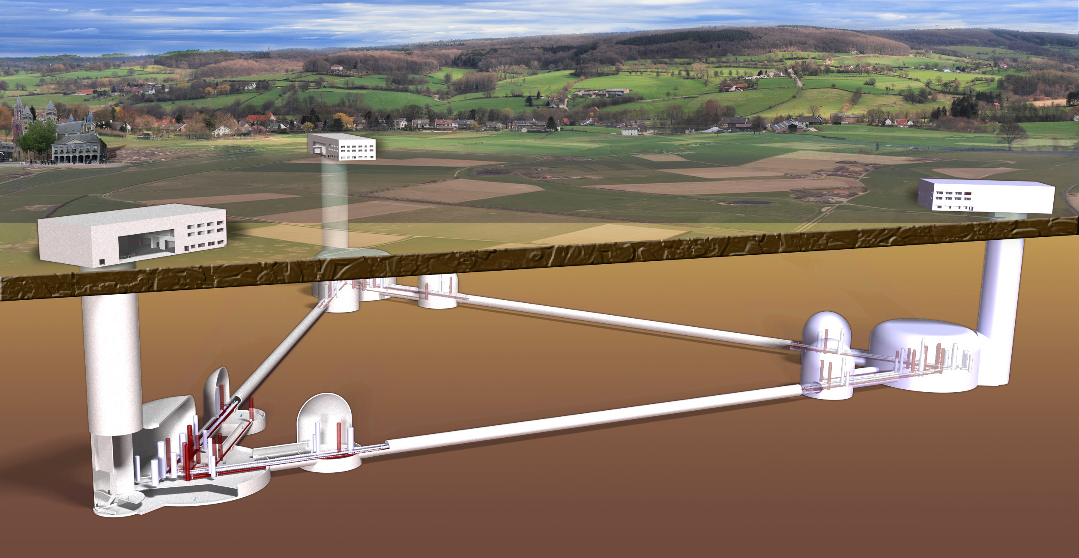
Einstein Telescope

Slide 25
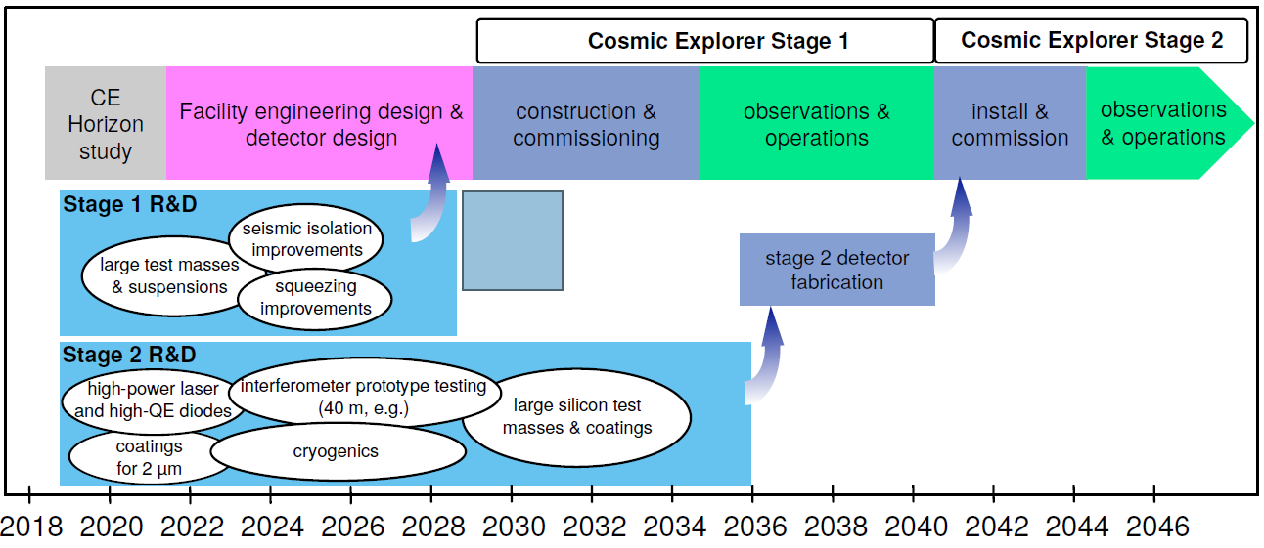
Cosmic Explorer

Slide 26
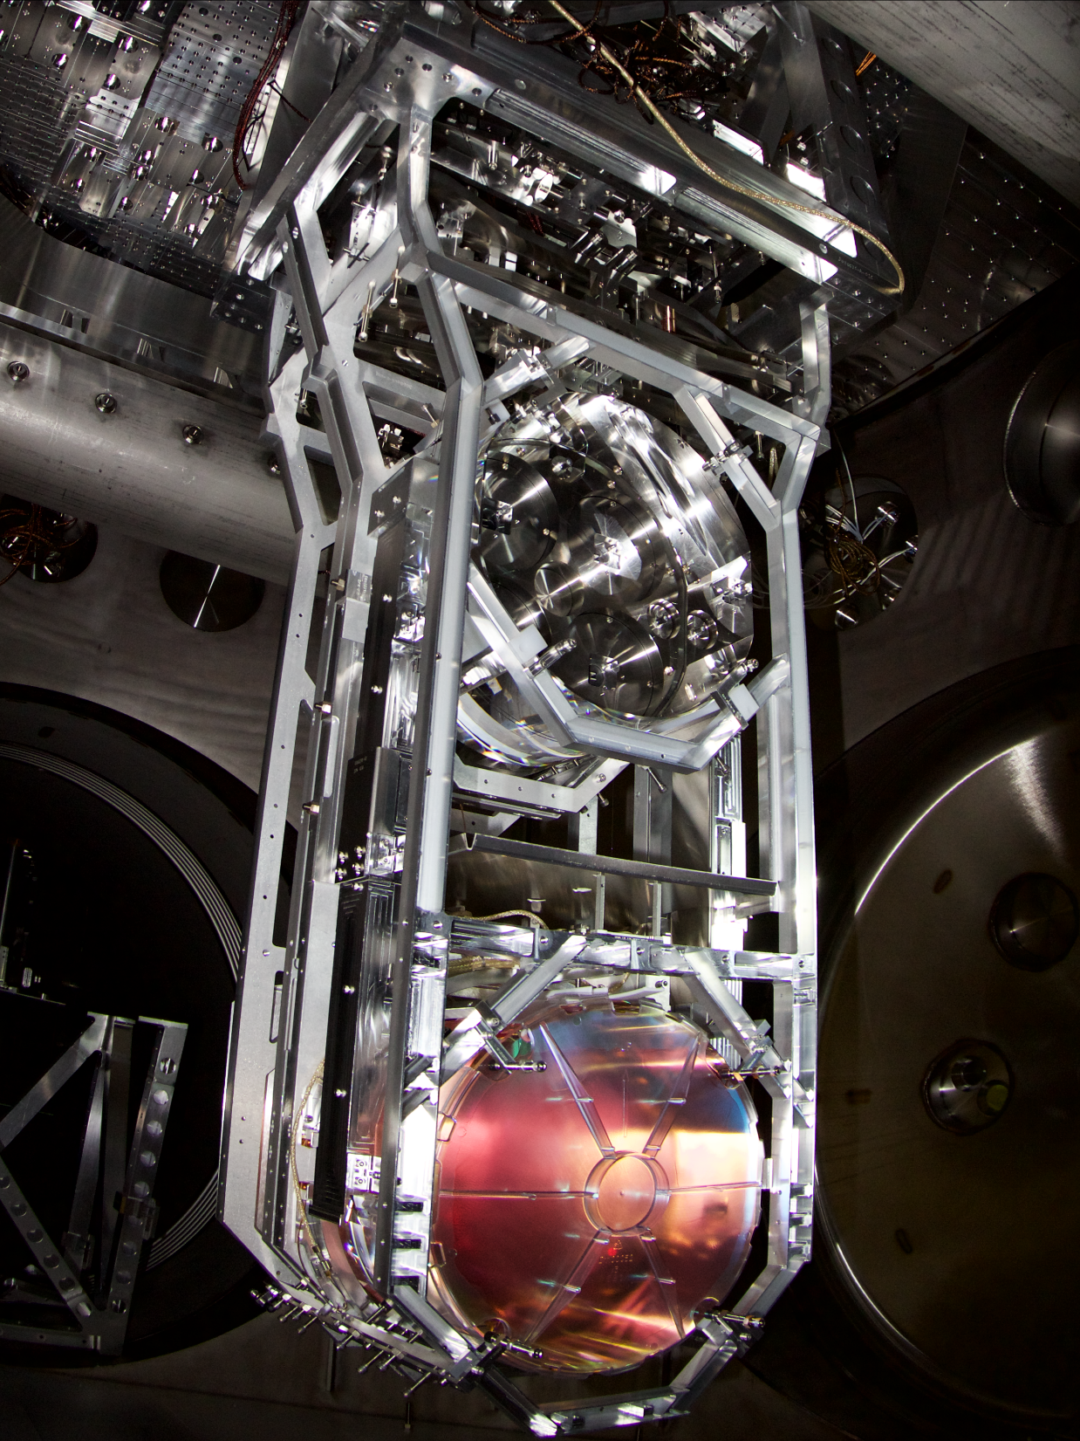

Test Mass Suspension
40 cm

Slide 27
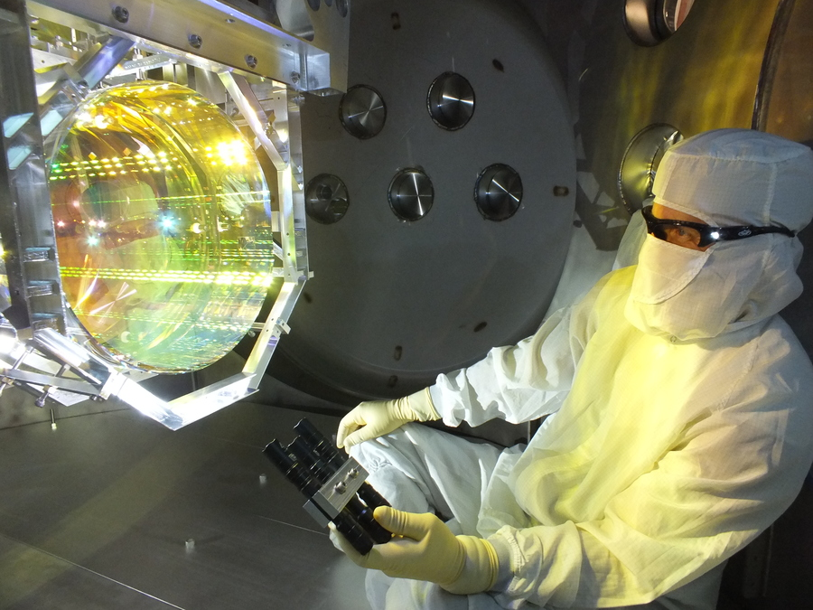
  Specifications:
  Diameter: 340 mm
  Thickness: 200 mm
  Mass: 39.6 kg
  ROC: 2250 m / 1940 m
  Figure: <1 nm rms
  Scatter: ~10 ppm
  Surface absorption: ~0.3 ppm
  Bulk absorption: ~0.2 ppm/cm
  HR transmission: ~4 ppm
  AR reflectivity: ~200 ppm
Large Test Mass Optics

Slide 28
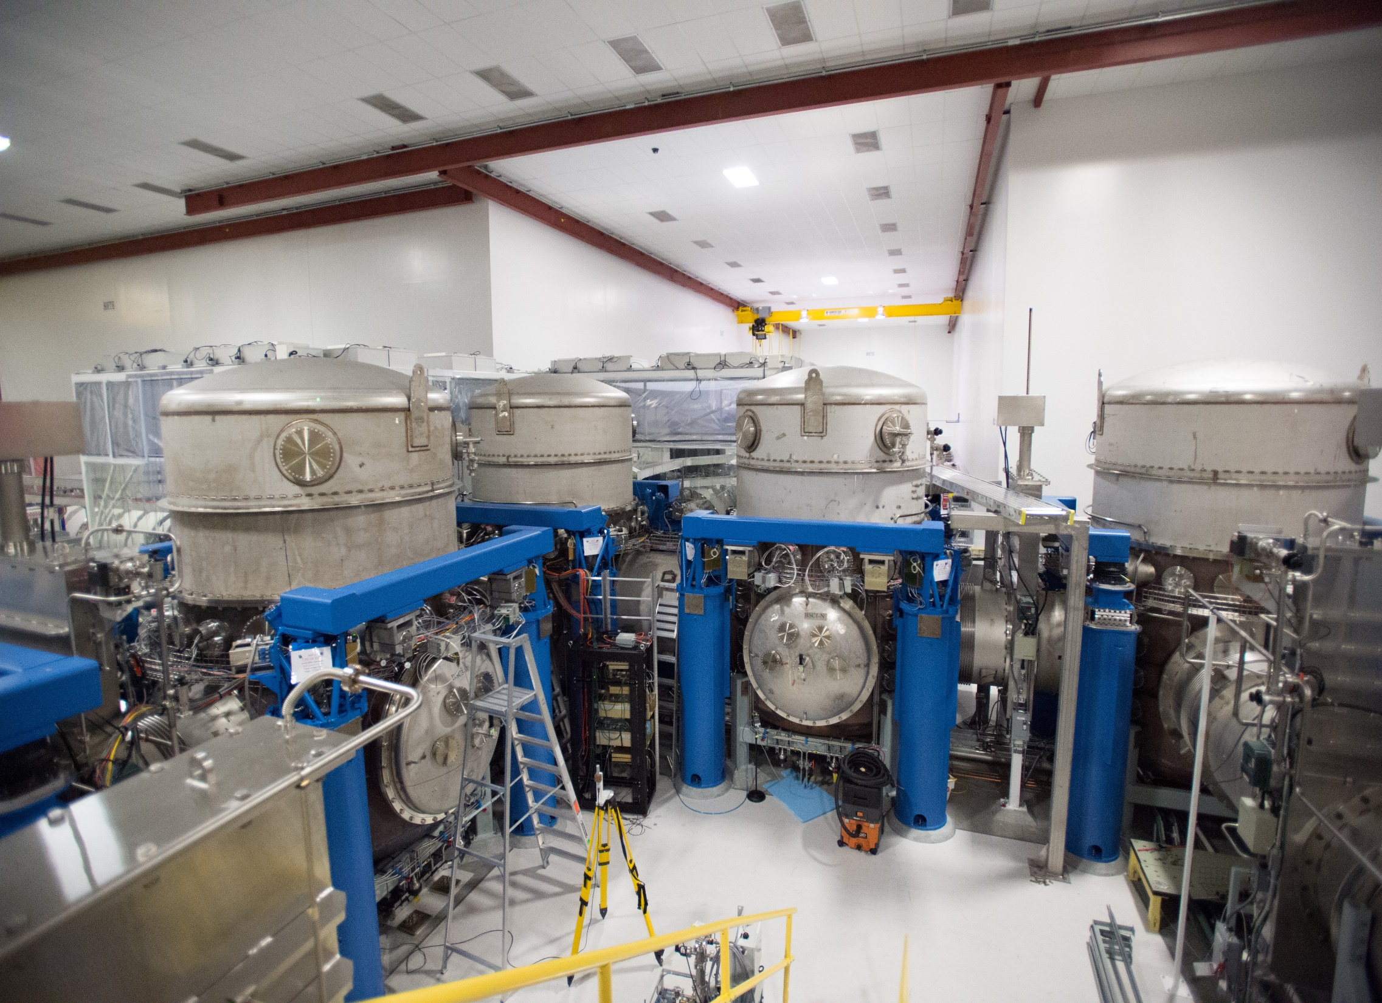
Vacuum System Vertex

Slide 29
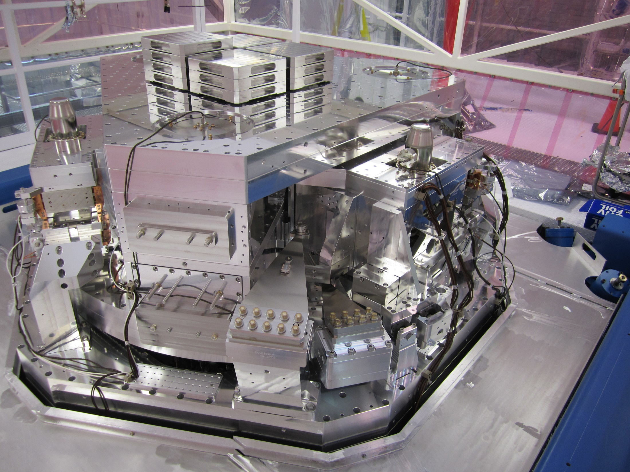
Seismic Isolation Platform

Slide 30
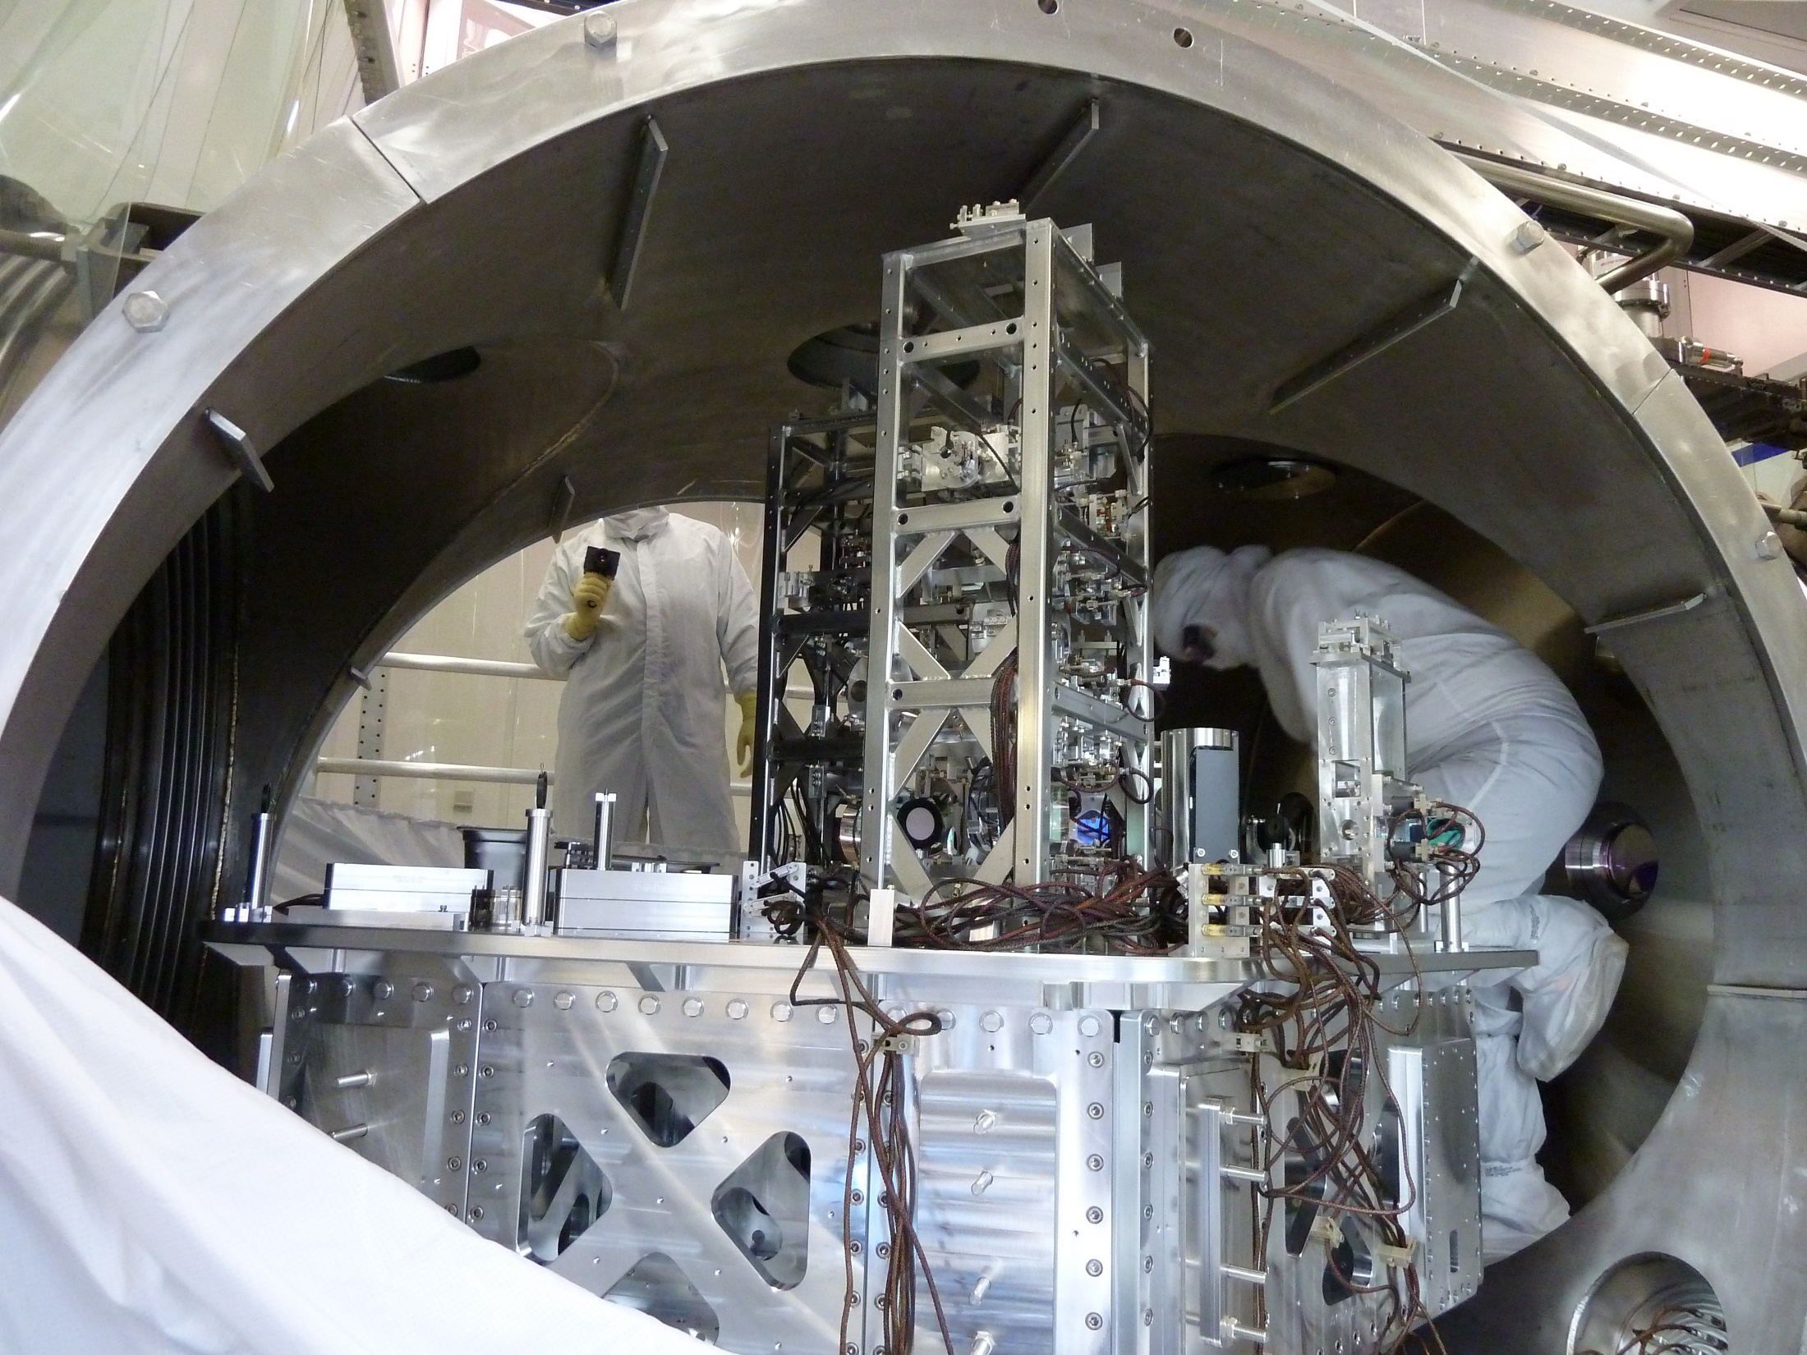
Input Optics Table

Slide 31
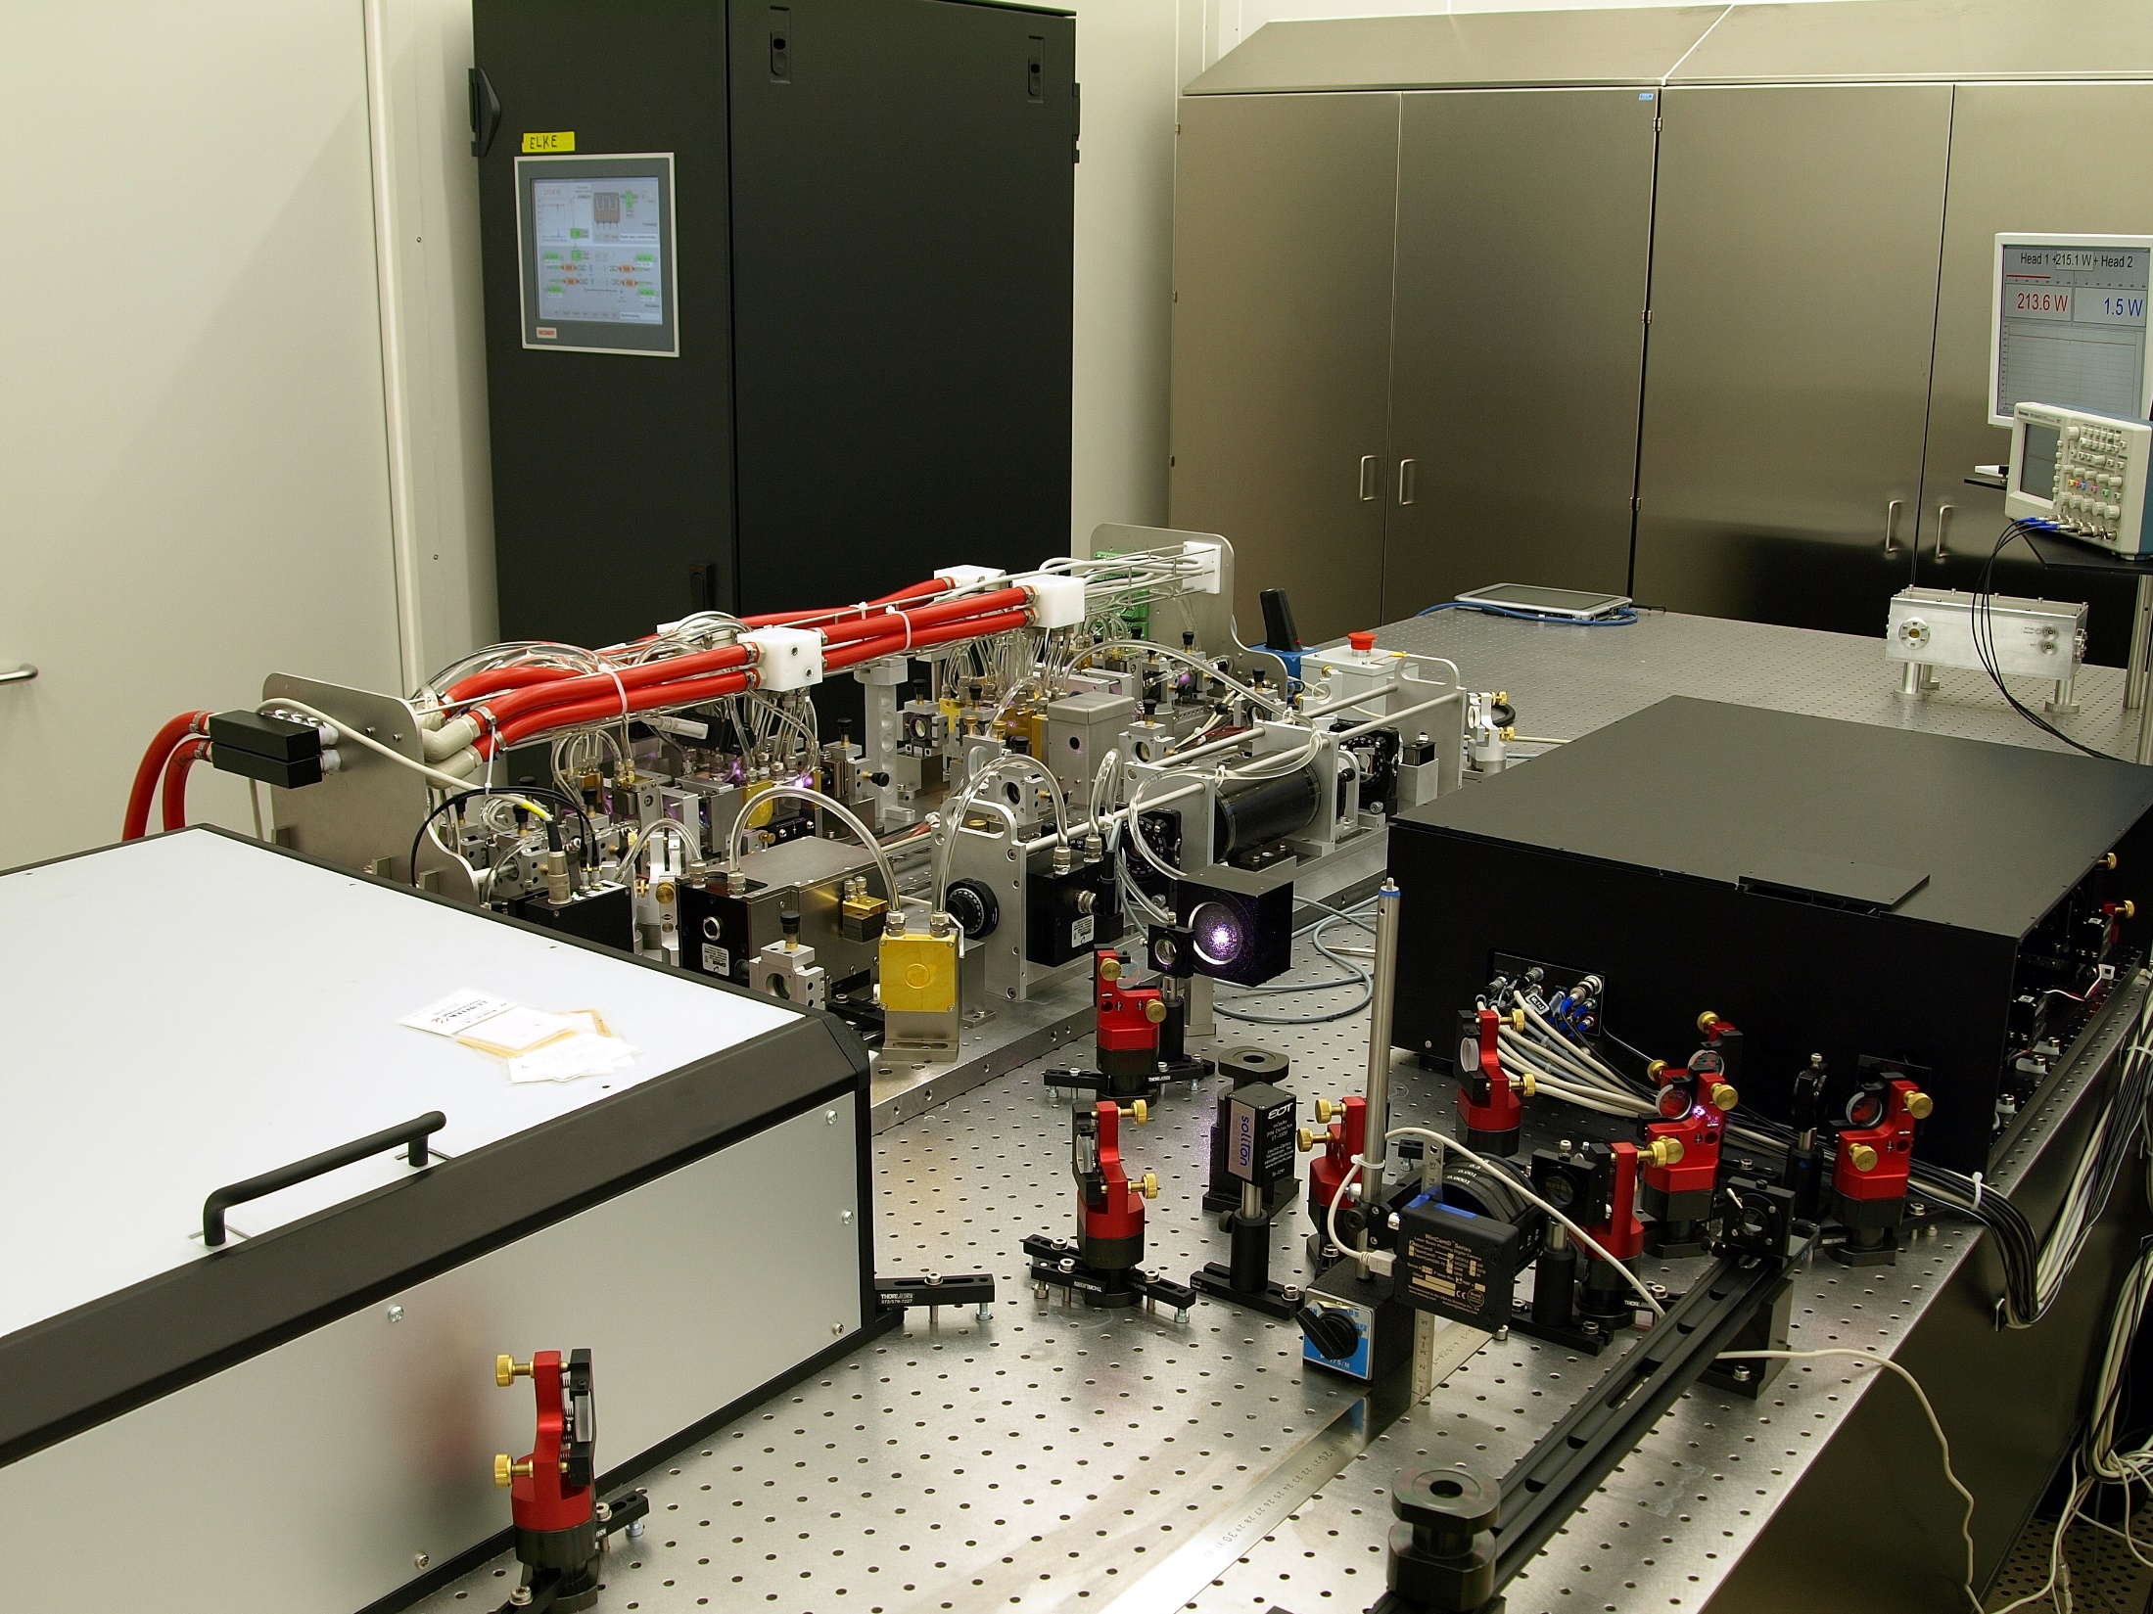
200W Pre-Stabilized Laser

Slide 32
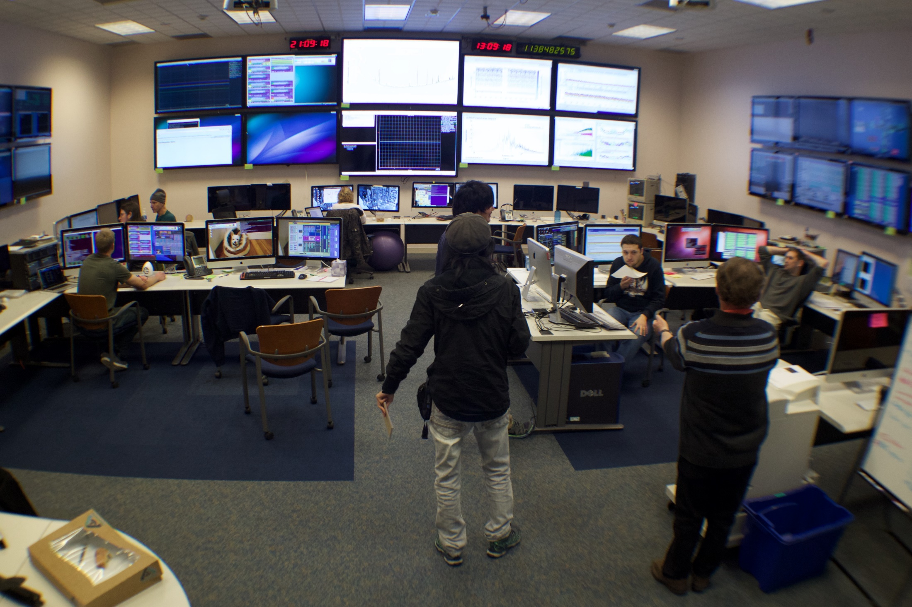
Control Room

