Slide 1
ETM14 absorber locations and images
LMA HR coating run C14058
Zhang, Billingsley
2019

Slide 2
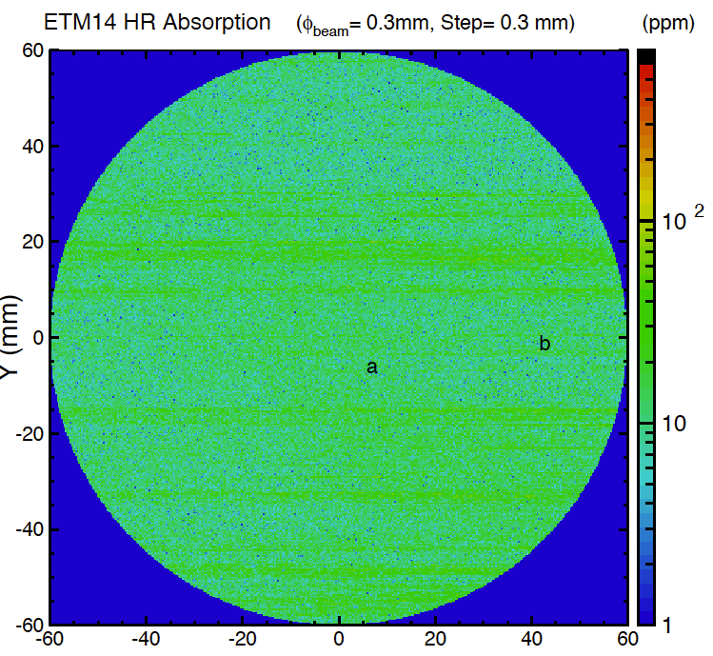
Full report at LIGO-E1500143

Slide 3
ETM14 Absorber Catalog
No | Scan | Mea. X (mm) | Mea. Y (mm) | Measurement (300 µm beam) | Micro. X (mm) | Micro. Y (mm) | Microscope 50x Measurement | Microscope Final dimension using calibration of 2µm/divison | Optic X (mm from center) | Optic Y (mm from center)
ETM14a | 51719 | 243.112 | 117.498 | ~500 ppm | -127.172 | 116.527 | ~10 x 20 div | ~ 20 µm x 40 µm | 6.112 | 7.498
ETM14b | 51719 | 278.838 | 112.69 | ~150 ppm | -91.446 | 111.719 | ~ 5 div | ~ 10 µm diameter | 41.838 | 2.69

Slide 4
Point a ~20 x 40 µm

Slide 5
Point b1 ~ 10 µm

