Slide 1
Absorption Test ITM03/11 Witness sample SN1549 LMA Run Reference C13074/13
Microscopy/absorption test/Microscopy
Billingsley/Zhang
December 2019

Slide 2
HR ITM03/11 Absorber is located in the large circle. Non-absorber in the small circle Image S1, Arrow down. SN1549 LMA ref C13074/13 We believe the /13 refers to the position in the coating chamber. Text is on the container

Slide 3
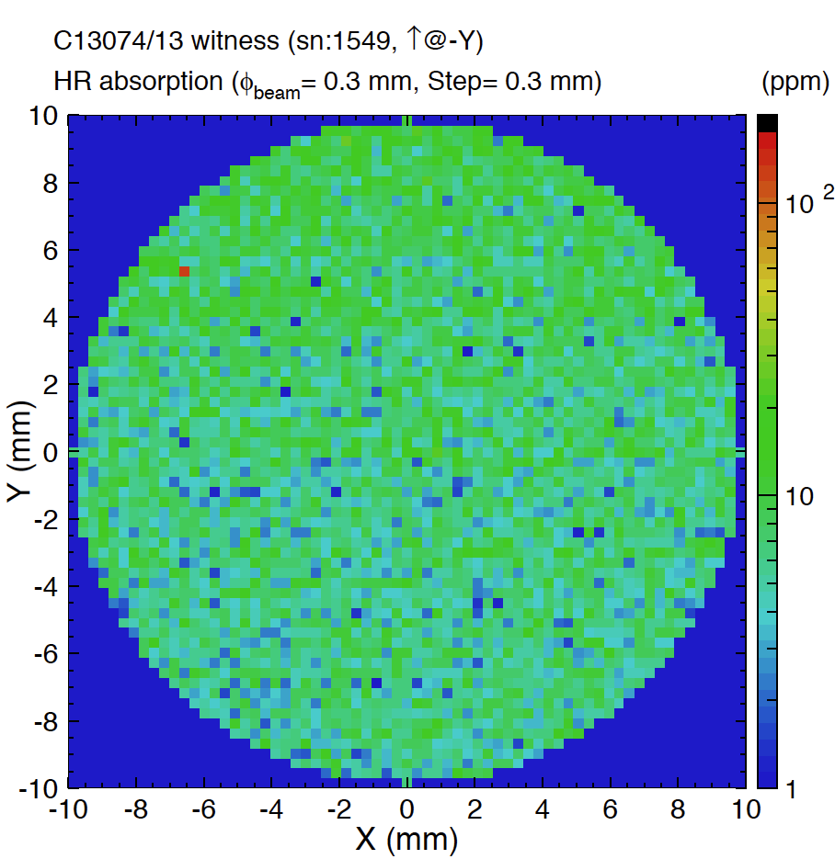
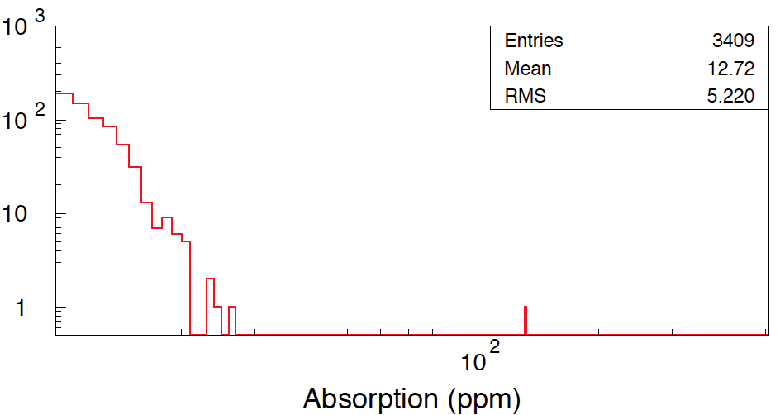
Image arrow at -Y

Slide 4
Close up of absorber circle/position

Slide 5
Absorber ~13 µm long

Slide 6
Many other things not absorbing Following are images of things in the scan area that did not register as absorbing.

Slide 7
Location of the “bubble” non-absorber inside the smaller circle

Slide 8
Non absorbing roughly 25 µm long no change in appearance before/after Abs. scan

Slide 9
Non Absorbing. Roughly 10µm long

Slide 10
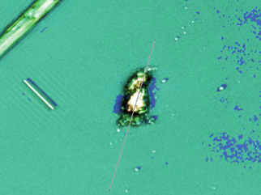
See G2000212 for micromachining tests.
Absorber Before
Absorber after →

Slide 11
Keyence images post ablation on the next slides For comparison – do we need a Leica confocal microscope to determine success?

Slide 13
Also found near the arrow

Slide 14
Large spot found in the zone where the absorber was.

Slide 15
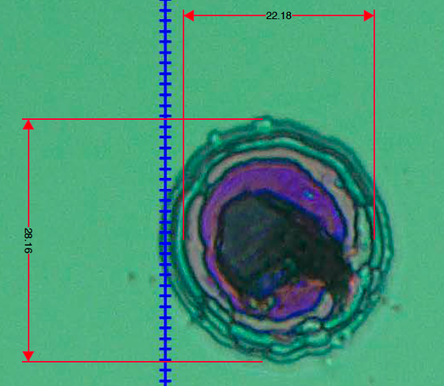
21.67 µm green dots, 22.16µm horizontal on Keyence

Slide 16
No surrounding scatter appears in dark field view

