Slide 1
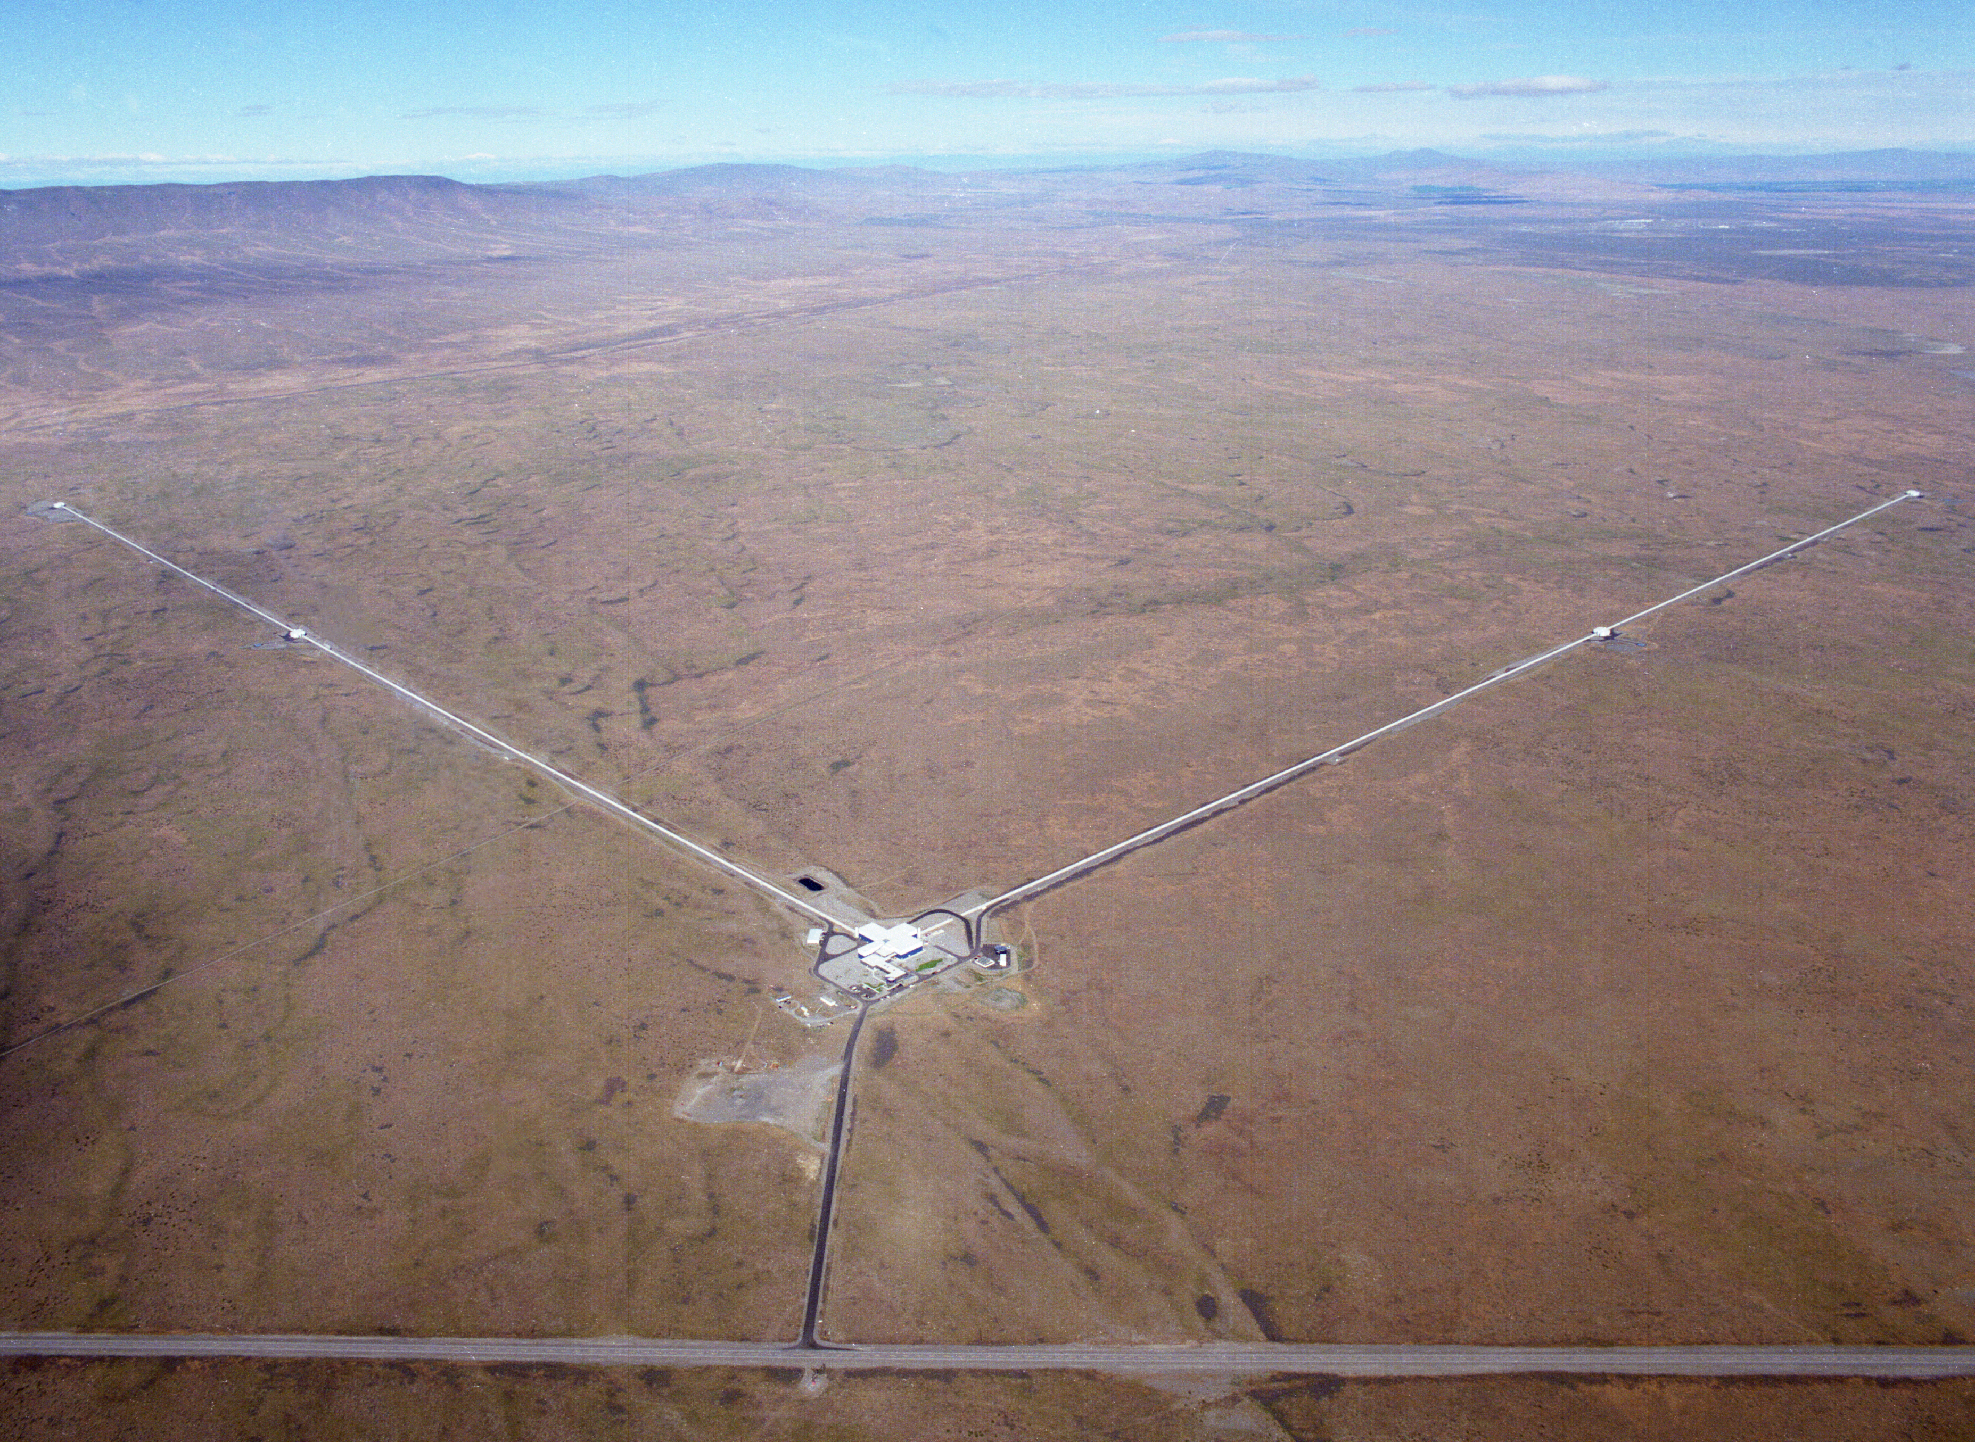
The Real Dirt on LIGO
Fred Raab,
06-Dec-19

Slide 2
Main messages
A new era of Gravitational-Wave Astrophysics (GWA) has dawned with great fanfare, but more importantly, it is poised to rapidly accelerate.
The rate of discovery over the next decades and the science that can be extracted from these discoveries will be accelerated by an international community of experimental physicists and engineers developing better understanding of detector physics and new detector technologies.
India will be an important stage for these developments.

Slide 3
Detectors of Gravitational Waves
No Law of Physics Forbids Them

Slide 4
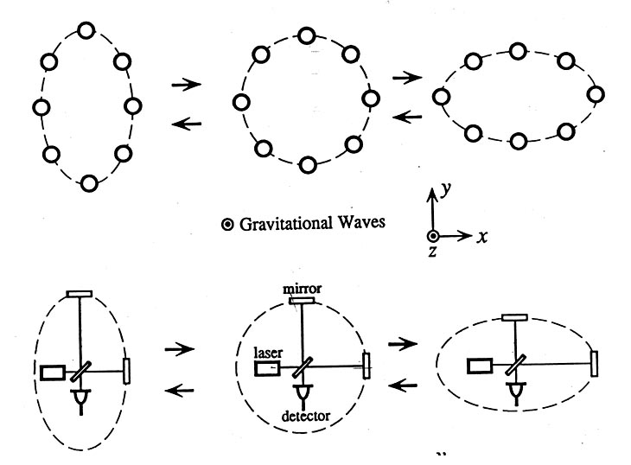
Basic idea for detection is simple
GW amplitude h = (R_{x}-R_{y})/R
When the arm lengths are equal, no light reaches the detector.
It takes longer for light to travel the longer arm path, which allows light to reach the detector.

Slide 5
You now know almost everything you need to know about General Relativity to contribute to accelerating the rate of discovery in Gravitational-Wave Astronomy.

Slide 6
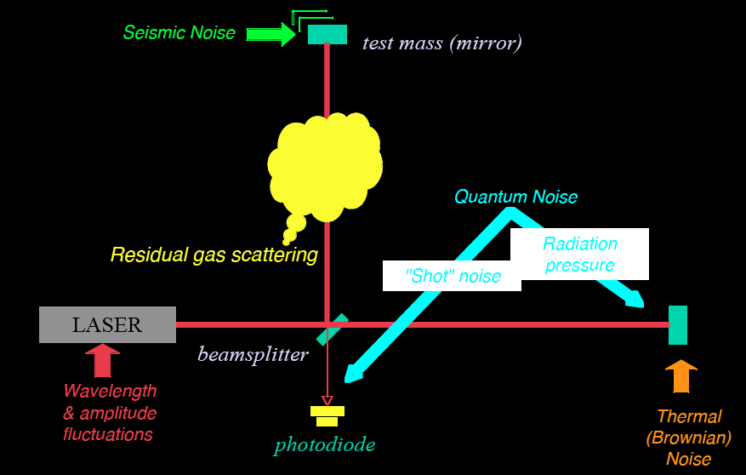
Rate of discovery ~ (Noise reduction)³
R. Adhikari

Slide 7
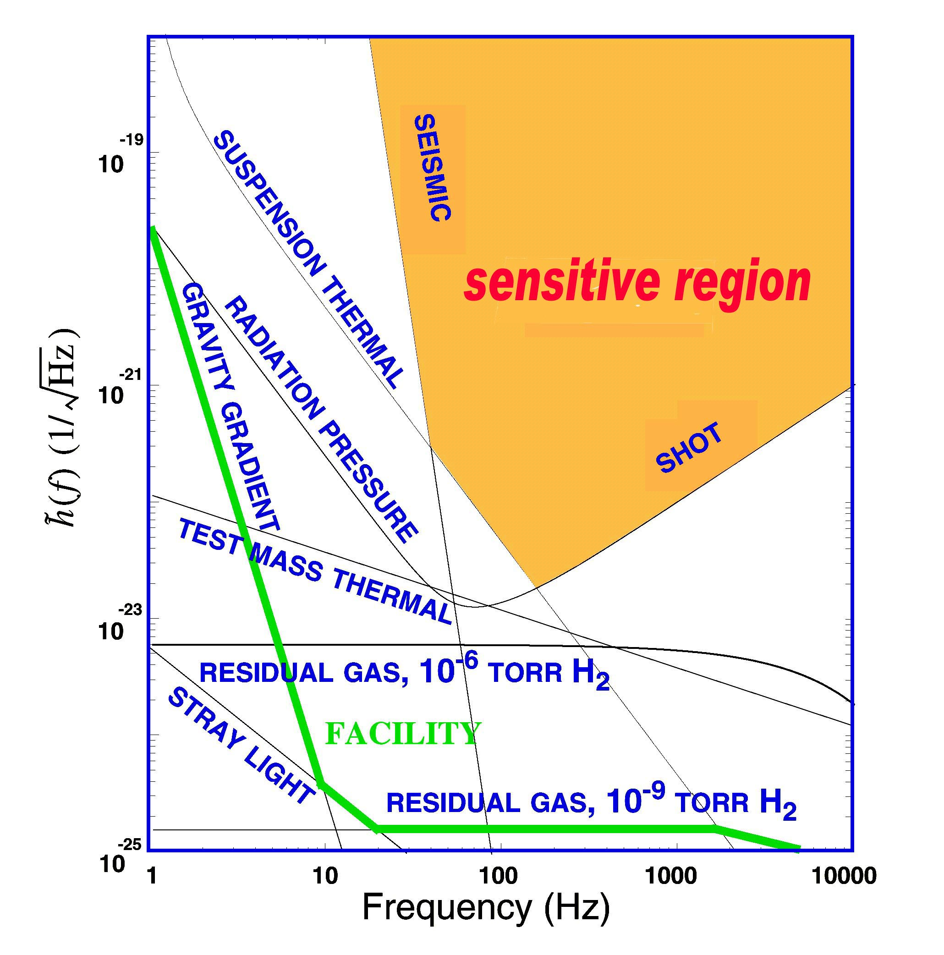
What Limits Sensitivity of Interferometers?
DESIGN
Seismic noise & vibration limit at low frequencies
Brownian (Thermal) Noise inside components limits at mid frequencies
Quantum nature of light (Shot Noise) limits at high frequencies
Myriad details of the lasers, electronics, etc., can make problems above these levels
COMMISSIONING

Slide 8
“Theory and practice are the same in theory. In practice, they’re different.”
- Yogi Berra

Slide 9
Principal noise terms
(by design, based on theory)

Slide 10
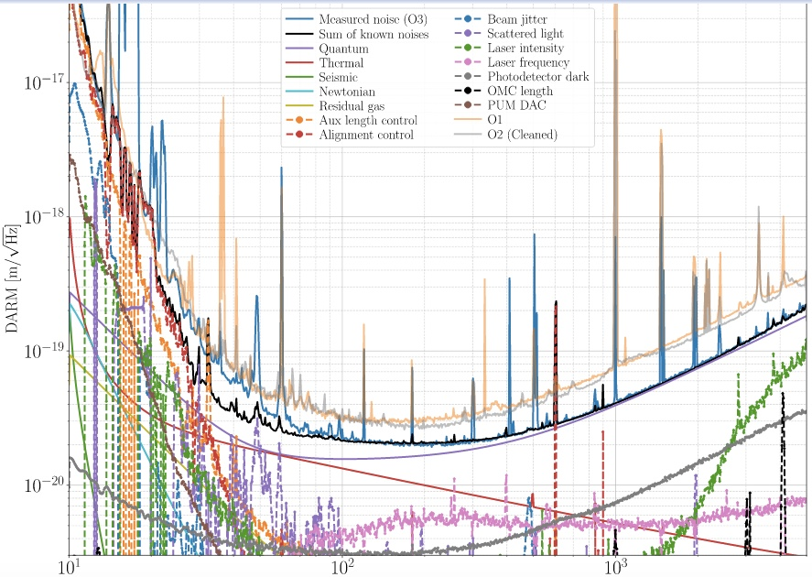
Noise terms
(in practice)

Slide 11

Optical configuration
Complete detector description in Class. Quantum Grav. 32 (2015) 074001

Slide 12

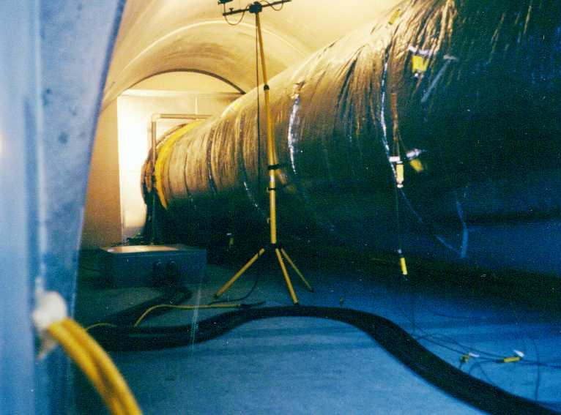
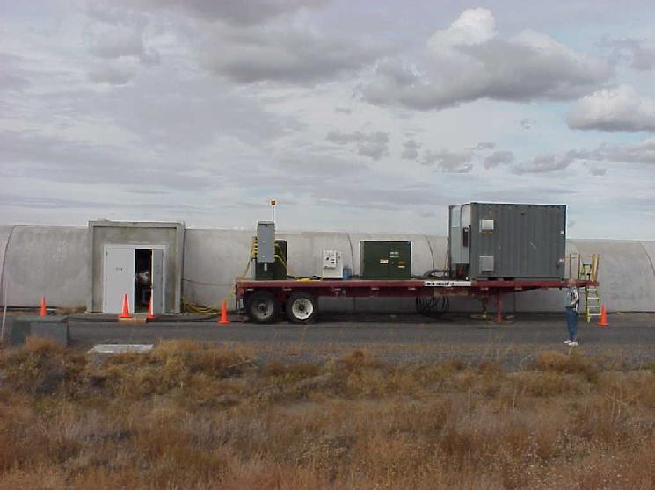
Evacuated Beam Tubes Provide Clear Path for Light
P< 10⁻⁹ Torr
Portable power supply for bakeout

Slide 13
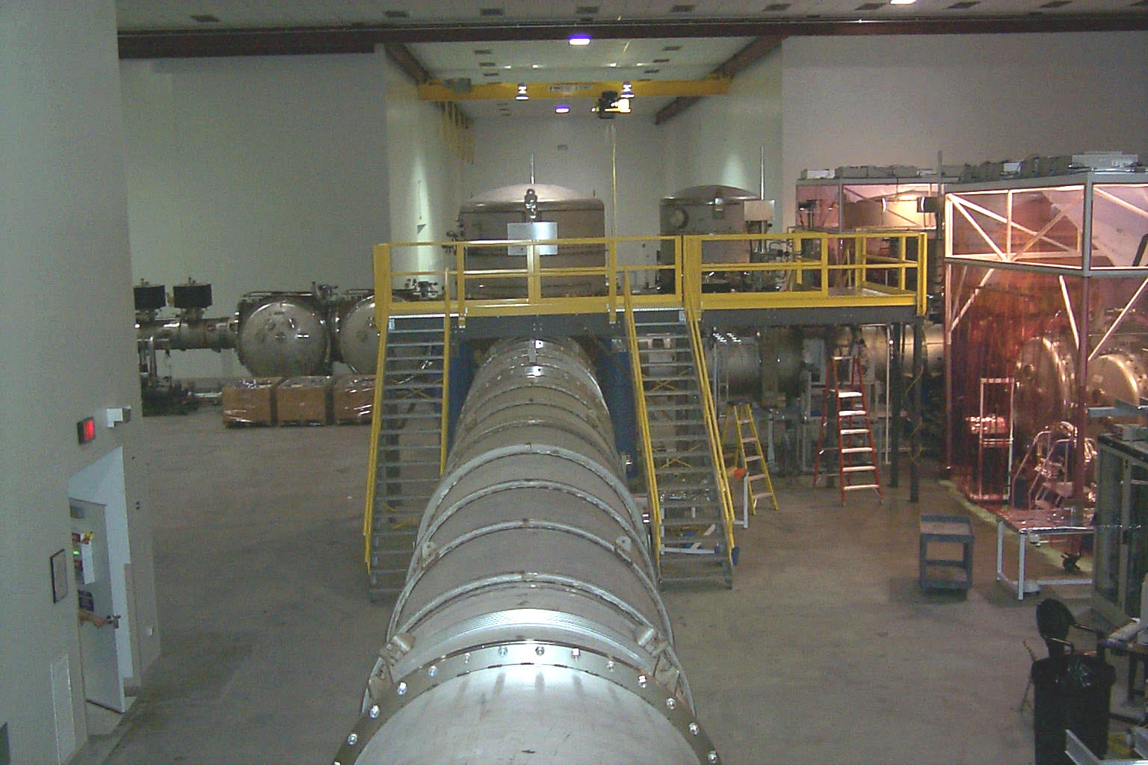
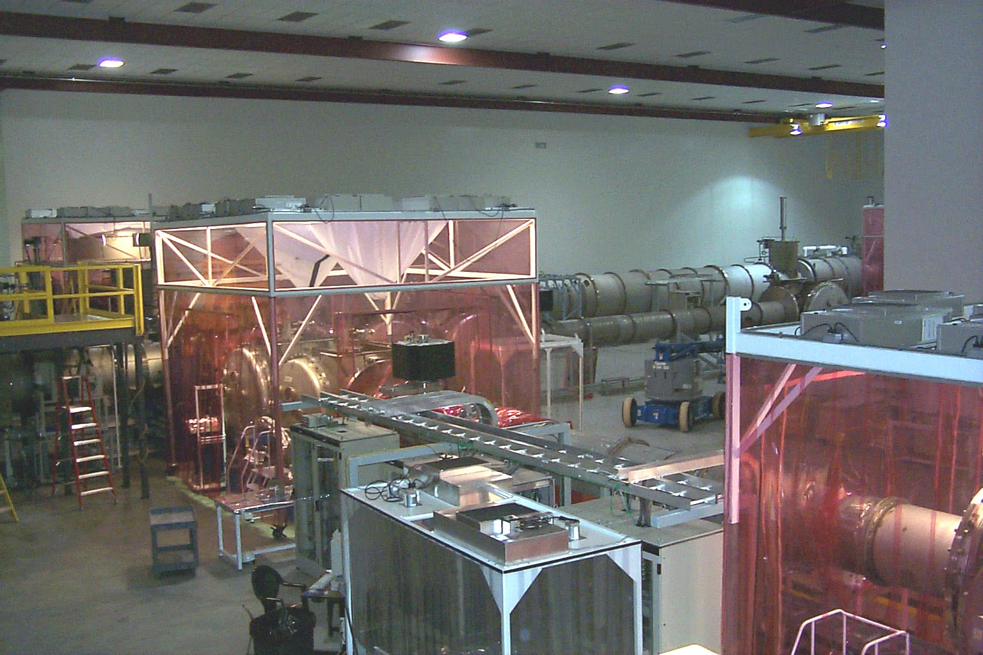
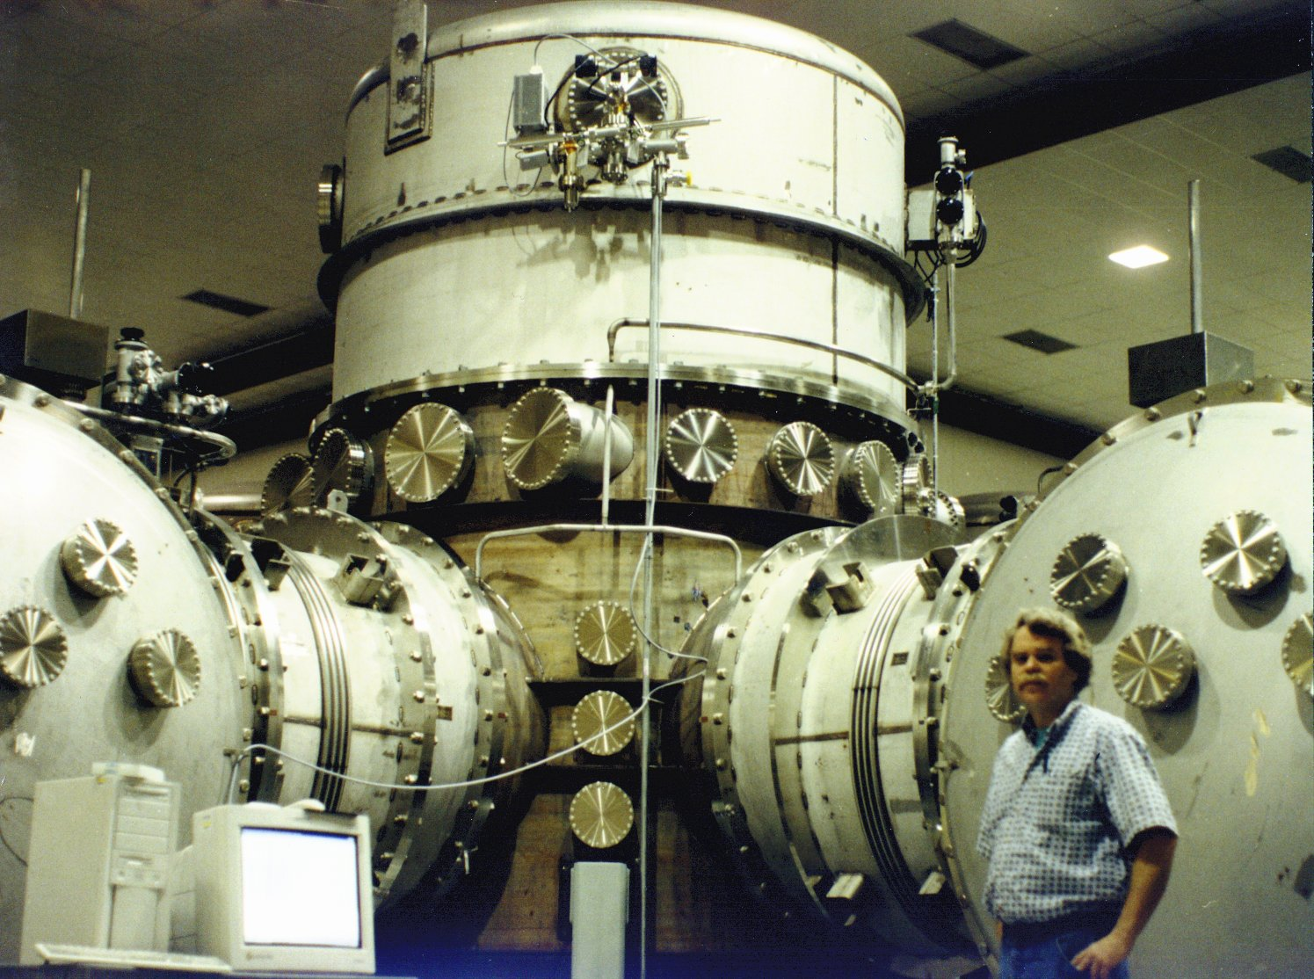
Vacuum Chambers Provide Quiet Homes for Mirrors
View inside Corner Station
Standing at vertex beam splitter

Slide 14
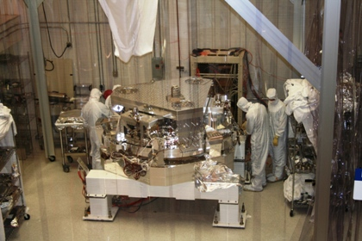
BSC Internal Seismic Isolator

Slide 15
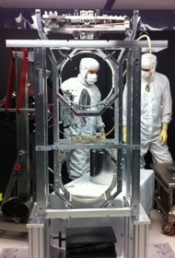
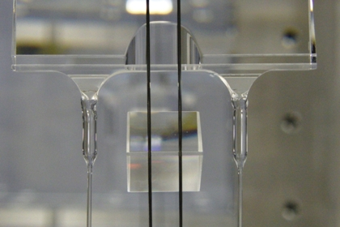
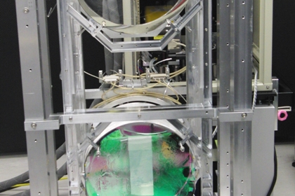
Advanced LIGO Monolithic Suspension

Slide 16
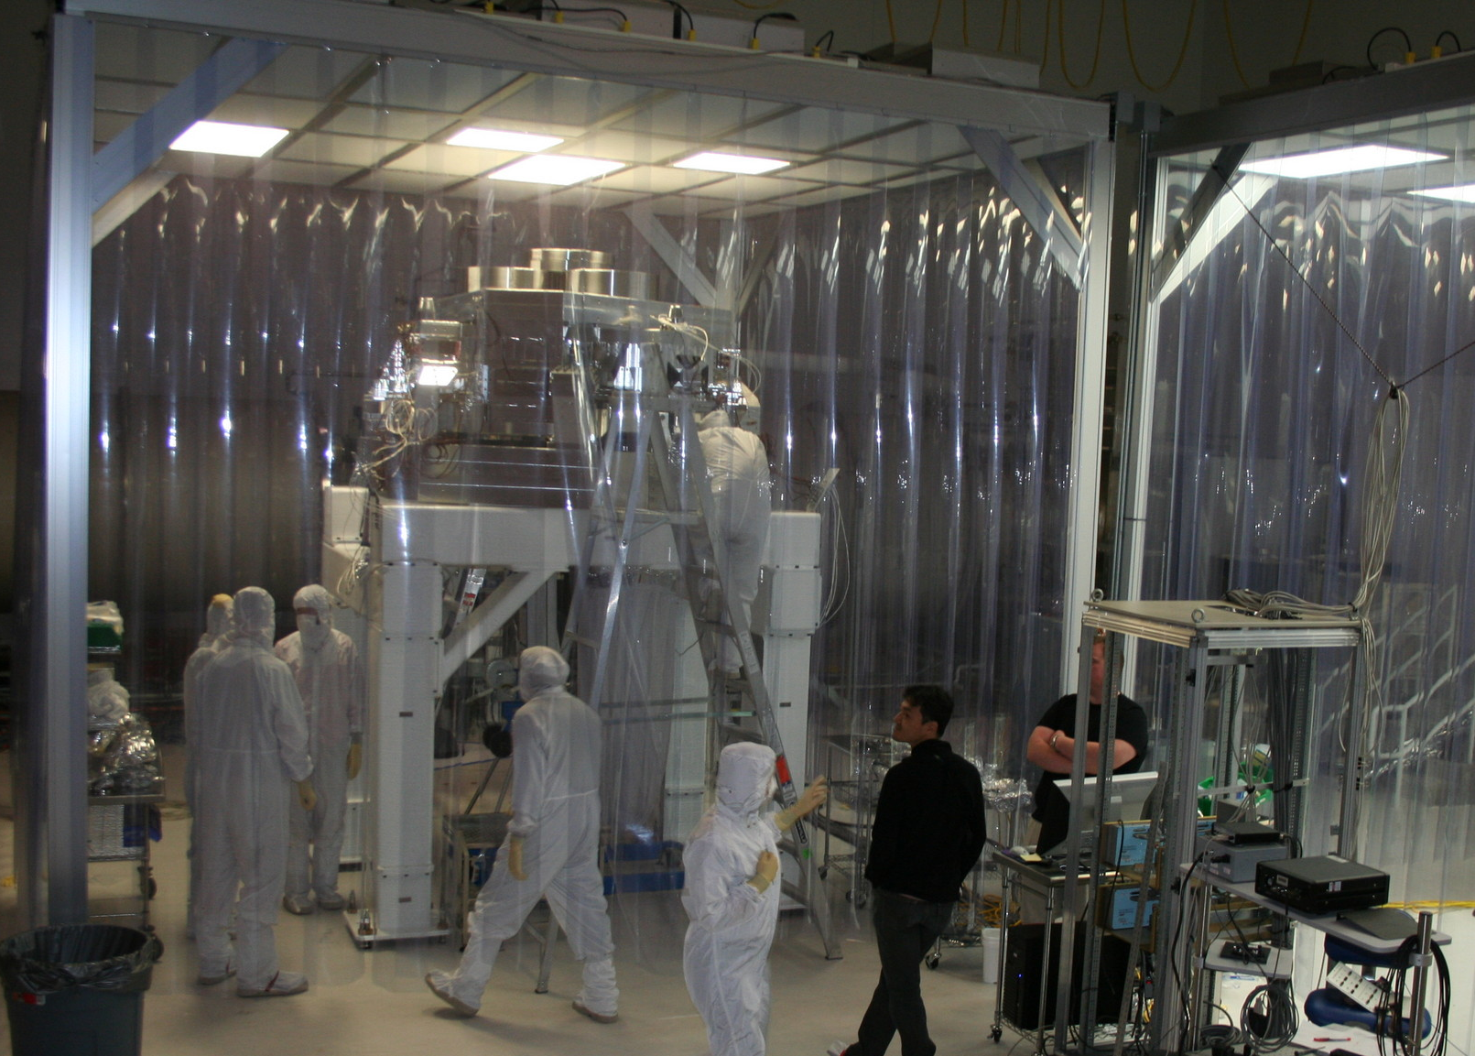
Advanced LIGO installation in progress
17-Aug-11

Slide 17
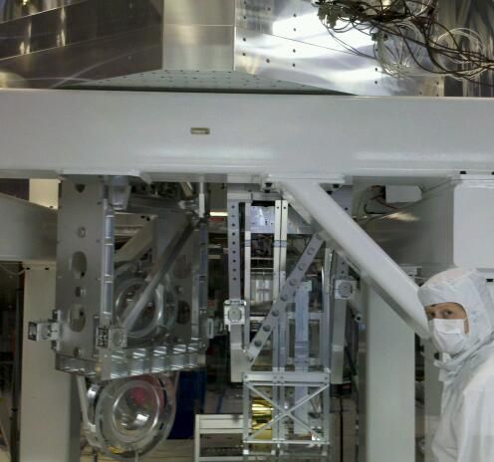
Putting it together:
Seismic & Suspension & Optics
Seismic isolation
Test mass suspension
Folding mirror suspension

Slide 18
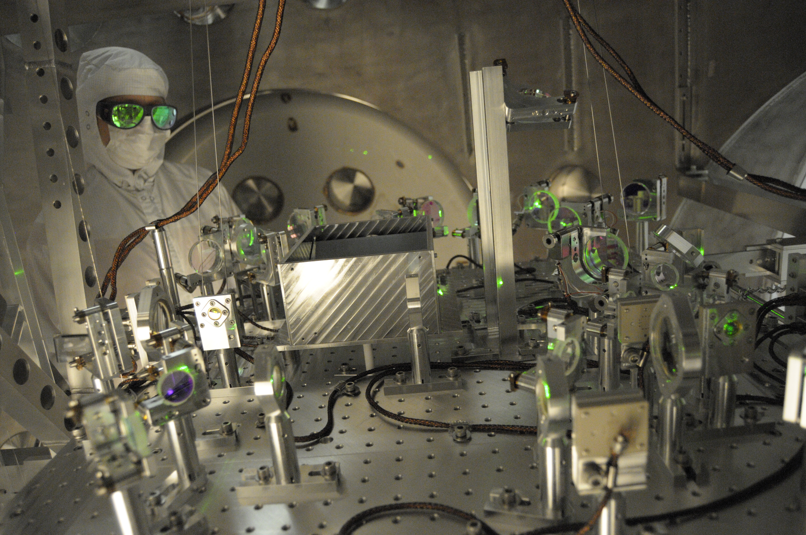
Lock Acquisition: Arm Locking Subsystem

Slide 19
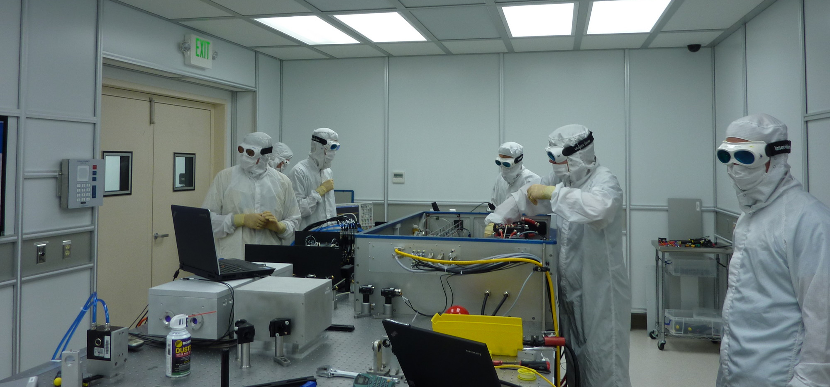
aLIGO Pre-stabilized laser

Slide 20
What could possibly go wrong?
A Case Study

Slide 21
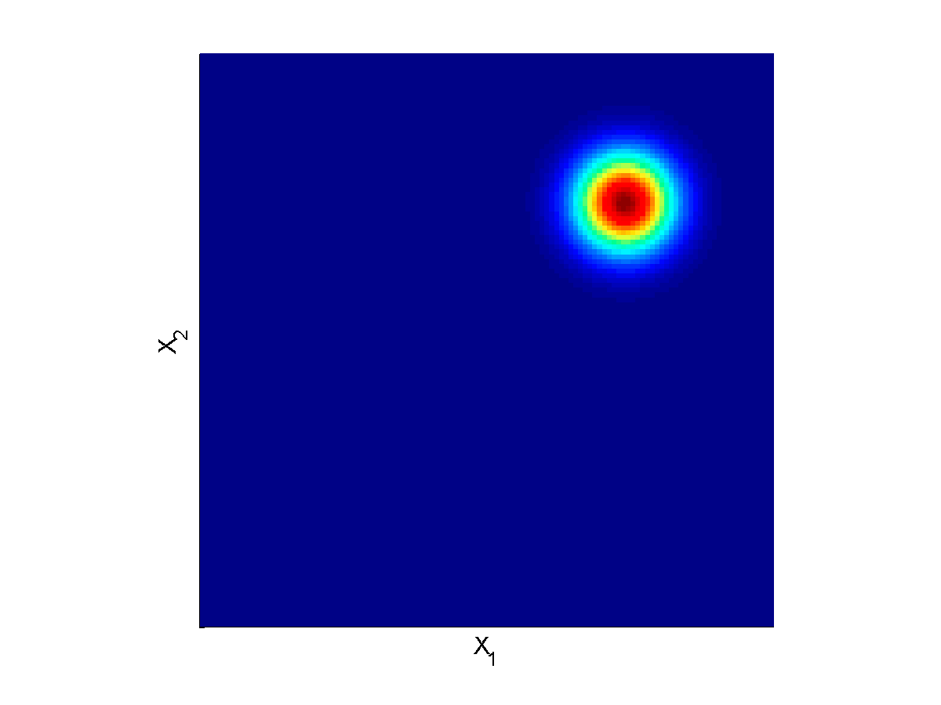
Quantum Noise is Fundamental, Caused by Vacuum Fluctuations
EM Vacuum Fluctuations Cause Shot Noise and Radiation Pressure Noise
Laser
C Caves (1981) Phys. Rev. D 23, 1693

Slide 22
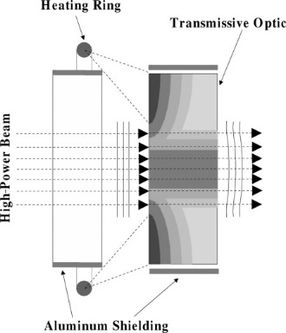
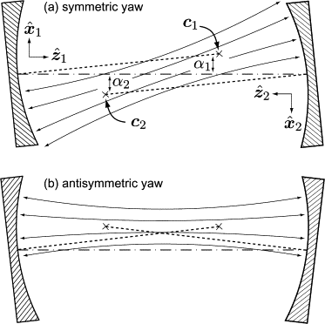
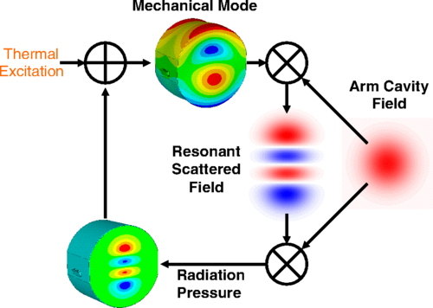
Nothing Is Easy: Classical Challenges to High-Power Operation
Thermal lensing and compensation
Angular radiation pressure
instabilities
Parametric instabilities
M Evans et al (2015) Phys. Rev. Lett. 114, 161102
R Lawrence et al (2004)
Opt Lett 29(22)2635-2637
J Sidles, D Sigg, Phys. Lett. A.
354, 167-172 (2006)

Slide 23
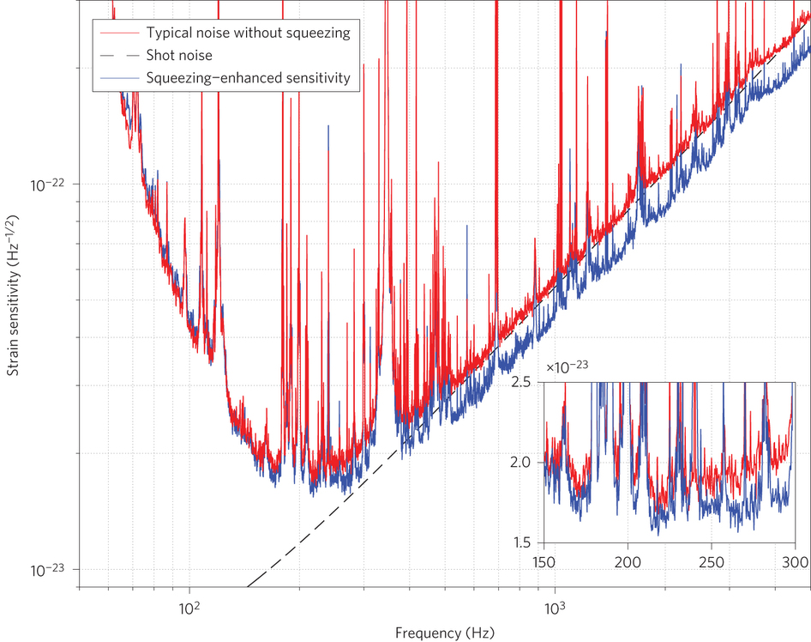
Vacuum squeezing: a partial work-around
Laser
LIGO Scientific Collaboration, Nature Photonics 2013
doi:10.1038/nphoton.2013.177

Slide 24
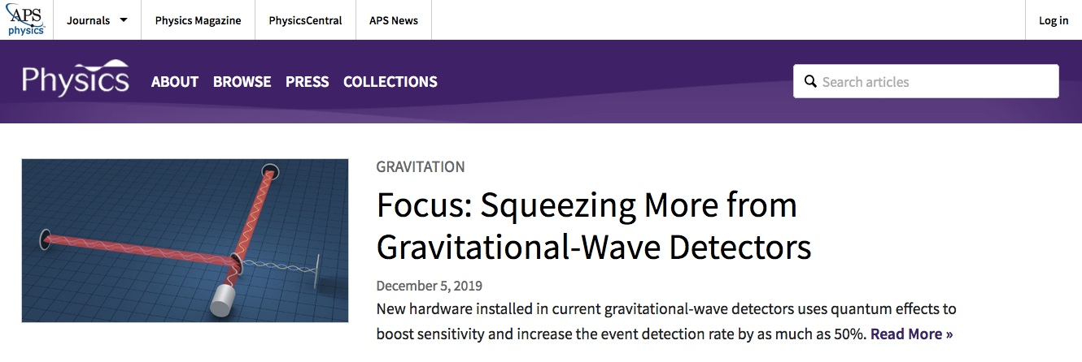
https://physics.aps.org/

Slide 25
Other technical solutions needed
Eliminate point absorbers in mirror coatings
Improve robustness to tolerances in optical designs
Identify and mitigate scattering
Improve adaptive servo designs using auxiliary channels
Improve interferometer alignment systems

Slide 26
The future

Slide 27


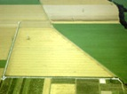

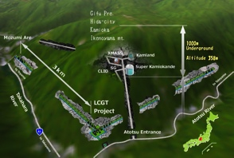



The advanced GW detector network:
2015-2025
Advanced LIGO
Hanford
2015
GEO600 (HF)
2011
KAGRA
2020
Advanced LIGO
Livingston
2015
Advanced
Virgo
2017
LIGO-India
2025 2026
27
27

Slide 28
The longer journey of exploration
Extending the reach of GW detectors
  The path traveled by LIGO’s detected waves expanded by a few times 10% as the universe expanded since the waves were launched.
  We can now imagine how to develop detectors to observe the universe when it was tens of times smaller and the first generations of stars were forming and dying.
  We now know that somewhere in the universe black holes mergers occur many times each hour and eventually we could observe each one.
Extending the spectrum of gravitational-wave observations.

Slide 29
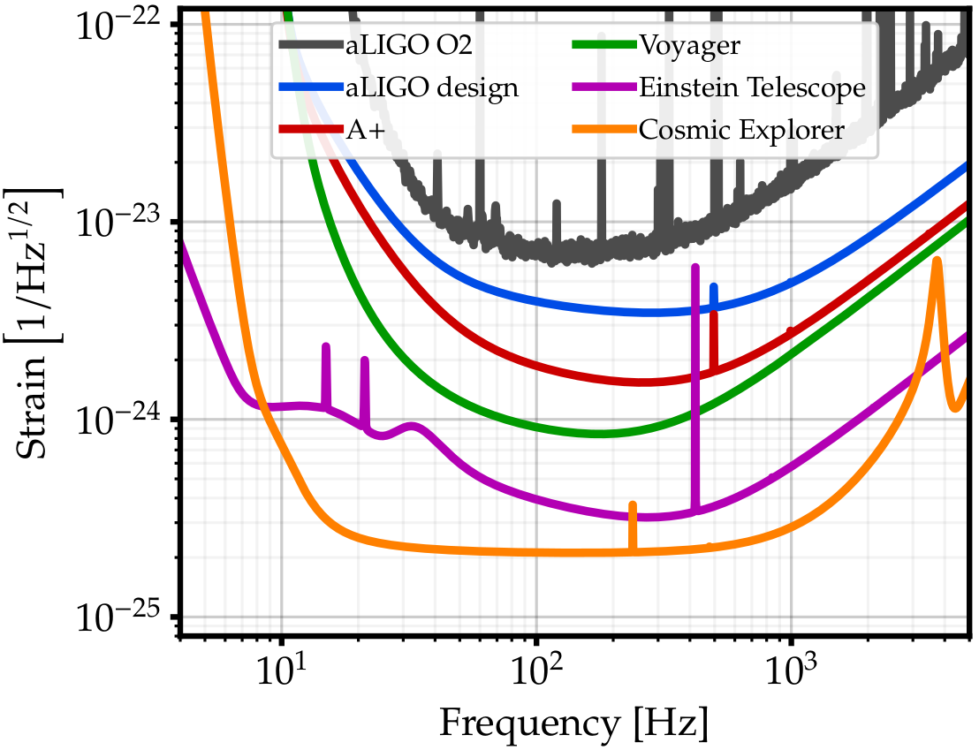
Upgrade possibilities
Exploring the sensitivity of next generation gravitational wave detectors (2017) CQG 34, 044001; www.et-gw.eu
Notes:
Adapted from Lisa Barsotti’s DAWN-IV presentation.

Slide 30
Technological path to the future
Advanced LIGO is limited by
quantum noise & mirror coating Brownian noise
Squeezed vacuum can reduce quantum noise
  A+ will implement frequency-independent squeezing
Options for Brownian noise:
  Better mirror coatings (high optical quality; low mechanical losses) – see talk by Stuart Reid
  Cryogenic operation (new mirror materials & coatings, new lasers, photo-detectors, vacuum-squeezers, etc.)
  Longer arms (new longer-arm observatory facilities)

Slide 31
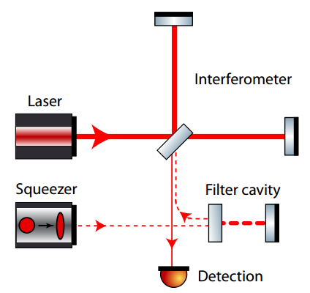
A better work-around: frequency-dependent squeezing
Original idea: J Kimble et al (2001) Phys. Rev. D 65, 022002
Practical designs: T Corbitt et al (2004) Phys. Rev. D 70, 022002
Demonstration in regime applicable to LIGO: E Oelker et al (2016) Phys. Rev. Lett. 116, 041102
M Evans et al, (2013) PRD 88 022002

Slide 32
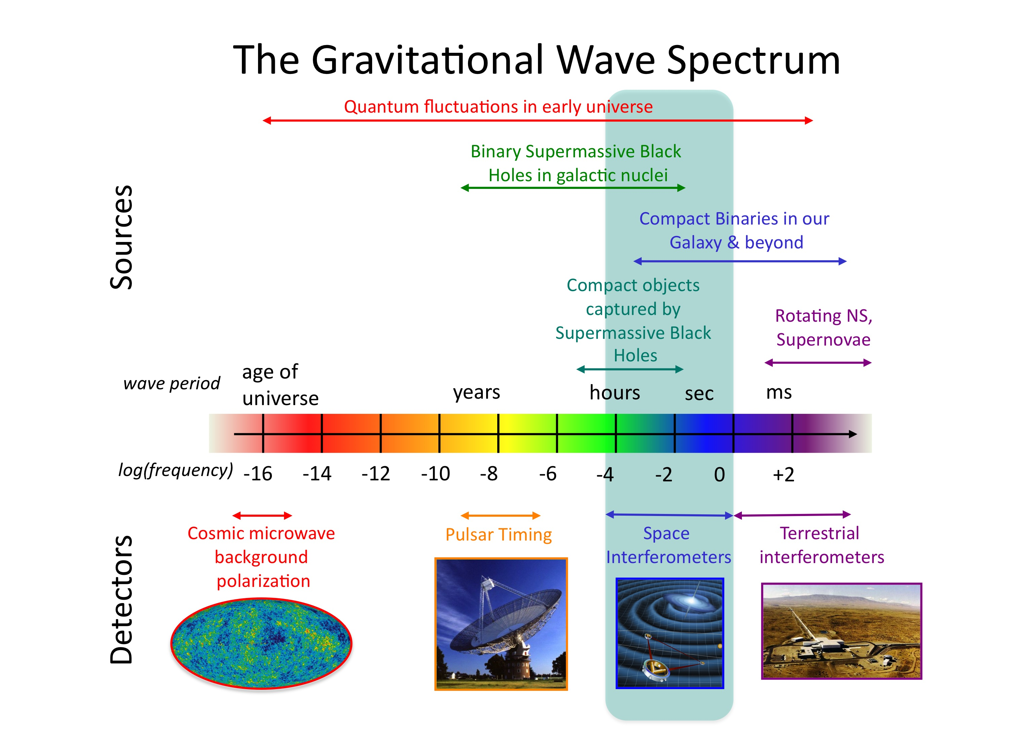
Credit: NASA

Slide 33
Summary: some useful links
Instrument Science White Paper:
https://dcc.ligo.org/LIGO-T1900409/public
Advanced LIGO Detector paper:
https://dcc.ligo.org/LIGO-P1400177/public
aLIGO Document Tree:
https://dcc.ligo.org/LIGO-E1200123/public
LHO alog:
https://alog.ligo-wa.caltech.edu/aLOG
LLO alog:
https://alog.ligo-la.caltech.edu/aLOG

