Slide 1
O3 LIGO-Virgo-KAGRA update
Keita Kawabe, Shinji Miyoki, Brian O’Reilly, Alessio Rocchi,
David Shoemaker, Matteo Tacca

Slide 2
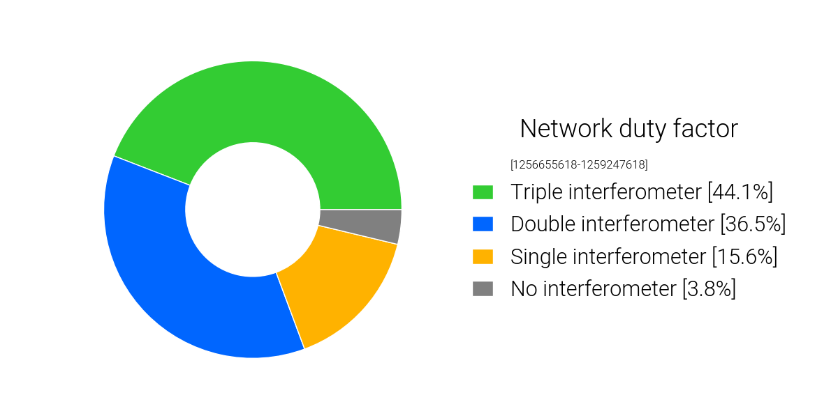
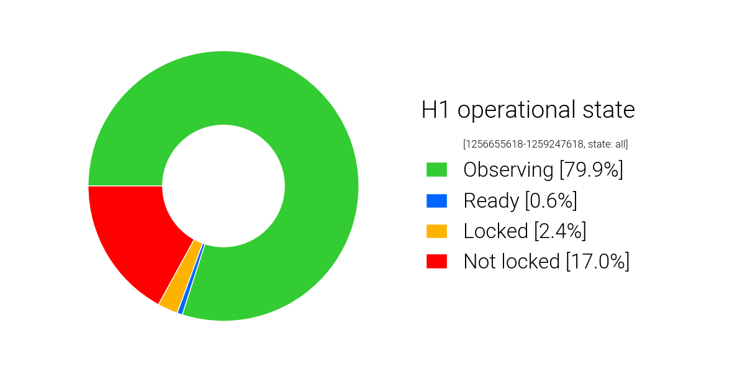
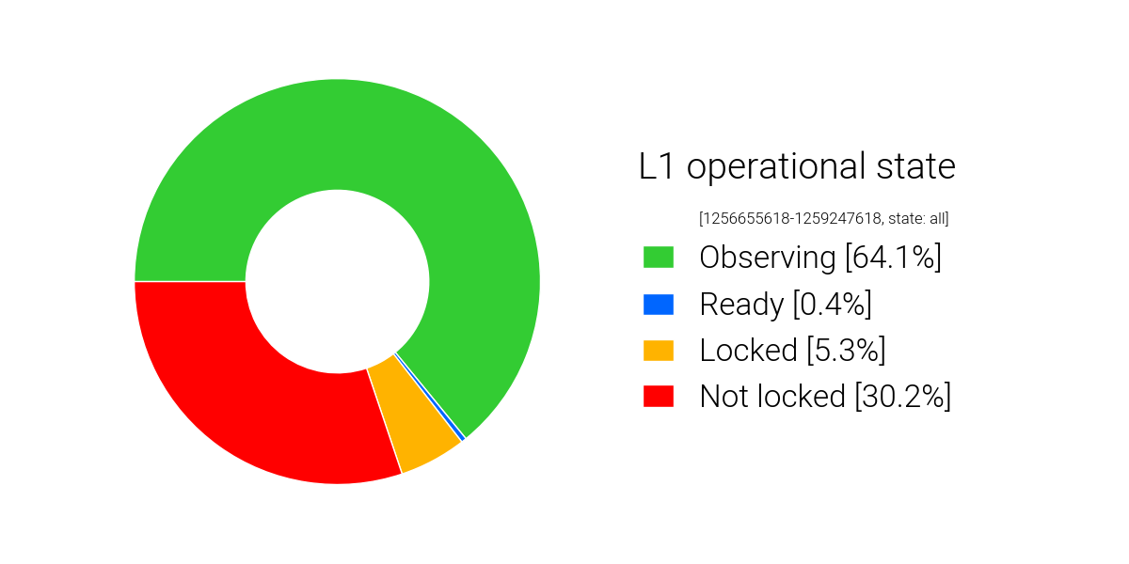
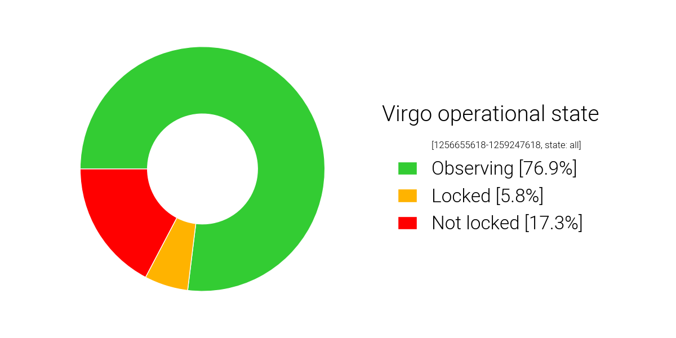
Detector Performance: O3b Cumulative Duty Factor
44.1% Triple IFOs
80.6% Double or Triple
3.8% zero IFO
(Downtime includes everything including but not limited to maintenance)

Slide 3
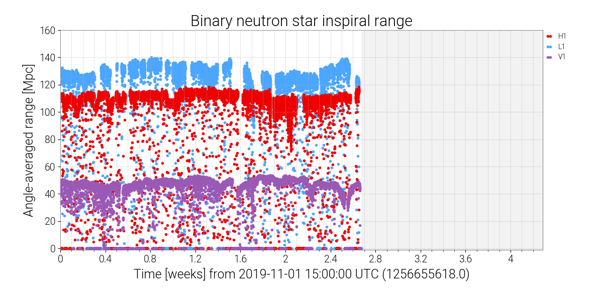

Slide 4
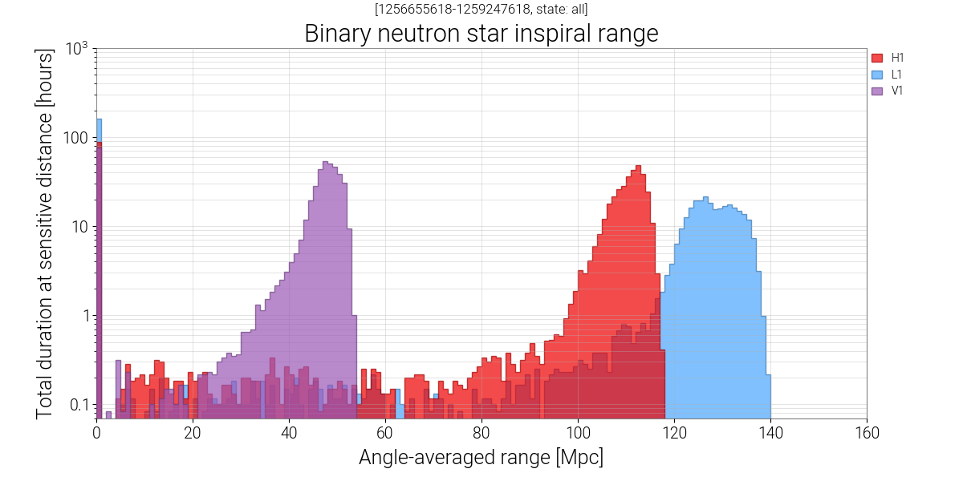

Slide 5
7 alerts including 5 retractions since the beginning of O3b.
You’ll hear about these in Deep’s presentation later:
S191105e -> BBH
S191109d -> BBH
S191110x -> retracted (CBC, took ~ 18 minutes), Loud glitch in LLO
S191110af -> retracted (burst, took ~ 3 days 23 hours), Veto + reanalysis
S191117j -> retracted (CBC, took ~ 4 minutes), Loud glitch in LLO
S191120aj -> retracted (CBC, took ~ 9 minutes), Environmental glitches in LLO
S191120at -> retracted (CBC, took ~ 3 minutes), Loud glitch in LLO

Slide 6
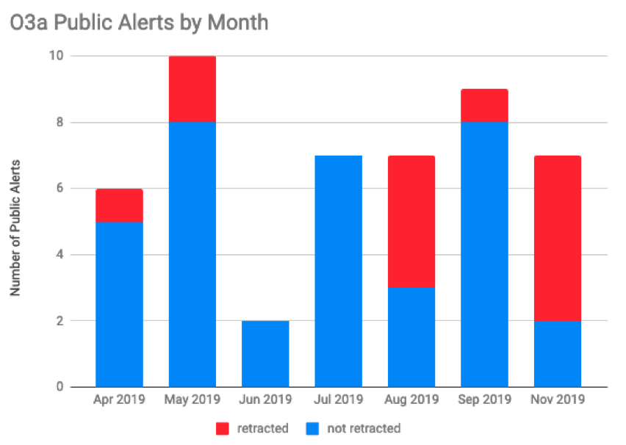

Slide 7
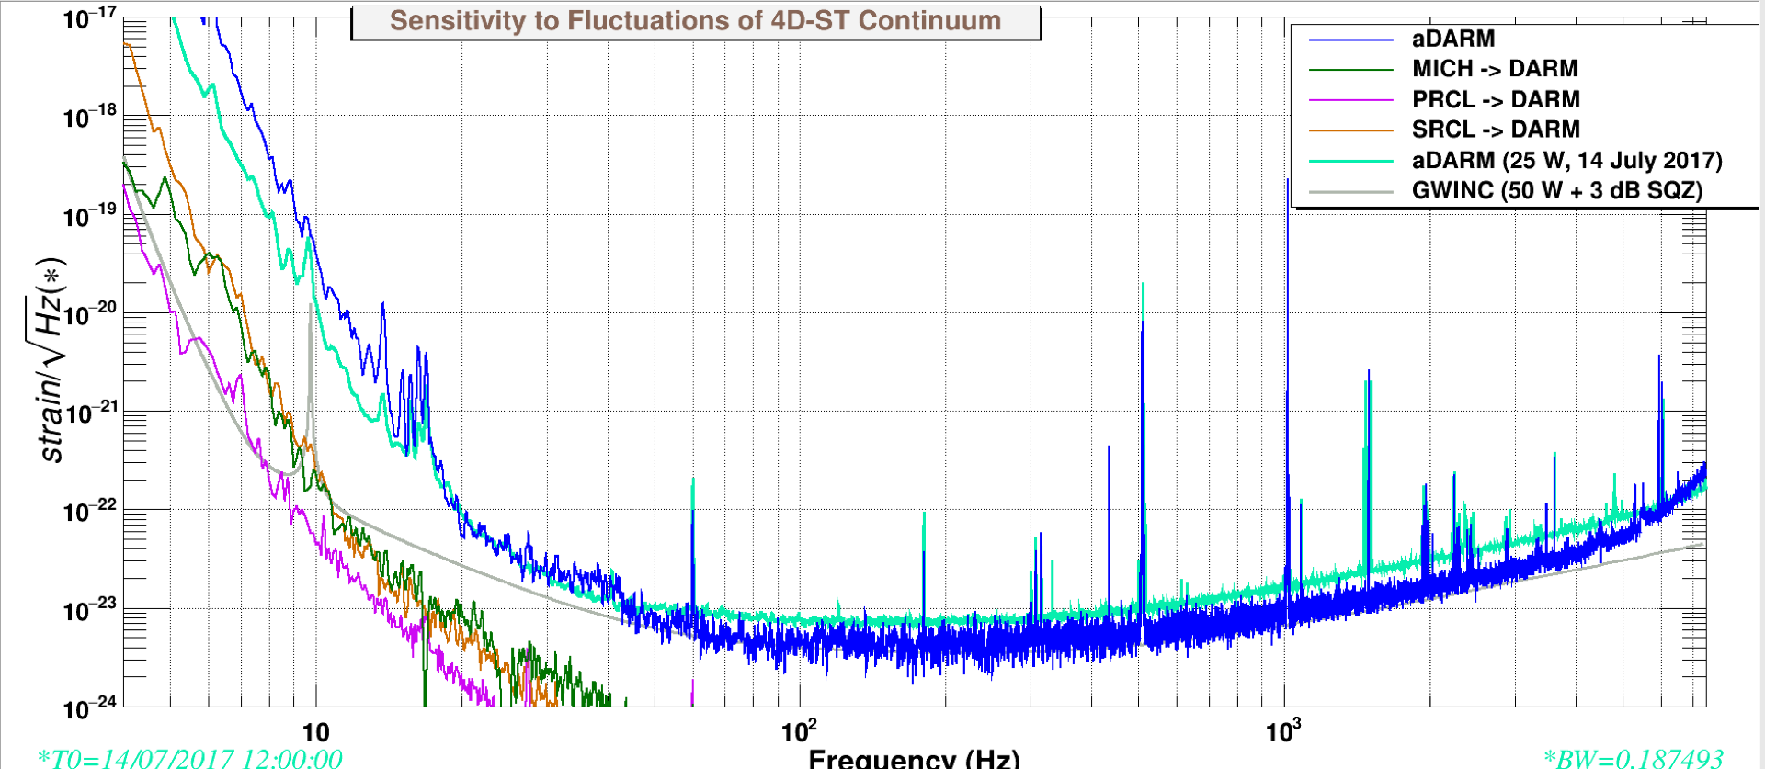
LLO status
Lost ~4.5% optical efficiency from before the break.
  Suspect new point absorbers on the end test mass
  Investigations ongoing.
  Some compensation for lost range by improved squeezer tuning.
Also dealing with large outside temperature variations (~75F to 25 F over a couple of days). Changes alignment, may have contributed to troublesome “ring up” of suspension fiber violin modes.
Damping the violin mode and cold/bad weather are the main reasons for the lower duty cycle at the start of O3b (~76% in O3a, ~65% so far in O3b).

Slide 8
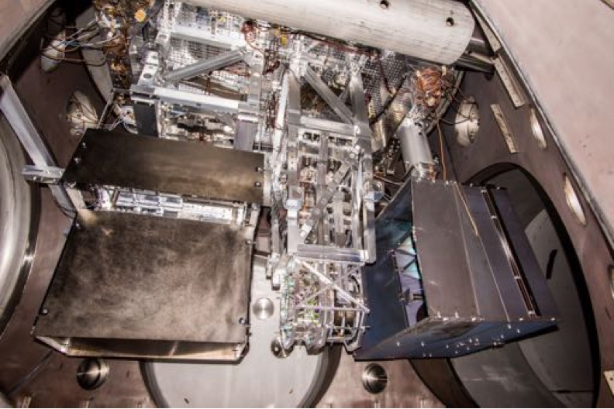
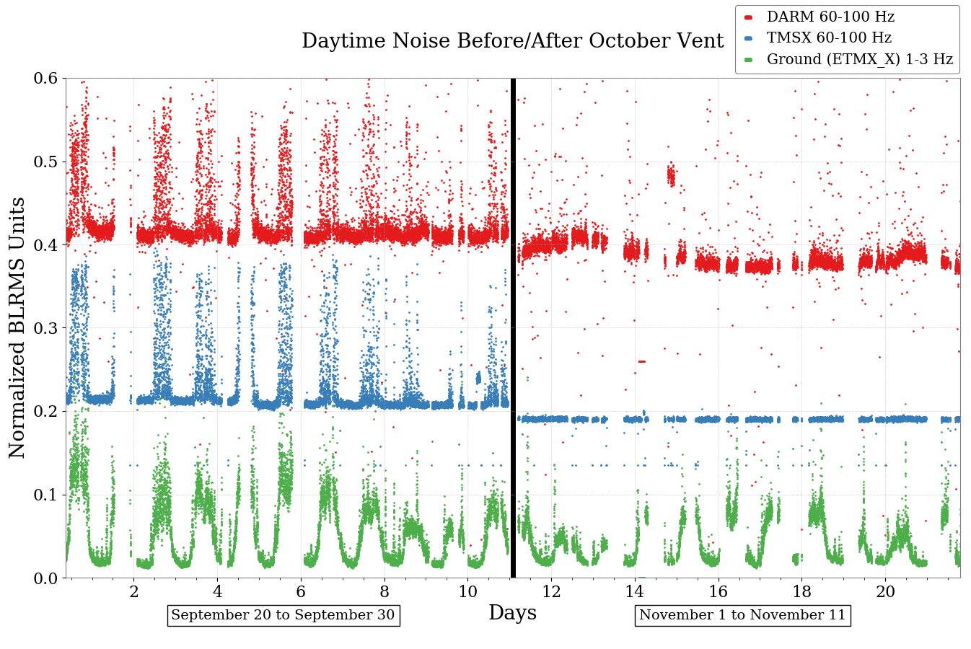
Improvements in Scattering Noise at LLO
During O3a we saw range drops that correlated with increased daytime noise.
Installed shroud around TMSX (Transmission Monitor Suspension at X-end) and baffles on the photon calibrator periscope and on viewport nozzles. After the break the correlation with daytime noise is gone. See alog entry here.

Slide 9
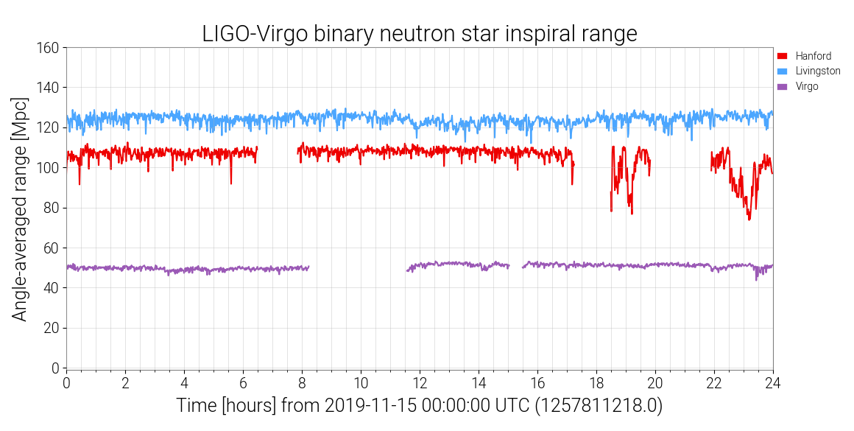
LHO status
Good duty cycle (~80% so far in O3b, ~71% in O3a)
Wind fence installation is being delayed further. Noisiest activities are over.
Not much impact on run time, apparent impact on the data during the noisiest activities.

Slide 10
Virgo status
Virgo is running steadily with almost 40 % higher power
Good duty cycle despite the very bad weather in the last weeks (strong wind, sea activity, storm, rain, possible flood)
At the begin of November high impact of misalignment and drift troubles in the laser system (high glitch rate) -> solved upgrading the cooling system to decrease the temperature of the laser amplifier
Some hints to make further investigations on the limiting noise in the mid-frequency range

Slide 11
KAGRA Present Status
Plan on 6th May
We are here
2019 | Jan | Feb | Mar | Apr | May | Jun | Jul | Aug | Sep | Oct | Nov | Dec
O3start
M
M
Noise hunting
Beam align
Pumping
P
R
M
I
Machine health check
Pumping
Yarm
FPMI
DRMI
DRFPMI
DR FPMI ASC/Laser power up
DR FPMI Noise Hunting
ASC/Laser power up
Short Eng
Run
Current schedule plan
Join O3
Y-TMS
VIS
ETMX WAB
Payload
control
Cooling
ETMX
Weekend run
Weekend run
Weekend
FPMI run
Cooling 3 TMs
Data Process Rehearsal (DPR) with IFO
ASC: Alignment Sensing Control
Noise hunting is undergoing with FPMI configuration. About 2 orders improvement is necessary to reach ~ “1” Mpc Binary range. (The target is 8 ~ 25Mpc in O3)
(PR)FPMI configuration will be used for Observation. We gave up DRFPMI configuration.
Several systems (VIS, AOS, DGS, MIF) in KAGRA are now under optimization.
Notes:
This slide shows outline of 2019 schedules. Upper panel shows schedule plan presented in the last PAB. Lower panel shows the current plan. I like to explain important difference between them.
This slide shows the schedule outline based on the Gantt chart.
Installation works, such as ...
ETMX WAB means installation of baffles in Xend. During this periods, we can not use ETMX. Major installation works complete in the next March.
We start beam alignment works for Xarm commissioning from September. The Xarm commissioning continues early December. From the end of November, we start beam alignment works for Yarm and DRMI commissioning. When ETMX is ready, we start commissioning of full interferometer. In this periods the full interferometer is FPMI.
After FPMI, we will proceed DRFPMI or FPMI.
In the case of DRFPMI, we start commissioning with low laser power. After then we construct alignment sensing control system with laser power increase. Then we do post commissioning and installation of baffles. I will explain later.
In the case of FPMI, we construct ASC system and then we do post com and baffle installation.

