Slide 1




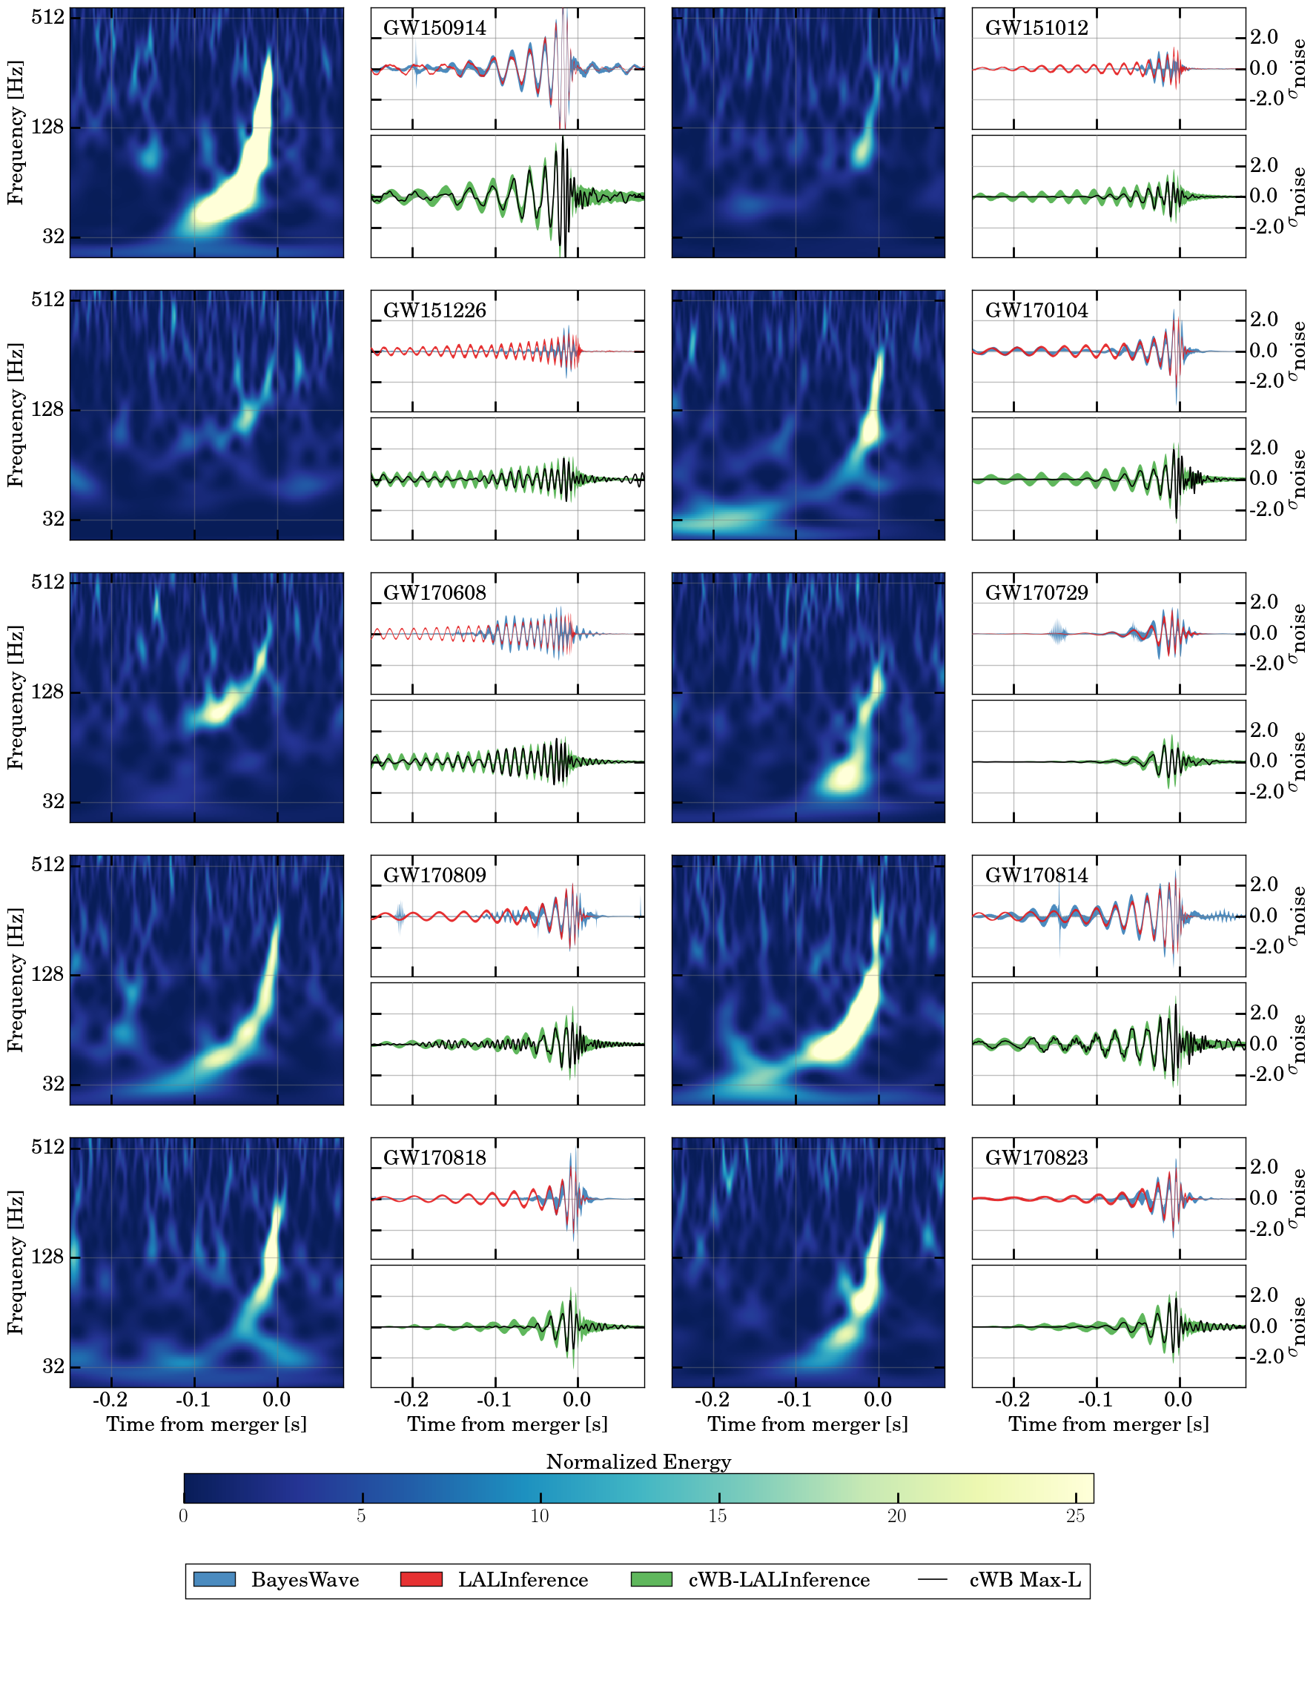
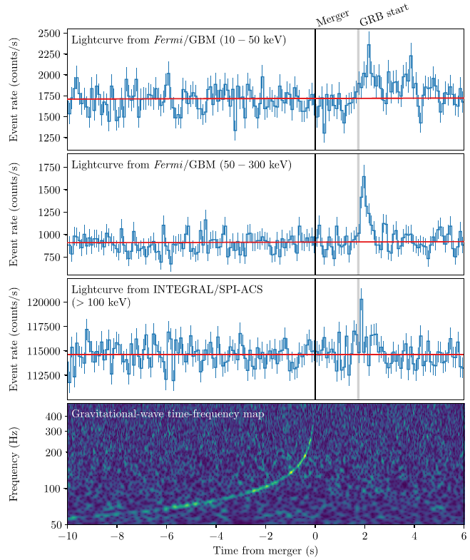
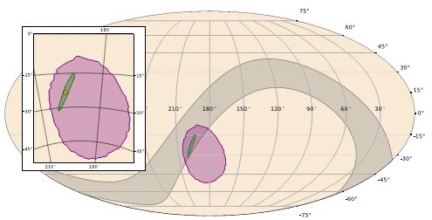
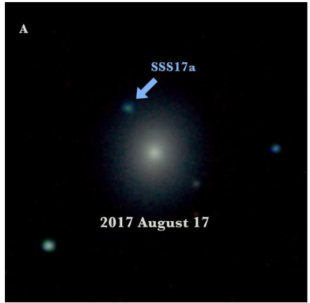
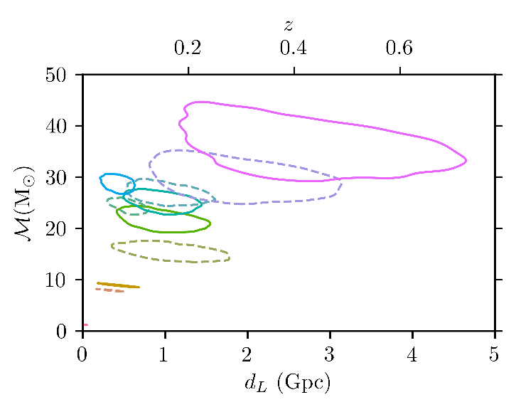
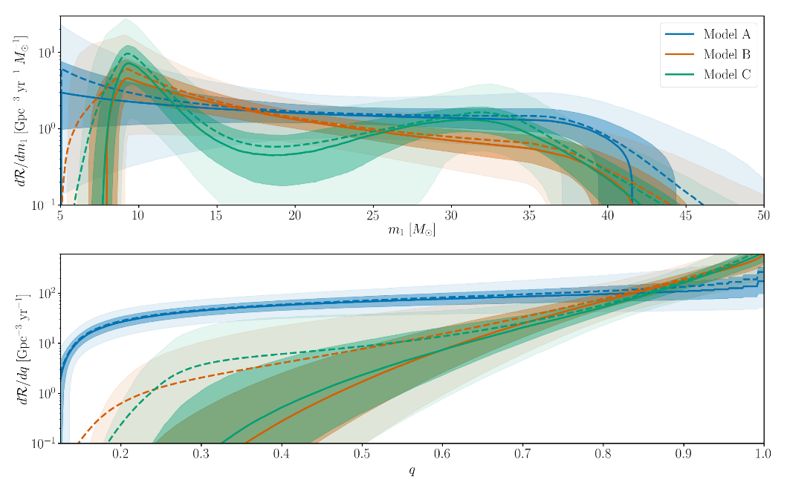
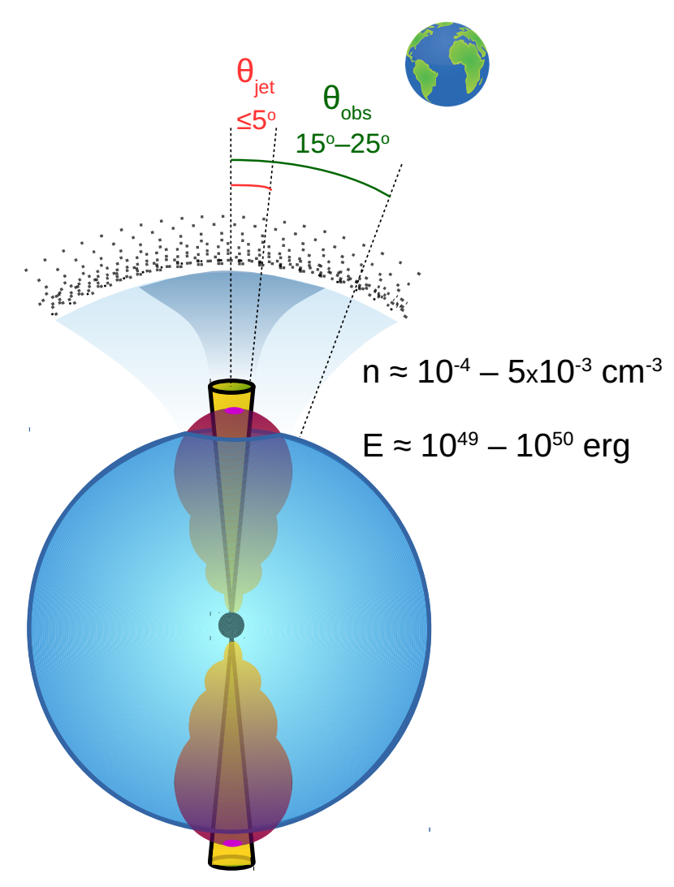
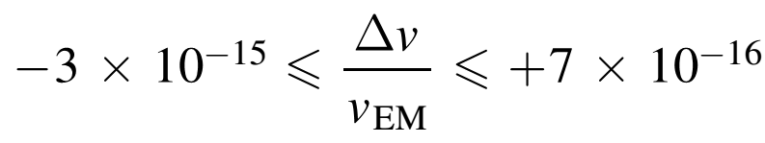

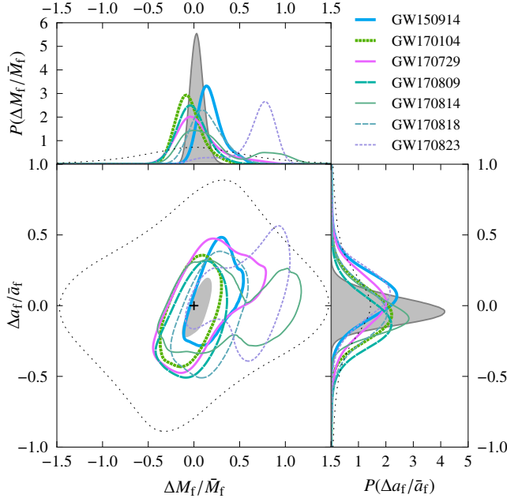
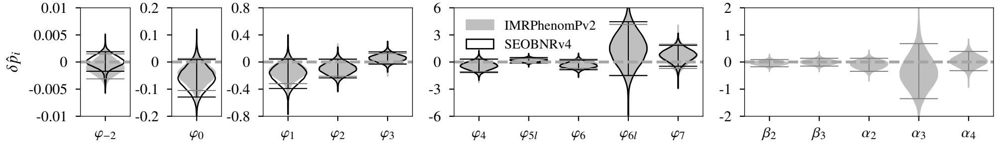
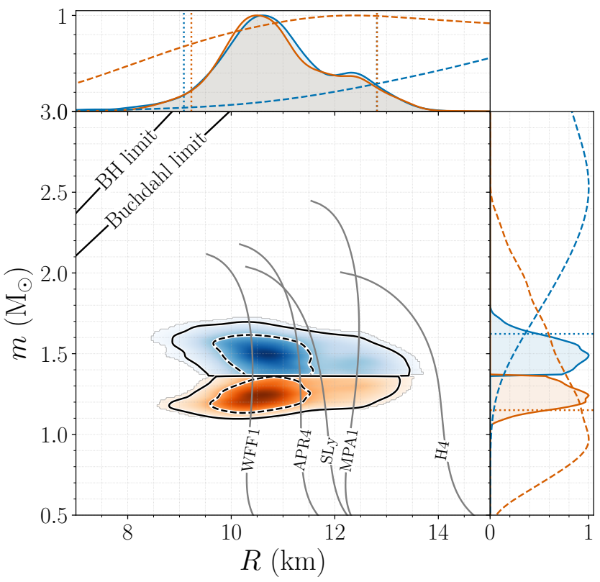
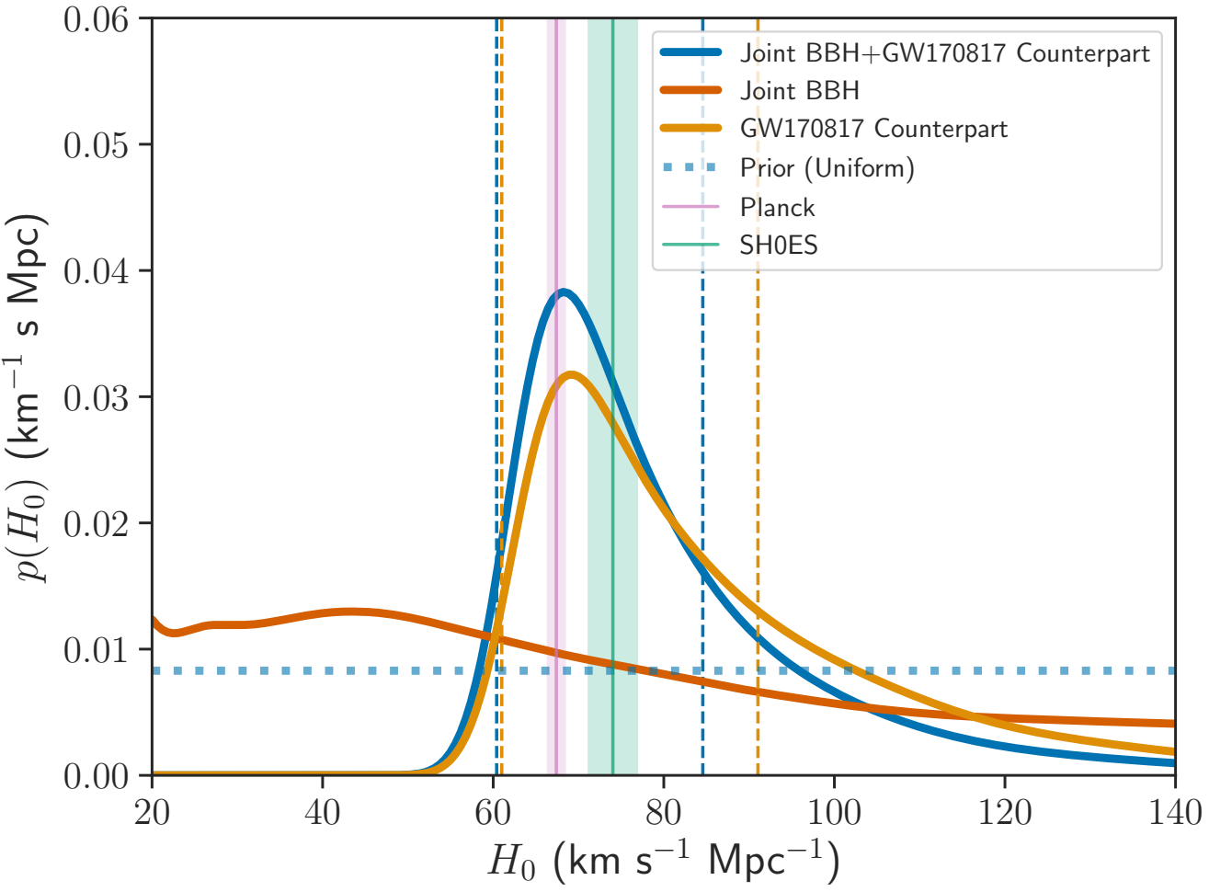
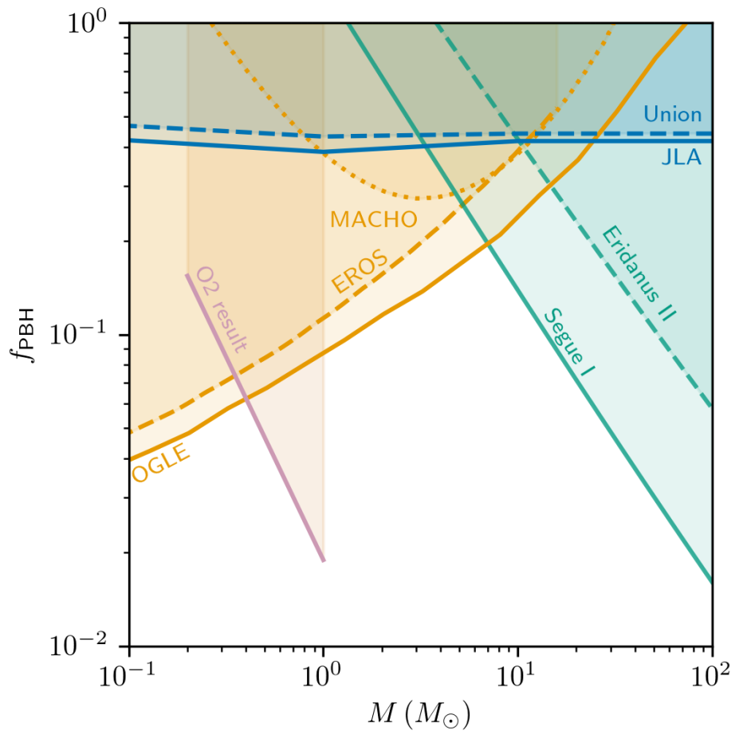
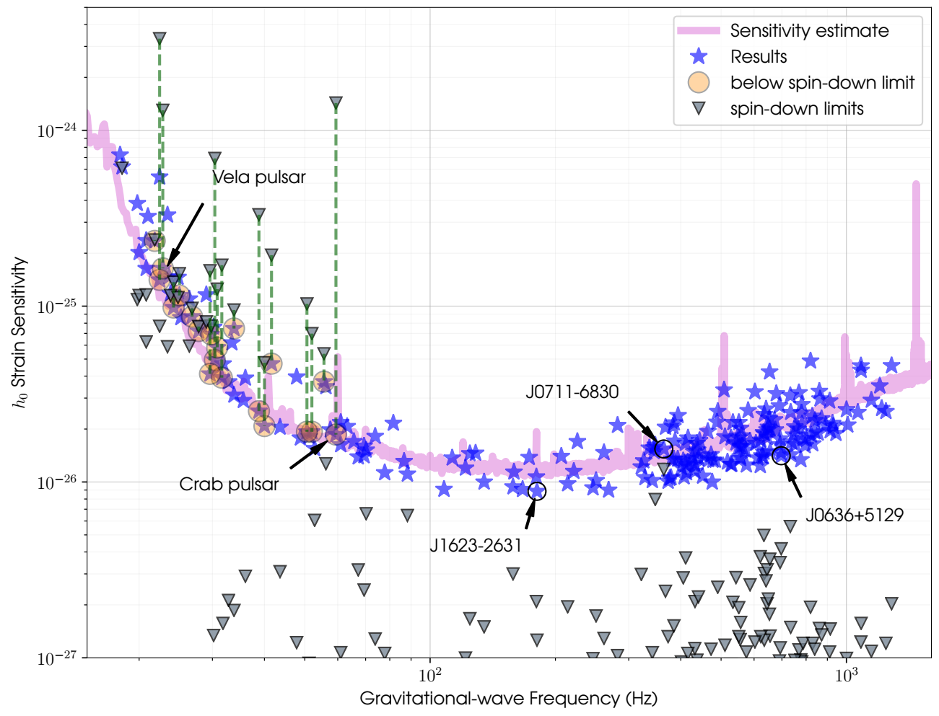
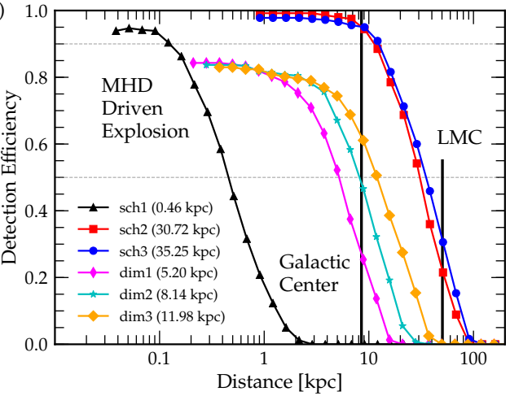
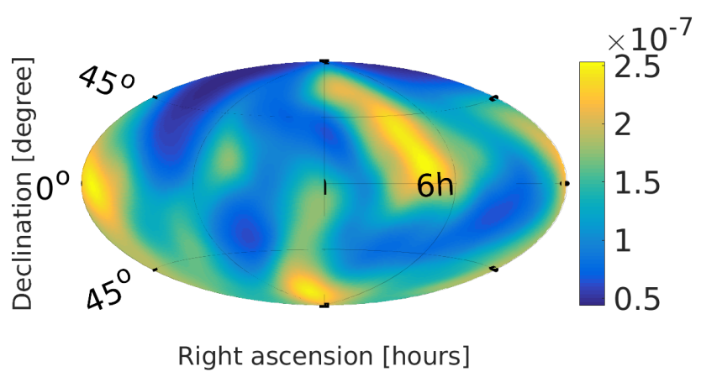
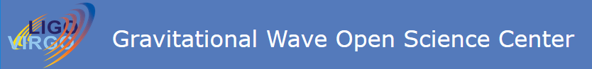
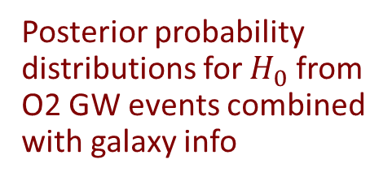



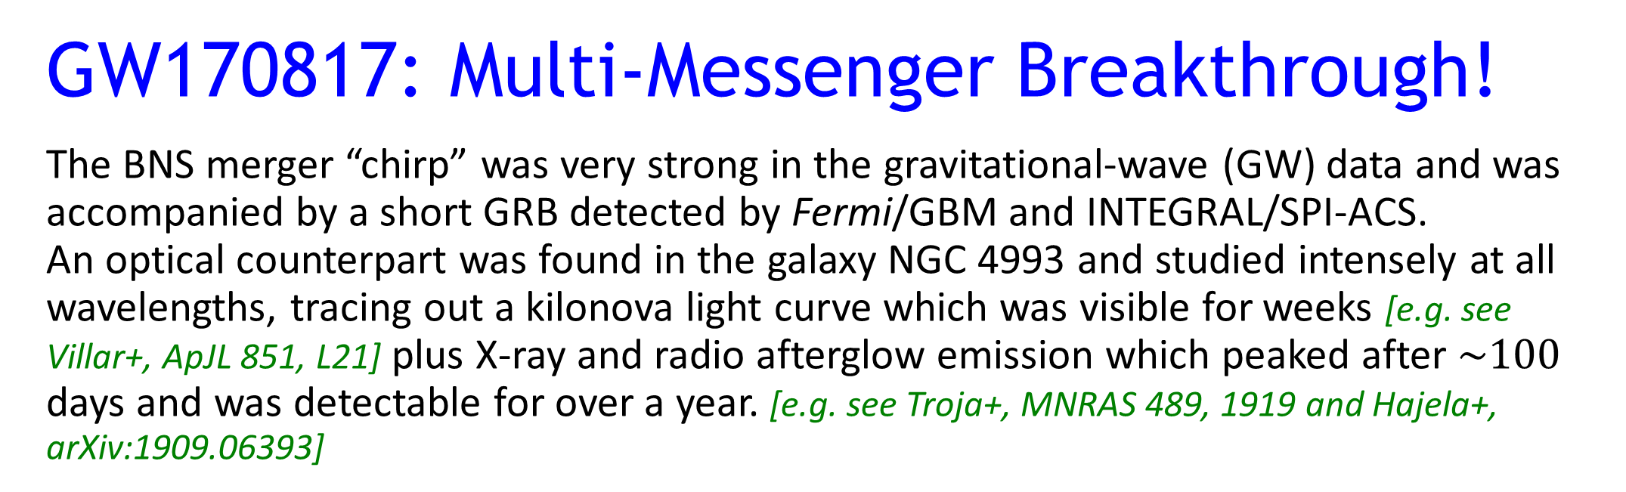

LIGO and Virgo Results
from the O2 Observing Run
Peter S. Shawhan
(University of Maryland and
Joint Space-Science Institute)
for the LIGO Scientific Collaboration
and the Virgo Collaboration
Poster 107.01
235th AAS Meeting — Honolulu, Hawai’i — January 5, 2020
LIGO-G1901966-v3
Seven BBH GW Events Confidently Detected in O2
During the O2 observing run (30 Nov 2016 to 25 Aug 2017), NSF’s Advanced LIGO observatories and Europe’s Advanced Virgo detected 7 binary black hole (BBH) mergers plus one binary neutron star (BNS) merger. Together with the 3 BBH mergers detected during the O1 run, these were published as the GWTC-1 catalog [Abbott+, PRX 9, 031040]
plus
GW170817: Multi-Messenger Breakthrough!
The BNS merger “chirp” was very strong in the gravitational-wave (GW) data and was accompanied by a short GRB detected by Fermi/GBM and INTEGRAL/SPI-ACS.
An optical counterpart was found in the galaxy NGC 4993 and studied intensely at all wavelengths, tracing out a kilonova light curve which was visible for weeks [e.g. see Villar+, ApJL 851, L21] plus X-ray and radio afterglow emission which peaked after $\sim 100$ days and was detectable for over a year. [e.g. see Troja+, MNRAS 489, 1919 and Hajela+, arXiv:1909.06393]
[Drout+ 2017, Science 10.1126/science.aaq0049]
[Also PRL 118, 221101 (GW170104); ApJL 851, L35 (GW170608); PRL 119, 141101 (GW170814)]
NGC 4993 (~40 Mpc)
Inferred merger rate density
[Abbott+, PRL 119, 161101; ApJ 848, L13; ApJ 848, L12]
Confirmed picture of BNS mergers
as progenitors of short-hard GRBs—
in this case, detected off-axis.
VLBI imaging [Mooley+, Nature 561]
and other observational handles are
consistent with viewing angle $\sim {20}^{∘}$
Verified to high precision that
GWs travel at the speed of light
Investigated dynamical
ejecta contribution to kilonova
associated with GW170817
[Abbott+, ApJL 850, L39;
also many other papers]
Detailed study of binary system properties from the GW waveform [Abbott+, PRX 9, 01101]
vs. mass of heavier BH
Chirp mass
(in source frame) vs. luminosity distance
vs. mass ratio
(3 different models)
Spectrograms and reconstructed signals (inferred
from strain data, whitened) for the 10 BBH mergers
Enables inferences about the BBH merger rate and distribution of progenitor system parameters [Abbott+, ApJL 882, L24]
Additional events/candidates with lower significance have been reported by other groups and in the GWTC-1 catalog paper
Tests of General Relativity (GR)
Using detailed studies of the waveforms to test general relativity
Tests of GR with GW170817 [Abbott+, PRL 123, 011102]
Tests of GR with BBH signals in the GWTC-1 catalog [Abbott+, PRD 100, 104036]
Price/Rosswog/Press
Neutron Star Astrophysics Investigations
Inferences from the detection and properties of GW170817
Searched for a post-merger GW signal from a metastable remnant, up to $\sim 1$ second or up to $\sim 500$ seconds long [Abbott+, ApJL 851, L16]
Searched for GWs from a possible long-lived remnant, up to 8.5 days (when the O2 run ended) [Abbott+, ApJ 875, 160]
Consideration of where and how the progenitor BNS system formed [Abbott+, ApJL 850, L40]
Measurements of neutron star equation of state (EOS)
and radii, using EOS models, EOS-insensitive relations,
or parameterized EOS [Abbott+, PRX 9, 10010; PRL 121, 161101]
Model comparison from LIGO-Virgo data on
GW170817’s binary components and consequences
for the merger remnant [Abbott+, arXiv:1908.01012]
Constraining the p-mode – g-mode nonlinear tidal
instability [Abbott+ and N. Weinberg, PRL 122, 061104]
Combined posteriors and limits on parameters describing GR violations
Inspiral-merger-ringdown consistency test
Cosmological Measurements
Binary mergers are “standard sirens”, measuring luminosity distance directly – although with statistical uncertainty if the binary orbit inclination angle is unknown
Measurement of the Hubble constant from associating GW170817 with the redshift of the cluster including its host galaxy, NGC 4993 [LIGO, Virgo, 1M2H, DECam GW-EM and DES Collaboration, DLT40, Las Cumbres Observatory, VINROUGE and MASTER, Nature 551, 85]
Implications for the stochastic GW background from BNS mergers
like GW170817 [Abbott+, PRL 120, 091101]
“Dark standard siren” measurement of the Hubble constant by
associating the BBH merger GW170814 statistically with galaxies
cataloged by the Dark Energy Survey [Soares-Santos+, ApJL 876, L7]
Combined Hubble constant measurement using statistical analysis of
several BBH events together with GW170817 [Abbott+, arXiv:1908.06060]
Heavier NS
Posterior probability distributions for $H_{0}$ from O2 GW events combined with galaxy info
Marginalized posteriors for mass and areal radius for the neutron stars which merged in GW170817
Lighter NS
Additional Multi-Messenger Searches
Rapid searches for EM counterparts was enabled by low-latency analysis of the GW data, selection of promising GW event candidates, and communication of their times, types and sky localization to astronomers [Abbott+, ApJ 875, 161]
Besides the observed electromagnetic counterpart to GW170817:
Search for high-energy neutrinos from the BNS merger GW170817 with ANTARES, IceCube and the Pierre Auger Observatory [ANTARES, IceCube, Pierre Auger, LIGO and Virgo, ApJL 850, L35]
And searches for GWs associated with astrophysical phenomena recorded during the O2 run:
Search for transient GW signals associated with magnetar bursts [Abbott+, ApJ 874, 163]
Search for GW signals (binary merger or generic GW burst) associated with any of $\sim 100$ gamma-ray bursts which were detected during the O2 run; no signal found except in the case of GW170817 [LIGO, Virgo and IPN, ApJ 886, 75]
Optically targeted search for GWs emitted by core-collapse
supernovae, sensitive out to several kpc, tens of kpc or
tens of Mpc for some emission models
[LIGO, Virgo, DLT-40 and ASSASN, arXiv:1908.03584]
Searches for Other Types of GW Signals
LIGO and Virgo are still exploring the gravitational-wave sky with data analyses optimized for a wide variety of plausible signals
Other classes of compact binary mergers
Search for sub-solar-mass ultracompact binaries, e.g. of primordial black holes
[Abbott+ and S. Shandera, PRL 123, 161102]
Search for intermediate mass black hole binary (IMBHB) mergers with total masses
up to $\sim 800 M_{⊙}$; distance reach $>1$ Gpc around $100+100 M_{⊙}$ [Abbott+, PRD 100, 064064]
Search for eccentric BBH mergers [Abbott+, 883, 149]
Continuous-wave (quasiperiodic) GW signals
Searches for GW signals from known pulsars; for 20 of them, set upper limits below allowable GW fluxes inferred from spin-down [Abbott+ and radio astronomers, ApJ 879, 10; PRD 99, 122002]
Search for GWs from Scorpius X-1 (the brightest low-mass X-ray binary) over a frequency range 60-650 Hz and allowing for spin wandering [Abbott+, PRD 100, 122002]
All-sky search for continuous GW signals from isolated neutron stars which are spinning
and not axisymmetric, from 20 to >1900 Hz [Abbott+, PRD 100, 024004]
A stochastic background of GWs, from cosmological and/or astrophysical sources
Search for an isotropic stochastic GW background [Abbott+, PRD 100, 061101]
Directional limits on persistent stochastic GWs [Abbott+, PRD 100, 062001]
GW “bursts” (generic transient searches)
All-sky search for short-duration (up to $\sim 1$ sec) GW bursts [Abbott+, PRD 100, 024017]
All-sky search for long-duration (up to $\sim 500$ sec) GW bursts [Abbott+, PRD 99, 104033]
Constraints on fraction of dark matter composed of primordial black holes
GW detection efficiency vs. distance for one class of core-collapse supernova models
Upper limits on continuous-wave GW strain amplitude for 221 pulsars
Download LIGO/Virgo Data and Software Tools
from gw-openscience.org
In addition to online materials, see guides to the data and recommended analysis techniques: [Abbott+, arXiv:1912.11716; arXiv:1908.11170]
Also see poster 103.03, “Discovery and Analysis with Public LIGO and Virgo Data” (Jonah Kanner)
Directional upper limits on stochastic GW energy flux, assuming flat spectrum
This work is supported by the U. S. National Science Foundation through grant PHY-1710286. In addition, the authors gratefully acknowledge the support of the NSF for the construction and operation of the LIGO Laboratory and Advanced LIGO as well as the Science and Technology Facilities Council (STFC) of the United Kingdom, the Max-Planck-Society (MPS), and the State of Niedersachsen/Germany for support of the construction of Advanced LIGO and construction and operation of the GEO600 detector. Additional support for Advanced LIGO was provided by the Australian Research Council. The authors gratefully acknowledge the Italian Istituto Nazionale di Fisica Nucleare (INFN), the French Centre National de la Recherche Scientifique (CNRS) and the Foundation for Fundamental Research on Matter supported by the Netherlands Organisation for Scientific Research, for the construction and operation of the Virgo detector and the creation and support of the EGO consortium. The authors also gratefully acknowledge research support from these agencies as well as by the Council of Scientific and Industrial Research of India; the Department of Science and Technology, India; the Science & Engineering Research Board (SERB), India; the Ministry of Human Resource Development, India; the Spanish Agencia Estatal de Investigación; the Vicepresidència i Conselleria d'Innovació,
Recerca i Turisme and the Conselleria d'Educació i Universitat del Govern de les Illes Balears; the Conselleria d'Educació, Investigació, Cultura i Esport de la Generalitat Valenciana; the National Science Centre of Poland; the Swiss National Science Foundation (SNSF); the Russian Foundation for Basic Research; the Russian Science Foundation; the European Commission; the European Regional Development Funds (ERDF); the Royal Society; the Scottish Funding Council; the Scottish Universities Physics Alliance; the Hungarian Scientific Research Fund (OTKA); the Lyon Institute of Origins (LIO); the Paris Île-de-France Region; the National Research, Development and Innovation Office Hungary (NKFIH); the National Research Foundation of Korea; Industry Canada and the Province of Ontario through the Ministry of Economic Development and Innovation; the Natural Science and Engineering Research Council Canada; the Canadian Institute for Advanced Research; the Brazilian Ministry of Science, Technology, Innovations, and Communications; the International Center for Theoretical Physics South American Institute for Fundamental Research (ICTP-SAIFR); the Research Grants Council of Hong Kong; the National Natural Science Foundation of China (NSFC); the Leverhulme Trust; the Research Corporation; the Ministry of Science and Technology (MOST), Taiwan; and the Kavli Foundation. The authors gratefully acknowledge the support of the NSF, STFC, MPS, INFN, CNRS and the State of Niedersachsen/Germany for provision of computational resources.

