Slide 1
O3 LIGO-Virgo-KAGRA update,
September 26 2019
Keita Kawabe, Shinji Miyoki,
Brian O’Reilly, Matteo Tacca

Slide 2
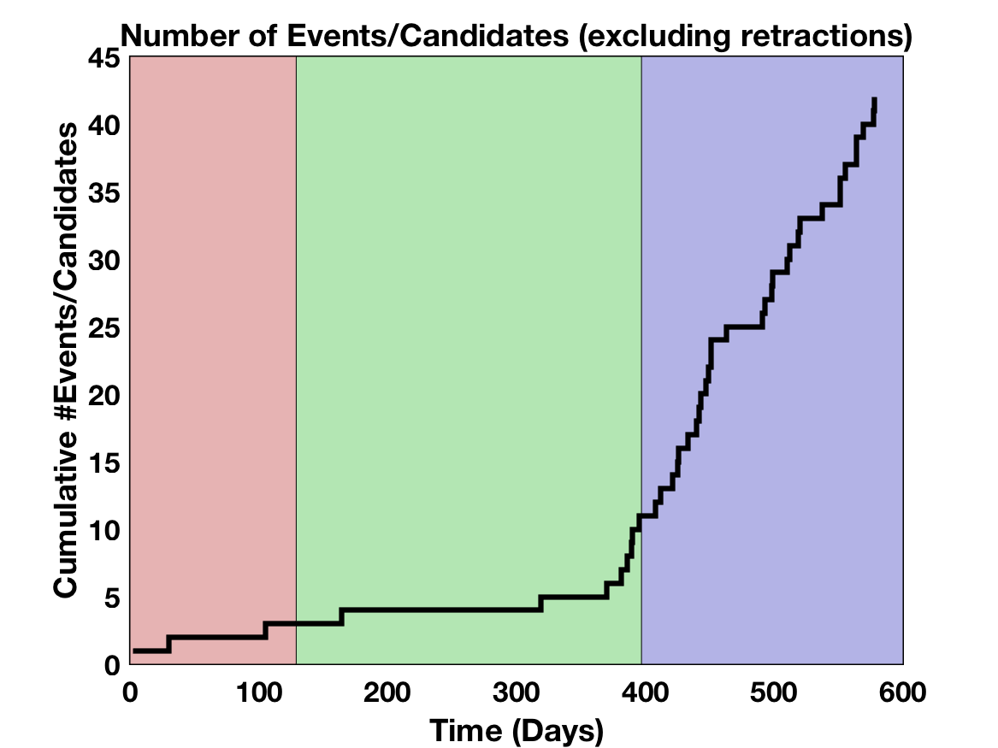
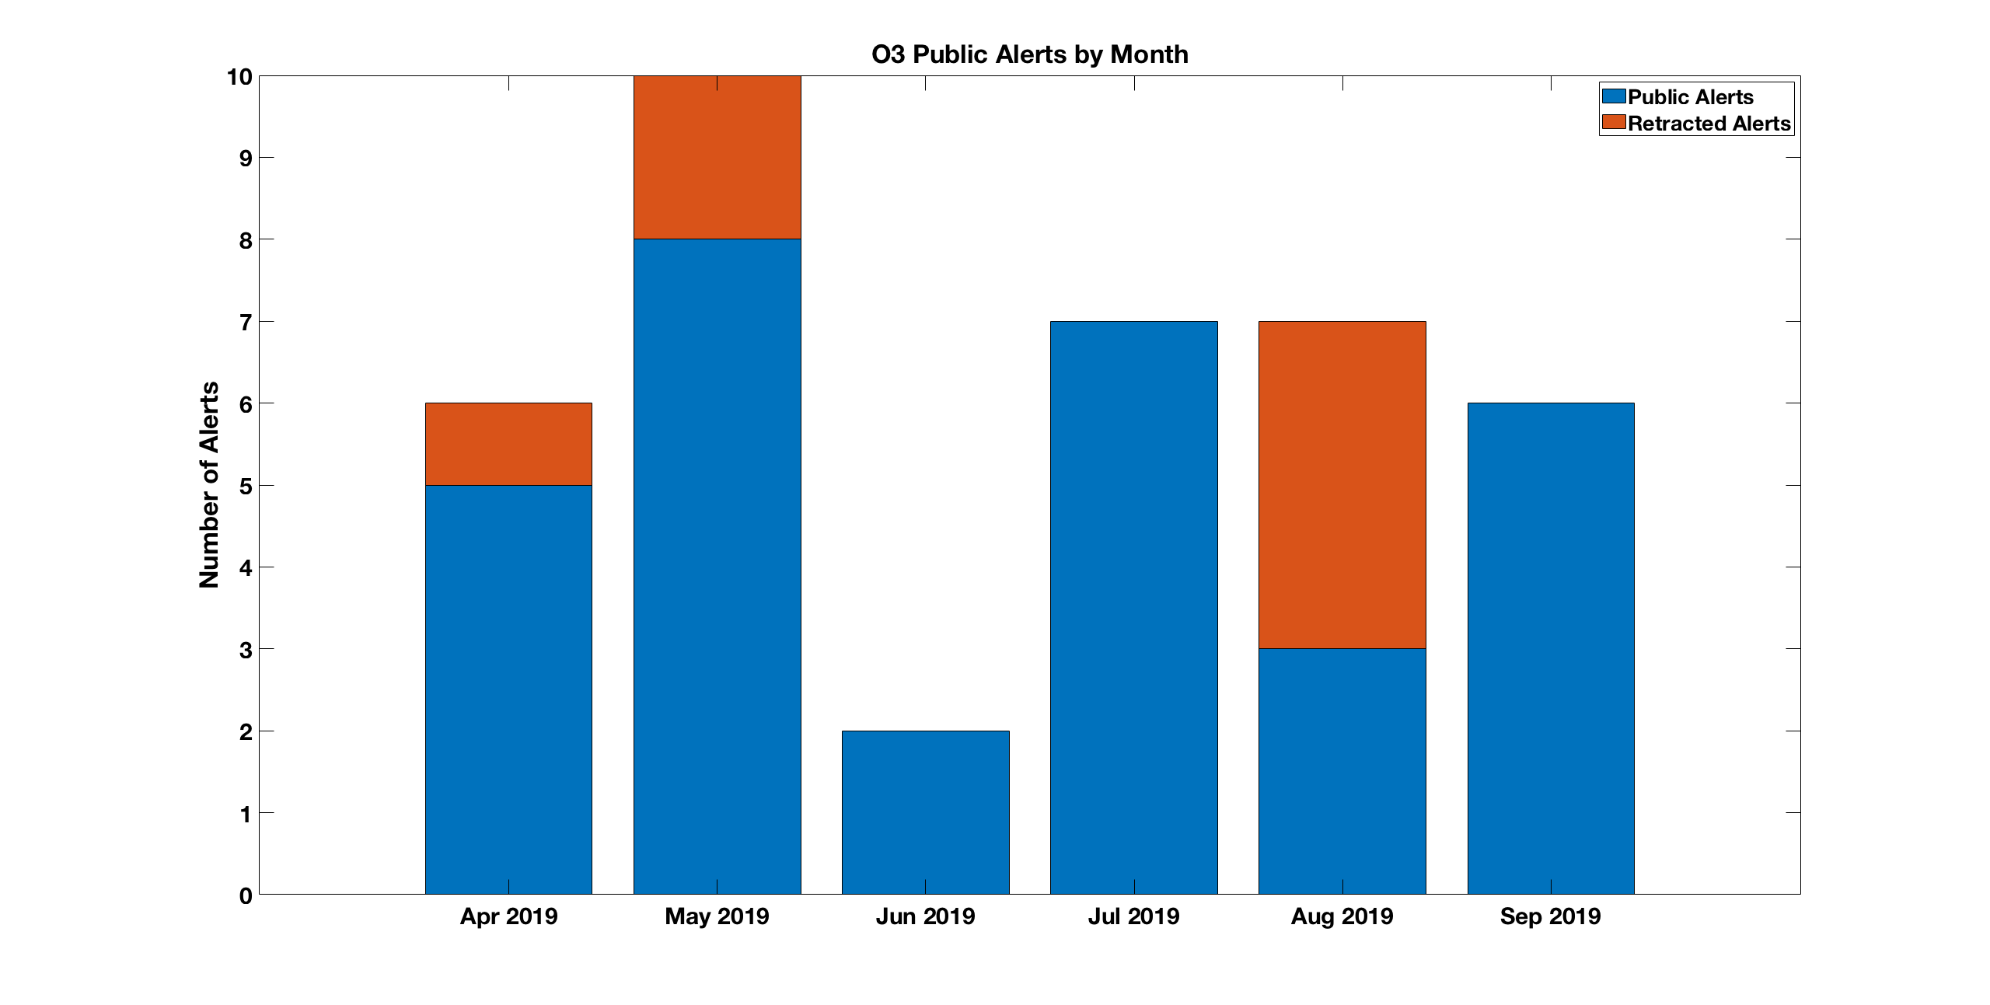
38 Alerts so far in O3, 7 retractions.
Mean number of alerts (not retracted)
5.3 +/- 2.3 per month
O1
O2
O3

Slide 3
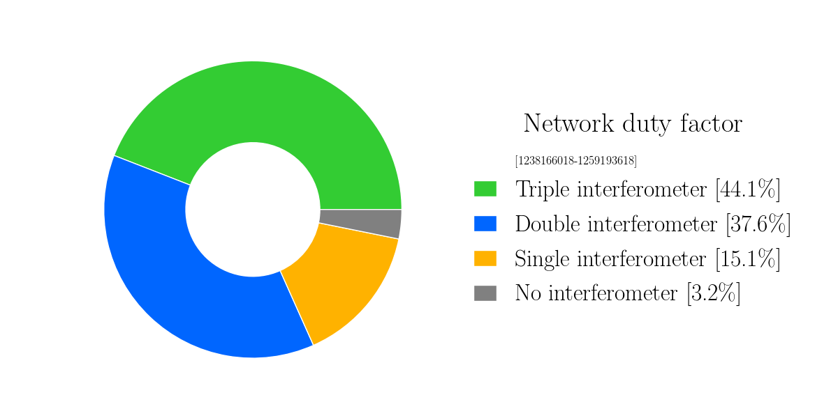
Detector Performance: O3 Cumulative Duty Factor

Slide 4
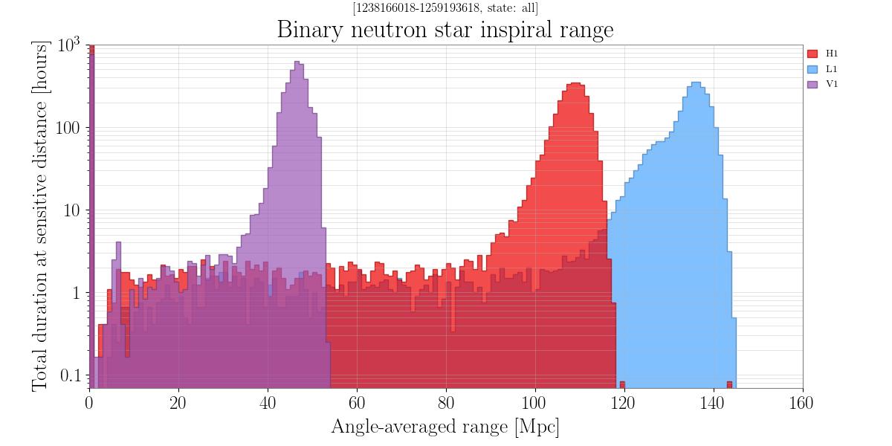

Slide 5
New Alerts Since August
S190828j : FAR = 1/10¹³ years, P_{BBH} > 99%
S190828l : FAR = 1/684 years, P_{BBH} > 99%
S190901ap: FAR = 1/4.5 years, P_{BNS}=86%, P_{Terrestrial} = 14%
  Updated skymap: 90% CR = 14753 deg²
S190910d: FAR = 1/8.5 years, P_{NSBH} =98%, P_{Terrestrial} = 2%
  Updated sky localization with Virgo added. Still 2482 deg²
S190910h: FAR = 1/10 months, P_{BNS} = 61% P_{Terrestrial} = 39%
S190915ak: FAR = 1/32.5 years, P_{BBH} > 99%
S190923y: FAR = 1/8 months, P_{NSBH} = 68%, P_{Terrestrial} = 32%
S190924h: FAR = 1/10¹⁰ years, P_{MASSGAP} > 99% HasNS = 30%, HasRemnant < 1%

Slide 6
Retracted Alerts Since August
S190816i : FAR = 1/2 yrs, Detector Characterization and pipeline expert evaluation recommended retraction due to instrument noise.
  Retraction took 20 minutes from time of preliminary notice.
S190822c: After removal of a loud glitch in L1 no significant signal remained.
  Initial indications were a BNS candidate with very low FAR.
  Retraction took 102 minutes from time of preliminary notice.
S190829u: Automatic gating in the GstLAL pipeline rejected this event during the vetting process. This automatic gating of glitches is now deployed to production.
  Retraction took 26 minutes from time of preliminary notice.
Since August 15 :
  Preliminary Notice issued on average approximately 9 minutes after the Event.
  Initial Notice issued on average approx. 36 minutes after the Event.
  Retraction issued on average approximately 44 minutes after Event.

Slide 7
KAGRA Present Status
Plan on 6th May
We are here
2019 | Jan | Feb | Mar | Apr | May | Jun | Jul | Aug | Sep | Oct | Nov | Dec
O3start
M
M
M
Beam align
Pumping
P
R
M
I
Machine health check
Pumping
Yarm
FPMI
DRMI
DRFPMI
DRFPMI ASC/Laser power up
Post COM.
Noise hunting
Current schedule plan
Mid-size
Baffle
Join O3
Y-TMS
VIS
ETMX WAB
Payload
control
Cooling
ETMX
Weekend run
Weekend run
Weekend
FPMI run
Cooling 3 TMs
Data Process Rehearsal (DPR) with IFO
ASC: Alignment Sensing Control
FPMI, SRMI configuration with low laser power was realized in August/September. The first sensitivity was obtained with FPMI configuration. 3.5 orders improvement is necessary to reach ~ “1” Mpc Binary range. (The target is 8 ~ 25Mpc in O3)
DRFPMI (or PRFPMI) configuration to obtain the better sensitivity was not realized yet.
Several systems (Vibration Isolation, Auxiliary Optics, Digital System, Main Interferometer) in KAGRA are now under optimization.
Notes:
This slide shows outline of 2019 schedules. Upper panel shows schedule plan presented in the last PAB. Lower panel shows the current plan. I like to explain important difference between them.
This slide shows the schedule outline based on the Gantt chart.
Installation works, such as ...
ETMX WAB means installation of baffles in Xend. During this periods, we can not use ETMX. Major installation works complete in the next March.
We start beam alignment works for Xarm commissioning from September. The Xarm commissioning continues early December. From the end of November, we start beam alignment works for Yarm and DRMI commissioning. When ETMX is ready, we start commissioning of full interferometer. In this periods the full interferometer is FPMI.
After FPMI, we will proceed DRFPMI or FPMI.
In the case of DRFPMI, we start commissioning with low laser power. After then we construct alignment sensing control system with laser power increase. Then we do post commissioning and installation of baffles. I will explain later.
In the case of FPMI, we construct ASC system and then we do post com and baffle installation.

Slide 8
Commissioning Break 1st to 31st Oct 2019
Expect no observation by LIGO/Virgo: 1/Oct/2019 1500 UTC - 1/Nov/2019 1500 UTC.
New end date April 30 2020 to preserve 1 year observation.

