Slide 1
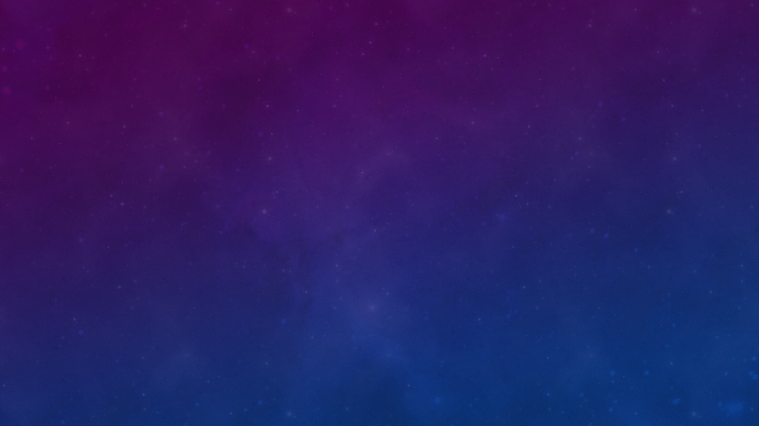
Gravitational wave polarization
A General relativity test
Samuel Patrone¹
Mentor: Alan Weinstein²
¹INFN, Sezione di Roma, I-00185 Roma, Italy
²LIGO, California Institute of Technology, Pasadena, USA

Slide 2
Research question
How well can we constrain small admixtures of scalar and/or vector polarizations in Gravitational Wave Transient detection, given the extended network of five ground interferometers available in the near future?

Slide 3
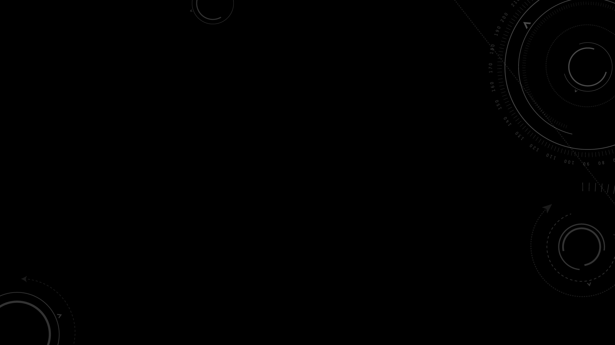
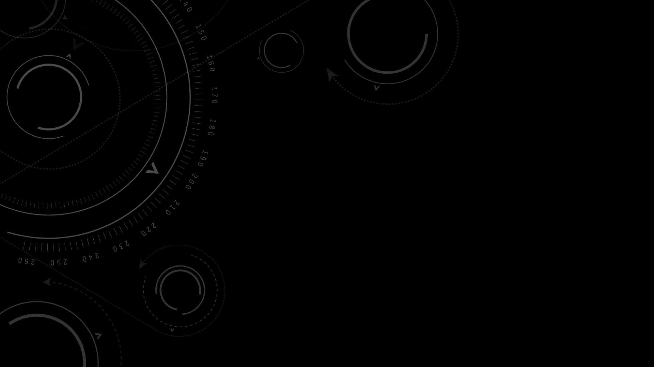
Gravitational Waves Polarization and Detector Response
Network of Interferometers and Overlap Factor
Toy Model for a non-GR signal
Nested Sampling and Bayesian Approach
Parameter estimation
Future work
Overview
3

Slide 4




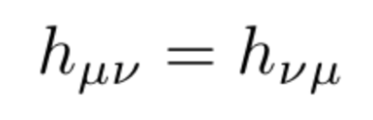
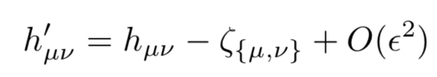

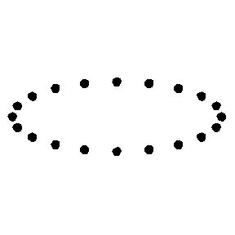
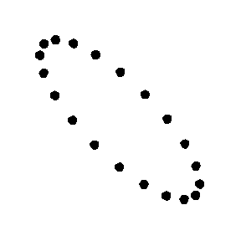
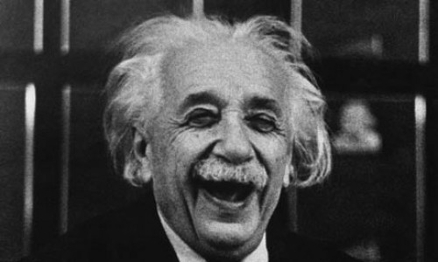
Two Polarizations
Linearized Theory of Gravity
4x4 metric
10 dof
6 dof
2 dof
Einstein Equations
(Bianchi Identity)
Symmetry
Gauge Invariance
TT-Gauge
Plus
Cross

Slide 5
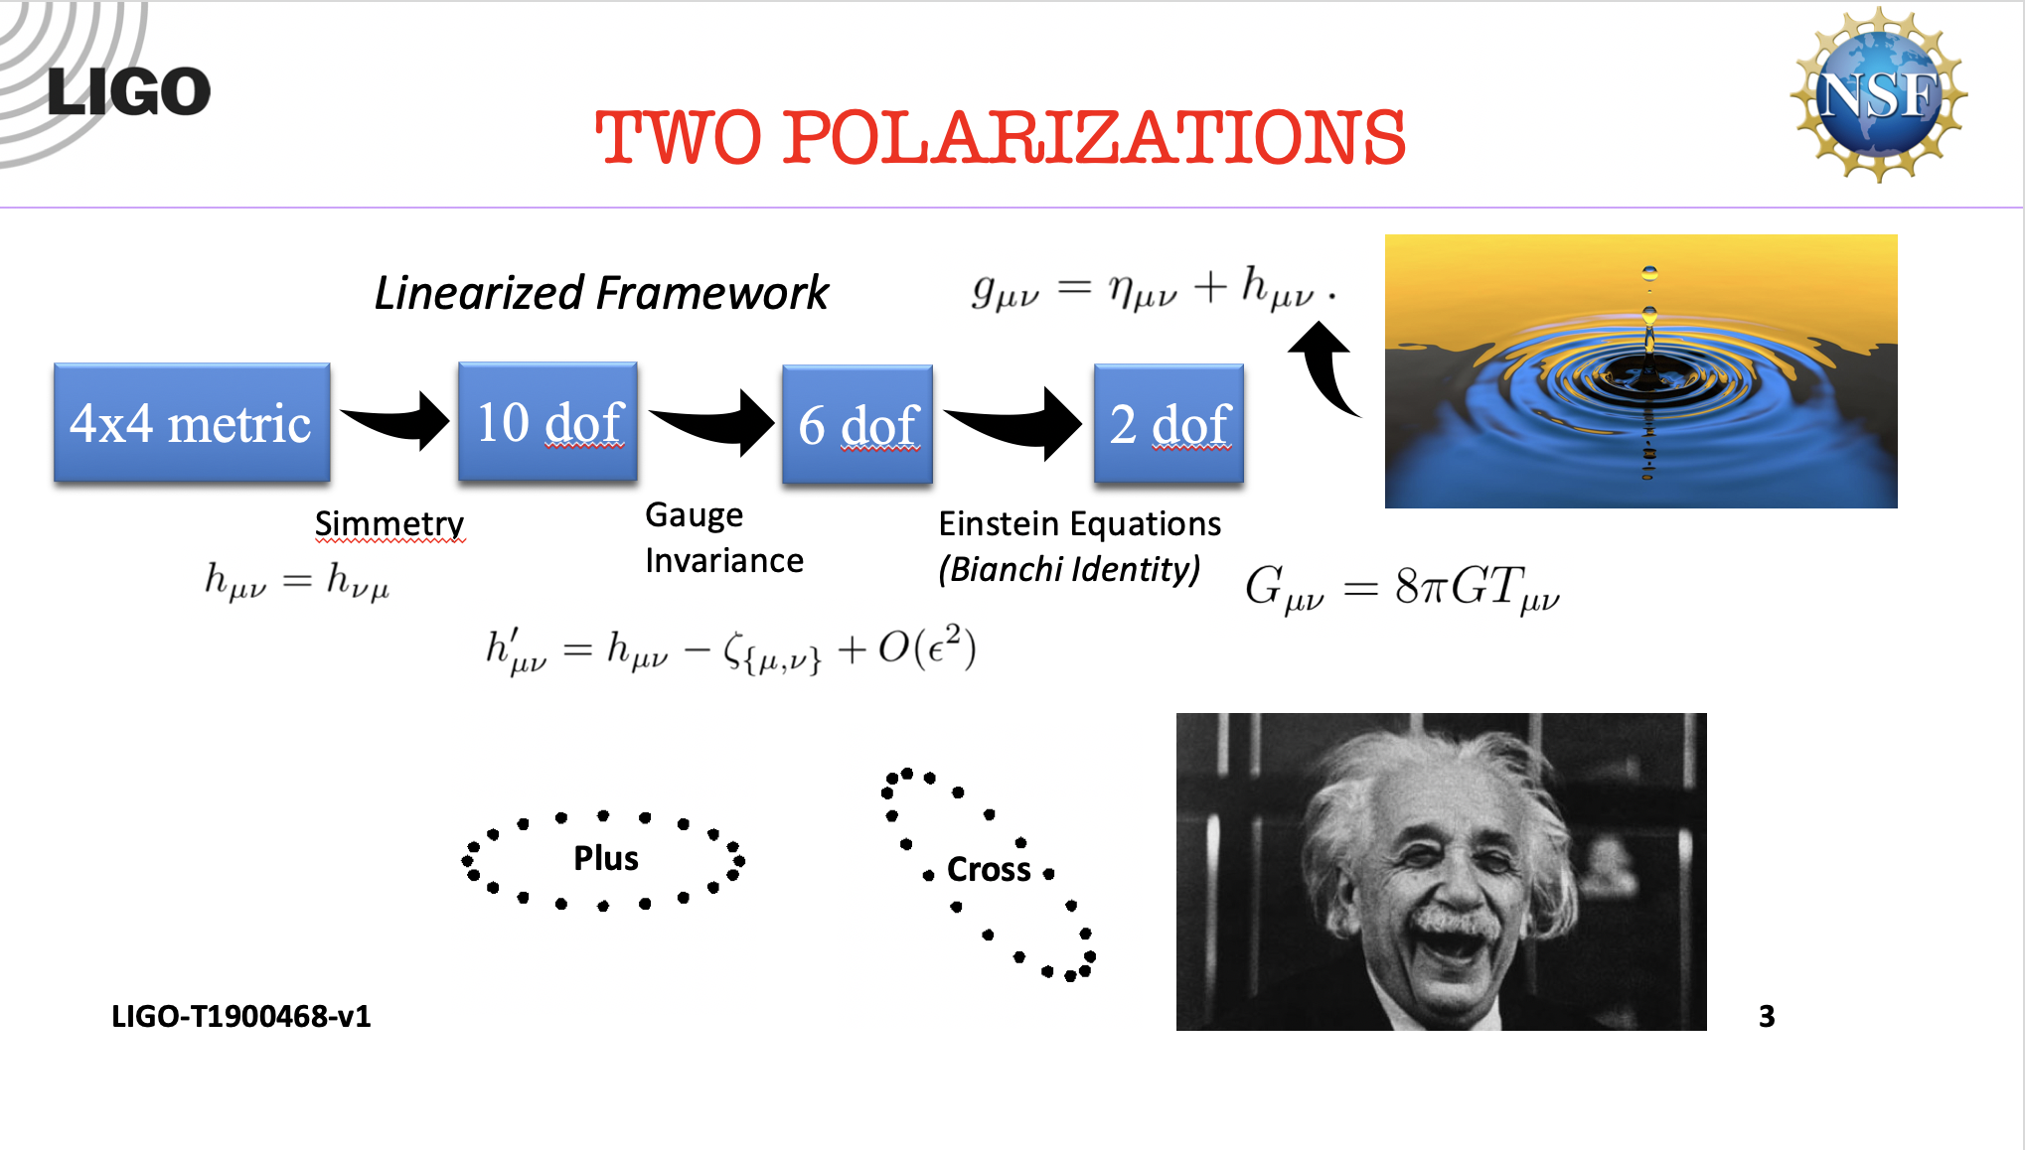
What if
Einstein’s gr is not the ultimate theory of gravity ?

Slide 6
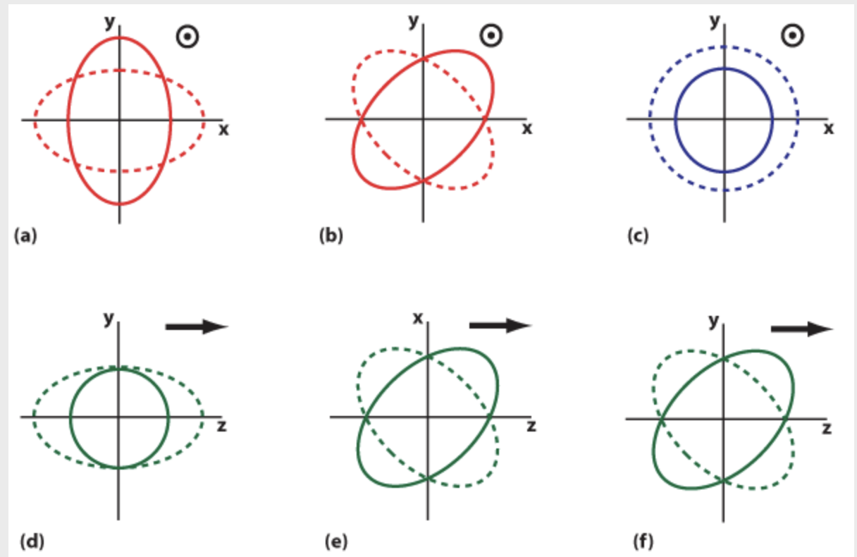
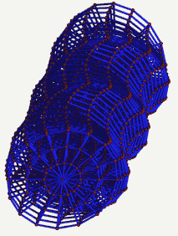
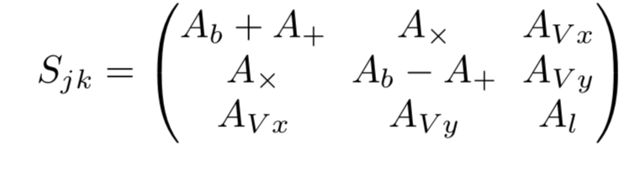


SIX
TWO Polarizations
Markus Pössel, Einstein online
Will, C.M. , arXiv
Notes:
Cite Alan, Isi work!!
IT IS POSSIBLE TO DISTINGUISH with 3 detectors the 2 extremes (Max & Alan) but with 5 non-co-oriented detectors, we can disentangle mixtures

Slide 7
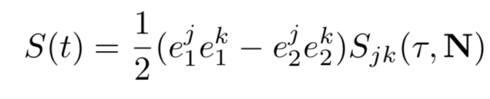

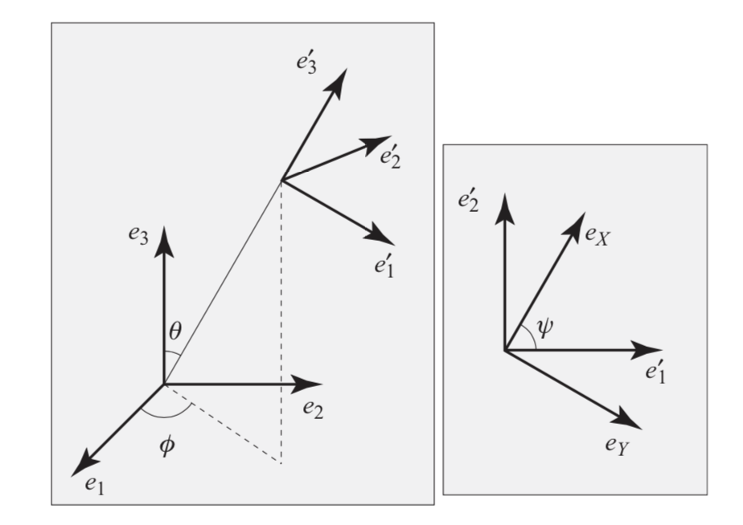


Detector DARM response
Antenna Patterns
Poisson and C. Will, Gravity
Notes:
DIFFERENTIAL ARM RESPONSE + IGNORING FREQUENCY DEPENDENCY that can be different for each mode

Slide 8
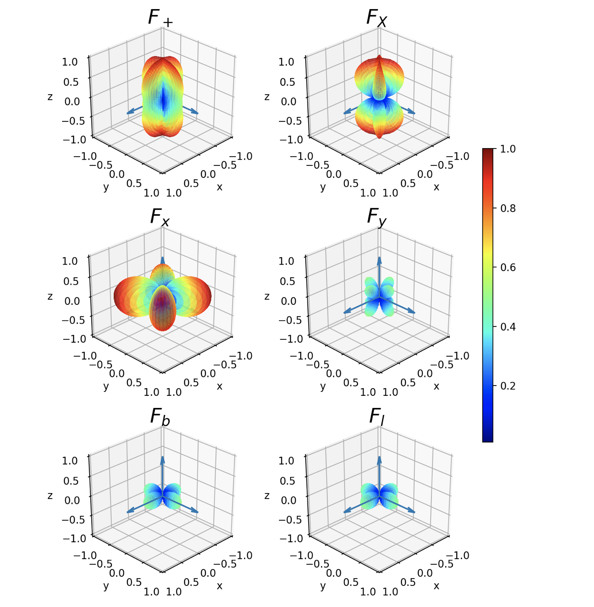
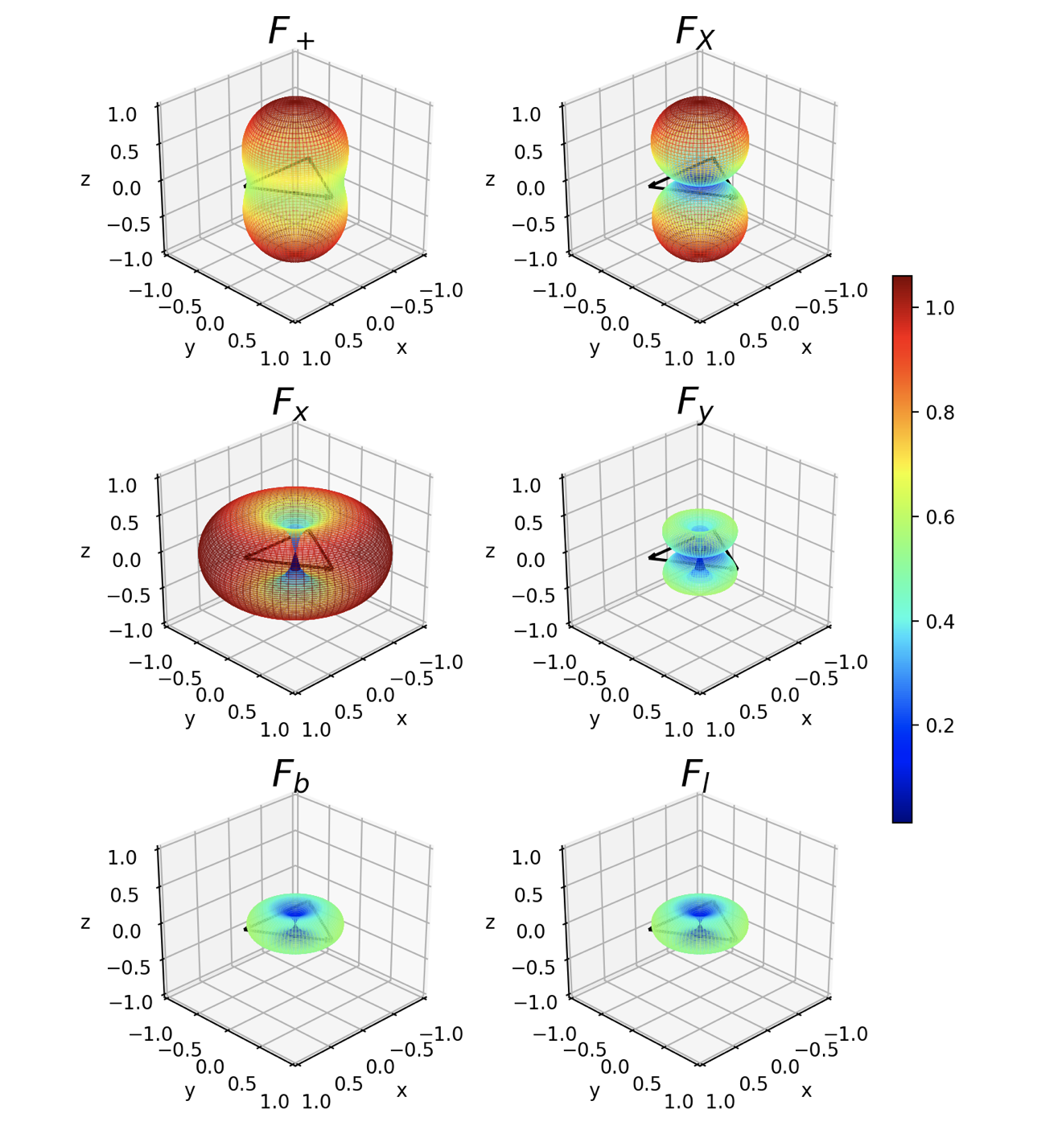
Antenna patterns
Two-Arm
Interferometer
(LIGO)
Three-Arm
Interferometer
(ET)

Slide 9

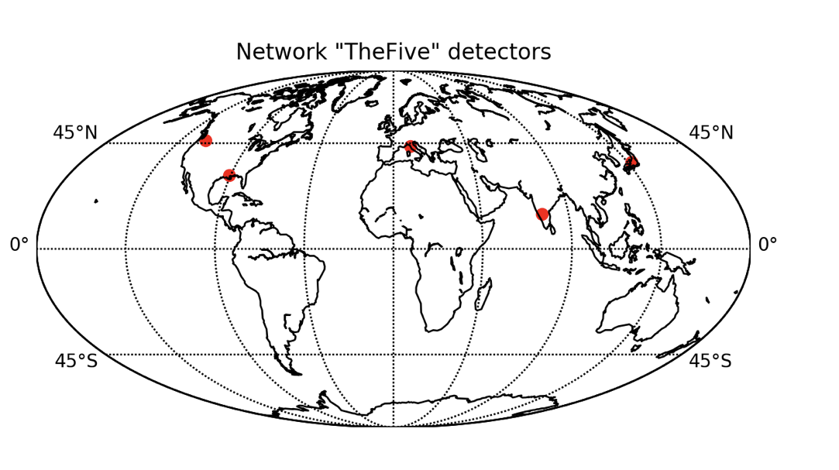
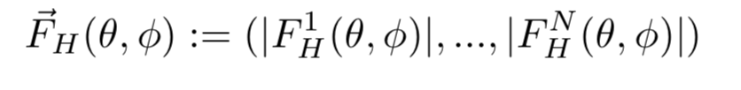
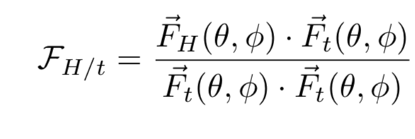
Network sensitivity
Vector of Antenna Patterns
  H in {s, v, t}
  1 ... N = no. detector
Overlap Factor
VIRGO
Hanford
Livingston
KAGRA
LIGOIndia

Slide 10
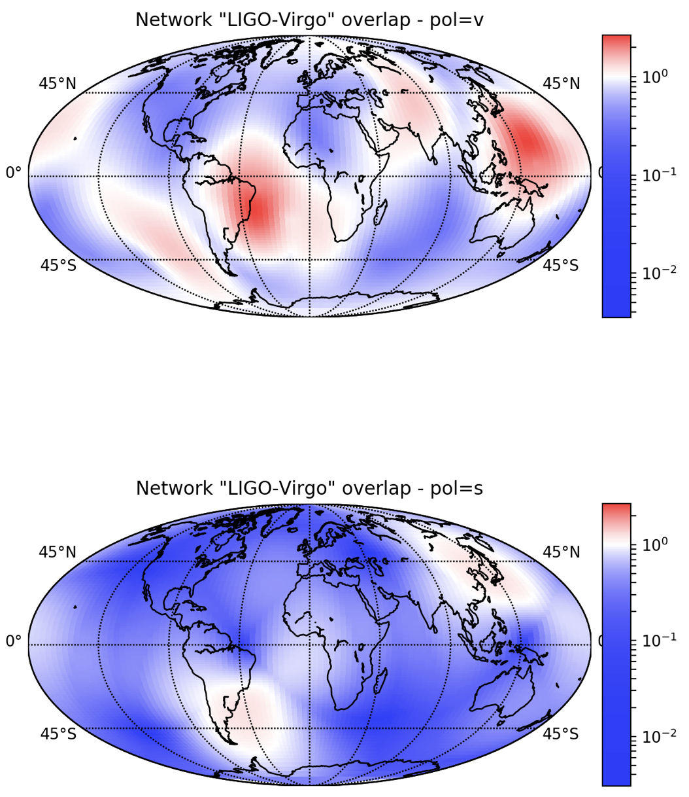
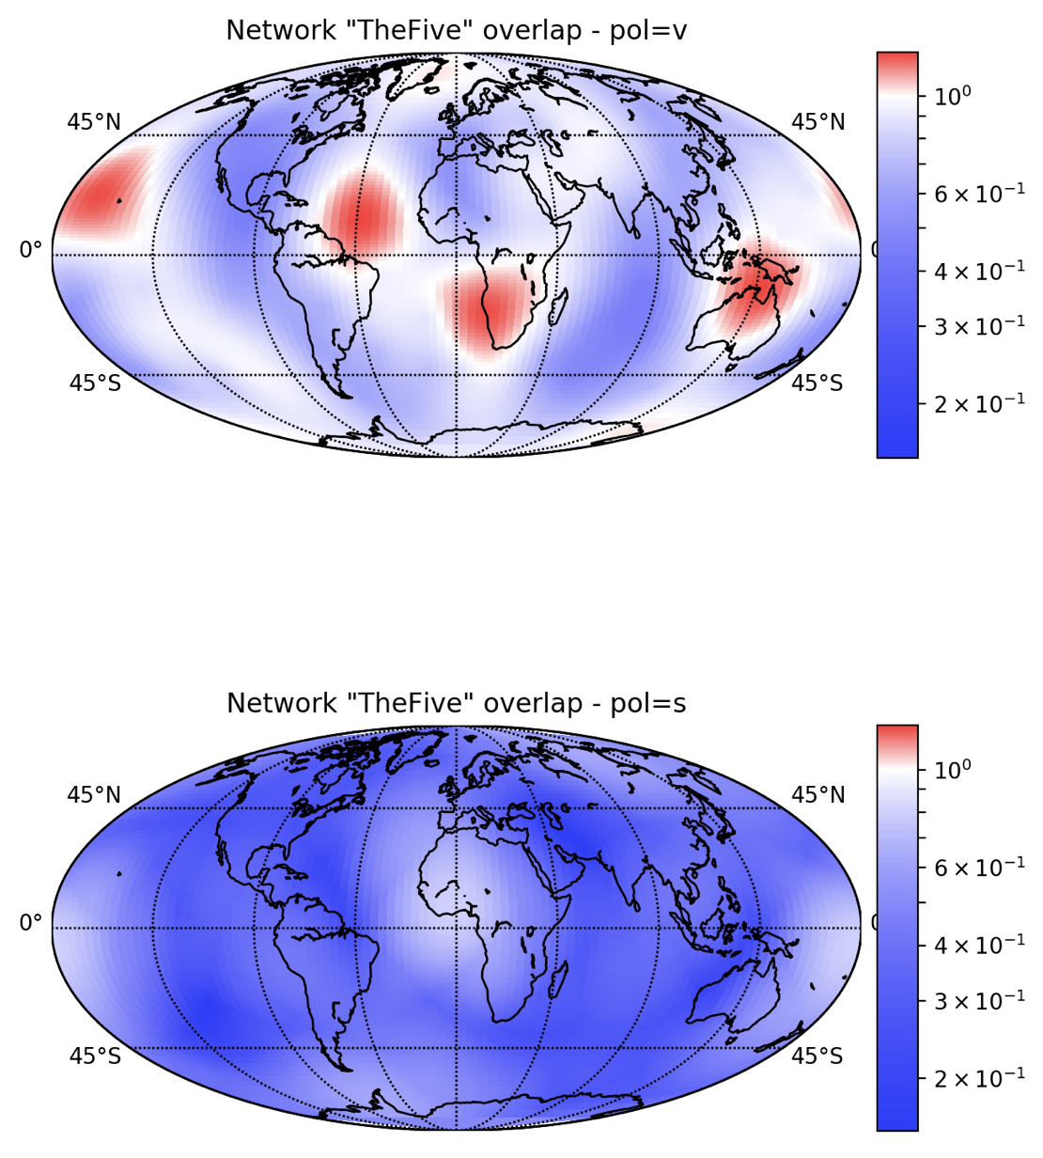
Overlap factor
LIGO – Virgo Network
+ LIGOIndia & KAGRA

Slide 11
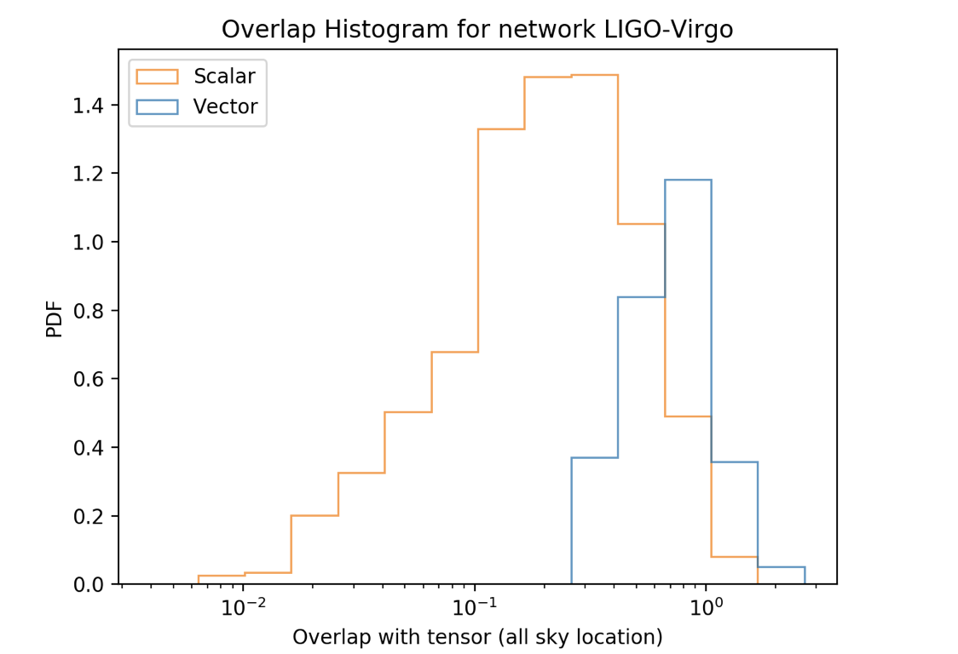
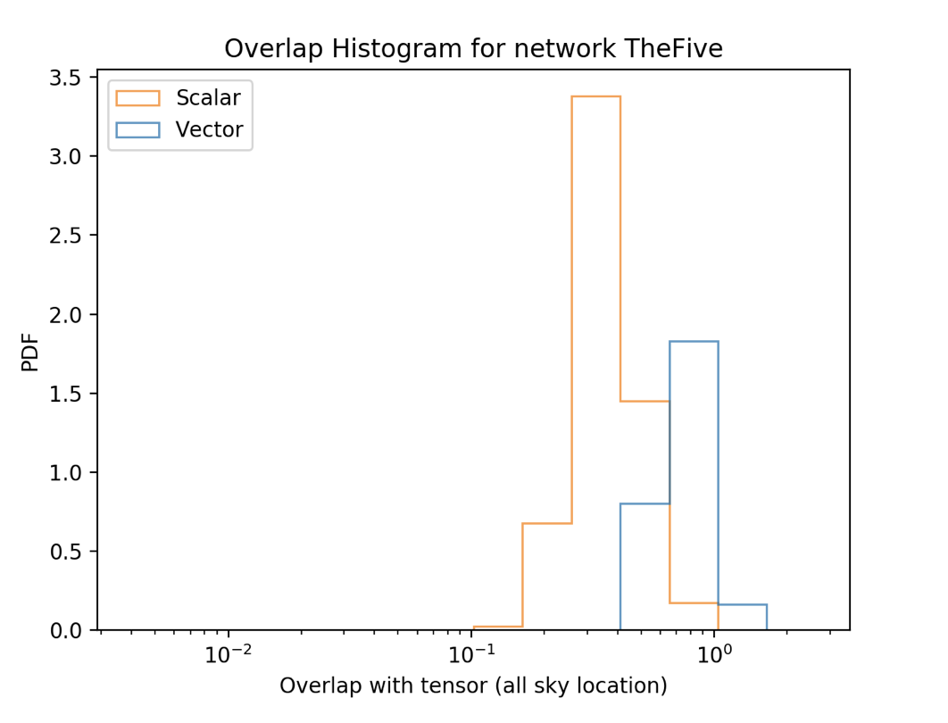
Overlap factor

Slide 12

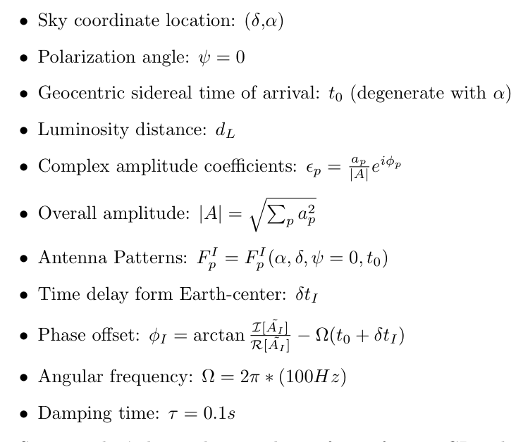
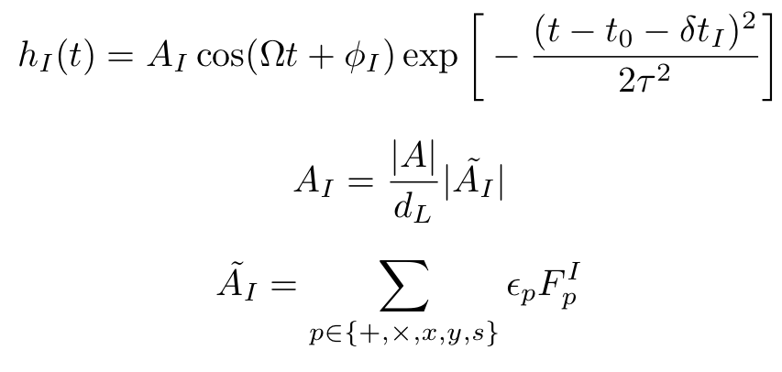
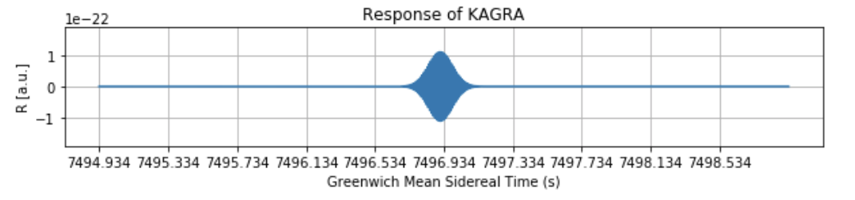
Toy model of a GW
Sine-Gaussian Waveform
1 s
Notes:
Neil Cornish and Tyson Littenberg, BayesWave, MODEL INDEPENDENT WAVEFORM
PROXY FOR A CHIRP
Short, well-defined t0, amplitude, phase at peak
EPSILON FOR CBC FIXED BY INCLINATION PARAMETERS

Slide 13
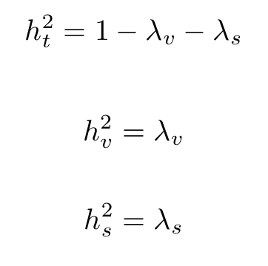
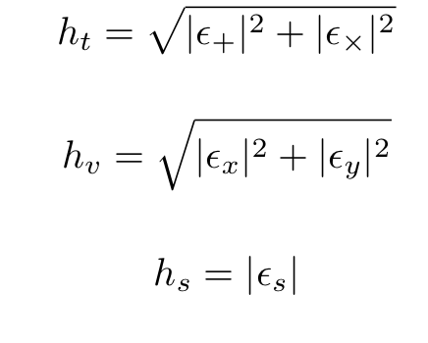
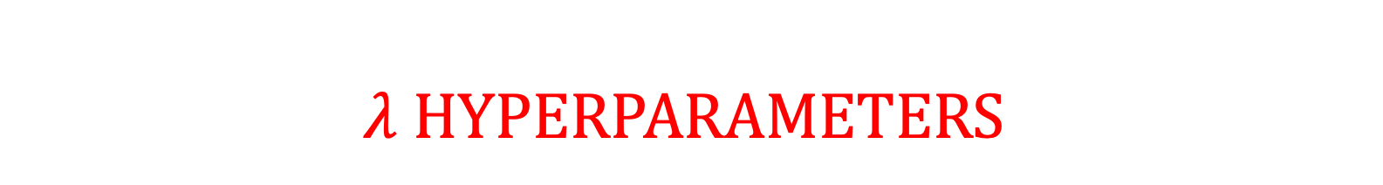
$$λ hyperparameters$$
Normalized effective
strain amplitude
Hyperparameters
of the model
bayes inference

Slide 14
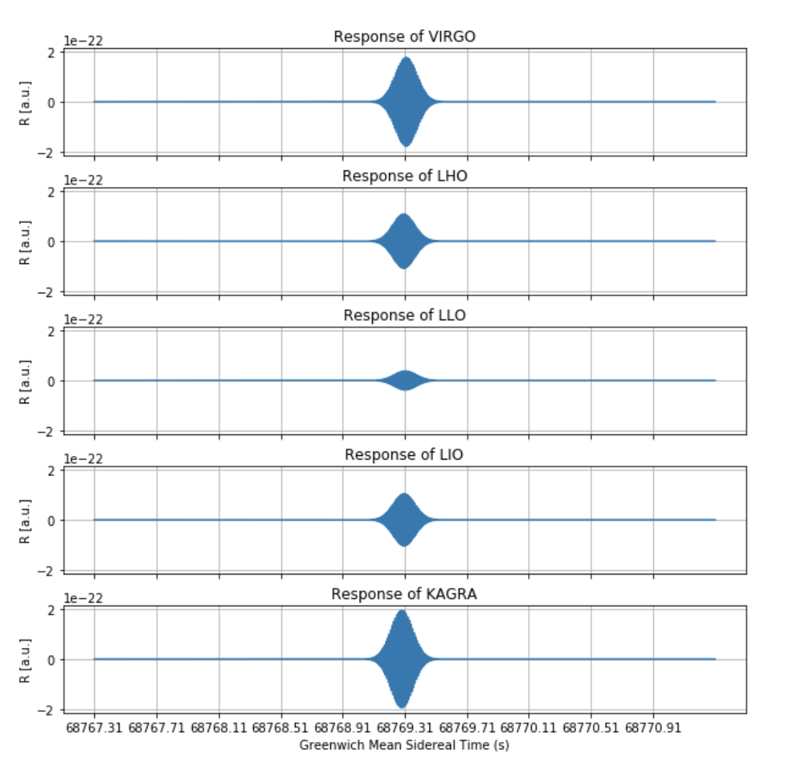
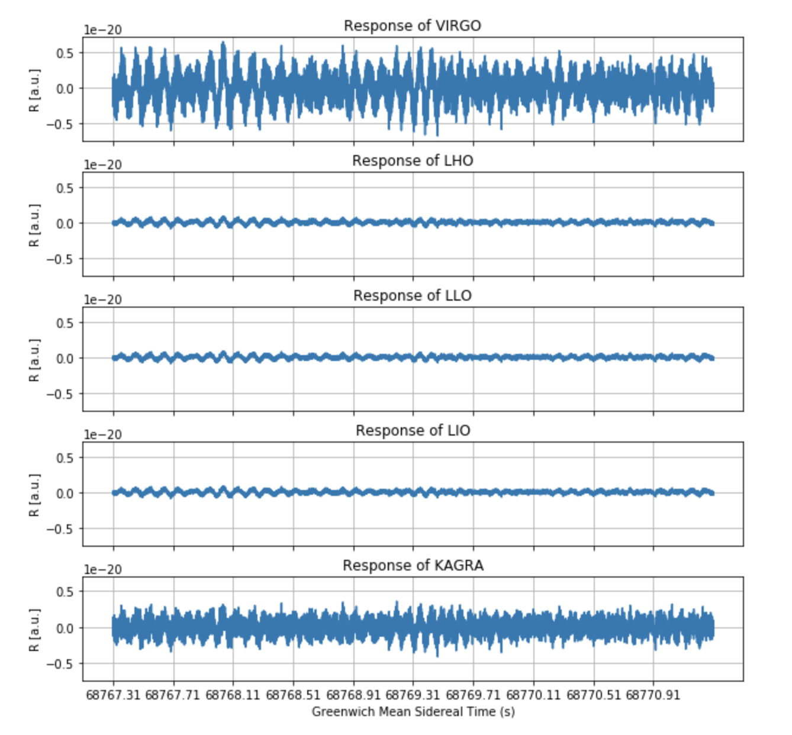
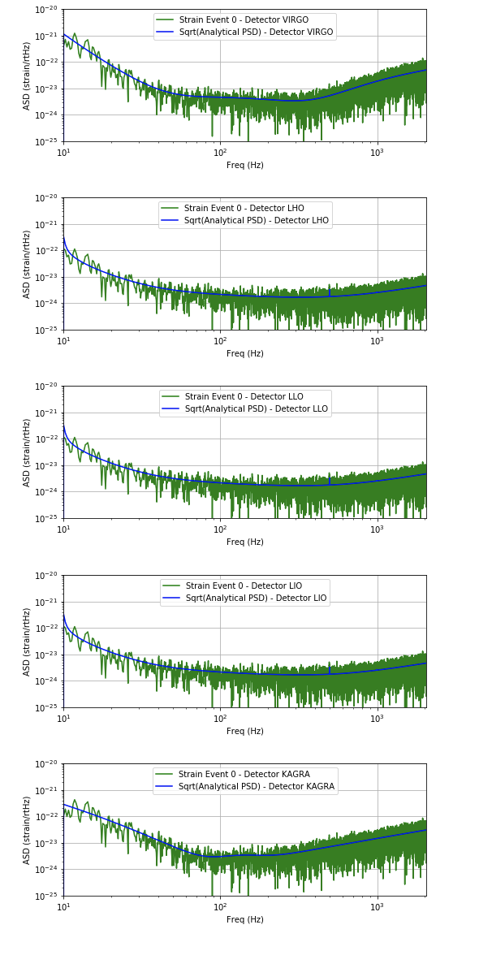


But first…
Let’s make some noise!
$$λ_{S}=0.1$$
$$λ_{V}=0.1$$
1 s

Slide 15
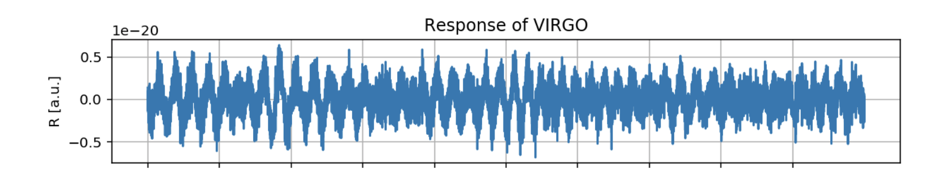
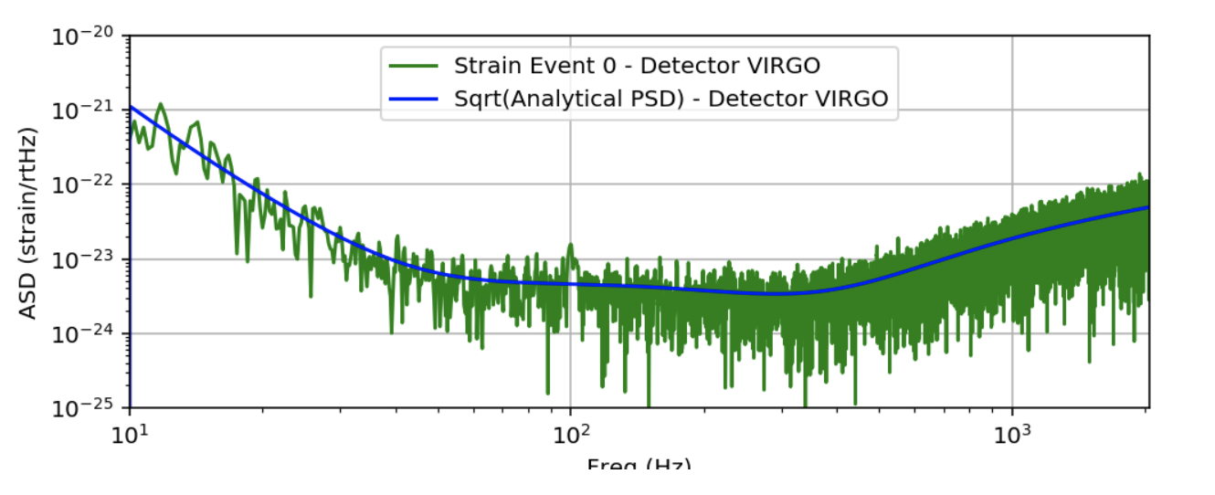
But first…
Let’s make some noise!
lOW SNR SOURCE
IFFT
FFT
Freq. (Hz)

Slide 16
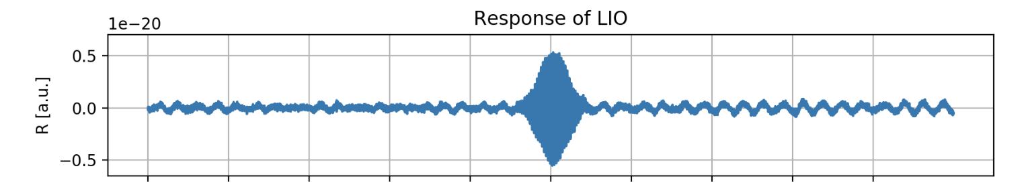
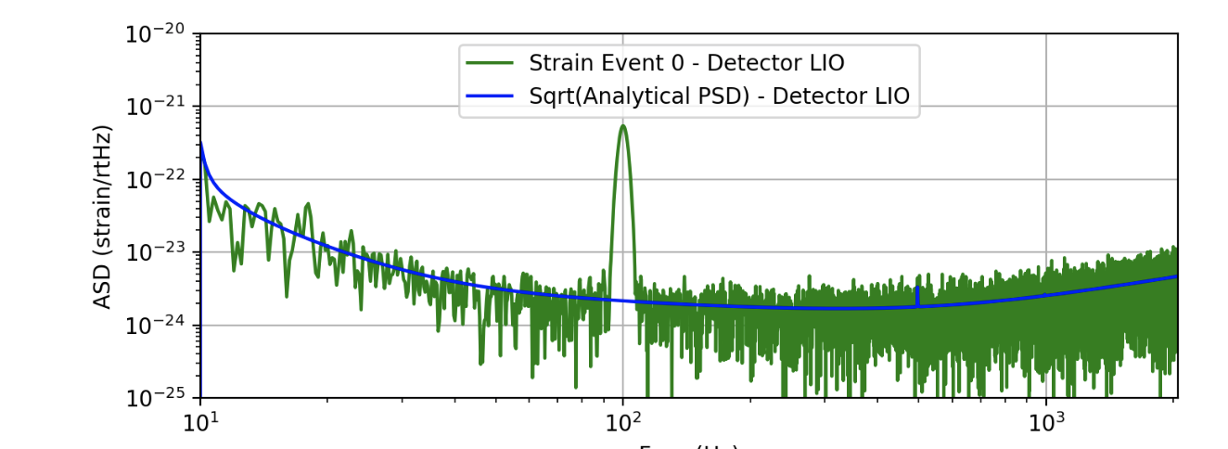
But first…
Let’s make some noise!
HIGH SNR SOURCE
IFFT
FFT
Freq. (Hz)

Slide 17
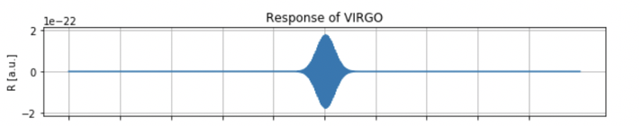
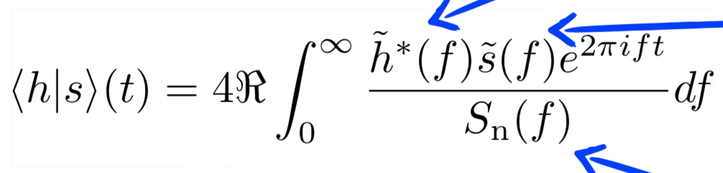


matched filtering
Wiener’s Optimal Filter

Slide 18
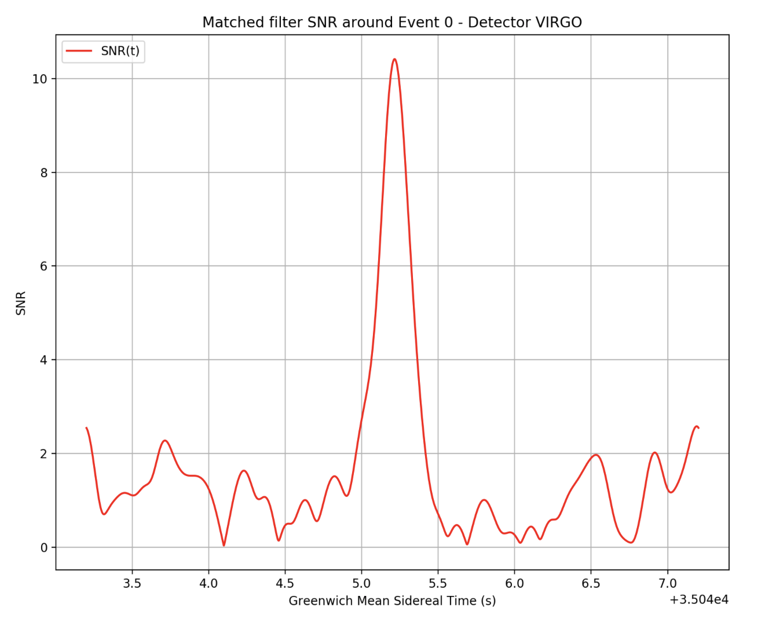
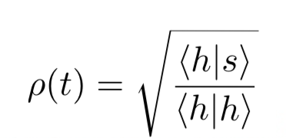
SNR
lOW SNR SOURCE
SNR
(Signal-to-Noise Ratio)
1 s
Time (s)

Slide 19

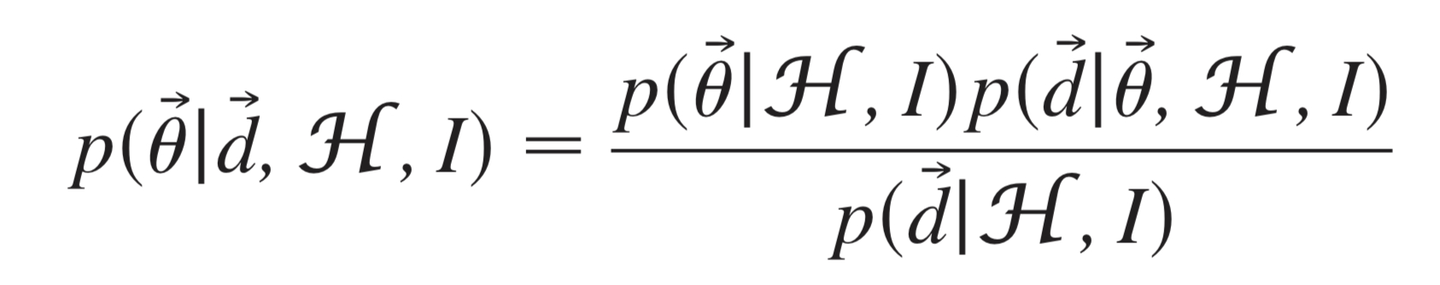
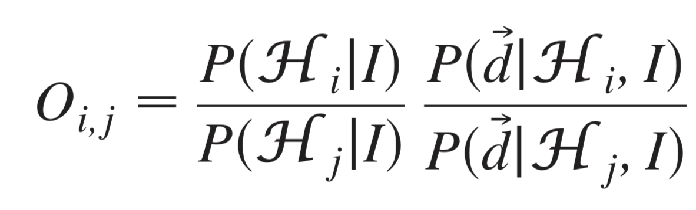
Bayes theorem
Prior
Likelihood
Posterior
Parameter Estimation
Evidence
Model Selection
Odds
Priors on
the model
Evidence
Ratio
Notes:
EXPLAIN THE THETA->parameters
H-> model
d-> data
Flat priors over the angle and over the epsilon

Slide 20
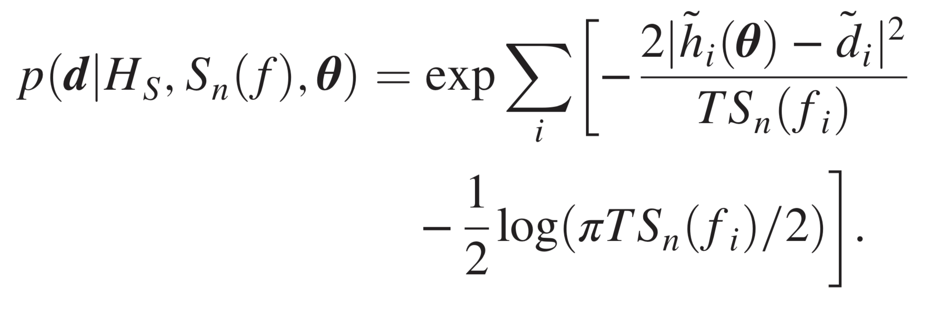
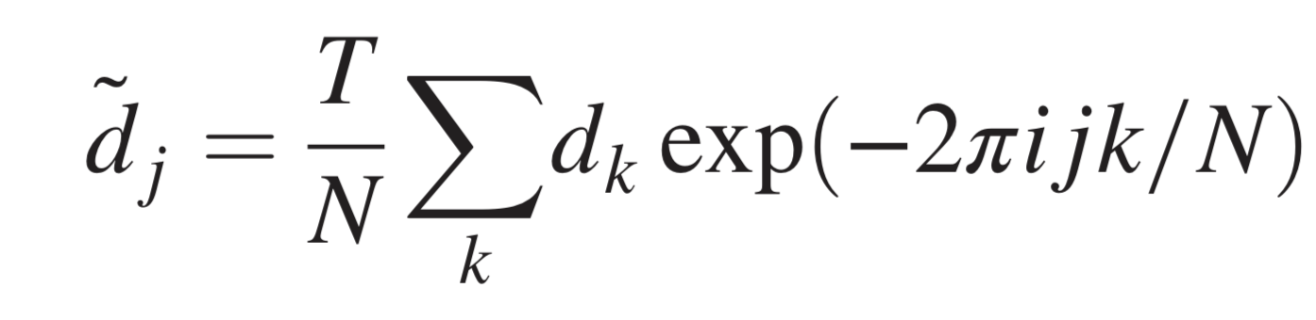
Likelihood
Two critical assumption at each detector for the noise:
  Gaussianity (in each frequency bin)
  Stationarity
Normalization crucial
for evidence computation
Discrete Fourier Transform

Slide 21
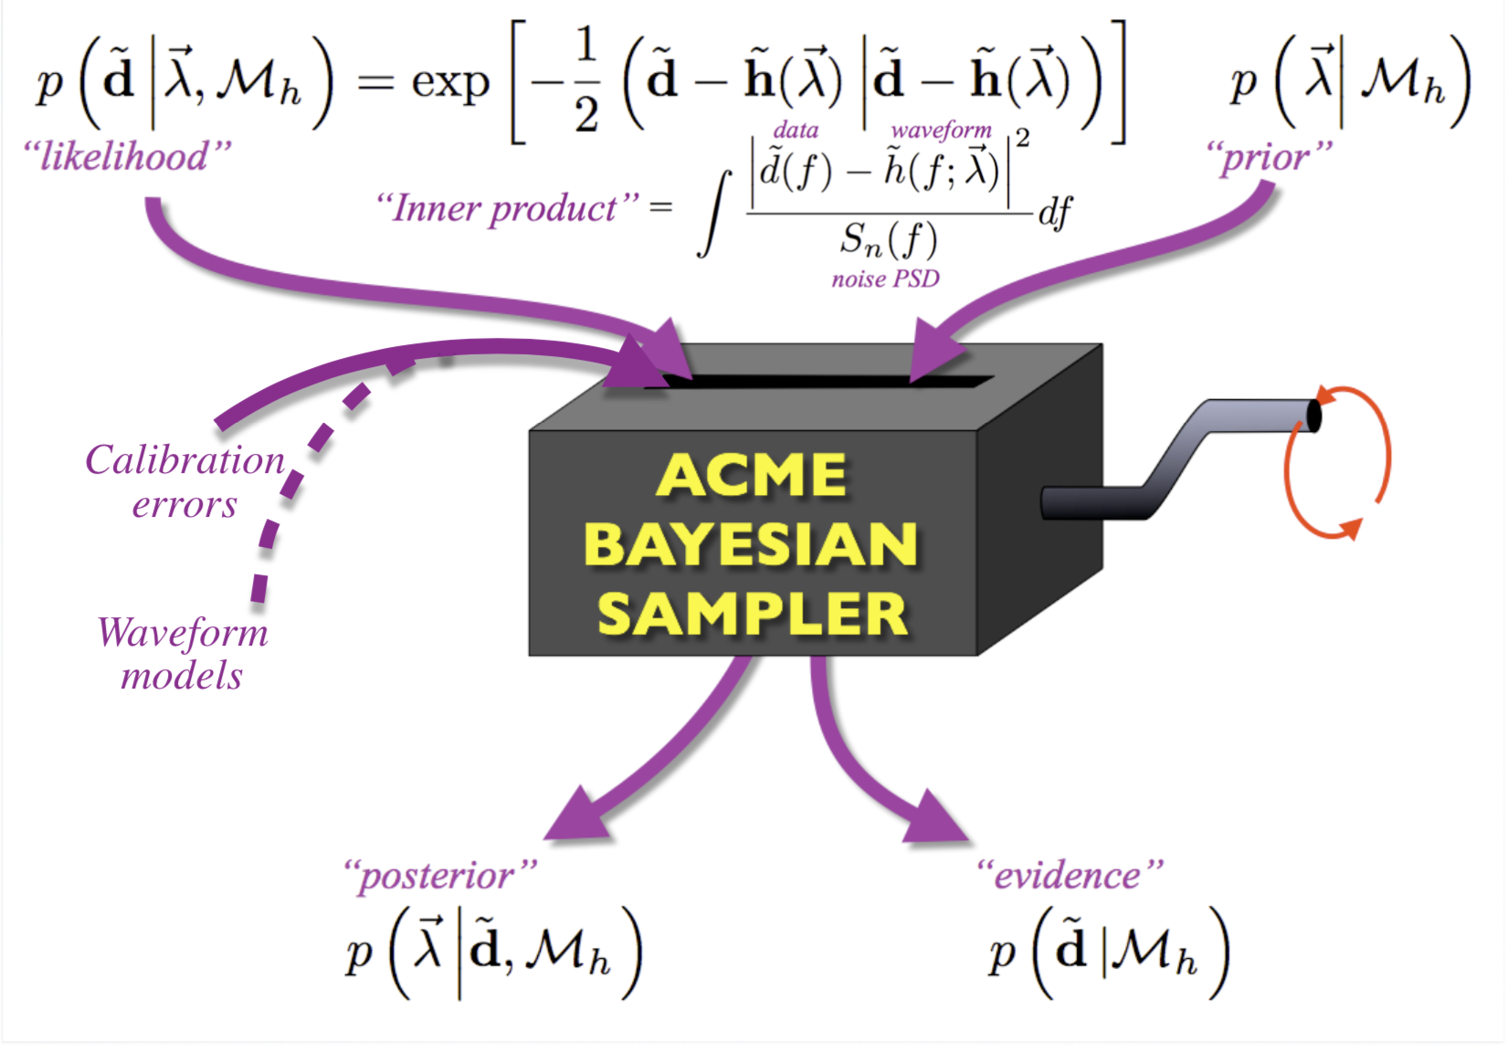
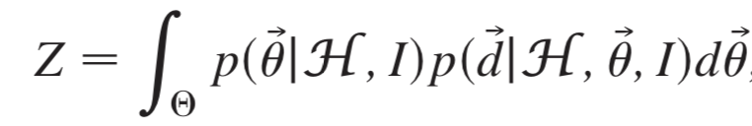
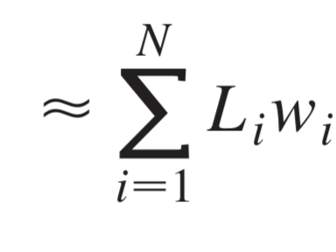
Nested sampling
Evidence Numerical Estimation
Prior
Likelihood
Live points in
parameters space
Credits: Littenberg

Slide 22

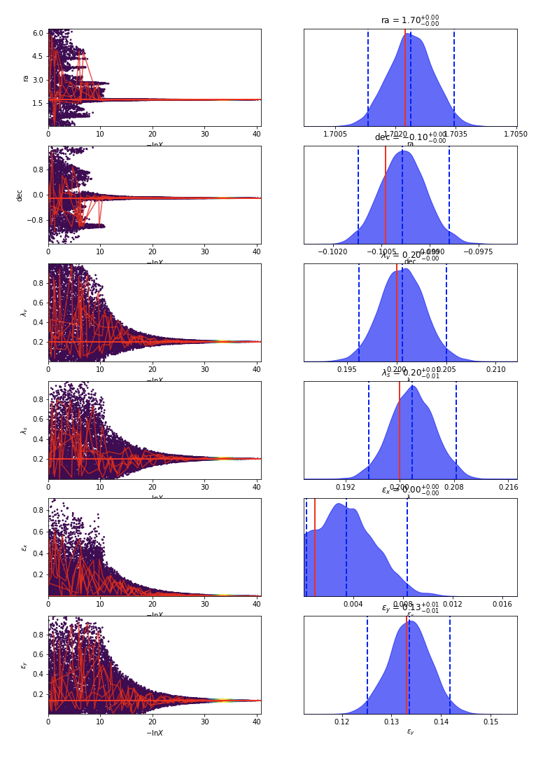
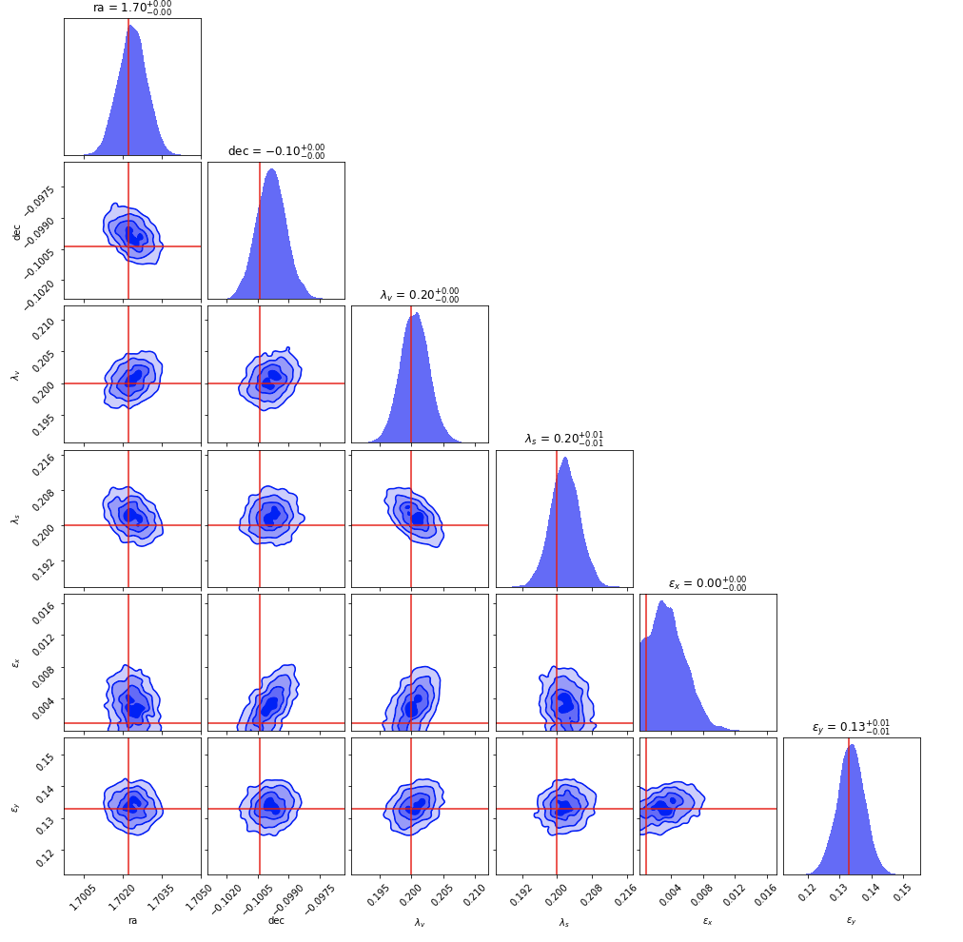












Parameter estimation
RA
HIGH SNR SOURCE
High Accuracy
High Precision
dec
dec
$$λ_{s}$$
$$λ_{s}$$
$$λ_{v}$$
$$λ_{v}$$
$$ε_{X}$$
$$ε_{X}$$
$$ε_{y}$$
$$ε_{y}$$
RA
dec
$$λ_{s}$$
$$λ_{v}$$
$$ε_{X}$$
$$ε_{y}$$
Notes:
ACCURACY –> CLOSENESS TO THE KNOWN VALUE
PRECISION -> WIDTH OF THE DISTRIBUTION

Slide 23
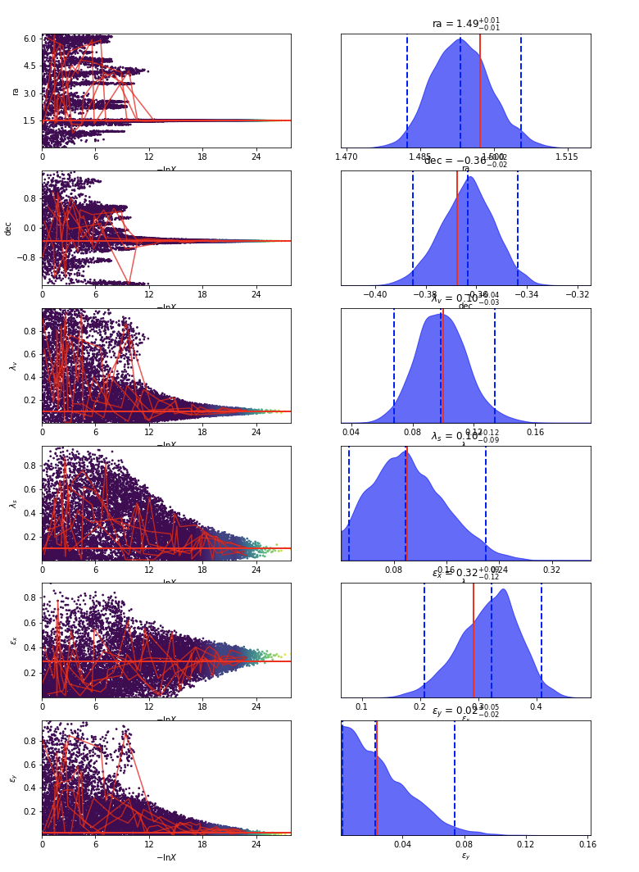




Parameter estimation
RA
lOW SNR SOURCE
High Accuracy
Lower Precision
dec
dec
$$λ_{s}$$
$$λ_{s}$$
$$λ_{v}$$
$$λ_{v}$$
$$ε_{X}$$
$$ε_{X}$$
$$ε_{y}$$
$$ε_{y}$$
RA
dec
$$λ_{s}$$
$$λ_{v}$$
$$ε_{X}$$
$$ε_{y}$$

Slide 24


Lambdas estimation

Slide 25


Lambdas estimation

Slide 26


Lambdas estimation

Slide 27


Lambdas estimation

Slide 28


Lambdas estimation

Slide 29


Future work
More quantitative analysis on the lambdas distribution as a function of external parameters (sky position, overall amplitude, max SNR …)
Repeat every simulation with a pure tensor model, to compute model selection odds
Using an extended post-Einsteinian Framework to compute new templates with complete polarization content (Arxiv)

Slide 30
thank you for your attention !
Alan J. Weinstein
Rico Lo
Aaron Markovitz
Shruthi Aradhya
Luca D’Onofrio
Liting Xiao
Gabriele Vajente
Francesco Pannarale
Alvin Li
And a special thanks goes to …
… and all my fellow SURFers !

Slide 31

Alternative metric
theories of gravity

Slide 32






Polarization angle
Conceptual distinction between triaxal GR and free tensor :
Rotation of antenna patterns:
Degeneracy between a_{p} and $ψ$:
$ψ$ fixed
$ψ$ varying

Slide 33


Polarization angle
Degeneracy between a_{p} and $ψ$:
from M. Isi, M. Pitkin, and A. J. Weinstein,
Probing Dynamical Gravity with the Polarization of Continuous Gravitational Waves, arXiv:1703.07530

Slide 34






Psd & matched filtering
Power Spectral Density:
Physical meaning:
Filtering a noisy signal:
Wiener’s optimal filter:
maximizes

Slide 35






Monodimensional study
of the likelihood

Slide 36





bidimensional study
of the likelihood
L(ra,dec)
L($λ_{v},$ $λ_{s}$)
dec
$$λ_{s}$$
ra
$$λ_{v}$$

Slide 37



Nested sampling
Live points
Evidence Numerical Estimation
Xi -> Normalized Volume of the prior with a likelihood greater than the lowest likelihood point of your set in each step i
Multidimensional
Integral
Monodimensional
integral
Sample from the prior N live points
Find the point with the lowest Likelihood L*
Replace this last with another point from the prior with L > L*
Repeat (2)-(3)

