Slide 1
Understanding Interferometer Lock Losses with Machine Learning
Laurel White, Syracuse University
Mentor: Jamie Rollins, California Institute of Technology

Slide 2
What is a lock loss?
Detectors must be in a stable state known as “lock” in order to collect data
In lock, there is:
Resonance in each of the cavities
Destructive interference at the output
The automated lock acquisition system, Guardian, is used to obtain lock, but it is a time-consuming process
A detector can be knocked out of lock, reducing its duty cycle
Some lock losses are caused by earthquakes, while others have unknown causes

Slide 3
Our approach
Besides the differential arm (DARM) channel which records gravitational-wave signals, there are thousands of auxiliary channels recording information about the detectors and their environments
Ex. SUS, PEM
Our goal is to identify features in the auxiliary channel data that are characteristic of impending lock loss
Ex. Large spikes, unstable oscillations
We want to use a regression algorithm to identify the most interesting features and channels out of thousands that we test and then a clustering algorithm to group lock losses with common features

Slide 4
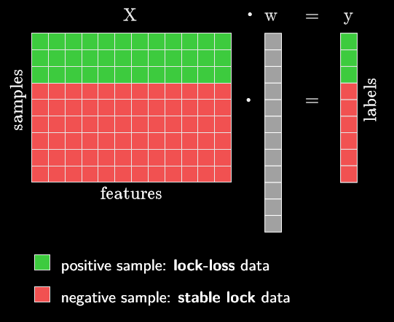
Our approach
Compile extracted features into matrix X
Use positive/negative labels to generate output vector y
Solve for w, which maps X onto y
Courtesy of Jamie Rollins

Slide 5
Overview
Generating the dataset
Methods and results
Feature extraction
Regression
Clustering
Follow-up of interesting results
Conclusions and future work

Slide 6
Generating the dataset
Use O2 data from Hanford
Channels: start with DQ channels, remove calibration channels, flat channels, and channels created during O2
Positive samples: just prior to lock losses that occurred during observing mode
Negative samples: stable, locked times spaced by 10,000 seconds and 1,000 seconds removed from the start and end of lock
Sample length is a tunable parameter (we use 4 seconds)
Left with 4,338 channels, 276 positive samples, and 1,086 negative samples

Slide 7
Approach
Step 1
Feature extraction
Step 2
Regression
Step 3
Clustering

Slide 8
Approach
Step 1
Feature extraction
Step 2
Regression
Step 3
Clustering

Slide 9
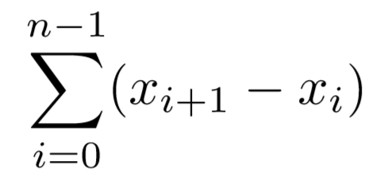
Step 1: Feature Extraction
Cannot use raw time series data
Channels are sampled at rates of up to 16,384 Hz
Too much data would hide interesting features in the regression
We select a set of calculations that return single-value outputs for each sample
Difference between maximum and minimum
Complexity
Absolute energy
Mean value
Standard deviation
Variance
Kurtosis
Skewness
Absolute sum of changes
Mean absolute change
Permutation entropy
Complexity
Take the diff:
Dot with itself
Take square root

Slide 10
Approach
Step 1
Feature extraction
Step 2
Regression
Step 3
Clustering

Slide 11
Step 2: Regression
Matrix is underdetermined, so we use Lasso regression
Alpha parameter controls degree of regularization
Use of L1-norm drives some coefficients to be zero so final model relies on less features
Ordinary least squares
Courtesy of Jamie Rollins

Slide 12
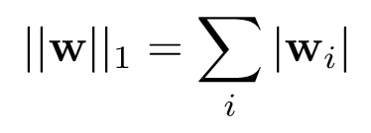
Step 2: Regression
Matrix is underdetermined, so we use Lasso regression
Alpha parameter controls degree of regularization
Use of L1-norm drives some coefficients to be zero so final model relies on less features
Ordinary least squares
Regularization
L1 norm
(Lasso)
Courtesy of Jamie Rollins

Slide 13
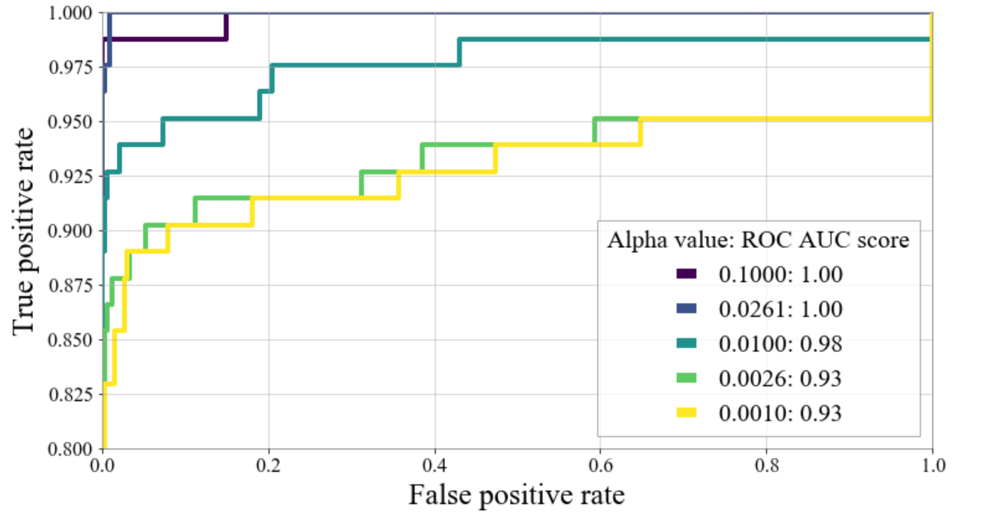
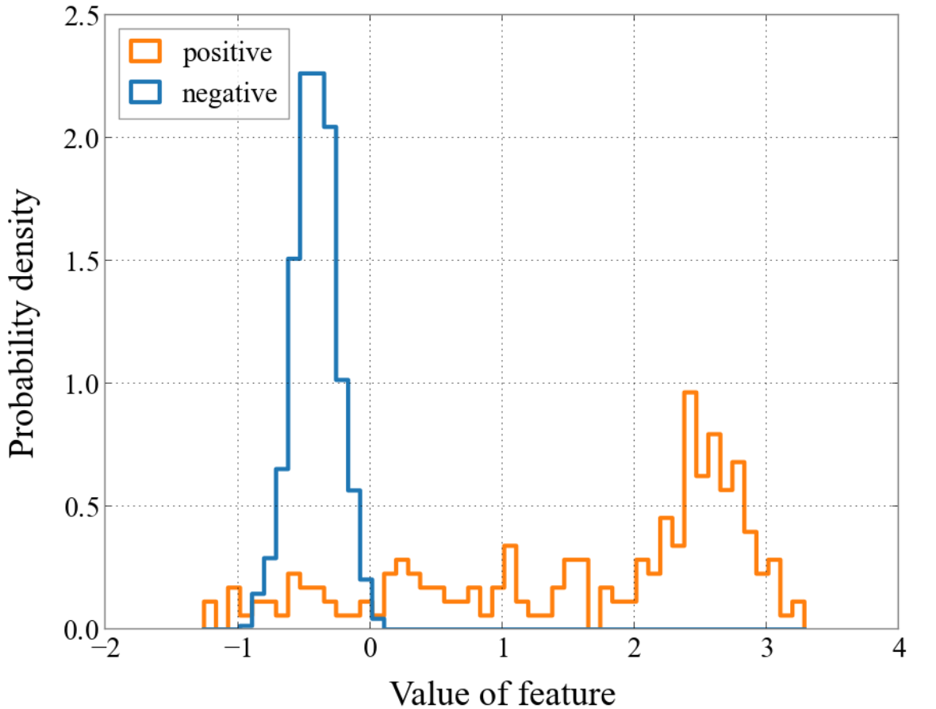
Step 2: Regression
Use receiver operator characteristic (ROC) curves with area under the curve (AUC) scores as well as histograms to evaluate success of regression
Complexity of H1:OMC-FPGA_DTONE_IN1_DQ

Slide 14
Approach
Step 1
Feature extraction
Step 2
Regression
Step 3
Clustering

Slide 15
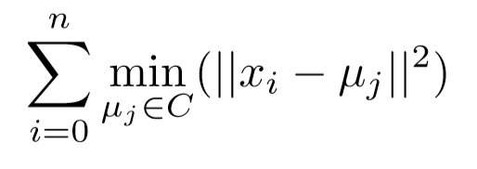
Step 3: Clustering
Attempt to cluster samples to find groups of lock losses that share common features
K-means algorithm groups into any specified number of clusters
No built-in functionality to figure out which features are most important for clustering
Y-axis
X-axis
http://shabal.in/visuals/kmeans/6.html

Slide 16
Step 3: Clustering
Ideally would see clear clusters in histograms
Complexity of H1:OMC-FPGA_DTONE_IN1_DQ

Slide 17
Step 3: Clustering
Ideally would see clear clusters in histograms
Complexity of H1:OMC-FPGA_DTONE_IN1_DQ

Slide 18
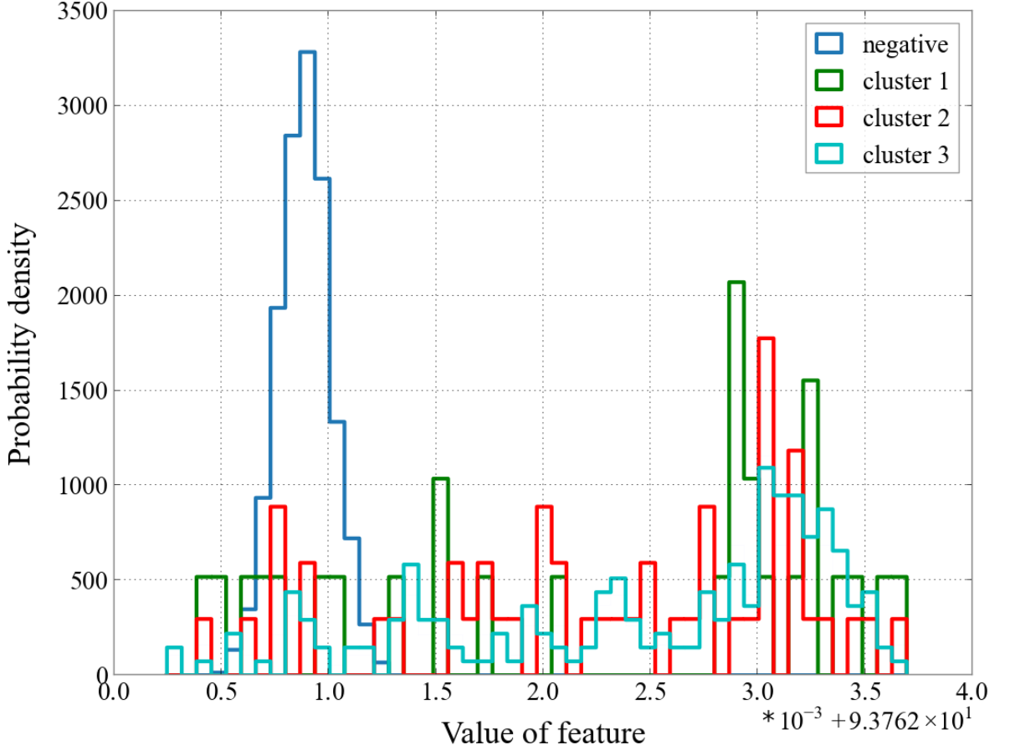
Step 3: Clustering
Ideally would see clear clusters in histograms
Complexity of H1:OMC-FPGA_DTONE_IN1_DQ

Slide 19
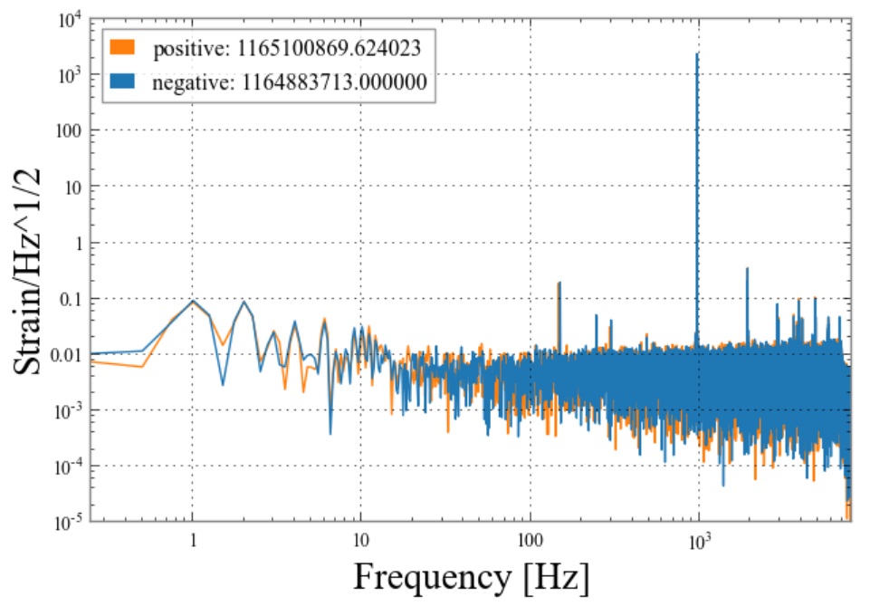
Follow-Up: H1:OMC-FPGA_DTONE_IN1_DQ
When we plot the ASDs, we see that positive samples tend to have peaks at lower frequencies than negative samples
This does not explain the higher complexity values for the positive samples

Slide 20
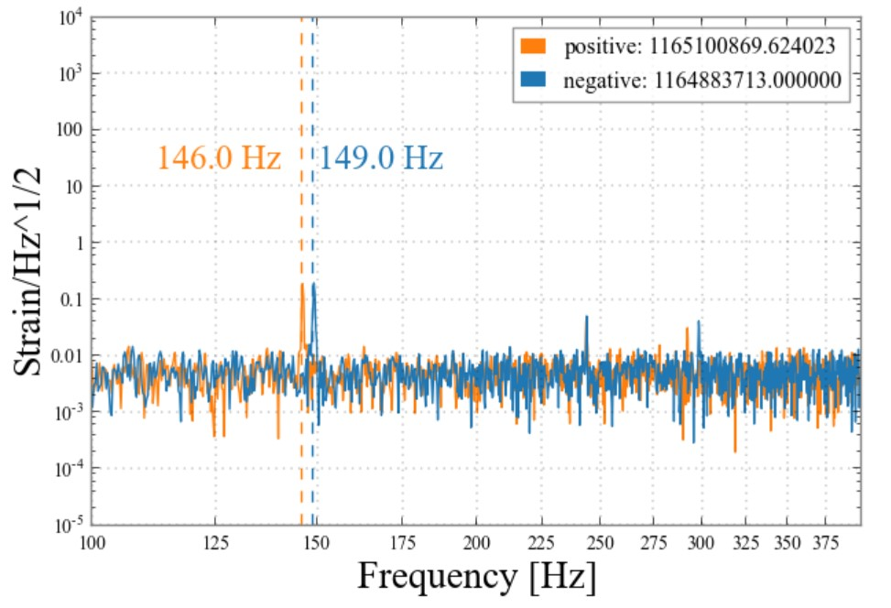
Follow-Up: H1:OMC-FPGA_DTONE_IN1_DQ
When we plot the ASDs, we see that positive samples tend to have peaks at lower frequencies than negative samples
This does not explain the higher complexity values for the positive samples

Slide 21
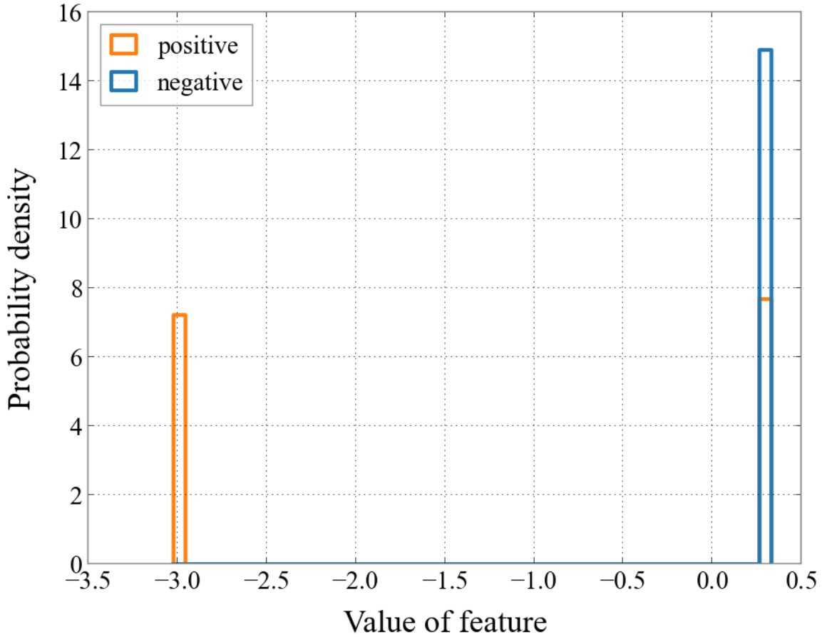
Follow-Up: H1:OMC-LSC_DITHER_OUT_DQ
The permutation entropy always hovers around one value for the negative samples, but it is split between two values for the positive samples

Slide 22
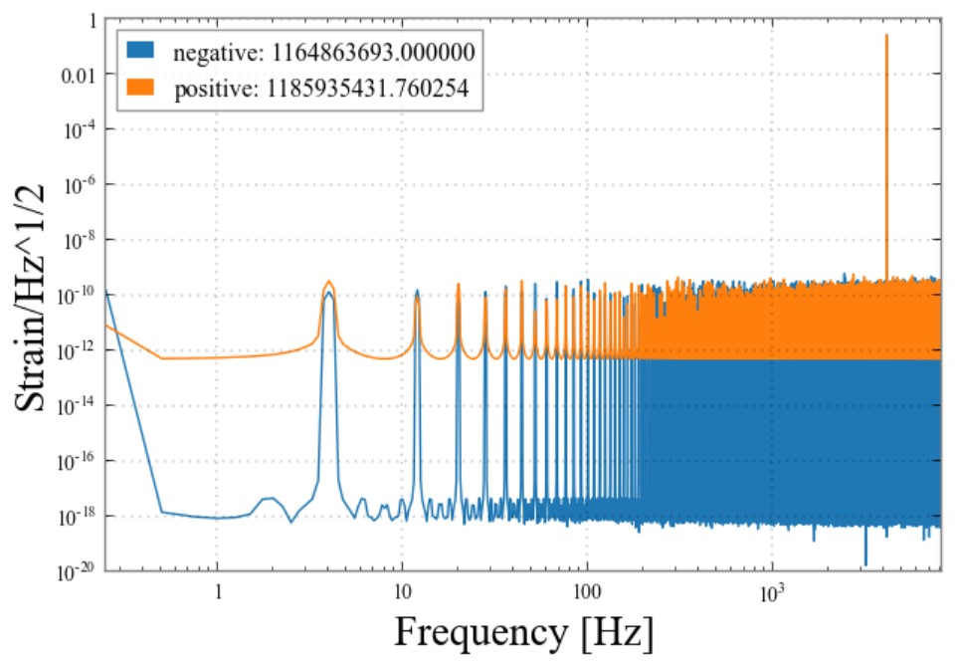
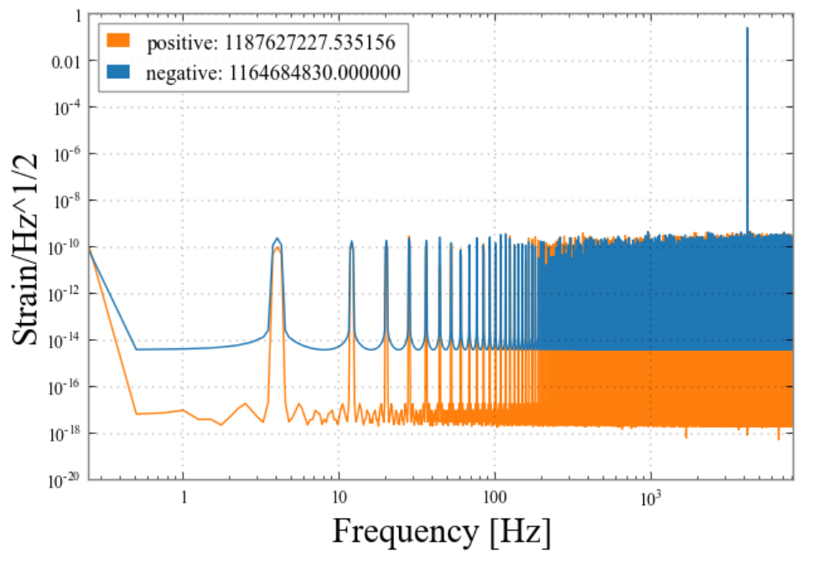
Follow-Up: H1:OMC-LSC_DITHER_OUT_DQ
Plotting the ASDs shows no pattern among the noise levels for the positive or negative samples, regardless of the values of the permutation entropy
Both samples have high permutation entropy
The positive sample has low permutation entropy

Slide 23
Conclusions
Identified a small number of interesting features which differ between lock loss and clean times
Did not find meaningful clusters
Future work
Prune channel list
Find new features that better distinguish positive from negative samples
Refine clustering

Slide 24
References
Evans, M., et al. (2002). Lock acquisition of a gravitational-wave interferometer. Optics Letters, 27(8).
Rollins, J. (2015, June 16). Advanced LIGO Guardian Documentation, Release 1447. Retrieved from https://dcc.ligo.org/public/0120/T1500292/001/AdvancedLIGOGuardian.pdf
Rollins, J. (2017, July 20). Machine learning for lock loss analysis. Retrieved from https://dcc.ligo.org/public/0144/G1701409/001/main.pdf.
Documentation of scikit-learn 0.20.3. (2018). Retrieved from https://scikit-learn.org/stable/documentation.html
Documentation of tsfresh. (2019). Retrieved from https://tsfresh.readthedocs.io/en/latest/
Documentation of EntroPy. (2019). Retrieved from https://raphaelvallat.com/entropy/build/html/index.html

Slide 25
Acknowledgements
My mentor, Jamie Rollins
The LIGO SURF program and NSF
My fellow SURF students
Thank you! Questions?

