Slide 1
Constructing Echo Waveforms from Spinning Exotic Compact Objects
Shuo Xin, Tongji University
Mentors: Ling Sun, Yanbei Chen, Baoyi Chen, Rico Lo
Notes:
Change a title

Slide 2
Overview
Introduction: What and why?
Method: How to construct echoes?
Results
Perspectives

Slide 3
Introduction
What is echo?
Why is it important?
Recent discussions

Slide 4
What is echo: familiar echoes
Credit: https://www.dkfindout.com/uk/science/sound/echoes/
Notes:
credit

Slide 5
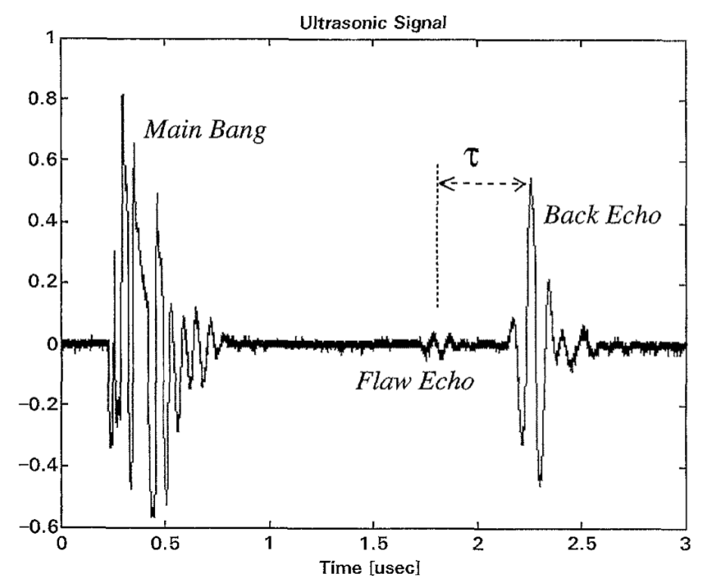
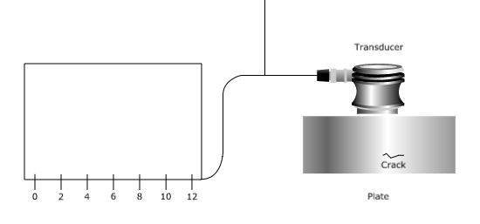
Find mechanical crack
Agostino Abbate et al. IEEE transactions on ultrasonics, ferroelectrics, and frequency control, 44(1):14–26, 1997.

Slide 6
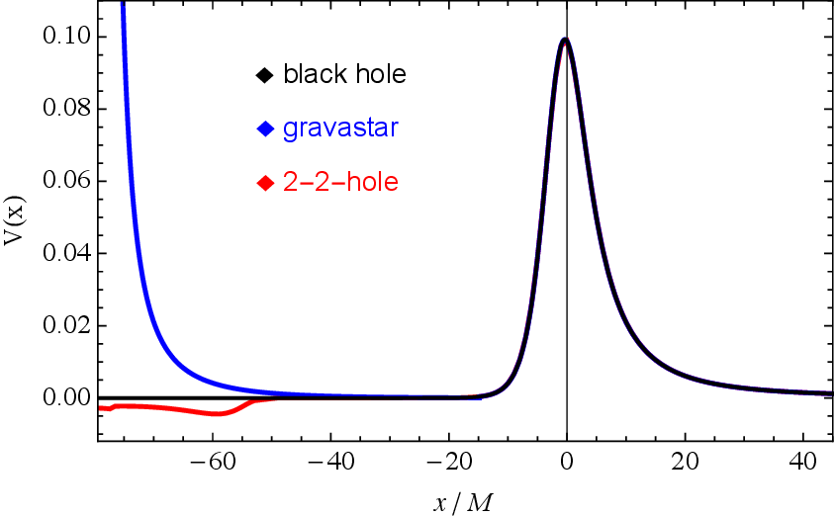
Find crack in compact object?
Horizon
Crack
Ringdown
Signal
Randy S. Conklin, Bob Holdom, and Jing Ren. Gravitational wave echoes through new windows. Phys. Rev. D, 98:044021, Aug 2018.

Slide 7
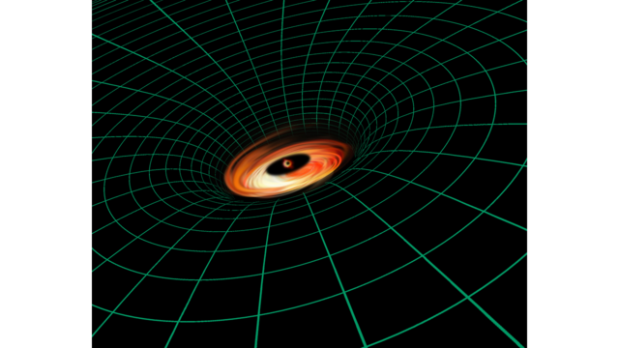
Potential hint for exotic physics
What’s hiding near horizon?
Black hole?
Wormhole?
Fuzzball?
…
Echo may tell.
?

Slide 8
Zoology of Exotic Compact Objects (ECOs)
$ε$: Compactness, defined by
$$r_{0}=r_{+}(1+ε)$$
$r_{0}$: radius of ECO,
$r_{+}$: radius of “horizon”
$𝓚_{max}$: Kretschmann scalar,
characterizing maximum
curvature in the spacetime
Vitor Cardoso, Paolo Pani. Testing the nature of dark compact objects: a status report. arXiv:1904.05363
Notes:
Why not BH

Slide 9
Recent discussions
Data Analysis (no echo is found yet)
Jahed Abedi et al. Phys. Rev. D, 96:082004, Oct 2017.
Andrea Maselli et al. Phys. Rev. D, 96:064045, Sep 2017.
Ka WaTsang et al. Phys. Rev. D, 98:024023, Jul 2018.
R Ka Lok Lo et al. Phys. Rev. D, 99: 084052, April 2019.
And a lot …
Models for echoes from non-spinning ECO
Zachary Mark et al. Phys. Rev. D, 96:084002, Oct 2017.
Song Ming Du et al. Phys. Rev. Lett., 121:051105, Aug 2018.
And a lot …
Models for echoes from spinning ECO
Qingwen Wang et al. Phys. Rev. D, 97:124044, June 2018
Hiroyuki Nakano et al. Prog. Theo. Exp. Phys., 2017(7), 07 2017.
Elisa Maggio et al. ArXiv 1907.03091

Slide 10
Past work for spinning ECO
Qingwen Wang et al. Phys. Rev. D, 97:124044, June 2018
ingoing wave packet from infinity
Hiroyuki Nakano et al. Prog. Theo. Exp. Phys., 2017(7), 07 2017.
ingoing wave is assumed phenomenologically
Elisa Maggio et al. ArXiv 1907.03091
Construct ingoing wave from outgoing wave assuming a source very close to the horizon

Slide 11
Method
Black Hole (BH) perturbation theory
From BH to ECO
Physical picture
Notes:
Black hole, define BH ECO

Slide 12
BH perturbation theory
Teukolsky equation Phys. Rev. Lett. 29: 1114, 1973:
Describes evolution of $ψ_{s} (s=0,1,2,3,4)$, projection of Weyl curvature tensor on Newman-Penrose tetrads
Boundary condition:
Only ingoing wave at horizon
Only outgoing wave at infinity
At infinity, solution is related to gravitational waves by
$ψ_{4}\left(r→∞\right)→\frac{1}{2}( \ddot{h_{+}}−i\ddot{h_{×}})$
A well tested Fortran code is already in hand
Wen-Biao Han and Zhoujian Cao. Constructing effective one-body dynamics with numerical energy ﬂux for intermediate-mass-ratio inspirals. Phys. Rev. D, 84:044014, Aug 2011.
Notes:
换成Teukolsky master eq(全slide唯一一个公式)

Slide 13
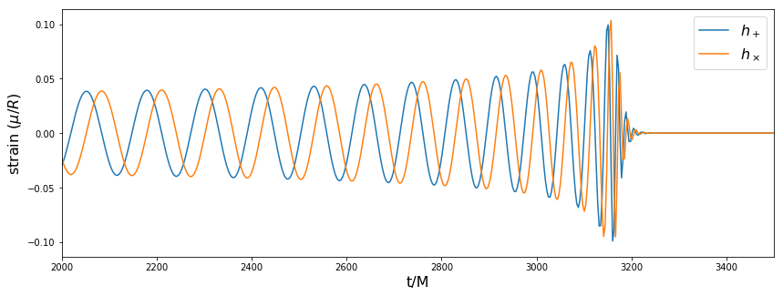
BH perturbation theory
Waveform example based on Post-Newtonian orbit
for 2 BH with total mass M and mass ratio 0.25,
Starting from an equatorial circular orbit with radius 15M
Notes:
Complete figure

Slide 14
From BH solution to ECO solution
Regard ECO as a reflecting boundary located at $r_{0}^{∗}$ with reflectivity $\tilde{R}(ω)$
BH boundary condition:
Only ingoing at horizon
Only outgoing at infinity
ECO boundary condition:
Reflecting at $r_{0}^{∗}$
Only outgoing at infinity
Solution in ECO background can be constructed from solution in BH background
Zachary Mark, Aaron Zimmerman, Song Ming Du, and Yanbei Chen. A recipe for echoes from exotic compact objects. Phys. Rev. D, 96:084002, Oct 2017.

Slide 15
Physical picture
Naïve echo

Slide 16
Physical picture
ECO
surface
Ringdown
signal
Teukolsky
potential
V(r)
~100 Mpc
away
……………

Slide 17
Physical picture
V(r)
Second echo
First echo
Direct signal
$$r^{∗}=r_{0}^{∗}$$

Slide 18
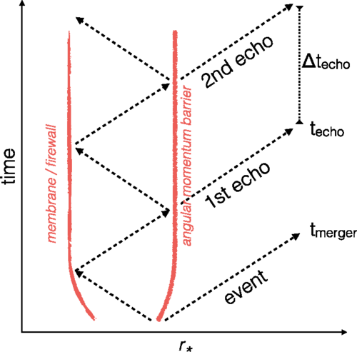
Physical picture
Jahed Abedi et al. Phys. Rev. D, 96:082004, Oct 2017.

Slide 19
Results
“Superradiance”
Waveform examples
Plunging particle source
Phenomenological source

Slide 20
“Superadiance”
Energy reflectivity may exceed 1 when spin turns on

Slide 21
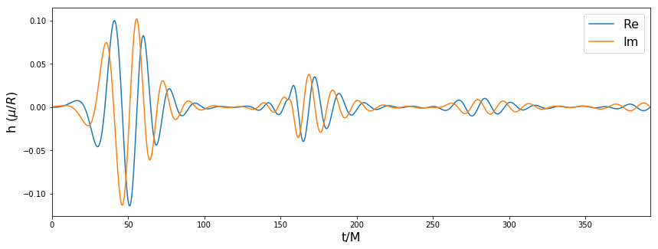
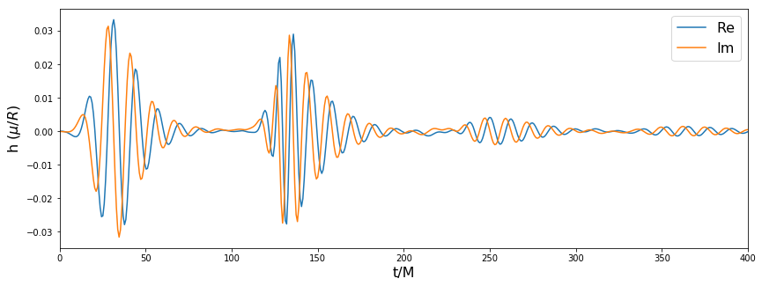
Waveform examples
$$a/M=0$$
$$a/M=0.6$$
Sourced by plunging orbit. Central ECO: $\tilde{R}=0.5, r_{0}^{∗}=−50$

Slide 22
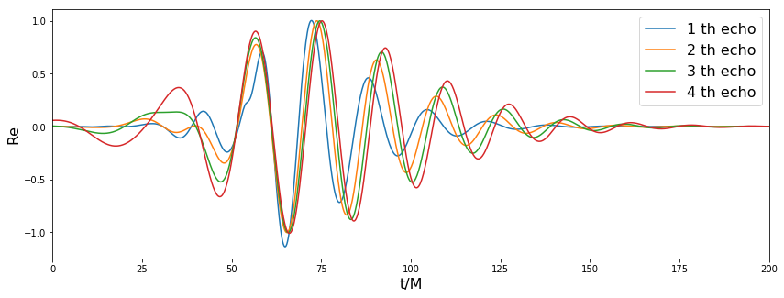
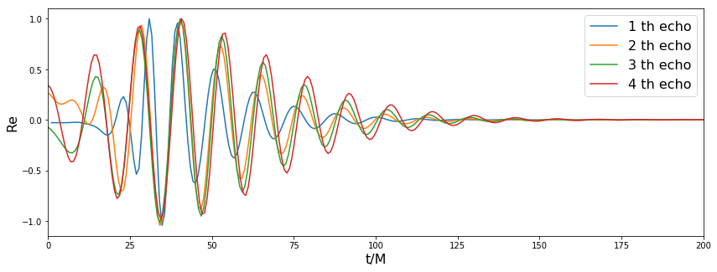
Waveform examples
$$a/M=0$$
$$a/M=0.6$$
Notes:
Larger caption

Slide 23
Phenomenological source
$C$: amplitude
$t_{s}$: arrival time
$ω_{s}$: primary frequency content of the source
$σ_{ω}$: dispersion in frequency
$r_{s}^{∗}$: the source is localized near $r_{s}^{∗}$
$σ_{r}$: dispersion in space

Slide 24
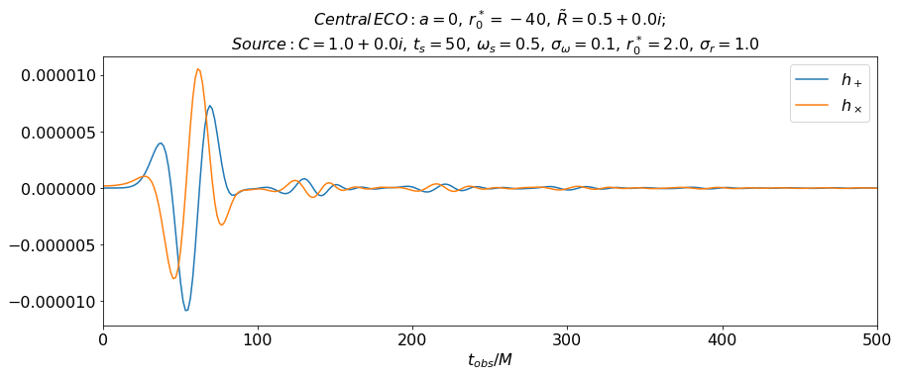
Waveform examples

Slide 25
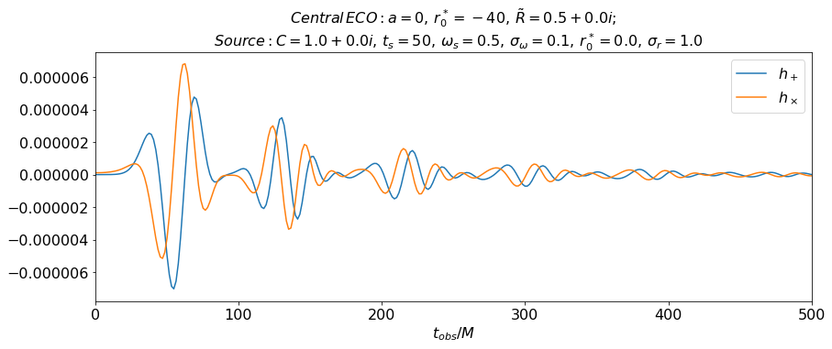
Waveform examples

Slide 26
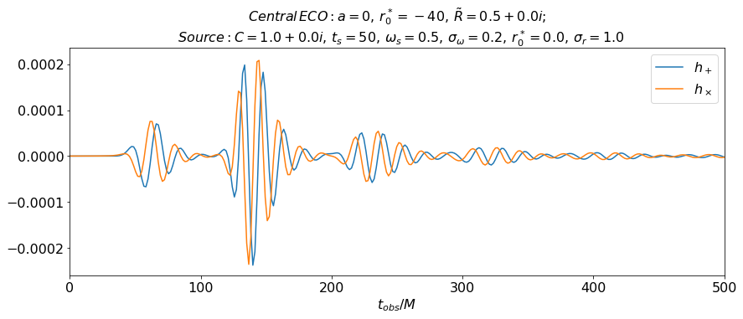
Waveform examples

Slide 27
Perspectives
Improve the formalism
The integral in Teukolsky formalism is diverging when source is unbounded
Regularization is needed PhysRevD.55.639
Implement the waveform in data analysis

Slide 28
Acknowledgement
Thank Yanbei Chen, Ling Sun, Baoyi Chen, Rico Lo, Songming Du and Wenbiao Han for guidance and discussions
Thank Alan Weinstein, Felicia Armijo, Aaron Markowitz, SFP and all fellow students for all kinds of help.

Slide 29
Thanks!

