Slide 1
Update on the Frequency Noise Budgeting and Controls
Daniel Sigg
LIGO Hanford Observatory
Commissioning Meeting July 12, 2019

Slide 2
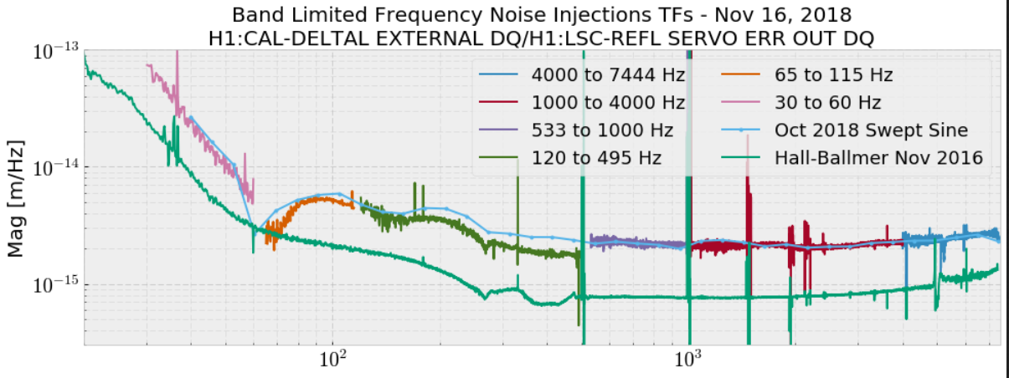
Frequency noise coupling to DARM tends to be non-negligible for f>~1kHz
Frequency noise coupling to DARM flattens out due to higher order mode couplings at >100Hz, measured 1-2 x 10⁻¹⁵ m/Hz (also ~flat in W/rad)
Frequency noise coupling depends on differential heating Can only get worse the higher the power
Craig Cahillane, LHO alog 45352

Slide 3
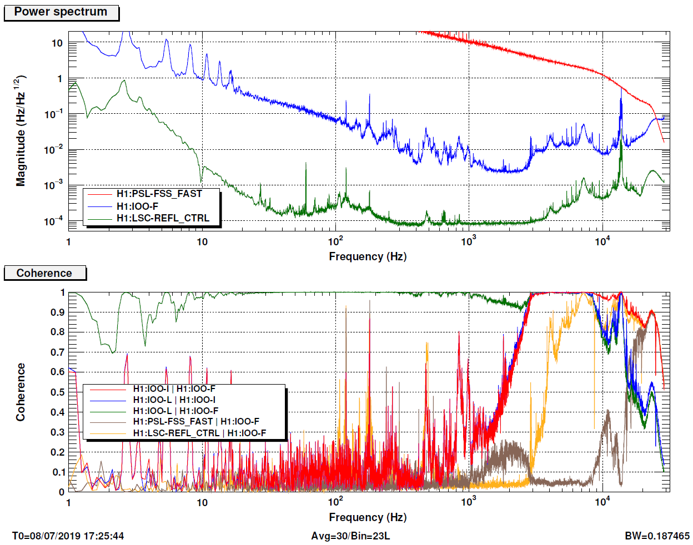
PSL Noise
MC-F
LLO VCO Noise
37W at input of IMC
Feature at 3-10kHz:
Not NPRO noise
Ref. cavity noise?
From PSL?
From IMC?
Not IMC sensing noise
IFO-REFL BW ~10-15kHz
IMC sensing noise limited by poor modulation index:
20x Γ → 10x lower sens. noise
PD: 750mW unlocked
9mW locked (99% carrier)
???
LHO VCO Noise
REFL-CTRL
IMC Shot

Slide 4
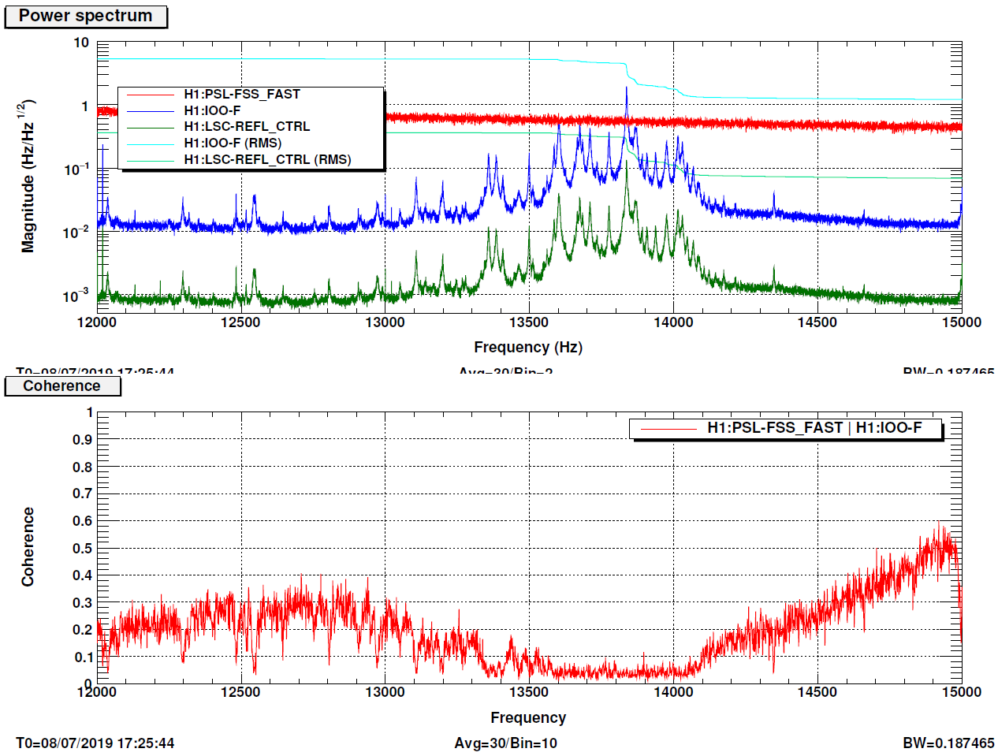
???
Peaks not in FSS FAST
Ref. cavity resonance?
Why so many?

Slide 5
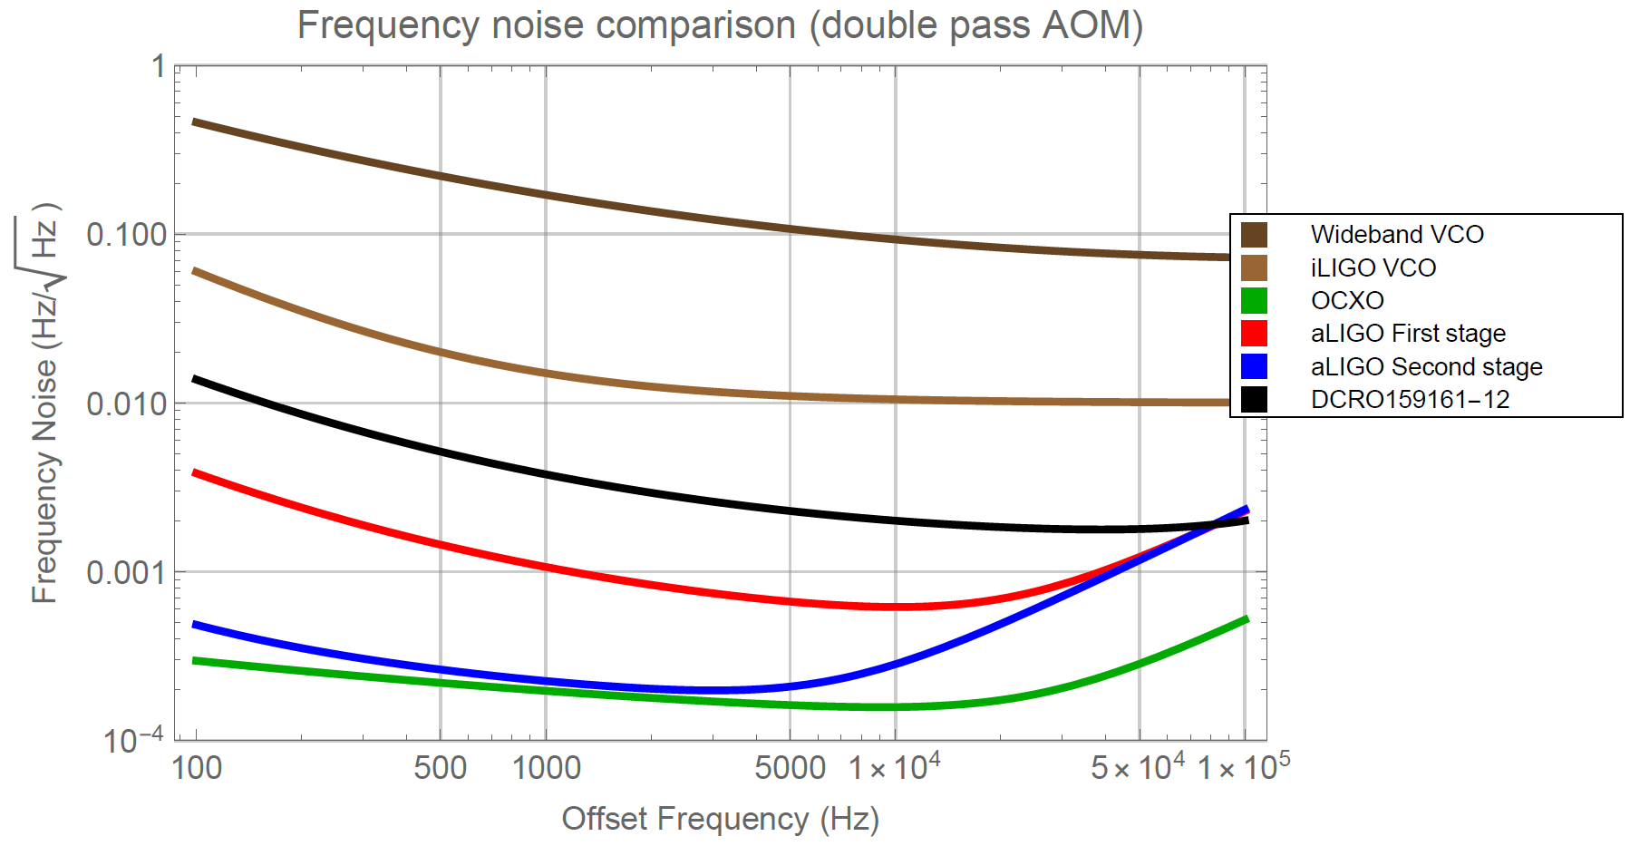
Available Options for VCOs (SAW)
Advanced LIGO VCO: 79.4±1.2MHz 1.05±0.14 GHz VCO (MCF91119-10) divide by 128 & mix with 71 MHz OCXO
Initial LIGO VCO: 80±5 MHz 800±50 MHz VCO (CRO750SA) divide by 10
Best available SAW VCO: 79.6±1.2MHz 1.595±0.025GHz VCO (DCRO159161-12) divided by 20
80 MHz VCO wideband (e.g., DCMO514-5)
Projections

Slide 6
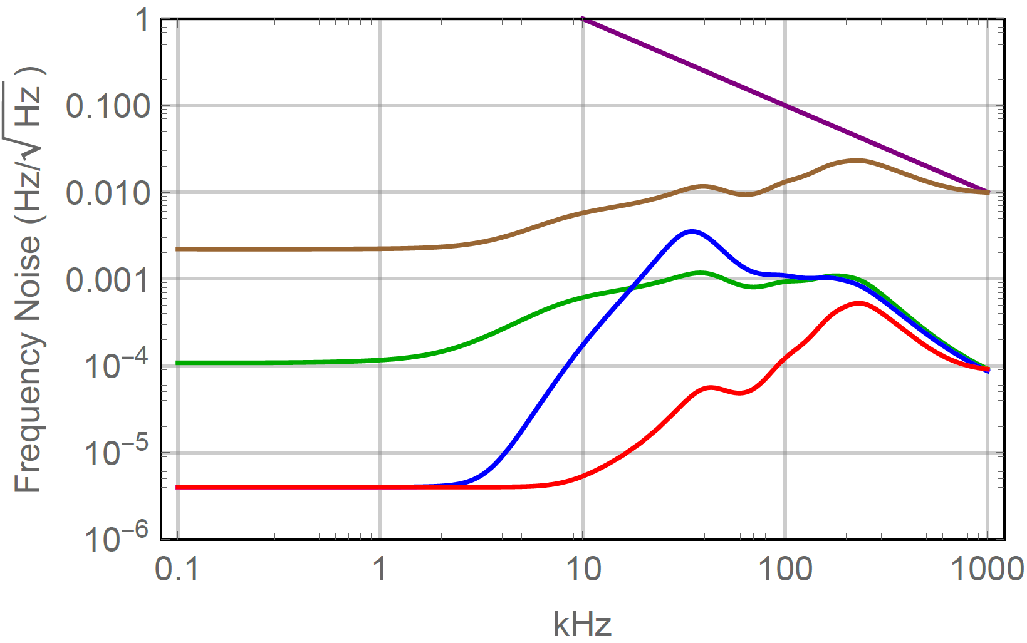
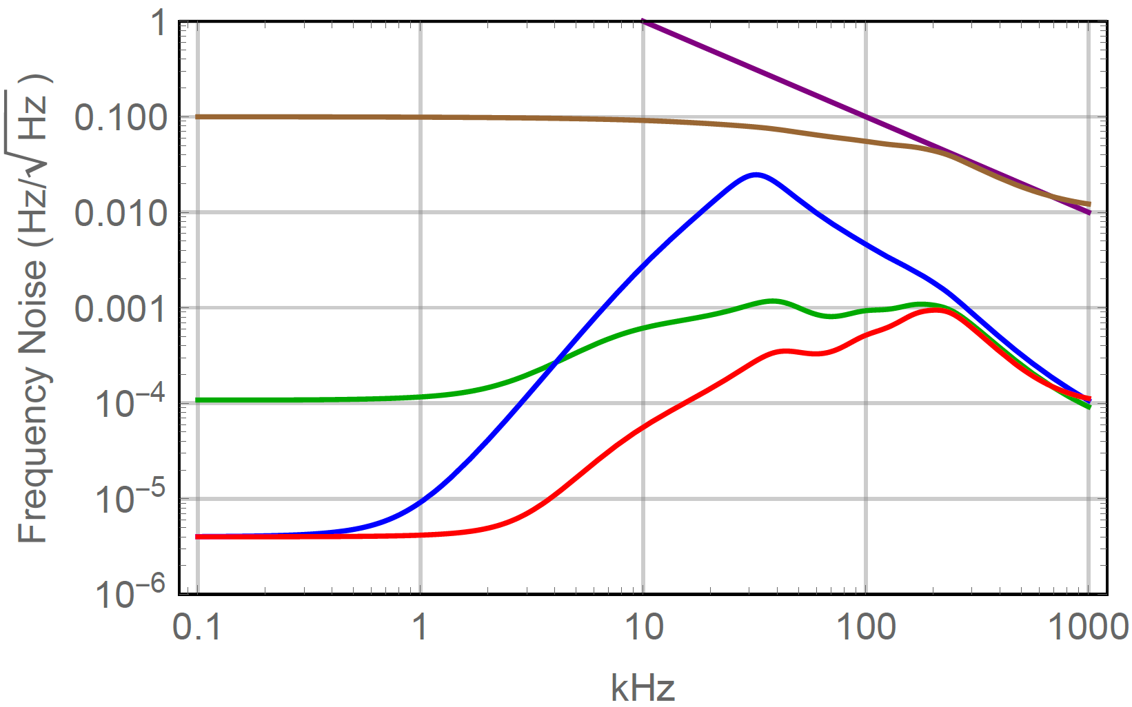
Are we gain limited at high frequencies?
Hierarchical approach: PSL ~ 500kHz BW, IMC ~100kHz BW
No reference cavity: IMC ~500kHz BW, current TTFSS
Serial approach: PSL ~500kH BW, IMC ~500kHz BW Requires IMC TTFSS and separate EOM
Conclusion: Serial approach & increasing modulation index will help >1kHz and allow for increased VCO noise
PSL Noise
LLO VCO
aLIGO VCO
MC-F
Not enough boost in TTFSS
LHO IMC shot
IMC shot best case

Slide 7
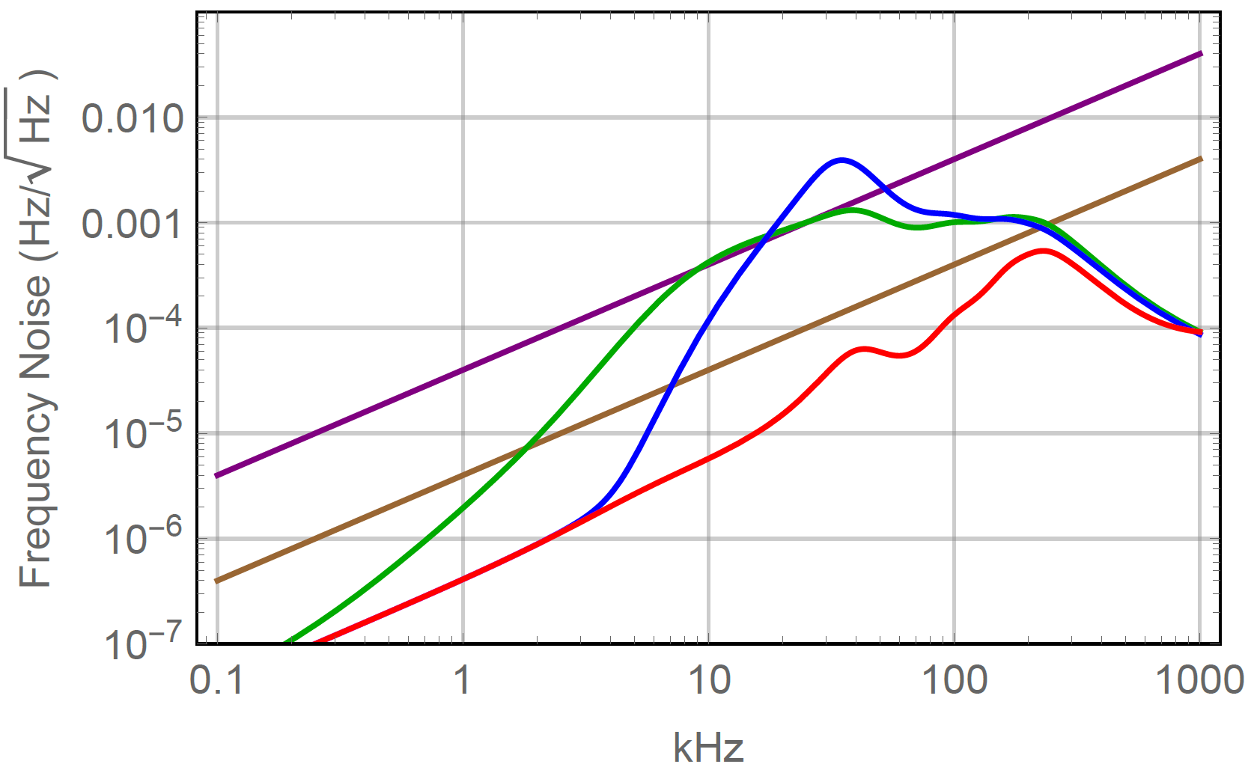
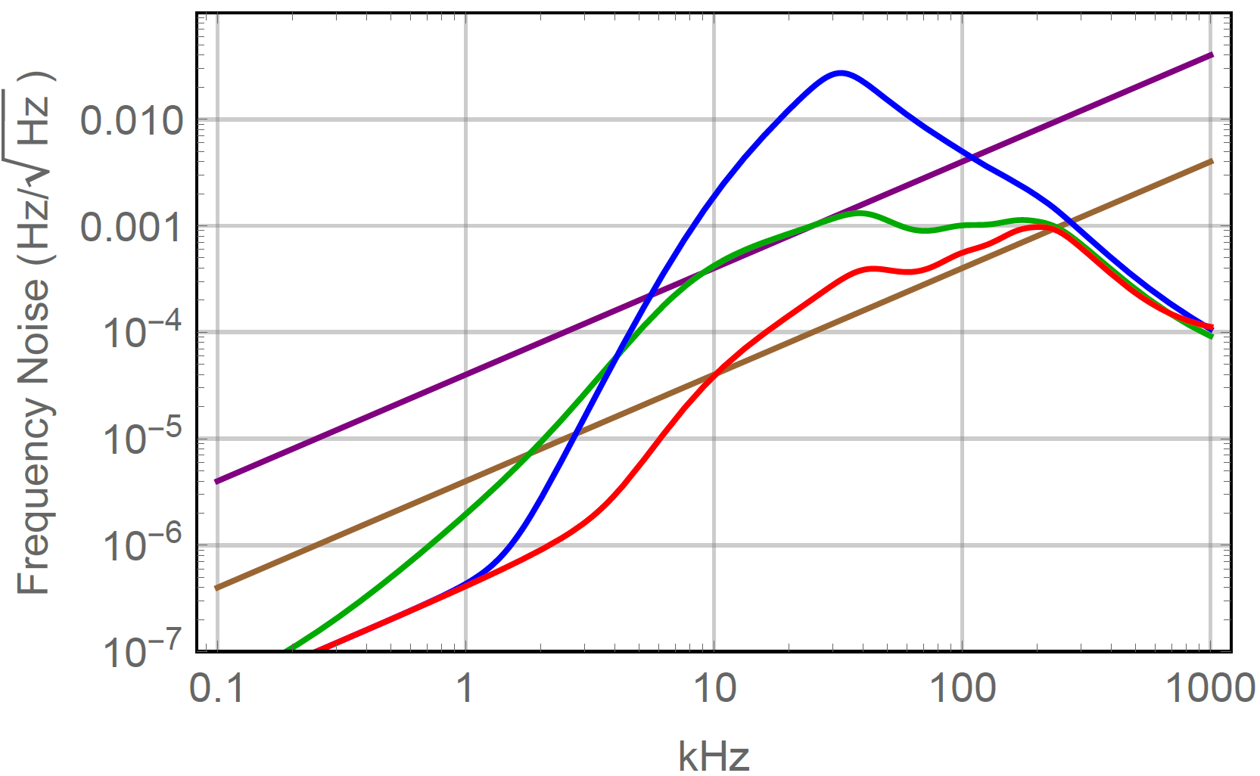
Interferometer Projection (assuming ideal IMC sensing noise)
Hierarchical approach: PSL ~ 500kHz BW, IMC ~100kHz BW, REFL ~15kHz BW
No reference cavity: IMC ~500kHz BW, current TTFSS, REFL ~15kHz BW
Serial approach: PSL ~500kH BW, IMC ~500kHz BW, REFL ~15kHz BW Requires IMC TTFSS and separate EOM
Below a 3-5 kHz: REFL sensing noise dominates
aLIGO VCO
LLO VCO
DARM
current REFL shot
ideal REFL shot

Slide 8
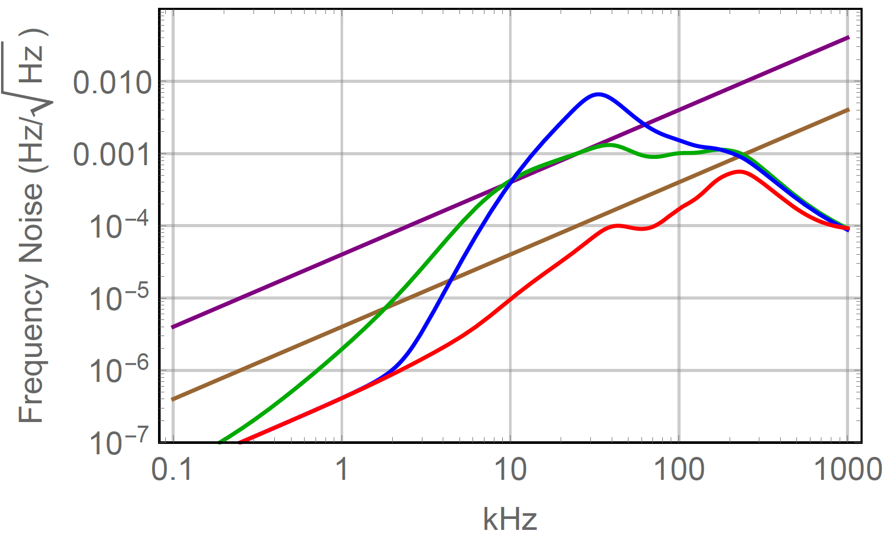
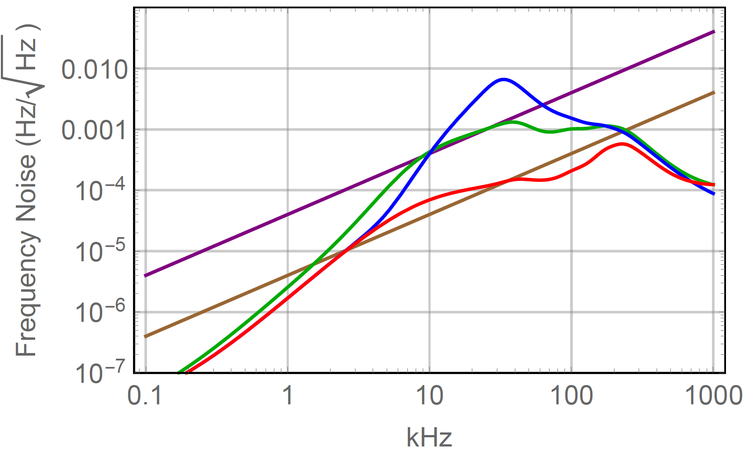
Interferometer Projection (Comparing IMC sensing noise)
Hierarchical approach: PSL ~ 500kHz BW, IMC ~100kHz BW, REFL ~15kHz BW
No reference cavity: IMC ~500kHz BW, current TTFSS, REFL ~15kHz BW
Serial approach: PSL ~500kH BW, IMC ~500kHz BW, REFL ~15kHz BW Requires IMC TTFSS and separate EOM
Above 3-5kHz: Better IMC sensing noise is required to take advantage of any REFL improvement
Ideal IMC Sensing Noise / iLIGO VCO
Current IMC Sensing Noise / iLIGO VCO
DARM
current REFL shot
ideal REFL shot

Slide 9
REFL Sensing (LHO)
REFL shot is high (estimate 10x over ideal): carrier dominated
Total AS port power is 240-270mW; numbers need to be multiplied by 2 to account for OMC.
REFL split ratio 1.25%, unlocked ~400mW.
40-50% of 45.5MHz sideband power is not accounted for.
70-80% of 9.1MHz sideband power is not accounted for: Loss where/why? Recommendation:
Investigate the 9.1MHz vanishing act
Check carrier mode matching and high order mode content in reflection
Maybe consider new RM with better optimized coating
Increase REFL power (maybe limited by RF signals due to sideband imbalance)
 | Input |  | AS (contrast?) |  | POP | REFL |  | Expect
Carrier | 97.6% | 37W | 19.4% | =25mW | 98.4% | 82.5% | 8.5mW
9.1 MHz | 0.9% | 0.33W | 6.3% | 8mW | 1.3% | 3.9% | 0.4mW | ~4mW
45.5 MHz | 1.5% | 0.56W | 74.3% | 96mW | 0.3% | 13.6% | 1.4mW

Slide 10
Possible Actions
Unknown prospects to reduce the frequency noise coupling
Higher power and improved squeezing will make frequency noise coupling more significant
Investigate 9MHz sideband mystery
Is the poor sideband power related to optical distortions by the ITMs which produce HOMs?
Does this correlate with the high frequency noise coupling?
Increase power in REFL
We are using 2 PDs at LHO already
Power is only 5mW/PD at 37W input, but RF signals tend to be large
Reduce carrier in reflection by adjusting RM reflectivity
Is the REFL power dominated by carrier TEM00?
New VCO: Propose to try 1.6GHz device
What’s the excess noise seen by IMC-F above 3kHz?
IMC sensing noise reduction (higher modulation index)
Dedicated EOM for IMC or dedicated electrode on existing EOM?
TTFSS for IMC (better performance by keeping reference cavity)
Neither will help <3kHz unless we also improve the REFL sensing noise

