Slide 1
Pulsar Timing Arrays CHIME in on Gravitational Waves
Deborah Good (CHIME/Pulsar collaboration, NANOGrav)
June 24, 2019
Notes:
(North American Nanohertz Observatory for Gravitational Waves)

Slide 2
Using Pulsars to detect gravitational waves

Slide 3
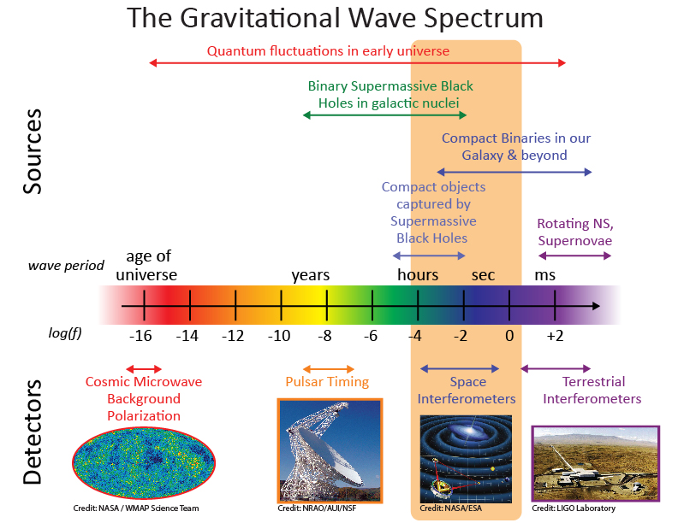
Image Credit: NASA

Slide 4
What (and who) is NANOGrav?
NANOGrav is a collaboration of over 100 researchers from 40 institutions across North America.
Our goal is to detect low-frequency gravitational waves resulting from the stochastic gravitational wave background or individual SMBH mergers (continuous wave signals), using precision pulsar timing measurements from an array of (currently) 56 pulsars.

Slide 5
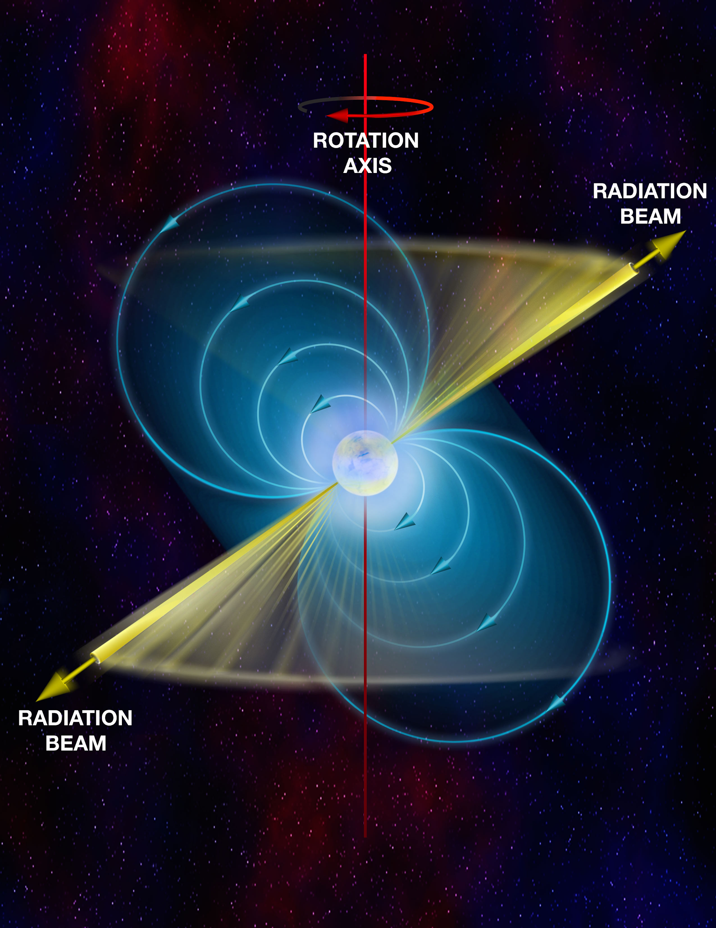
Quick reminder: Pulsars
Pulsars:
Rapidly rotating neutron stars
Large magnetic fields
Pulsars & Gravity
Double pulsar system provided indirect proof of gravitational radiation
Pulsar binaries provide important tests of gravity.
Millisecond pulsars:
“Recycled”
Extremely accurate clocks.
Image credit: NRAO

Slide 6
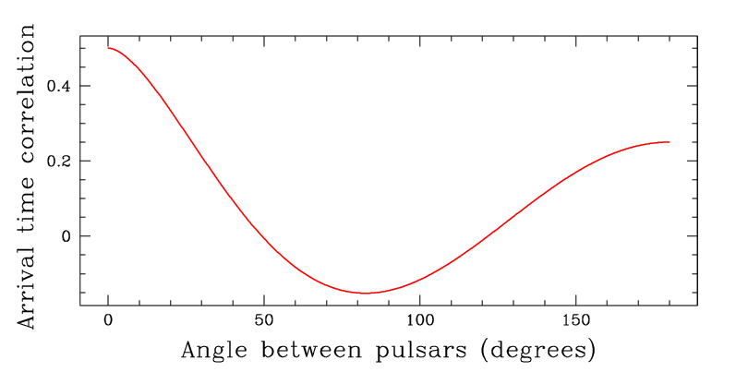
How do we see gravitational waves with pulsars?
A gravitational wave signal in pulsar-timing array data will create a correlated signature in the timing residuals for all pairs of pulsars, dependent only on the pulsar pair baseline.
Image credit: NANOGrav Collaboration

Slide 7
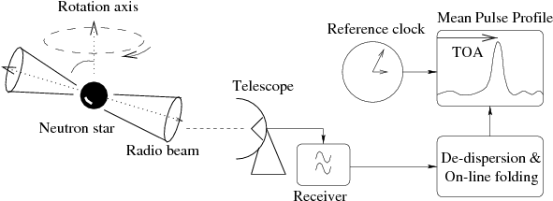
How do we time pulsars?
Observe pulsars (we use mostly Arecibo Observatory & the Green Bank Telescope) regularly for a long period of time (14+ years for NANOGrav)
Determine Times of Arrival (TOAs) for every observation
Fit a timing solution to the total set of data.
Focus in on residuals and model out as much structure as possible.
Lorimer & Kramer 2004

Slide 8
What do we see when we time pulsars?
Rotation Period Rotation Period Derivative Keplerian Orbital Elements Relativistic Orbital Elements Kinematic Perturbations of Orbital Elements | Dispersion Measure Dispersion Measure Variation | Position Proper Motion Parallax Solar Electron Density
Slide from Jeff Hazboun (and David Nice)

Slide 9
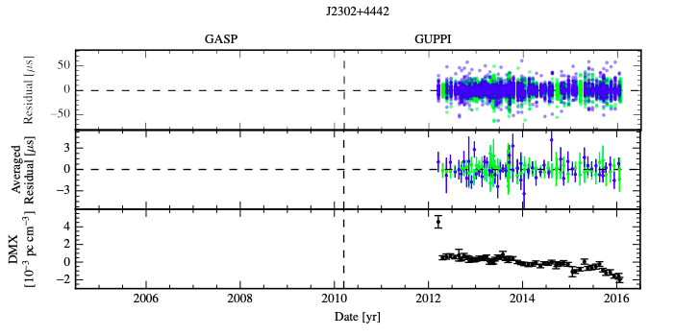
What do we see when we time pulsars?
(Arzoumanian et. al. 2018)

Slide 10
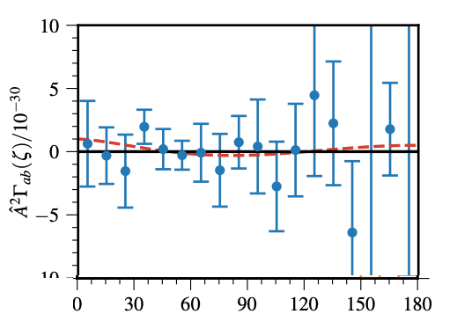
NANOGrav Current Status
11 yr Spatial Correlations
Image credit: NANOGrav Collaboration
(Arzoumanian et. al. 2018)

Slide 11
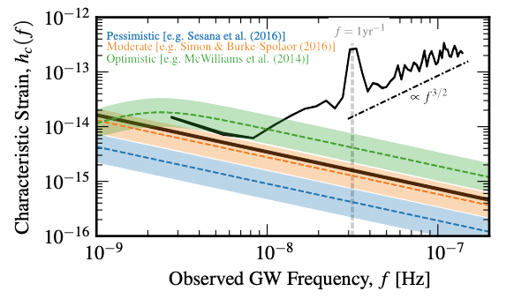
NANOGrav Current Status:
Upper Limit on Stochastic Gravitational Wave Background
Green, orange, and blue lines: predictions for the stochastic gravitational wave background.
Black line: GWB-amplitude 95% upper limits for an uncorrelated common process
Solid: with γ = 13/3 power law
Dashed: with independently determined components.
(Arzoumanian et. al. 2018)

Slide 12
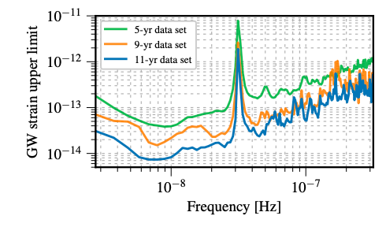
NANOGrav Current Status:
Upper Limit on Continuous Wave Signals
(Aggarwal et. al. 2019)

Slide 13
Using CHIME for pulsar timing

Slide 14
Imagine you were designing a new instrument to improve the NANOGrav data set.
What data would you like to get from that instrument?
What isn’t well-covered by current NANOGrav data?
What other science could you explore at the same time?

Slide 15
Imagine you were designing a new instrument to improve the NANOGrav data set.
You would probably want…
High cadence data with lots of TOAs
At a frequency range where pulsar emission is bright
But where you can learn new things you didn’t know from other NANOGrav observations to improve that data
While still being able to integrate new TOA measurements into the NANOGrav dataset.
(And you might want to be able to do other science too!)

Slide 16
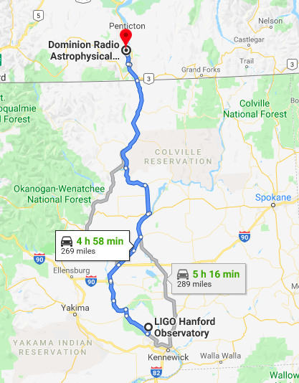
The Canadian Hydrogen Intensity
Mapping Experiment (CHIME)
Originally designed to map redshifted neutral hydrogen to detect baryon acoustic oscillations and constrain dark energy, it now hosts several projects, including a pulsar timing project and a fast radio burst search.
CHIME is a radio transit telescope, with no moving parts, which observes 24/7.

Slide 17
What is CHIME?
Parameter | CHIME/FRB Value
Collecting Area | 8000 m²
Number of cylinders | 4
Number of antennae | 1024, each with 2 polarizations
Frequency Range | 400-800 MHz
E-W FoV | 2.5-1.3°
N-S FoV | ~110°
Video Credit: Richard Shaw/CHIME Collaboration

Slide 18
How does CHIME meet NANOGrav’s needs?
CHIME/Pulsar can:
Observe (and time) every northern hemisphere NANOGrav pulsar every day
Monitor for Dispersion Measure & scattering variations
Combined, this will result in up to factor of 2 timing improvement!

Slide 19
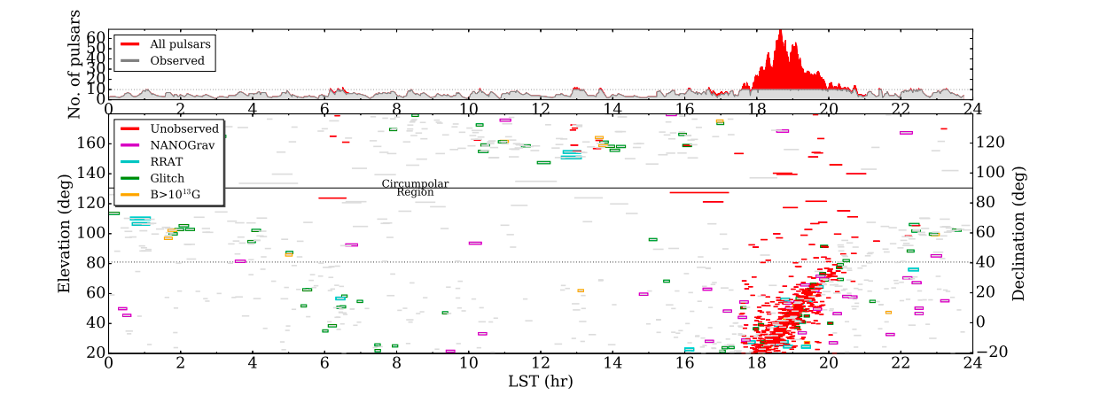
CHIME/Pulsar can observe NANOGrav pulsars daily
Image: Ng & CHIME/Pulsar Collaboration 2017

Slide 20
CHIME/Pulsar System Details
Image: Ng & CHIME/Pulsar Collaboration 2017

Slide 21
CHIME/Pulsar System Details
Parameter | CHIME Value
Number of Tracking Beams | 10
Frequency Resolution | 390 kHz
Spectral channels | 1024
Output data bit depth | 8 or 16 bits
Output polarization info | Full Stokes (fold mode) Total intensity (filter bank)
Pulsar data output rate | 67 Mbps
In the X-Engine:
Form 10 tracking beams
In 10 pulsar GPU nodes:
Data are scaled down, encoded into 4+4 complex numbers, and packetized in VDIF format.
Fold Mode: Data are coherently dedispersed with DSPSR
Filter-bank Mode: Data are processed using CHIME specific software capable of handling DM up to 2500 pc/cm³.
Scheduler & Monitoring
Automatic scheduler ensures pulsars are observed 24/7, prioritizing PTA pulsars.
Web monitoring tools to check on performance.

Slide 22
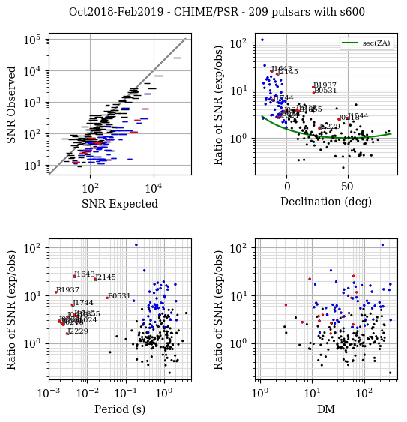
CHIME/Pulsar System Performance
While we still have work to do, our observed signal to noise is increasingly lining up with our expected signal to noise.
Red points: Millisecond pulsars Blue Points: Pulsars with declination <0 deg Black Points: All other pulsars
Preliminary
Image credit: Cherry Ng

Slide 23
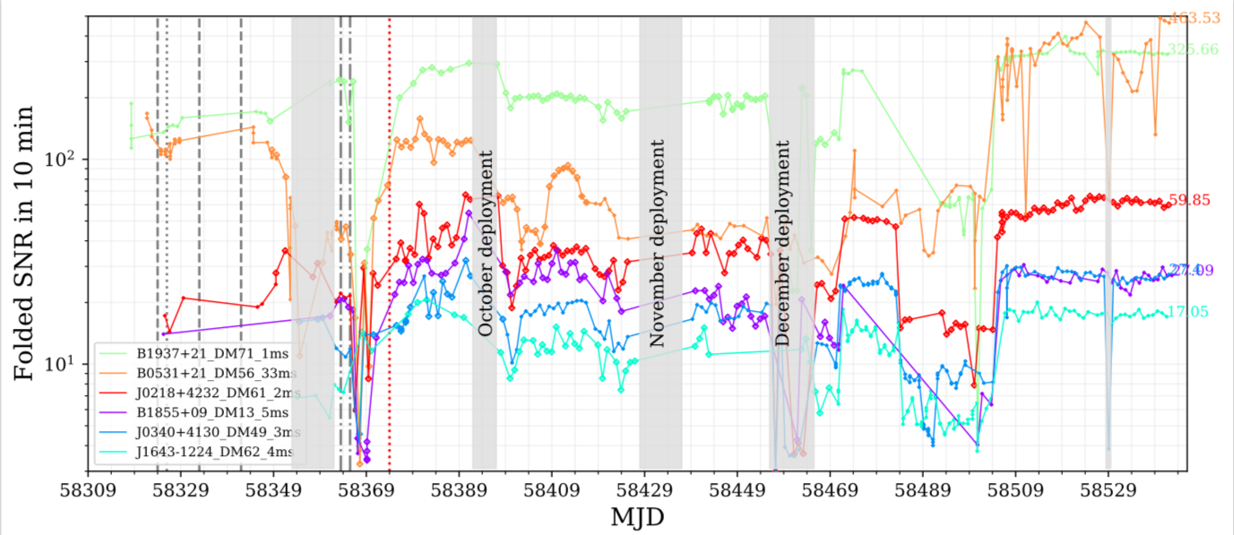
CHIME/Pulsar System Performance
Image credit: Cherry Ng
Preliminary

Slide 24
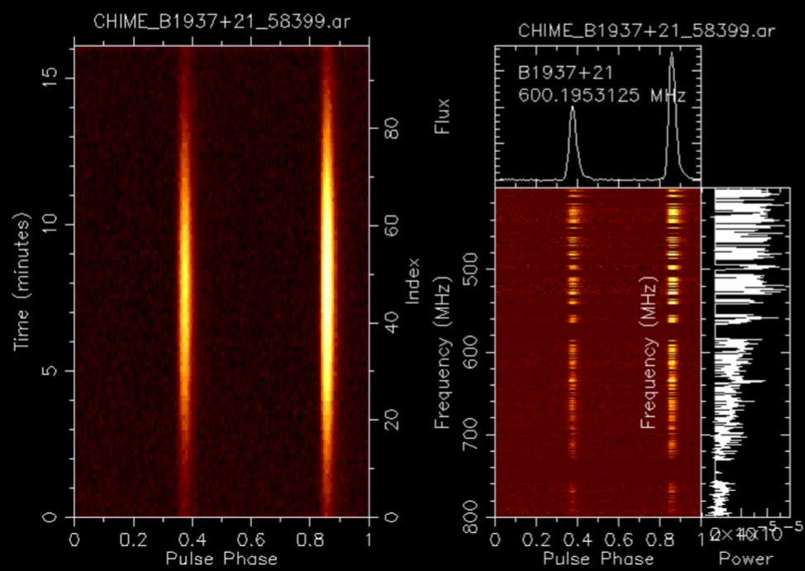
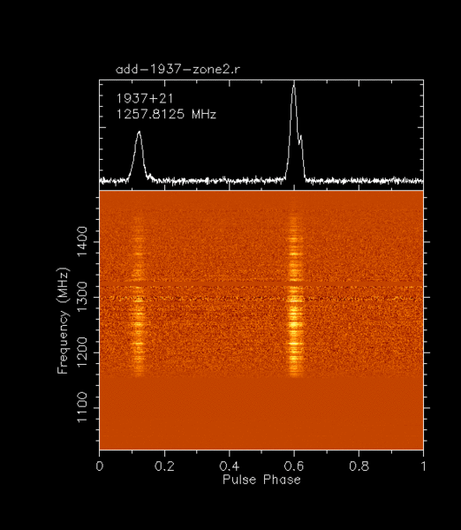
Recent results:
Successful measurements of NANOGrav pulsars
Preliminary
Max Planck Institute for Radio Astronomy
Image credit: Emmanuel Fonseca

Slide 25
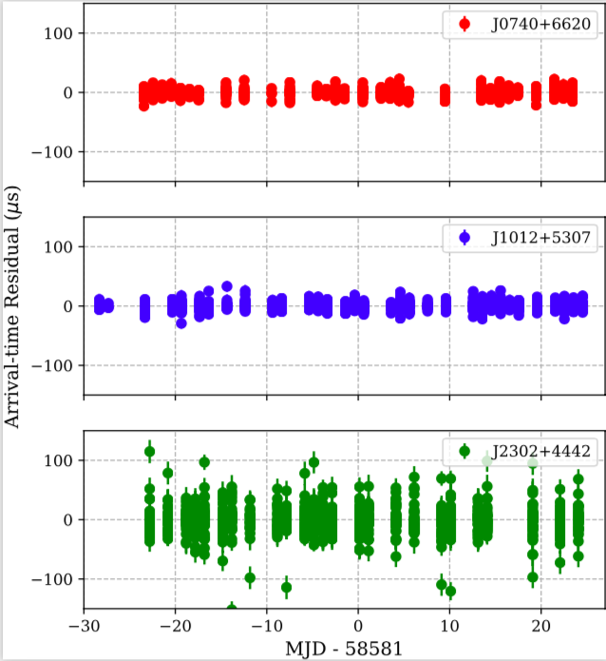
Recent Results from CHIME:
Early timing residuals
Left: NANOGrav 11 year release (Arzoumanian et. al. 2018).
Right: CHIME/Pulsar preliminary timing
Preliminary
Image credit: Emmanuel Fonseca

Slide 26
Science with CHIME/Pulsar: beyond NANOGrav
Discovering new (slow, not milli-second) pulsars
Discovering new Rotating Radio Transients (RRATs)
Monitoring known RRATs and pulsars with interesting time domain structure
Mode Changing
Nulling
Monitoring ISM Weather
Repeating FRB follow-up

Slide 27
Conclusions
Searching for gravitational waves with pulsar timing provides a handle on a different portion of the gravitational wave spectrum than that studied by LIGO (or LISA).
NANOGrav continues to set upper limits on the stochastic gravitational wave background, which are beginning to rule out models. 12.5 year dataset coming soon!
CHIME/Pulsar is an exciting new instrument which will help improve our NANOGrav dataset by as much as a factor of 2.

