Slide 1
Optical Decoherence Studies
SURF 2019
Kruthi K¹
Mentors: Gautam Venugopalan², Koji Arai² and Rana X Adhikari²
¹Indian Institute of Science, Bangalore, India
²LIGO Laboratory, California Institute of Technology, Pasadena, CA
LIGO-T1900281-v1
LIGO R&D
Notes:
Hi, I’m Kruthi
LIGO 40m prototype lab
With my mentors Gautam, Koji and Rana…
presenting a couple of things I have worked on so far

Slide 2
Overview
In situ scatter measurements
Camera setup
Analysis of images
Future work
LIGO-T1900281-v1
LIGO R&D
Notes:
This is the overview of my today’s talk….
Focusing on in situ
Infrastructure I have been trying to setup
Various studies that can be done
Scope for further research
Why these studies are important to LIGO

Slide 3
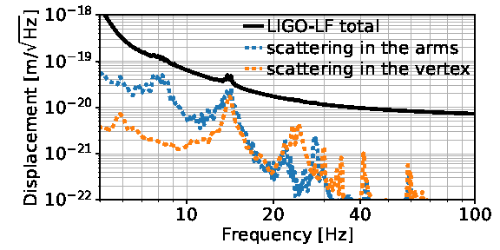
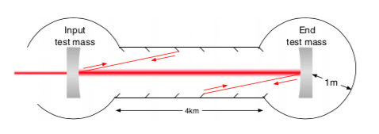
Backscattered light noise
Backscattered light modulates the phase and amplitude of main beam and introduces a random phase noise.
Scattering is a critical noise source below 30 Hz.
Loss from scattered light reduces squeezing and will limit the sensitivity in the future upgrades.
LIGO-T1900281-v1
LIGO R&D
Notes:
new era of astronomy
culmination of decades of instrumentation research
GWs in 10 to 1000 Hz band with a strain sensitivity of 10^-23 around 100Hz
millions of times smaller than a proton.
SNR
Understand sources
Due to surface imperfections ….hit the baffles... recombine with the main beam.

Slide 4
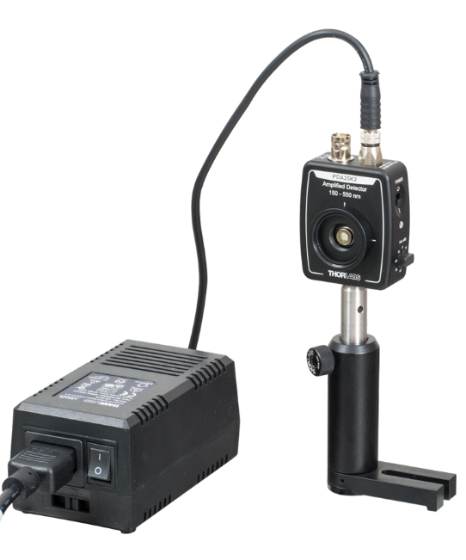
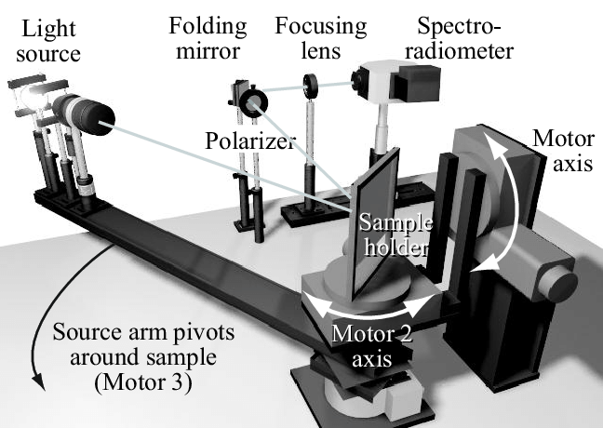
Scatter Measurements
To further develop techniques to reduce the scatter losses from arm cavity mirrors, it is necessary to have reliable methods to -
study scattering due to surface imperfections, point scatters, coating, etc
characterize the scatter loss and
understand the nature of scattered light
To do all these, first off - how to measure scattered light?
Photodetector
Scatterometer
LIGO-T1900281-v1
LIGO R&D
Notes:
Photodetector
Scatterometer..access to all angles

Slide 5
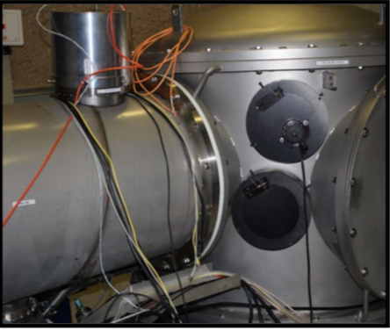
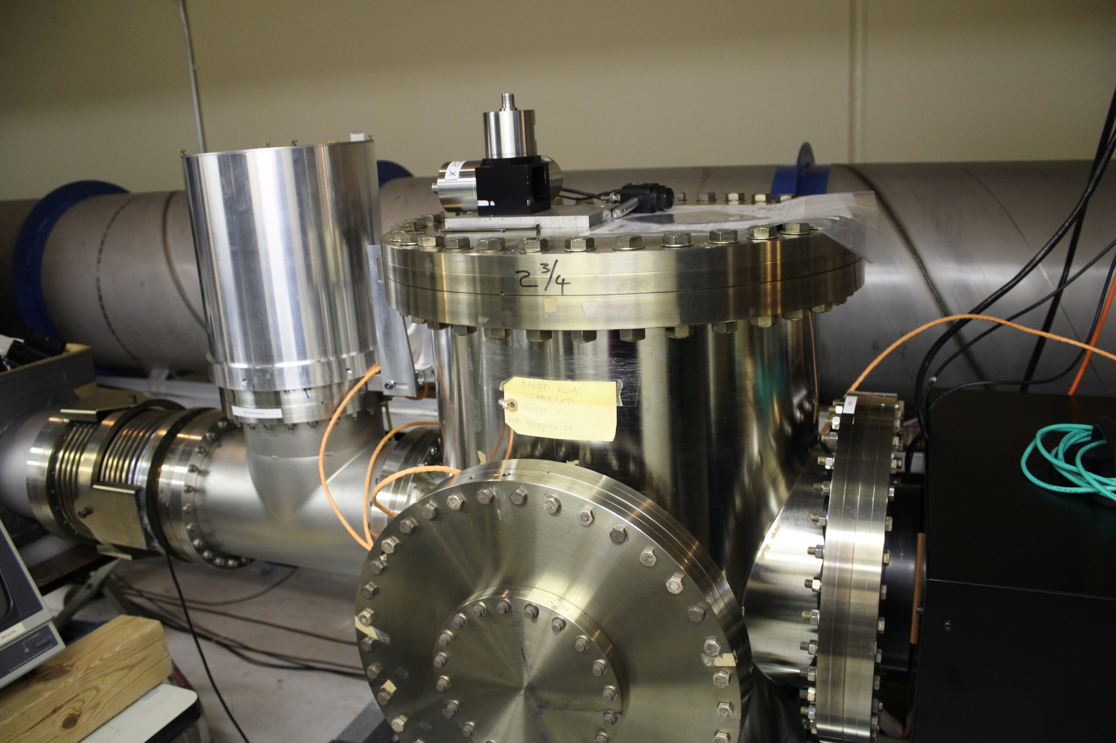
How to measure scattered light in situ?
<MC2 pic>
→ Mirrors/test masses are inside the vacuum chamber. Limited access!
→ Make the best use cameras!
MC2 chamber
ETMX Chamber
LIGO-T1900281-v1
LIGO R&D
Notes:
Cameras are already there for interferometer diagnostics
Having lot of photodetectors inside the vaccuum is not feasible
Own scatter and noise
Making so many photodetectors clean enough

Slide 6
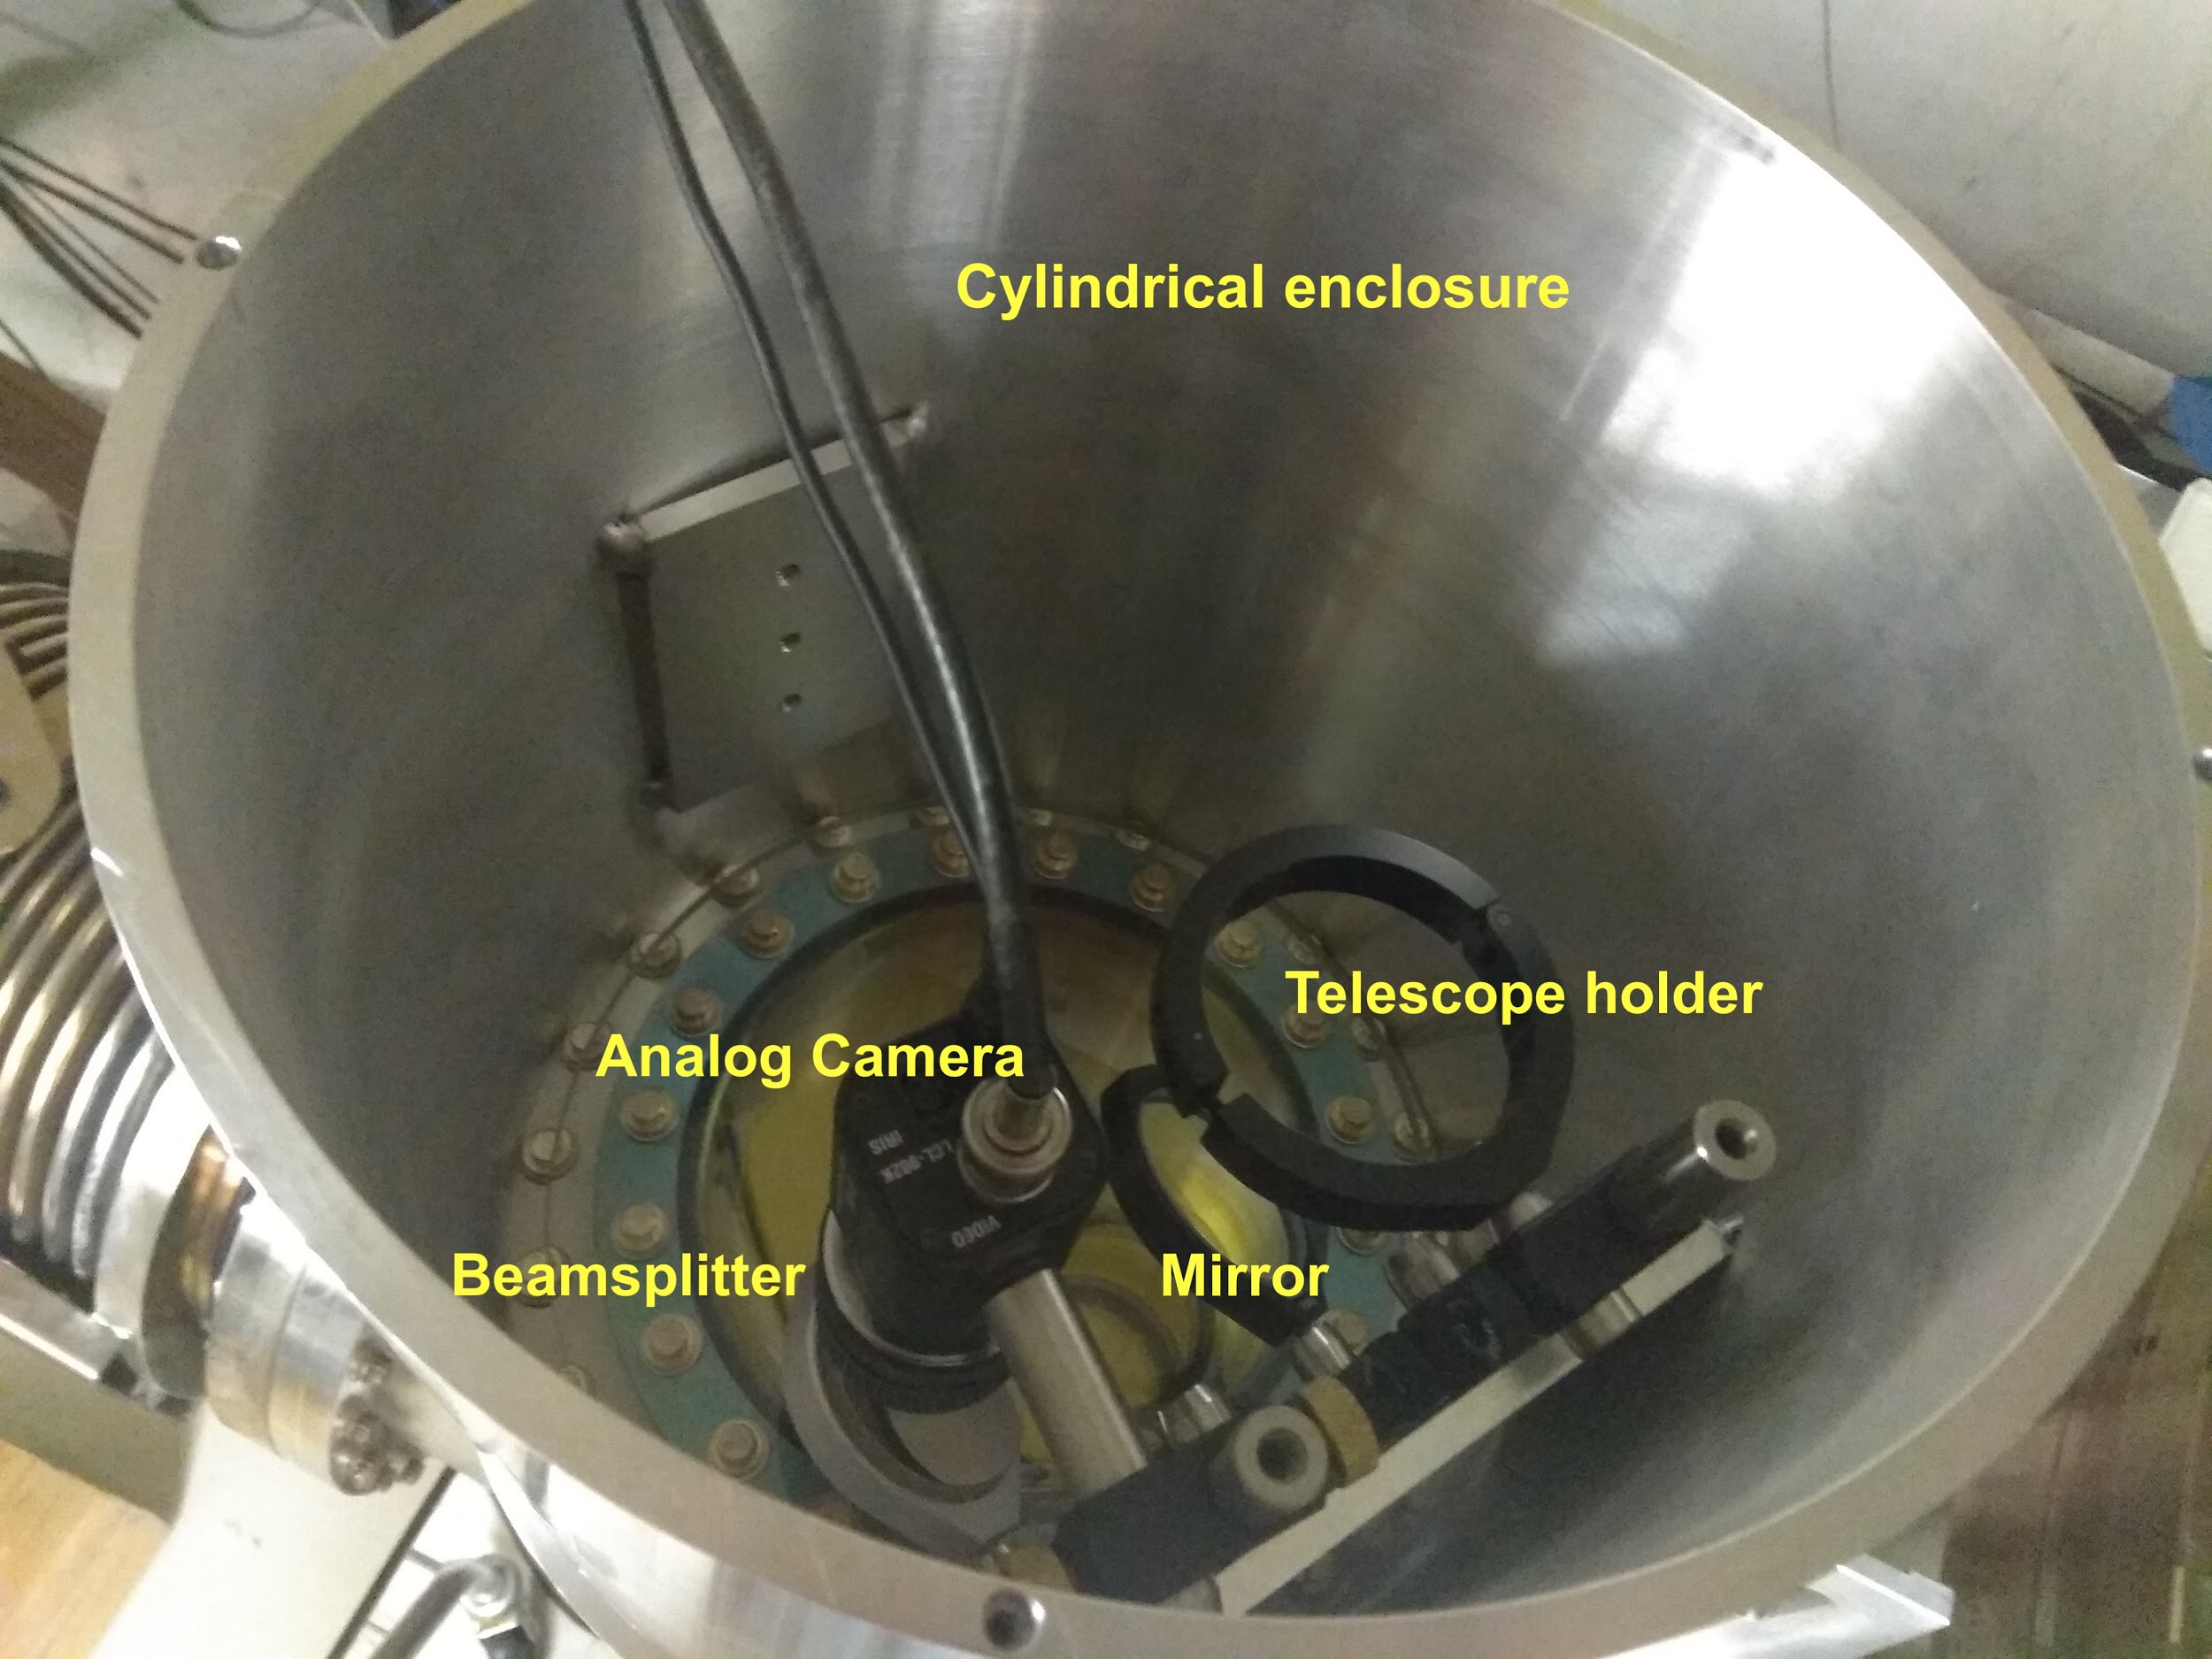
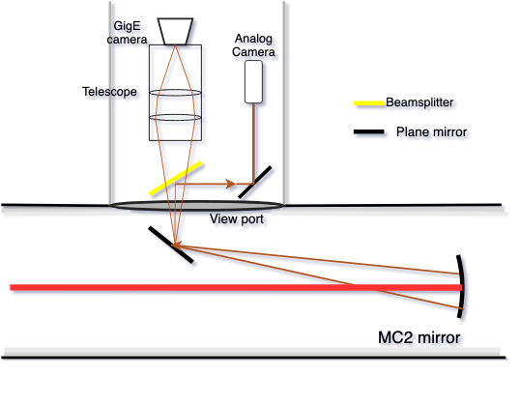
Camera setup
MC2 Camera setup schematic
Study point scatterers, nature of scattered light, etc
Estimate scattered light power (loss)
LIGO-T1900281-v1
LIGO R&D
Notes:
Where to put the camera
What next with the images?

Slide 7
Understanding the image
Studies on point scatterers:
Size vs number of point scatterers
Spatial distribution of point scatterers
What fraction of scattering is due to these point scatterers?
Other studies:
Can we get some info about the coherence of scattered light from these images?
Understanding how effective our cleaning methods are
Can we get some info about how different coatings affect scattering?
Image of beamspot on MC2 mirror
LIGO-T1900281-v1
LIGO R&D
Notes:
Analysing the images for 1 or 2 weeks while I draft my final report
Address some questions

Slide 8
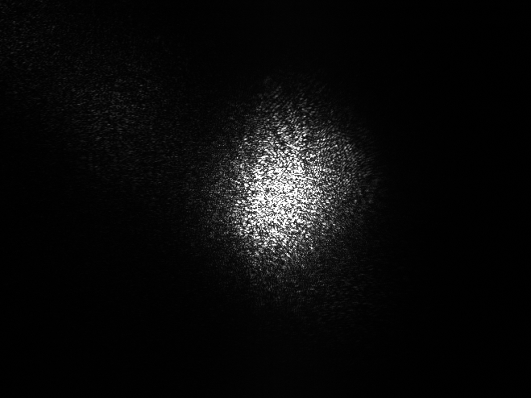
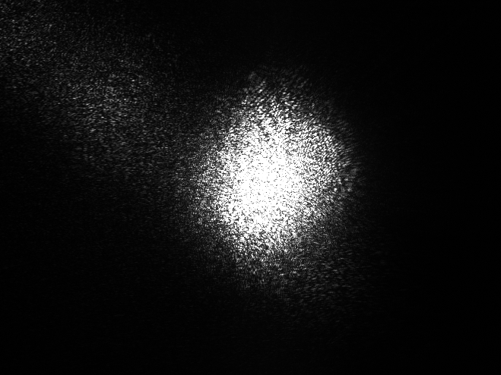
High Dynamic Range Images
Dynamic range is the ratio of intensity corresponding to the brightest region of the image and to the darkest.
HDR image resolves the contrast and image details much better than an ordinary image which might be limited by pixel saturation.
100 μs 300 μs 1000 μs 3000 μs
LIGO-T1900281-v1
LIGO R&D
Notes:
To do all the studies…
Better contrast

Slide 9
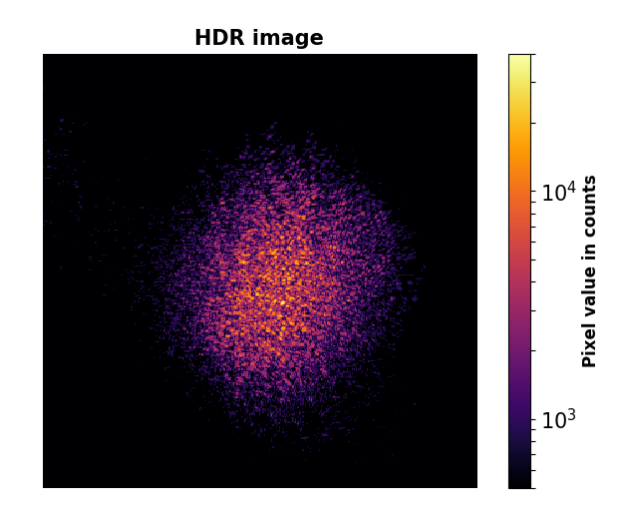
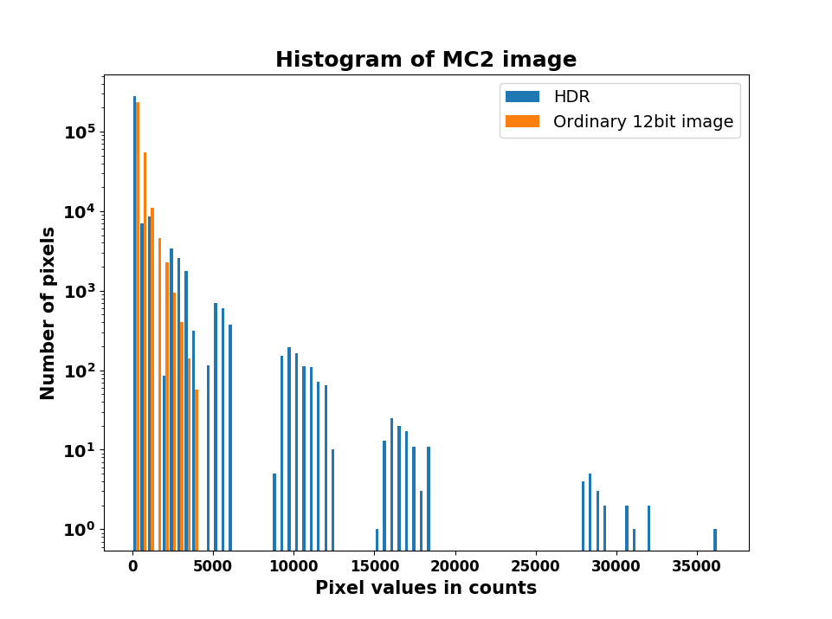
HDR images
Increased dynamic range and bit depth
→ Better resolution of intensity of points on the image
LIGO-T1900281-v1
LIGO R&D
Notes:
HDR images can’t be display on normal screens
Limited dynamic ratio
Color coded
Pixel values ←→ intensity (seen in a few slides down)

Slide 10
Scatter loss measurements
How to measure scattered power from the images?
→ take pixel sum of the image and convert it into physical measure - power incident on our camera
Pixel sum is a function of both incident power and exposure time!
How to do convert pixel sum to power?
→ Radiometric calibration
LIGO-T1900281-v1
LIGO R&D
Notes:
Measuring scattered power itself...

Slide 11
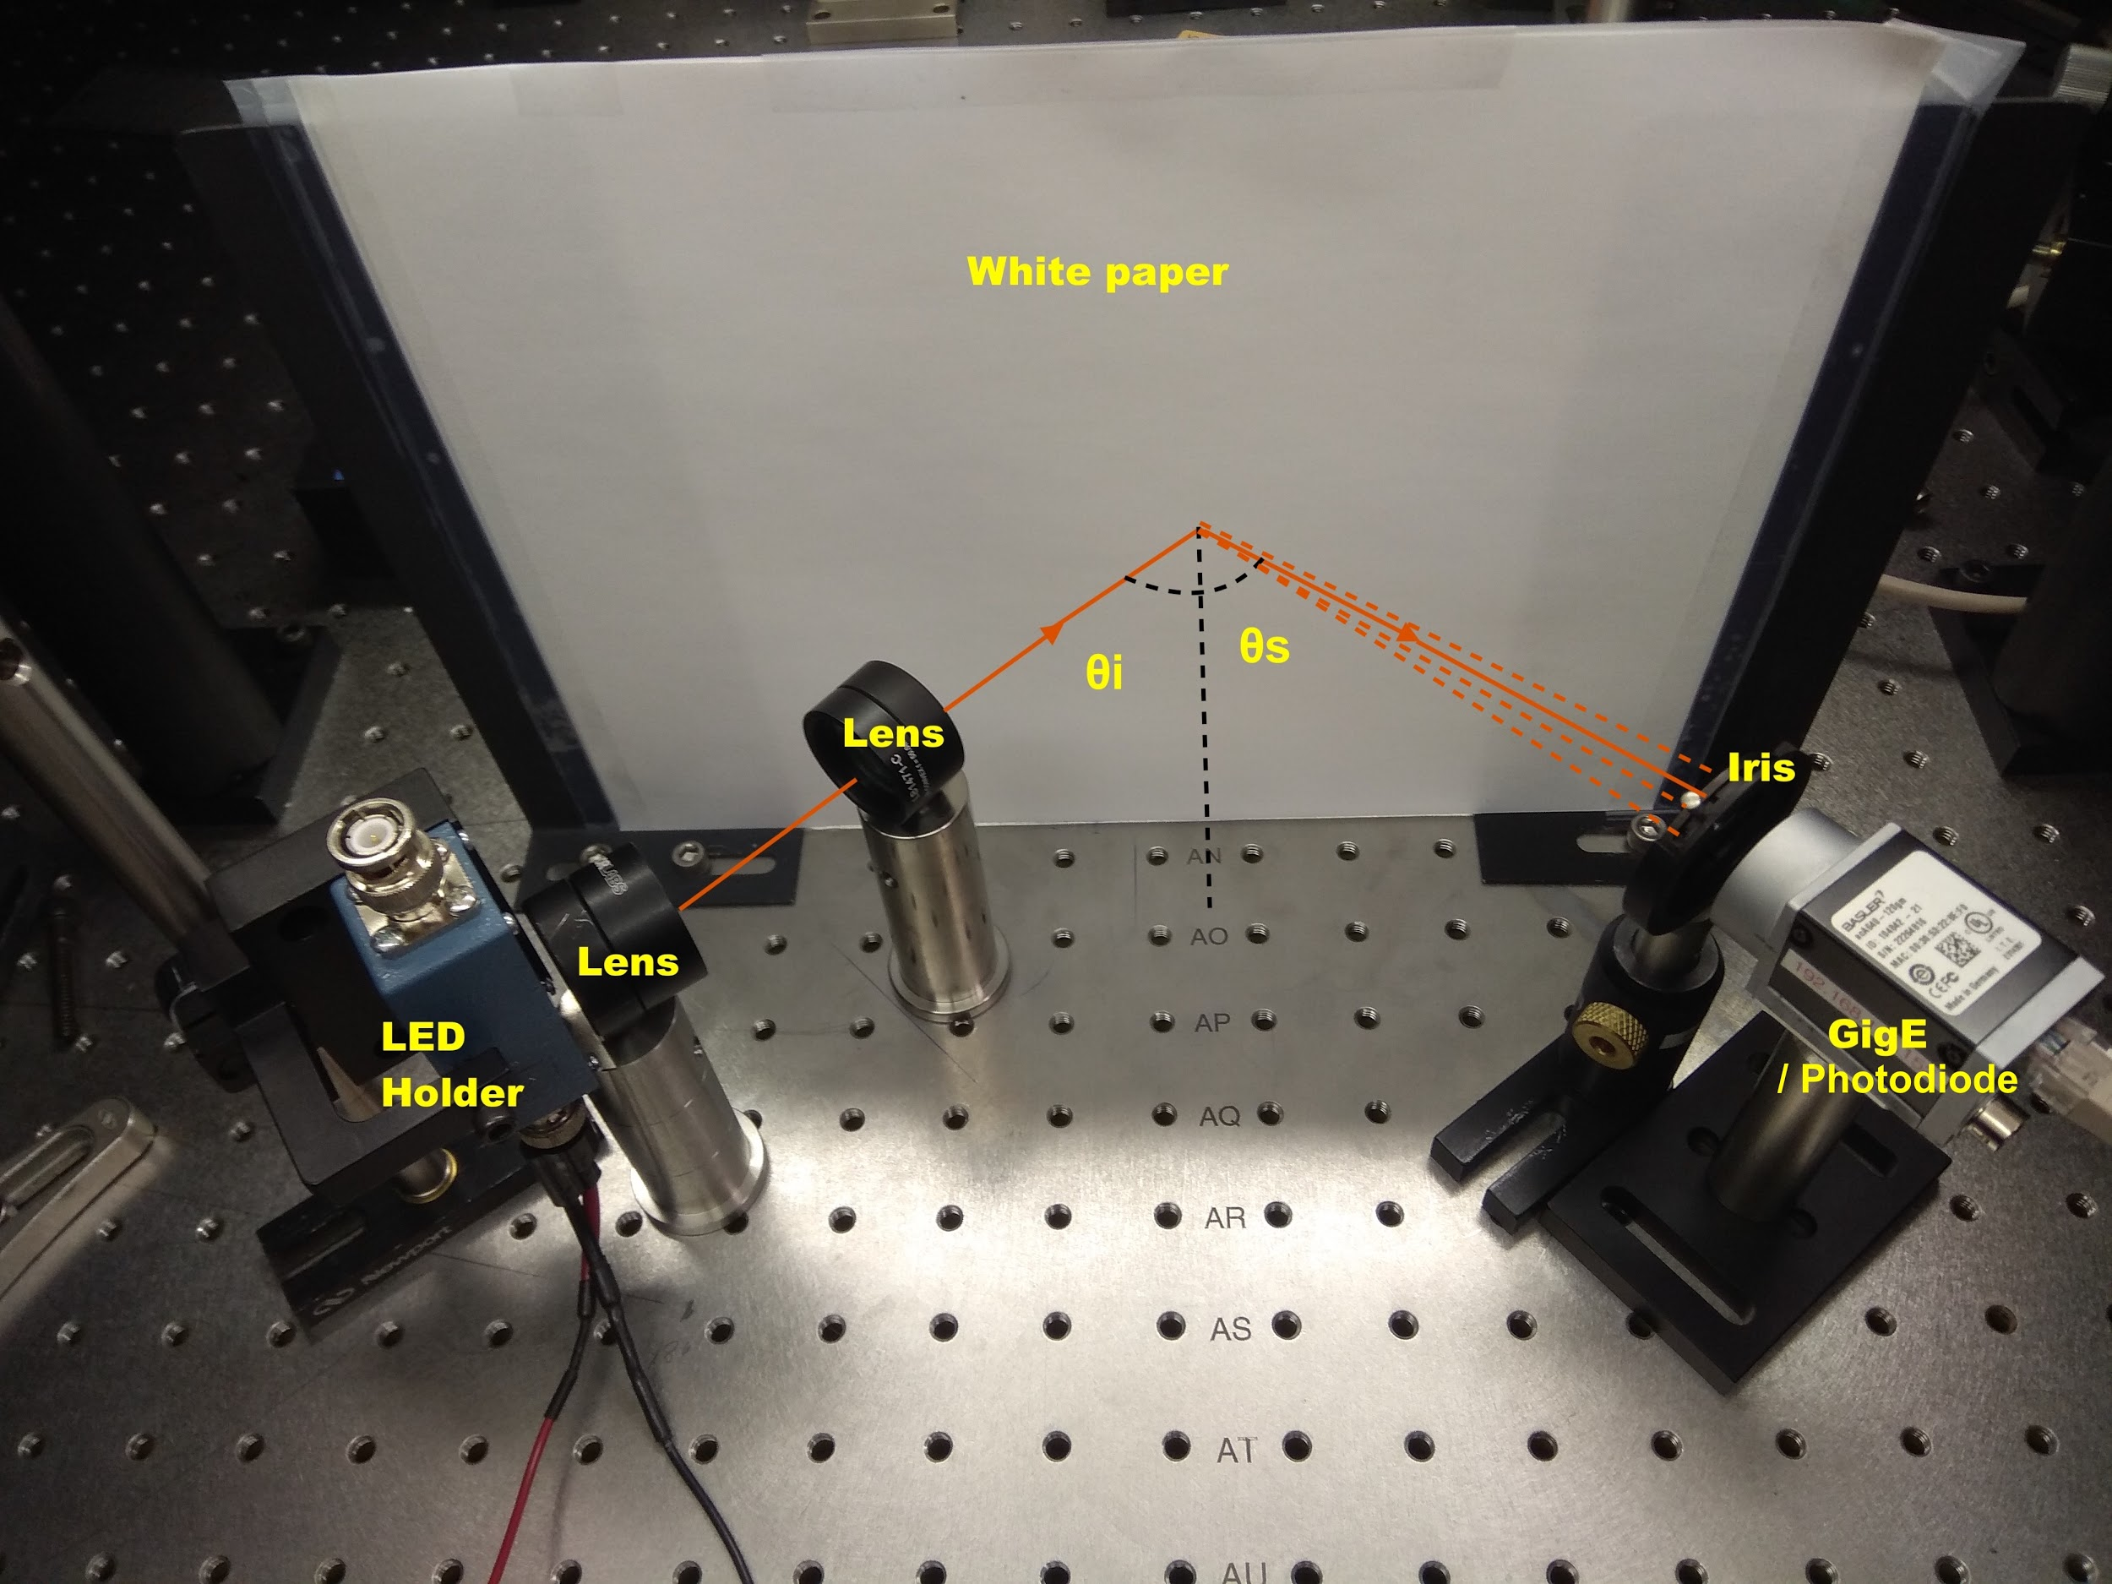
Radiometric Calibration
Light source - 1050 nm LED (to avoid any effect due to coherence of laser light)
Comparative measurement between camera and photodetector
Uniform secondary source - White paper (an approximation to
Lambertian scatterer)
LIGO-T1900281-v1
LIGO R&D
Notes:
Lambertian scatterer used to account for the different sensor sizes of camera and photodetector
Comparative measurement -- put photodiode in the place of GigE camera and measure power

Slide 12
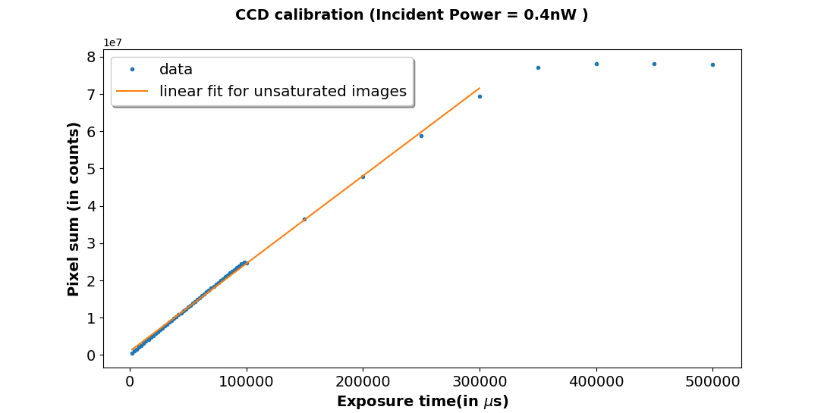
Calibration factor
Calibration factor converts pixel counts to power
For unsaturated images,
In saturated images some information about the power is lost!
LIGO-T1900281-v1
LIGO R&D
Notes:
Now that we know how to measure scattered power, what next?

Slide 13
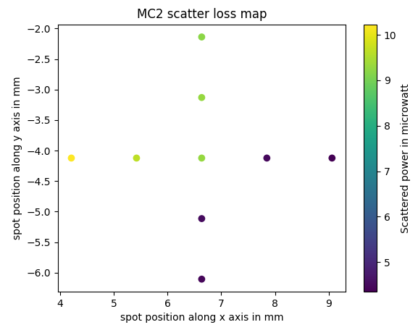
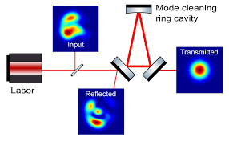
Scatter loss map of MC2
Diagram of MC2 mirror
(not to the scale)
Combining this kind of map with Transmission and Reflection maps of the cavity helps us estimate total optical loss
LIGO-T1900281-v1
LIGO R&D

Slide 14
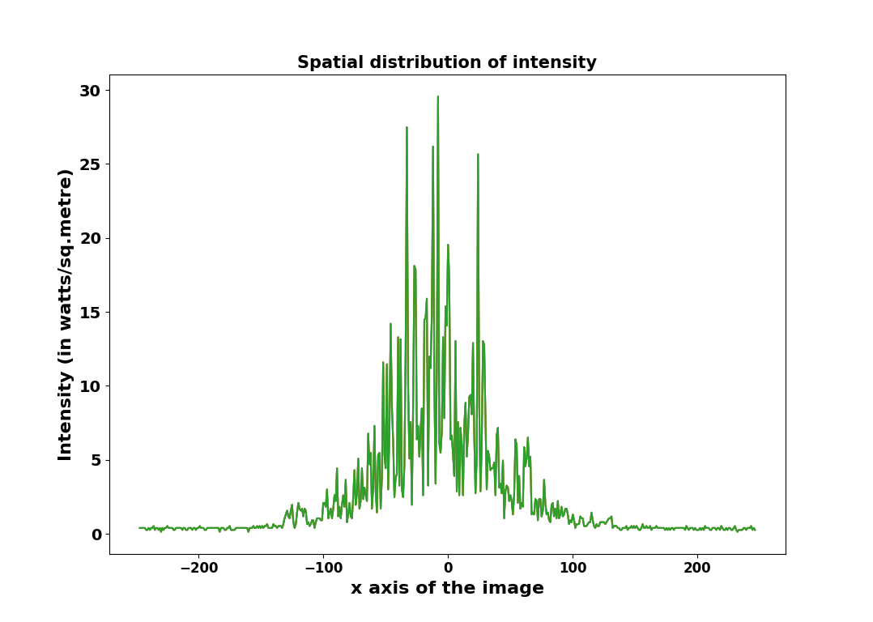
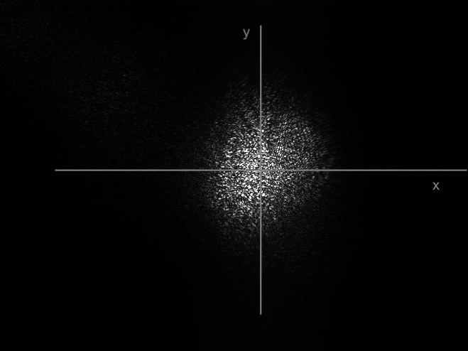
Intensity analysis of the image
MC2 beamspot image
Beamspot is not quite a Gaussian - due to scattering effects
Needs more analysis to quantify the deviation
LIGO-T1900281-v1
LIGO R&D
Notes:
One more example of what kind of info can be obtained from the images we have now. I’ll put more thought into it and see what kind of info can be obtained from these plots

Slide 15
Summary
Importance of scattering studies
HDR images and their uses
Measuring scattered power/ scatter loss
LIGO-T1900281-v1
LIGO R&D

Slide 16
Future work
Installation of GigE cameras for all cavities
Design for real time BRDF measurements at small angles
Studies with a scatterometer
LIGO-T1900281-v1
LIGO R&D

Slide 17
Thank you!
LIGO-T1900281-v1
LIGO R&D

Slide 18
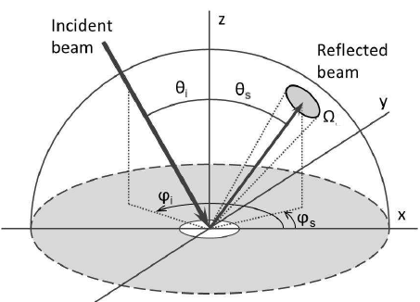
Supplementary - BRDF
Bidirectional reflectance distribution function (BRDF)
BRDF models are used to characterize anisotropy of a surface
BRDF can be used to estimate the total integrated scattering (TIS). Knowing the incident power(P_{i}) and reflectivity of the surface, we can get the total scatter loss (P_{s})
LIGO-T1900281-v1
LIGO R&D
Notes:
BRDF is a function of essentially 7 variables, x, y to specify the point,
Right hand side of equation we have Ps and Pi and theta and omega
This we can model the reflection from surface

Slide 19
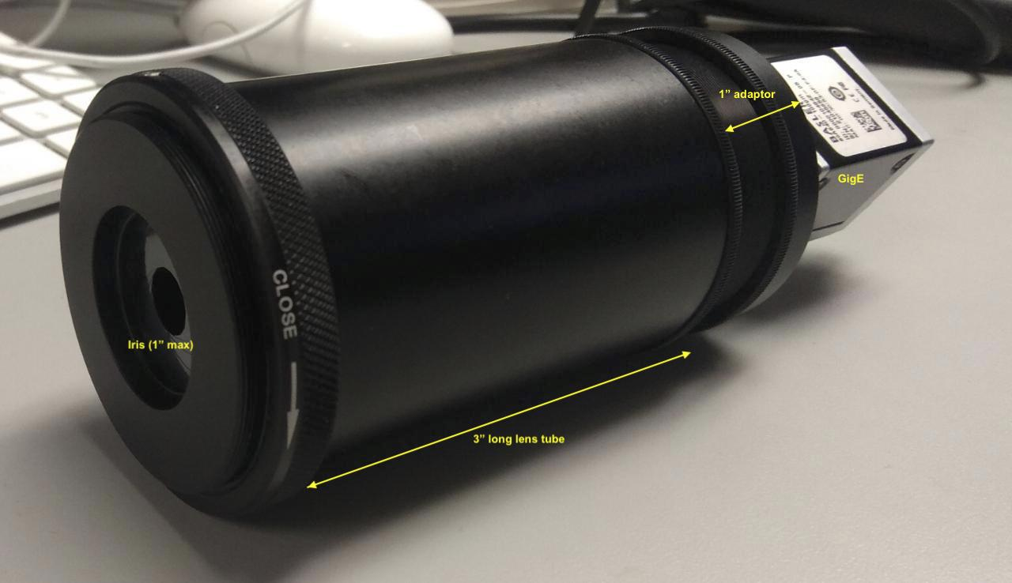
Supplementary - Telescope
Why use telescope?
Telescope parameter optimization
LIGO-T1900281-v1
LIGO R&D
Notes:
With the cameras and lenses so far we don’t have a good pictures
Coz we can’t zoom in and pixels are saturated

Slide 20
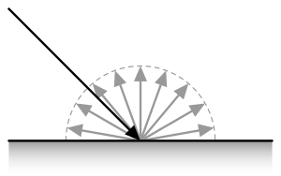
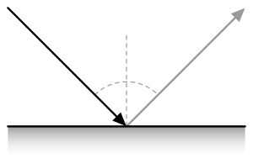
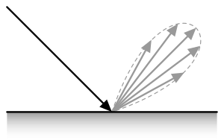
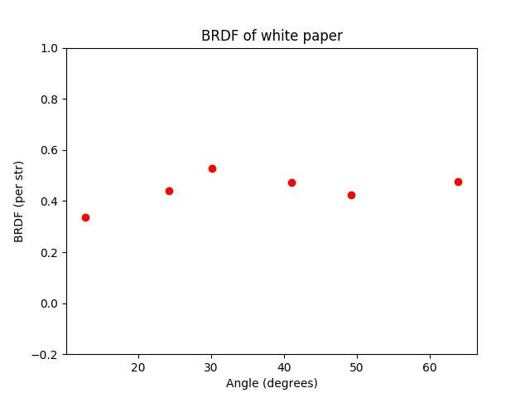
Supplementary - Lambertian Scatterer
Diffuse reflection
Specular reflection
Intermediate
LIGO-T1900281-v1
LIGO R&D
Notes:
Studying the reflection models will help us understand the anisotropy imperfections of the surface

