Slide 1
Optimal non-linear control for LIGO interferometers
SURF 2019
Milind Kumar V
Mentors- Rana Adhikari, Gautam Venugopalan and Koji Arai

Slide 2
A Brief Overview
Motivation - the what and why of the beam tracking project
Methods and results-
Weighted pixel sum
OpenCV based image processing
Major thrust: Neural networks - CNN and LSTM based approach
Future work

Slide 3
Beam tracking - what and why?
To detect gravitational waves we would like the LIGO interferometers to operate at highest sensitivity.
Need laser beam spot to be positioned at particular positions despite seismic noise.
Therefore, the objective is to build a black box that can look at video feed of scattered light from optic and predict position of beam spot on the optic.
Notes:
1 - Well, that’s what whole interferometer is about
2 - Gravitational wave detection a strain (length) measurement. Implies, if beam spot not centered (at the place where you want it to be) pitch and yaw motion will lead to angle to length coupling leading to fake GW signal.
3 - What camera? A Gigabit Ethernet camera. Why? High dynamic range! IP! Why camera - check next slide!

Slide 4
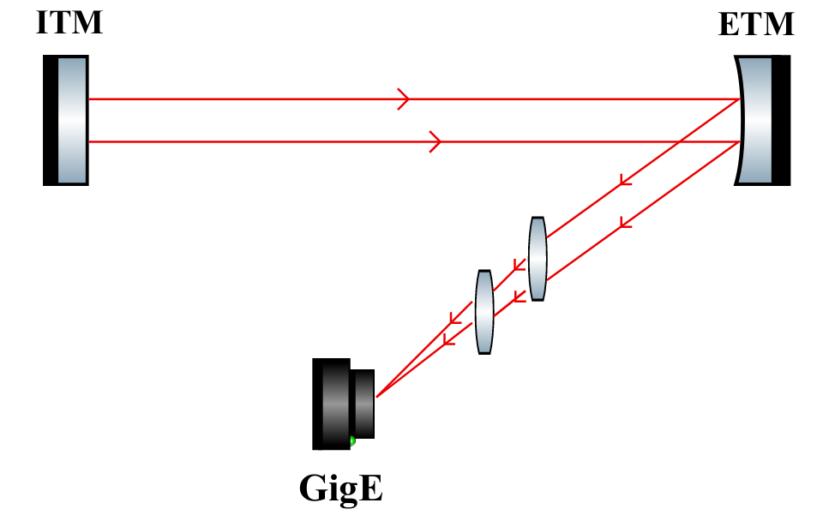
Beam tracking - more of the why
Why a camera feed? Why not a QPD? Why not A2L measurements?
Notes:
camera feed non-invasive
QPD not possible to place at certain positions
Once you build your black box - use it directly

Slide 5
Methods
Simple techniques
Weighted pixel sum
Image processing
More sophisticated/general approach
CNNs
CNN-LSTMs

Slide 6
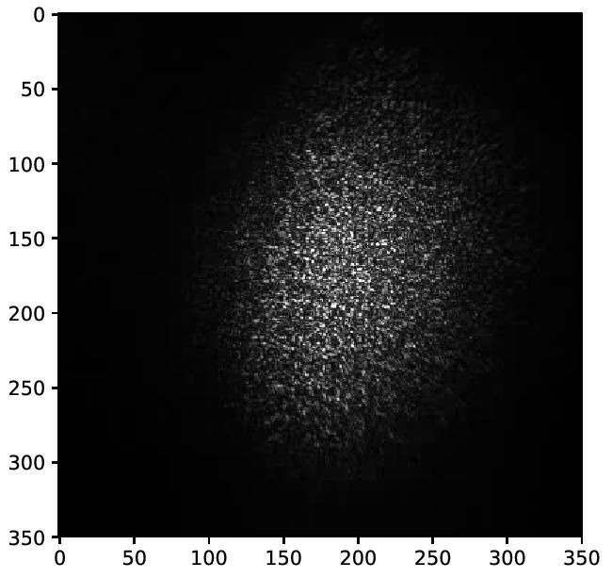
Methods
Simple pixel sum
The centroid of the beam spot is calculated as the weighted sum of the pixel coordinates with the pixel intensities as weights. This is essentially a center of mass calculation.
Notes:
colr map log

Slide 7
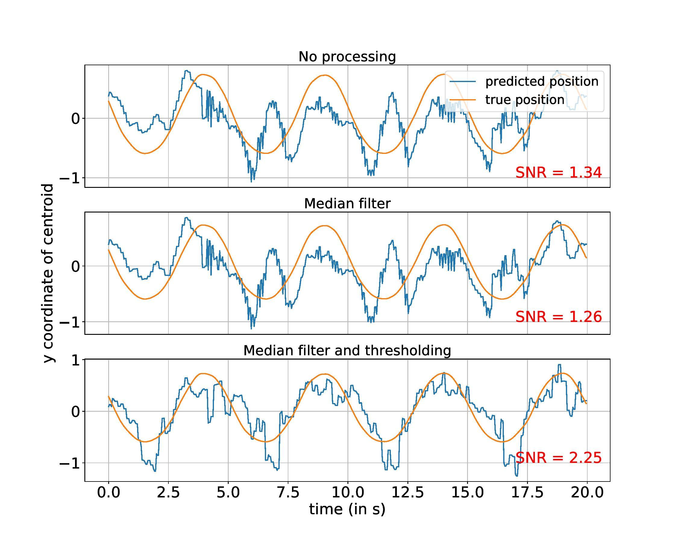
Methods
Simple pixel sum
Notes:
spend more time on this

Slide 8
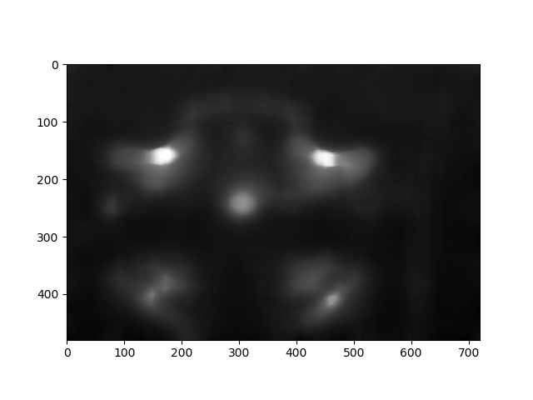
Methods
OpenCV based approach
Notes:
More time here

Slide 9
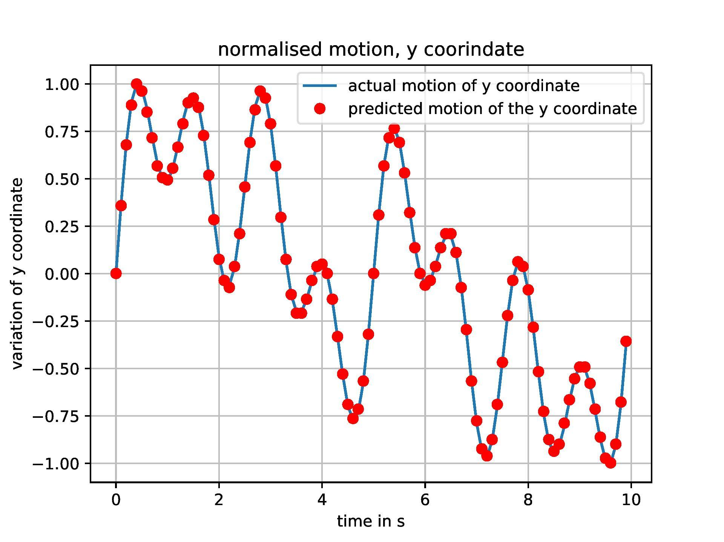
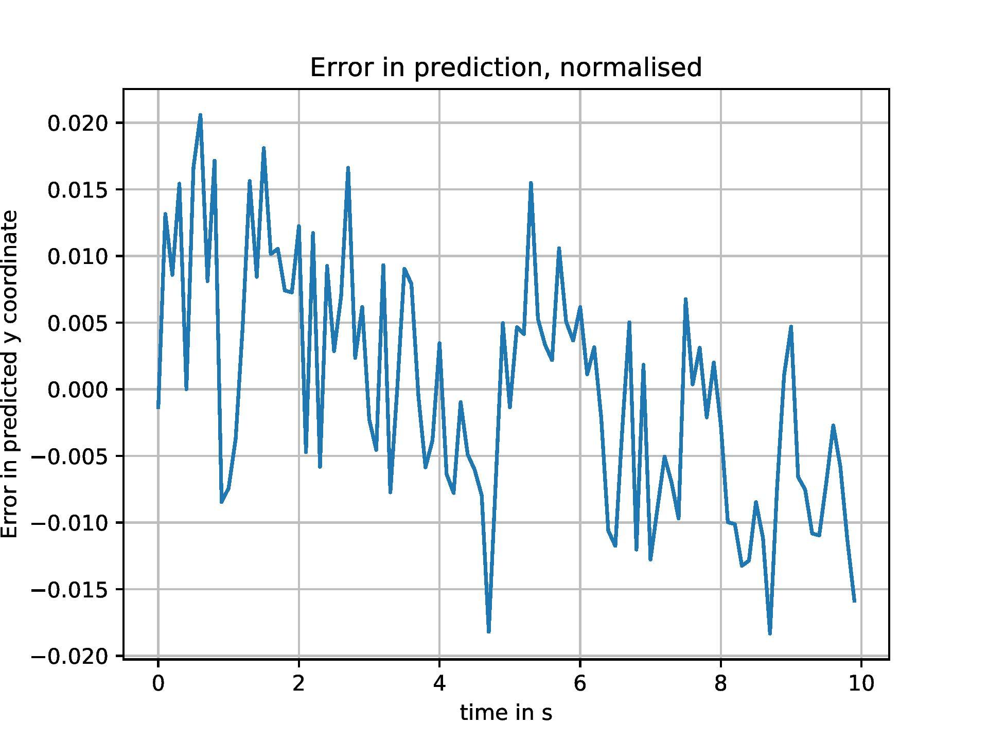
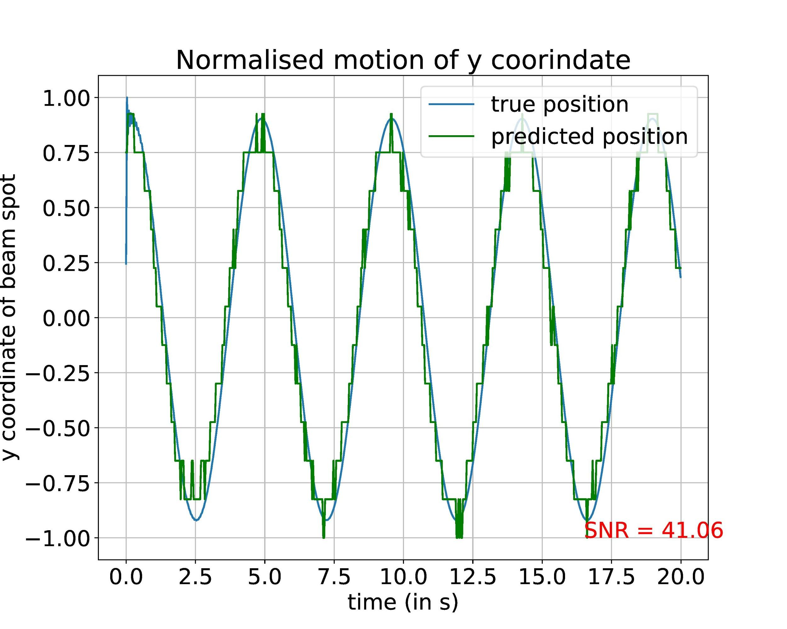
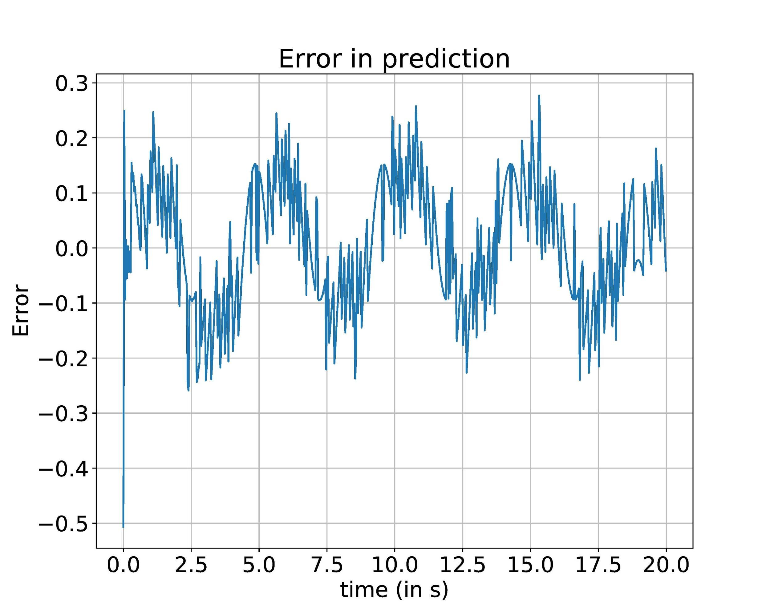
Methods
OpenCV based approach
Works well for simulated Gaussian beam spot data! Fails for real video data.
Notes:
combine the

Slide 10
Methods
Why do simple techniques fail?
The intensity profile of the beam spot is no longer Gaussian.
The relation between video of beam spot motion and position of the spot is complex and nonlinear.
Further, these methods are not general and require a degree of hard coding- threshold value for instance.
Notes:
1 - define baseline
2 - use a single number
3 - use a baseline
4 - use a time series
put pixel intensity plot

Slide 11
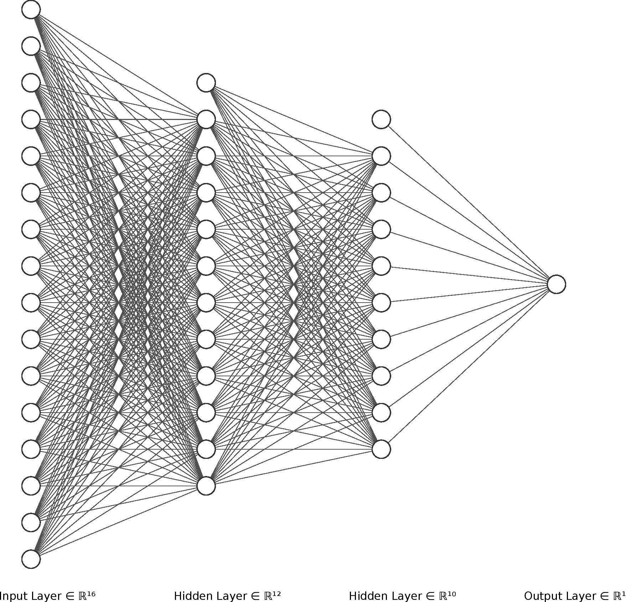
Methods
Neural Networks
What are neural networks?
y = f(x;W,b)
These weights and biases can be “learnt” using optimization algorithms.
CNNs are used as this is an image processing task. They are better suited to handling images because of weight sharing.
Notes:
To mention or not to mention- UAT? Backprop? Adam etc?

Slide 12
Methods
Neural Networks - the training
Optimizer: Adam
Loss function: Mean squared error
Framework: Keras with tensorflow backend
Hidden layer activation: relu
Output layer activation: linear
Regularization: Dropout
Preprocessing: crop and apply median blur
Notes:
add qpd
use colors

Slide 13
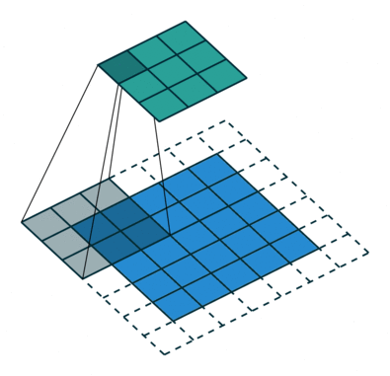
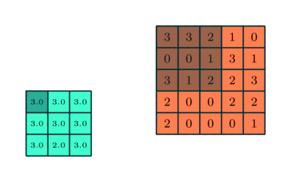
Methods
Neural Networks - CNNs
2D convolution
Max pooling
Graphics retrieved from https://towardsdatascience.com/a-comprehensive-guide-to-convolutional-neural-networks-the-eli5-way-3bd2b1164a53
Notes:
convert to physical units

Slide 14
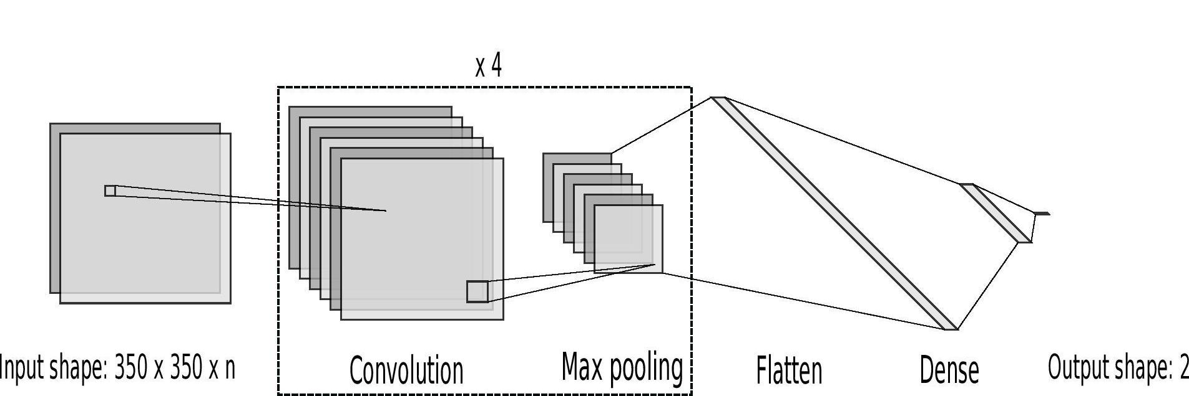
Methods
Neural Networks - CNN architecture
Notes:
convert to physical units

Slide 15
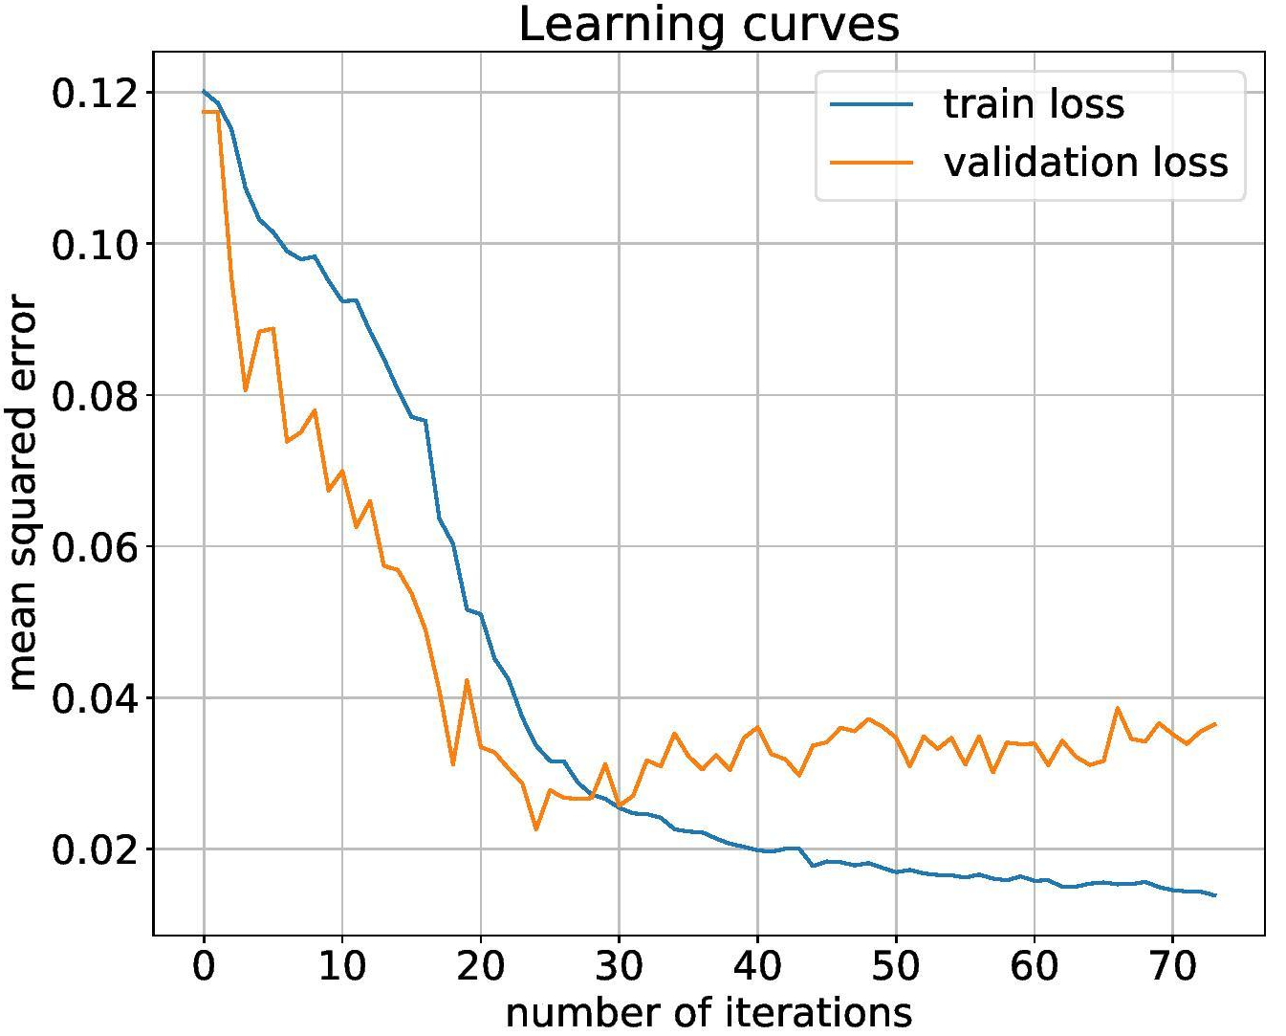
Methods
Neural Networks- testing
After much hyper parameter tuning, the following learning curves.

Slide 16
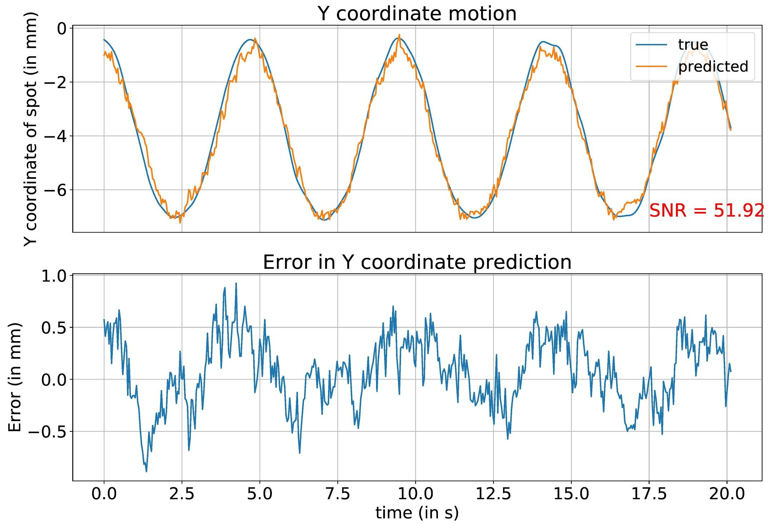
Methods
Neural Networks- testing
And the following test results:
Notes:
how does this compare to before to previous results
feed stochastic input
random noise

Slide 17
Future work
Collect and train on data at different frequencies, amplitudes and exposure times.
GANs for simulation- data generated is similar to real data.
Transfer learning using weights from the previous experiments.
Notes:
1 -
2 - Approach essentially arose from the assumption that motion of larger amplitude would be easier to discern usin a NN. May not strictly speaking be true.

Slide 18
Summary
Need for beam tracking
Traditional image processing
Deep learning for beam tracking

Slide 19
Thank You!

