Slide 1
LIGO-Virgo status
Lisa Barsotti, Keita Kawabe, Nicolas Leroy, Brian O’Reilly, Alessio Rocchi

Slide 2
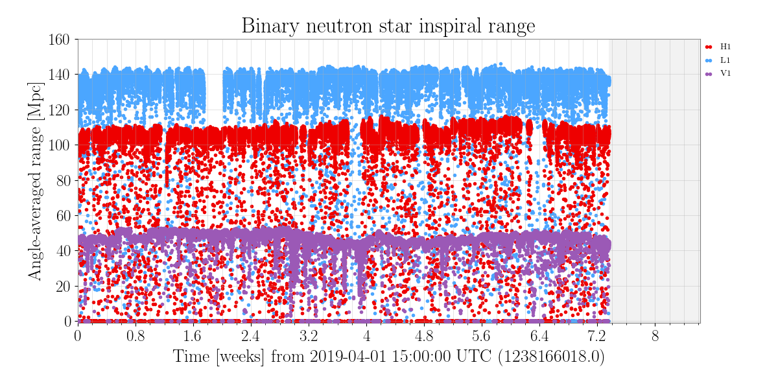
Broad picture
Small (few hours) commissioning breaks happened (and will happen again) to fix problems that can impact the stability or the sensitivity
Keep the same schedule as announced during last call for maintenance and calibration period:
Tuesday maintenance: 6-10 UTC for V1, 14-18 UTC for L1 and 15-19 UTC for H1 (with seasonal changes due to summer time);
Calibration on Wednesday: 15-19 UTC @ V1 and 20-23 UTC @ LIGO
At least one instrument tries to remain online at any given time.

Slide 3
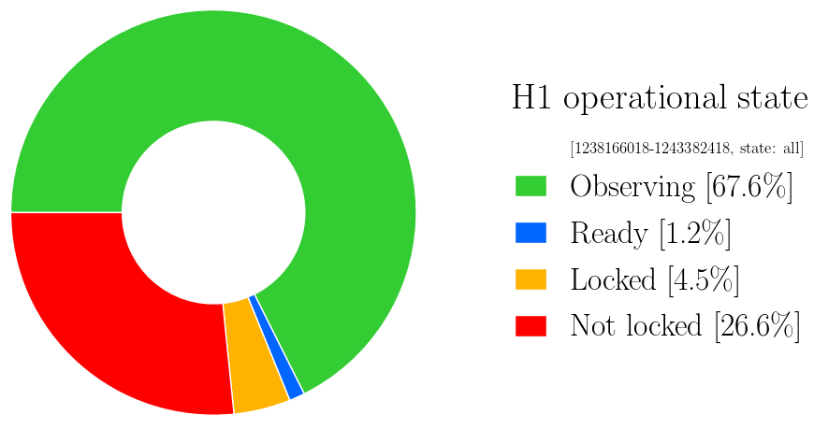
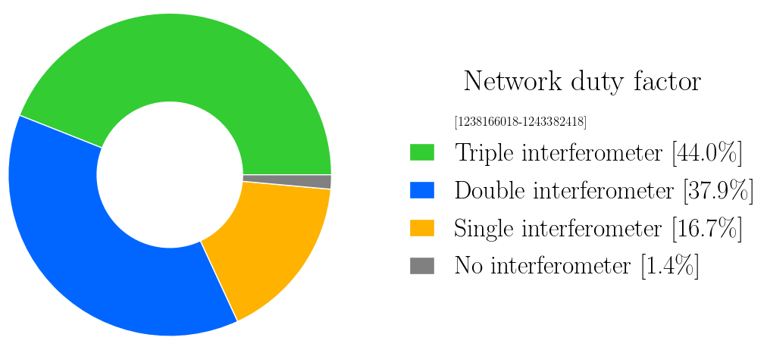
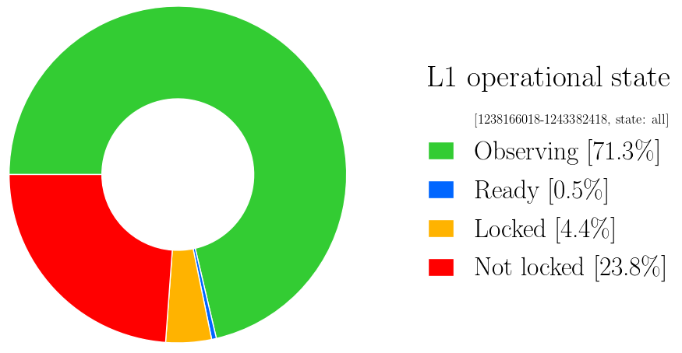
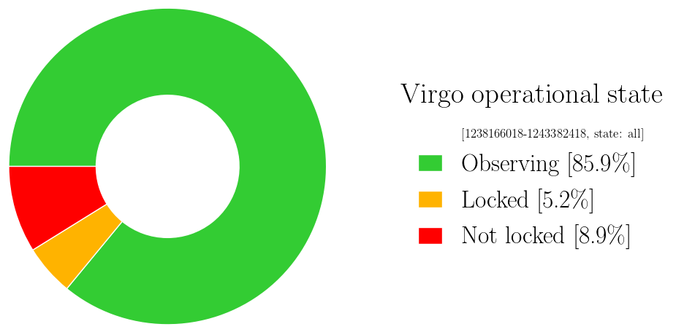
Duty cycle

Slide 4
Summary
We continue to have good performance of the network with 78 % of the time with at least 2 interferometers and only 1.4 % of time without any interferometer
Number of alerts is growing and will be discussed later
As mentioned during last call, we may have a longer break during autumn, still in discussion

