Slide 1
Status on Public Alerts
LIGO-Virgo Low-latency Analysis Group
May 23, 2019

Slide 2
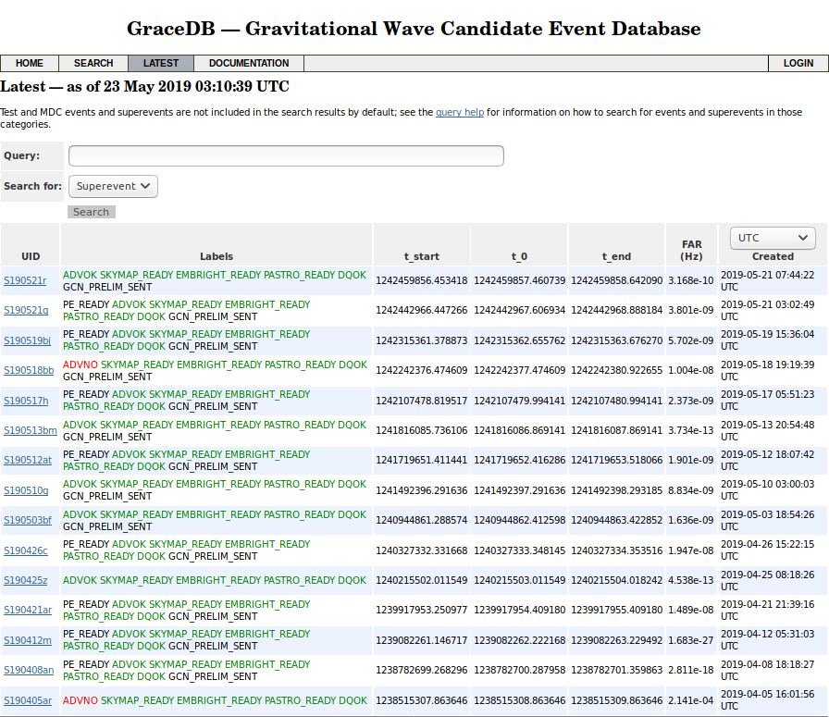
Compact binary and unmodeled burst pipelines are running
Background estimation is reasonably stable.
Robust identification of candidates according to false-alarm-rate criteria.
https://gracedb.ligo.org/latest/
1 sent in error and immediately retracted (S190405ar)
1 attributed to noise and retracted (S190518bb)
13 remaining events of interest

Slide 3
Current status of low-latency analysis system
System encountered additional technical issues that prevented automatic generation of alerts.
Many of the detection candidates (and public alerts material) involve multiple individual “triggers” corresponding to a combination of multiple search pipelines and how templates/signal parameter space are treated by them.
Timing (time stamp of notifications within our system) and additional analysis tasks required to be completed before alerts can be sent out automatically may result to race conditions and overall stability issues that proved to be complex and unlike what we have seen in previous testing.
End-to-end system continues to operate under human supervision with people on-shift and experts typically responding to (internal) notifications within O(1min).

Slide 4
S190518bb -- First automated GCN Notice (retracted later)
S190521g and S190521r -- Also automated GCN Notices
S190518bb
https://gracedb.ligo.org/superevents/S190518bb/
https://gcn.gsfc.nasa.gov/other/GW190518bb.gcn3
Notes:
An automated GCN Notice went out in ~5 minutes
Event retracted within ~30 minutes following manual inspection (H1 displayed noise over tens of seconds prior to candidate’s merger time)

Slide 5
Event updates: S190510g and S190426c
Updated information on skymaps and classification for previous alerts follows as soon as it is vetted by the search groups
S190510g:
https://gracedb.ligo.org/superevents/S190510g/
https://gcn.gsfc.nasa.gov/other/GW190510g.gcn3
https://gcn.gsfc.nasa.gov/notices_l/S190510g.lvc
P_astro calculation shifted from 98% to 42% for p(BNS)
S190426c:
https://gracedb.ligo.org/superevents/S190426c/
https://gcn.gsfc.nasa.gov/other/GW190426c.gcn3
https://gcn.gsfc.nasa.gov/notices_l/S190426c.lvc
Initial P_astro calculation updated from parameter-estimation samples

Slide 6
Compact Binary Publication Plans
Paper releases in 2nd and 4th quarter of 2020 for O3a and O3b respectively.
CBC Catalogs & Companions, including
(O3a: 2nd quarter 2020; O3b: 4th quarter 2020)
Compact binary catalog
Tests of GR
H₀ measurement
Characterization of astrophysical distributions
GRB follow-up
Exceptional events, including
(4 months after detection)
New classes (e.g., NSBH)
Outside previously observed region, e.g.,
High spins
Spin precession
Large mass ratio
Large/small component masses

Slide 7
Outlook
Ongoing work to allow single interferometer triggers to create public alerts
Automated response to external triggers (GRBs) still in the works
LIGO-Virgo Public Alerts User Guide & Support
https://emfollow.docs.ligo.org/userguide/
Feedback or requests for information to: emfollow-userguide@support.ligo.org
Mailing list
Please sign up to the public openlvem mailing list; anyone can subscribe
Instructions at https://wiki.gw-astronomy.org/OpenLVEM
We will use it to announce changes of configuration, plans, etc

