Slide 1
The Retraction of S190518bb
Keita Kawabe, Brian O’Reilly, Alessio Rocchi
For the LVC

Slide 2
Rapid Response Team
React quickly to GW candidates found by low-latency search pipelines.
Composition:
Advocate from each site (i.e. Run Coordinator).
Low-Latency Advocate
Detector Characterization experts from LSC and Virgo.
Pipeline Expert
GraceDB Expert
On-shift operator from each site.

Slide 3
The RRT Process

Slide 4
The RRT Process

Slide 5
The RRT Process

Slide 6
The RRT Process

Slide 7
Retraction of S190518bb
Seen by all detectors (HLV)
Preferred event from GstLAL pipeline (also detected by SPIIR pipeline).
Automatic Preliminary Notice was sent ~6 minutes after the event:
FAR: 1.004e-08 [Hz] (one per 1152.6 days) (one per 3.16 years)
PROB_NS: 1.00 [range is 0.0-1.0]
PROB_REMNANT: 1.00 [range is 0.0-1.0]
PROB_BNS: 0.75 [range is 0.0-1.0]
PROB_TERRES: 0.24 [range is 0.0-1.0]
NS and Remnant probabilities meant that this event could garner a lot of attention.

Slide 8
RRT Meeting for S190518bb
Promptly after event (18 May 19 19:19:21 UTC) the RRT met to decide on whether to send an Initial Notice and Circular, or a Retraction Notice and Circular.
Noticed some issues right away:
Hanford instrument was dominant contributor to Network SNR for the event.
Noise seen in Hanford strain channel starting 20 seconds before the event.
LIGO DetChar experts identified it as scattered light noise, usually related to some local seismic activity.

Slide 9
Event at t=0

Slide 10
RRT Meeting for S190518bb
We discussed whether any of our data quality methods were effective in mitigating the noise, and ran some quick tests.
Pipeline and DetChar experts agreed that the candidate should be retracted due to the effect of the noise.
Retraction notice sent at 19:57:17 UTC. Approximately 38 minutes after the event.

Slide 11
Retraction Circular S190518bb
TITLE: GCN CIRCULAR
NUMBER: 24591
SUBJECT: LIGO/Virgo S190518bb: Retraction of GW compact binary merger candidate
DATE: 19/05/18 20:08:37 GMT
FROM: Geoffrey Mo at LIGO <geoffrey.mo@ligo.org>
The LIGO Scientific Collaboration and the Virgo Collaboration report:
The trigger S190518bb is no longer considered to be a gravitational wave signal.
The data in LIGO-Hanford was highly non-stationary leading up to the reported trigger time.

Slide 12
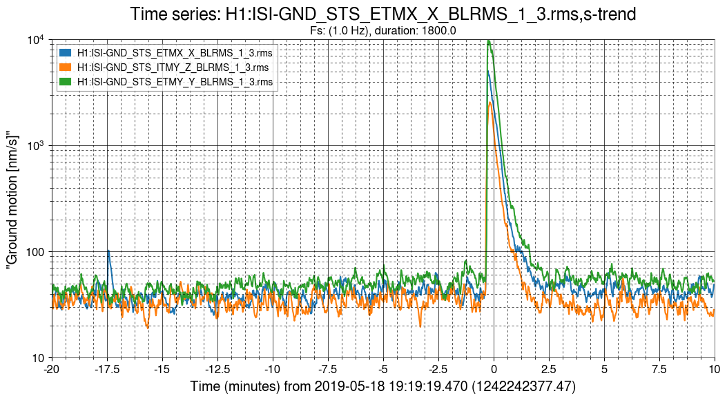
The Underlying Cause
Later examination of the Hanford environmental channels revealed an unusual small-magnitude seismic event.
Investigations are ongoing.

