Slide 1
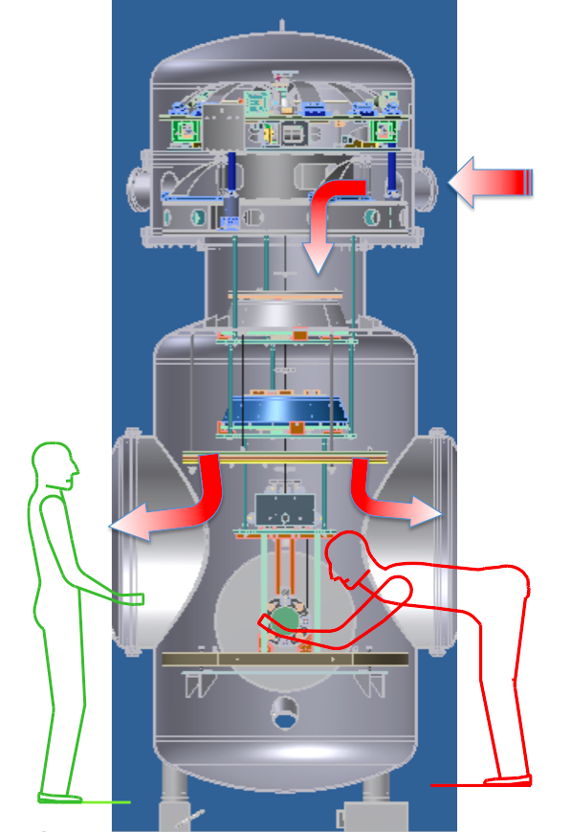
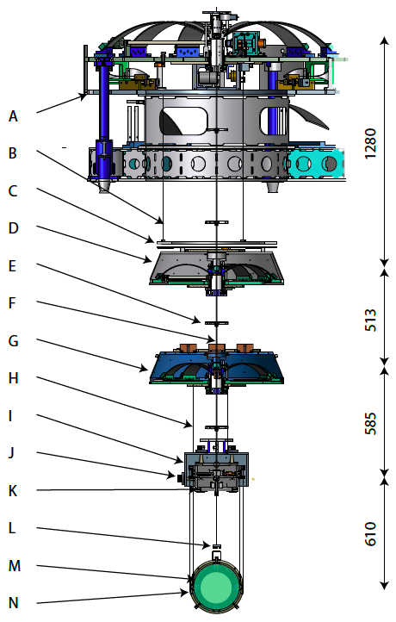
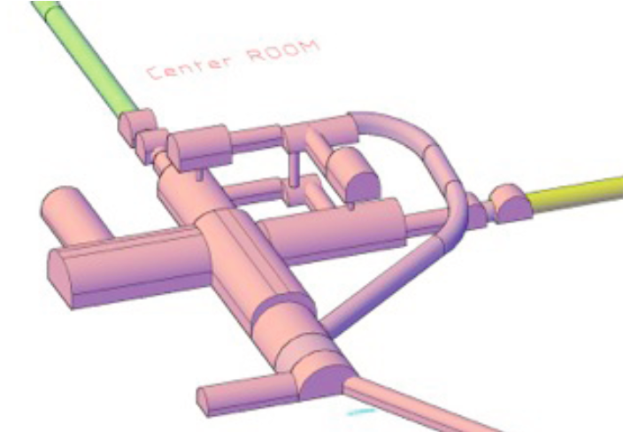
Considerations on Michelson beam splitters for third generation Gravitational Wave Observatories.
Riccardo DeSalvo, University of Sannio - RicLab LLC
G1900927
The large test masses of third generation Gravitational Wave detectors and the possible 60º angle of the proposed ET triangular configuration impose difficult requirements on the size and quality of the beam splitter. A method is presented here to allow use of beam splitters of arbitrary size, at the optimal 90º recombination angle, while also offering a way to dynamically correct the mode matching of the two interfering light spots.
To
detection
bench
From
input
bench
2) The original proposed ET solution
Original ET proposal: lensed ITMs would be used to reduce the beam sizes on the beam splitter.
This configuration is has insufficient control degrees of freedom and is very un-wielding for size, position and shape mode matching on the beam splitter.
Pitch yaw corrections for position mode matching on the beam splitter
Mode matching heating ring for
corrections of ITM thermal aberration
1) The problem
Beam splitter size comparison between the 60º and the 90º configuration.
An arbitrary 203 mm beam diameter is chosen to illustrate the beam splitter size problem in the two configurations (actual beams would be much larger). A thickness vs. diameter ratio of 0.21 is chosen for minimal mechanical rigidity.
Without beam clipping irises or focusing, the beam splitter would have to be wider than the test mass mirrors. In the case of the 60º they would be twice larger and 8 times heavier than in the 90º configuration.
Advantages
A beam splitter of almost arbitrarily small size can be used accepting the entire beam profile from the Fabry-Perots without beam tail clipping and the ITM with a flat back surface would be simpler to manufacture.
The focal lengths of the telescope mirrors can be adjusted to reduce the beam size within a smaller distance than the lensed ITM.
Independent angular control of the two mirrors in each telescope allows for best light spot mode matching on the beam splitter, independent from the two Fabry-Perot alignments.
Thermal compensation techniques on the beam expanding telescope mirrors allow dynamical and precise matching of the size and shape of the beam spots on the beam splitter
  Correcting for power-dependent thermal lensing in the ITM.
  The ITM compensation plates may become unnecessary.
The beams from the multiple detectors can be sequentially extracted from the tunnel with beam splitters located in well separated places, as illustrated in figure 4.
The the ghost images of the two ITM can be extracted easily for diagnostic and control use, as illustrated in figure 6.
  The ghost images provide a direct imaging feedback signal for the mode matching of the two beams.
  The length of the telescopes can be adjusted to extract the ghost images while using smaller ITM wedge angles.
3) The proposed solution
Install beam-reducing telescopes from outside to inside the Michelson.
The beams from the Fabry Perot cavities encounter a primary parabolic beam tilted at 3.75º from the beam line. The reflected beam emerges at 7.5º and is focused at a distance sufficient to separate the focused beam from the large diameter stored beam. After the focusing, a secondary mirror tilted by an additional 3.75º produces a collimated beam propagating at a combined 15º from the Fabry-Perot beam line that crosses the beam line. After a distance determined by the separation of the two main tunnels at the point of extraction, the two beams recombine on a standard 90º , reduced-size beam splitter.
To
detection
bench
From
input
bench
wells
5) Small and nimble seismic isolation
The seismic attenuation requirements for optics outside the Fabry-Perot are less stringent than for the test masses. Small and easily relocatable seismic attenuators similar to those used for the KAGRA beam splitter are sufficient and can provide the full controls for position mode matching on the beam splitter. Easy optical access to the back of the mirrors allow thermal compensation for ITM thermal lensing and size mode matching.
4) Multiple interferometer configuration advantages
The beams from different interferometer can be extracted from the main tunnels at arbitrary locations. The beam splitters and input-output optics of different interferometer can be separated in physically different locations. Small cross section transfer tunnels and small cross-shaped halls, which are much more stable and cheaper than a large experimental hall containing multiple detectors, can be used.
The use of two-level tunnels connected by wells (like in KAGRA) for the test mass seismic attenuators eliminate the need of widening the main tunnel into large caverns to host the test masses.
With the addition of a small relay mirror similar to the ones used in the second Hanford interferometer, the technique can be used to separate the beam splitters of multiple interferometers even in the 90º configuration.
8) Conclusions
Moving the expansion beam telescopes inside the Michelson (instead of in front of its ports) allows use of much smaller beam splitters, gives much better position control and mode matching options for optimal recombination on the beam splitter.
By appropriately tilting the telescope mirrors the beams of the triangular ET configurations can be brought to interfere at the optimal 90º crossing angle.
Recombination of the beams of multiple detectors can be separated in different locations for enhanced flexibility and reliability of the facility.
6) Extraction of ghost beams
The extraction of ghost beam for diagnostics and controls is easy. The wedge angle of the input test mass and length of the beam expanding telescope can be adjusted to optimize the ghost beam separation.
7) Acknowledgments
The figures of the KAGRA seismic attenuation and vacuum chambers are provided courtesy of Galli & Morelli, that owns the KAGRA seismic design.
This poster was assigned the DCC numbervLIGO-G1900927

