Slide 1
LSC Data Policies
For NASA LISA Study Team and friends
David Shoemaker (personal observations)
27 April 2019
G1900861

Slide 2
Current Phases of release
Alerts
Publications of transients
Publications of CW/Stochastic analysis
Bulk data release

Slide 3
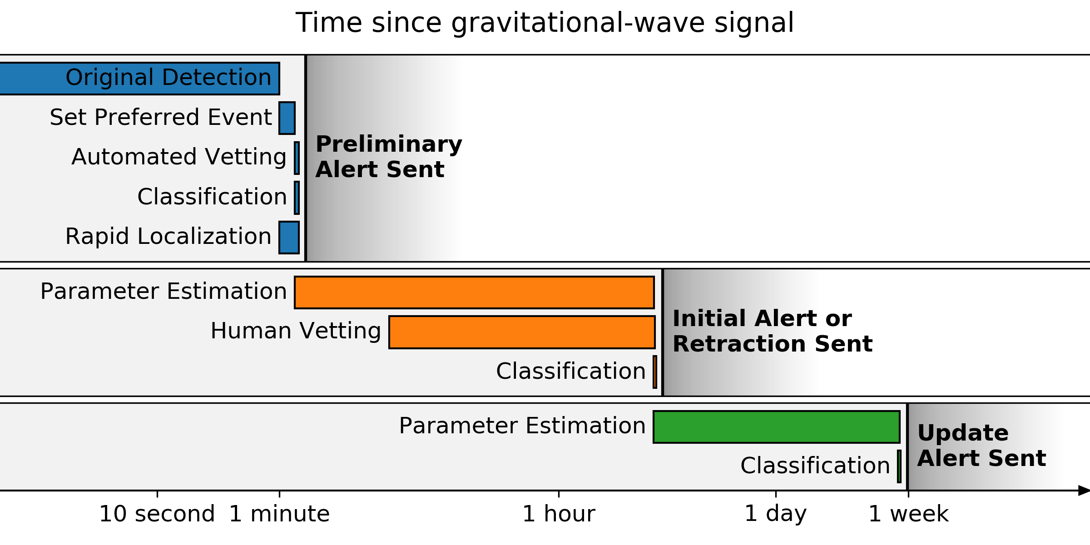
Alert timeline for O3 (goal…)

Slide 4
Alert timeline for O3
Within 1–10 minutes after GW trigger time, a preliminary notice will be sent autonomously, with a skymap as soon as it is available

Slide 5
Alert timeline for O3
Within 24 hours after the GW trigger time (goal: within 4 hours for BNS or NSBH sources), the Initial notices and circulars will be distributed with an update for the sky localization area and the source classification.
They are vetted by human instrument scientists and analysts.
The initial circular will be labeled as retracted or confirmed.
Note that the initial circular is considered the first LIGO/Virgo publication of a GW candidate, appropriate to cite in publications.

Slide 6
Alert timeline for O3
Update notice and circulars are sent whenever the sky localization area or significance accuracy improves (e.g. as a result of improved calibration, de-glitching, or computationally deeper parameter estimation).

Slide 7
Notice Contents
Date, Author, Where/When
FAR - Estimated false alarm rate in Hz
SkyMap - URL of HEALPix FITS localization file
Group -- CBC or Burst; Pipeline
If Burst: Central Frequency, Duration, Fluence
If CBC:
Probability that the source is a BNS, NSBH, BBH merger, or noise
Probability of a neutron star, and ejection of neutron star matter
The objective is to provide all the information needed to find a host
The Collaboration holds back additional information to allow Collaboration-exclusive Science…
But sees need to allow observers to perform triage – “too many events”
The circular update available within 24 hours will include text with an expert evaluation of the impact of any data quality issues

Slide 8
Expected Detection rates in O3
Binary neutron stars (BNS)
1/month to 1/year
Median 90% credible localization 120-180 deg²; 12-21% localized < 20 deg²
Binary black holes (BBH)
few/week to few/month
Neutron-star black-hole binaries (NSBH)
Uncertain, estimates include zero
Other transients
Unknown
Observed rate: upper end of the estimates!
so far 3 BBH, a BNS, and a likely BH-NS

Slide 9
Publications of transients
All detections are published by the full qualified author list
LSC and Virgo together; speak here of LSC practice
Authors must spend 50% or more of research time on LIGO
~800 people qualify (out of 1300 LSC members)
Alphabetical author list; includes operators, engineers, some undergrads
Want to reward all members; putting some names first ‘demotes’ e.g., instrumentalists
Publications release 1 hour of strain h(t) around the event(s)
Posterior samples
Data quality flags
Data behind figures
Currently no ‘auxiliary channels’ --- environment, other detetecto DOF, etc. (~100,000 of ‘em)
Due to the difficulty of documenting them; and the concern that it is too easy to misinterpret them if you don’t know the machine inside and out

Slide 10
Gravitational-Wave Open Science Center
GWOSC -- https://www.gw-openscience.org
LIGO and Virgo’s portal for
Bulk data
Event 1-hour time-series data, etc.
Pointers to papers, data behind figures, posterior samples
Pointers to analysis codes
Pointers to Workshop materials
The nominal scope is determined by the LIGO Laboratory-NSF Data Management Plan
Some postings beyond the DMP scope
Community requests to GWOSC on other elements of interest welcome

Slide 11
Bulk Data Releases for O3
Catalogs are planned to be issued on 6 month observing ‘chunks’
18-month proprietary period
Designed to allow catalogs and associated papers to be completed
As laid out in the LIGO Laboratory-NSF Data Management Plan
We will strive to complete these steps as quickly as possible, which could enable an earlier bulk release of data
Evolution to shorter proprietary periods foreseen by LIGO (Virgo less so)

Slide 12
What influences the Bulk Release Plan?
Delay in release is driven by…:
Desire to put out a quality product
Desire to reward collaboration members with first papers
‘real time’ investment/reward
‘payback’ for people who spent decades getting us here
Magnitude of delay driven by
Time to get data set clean and calibrated
Time to complete catalogue papers
Time to perform full-dataset analyses (Continuous Waves, Stochastic)

Slide 13
What influences the Bulk Release Plan?
Pressure to reduce delay is growing
More interest (and skill) outside of collaboration to do independent analyses
Suspicion we are making stuff up
Data belong to the taxpayers!
Collaboration should evolve from current form (optimized for first detection), with more of the astrophysics done on the outside
Need larger community to argue for new observatories!
Will only happen if we have a lot of very happy customers, and many people whose career depends on growth of the field

Slide 14
The Network, the Future
LIGO and Virgo coordinating closely on O3
Observing, Analysis and publication, Data releases
MoU puts us in lockstep, but still two collaborations
KAGRA hoping to join toward the end of O3
Working toward joint analysis with LIGO/Virgo
O4 Currently foreseen for early-2021 to mid-2022, at design sensitivity
Hoping it will be the 4-detector network of 2xLIGO, Virgo, KAGRA
LSC, Lab, NSF considering shorter periods before release of data
Decisions will depend on ability to shorten preparation and analysis times, scope of key core collaboration analysis goals
A+ Upgrade follows for LIGO, AdV+ for Virgo – observing by 2024
LIGO-India comes into play ~2025 (at A+ sensitivity)

Slide 15
Long term? – dhs musing, not LSC policy!
Need to evolve to open data
It is inevitable that this is the end state
How much ‘payback’ is enough?
Ideally, leave a ‘core collaboration’
Create secure positions to operate detectors, calibrate, data quality, low-latency alerts, low-latency detections/parameter estimation
Probably ~300 persons or so
….also instrumentalists?
Question: how to keep next-generation instrumentalists rewarded?
Most are not natural authors of astro/interpretation papers
But most academic institutions want those papers on a CV even for instrumentalists
Core collaboration opt-in option to a handful per year of external papers?
When open data?
Gradual decrease as we get faster with prep/catalogues; CW/Stochastic remains an issue
Certainly should be immediate release by the time of 3G detectors (2030s – LISA-time)

