Slide 1
Detectors and observations in O3
Lisa Barsotti, Nicolas Leroy,
Keita Kawabe, Shinji Miyoki, Brian O’Reilly, Alessio Rocchi
for the LIGO-VIRGO Joint Run Planning Committee

Slide 2
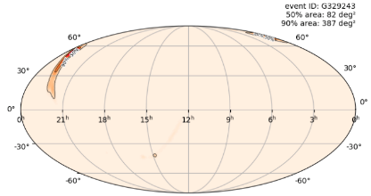
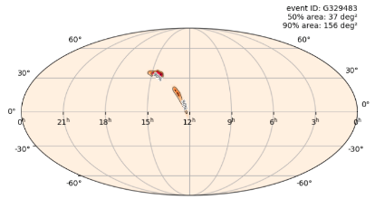
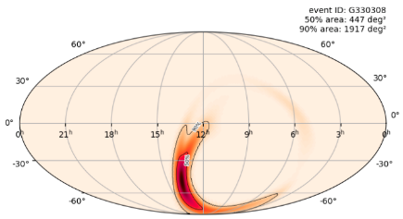
24 days, 3 public alerts.
S190408an
S190412m
S190421ar
https://gracedb.ligo.org/

Slide 3
O3 and Instruments Status
O3 started in time on Mon Apr. 1st 2019
  Better sensitivity than O2 for all 3 instruments.
  As planned, shorter than usual commissioning time at all three sites for the first week.
  Coordination between the sites to maximize 3-IFO operation.
  Planned down time for:
    Tuesday maintenance: 6-10 UTC for V1, 14-18 UTC for L1 and 15-19 UTC for H1 (with seasonal changes due to summer time);
    Calibration on Wednesday: 15-19 UTC @ V1 and 20-23 UTC @ LIGO
    At least one instrument tries to remain online at any given time.
  Very good triple coincidence OBSERVING so far, about 40%.
    Only 1.1% with no interferometer in observation mode.
    At least two interferometers 80% of the time.
  We WILL spend time on problems that need immediate attention, or if we think we can make significant improvement in short period.

Slide 4
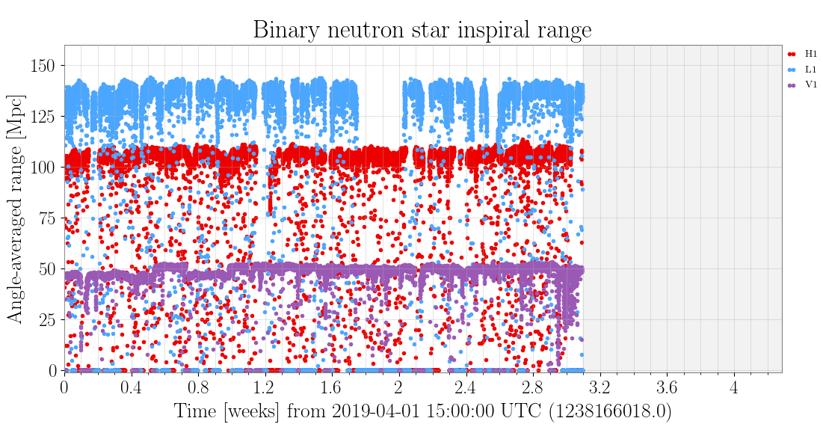
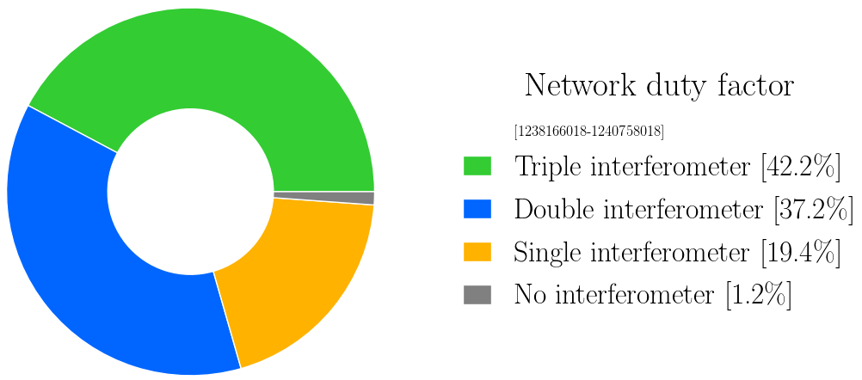
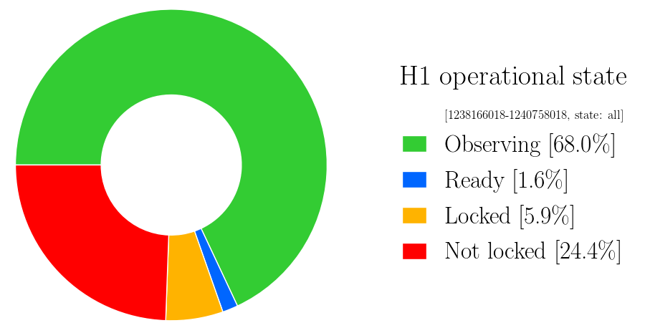
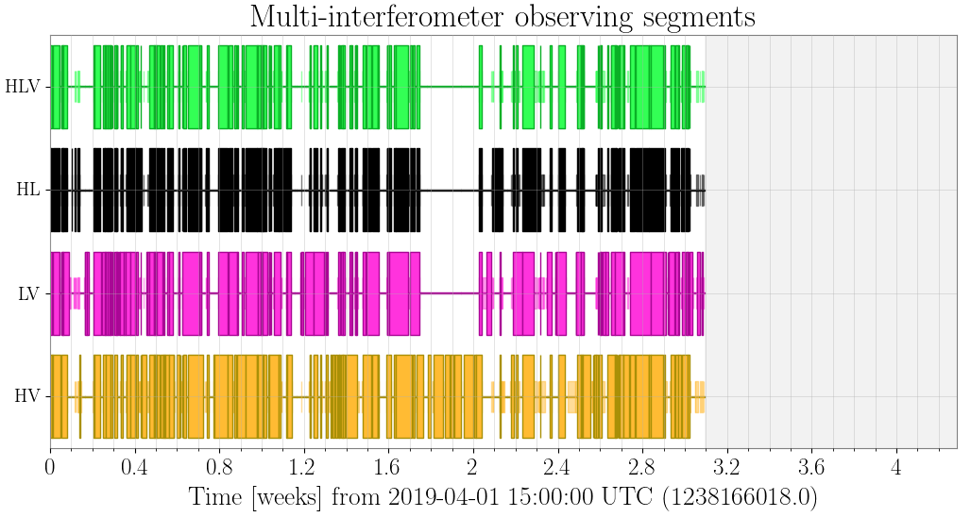
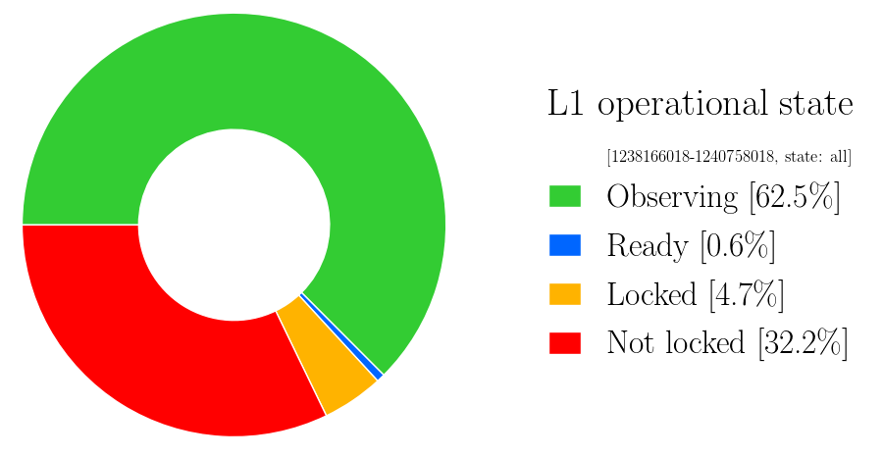
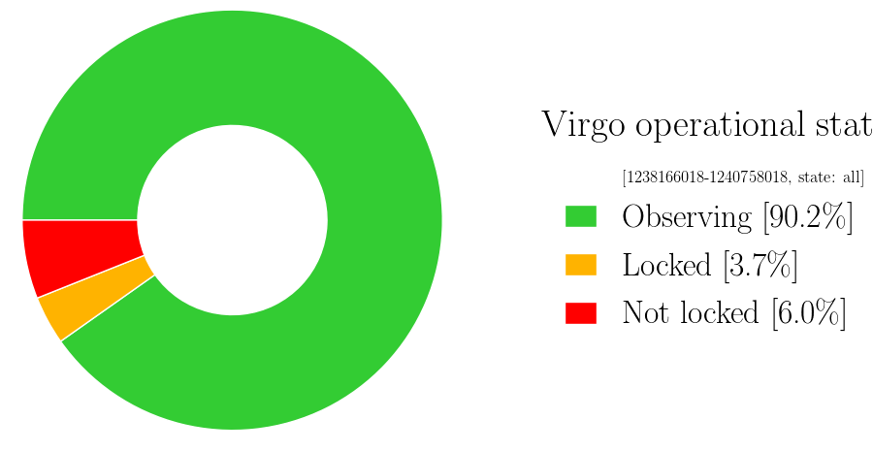
https://www.gw-openscience.org/detector_status/

Slide 5
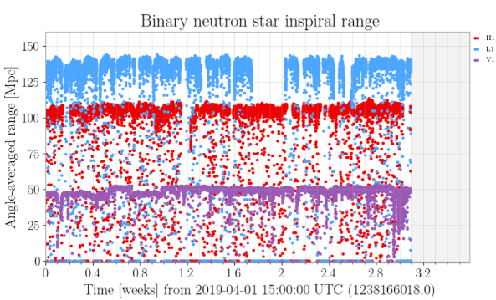
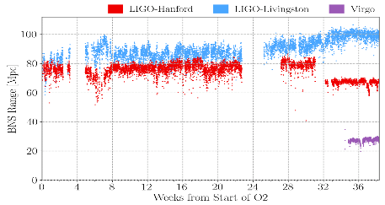
Improved Noise Performance
O2
First three weeks of O3

Slide 6
Reminder: LIGO improvements for O3
Higher laser power
Replaced 5 of 8 test masses (better optical quality)
Added squeezed light injection systems
New baffles to mitigate scattered light
Improvements to various controls systems (seismic, alignment, etc)

Slide 7
H1: O2 vs O3

Slide 8
Current detector performance: H1
2.2dB of squeezing + 35W
Higher recycling gain (~45 as opposed to ~35). Mirror replacement paid off.
No major bumps/peaks from the laser (unlike O2).
Longer planned downtime for the first month or so to perform various investigations. Will be back to normal schedule in a couple weeks.
  Calibration, environment noise, glitches, lock losses, upconversion from wind and EQ, stability, larger low frequency noise than L1.
Good duty factor (68%) despite this. Very good considering that this is the start of the run.

Slide 9
L1: O2 vs O3

Slide 10
Current detector performance: L1
Sensitivity impacted by seismic noise: microseism, wind, human-induced daytime activity.
Work continues on increasing robustness to improve duty cycle. Budgeting 4-6 hours a week for tests and investigations.
Calibration systematics at the 2% level. Weekly measurements to improve statistical accuracy (currently around 5%).

Slide 11
Reminder: Virgo improvements for O3
Higher laser power
All test masses suspended with fused silica fibers
Intracavity power improved with adaptive optics
Injection bench suspension activated
Added squeezed light injection systems
Scattered light mitigation on output optics
New high quantum efficiency PDs with optimized electronics
Improvements to various controls systems (seismic, alignment, etc)

Slide 12
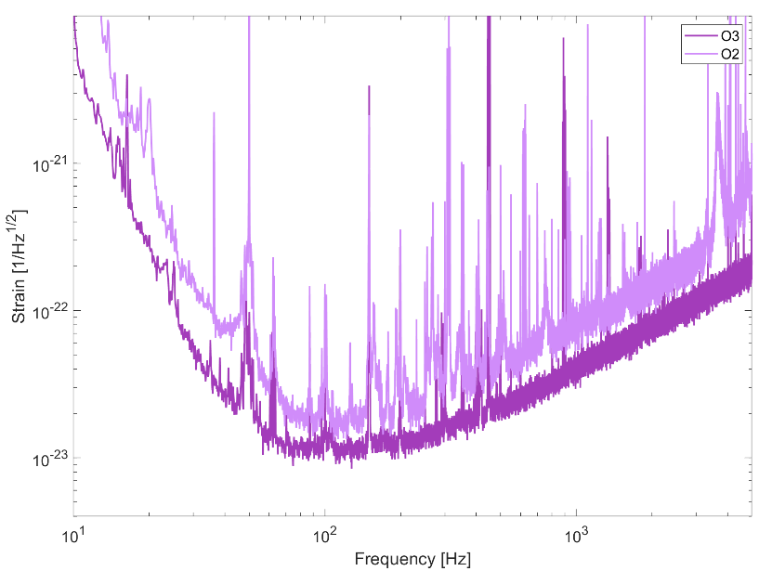
V1: O2 vs O3

Slide 13
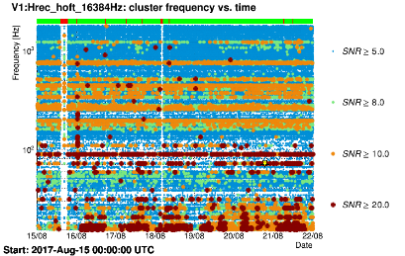
Current detector performance: V1
Good (>90%) duty cycle in science mode
Rather stable sensitivity:
  about 50 Mpc for BNS;
  around 600 Mpc for 30 Msol BBH
Glitch rate greatly reduced wrt O2;
Highest science mode state comprises injection of squeezing (up to 3 dB), but science mode state without squeezing is also possible;
Short commissioning breaks (order of few hours) planned on a weekly basis to improve both sensitivity and robustness;
One week of O2
Two weeks of O3

Slide 14
KAGRA, the Japanese cryogenic detector, is expected to join late 2019
Oct/Nov 2018: 3km X-arm “locked” using IR and green.
  EXC mirror trouble after that, chamber was opened, now pumping down. IXC mirror is being cooled down.
Apr 2019: 3km Y-arm “locked” using green at cryogenic temperature.
  IYC is already fully cooled down. Still cooling EYC.
Control optimizations undergoing for cryogenic suspensions.
40W fiber laser, 10W after input mode cleaner. Long term stability under investigation.
Will start combining two arms using Michelson ~mid May 2019, will transition to the final configuration later.
Detailed study of the impact of adding KAGRA to LV network is ongoing.

Slide 15
Current KAGRA schedule for O3
O3 start
2019 | Jan | Feb | Mar | Apr | May | Jun | Jul | Aug | Sep | Oct | Nov | Dec
Beam Align
Pumping
PRMI
Machine
Health
Check
Pumping
Yarm
FPMI
DRMI
DRFPMI
DRFPMI ASC
Laser Power Up
Post
Comm.
Noise hunting
Middle
Baffle
O3 Joining
If possible
ETMX WAB
Payload
Control
Weekend
FPMI
Run
Weekend run
Cooling 3 TMs
Cooling
ETMX
FPMI
Check
Point
Data
Process
Rehearsal

Slide 16
Summary
First 24 days excellent with 3 public alerts.
  Good noise performance, extremely good V1 duty factor, good LIGO duty factor.
KAGRA is planning to join later this year.
Projected observation period of O3: 1 Calendar year (nominally ends at the end of March).
  Nothing is concrete yet, but if we ever decide to make a break of ~weeks and if we shift the end date, how much advance notice do you need? Please respond to our email inquiry.

