Slide 1
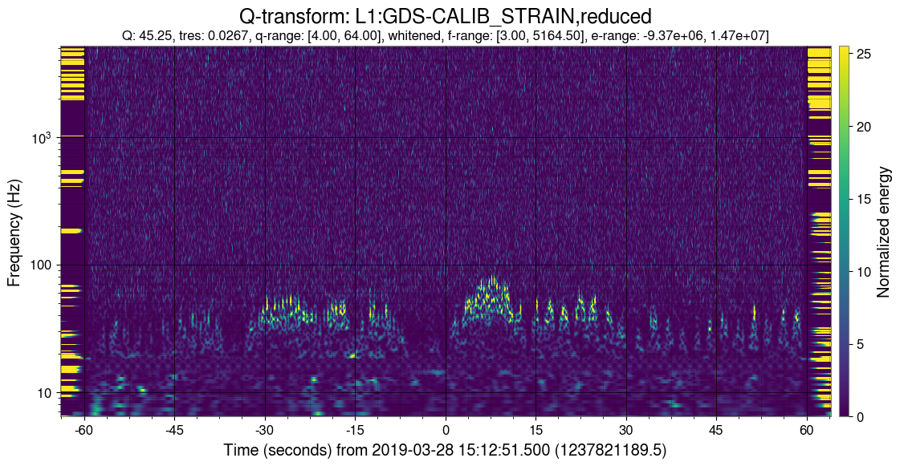
Daytime Scatter at LLO

Slide 2
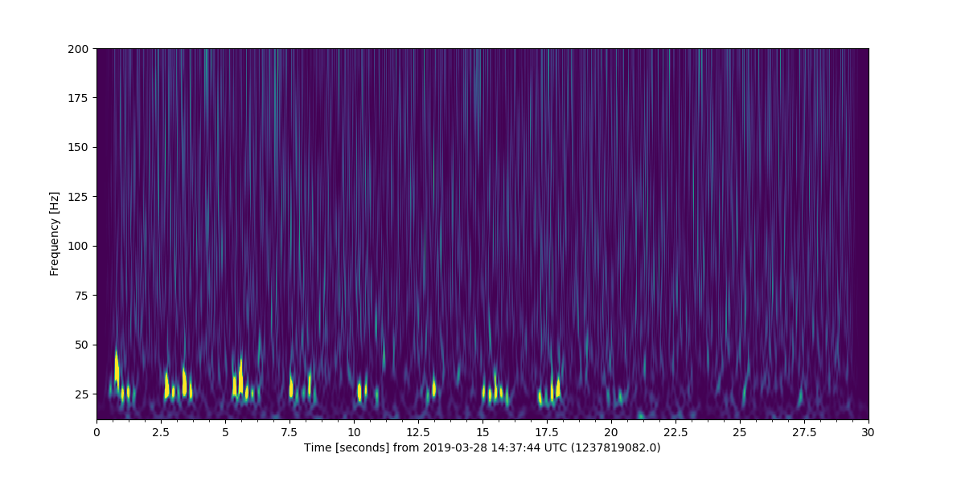
What’s going on here?

Slide 3
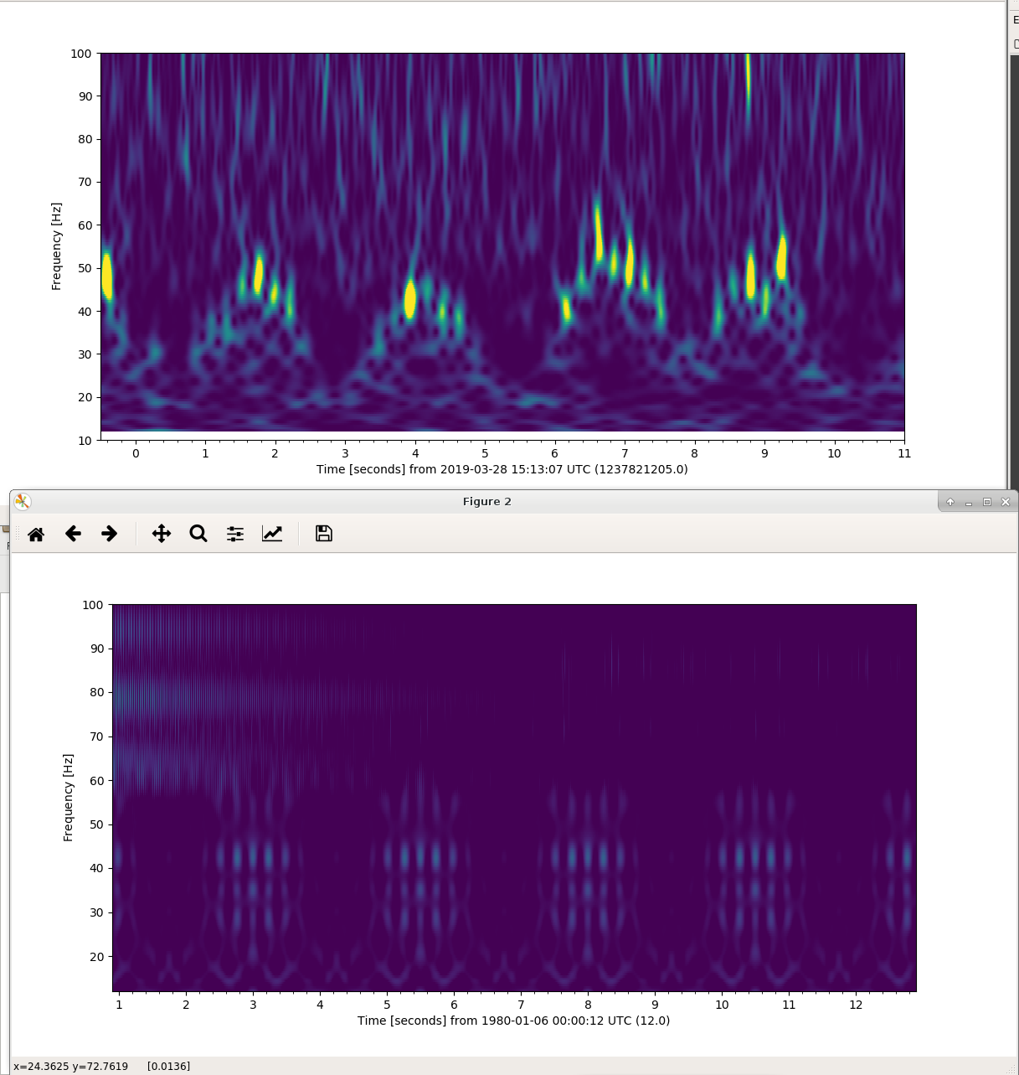
Spectrogram during high scatter time
$$f_{fringe}\left(t\right)=\left|2\frac{v_{scat}(t)}{λ}\right|$$
Scatter model using ~0.2 Hz + ~4 Hz velocities

Slide 4
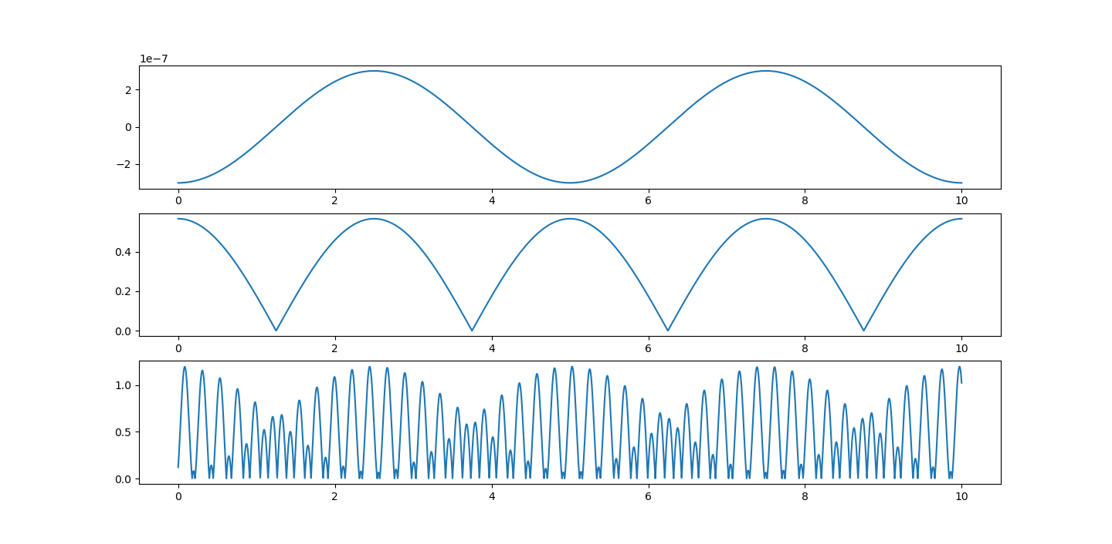
1 cycle in 5 sec = 0.2 Hz
0.2 Hz Sine wave
Abs(0.2 Hz Sine wave)
Abs(0.2 Hz Sine wave + 4.45 Hz Sine wave)

Slide 5
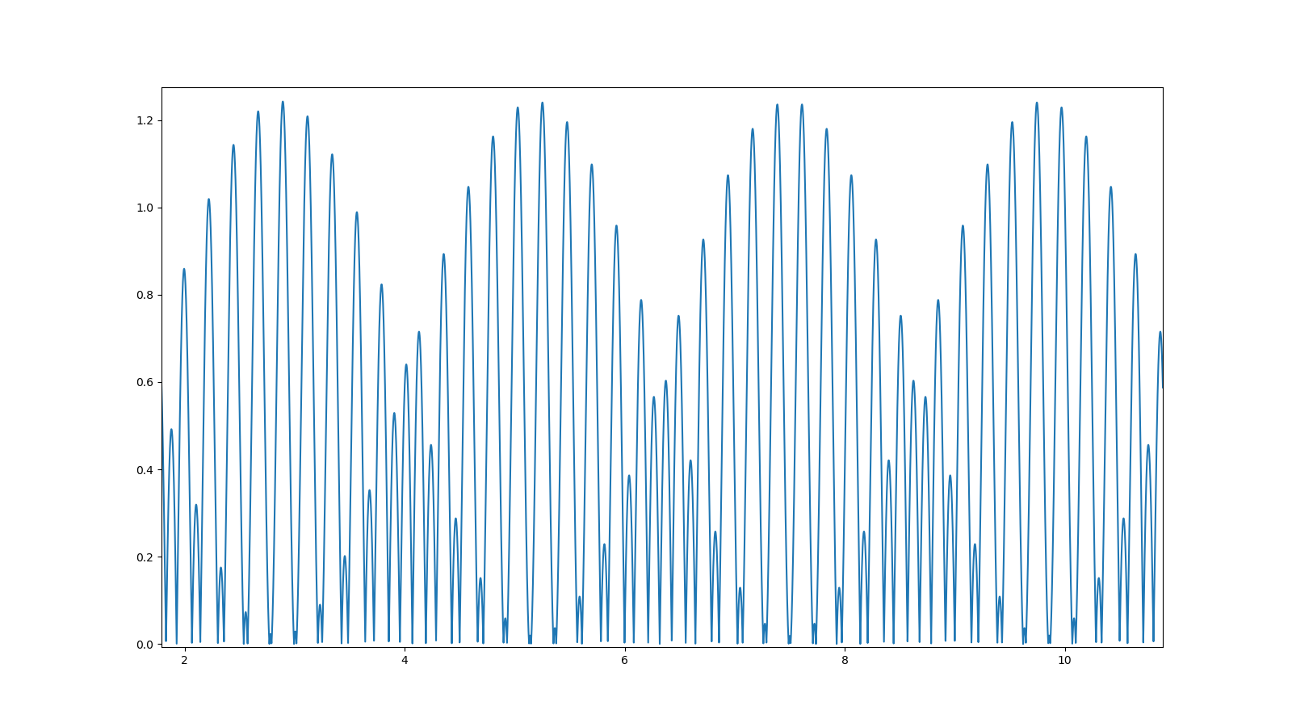
But it’s not as simple when you beat two frequencies against each other…Here we see that the amplitude of the 4.45 Hz is smaller than the 0.2 Hz, so the small peaks correspond to a full cycle instead of a half cycle as we saw with the 0.2 Hz series.
𝚫t = 0.22 sec -> 4.45 Hz

Slide 6
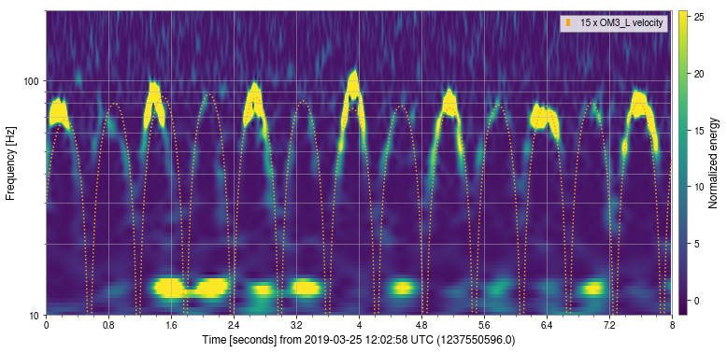
What’s been done:
Marissa, Sidd, et al looked for correlations with trains during noise sprint in January, but didn’t find a clear winner
Terra looked for ~4 Hz motion in accelerometers during scatter times, but didn’t find a clear winner (alog 44897)
Lots of injections at various places show high coupling at End-Y, but haven’t been able to fully replicate the noise we see or identify a sensor that sees the same motion as the scattering surface (alogs 41789,44485 + many more)
Next steps:
Collect statistics on fast and slow arches as Josh did in alog 44803
Look for correlations with motion of mirrors as Andy did in alog 44561
Look for correlations with control signals: ASC, tidal, etc (can provide a list of channels)
Look back through commissioning data to see if the behavior changed with IFO configuration changes
Continue to look for correlations with accelerometers (as per Terra’s work in 44897)

Slide 7
Other ideas
Look for thresholds of motion
Is there a threshold of the sum of the microseism BLRMS and anthropogenic BLRMs for scatter in DARM?
Look at locklosses coincident with trains
April 6 at ~14:00 UTC
Range dip April 8 at ~0:00 UTC

