Slide 1
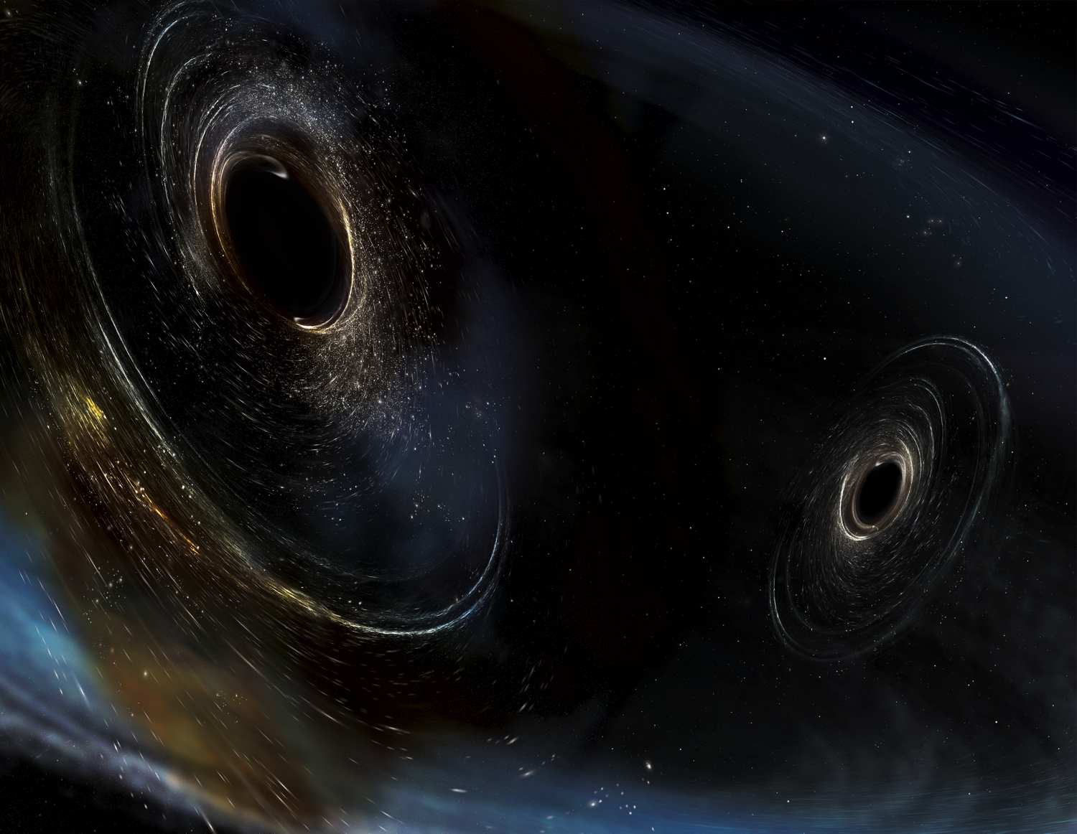





A+ FOR LIGO
GariLynn Billingsley
On Behalf of
LIGO Laboratory
Advanced LIGO UK Group
Oz-Grav ANU, Oz-Grav UA
LVC 21 March 2019
LIGO-G1900666-v1

Slide 2
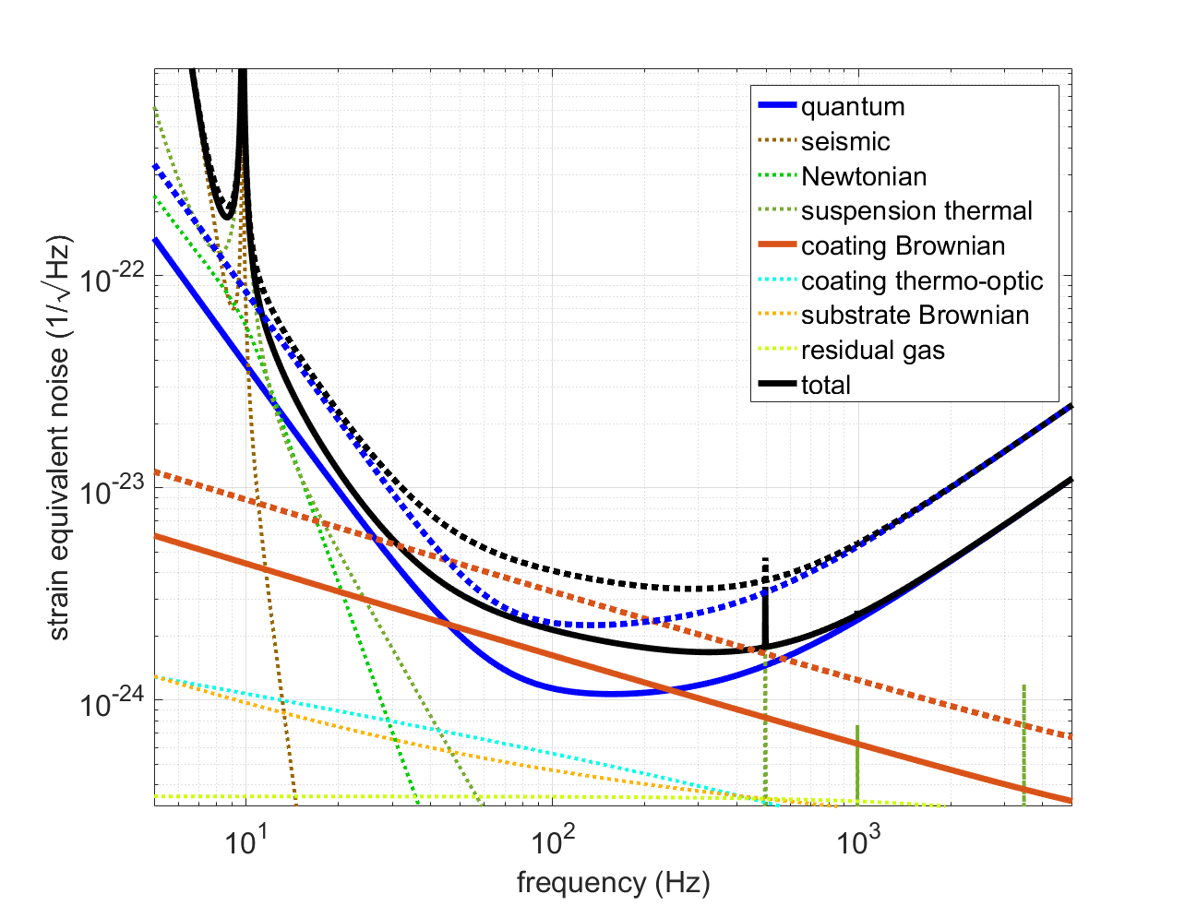
Performance goals
aLIGO curves are shown dotted
for reference
observing range improvement
NS:NS 1.4 M
173 Mpc
-> 325 Mpc
BH:BH 30 M
1606 Mpc
-> 2563 Mpc
quantum
.
.
coating thermal
LIGO Document T1800042-v5 (public)

Slide 3
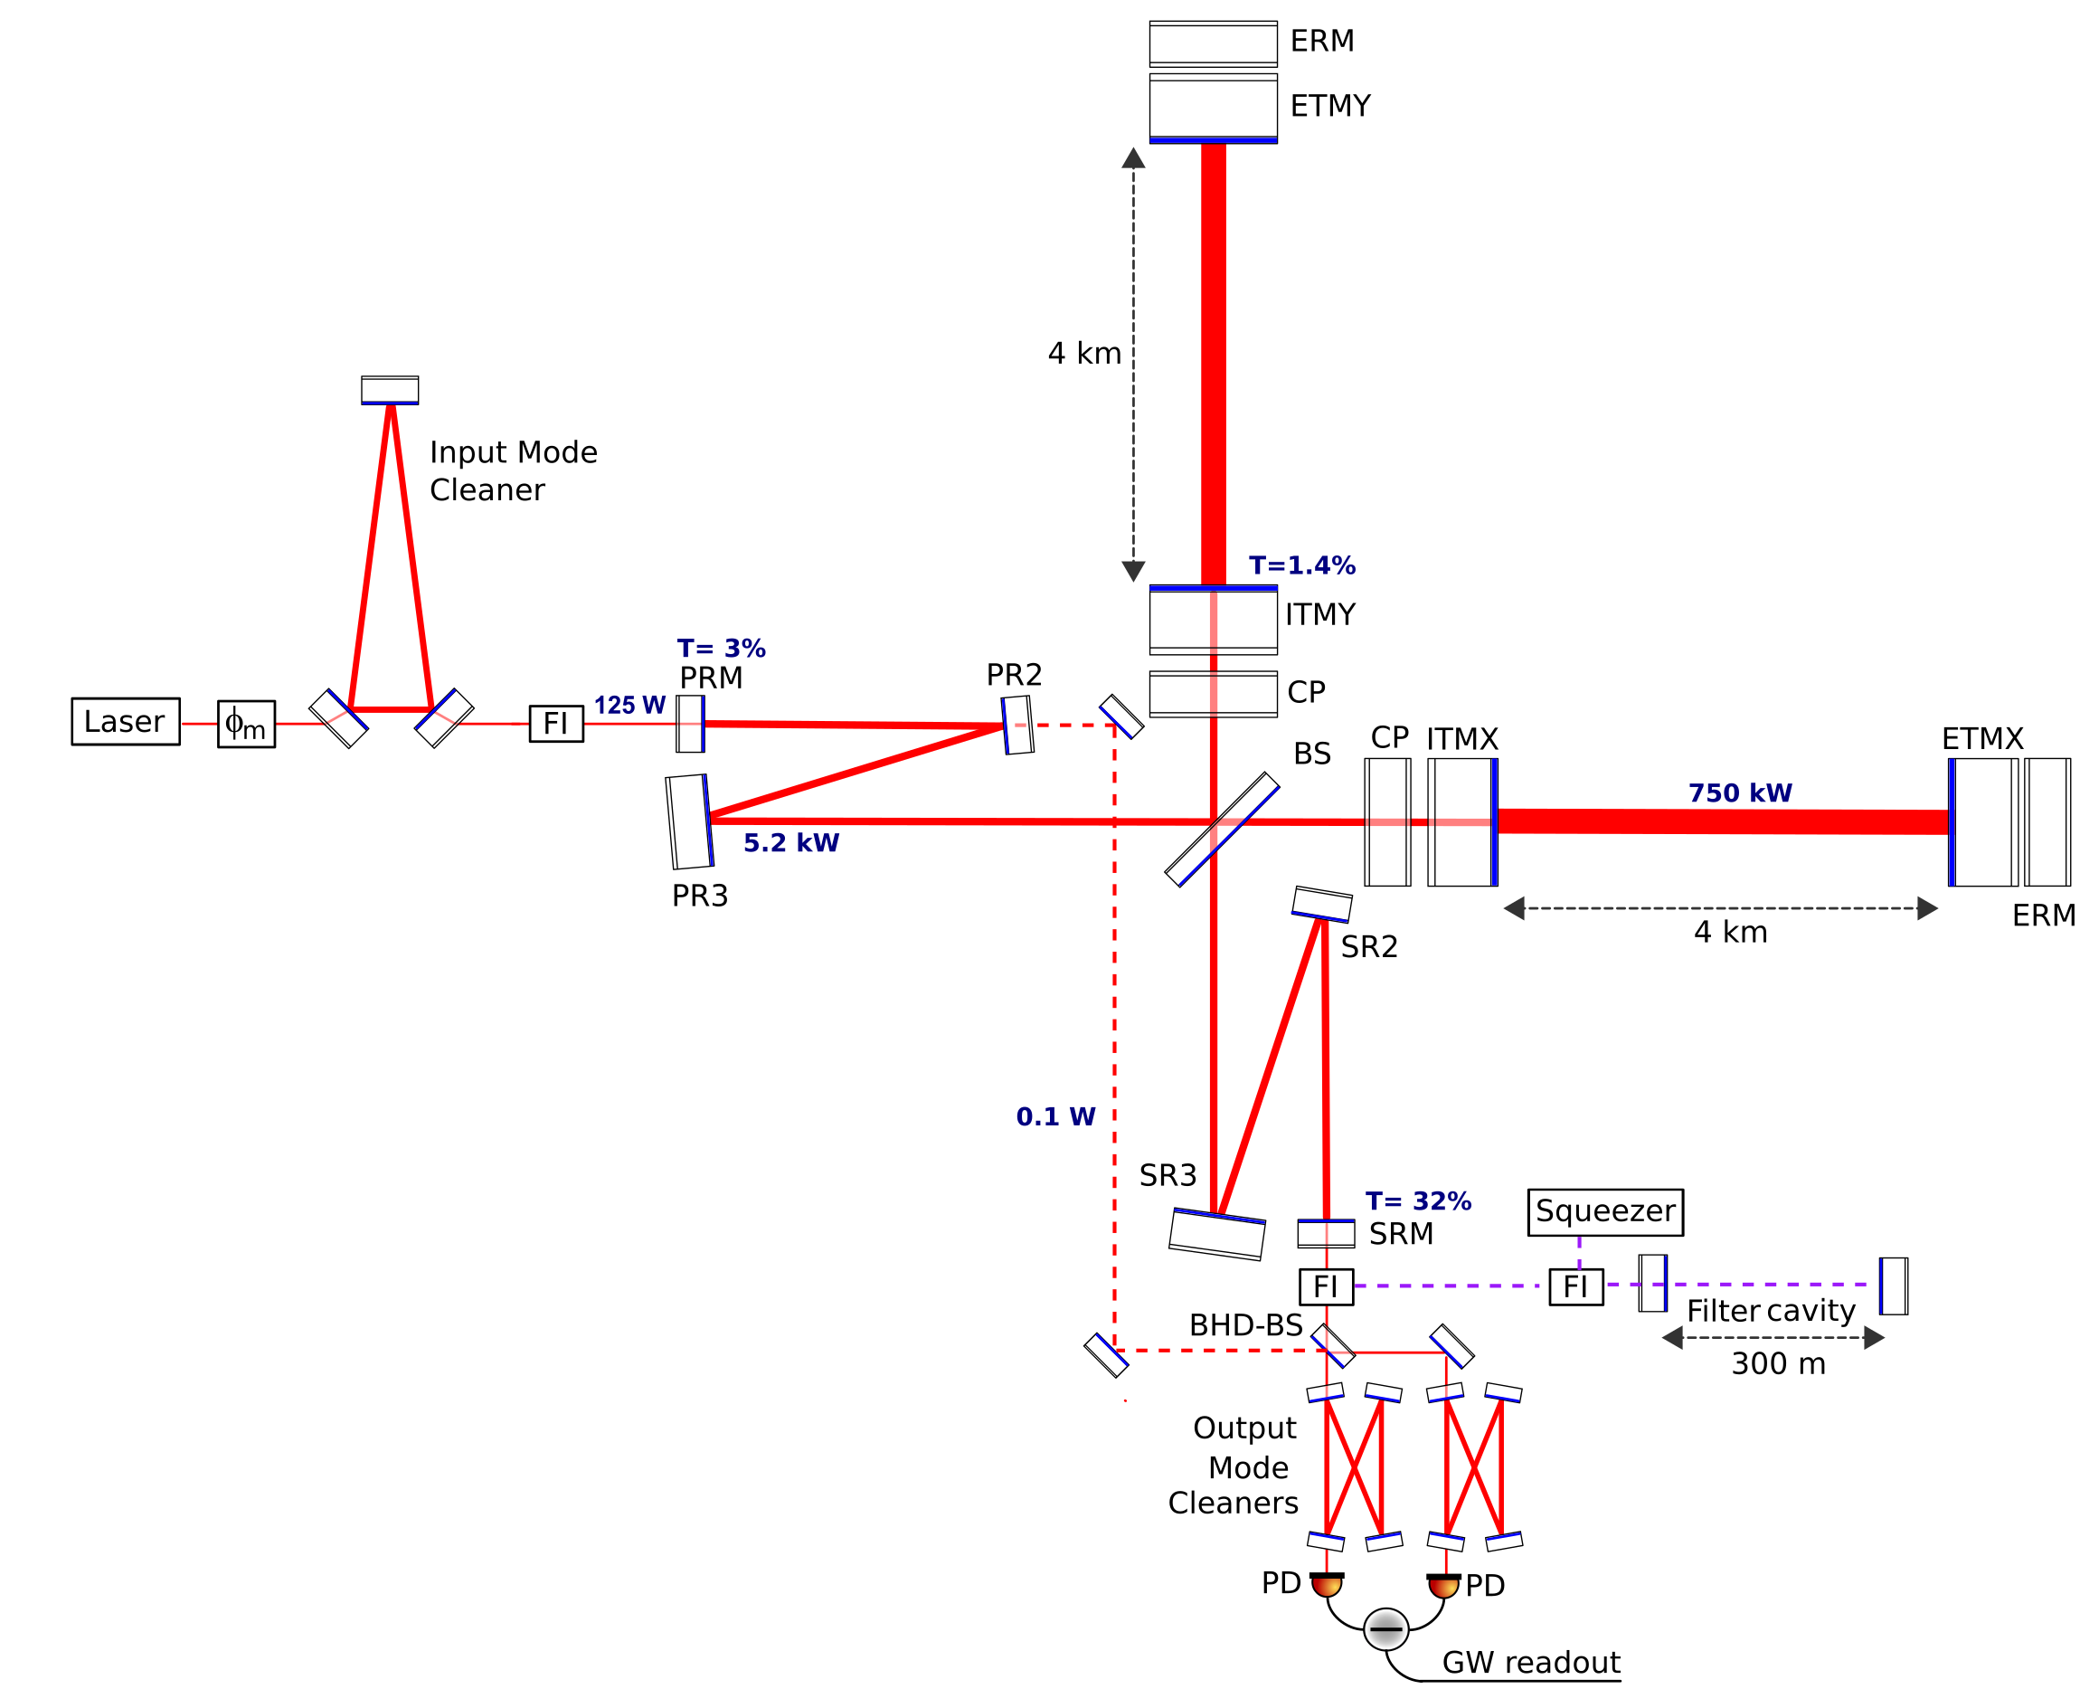
Sketch S. Hild
Test Mass Coatings
Lower CTN
Larger Beamsplitter
450 mm
Balanced Homodyne Readout
Frequency Dependent Squeezing

Slide 4
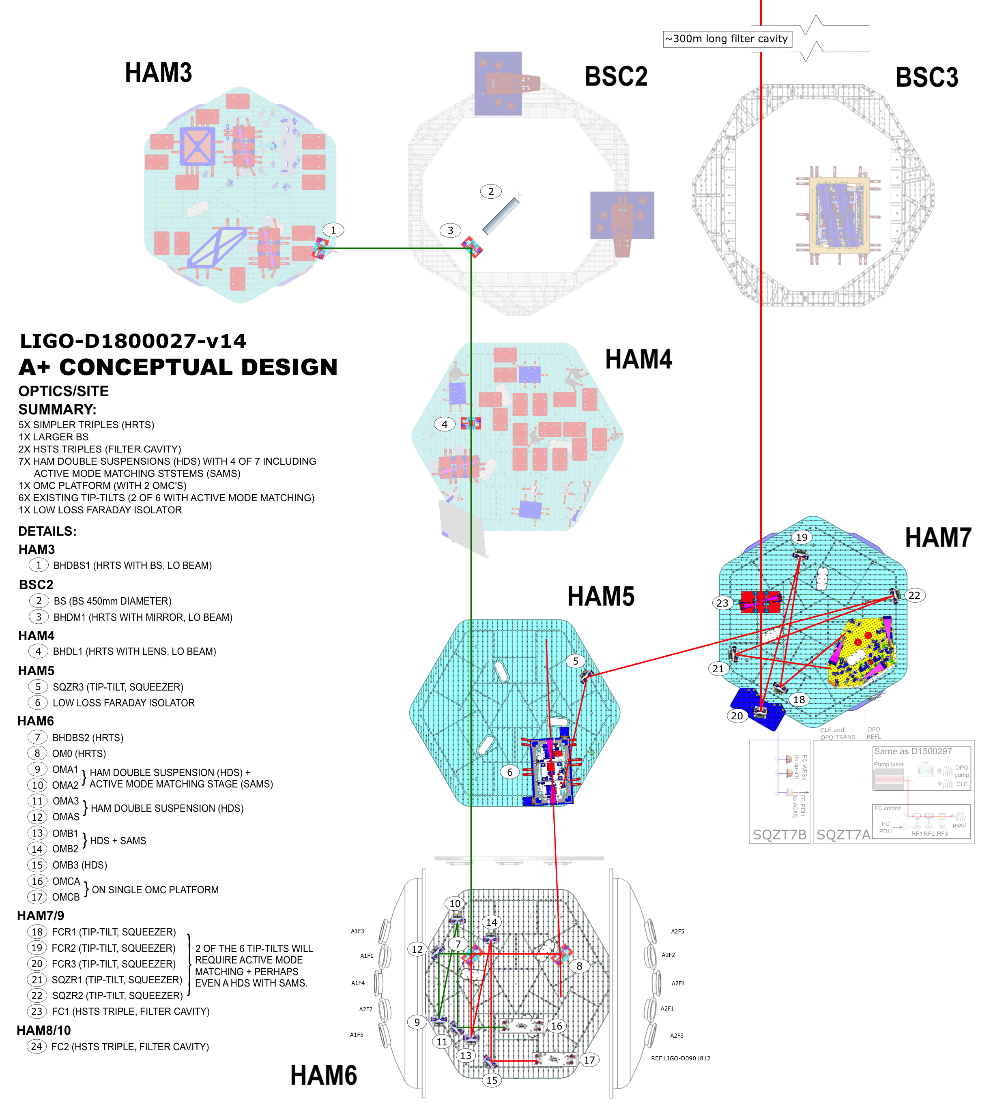
A+ Cartoon
+Y
+X
UK/US breakout see
LIGO-G1900646

Slide 5
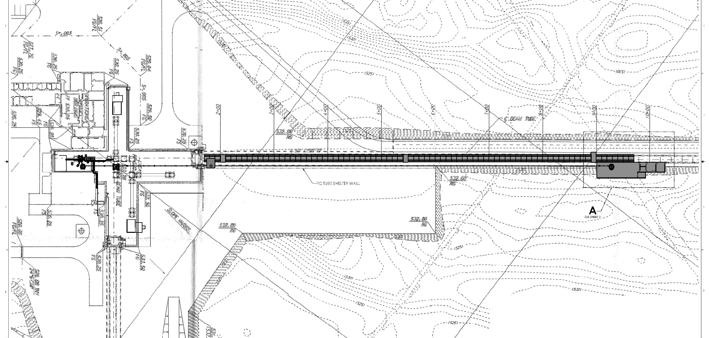
+Y
+X
A+, SITE LAYOUT (H1)
(EXTRACTED FROM LIGO D1900060)

Slide 6
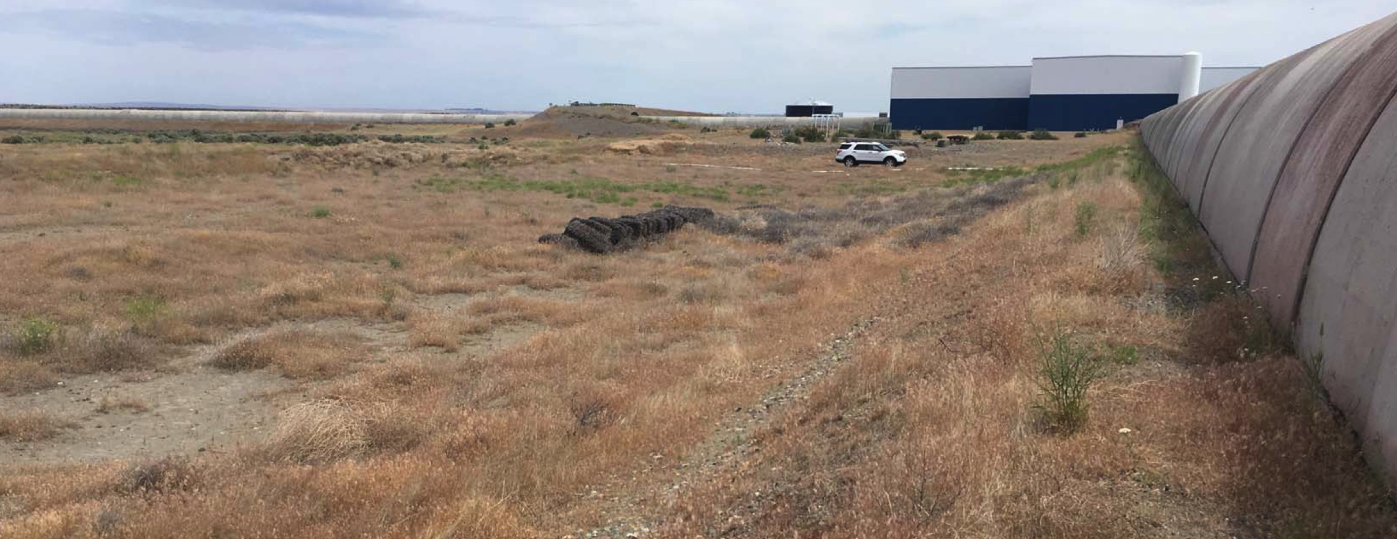
A+ Filter Cavity End Station Building Sites
Livingston
View toward LVEA

Slide 7
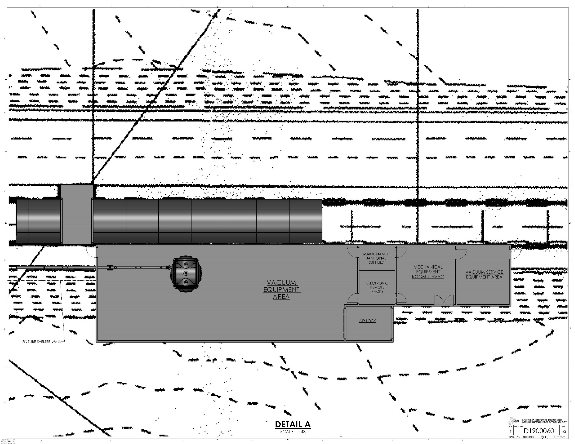
+Y
+X
A+, SITE LAYOUT (H1):
END STATION
(EXTRACTED FROM LIGO D1900060)

Slide 8
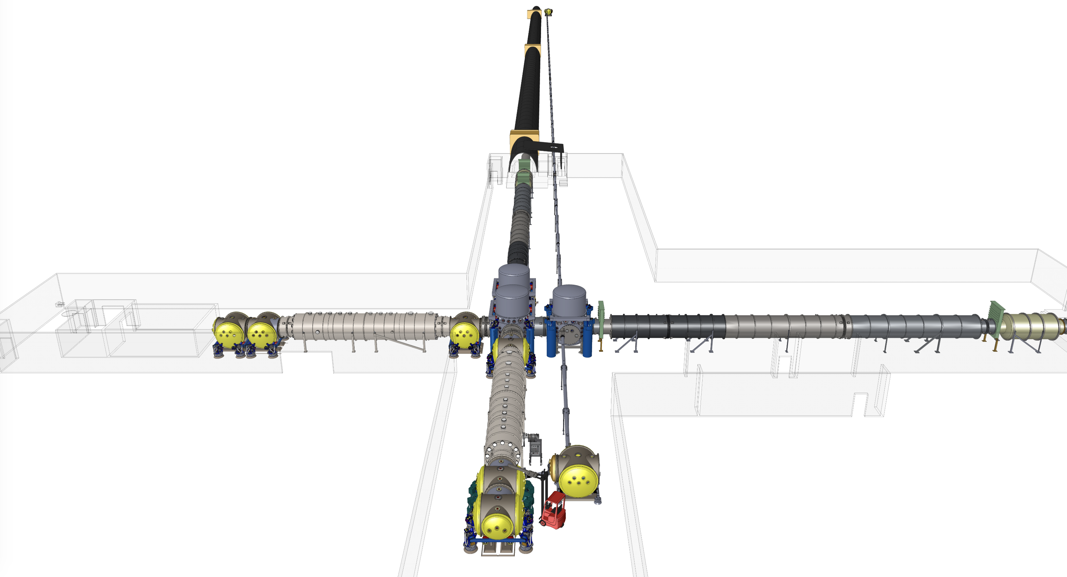
+Y
+X
E. Sanchez at CIT
More at LIGO-G1900621

Slide 9
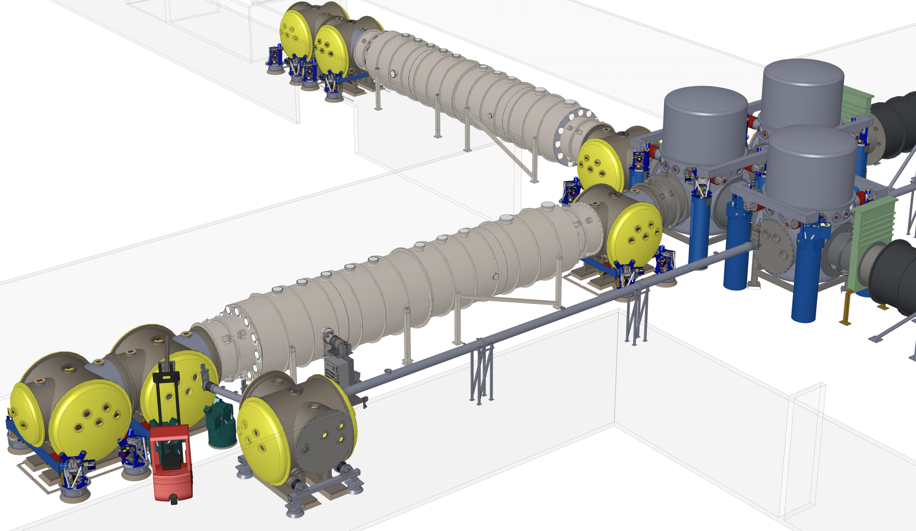
+Y
+X
E. Sanchez at CIT
More at LIGO-G1900621

Slide 10
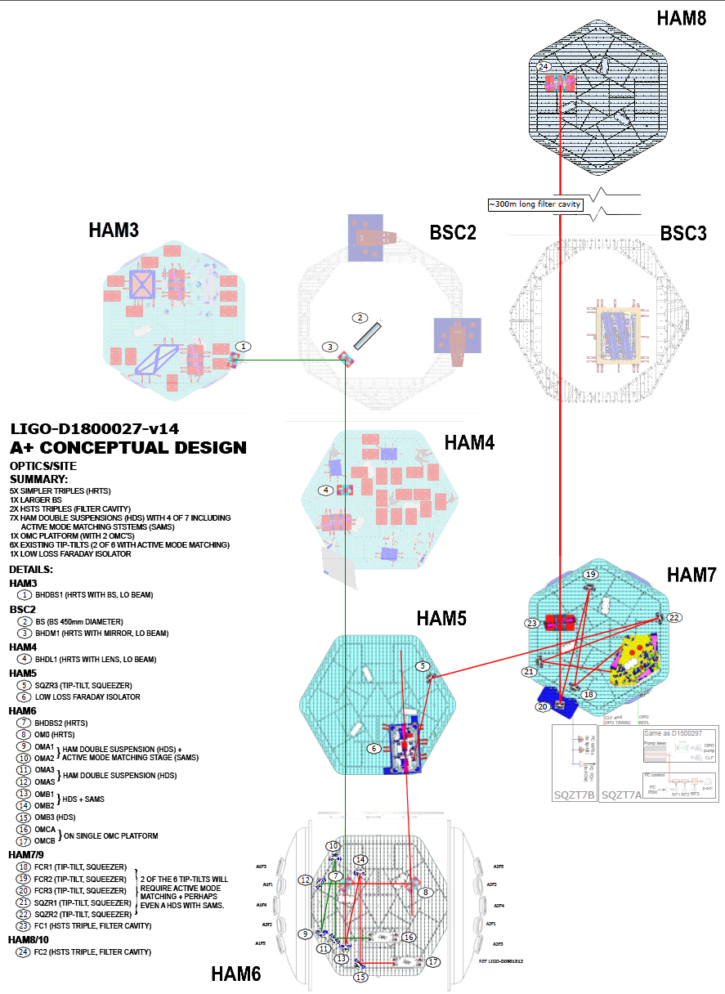
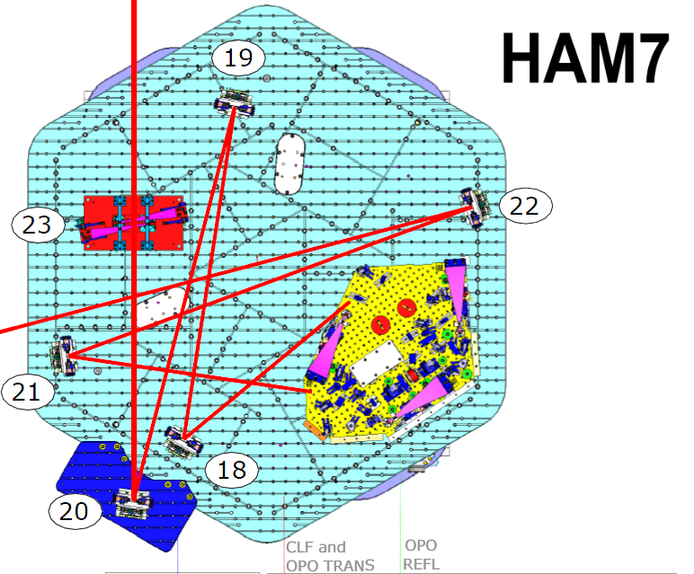
HAM Double Suspension (aka SAMS)
D1800027-v14
Top Level Conceptual Layout of A+
+Y
+X
Up to 12 Double Suspension for A+
First units possibly installed for O4
HDS Main functionalities:
Seismic isolation (2 stages)
DC tip-tilt steering
Dither for alignment signals (2kHz tip-tilt)
Mode matching (Mirror curvature control
Huy Tuong Cao, Sebastian Ng, Daniel Brown, Peter Veitch at University of Adelaide
Minkyun Noh, Peter Fritschel, Fabrice Matichard at MIT
Calum Torrie, Dennis Coyne, Aidan Brooks at Caltech

Slide 11
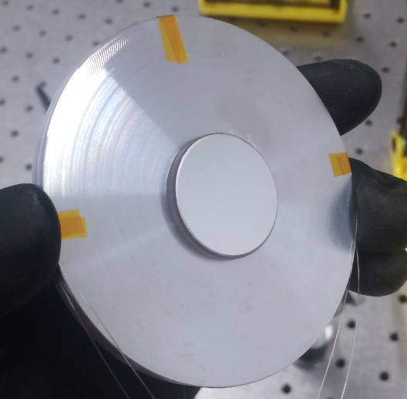
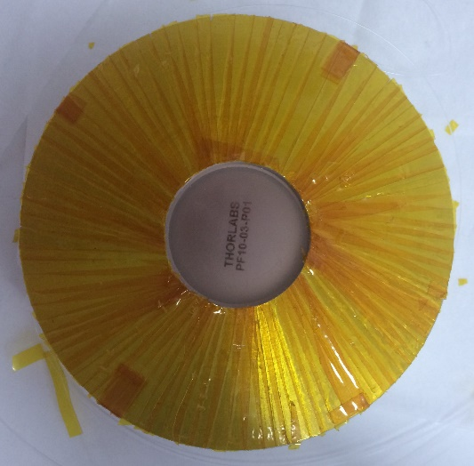
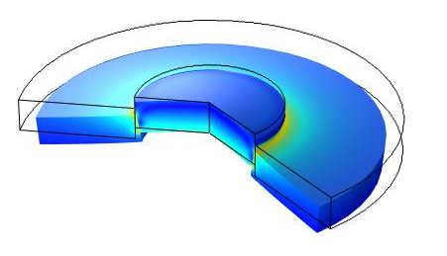
Compression Fit Mirror (CFM) - Cao Huy-Tuong, Sebastian Ng, Peter Veicht
The University of Adelaide
Thermal expansion allows assembly and provides actuation
Demonstrated low higher order aberration
No adhesive
Requires optimization of geometry
Curvature actuation: up to ~ 3 mD / degree C
LIGO-E1900044: SAMS-Compression fit mirror A+ Stress and deformation optimization
LIGO-E1900073: SAMS - Thermal adaptive optics geometry parameter optimization
11

Slide 12
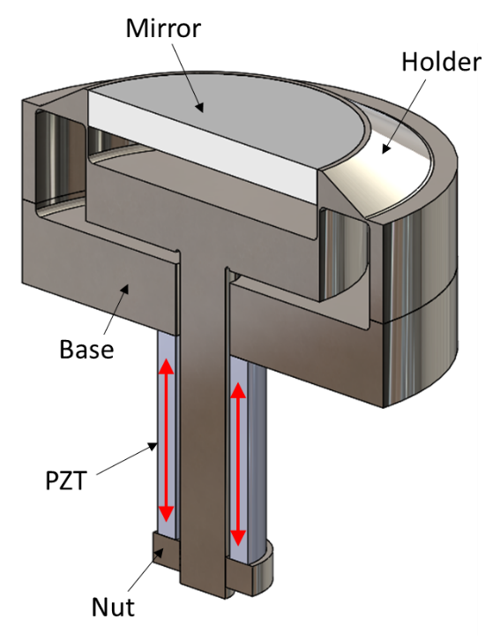
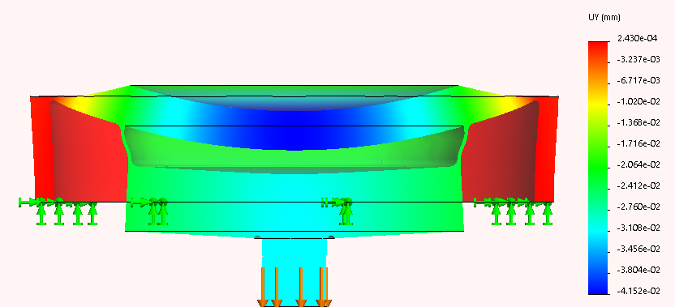
Piezo Deformable Mirror
Piezo flexure mechanism designed by Minkyun Noh
Compression fit inspired by Adelaide’s concepts
Flexure Mechanism designed to translate axial displacement into moment on the barrel of the mirror.
Pros | Cons
High bandwidth Adhesive-free Standard mirror Standard PZT | PZT hysteresis Sensing for closed-loop control Flexure machining Large inertia for dithering PZT column resonance
LIGO-E1900007: SAMS Development - Summary 4 - Piezo flexure mechanism

Slide 13
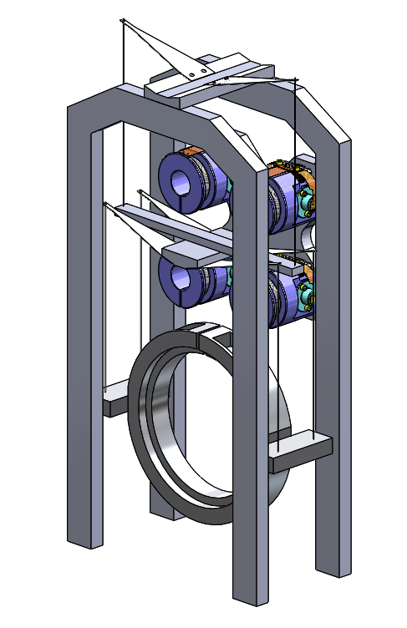
Suspension Concepts
Thermal Deformable Mirror
Piezo Deformable Mirror
LIGO-E1900056: SAMS - Suspension Interface
LIGO-E1900066: SAMS - Suspension Interface: Bracket Option

Slide 14
A+ Team
Name | Home | A+WBS/WP | A+ Project Subsystem/WP Title
D. Reitze | CIT | PM | PI
A. Lazzarini | CIT | PM | Co-PI
M. Zucker | MIT | PM, FAC | Co-Pi, Facilities
G. Billingsley | CIT | PM, COC | Project Lead Engineer, Optical Test
H. Hansen | LHO | PM | Business
C. Torrie | CIT | SYS | Systems Engineering
N. Robertson | CIT | SUS | Suspensions
K. Mason | MIT | SEI | Seismic Isolation
R. Abbott | CIT | CDS | Controls & Data Systems
C. Romel | LHO | VAC | Vacuum Systems
L. Barsotti | MIT | ISC | Interferometric Sensing & Controls
S. Rowan | GU | WP1 | Test Mass Production/Coatings
K. Strain | GU | WP2/WP7 | Beamsplitter Production and Project Management
J. O’Dell | RAL | WP3 | Suspensions
C. Mow-Lowry | BU | WP4 | Sensors and Actuators
S. Hild | GU+CU | WP5 | Balanced Homodyne Readout
G. Hammond | GU | WP6 | Suspension Upgrades

Slide 15
Project Summary
  PM infrastructure is in place
    Resource-loaded schedule now under baseline review
    WBS, cost accrual structures and interface definitions complete
  Early deliverables on track for pre-O4 integration
    Facility Design Requirements complete and reviewed
    Vacuum Design Requirements complete and reviewed, moving into procurement
    Seismic isolation systems, fabrication underway
    Low Loss Output Faraday Design Requirements complete, moving into procurement
  UK announcement in February 2019
    Integrate deliverables into plan and move ahead together on all fronts

Slide 16
Extra Slides

Slide 17
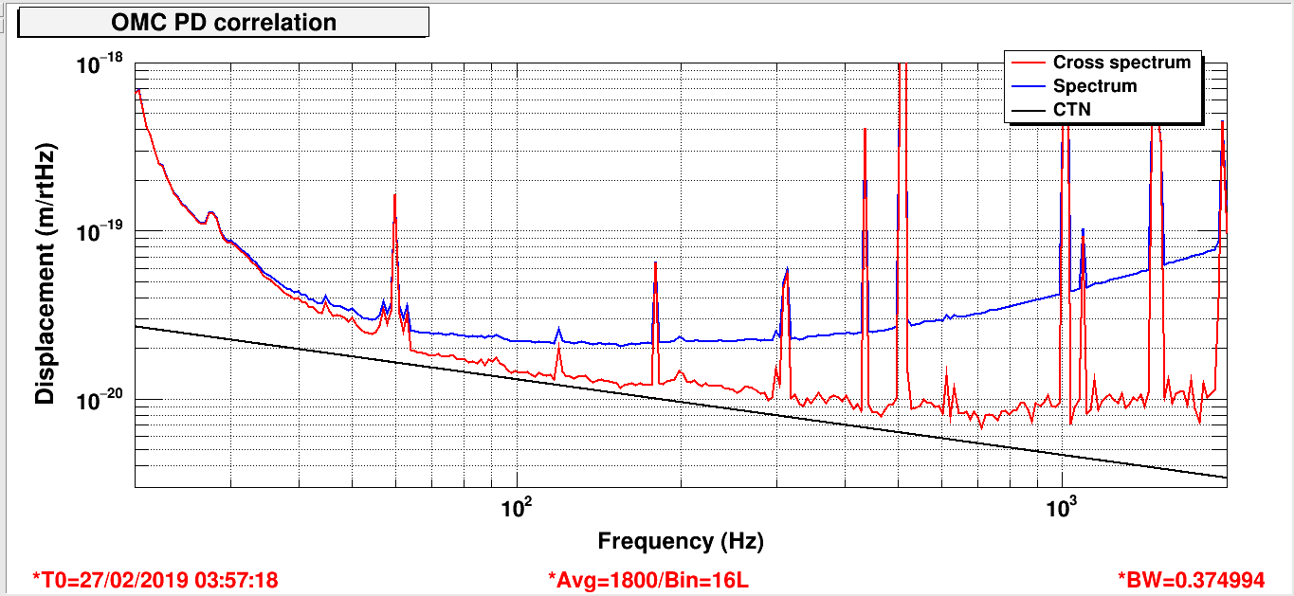
LLO February 27, 2019

Slide 18
UK Work Package Overview
See also
LIGO-G1900646

