Slide 1
Laser Power Meter Calibrations at NIST
Matthew.Spidell@NIST.GOV

Slide 2
LIGO Gold Standard traceability to the SI
Details of the NIST Standard Calorimeter
Verification of the NIST standard
LIGO Gold Standard test conditions
Incident optical power inequivalence contributions

Slide 3
LIGO Gold Standard traceability to the SI

Slide 4
Representation of the optical Watt through electrical substitution
Primary Standard
C-Calorimeter
Base/Derived Unit
V
Ω
s
Defining Constants
e
h
Δν

Slide 5
Details of the NIST Standard Calorimeter

Slide 6
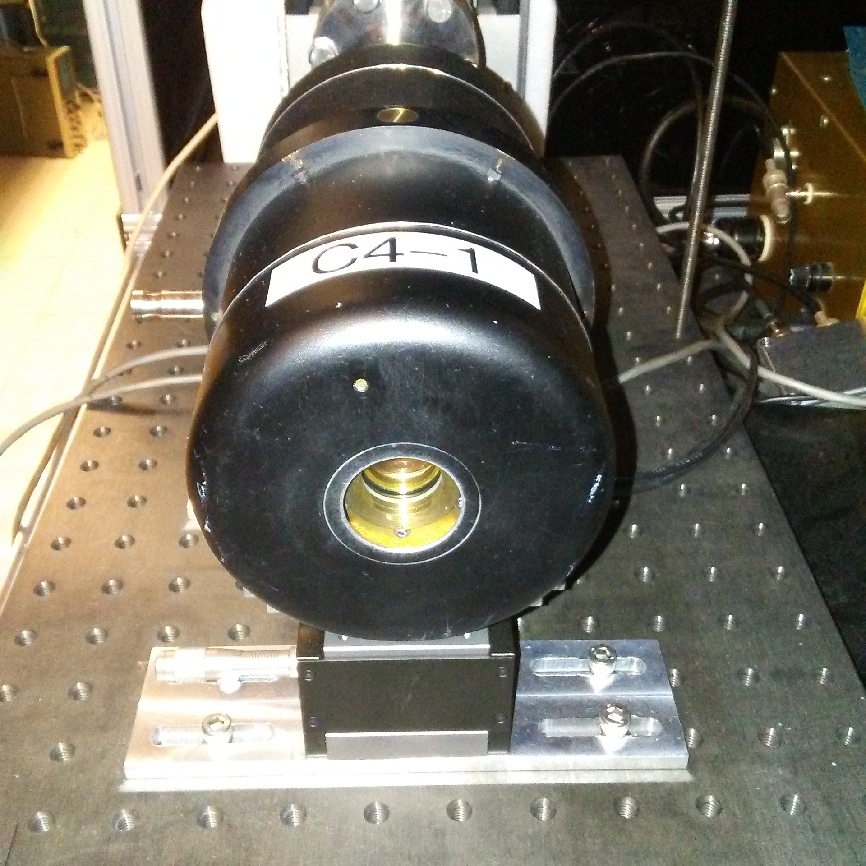
Calorimeter Design
Insulating shell
Heater windings
Isothermal vacuum shell
Thermal dampening shell
Electrical-Substitution heater windings
DC Amplifier
Carbon-Black absorbing cavity
1° Wedge Window
Multi-Junction thermopile/Weak thermal link

Slide 7
Systematic uncertainties
Source | Standard Uncertainty (type)
Standard meter ratio | 0.29% | ($u_{rel, Type B}$)
Inequivalence | 0.087% | ($u_{rel, Type B}$)
Window Transmission | 0.064% | ($u_{rel, Type B}$)
Electronics | 0.058% | ($u_{rel, Type B}$)
Inject time | 0.029% | ($u_{rel, Type B}$)
Absorptivity | 0.0058% | ($u_{rel, Type B}$)
Heater Leads | 0.0058% | ($u_{rel, Type B}$)
Electronics | 0.0033% | ($u_{rel, Type A}$)(N=30)
Window Transmission | 0.0033% | ($u_{rel, Type A}$)(N=30)

Slide 8
Systematic Uncertainty Details
Standard meter ratio (0.29 %)
Uncertainty attributable to pointing instability integrated with last external aperture and /or standard entrance aperture
Inequivalence (0.087 %)
Difference in temperature response between optically delivered power and electrically delivered power (during calibration of the standard)
Window Transmission (0.064%)
Composite polarization and spectral-absorptivity uncertainty
Electronics (0.058 %)
Composite of the pre-amplifier and A-D converter uncertainty contributions

Slide 9
Verification of the NIST standard

Slide 10
Optical inter-comparisons
Laser Optimized Cryogenic Radiometer
1 mW
1 μm
$∆_{C_std vs LOCR_std}≅0.05\%\text{ (}\text{C}\text{.}\text{F}\text{.= 1.0005)}$
U (k=2) 0.86%

Slide 12
Optical inter-comparisons
K-Series Calorimeter
2 W
1 μm
$∆_{C_std vs K_std}≅0.2\%$ (C.F.= 0.9981)
U (k=2) 1.5%

Slide 13
Kg inter-comparison (via Radiation Pressure Power Meter & K-series calorimeter)
Kg via RPPM & K-Series Calorimeter
$∆_{C_std vs Kg_transfer}≅0.6\%$ (C.F.= 0.9941)
U (k=2) 1.7%

Slide 14
LIGO Gold Standard test conditions

Slide 15
LIGO ‘Gold Standard’ Calibration Conditions
1047nm Diode Pumped Solid State Source
1/e² diameter of approximately 4 mm
24 Hour+ thermal equilibrium
20 ± 1 °C
20 ± 5 % RH

Slide 16
Measurement Procedures
Order of Operations:
Calorimeter vs monitor
Gold Standard vs monitor
Calorimeter vs monitor
Each step consists of 4+ measurements to meet minimum degrees of freedom for a 96% confidence interval
Shutter
Calorimeter
Beamsplitter
Laser
DUT
Calorimeter
Data Acquisition and Control

Slide 17
Detailed Calibration Geometry
Shutter
Attenuator
Entrance Iris
M1
Standard 1
Standard 2
GS
Enclosure
M2
Enclosure
Beamsplitter

Slide 18
Inequivalence contributors to Standard and Device Under Test incident power

Slide 19
Incident optical power inequivalence contributions
Setup geometry
Intermediate optics (scatter, diffraction, alignment, etc…)
Long paths between last optical element and standards preferred
renders apertures effective against scatter
Minimum 30 cm separation between integrating sphere and any normal surface (more on this latter)
Unintended etalons
Avoid planar beamsplitters (to monitor)
Avoid attenuators after beamsplitter
example:
Assume planar surfaces
R=0.5%
$\frac{∆t}{℃}≤\frac{0.16\%}{℃}$

Slide 20
Incident optical power inequivalence contributions (cont.)
Laser induced heating of optics
Absorbing ND filters and invar film attenuators can see laser induced heating and resulting transmission variation
Continually-variable attenuators after the beamsplitter (to monitor) yield splitting ratio variation due to pointing instability
Atmospheric absorption
Typically water lines in Short Wave IR
Negligible at 1047nm, 20 cm gas cell
Source instability
Active power stabilization or Concurrent measurement of a monitor and Standard/Device under test preferred

Slide 21
An Unintended Etalon
Assume planar surfaces
R=0.5%
$\frac{∆t}{℃}≤\frac{0.16\%}{℃}$

Slide 22
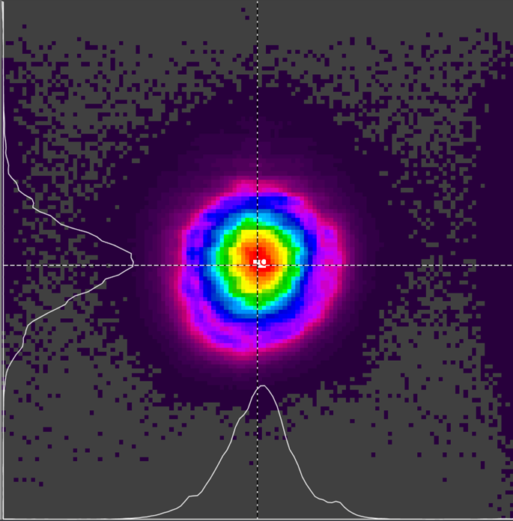
Beam cameras
Unreliable for defining ‘maximum extent’ beam diameter since significant energy may exist in large diameter “margin” of the beam
Gain conditions may suppress the signal in the “margin”
May miss diffraction spikes and interference fringes
Significant variation between manufacturers
Easily damaged at the focus of even a low powered beam

Slide 23
A special caution regarding integrating sphere calibrations

Slide 24
Test Setup
Aperture stop typically located before standard and device under test to ensure scattered light does not yield inequivalence
Aperture diameter must exceed main beam diameter to bar against introducing edge diffraction

Slide 25
Test Setup
Reflectance of PTFE >98% at 1047 nm
Integrating spheres can have a diffuse exitance of approximately 50%
Worst case conditions yielded a 2% increase in detected signal
Aperture stops must be located >30 cm from the detector entrance port (empirically determined)
Sphere Shell
50% Exitance
Diffuse reflectance wall material (PTFE)
Detector at top of sphere

Slide 26
What grants a National Metrology Agency authority to disseminate standards?

Slide 27
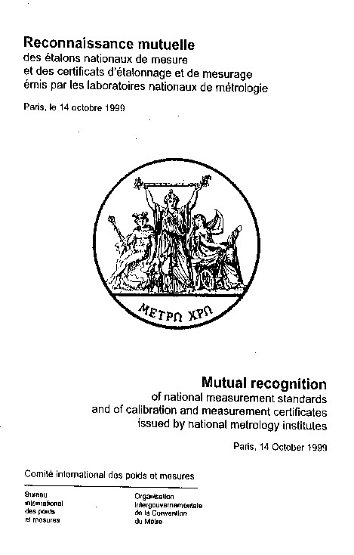
CIPM Mutual Recognition Arrangement (MRA)
Provides open, transparent, and comprehensive scheme to assess:
Comparability of national metrology standards and services
Technical basis for wider agreements for international trade, commerce, and regulatory affairs
Notes:
Driven by emergence of more globalized economy
October 1999: The directors of the national metrology institutes (NMIs) of 38 Member States of the Metre Convention signed a Mutual Recognition Arrangement (MRA) for national measurement standards and for calibration and measurement certificates issued by national metrology institutes.
Today, 101 institutes have signed, covering 101 institutes plus 153 designated institutes
MRA drawn up by International Committee of Weights and Measures (CIPM) under authority of Metre Convention
By signing, accept the scheme for assessing comparability and recognize results/outcomes of the scheme

Slide 28
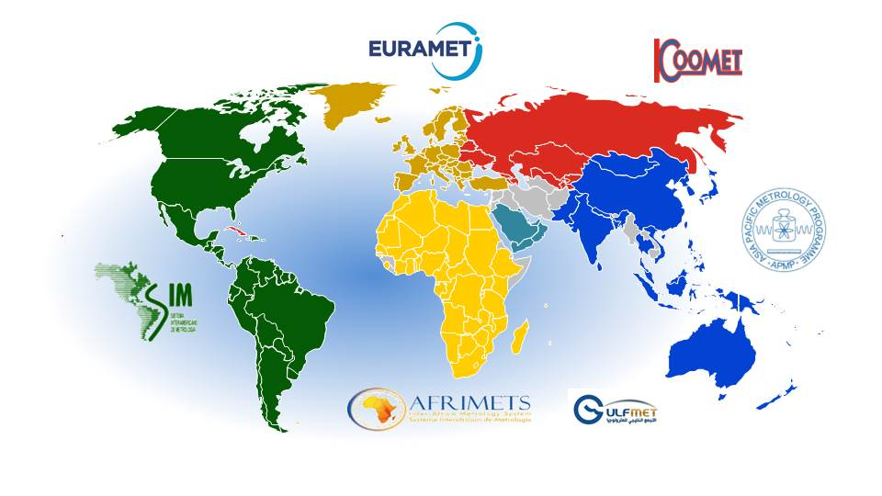
Regional Metrology Organizations RMOs
Run key comparisons and supplementary comparisons to support the CIPM MRA
Validate NMI Quality Systems
Review NMI Calibration and Measurement Capability Statements (CMCs)

Slide 29
Components for international recognition/approval of measurement capabilities
Signing of the CIPM Mutual Recognition Agreement
Peer-Reviewed Quality Management System
Inter-comparisons

Slide 30
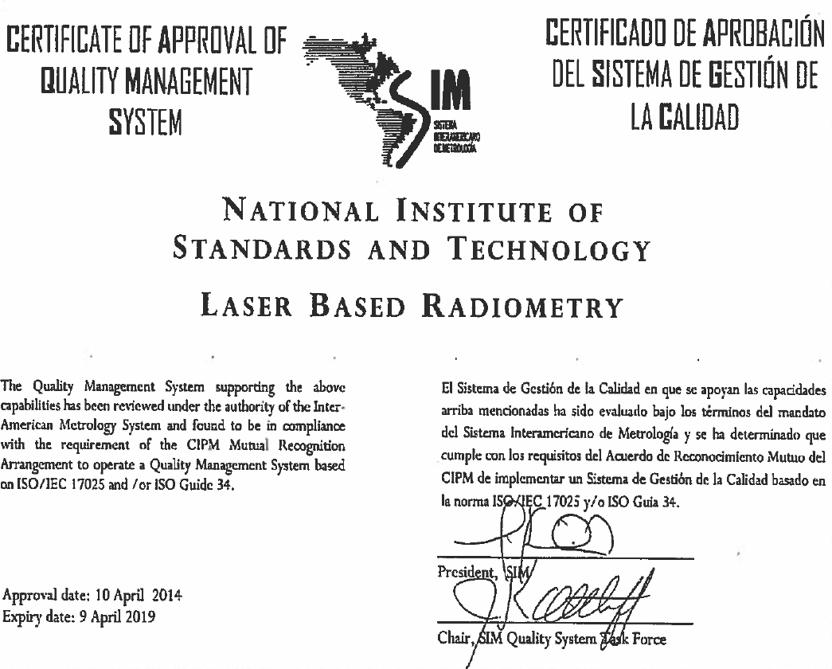
The Americas: Sistema Interamericano de Metrologia
5 Year review cycle
Past and planned key comparisons conducted with low power (100 μW) high precision cryogenic radiometers

Slide 31
What about ISO 17043
NIST quality system follows ISO 17043 guidelines
Not reviewed by a third party corporation
SIM supersedes such entities

