Slide 1
GW (Gravitational Wave) Metrology Workshop
14,15 March 2019
The National Institute of Standards and Technology
LIGO Hanford Observatory

Slide 2
Thanks to Rick, Michelle, and Michelle
Social Event
Slide Repository (Jeff Kissel)

Slide 3
Structure of the CCPR/BIPM, Overview of “EUROMET Comparison Project 156”
John Lehman
NIST

Slide 4
2009 EUROMET Comparison Project no. 156

Slide 5
ABSOLUTE CALIBRATION IN LIGO “Photon Calibrators”
Induced fiducial displacements via laser radiation pressure.
Developed within LIGO over past 10-15 years.
LIGO calibration accuracy directly proportional to the laser power measurement accuracy.
Power calibration of LIGO’s Gold Standard provided by NIST (approx. 300 mW at 1047 nm)
Induced sinusoidal displacement of
40 kg mirror ~ 10⁻¹⁸ m at 100 Hz

Slide 6
2009

Slide 7
Some Background

Slide 8
 | The intergovernmental organization through which Member States act together on matters related to measurement science and measurement standards.

Slide 9
International Bureau of Weights and Measures (BIPM)
(provide a single coherent system of measurements throughout the world traceable to the SI)

Slide 10
International Bureau of Weights and Measures (BIPM)
(provide a single coherent system of measurements throughout the world traceable to the SI)
International Committee for Weights and Measures

Slide 11
International Bureau of Weights and Measures (BIPM)
(provide a single coherent system of measurements throughout the world traceable to the SI)
International Committee for Weights and Measures
There are Ten consultative committees
The Consultative Committee for Photometry and Radiometry (CCPR)

Slide 12
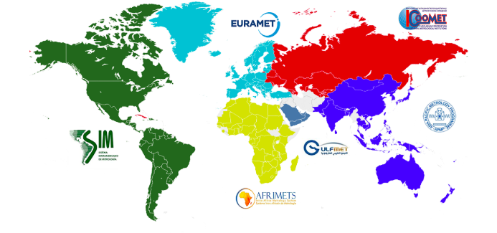
International Bureau of Weights and Measures (BIPM)
(provide a single coherent system of measurements throughout the world traceable to the SI)
International Committee for Weights and Measures
(mutual recognition agreement)
There are Ten consultative committees
The Consultative Committee for Photometry and Radiometry (CCPR)
Regional Metrology Organizations (e.g., SIM, EUROMET)
Are made up of National Metrology Institutes (e.g. NIST, PTB, LNE)

Slide 13
International Bureau of Weights and Measures (BIPM)
(provide a single coherent system of measurements throughout the world traceable to the SI)
International Committee for Weights and Measures
(mutual recognition agreement)
There are Ten consultative committees
The Consultative Committee for Photometry and Radiometry (CCPR
Is the one we care about for this context
Regional Metrology Organizations (e.g., EUROMET)
Are made up of National Metrology Institutes (e.g. NIST)
RMOs undertake Key Comparisons to establish
Calibration Measurement Capability (CMC)

Slide 14
CCPR
Consultative Committee for Photometry and Radiometry
“establish and maintain a list of key and other comparisons in the field of photometry and radiometry […]”
National Metrology Institutes (or RMOs) work together to review, record, organize, ordain, etc.

Slide 15
Completed 2009 (Stefan Kück)

