Slide 1


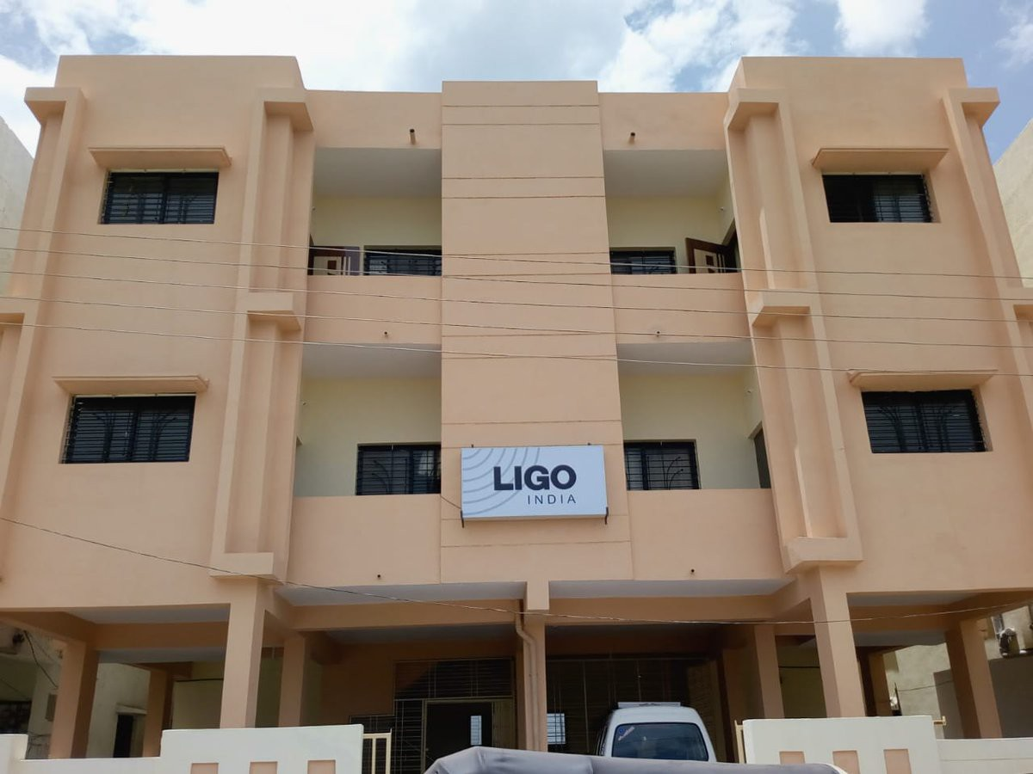
LIGO-India: Status and Calibration plans
Shivaraj Kandhasamy
Inter University Center for Astronomy and Astrophysics
Gravitational Wave Metrology Workshop, Boulder
March 15, 2019

Slide 2
LIGO-India: Project
US-India collaborative project to build a 4 km long GW detector in India
  Identical to existing US-LIGO detectors
US will provide core components and India will provide facility to house the detector and resources to run it.
  Core components will come from the second detector that was initially planned to be installed in Hanford, WA (two collocated detectors in Hanford, WA).
2

Slide 3
LIGO-India Advantage
First GW detection by Advanced LIGO-US observatories
Current:
Two US detectors
sky-localization
(620 square degree
2500 full moons)
Forecast : LIGO-India
in joint operation
sky-localization
100 time smaller
(5 square degrees
20 full moons) !!!
LIGO-India will
make
a BIG difference !!!!
3

Slide 4



LIGO-India: Institutions
Indo-US collaboration
Funding agencies: NSF (USA) and jointly DAE(India) & DST(India)
Institutions: LIGO Lab., Caltech & MIT (USA)
IPR, IUCAA, RRCAT & DCSEM (India)
Executed by four Indian lead institutes:
Inter-University for Centre for Astronomy & Astrophysics (IUCAA)
Institute of Plasma Research (IPR)
Raja Ramana Centre for Advanced Technology (RRCAT)
Directorate of Construction & Estate Management (DCSEM)
[Affiliated to Department of Atomic Energy]
Management structure
  LIGO-India Apex committee
  LIGO-India Project Management Board
  LIGO-India Scientific Management Board
4

Slide 5
LIGO-India: Project status
Land acquisition is almost complete.
  Detailed Topographical study : Done
  Detailed Geotechnical study : Done
  Long term Seismic monitoring and study: Govt. permission granted, will be undertaken by the National Geophysical research institute (NGRI), Hyderabad
  Temporary office and guest accommodation near site functional
Environmental clearance is approved.

Slide 6
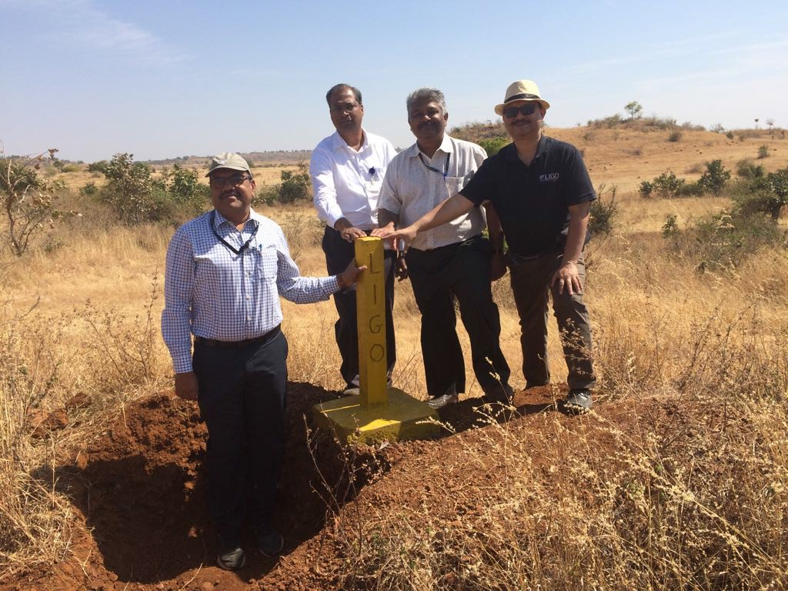
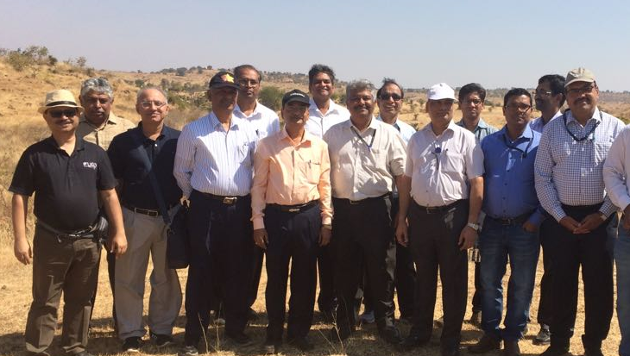
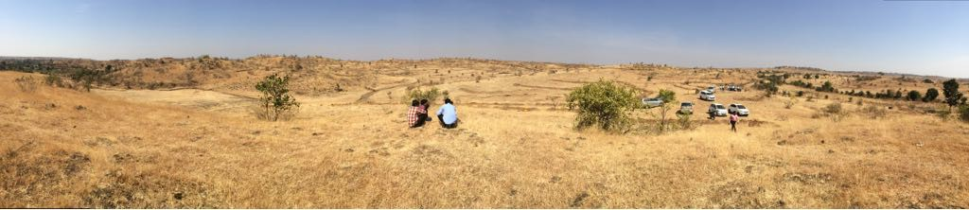
Detector Site

Slide 7
LIGO-India: Project status
Many meetings in the next few months.
  Detailed Project Report (DPR)
    Approved by highest body of DAE and being forwarded for Union cabinet approval
  Project Execution Plan (PEP)
    Detailed plan of the project execution including the interface document, risk register and the observatory staffing plan.
    Review by the Project (Technical) and Science Management boards.
  Discussions with US Colleagues
Civil Infrastructure
  First complete and detailed version of architectural drawings for civil infrastructure has been prepared.
    Site levelling plan
    Electrical and mechanical layout drawings
7

Slide 8
LIGO-India: Project status
Vacuum infrastructure
  Outgassing setup development, procurement of necessary pumping hardware (pumps, gauges, controls, residual gas analyzer, etc) (ongoing)
  Prototype beam tube and testing it for vacuum measurements; prototype HAM and BSC chamber (1:1 size)
Control and Design System (CDS)
  Hardware and software needed for interferometer control as well as final data storage and analysis.
  GW Data center at IUCAA (being set up)
Offsite facility at RRCAT for detector testing and validation
  10 m prototype
LI-TRD (Training and R&D)
  Many institutions across India participating in LI-TRD
8

Slide 9
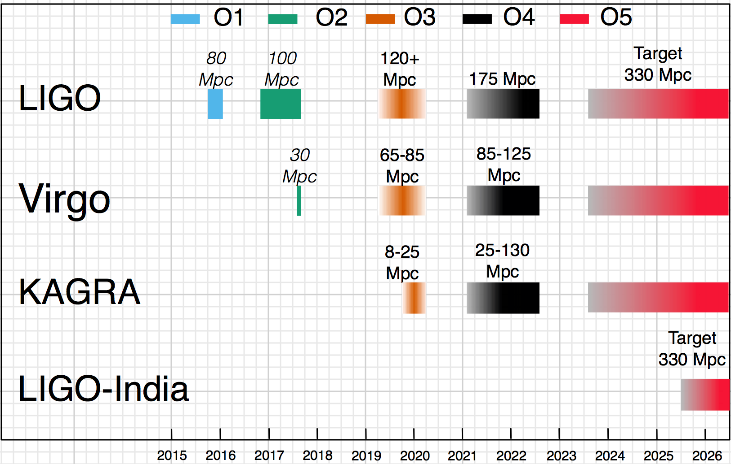
LIGO-India: Project status
From Stefan Hild’s presentation G1900474
9

Slide 10

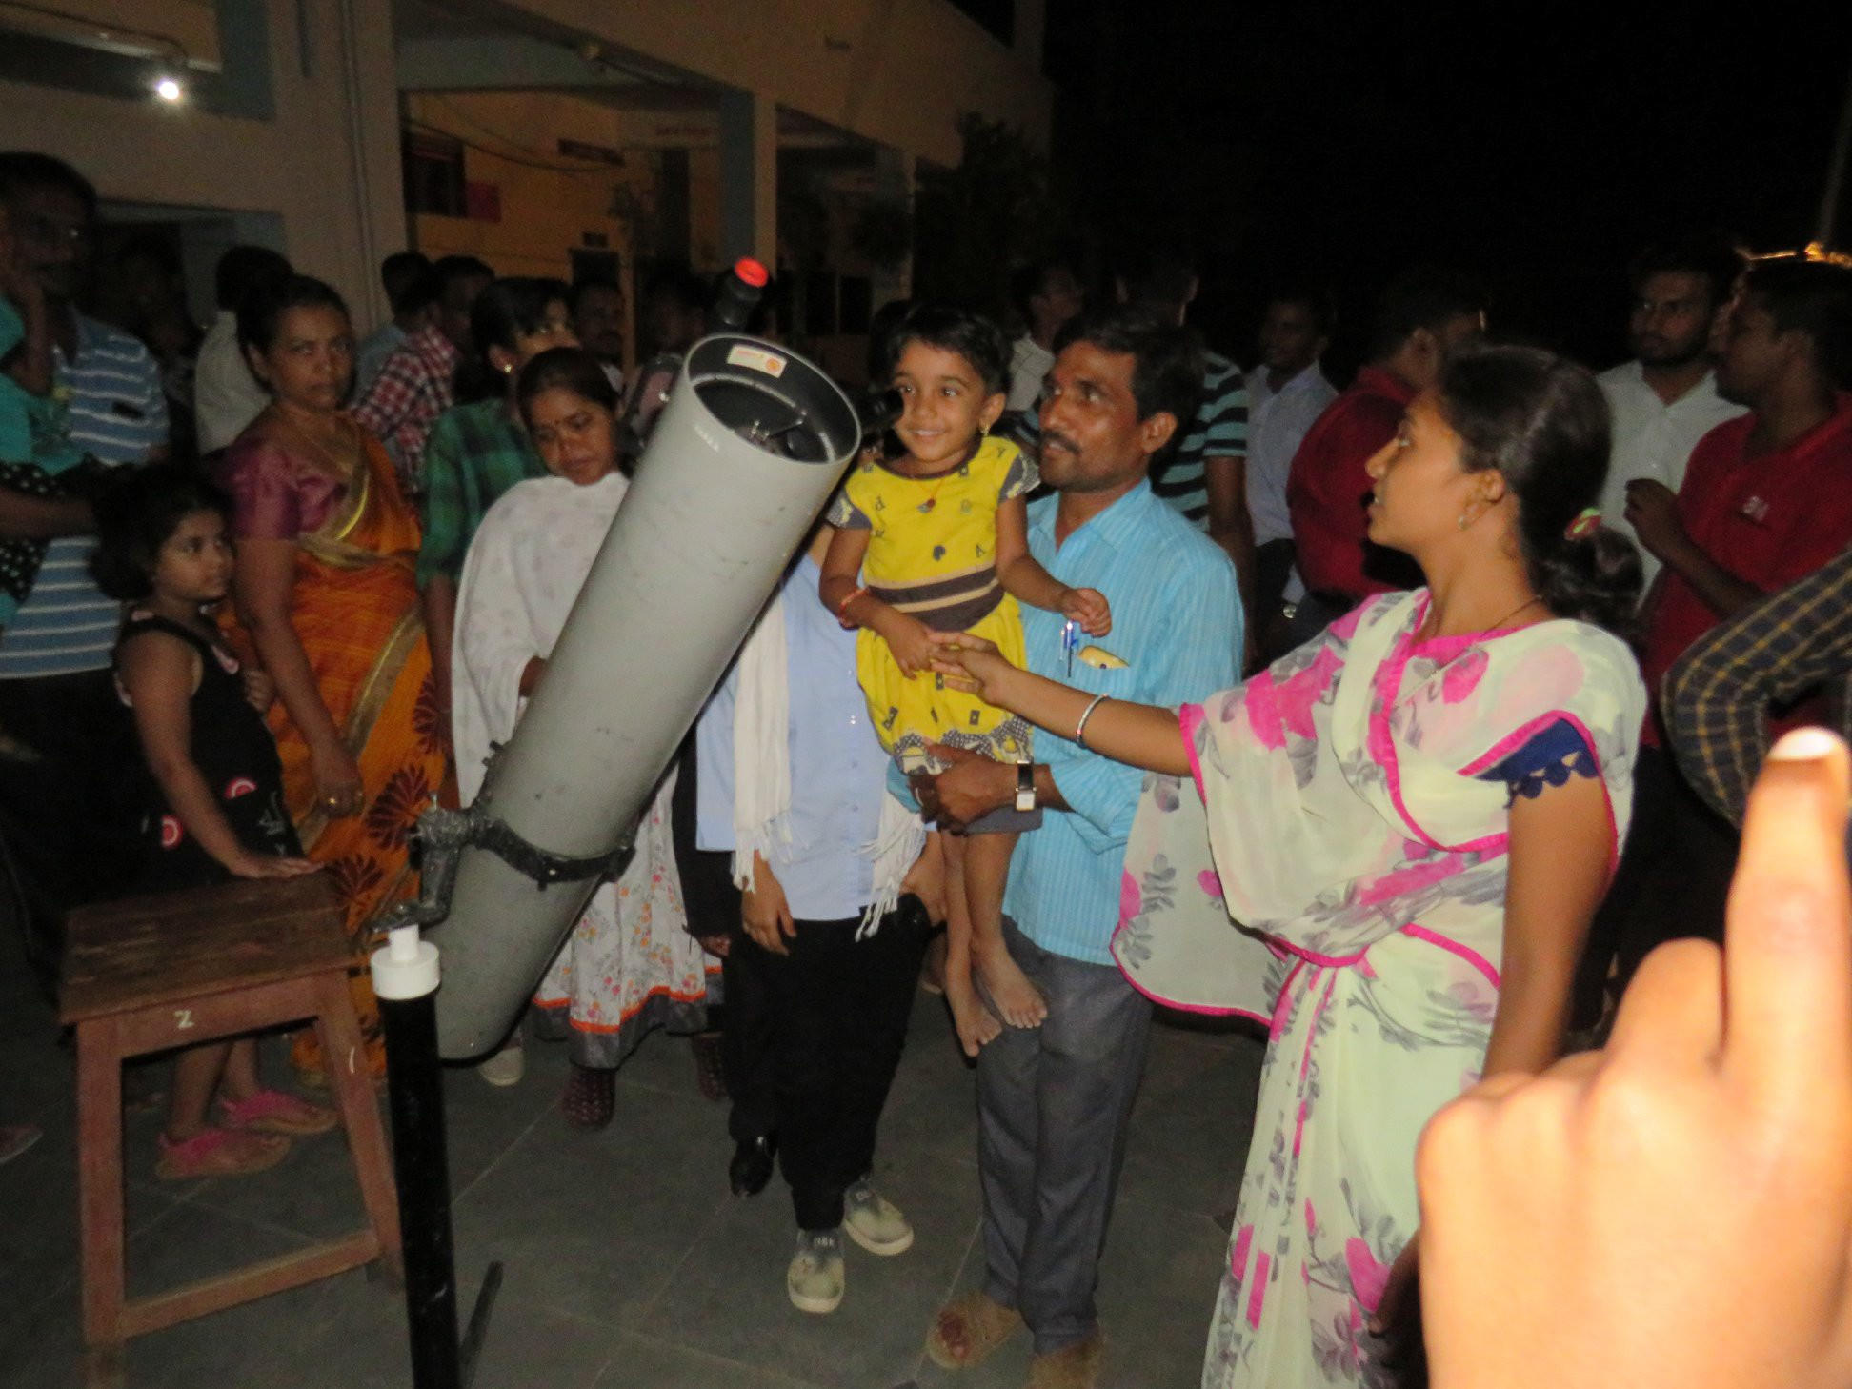
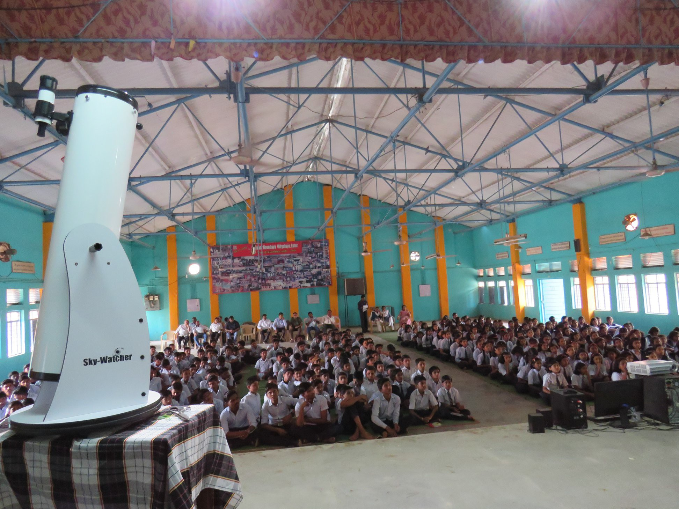
EPO Activities Near The Site

Slide 11
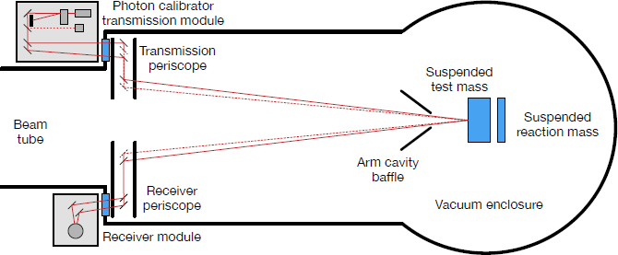
Calibration of the detector
Extracting astrophysical and cosmological parameters require good calibration of the detectors.
  Relative calibration at different frequencies affect estimations of masses, spins, equation of state etc.
    Astrophysics of black holes and neutron stars
  Absolute calibration determines source distance, orbital orientation etc.
    Distributions of the compact objects -> Evolution of the universe.
LIGO-India, similar to other current GW detectors, will use radiation pressure based calibration method.
11

Slide 12
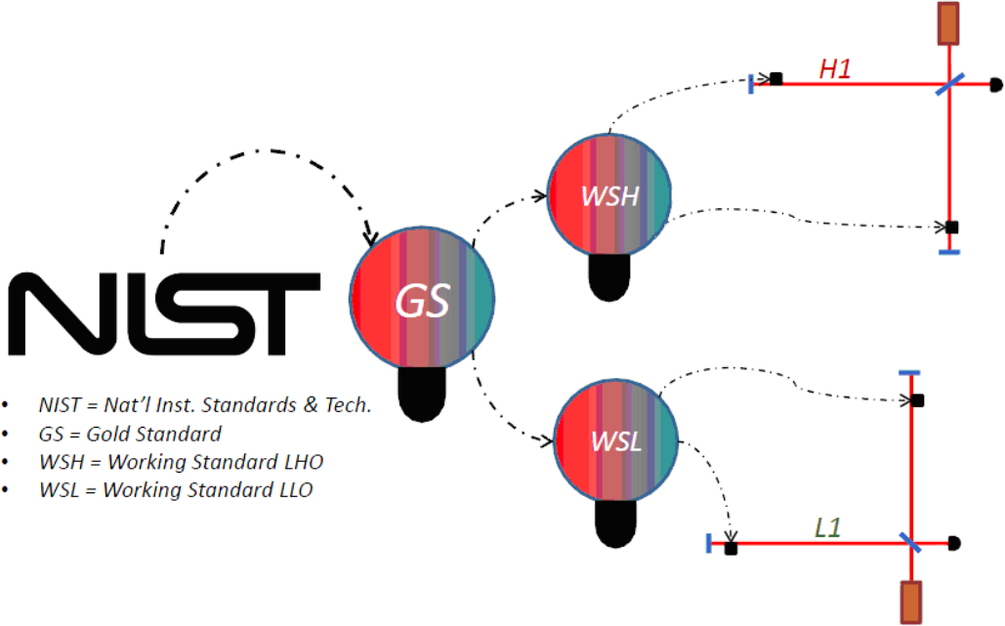
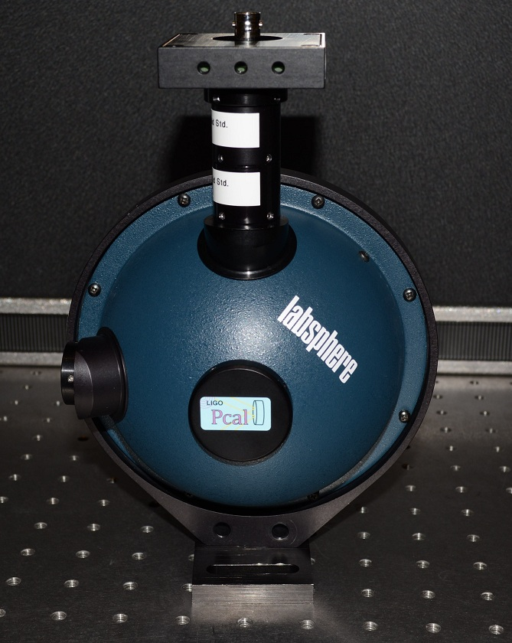
Calibration of the detector
A secondary laser will be used to produce known displacements of one of the end mirrors.
A well calibrated photodetector will be used to measure power from the secondary laser.
  Thus the calibration accuracy of the photo-detector will dictate the calibration accuracy of the GW detector.
  Calibration of the photodetectors (power sensors) will be traced back to NIST or equivalent standard.
12

Slide 13
Calibration of the detector
Calibration hierarchy is expected to be similar to LIGO
Gold standard will be calibrated against NIST or equivalent standard
  Gold standard will be maintained by NPL (National Physical Laboratory). NPL is equivalent to NIST in India.
  Being at NPL, this standard could be used for calibration of other power sensors (industry and academic)
  In the long term, NPL will try to develop its own techniques for power calibration
Working standard will be kept at the site and will be periodically compared against the Gold standard
13

Slide 14
Summary
Continued top level support and goodwill for LIGO-India
LIGO-India site acquisition close to completion. Critical steps passed. Environmental clearance.
Work towards finalising Civil and Vacuum infrastructure
Developing scientific human resource development through R&D program involving several institutions in India.
As far as calibration of the detector is concerned, it will be similar to existing LIGO detectors.
June 9, 2018
14

