Slide 1
LIGO NCAL
Quick Summary
See Poster for Additional Information
Jeff Kissel, Richard McCarthy, Daniel Sigg
LIGO Hanford Observatory
Robert Schofield
University of Oregon
Kavic Raman Kumar, Michael Ross, Jens Gundlach, Krishna Venkateswara
University of Washington

Slide 2
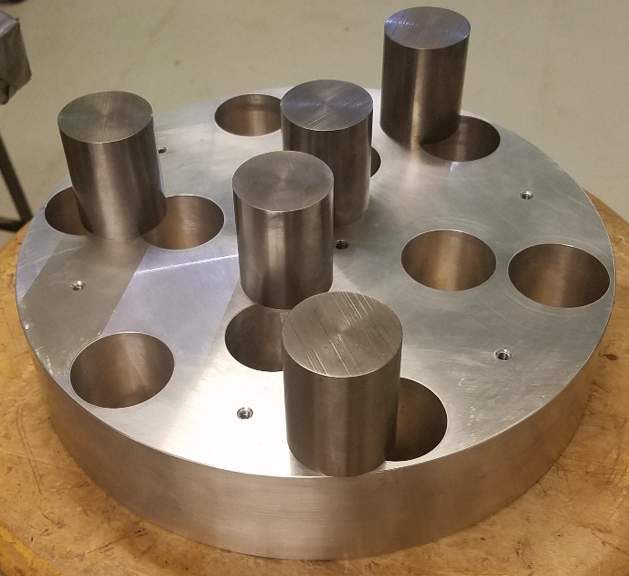
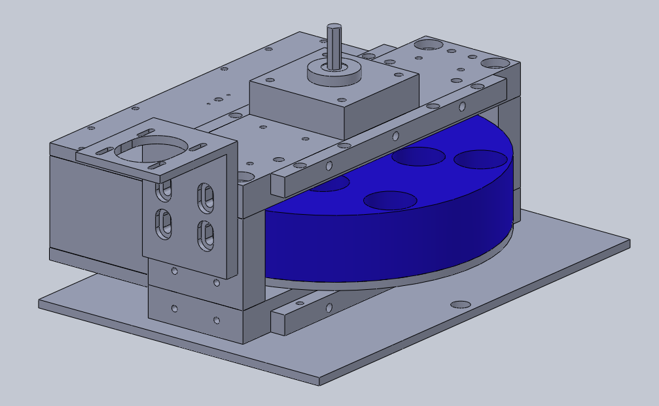
Quick Facts
Total Disk weight ~ 11.5 kg
Disk outer diameter 10” = 25.4 cm
Moment of Inertia ~ 0.093 kg.m²
Planned operational speeds < 100 Hz
Stored Energy at 30 Hz = 1.7 kJ
  Lots of carefully designed protective measures
Current power consumption is ~38 Watts at a rotor speed of ~30 Hz.
Never intended for running during LIGO “observation mode.”

Slide 3
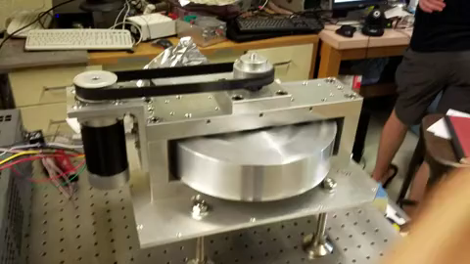
The thing everyone likes seeing…

Slide 4
Other Details
Frame = ~ 30 X 38 X 35(h) cm.
Two separated bearings support the rotor shaft, driven by a brushless dc motor and a timing belt ⇒ allows the motor frequency to be offset from the rotor.
Commercial rotary encoder (with 1440 pulses per cycle) attached on other side of shaft
Vibration/acoustic noise are relatively small (less than most roughing pumps).
Rotor was machined by Wire-Electrode Discharge Machining.
  CMM confirms that the hole positions are accurate to ~ +/- 5 μmeters.
Rods are made of Tungsten alloy (ASTM B777) with density = 16.96 g/cc. They weigh 1.0558 +/- 0.0003 kg (matched to < 0.1%)
  Press fit into disk (by heating disk)
The rods are slightly magnetic and will be demagnetized prior to use.

Slide 5
Location

Slide 6
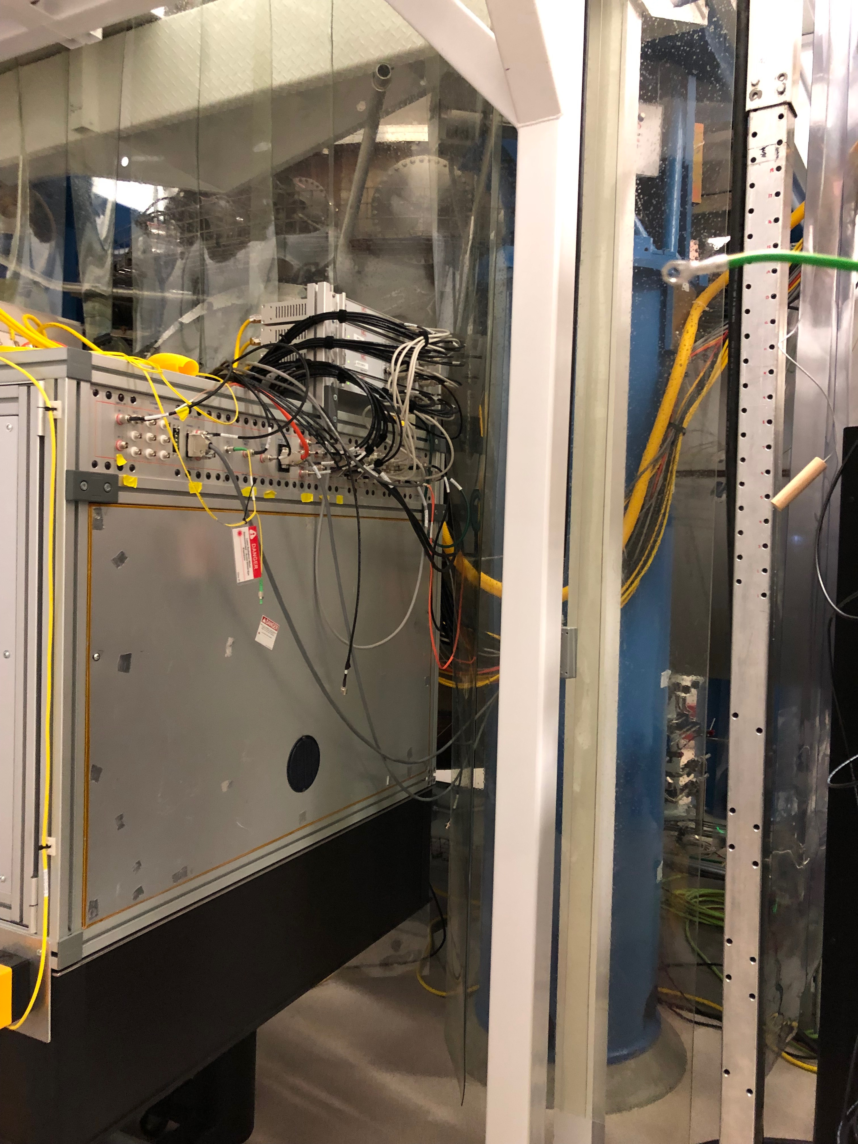
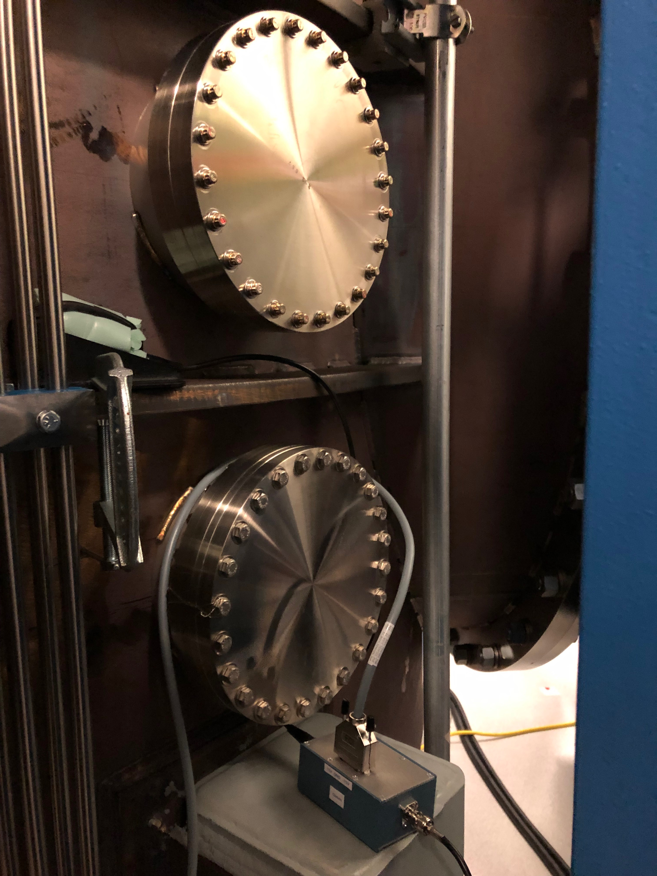
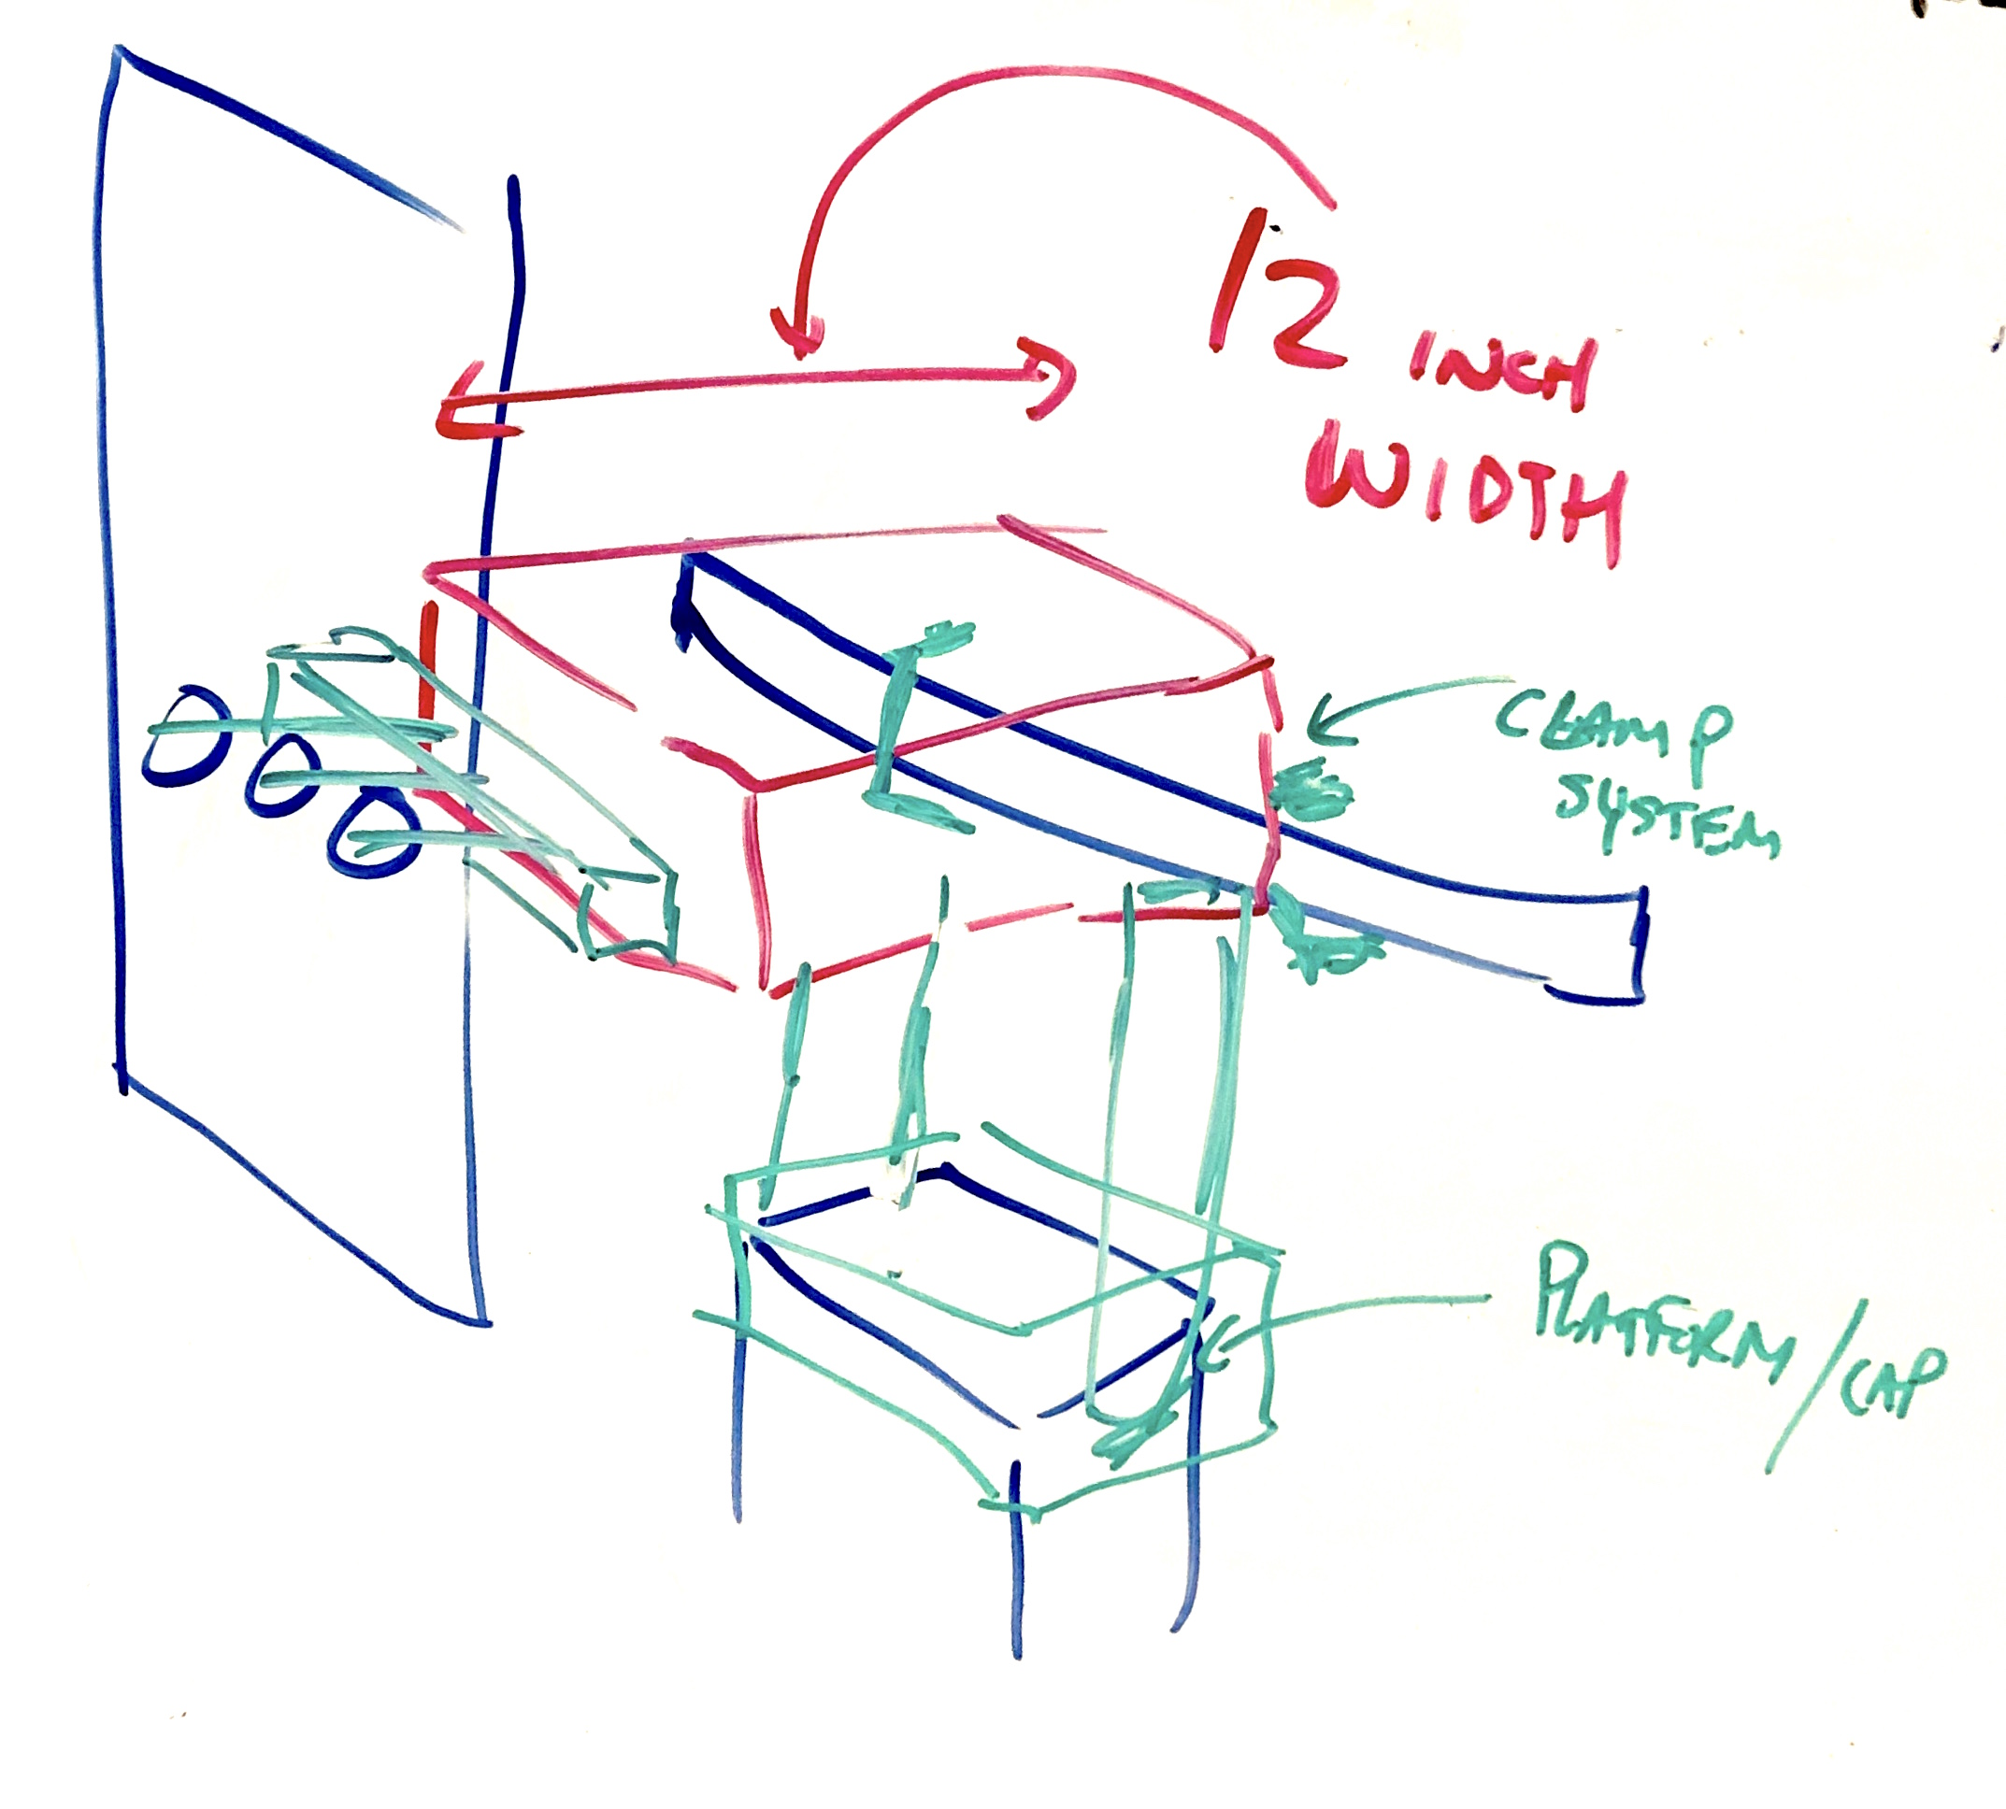
Location
HEPI
Pier
Bolts +
Steel Square
Tubing
Clamp
System
BSC
Chamber
Ribbing
HEPI Pier
Stiff Platform w/
Cap and Bolts
BSC Chamber Pier

Slide 7
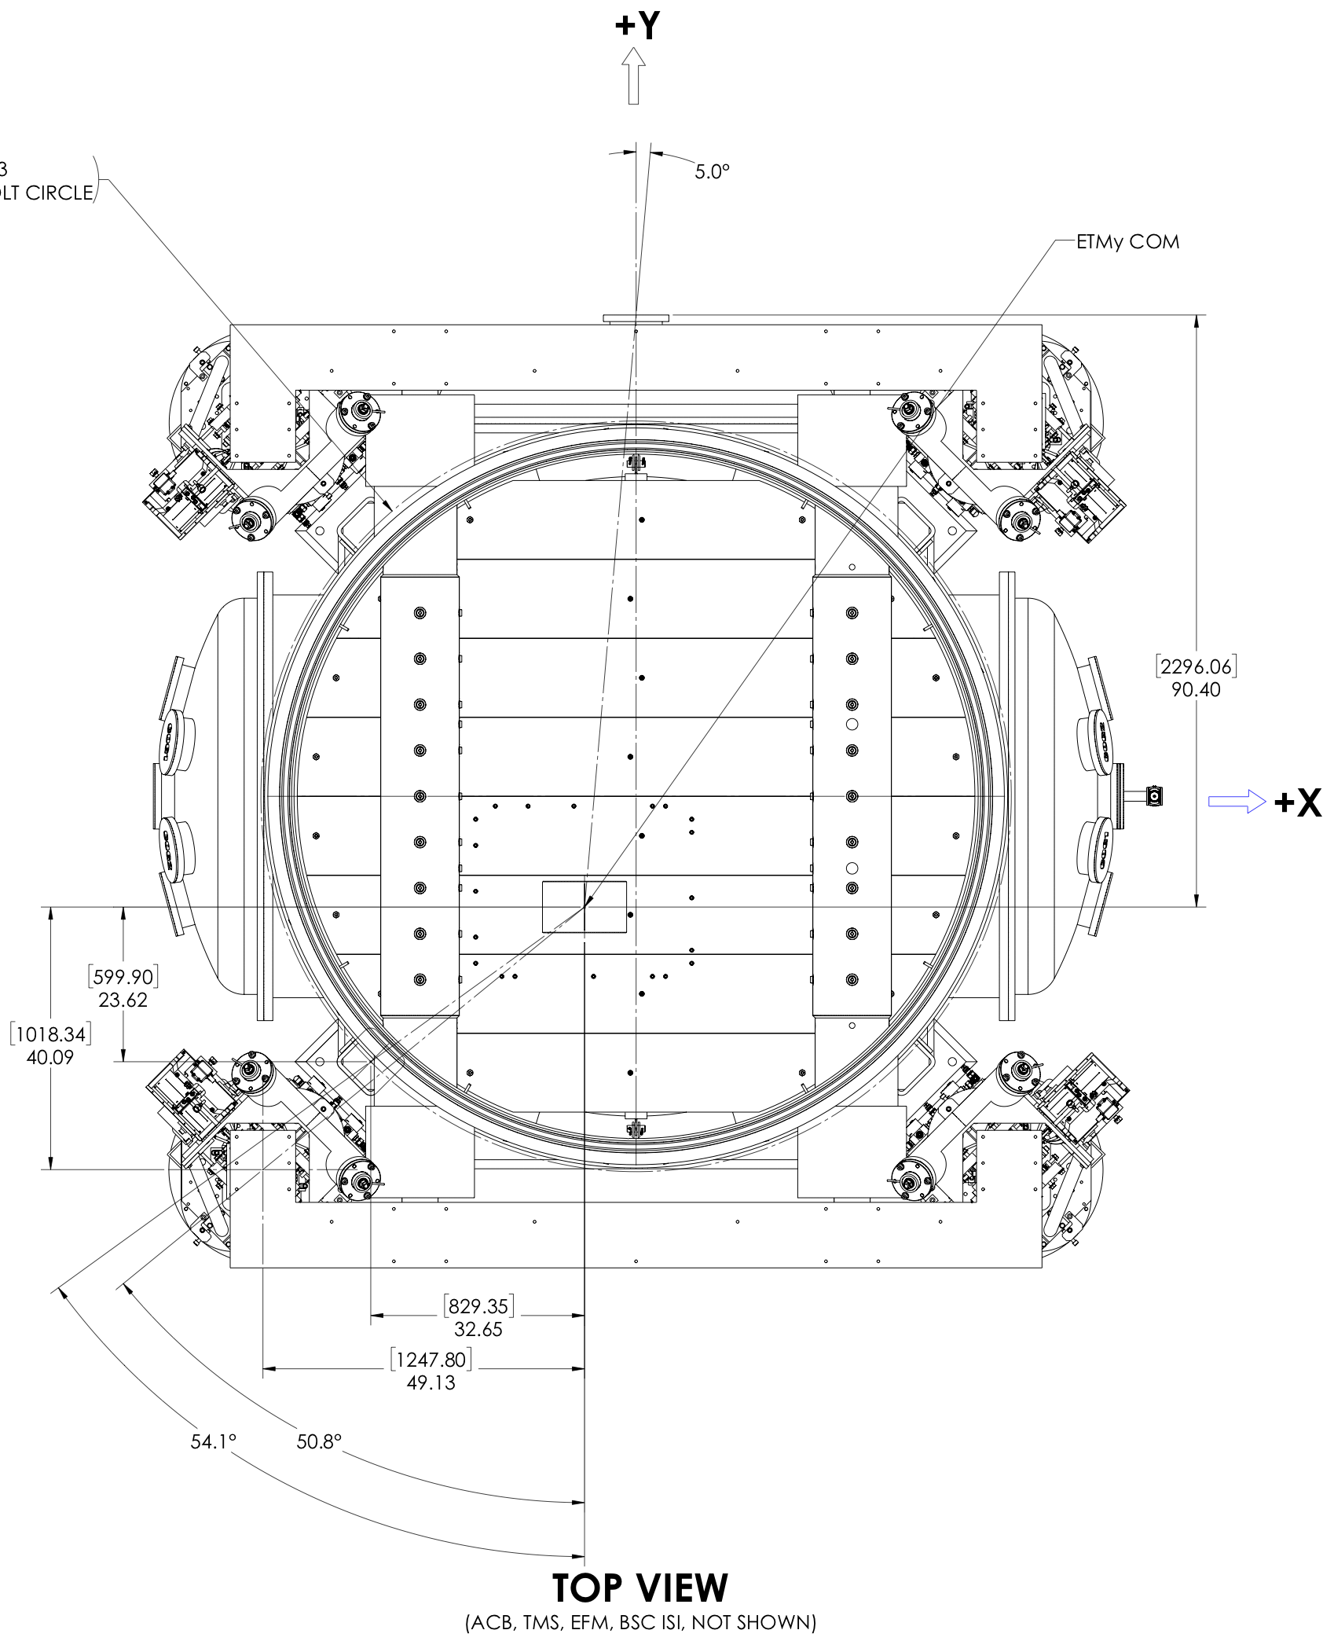
Location, Location, Location
Take rotation speed at 30 Hz
3f (hexapole) signal goes as 1/d⁵
rough estimate for d = 1.2 m
= 6 e -18 m @ 90 Hz
(along beam direction)
atand(829.35/599.9) = 54 deg
  Forces in desired beam direction (Y, in this case)
    AND the transverse (X) direction
    AND in Pitch and Yaw
d = 1.023 m

Slide 8
Readout Integration Design
(Thus Far)

Slide 9
Rough Schedule
R&D First article built and spinning at UWash
LIGO Observing Run starts ~April 1st (no kidding!)
NCAL is not the highest priority, treating as an R&D project, installed during maintenance periods, commissioned during “targets of opportunity.”
Controller computers will arrive on site soon
Working with engineering team to design mounting system
On site integration begins over the next ~2 months
Goal: “We will inject gravity into H1 during O3”

