Slide 1
Calibrating thE LIGO Interferometers:
Third Time’s a Charm
J. Kissel, for the LIGO Calibration Team and the LIGO Scientific Collabortation

Slide 2
This morning: The DARM Loop
Multi-stage
Actuator, A
Interferometer is non-linear unless extremely well controlled.
Detector readout is fed to control differential arm lengths.
Interferometer
Sensor, C
To produce an estimate of uncontrolled input, h, we must have an exquisite model of the loop.

Slide 3
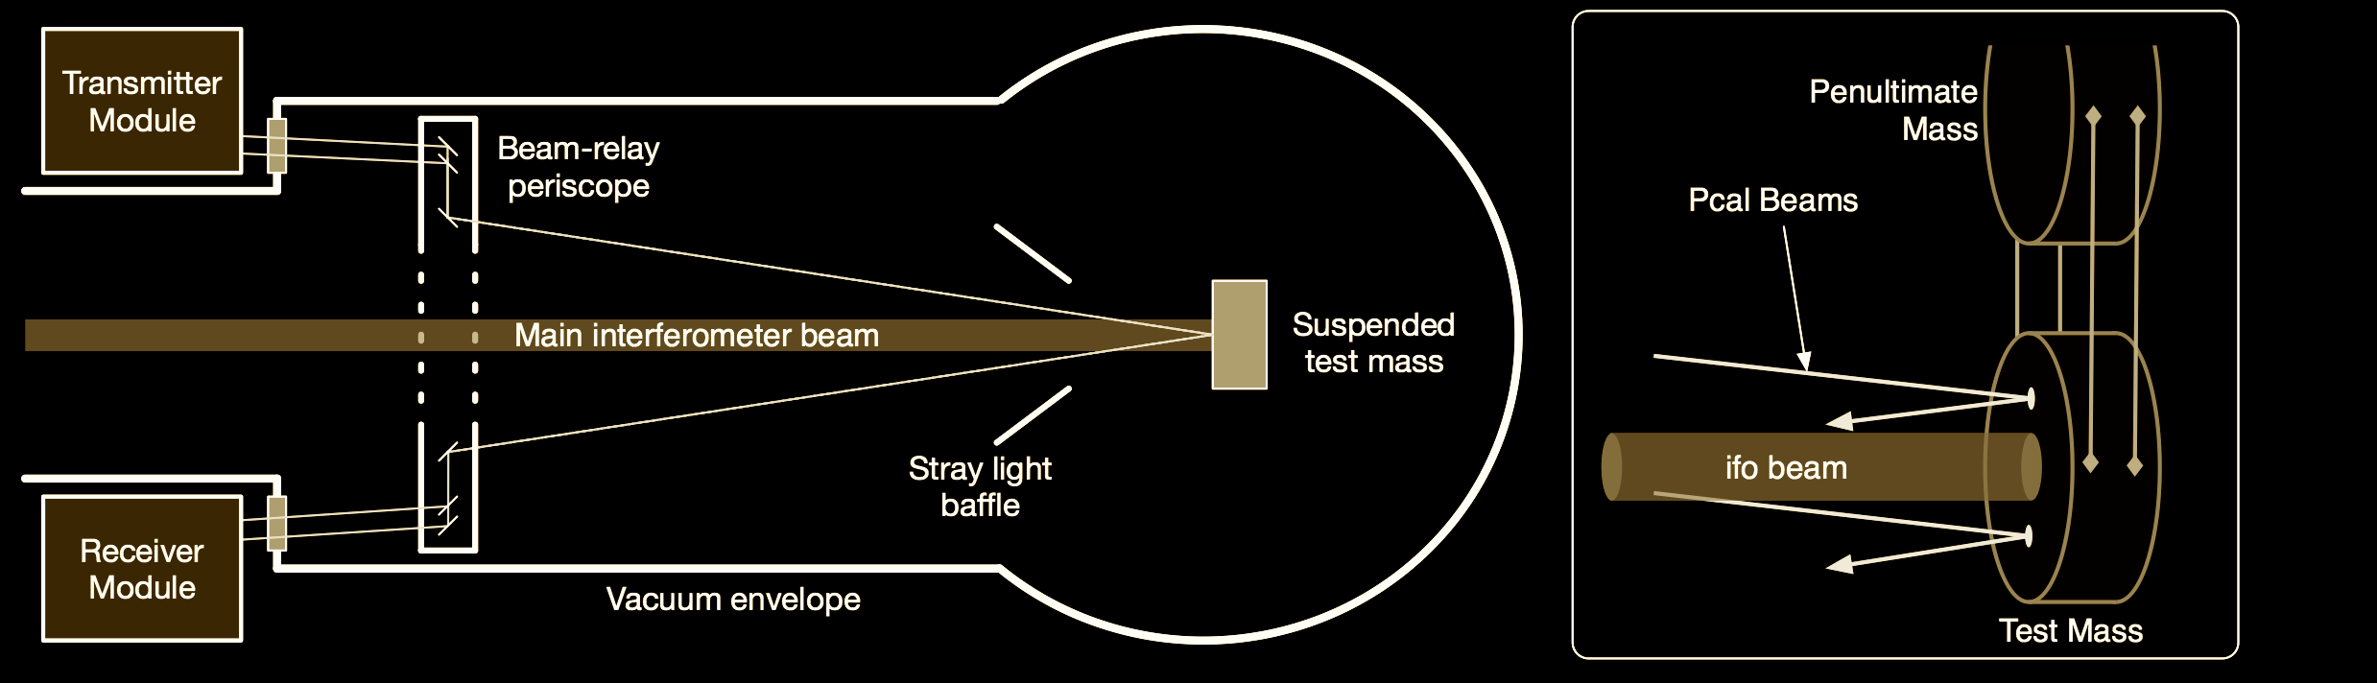
This morning: Absolute Reference
Let’s assume that …
Sudarshan told you everything about using photon radiation pressure as our absolute reference,
the PCAL team has delivered us a perfect reference (no systematic error, but still with statistical uncertainty)
we have digital signal, pd_{pc} (the digitized voltage from receiver module’s integrating sphere and PD) that’s been converted to displacement of the test mass, x_{pc} .
O2 Uncertainty = 0.76 %
O3 Uncertainty = 0.5%

Slide 4
OVERALL Uncertainty
h =
R
d_{err}
1
1 + G
R ≡
__
_________
L
C
G = A D C
1
h L =
____
d_{err}
+
A^{(model)}
d_{ctrl}
C^{(model)}
The model, and therefore the estimated detector input, has uncertainty and systematic error:
(
1
)
²
(
∂ C
)
²
(
G
²
∂ A
²
)
(
)
∂ h ² ≈ ∂ R ² ≈
_________
____
+
_________
____
1 + G
C
1 + G
A
+ Systematic Errors

Slide 5
The problem Gets HARDer…
With all loops closed and the detector running at its best sensitivity, we request a series of in-loop excitations to obtain direct measurements of the sensor and actuator
d_{exc}
d_{err}
)
x_{pc}
(
1 + G
)
(
C
C =
_________
____
____
____
_________
x
x
d_{IN2}
pc_{exc}
pd_{pc}
1
1 + G
Complex Transfer
Functions w/ Full IFO
Absolute Scale Factor
d_{err}
(
pc_{exc}
)
pd_{pc}
(
A_{i} C
)
1 + G
A_{i} =
_________
____
____
____
_________
x
x
a_{i,exc}
d_{err}
x_{pc}
1 + G
C
Our measurements of C and A are
ratios of complex transfer functions
>> the frequency-dependent, magnitude and phase are important for A and C

Slide 6
The Simple version…
Evan mentioned the “free” parameters that dominate the uncertainty in A and C.
Here’s what you normally tell people in a talk:
(
1
)
gain
x
______________
1 + i f / f_{c}
gain 1 / f ⁶
x
f_{c} =“cavity pole
frequency”
gain 1 / f ⁴
x
gain 1 / f ²
x
Why focus on these?
(they’re “easily” accessible to the “average” audience)
They can only be measured with the interferometer running.

Slide 7
…But there’s MorE
IFO measurements contain more than just simple functions.
There are WAY more details in
  C’s analog-to-digital conversation path
  A’s digital-to-analog path
that must be measured and modelled, in order to obtain a “clean” result that can be fit for free parameters
For C (two paths of):
  Detuning of optical plant
  PD trans-impedance amplifiers
  analog whitening filters,
  analog anti-aliasing filters,
  computational delays,
  digital down-sampling filters
For A (three stages of…):
digital up-sampling filters,
computational delays
analog anti-imaging filters
analog low-pass filters
trans-conductance/voltage drivers
drive signal to force actuators
non-trivial force to displacement dynamics of multi-stage pendula
… all must be included with systematic error quantifiably negligible in the model

Slide 8
Assuming we’ve got that under control…
Back to the full interferometer measurements…
d_{exc}
d_{err}
x_{pc}
C =
____
x
____
x
____
d_{IN2}
pc_{exc}
pd_{pc}
Complex Transfer
Functions w/ Full IFO
Absolute Scale Factor
d_{err}
pc_{exc}
pd_{pc}
A =
____
x
____
x
____
a_{i,exc}
d_{err}
x_{pc}

Slide 9
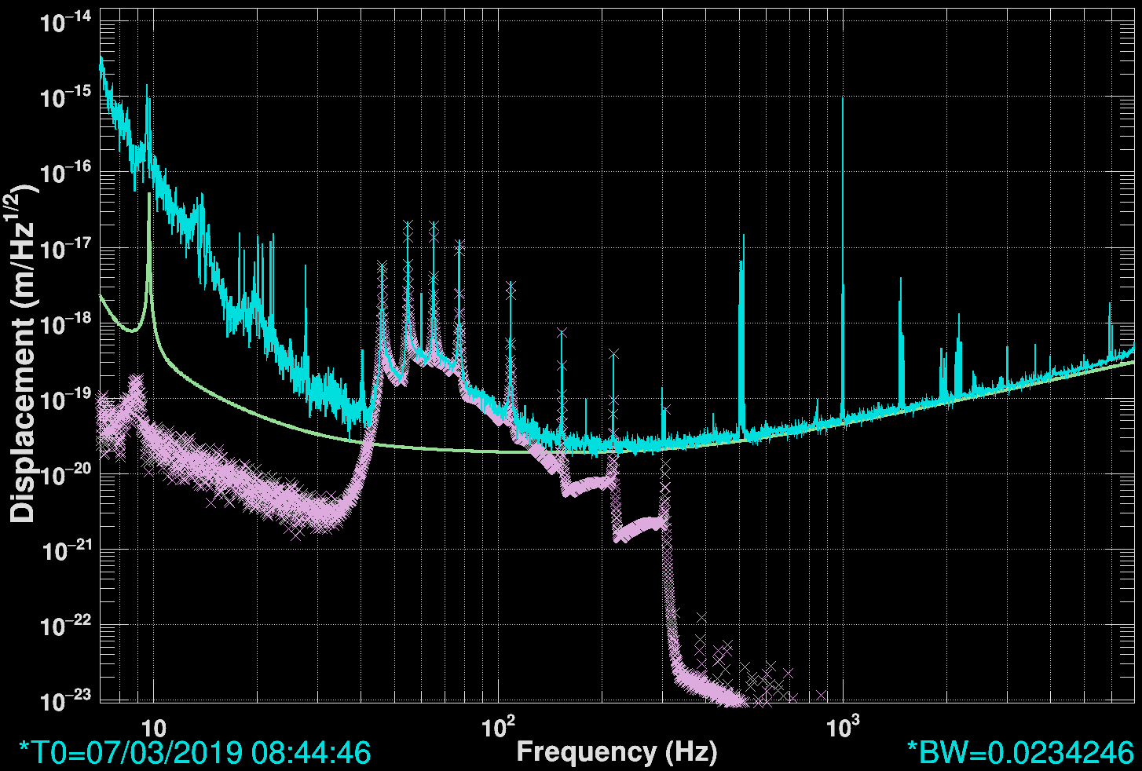
Example Measurement
d_{err}
This is what it looks like when we measure
____
pc_{exc}
“Swept Sine” Excitation
Reconstructed,
Live, ΔL
Cartoon
Target ΔL
Taken during lowest noise state, in loop
Two measurements per function
Actuator strength vs. Detector Noise limited!
Reconstructed
PCAL RX PD x_{pc}

Slide 10
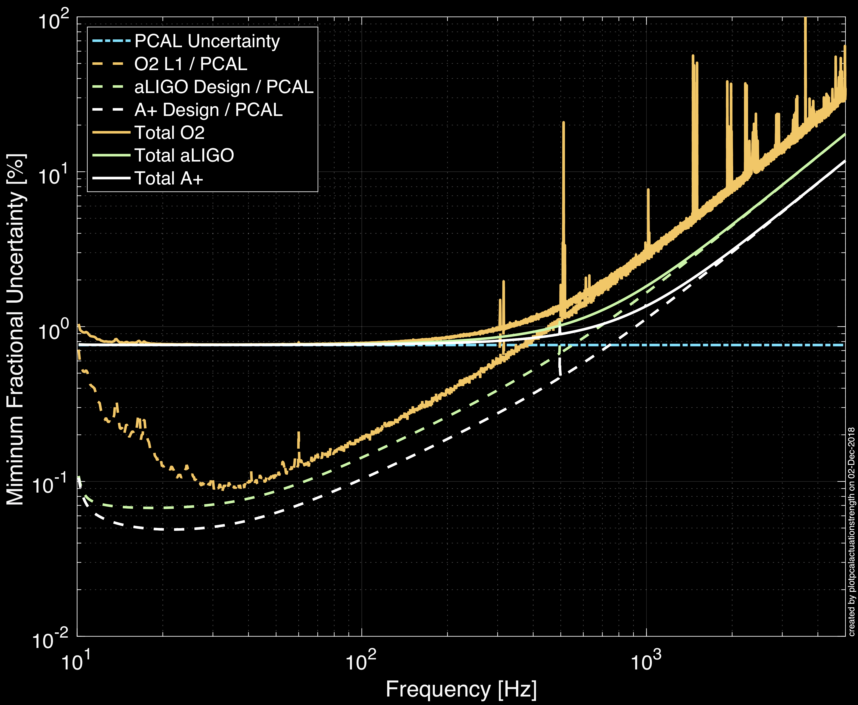
Limitations
d_{err}
____
pc_{exc}
Absolute reference limits where detector is most sensitive
Actuator strength limits where noise is worse
Black Holes and Pulsars
Neutron Stars and Supernovae

Slide 11
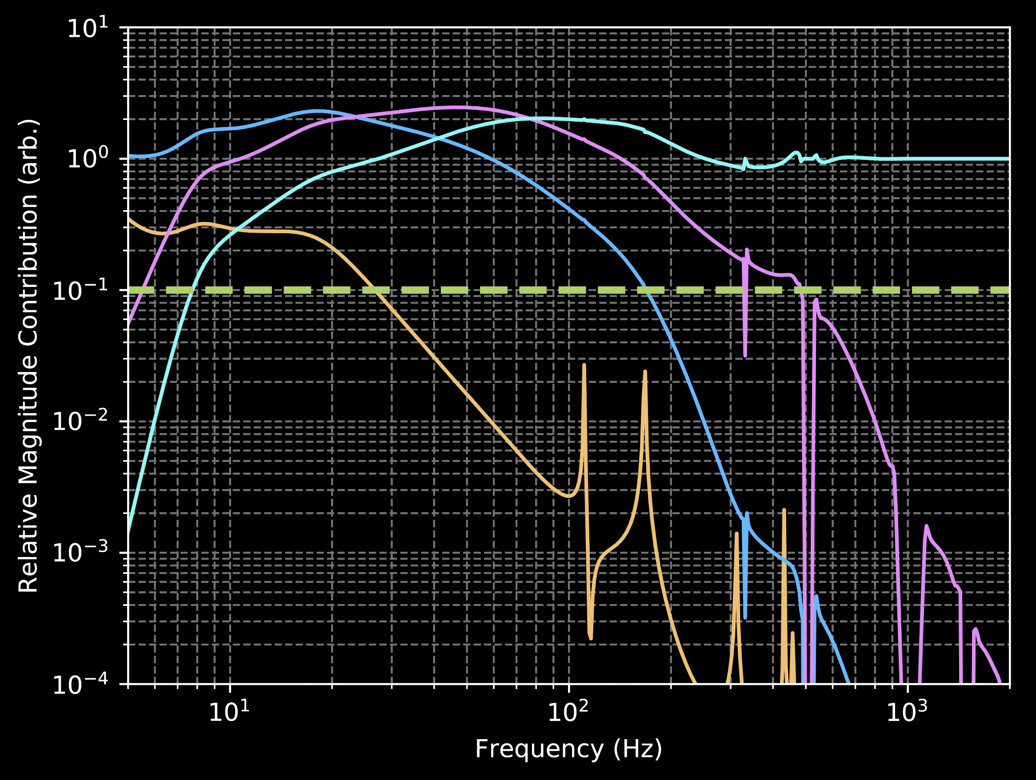
Uncertainty Component Breakdown
Actuator Model, A
Sensor Model, C
Gravitational Wave Band
10%

Slide 12
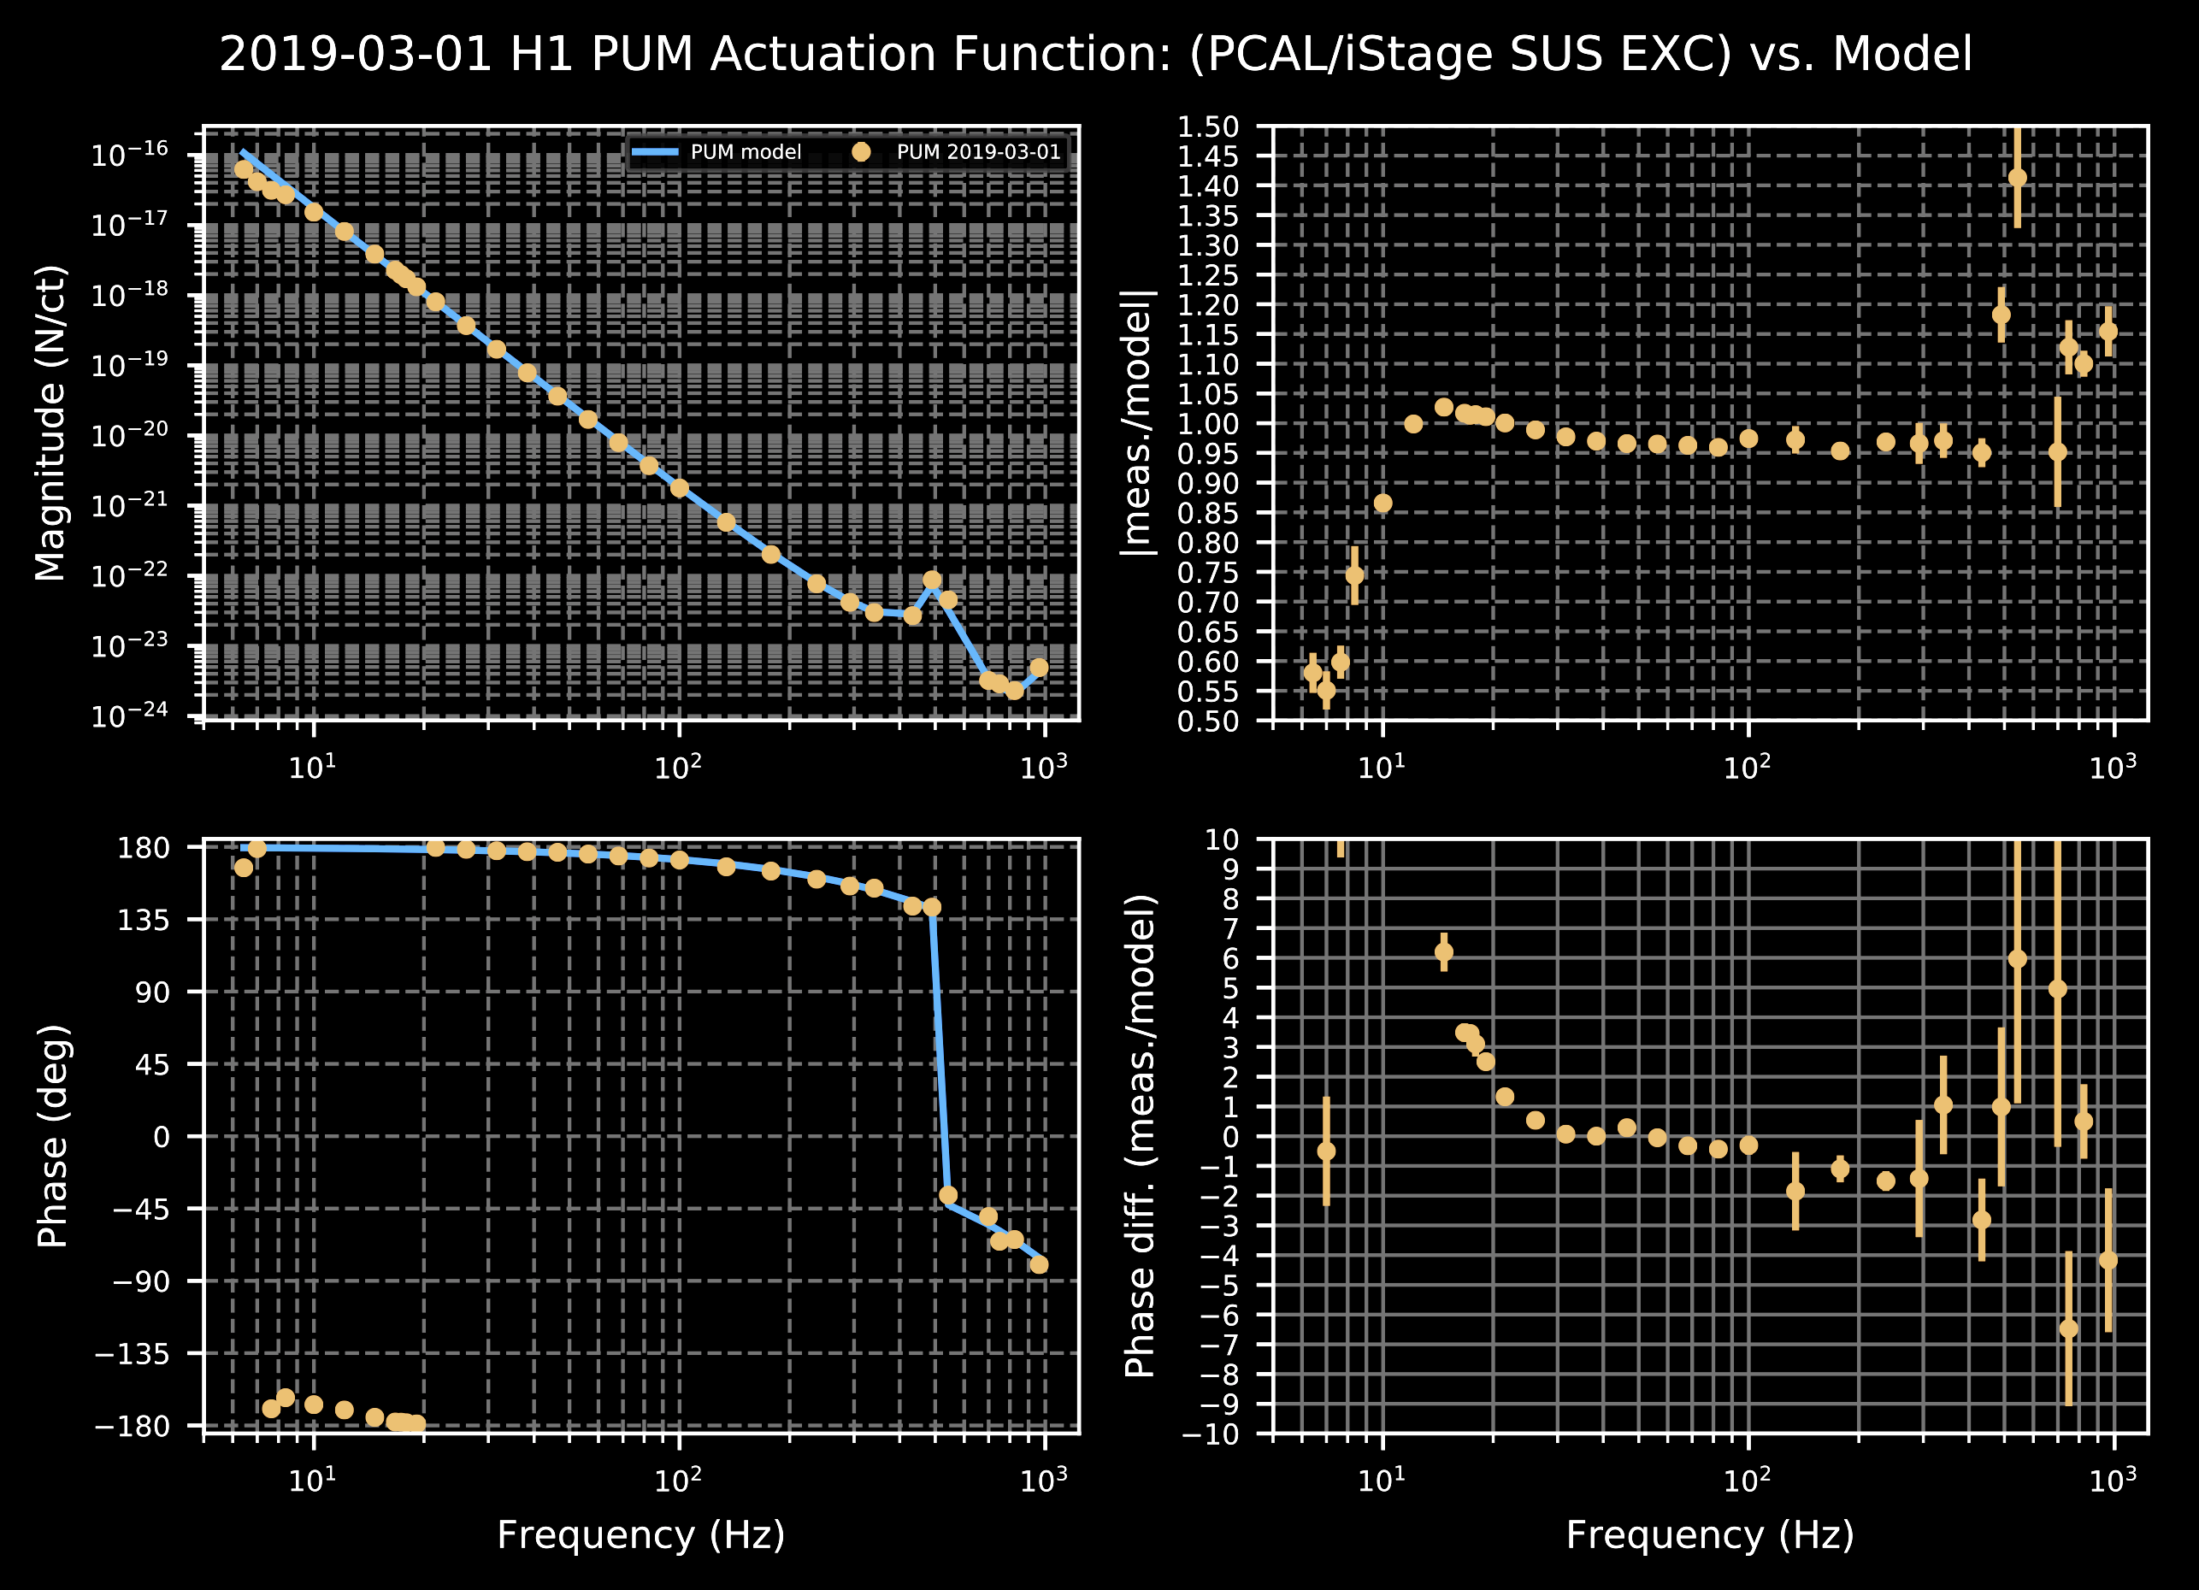
Current Status, A
PUM Matters HERE
Violins
Huh?
~1 / f ⁴
Systematic error we must fix!
PUM Matters HERE
Known delays and HF electronics response
= 10 deg phase loss at 200 Hz…

Slide 13
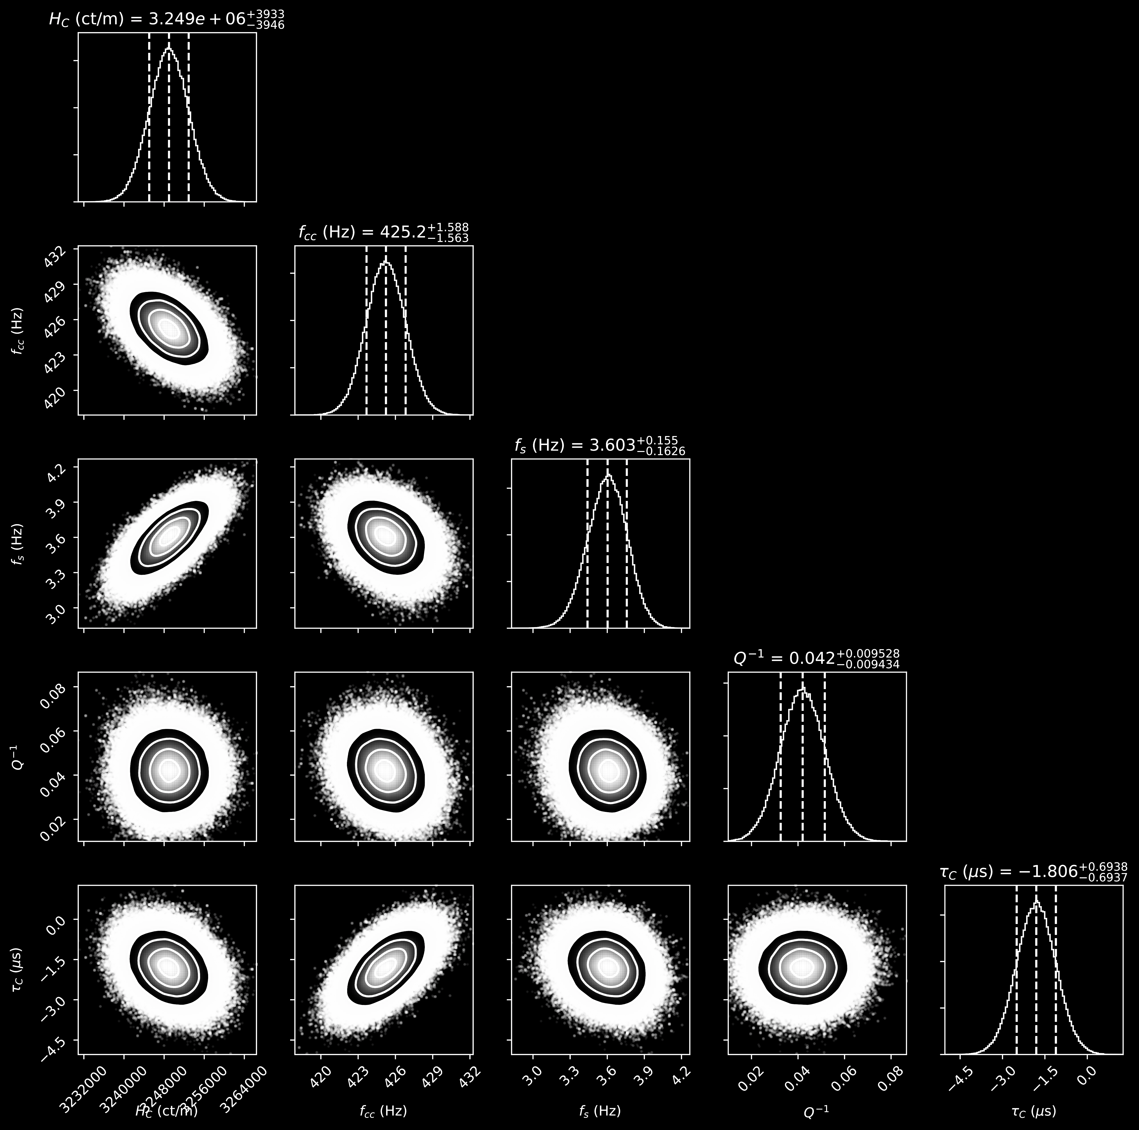
Statistical Uncertainty
there are 17 free parameters per IFO:
5 sensing function parameters
2 actuation parameters for each stage
5 parameters that we track as a function of time
1 parameter for PCAL uncertainty
Each has a posterior distribution, and a well-defined contribution to the response
1
1 + ADC
R =
__
_________
L
C
So, we numerically evaluate the uncertainty on R
example results for 5 sensing function parameters

Slide 14
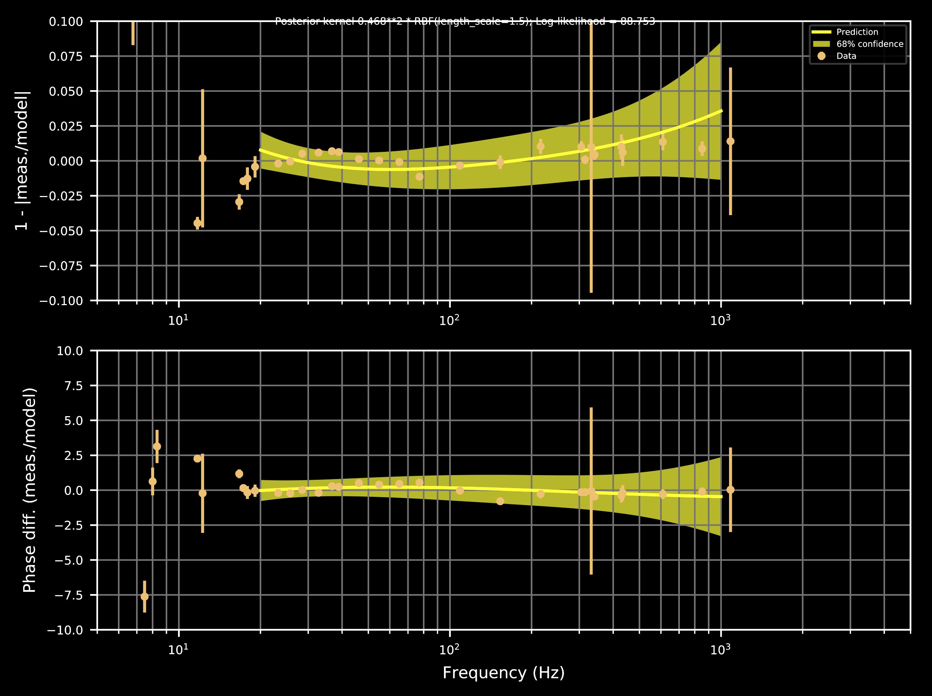
How to Handle Unknown Systematic Error?
Instead of concatenating all the residual systematic errors from every single part of each function, we divide out the model from our measurement
example GPR fit to Sensing Residual
Remaining frequency dependence is unknown systematic error, for which we can fit
Gaussian Process Regression (GPR):
It’s black magic, like any other transfer function fitting program
but importantly it gives you a posterior distribution of curves, do be sampled for numerical evaluation of total uncertainty in R
4 more distributions of free parameter functions…

Slide 15
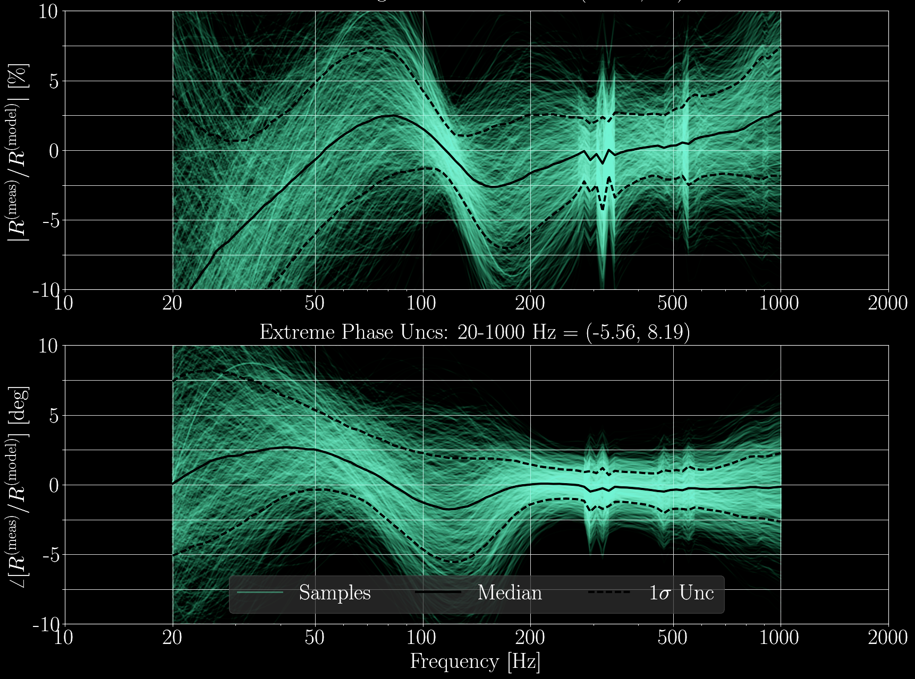
The Final Answer (Example)
Individual
Draws of
(R + ∂ R)_{i} / R
Median
68% C.I.
Uncertainty is informed by individual, numerically evaluated draws from the collection of posterior distributions, divided by “nominal” model (model of maximum a posteriori values, and assuming no systematic error )
The 68% confidence interval bounds at each frequency are the response function’s frequency dependent uncertainty and systematic error.
(
1
²
∂ C
²
²
²
∂ h ² ≈ ∂ R ² ≈
)
(
)
+
(
G
)
(
∂ A
)
_________
____
_________
____
1 + G
C
1 + G
A
+ Systematic Errors

Slide 16
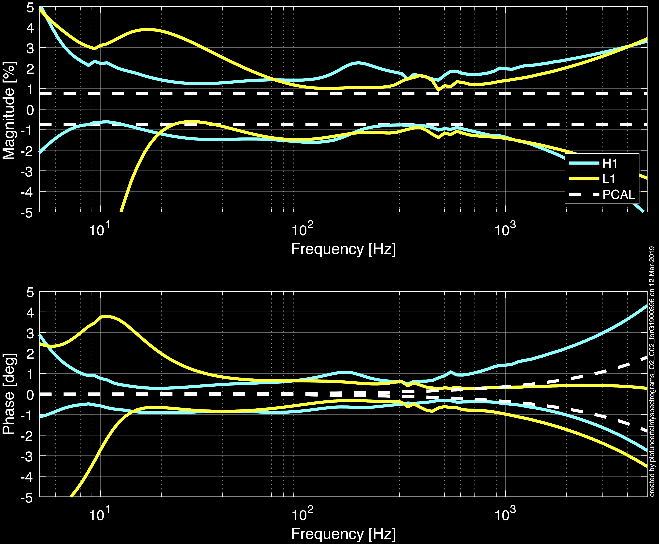
We were able to get to “fundamental” limit last time…
68% C.I. for L1
68% C.I. for H1
68% C.I. for PCAL

Slide 17
Where To?
We’re using photon radiation pressure to great success.
Improving PCAL uncertainty will directly improve interferometer response uncertainty, and thus astrophysical parameter uncertainty
We’re (on our 3rd round of) reducing as much of our other systematic error such that we can reach the PCAL’s “fundamental” limit (again)
Coordinate standards in the global GW Network
Let us know if there’s a systematic error in the estimate of the power…

Slide 18
Thank You

Slide 19
Bonus Material

Slide 20
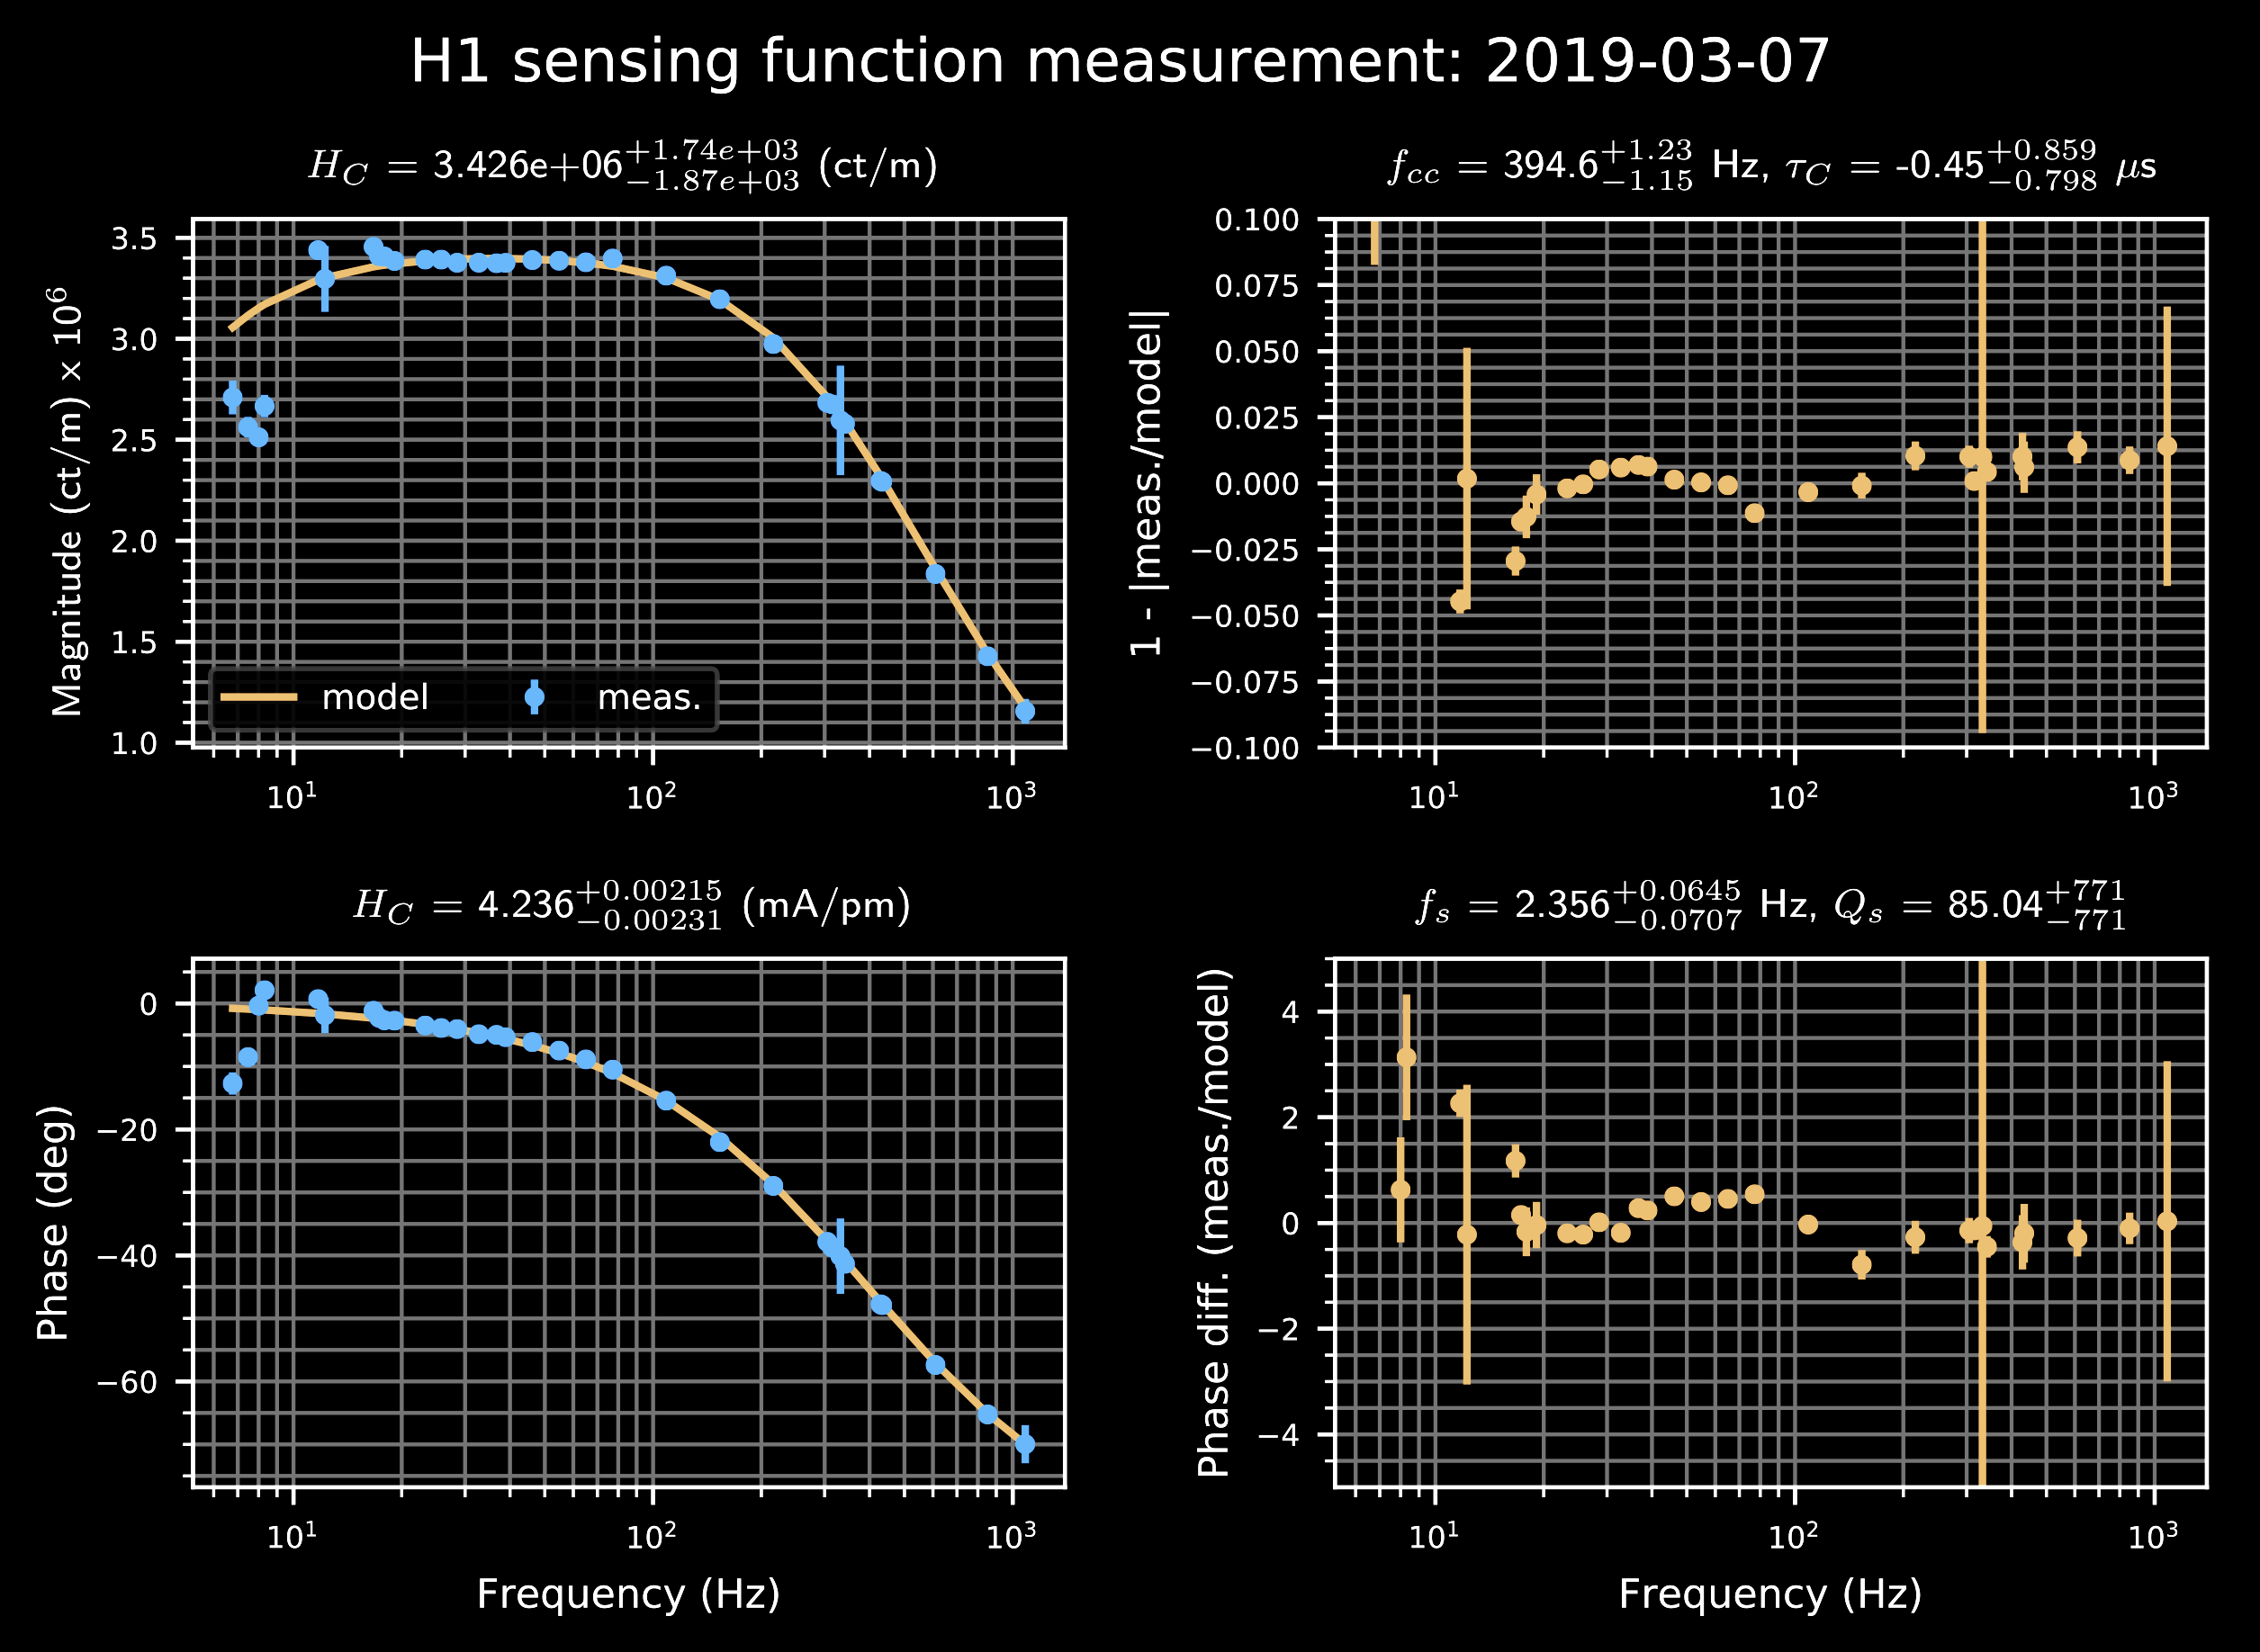
Current Status, C
C Matters HERE
Optical Plant Detuning
Cavity Pole
Parametric Fit Results

Slide 21
Why Is it Different Between Runs?
The interferometers are constantly evolving between (and during!) runs to improve the noise, and due to reality of experiment!
Change for Noise between O2 and O3 | Consequence For Calibration
New Test Masses | new force to displacement dynamical model
Higher power for O3 | more complex interferometer response
Loss on optics accrued from vent | more complex interferometer response
Better sensor electronics for sensitivity features | New measurement of electronics
Better actuator electronics to reduce impact of DAC noise | New measurement of electronics
One of the O2 actuators are broken | New actuator scheme model
The calibrator’s job is never finished!

Slide 22
Why Bother Being FullY Bayesian?
In detection era, it was safe to just quote a maximum in magnitude and phase “XX % / YY deg,” because detection is relatively insensitive to calibration uncertainty
In the observational era, astrophysical parameters depend ~proportionally to calibration uncertainty.
Astrophysical parameter estimation is fully Bayesian, with its own set of 14 parameters
New, on-going project: study the subtle interactions between astrophysical parameters and physical interferometer parameters.
  Can better marginalize (integrate) over Gaussian distribution of real uncertainty, instead of naïve box-car distribution
  Can retrace steps to ask “I want to improve estimation of astro-param M, so please improve estimation of interferometer-param N”

Slide 23
LIGO Calibration References
Viets, A. D., et al. "Reconstructing the calibrated strain signal in the Advanced LIGO detectors." Classical and Quantum Gravity 35.9 (2018): 095015. P1700236
Cahillane, Craig, et al. "Calibration uncertainty for Advanced LIGO’s first and second observing runs." Physical Review D 96.10 (2017): 102001. P1600139
Abbott, B. P., and LIGO Scientific Collaboration. "Calibration of the Advanced LIGO detectors for the discovery of the binary black-hole merger GW150914." Phys. Rev. D 95, 062003 (2017). P1500248
Karki, S., et al. "The Advanced LIGO photon calibrators." Review of Scientific Instruments 87.11 (2016): 114503. P1500249

