Slide 1
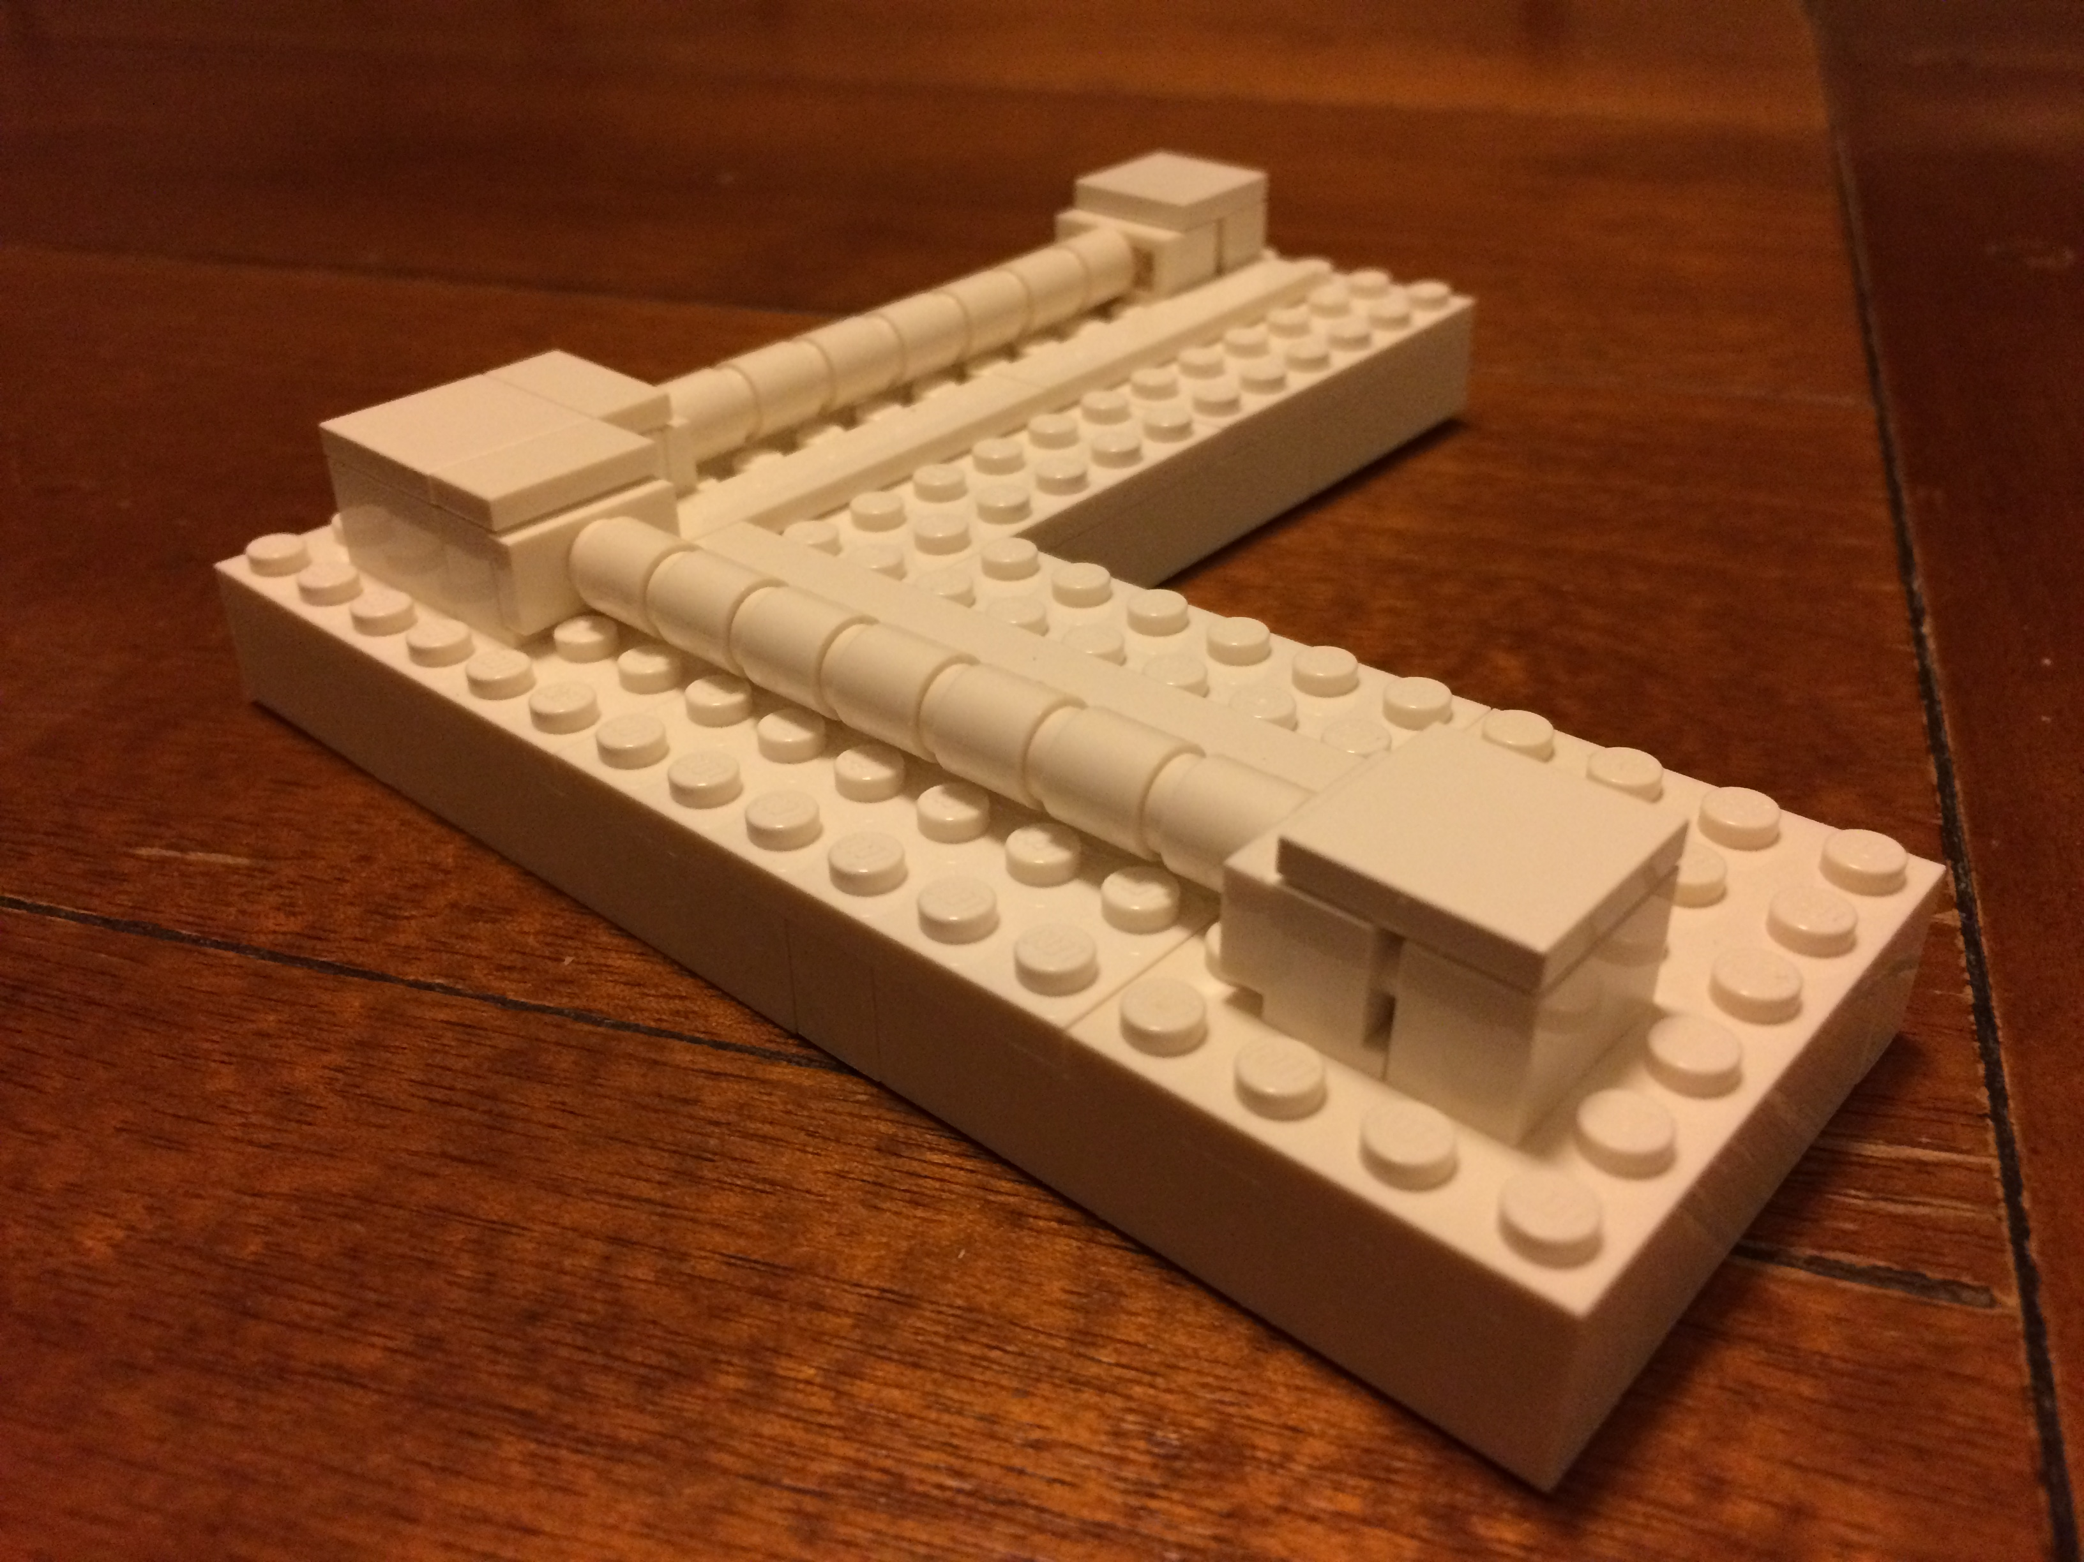

Methods for calibrating kilometer-scale interferometers
Evan Goetz
University of Michigan
Gravitational wave Metrology Workshop
NIST, Boulder, CO
Notes:
10-15 LIGO people
Few observers from NIST
33 total

Slide 2
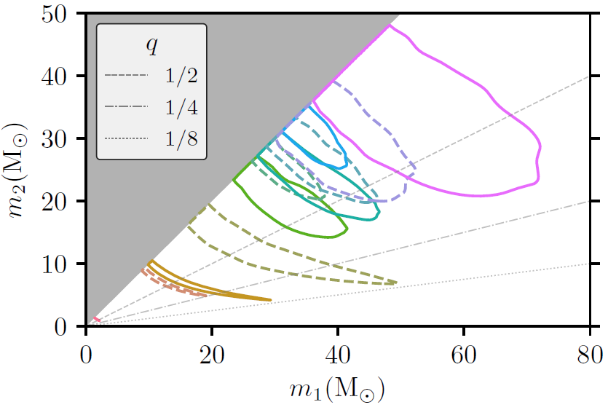
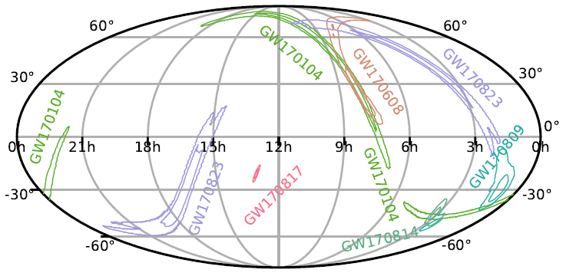
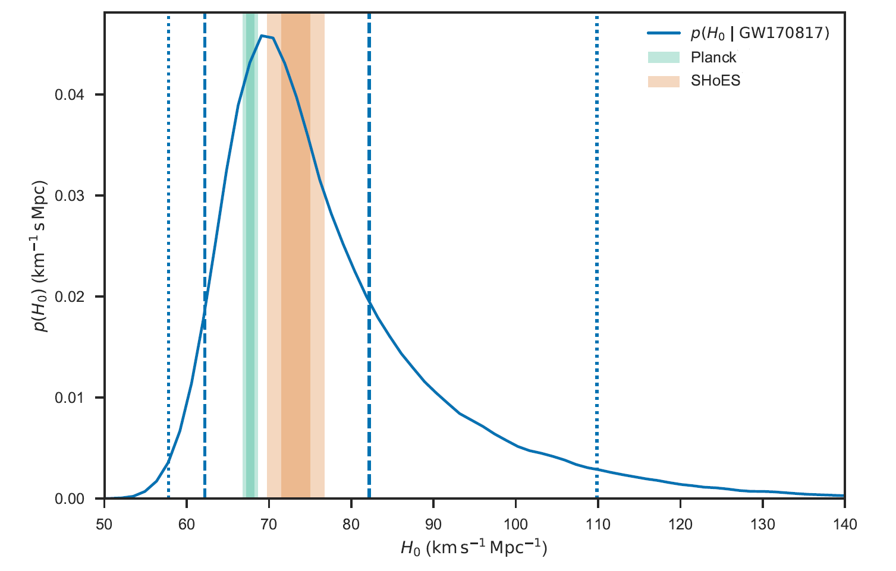
O2 events masses
GW150914 strain
O2 events sky locations
GW170817 Hubble const.
Abbott, B P, et al. PRL 116 061102
LVC, et al. Nature 551 85-88
arXiv:1811.12907 [astro-ph.HE]
Notes:
Calibration important for sky localization, parameter estimation, rate estimation, precision cosmology
See David and Dan’s talks earlier, Reed and Maya’s talks tomorrow
Goal: provide h(t) data stream with sufficiently small uncertainty to maximize scientific output from GW detectors

Slide 3
Outline
What is GW interferometer calibration
State-of-the-art calibration methods
  Modeling and measurement
  Hardware / techniques
  Uncertainty estimation
  Computing
GW interferometer calibration challenges

Slide 4
Gravitational wave interferometers
Abbott, B P, et al. PRD 95 062003
Notes:
Schematic is LIGO-centric, but generally applicable to all IFOs:
Gravitational wave interferometers utilize optical cavities, suspended optics, weak actuators, operate in closed servo-loop configurations
Differential-arm length control loop is sensitive to GWs; actually, it suppresses GWs (the UGF is in-band)
Goal of calibration is to estimate the sensed strain and remove the effect of the servo control loop
F-P IFO is non-linear except in a small range

Slide 5
Gravitational wave measurement
Estimate
Real
Abbott, B P, et al. PRD 95 062003
Notes:
Components are frequency dependent and time dependent
Gravitational wave signal reconstruction requires use of the known antenna patterns

Slide 6
Measurement of loop components
Measure free parameters in and
Require techniques with small systematic and statistical uncertainty
Techniques with different length fiducials are desirable
Notes:
Repeated measurements of free parameters (for LIGO) changing in time
Changing on order of ~ few - 10% over course of minutes - days
Requires monitoring with calibration lines

Slide 7
Measurement techniques
Several methods developed over the last 20+ years
  Laser wavelength
  Photon radiation pressure
  Frequency modulation
  “Gravitational” calibration
Notes:
Different fiducials: Swinging through fringes, laser power, Fabry-Perot freq-to-L, rotating masses/big G
Pros and cons to all the methods
Pcal in low noise which is desirable and (in-principle) simple; Ncal also (in-principle); Bootstrapping laser wavelength and frequency modulation (common mode)
Desire techniques with small systematic and statistical uncertainty
Comparison also may reveal unknown systematics; need comparably small uncertainty

Slide 8
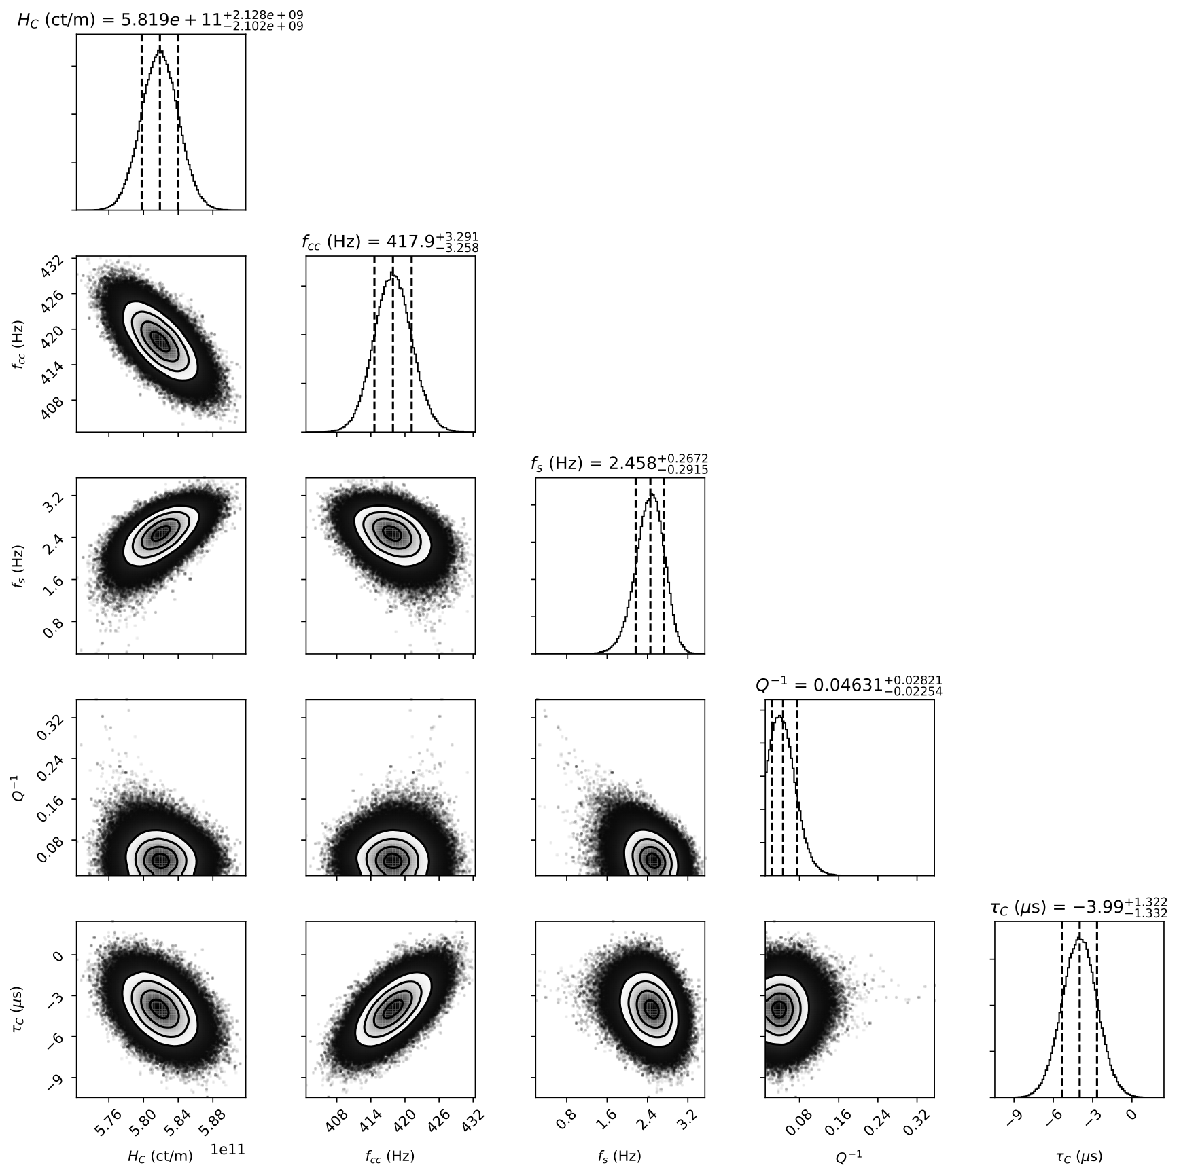
Measurement of free parameters
Interferometer measurement
Multiple measurements
Divide known components
Remove known time-dependence
MCMC fit free parameters
Gaussian Process Regression
Notes:
Repeated measurements of IFO free parameters
Need to remove time dependence

Slide 9
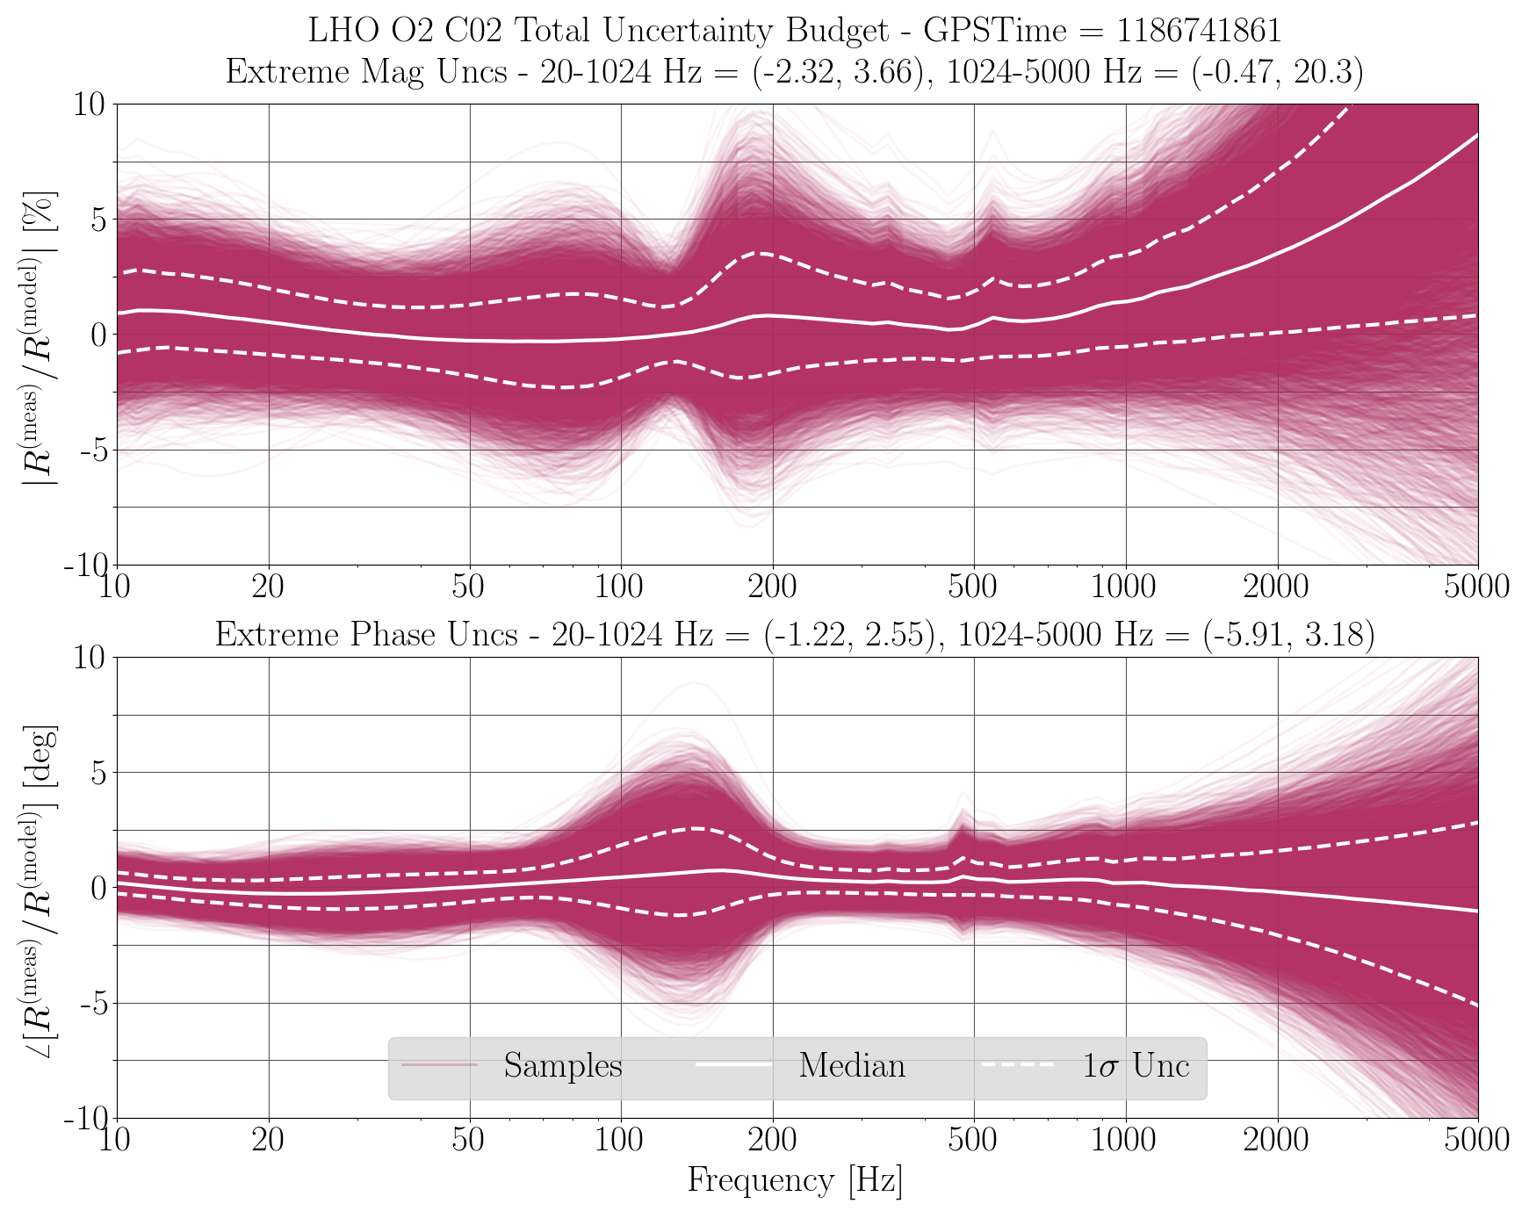
Estimating GW measurement uncertainty
Notes:
Combine calibration line data, posteriors, and model to obtain uncertainty estimate
This also must include systematic and statistical uncertainty of calibration technique

Slide 10
Putting everything together
Notes:
LIGO-centric diagram
Bottom line: can do calibration in low-latency, but will often have larger uncertainty
Typically re-run calibration with better understanding, more measurements to have smaller uncertainty (at cost of time to obtain)

Slide 11
Challenges
Time- and frequency-dependent systematic and statistical uncertainty must be estimated
Record keeping and tracking
Maintain calibration hardware / infrastructure
Track a changing interferometer (purposefully or not)
Notes:
Hard to measure at 1% uncertainty in amplitude; 2-3 degrees in phase over wide frequency band with IFO that evolves with time (purposefully or not)
A lot of bookkeeping / record keeping required
Many pieces of the IFO loop must be carefully checked and considered
Hard realities of commissioning often compete with requirements of calibration / astrophysics

Slide 12
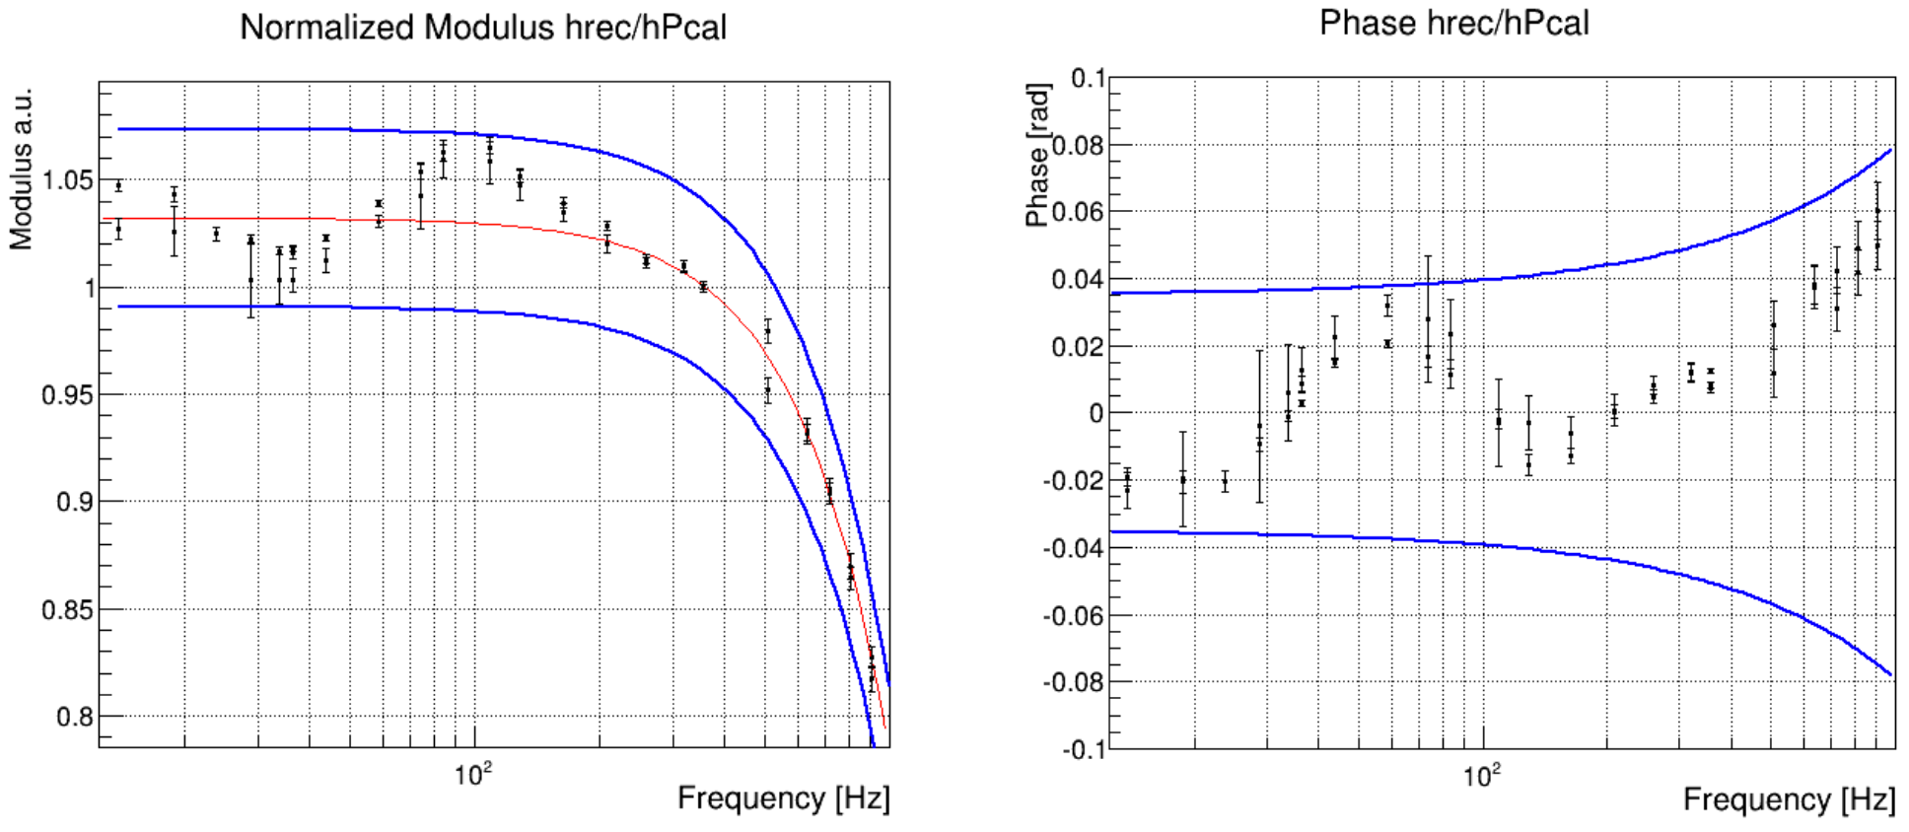
Comparing fundamentally different techniques
iLIGO comparison (S5, 2007)
aLIGO comparison (O1, 2015)
Abbott, B P, et al.
PRD 95 062003
Virgo comparison (O2, 2017)
Laser wavelength
Frequency modulation
Radiation pressure
Goetz E, et al. CQG 27 084024
Acernese F, et al.
arXiv:1807.03275 [gr-qc]

Slide 13
Conclusion and outlook
More GW signals – the future is bright!
Detector calibration will play increasingly important role
Continuing characterization, maintenance, development
Era of precision astrophysical/cosmological measurement with GWs is now
Notes:
Era of precision astrophysical measurement and cosmology with GWs is basically upon us. Need for precision calibration is now

Slide 14
Thank you
Questions?

Slide 15
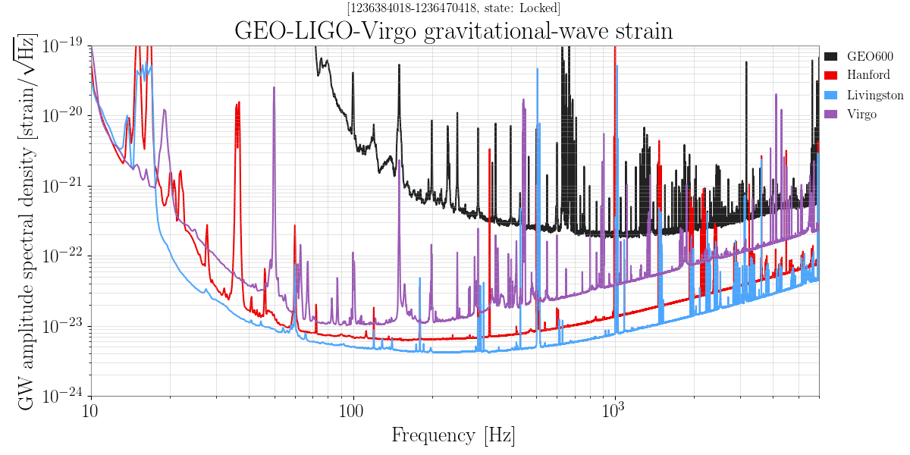
Calibrated interferometer sensitivity

Slide 16
Sensing and actuation measurement examples

Slide 17
Measurement technique development
Free-swinging Michelson (laser wavelength)
  GEO600, iLIGO, Virgo, (aLIGO cross-check)
Photon radiation pressure (laser power)
  aLIGO, KAGRA, (GEO600, iLIGO, Virgo cross-checks)
Frequency modulation (Fabry-Perot frequency-to-length transfer function)
  (GEO600, iLIGO, aLIGO cross checks)
Gravitational calibration (rotating masses, G)
  (Under development: Virgo, aLIGO, KAGRA)

Slide 18
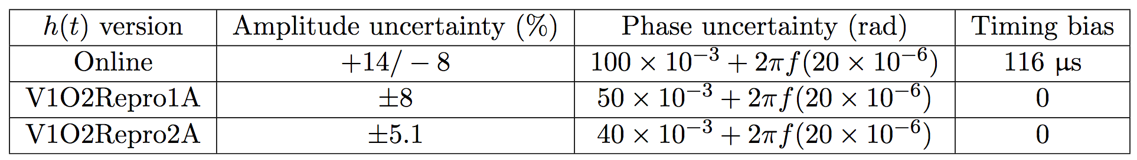
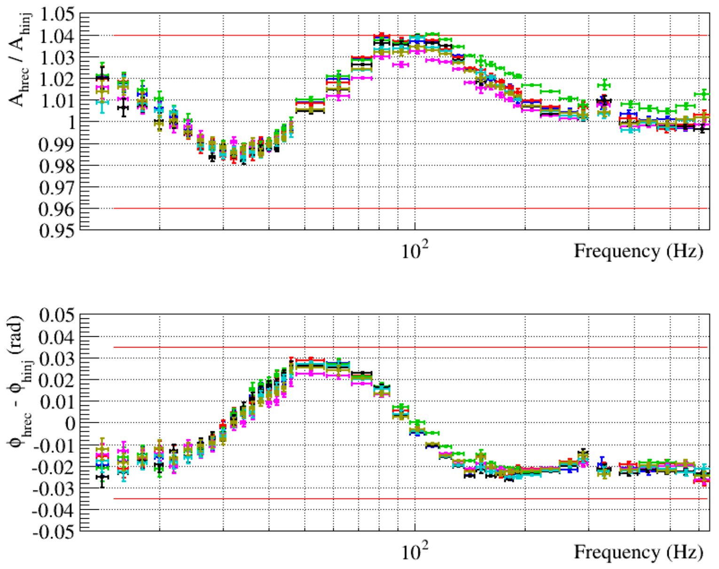
Virgo calibration
Acernese F, et al.
arXiv:1807.03275 [gr-qc]

Slide 19
Many publications!
Goetz, et al. CQG 26 24
Goetz, et al. CQG 27 8
Goetz, et al. CQG 27 21
Karki, et al. RSI 87 114503
Abadie et al NIM A 624 1
Tuyenbayev, et al CQG 34 1
Abbott, et al PRD 95 062003
Viets, et al. CQG 35 9
Leong, et al. CQG 29 6
Accadia, et al. JoP Conf. 228 1
Accadia, et al. CQG 28 2
Inoue, et al. PRD 98 022005
Adhikari, et al. CQG 20 17
Hewitson, et al. CQG 20 17
Siemens, et al. CQG 21 20
Landry, et al. CQG 22 18
Hewitson, et al. RSI 74 4184
Hewitson, et al. RSI 75 4702
Hewitson, et al. CQG 21 20
Mossavi, et al. PL A 353 1
Hewitson, et al. CQG 22 20
Clubley, et al. PL A 283 1-2
Acernese, et al. CQG 35 20
Yamamoto, et al. JPS Conf. 1 013119
And more!

