Slide 1
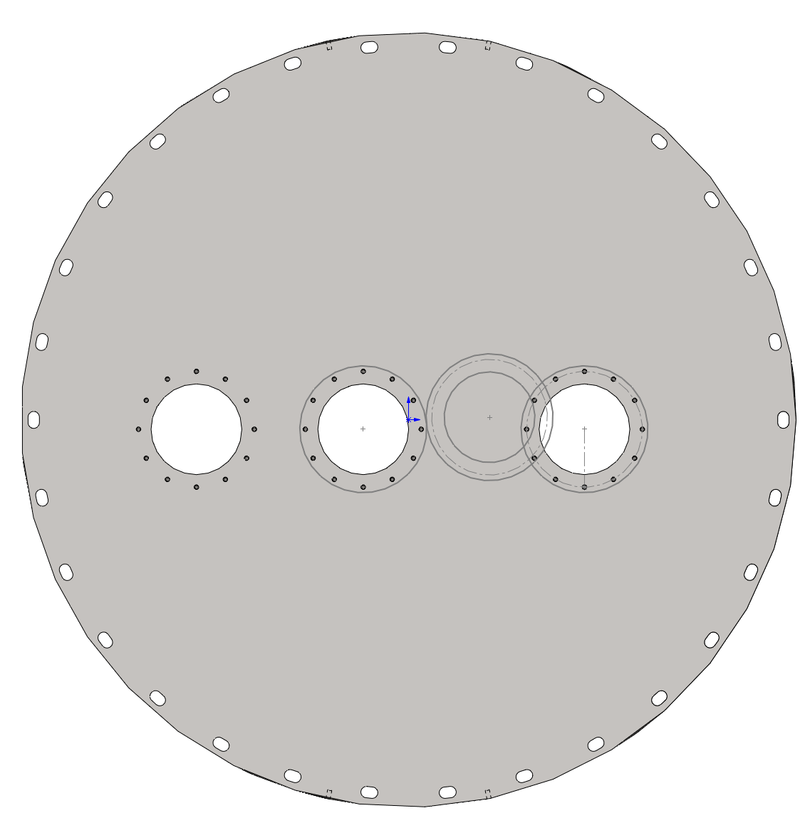
A+ OUTPUT SEPTUM PLATE LAYOUT
SPARE VP
EXISTING VP ON C1101241
BHD BEAM VP
MAIN IFO BEAM VP
VP1
VP2
VP3
VIEW LOOKING ALONG +Y GLOBAL DIRECTION (FROM HAM6 TOWARD BS)
THIS SIDE IF THE SEPTUM PLATE DOES NOT HAVE O-RING GROOVE

