Slide 1
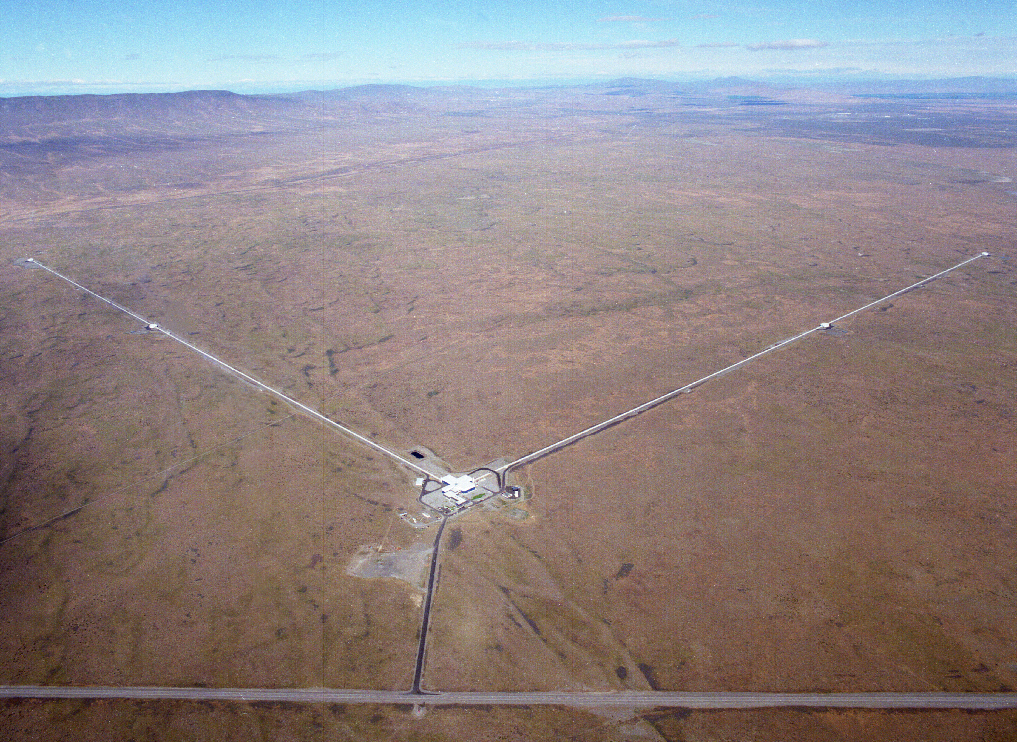


The Bright Future of
Gravitational-Wave Astronomy
Fred Raab,
for the LIGO Laboratory,
the LIGO Scientific Collaboration (LSC)
& the Virgo Collaboration
15-Mar-19

Slide 2
Main messages
A new era of astrophysics has dawned with great fanfare, but more importantly, it is poised to rapidly accelerate.
The rate of discovery over the next decades – your professional lifetimes – and the science that can be extracted from discoveries will be driven by an international community of experimental physicists and engineers developing better understanding of detector physics and new detector technologies.
India will be an important stage for these developments.

Slide 3
Astronomy 3.0
Astronomy 1.0 – millennia of naked-eye astronomy
Astronomy 2.0 – four centuries developing new telescopes to view “light” across the electromagnetic spectrum
Astronomy 3.0 – multi-messenger astronomy, viewing the universe across the electromagnetic spectrum, hearing the universe across the spectrum of gravity, and using astro-particle detectors to study the universe

Slide 4
Basics of General Relativity and Gravitational Waves
Wherein it is realized that space and time are things whose properties are manifested by phenomena that we collectively refer to as “gravity”.

Slide 5
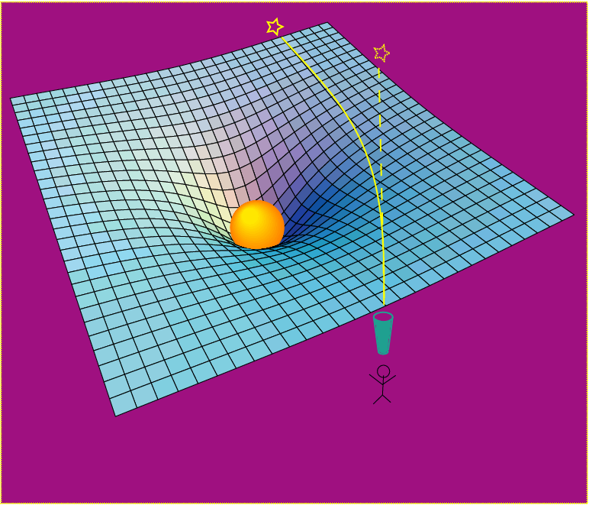
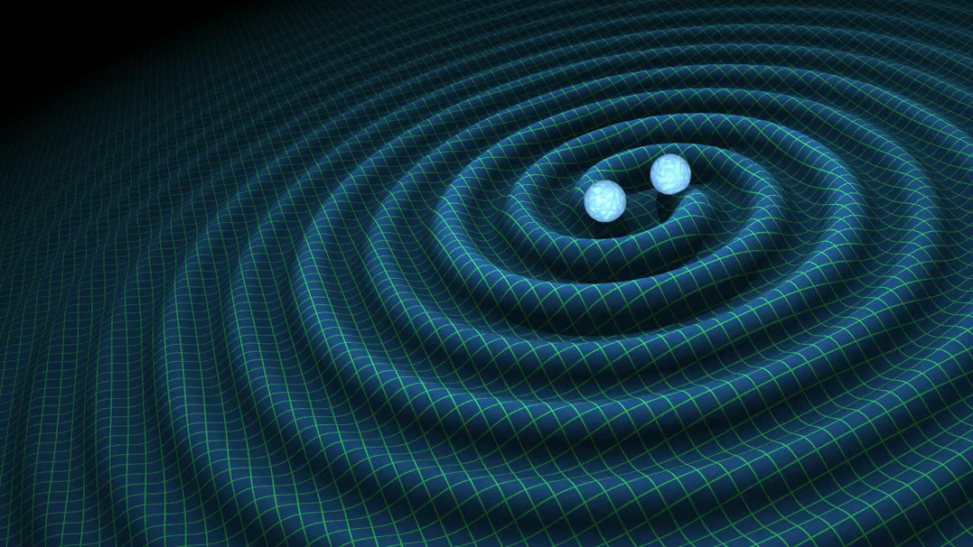
Einstein’s General Relativity re-wrote the rules of space and time
dynamic deformation of spacetime
Credit: R. Hurt - Caltech / JPL:
A massive object shifts apparent position of a star
Empty space and time are things, with real physical properties. Space has a shape, a stiffness and a maximum speed for information transfer.

Slide 6
The problem with checking relativity in Einstein’s time
A figure of merit for manifesting relativistic effects is v/c.
In Einstein’s time, there was not a lot of v/c available to observe and rulers and clocks were poor.
  v/c for a locomotive is approximately 10⁻⁷
  Ruling engines could get down to micron resolution (10⁻⁶ m)
  Clocks could keep time to a second per day
Today
  v/c reached 0.5 for GW150914
  LIGO resolution is approximately 10⁻²⁰ m
  Clocks keep time to a second per 300 million years

Slide 7
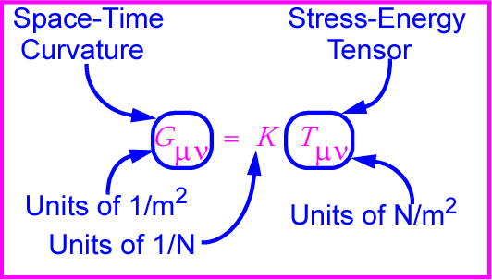
Gravitational waves: hard to find because space-time is stiff!
K ~ 10⁻⁴⁴ N⁻¹
⇒ Wave can carry huge energy with miniscule amplitude!

Slide 8
Sources of Gravitational Waves
Accelerating Quadrupole Mass Moments

Slide 9

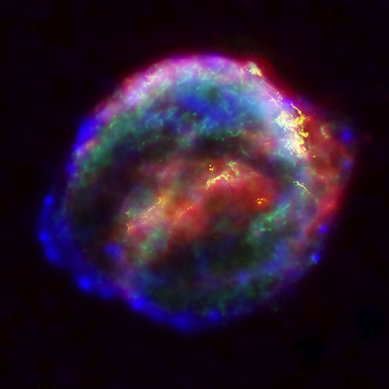

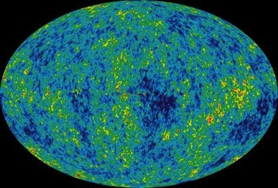
Astrophysical Sources of Gravitational Waves
Coalescing Compact Binary Systems: Neutron Star-NS, Black Hole-NS, BH-BH
- Strong emitters, well-modeled,
- (effectively) transient
Asymmetric Core Collapse Supernovae
- Weak emitters, not well-modeled (‘bursts’), transient
Credit: Chandra X-ray Observatory
Credit: AEI, CCT, LSU
Cosmic Gravitational-wave Background
- Residue of the Big Bang
- Long duration, stochastic background
Spinning neutron stars
- (nearly) monotonic waveform
- Long duration
NASA/WMAP Science Team
Casey Reed, Penn State
Notes:
LIGO is designed to be an observatory, not a one-off proof that GWs exist. What do we look for?
There are number of predicted astrophysical sources of gravitational radiation, and most of them involve cataclysmic events.
Binary systems – NSs and BHs, most likely source, theoretically well understood with known waveforms
Bursts – GW emissions that are not well modeled or understood. These include asymmetrically core collapse supernova, cosmic strings, and perhaps unknown sources
The residual GW background
Continuously emitting sources such as spinning neutron stars, which have a pure monotone emission.

Slide 10
Distinct Frequency-Time
Characteristics of GW Sources
time
Ringdowns
Broadband Background
Bursts
frequency
CW (quasi-periodic)
Chirps
Earth’s orbit
Earth’s rotation
frequency
frequency
time
time

Slide 11
Detectors of Gravitational Waves
No Law of Physics Forbids Them

Slide 12
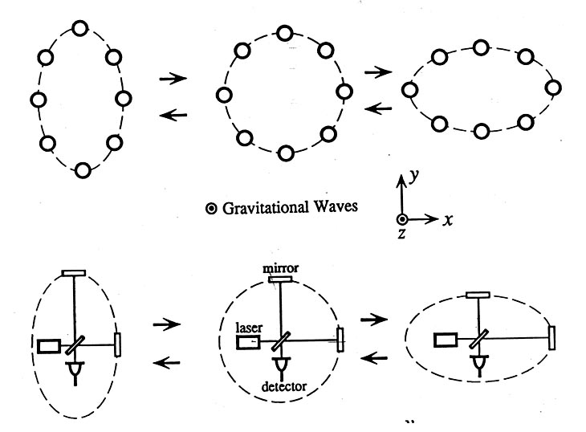
Basic idea is simple
GW amplitude h = (R_{x}-R_{y})/R
Spatial asymmetry induces relative phase shifts on light in arms

Slide 13
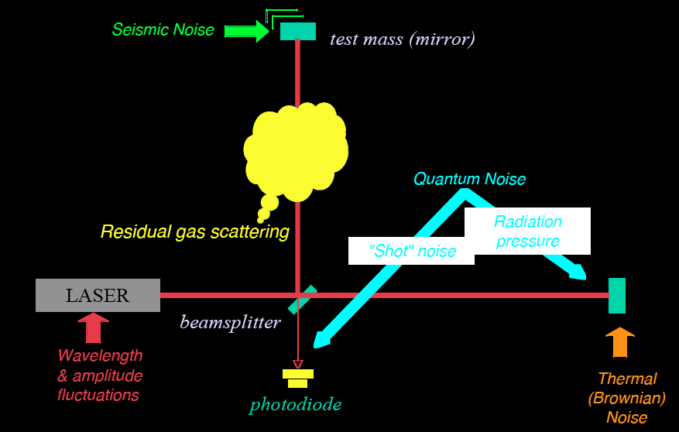
Noise cartoon
R. Adhikari

Slide 14
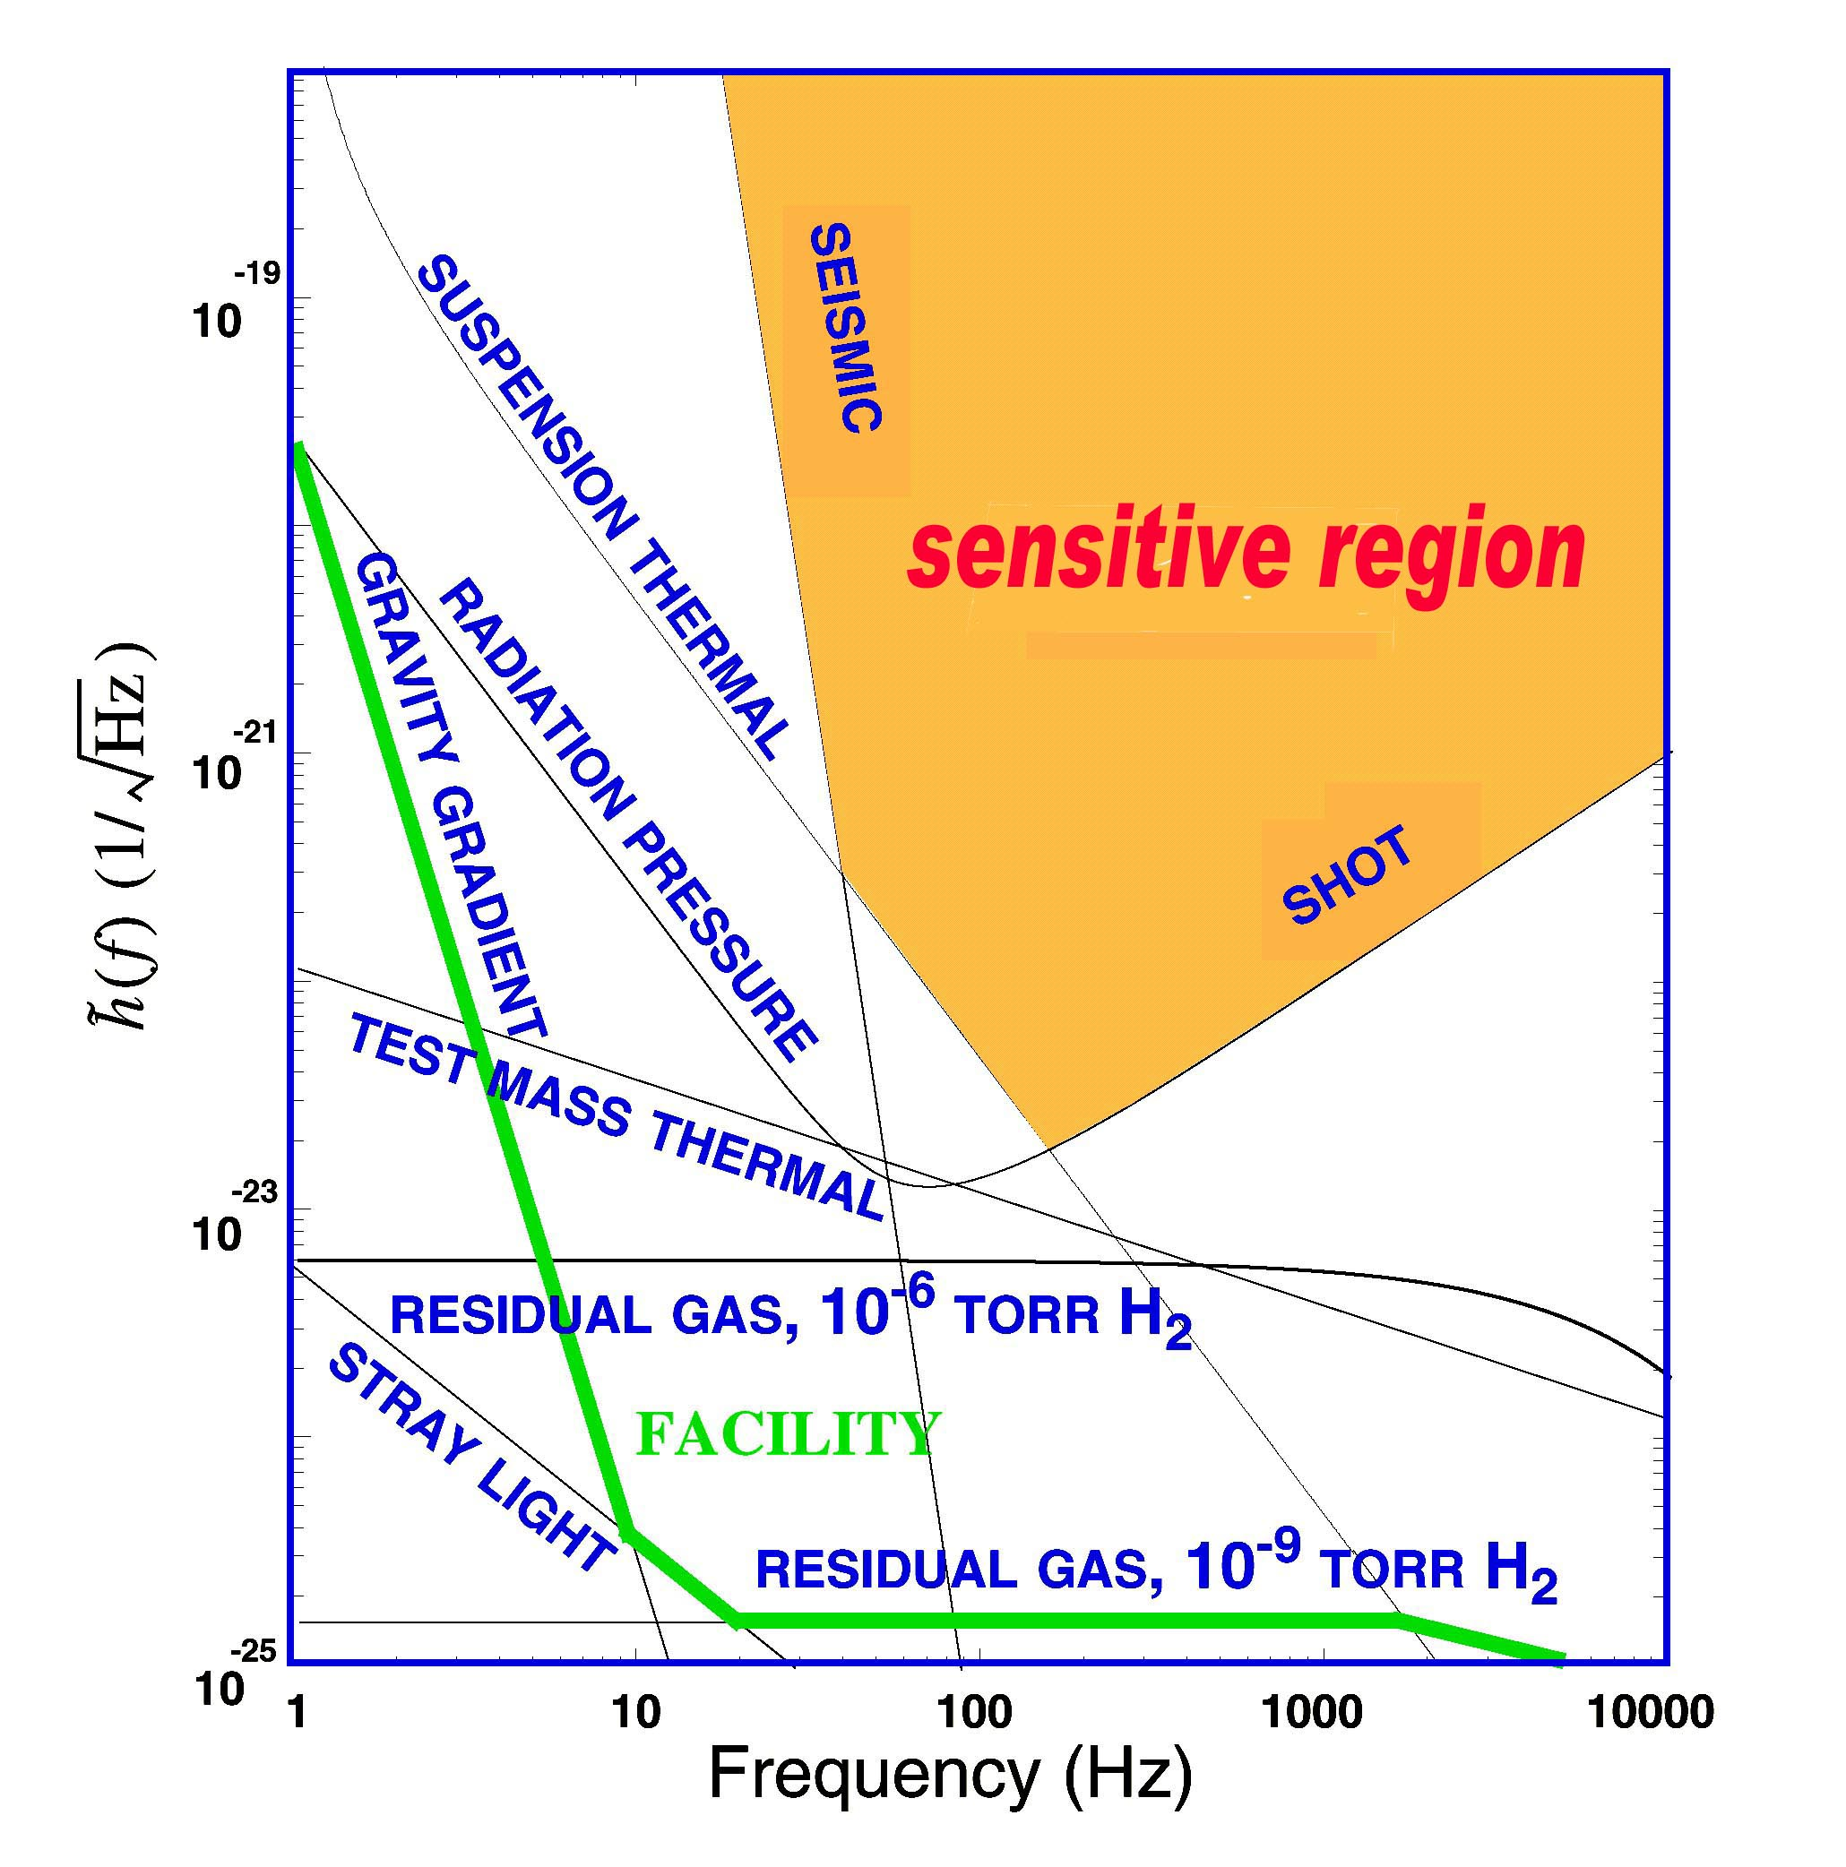
What Limits Sensitivity of Interferometers?
DESIGN
Seismic noise & vibration limit at low frequencies
Brownian (Thermal) Noise inside components limit at mid frequencies
Quantum nature of light (Shot Noise) limits at high frequencies
Myriad details of the lasers, electronics, etc., can make problems above these levels
COMMISSIONING

Slide 15

Optical configuration
Complete detector description in Class. Quantum Grav. 32 (2015) 074001

Slide 16

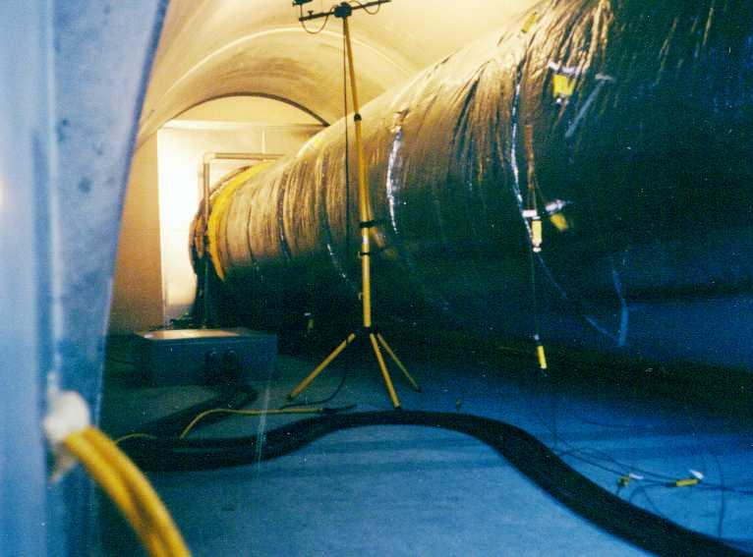
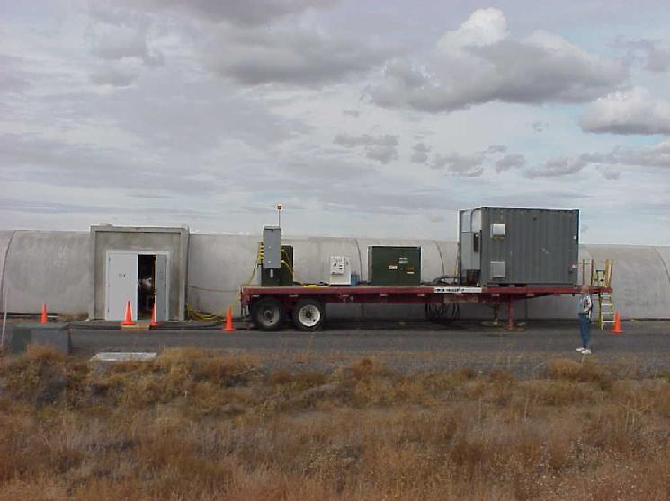
Evacuated Beam Tubes Provide Clear Path for Light
P< 10⁻⁹ Torr
Portable power supply for bakeout

Slide 17
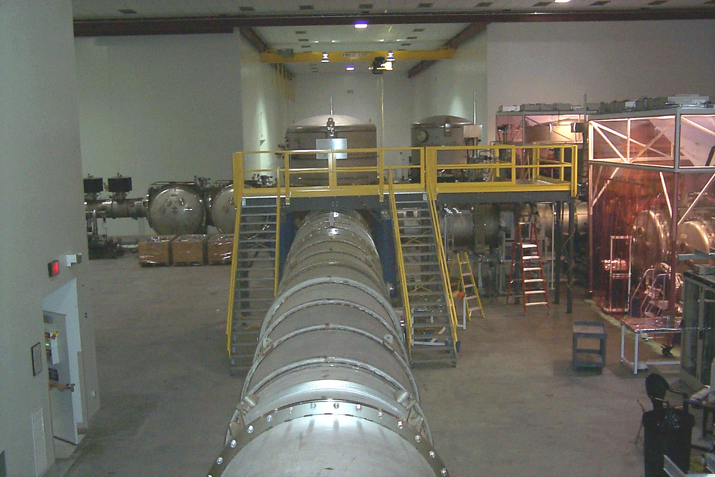
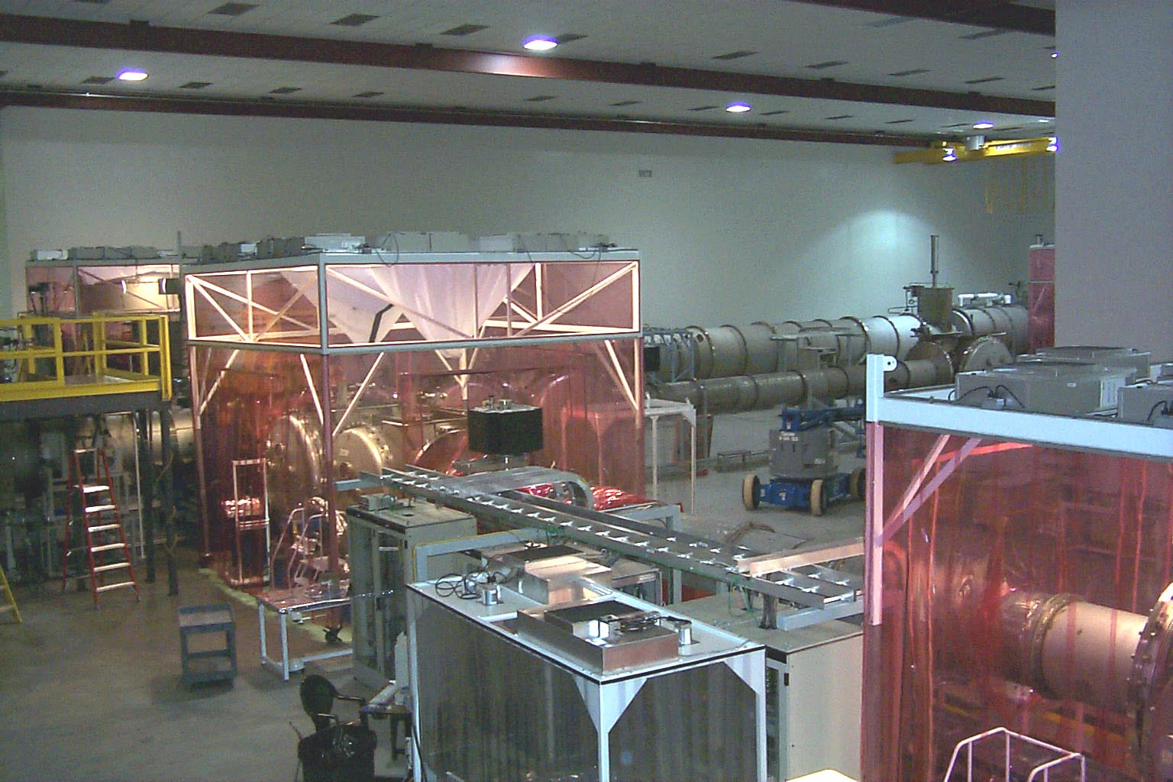
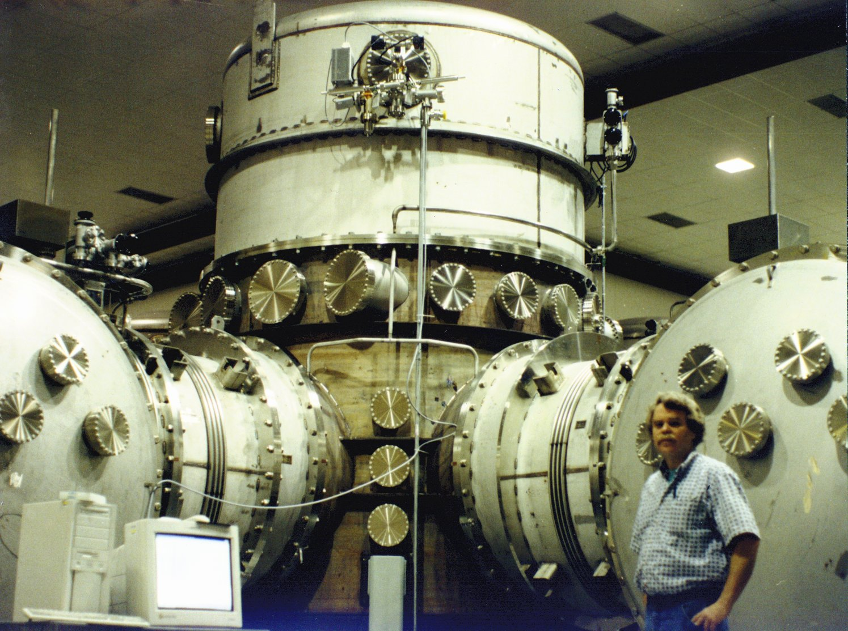
Vacuum Chambers Provide Quiet Homes for Mirrors
View inside Corner Station
Standing at vertex beam splitter

Slide 18
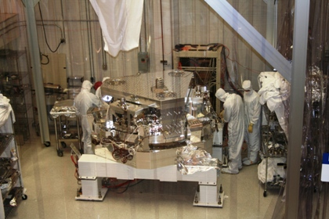
BSC Internal Seismic Isolator

Slide 19
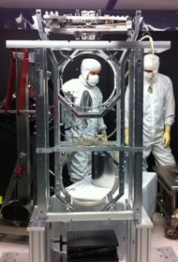
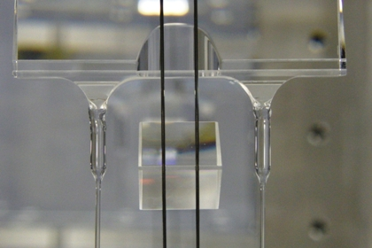
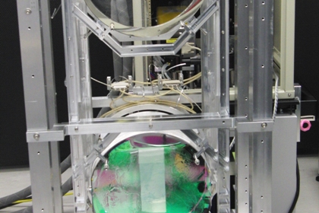
Advanced LIGO Monolithic Suspension

Slide 20
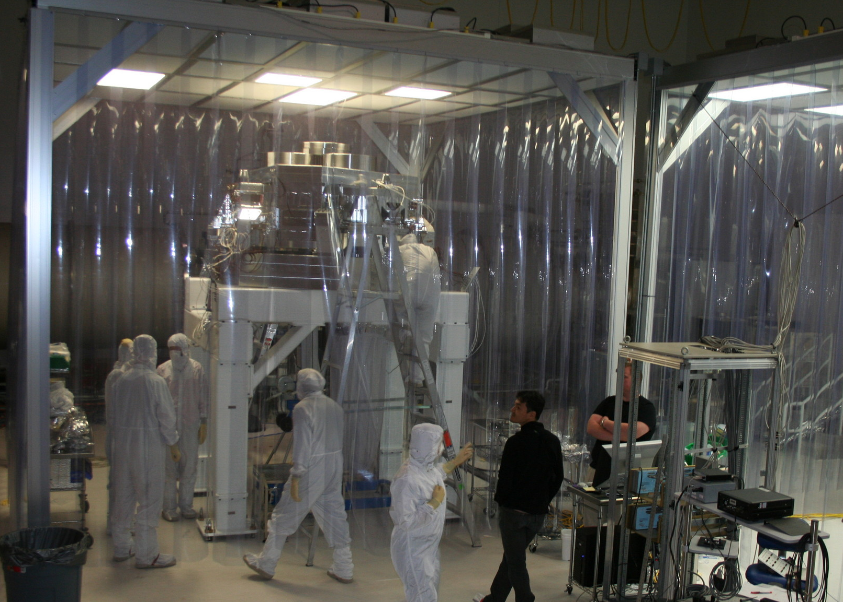
Advanced LIGO installation in progress
17-Aug-11

Slide 21
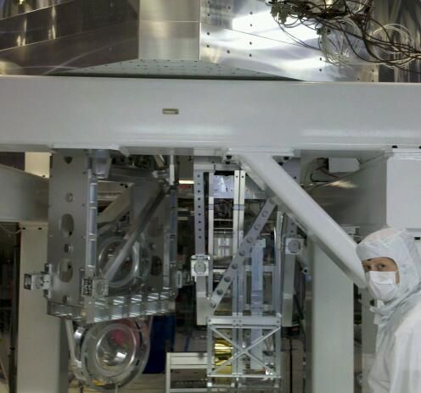
Putting it together:
Seismic & Suspension & Optics
Seismic isolation
Test mass suspension
Folding mirror suspension

Slide 22
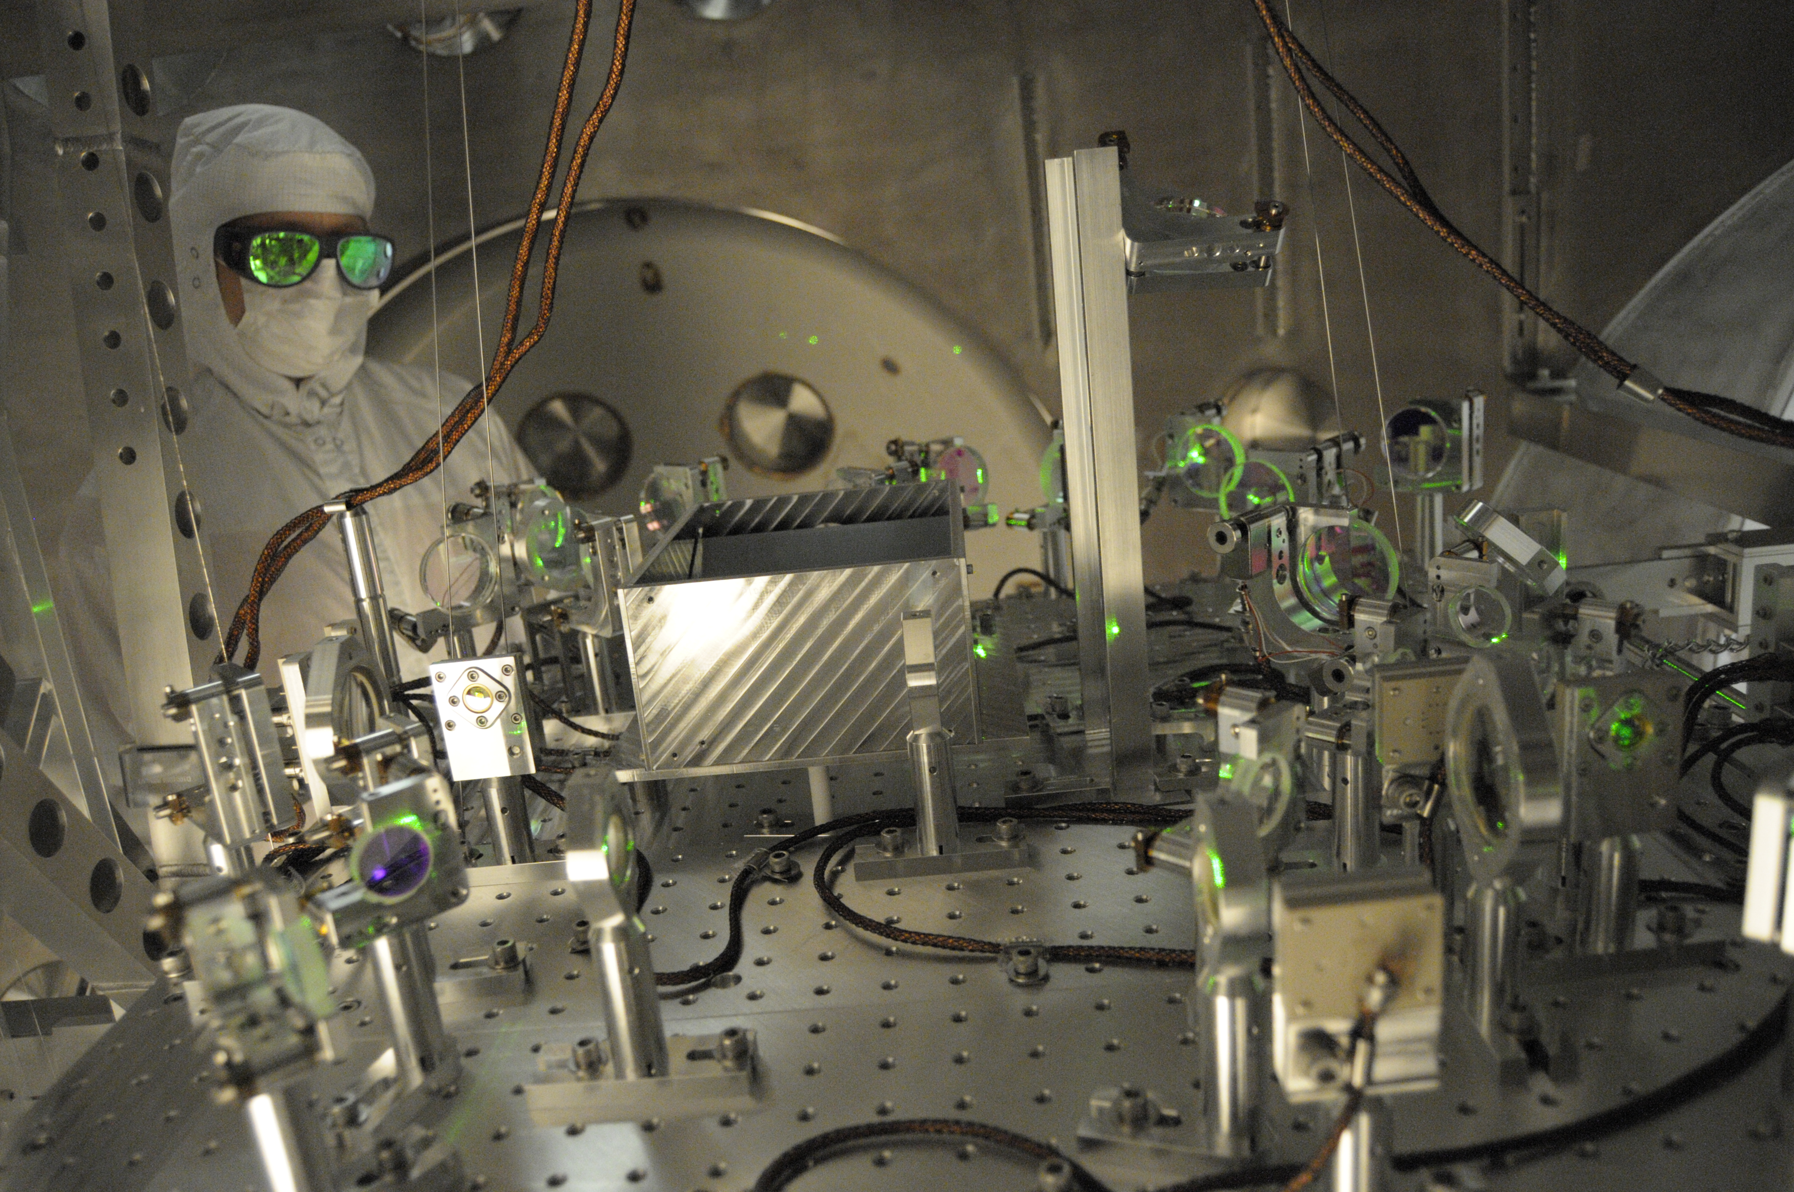
Lock Acquisition: Arm Locking Subsystem

Slide 23
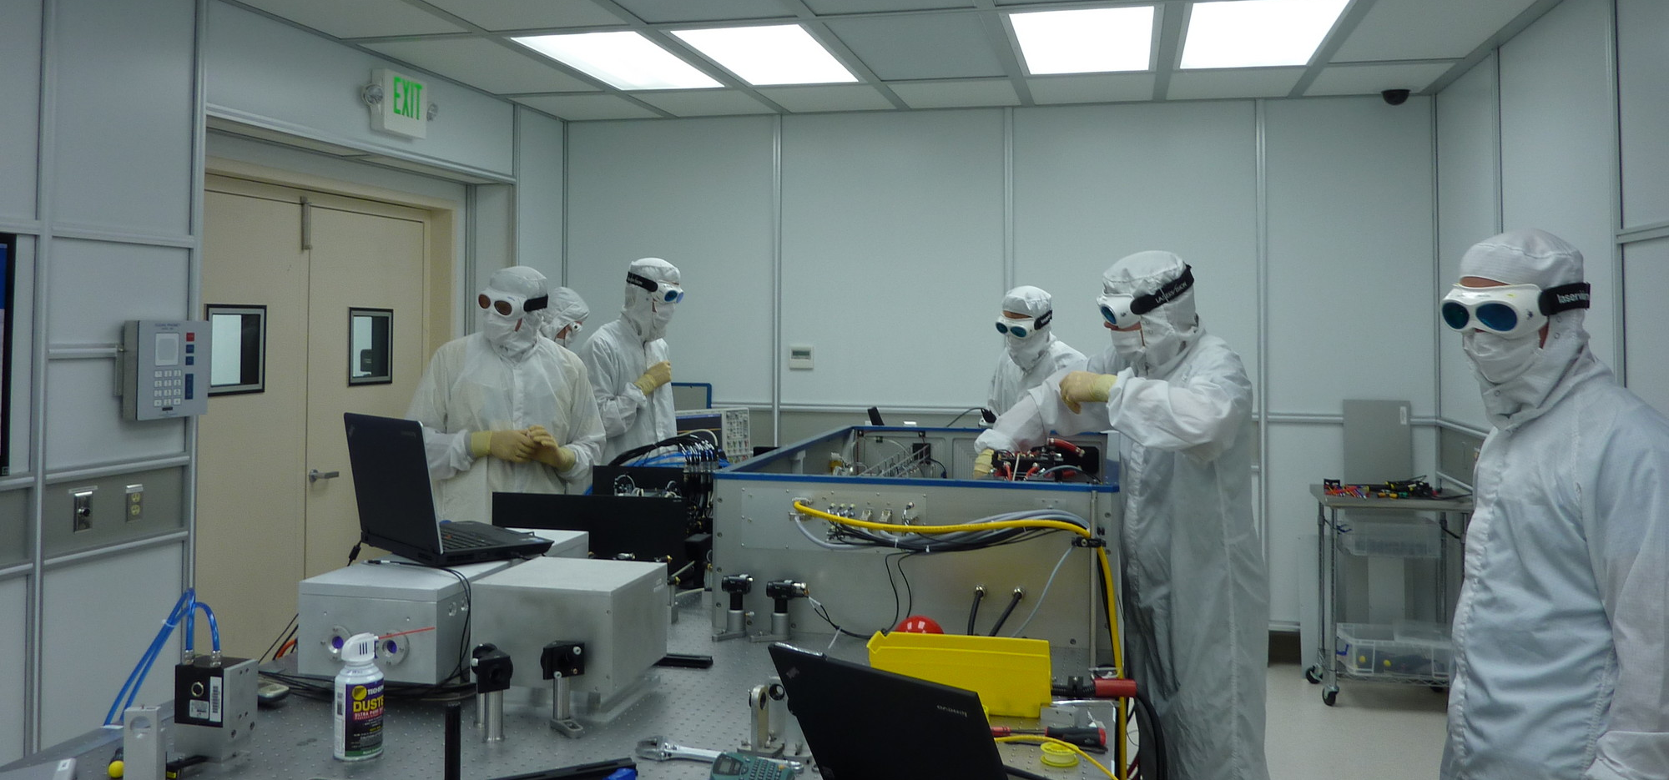
aLIGO Pre-stabilized laser

Slide 24
Principal noise terms

Slide 25
Some History

Slide 26
Strategy: Build Facilities That Could House Evolving Generations of More Powerful Detectors as Part of an International Network
LIGO proposed in 1989.
LIGO Observatories constructed from 1994-2000.
LIGO establishes international LIGO Scientific Collaboration (LSC) in 1997.
Initial LIGO operated from 2002-2010.
Advanced LIGO construction 2008-2015.
Virgo proposed in 1989.
Virgo construction from 1996 to 2003.
Virgo and LIGO establish a common data format for GW observatories.
Initial Virgo operated from 2007 to 2011.
Advanced Virgo construction from 2011 to 2016.
LSC and Virgo Collaboration established an MOU for joint operations in 2007.

Slide 27
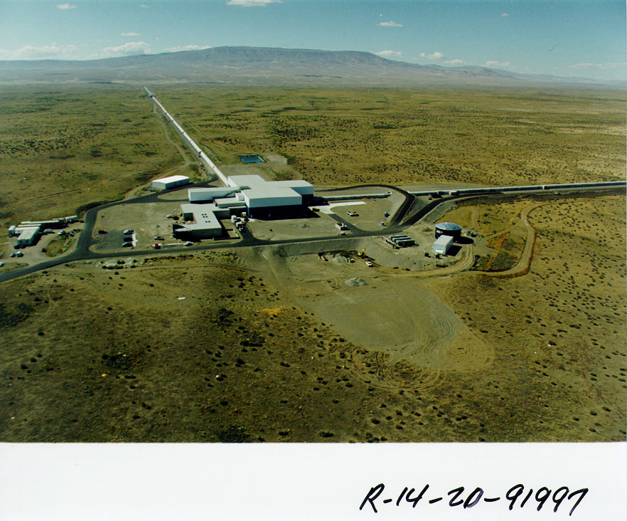
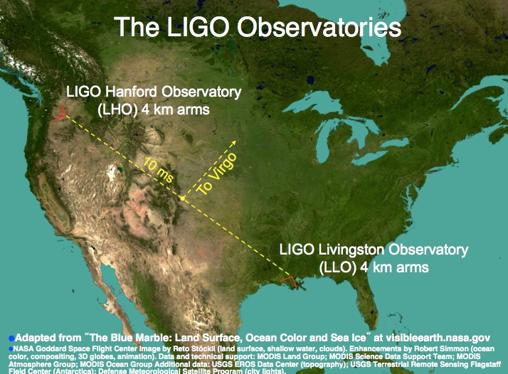

The Laser Interferometer Gravitational-wave Observatory
LHO
LLO
Livingston, LA

Slide 28
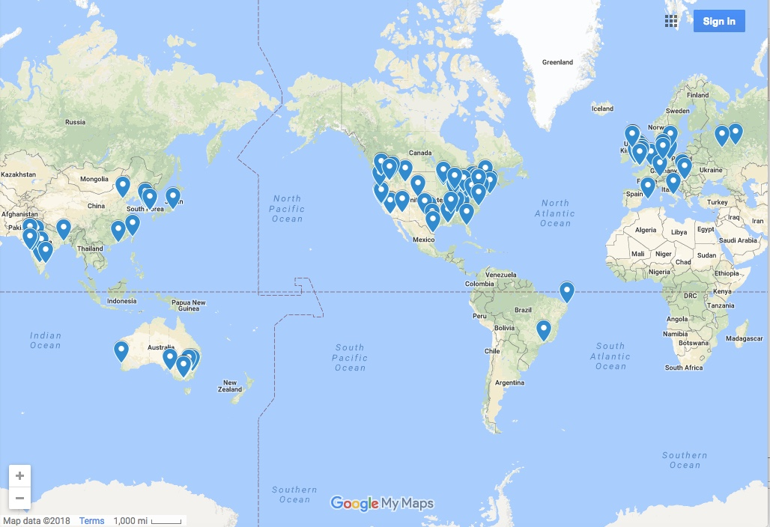
The LIGO Scientific Collaboration
LSC Institutions
Livingston, LA

Slide 29
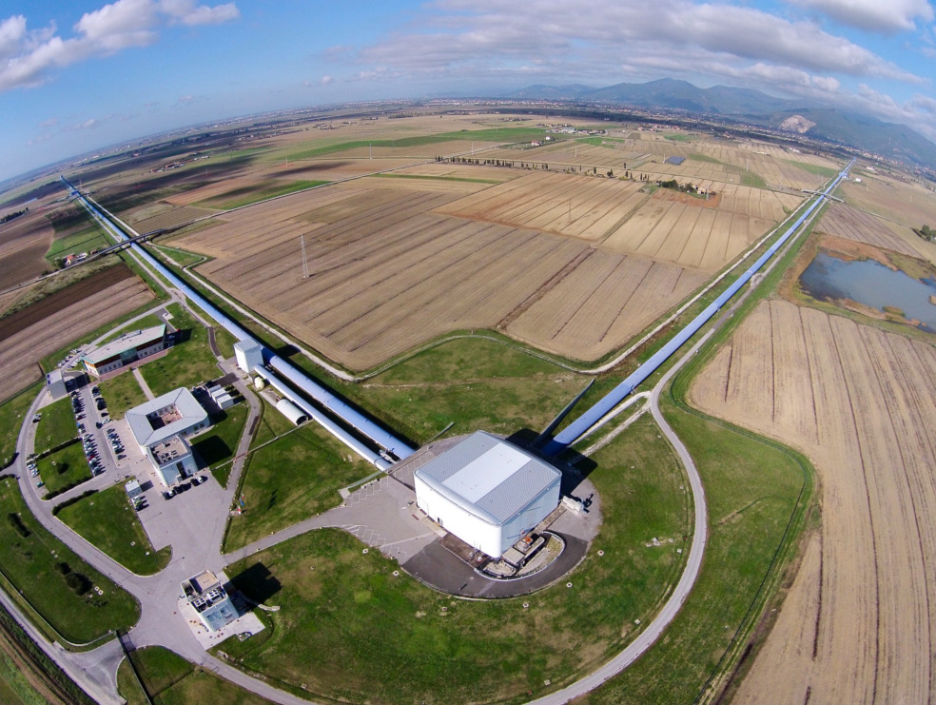
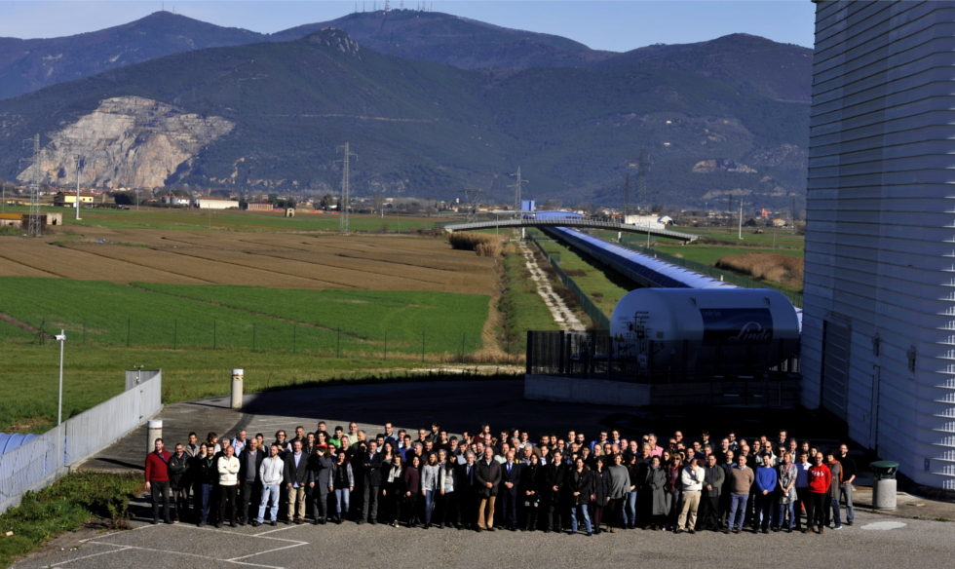
VIRGO
The Virgo Collaboration is currently composed of approximately 350 scientists, engineers and technicians from about 70 institutes from Belgium, France, Germany, Hungary, Italy, the Netherlands, Poland and Spain

Slide 30
Breakthroughs
Opening a New Window on the Universe

Slide 31
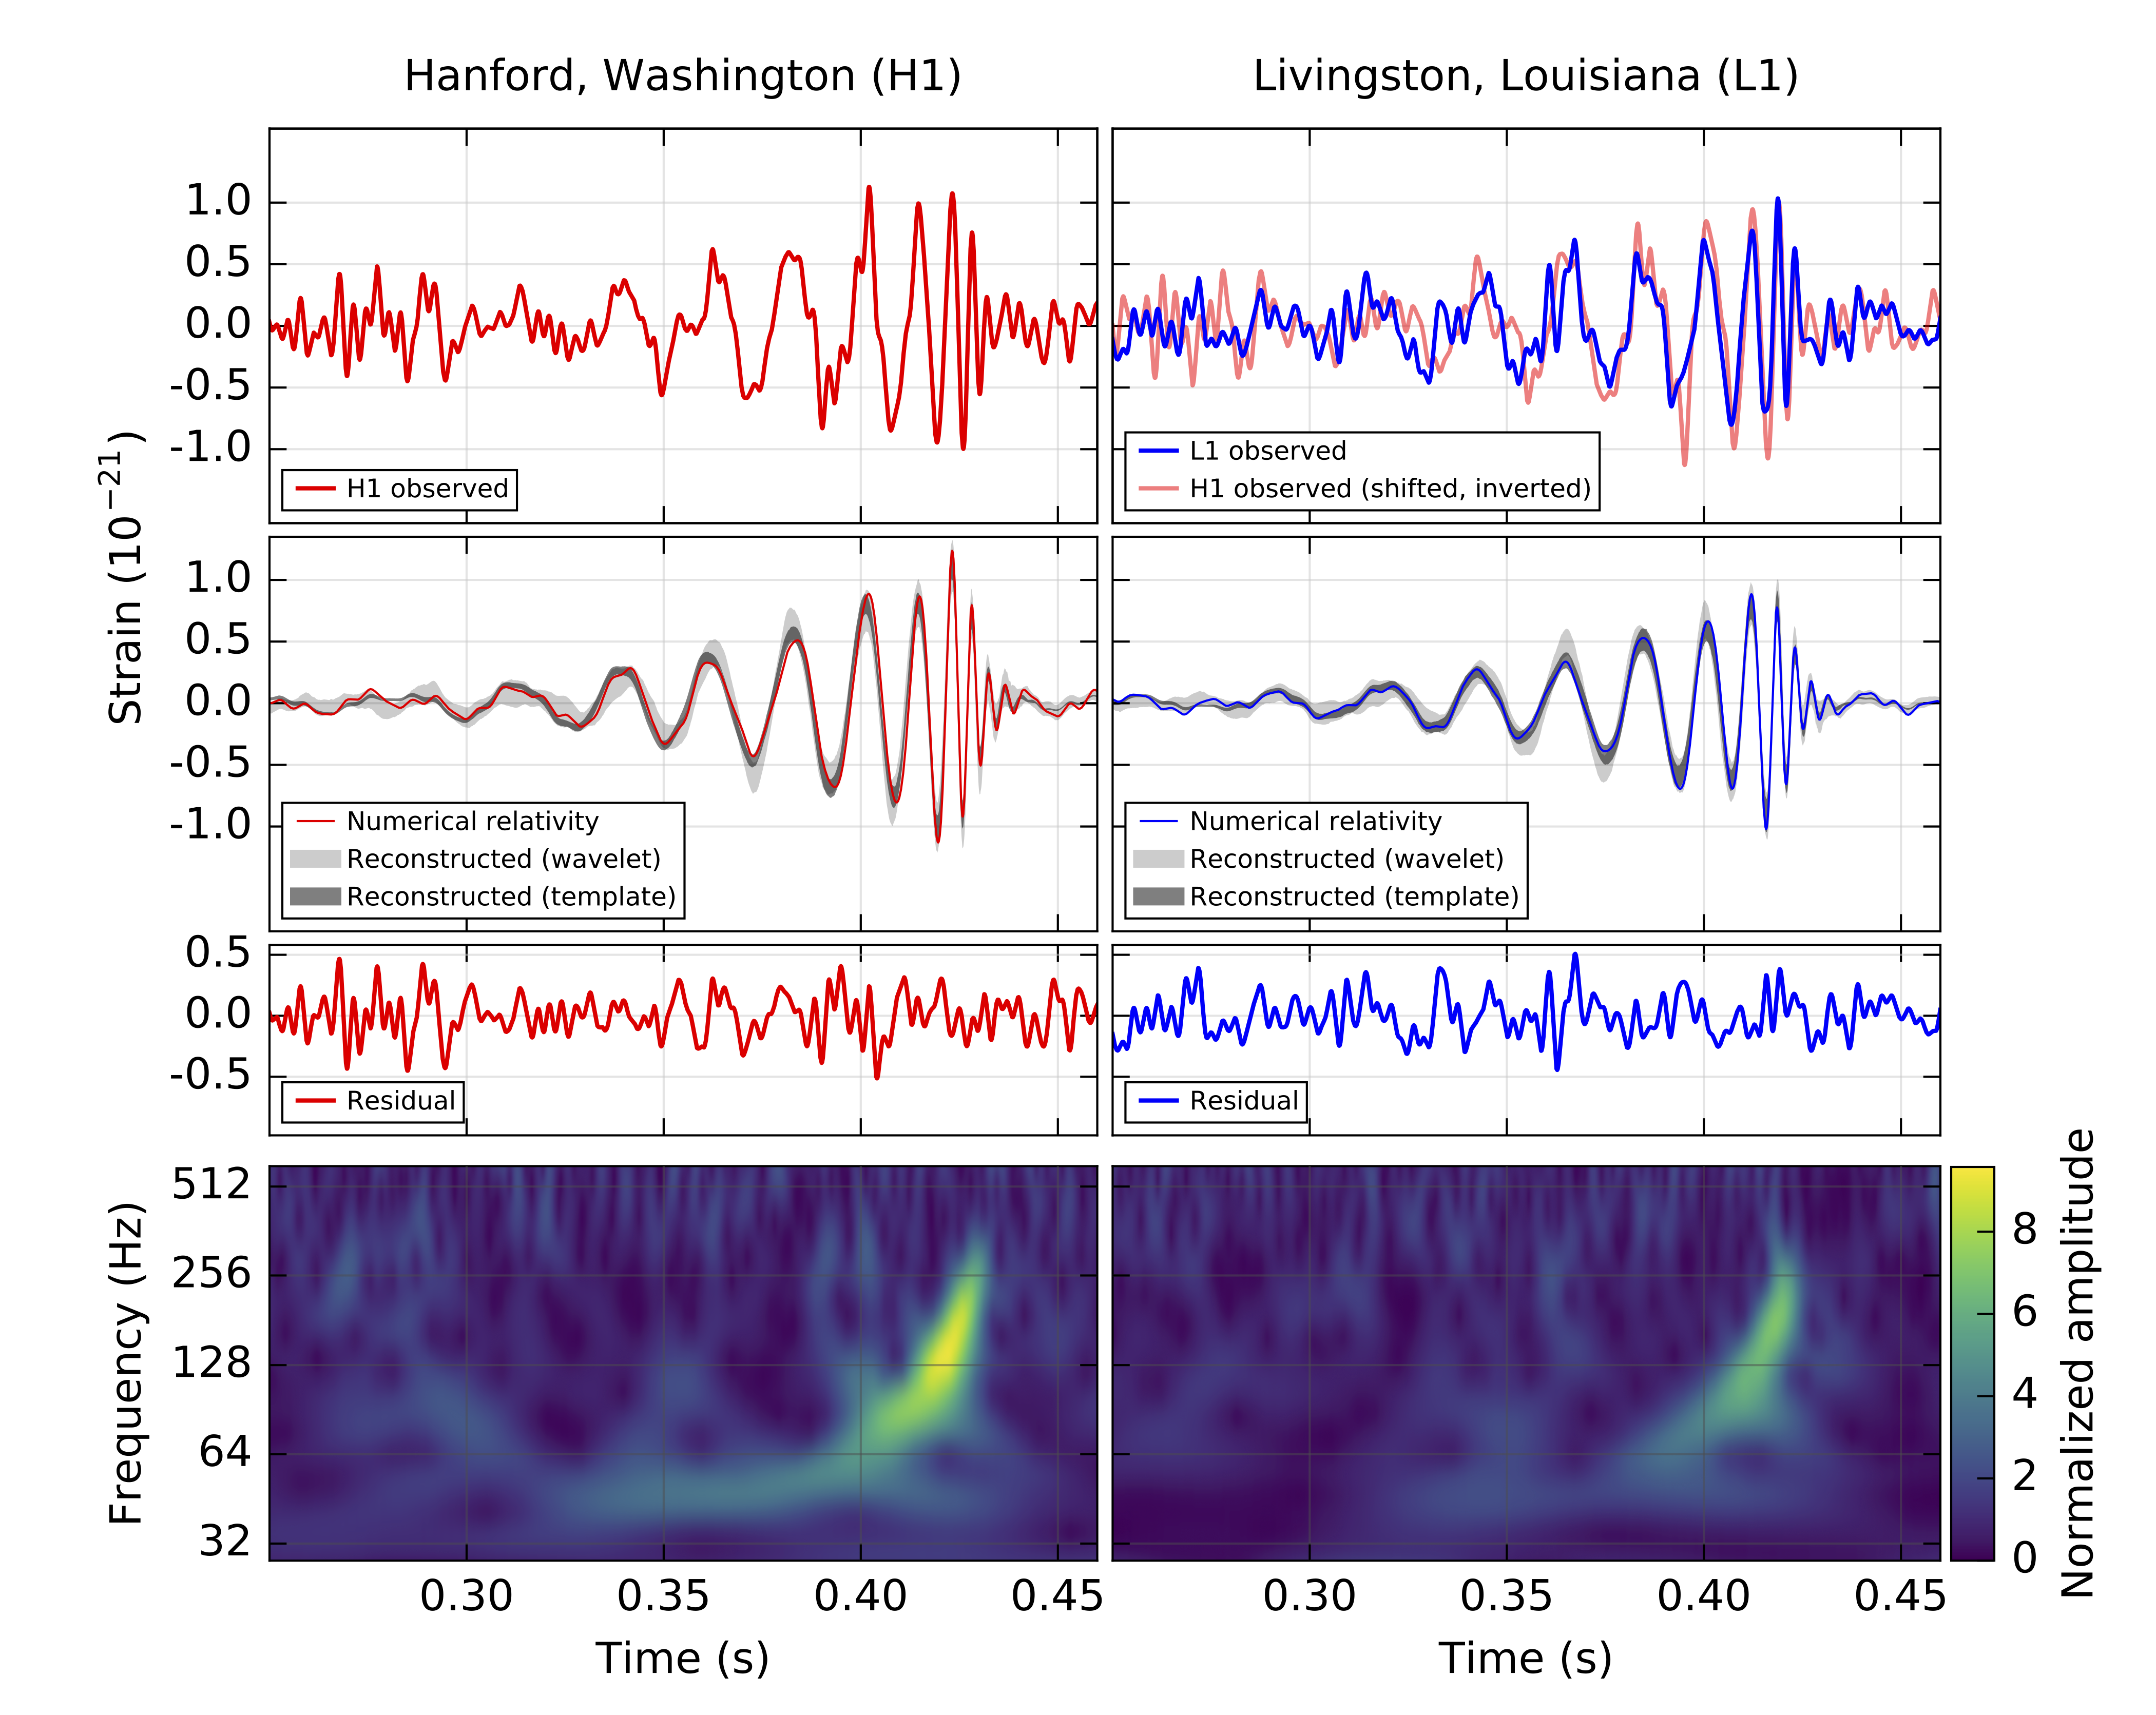
GW150914: What was observed?
B. P. Abbott et al., Phys. Rev. Lett. 116, 061102

Slide 32
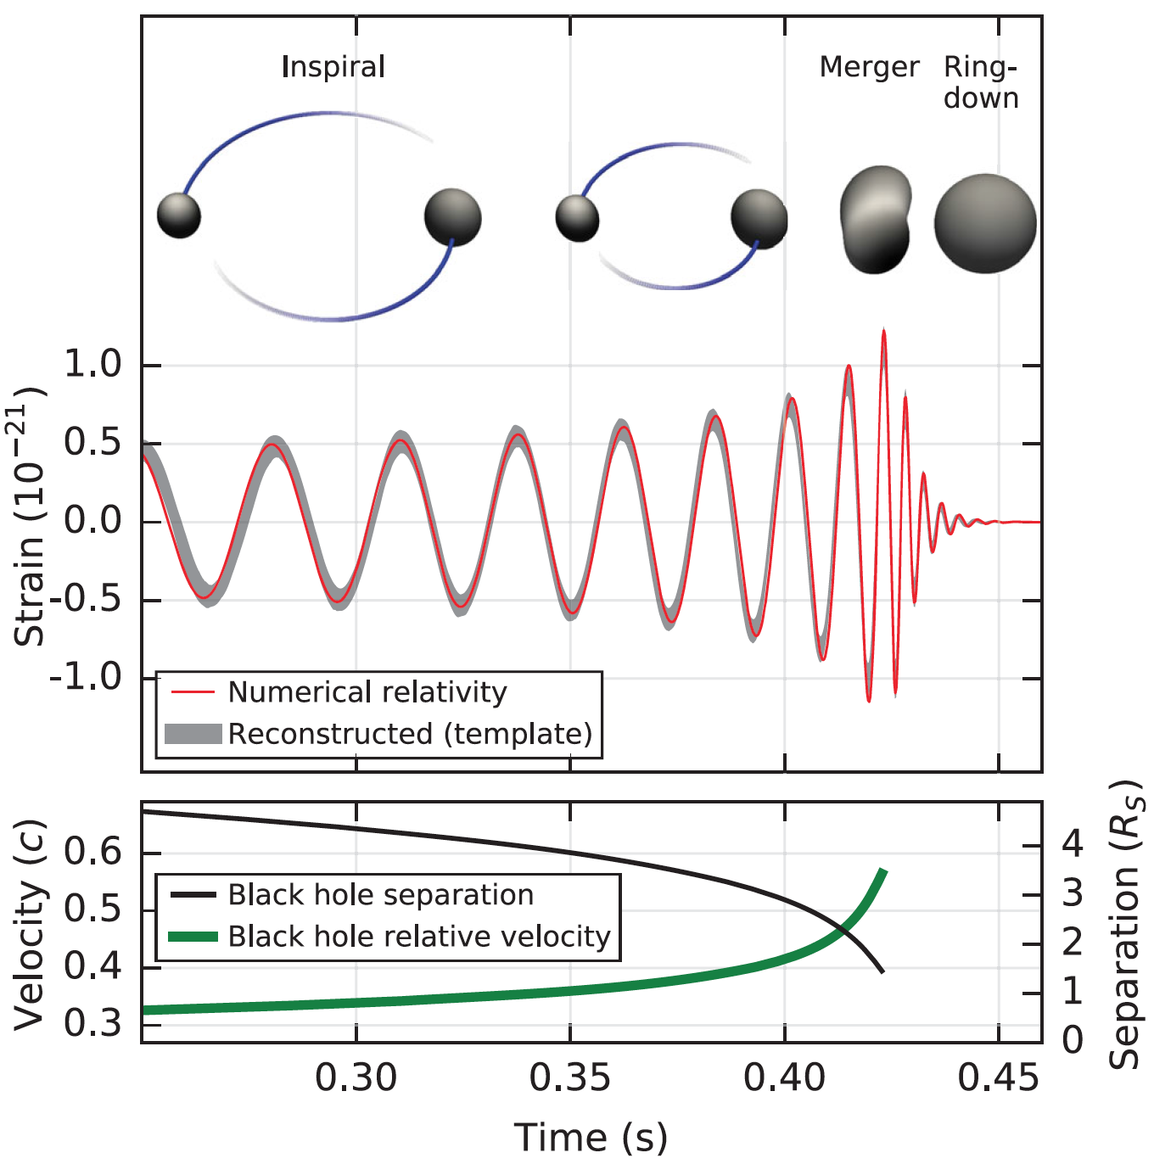
What can we learn from h(t)?
Phase evolution gives chirp mass and aligned components of spin
B. P. Abbott et al. (LIGO Scientific Collaboration and Virgo Collaboration), Observation of Gravitational Waves from a Binary Black Hole Merger, Phys. Rev. Lett. 116, 061102 (2016)
Signal size gives distance to the source
Ringdown frequency and Q
give mass and spin
of final black hole
Modulation of amplitude gives nonaligned spin components
Highest frequency gives sizes of objects just before merger.

Slide 33
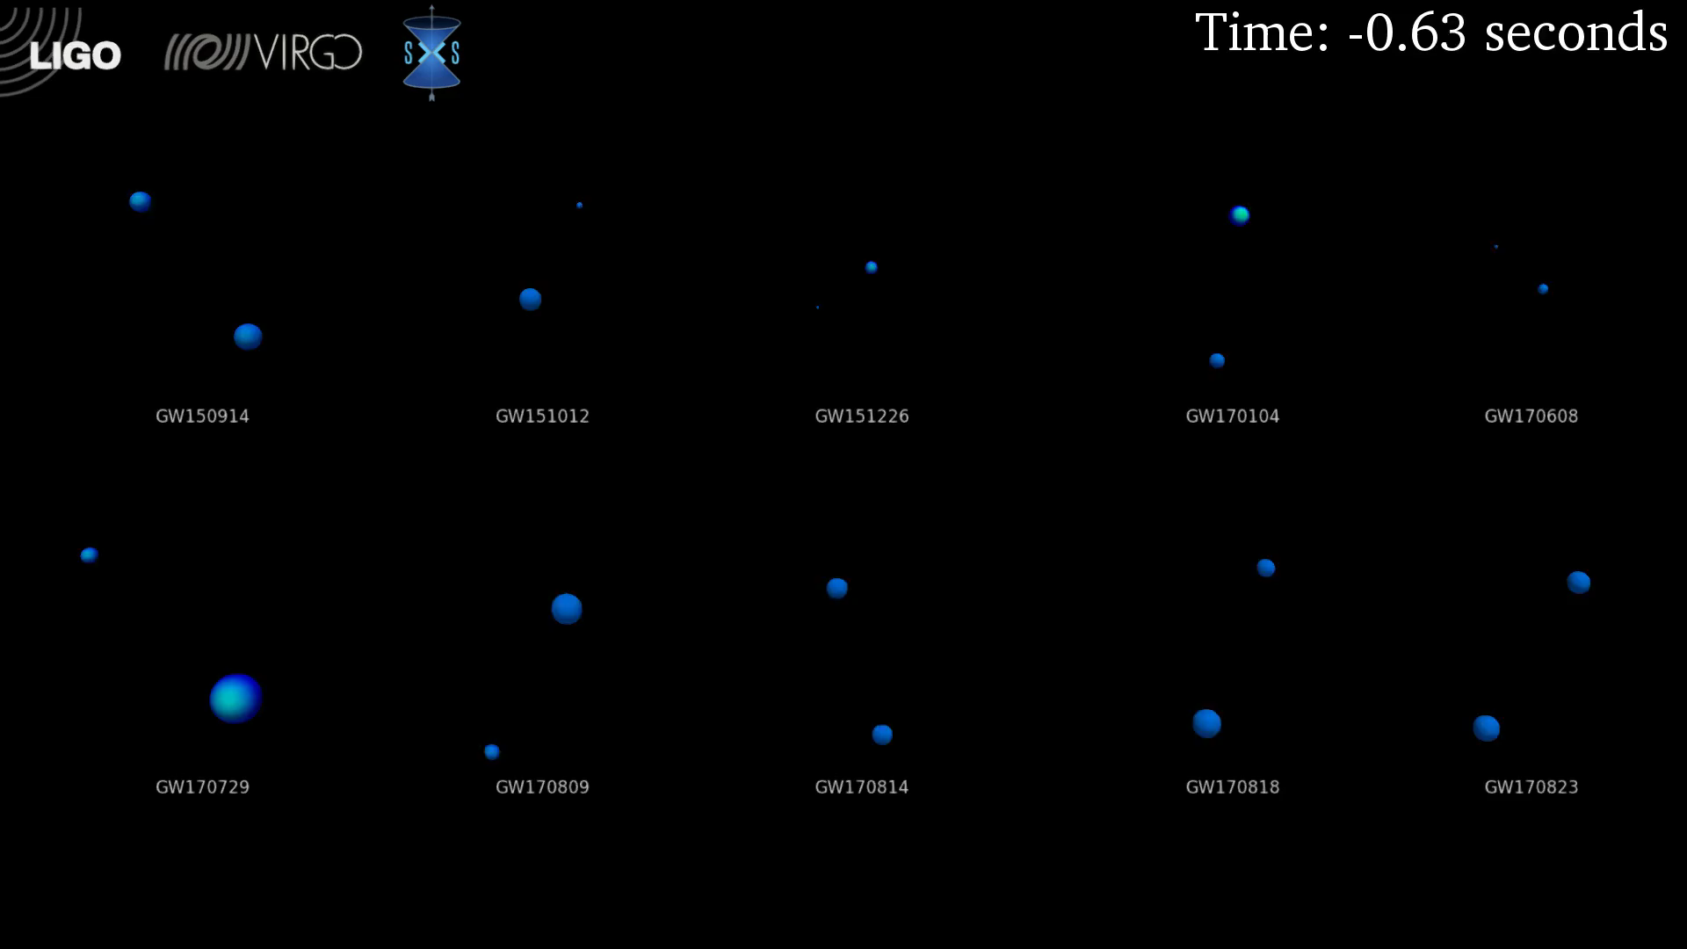
Comparison of BBH GW Waveforms from GWTC-1

Slide 34
Multi-Messenger Astronomy
These first observations of dynamic extreme spacetimes with BBHs show us that GR is reasonably accurate in this regime and can be used as a tool for examining and interpreting extreme states of matter.
There are a rich collection of sources still to be examined!

Slide 35
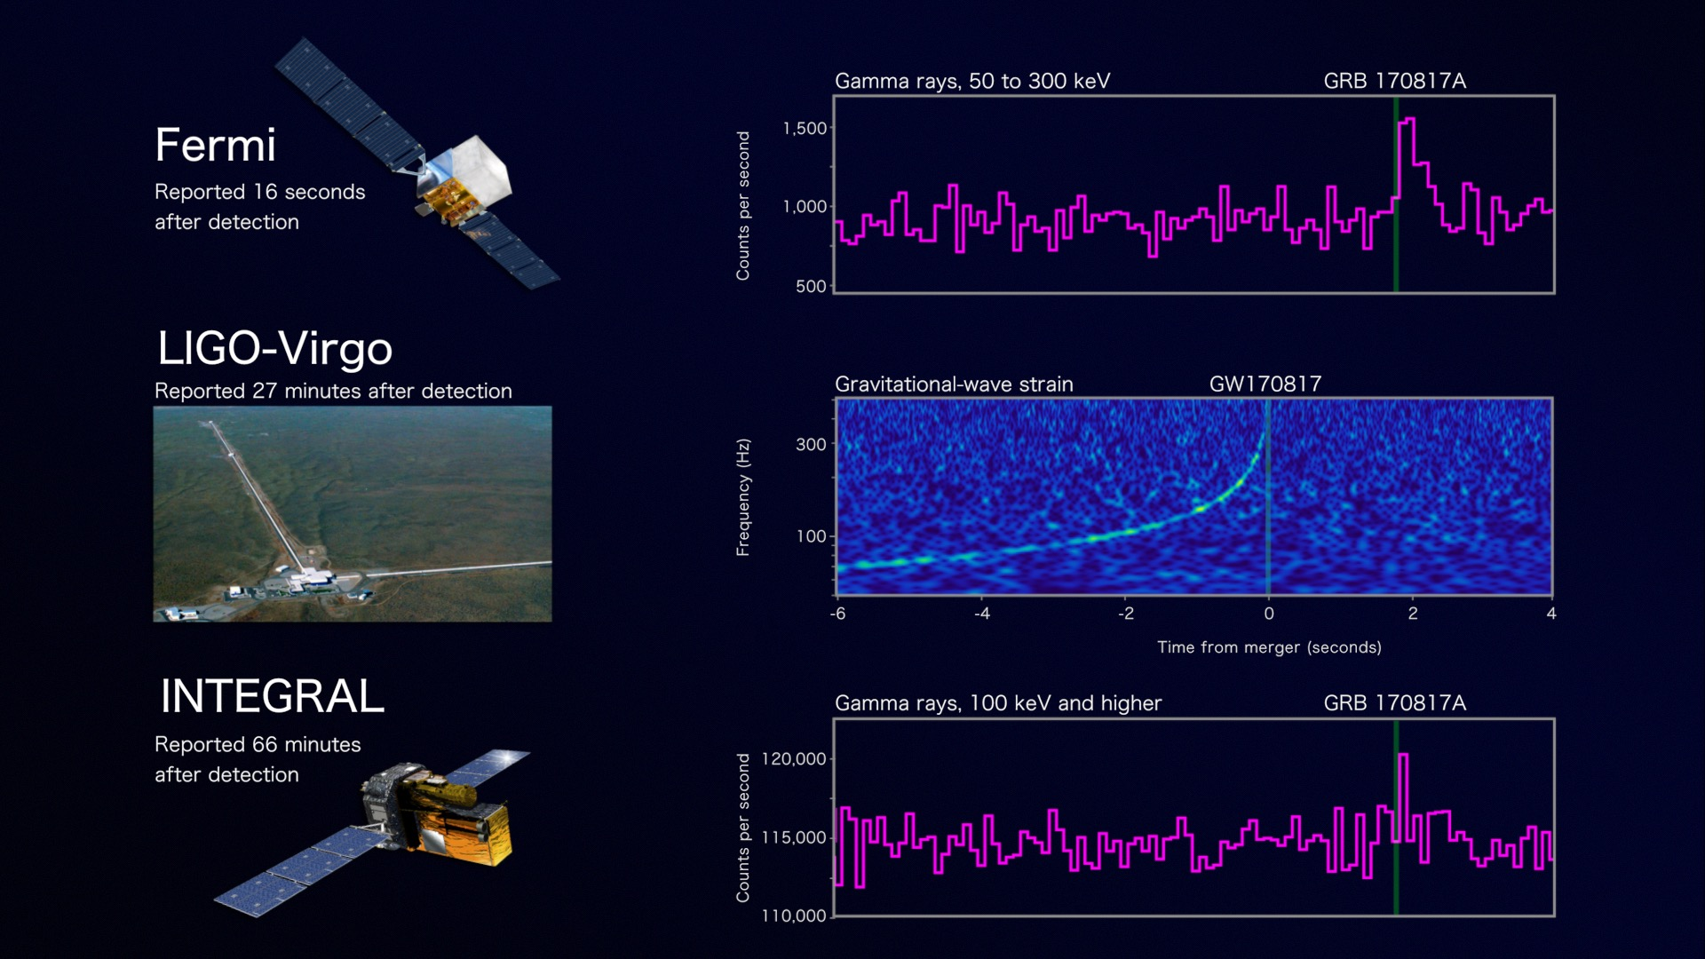
Onto the study of the most extreme states of matter
Credit: NASA's Goddard Space Flight Center, Caltech/MIT/LIGO Lab and ESA

Slide 36
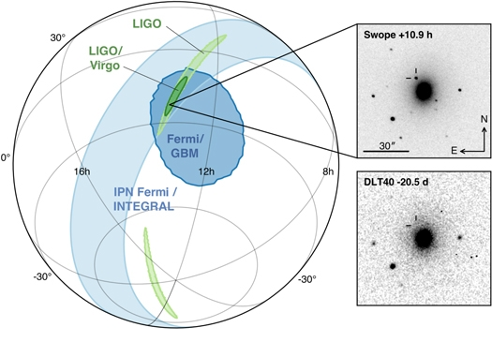
LIGO-Virgo network localization enables discovery of optical counterpart
Figure 1 from Multi-messenger Observations of a Binary Neutron Star Merger
B. P. Abbott et al. 2017 ApJL 848 L12 doi:10.3847/2041-8213/aa91c9

Slide 37
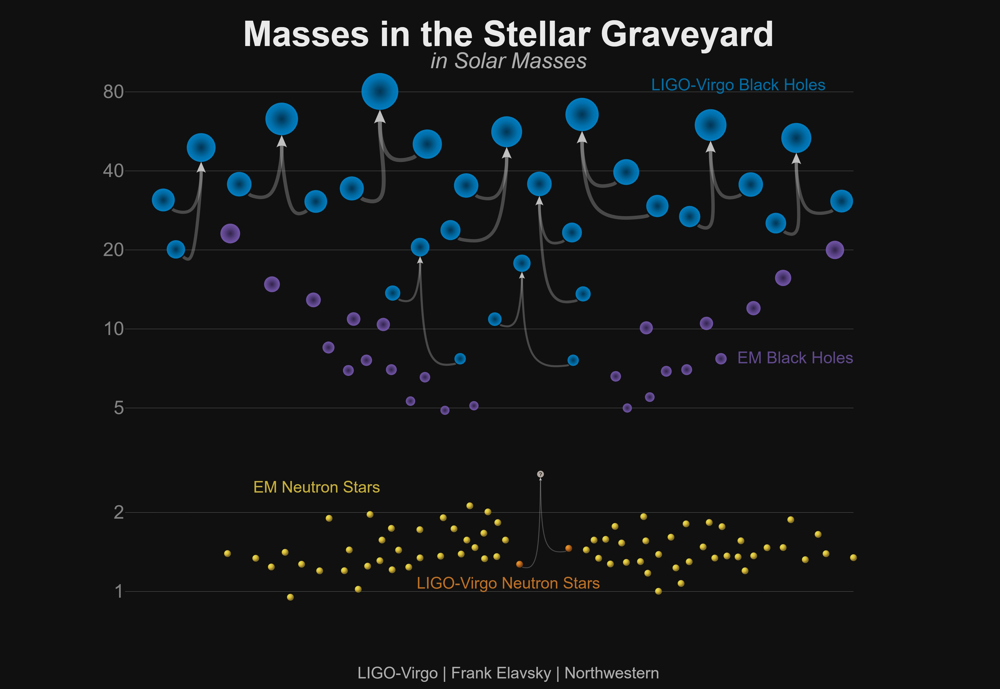
Known Masses of Stellar Remnants – GWTC-1
Non-LIGO Data Sources: Neutron Stars: http://xtreme.as.arizona.edu/NeutronStars/data/pulsar_masses.dat
Black Holes: https://stellarcollapse.org/sites/default/files/table.pdf |
LIGO-Virgo Data: https://www.gw-openscience.org/catalog/

Slide 38
The Future
Headline: “Get Ready For Gravitational Waves All Day, Every Day” – Sophia Chen, Wired 2/20/19
https://www.wired.com/story/get-ready-for-gravitational-waves-all-day-every-day/

Slide 39
Future directions
Build out the terrestrial network of kilometer-scale GW observatories
Extend the reach of GW observatories
  Upgrade detector technologies to fully exploit the facilities limits of the kilometer-scale facilities
  Build a new generation of tens-of-kilometer-scale facilities
Extend the spectrum of GW observatories

Slide 40


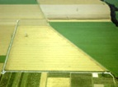

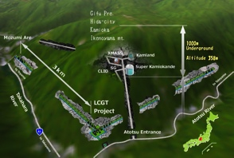



The advanced GW detector network:
2015-2025
Advanced LIGO
Hanford
2015
GEO600 (HF)
2011
KAGRA
2020
Advanced LIGO
Livingston
2015
Advanced
Virgo
2017
LIGO-India
2025
40
40

Slide 41
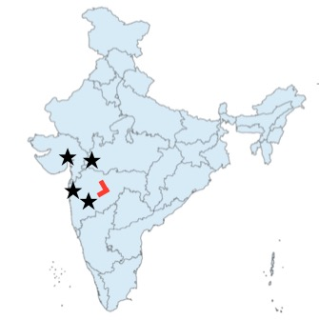
LIGO-India http://www.ligo-india.in http://www.gw-indigo.org/
Partner Agencies
  Department of Atomic Energy
  Department of Science & Technology
  US National Science Foundation
LIGO-India Institutes:
  Institute for Plasma Research(IPR), Gandhinagar
  Inter-University Centre for A&A (IUCAA), Pune
  Raja Ramanna Centre for Advanced Technology (RRCAT), Indore
  Directorate of Construction, Services and Estate Management (DCSEM), Mumbai
  LIGO Laboratory, Caltech & MIT
R&D at institutes across India

Slide 42
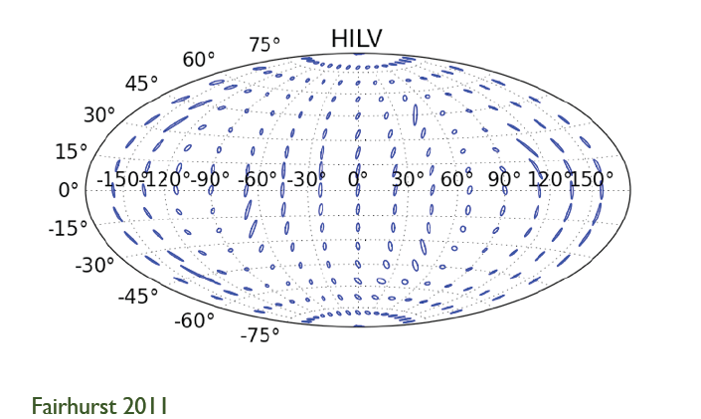
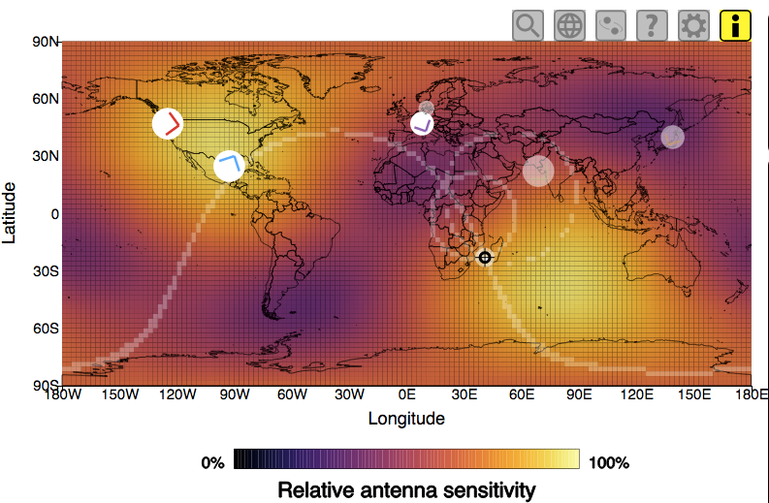
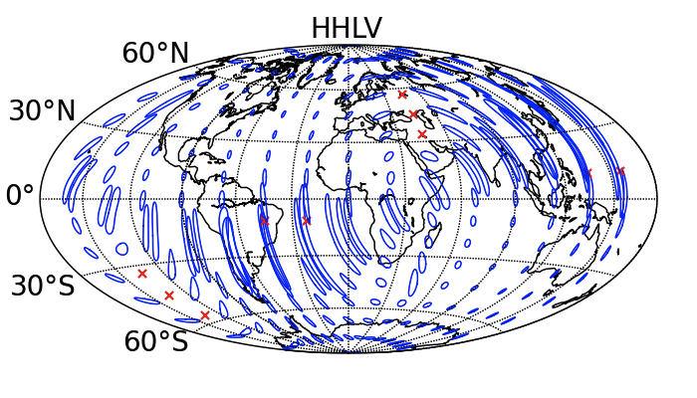
GW170817 Landed in a Good Region of Sky When 3 Detectors Were Up
S. Fairhurst - P1200054
Effect of adding LIGO-India to LIGO + Virgo
Visualization courtesy of Chris North

Slide 43
Extending the Reach: Science goals drive Requirements
Stellar Evolution at High Red-Shift: Black Holes from the first stars (Population III)
  Reach z > ~10
  At least moderate GW luminosity distance precision
Independent Cosmology and the Dark Energy Equation of State
  Needs precision GW luminosity distance and localization for EM follow-ups (for redshift)
Checking GR in extreme regime
  High SNR needed
  GW luminosity distance and localization not essential

Slide 44
Technological path to the future
Advanced LIGO is limited by
quantum noise & mirror coating Brownian noise
Squeezed vacuum can reduce quantum noise
Options for Brownian noise:
  Better mirror coatings (high optical quality; low mechanical losses)
  Cryogenic operation (new mirror materials & coatings, new lasers, photo-detectors, vacuum-squeezers, etc.)
  Longer arms (new longer-arm observatory facilities)

Slide 45
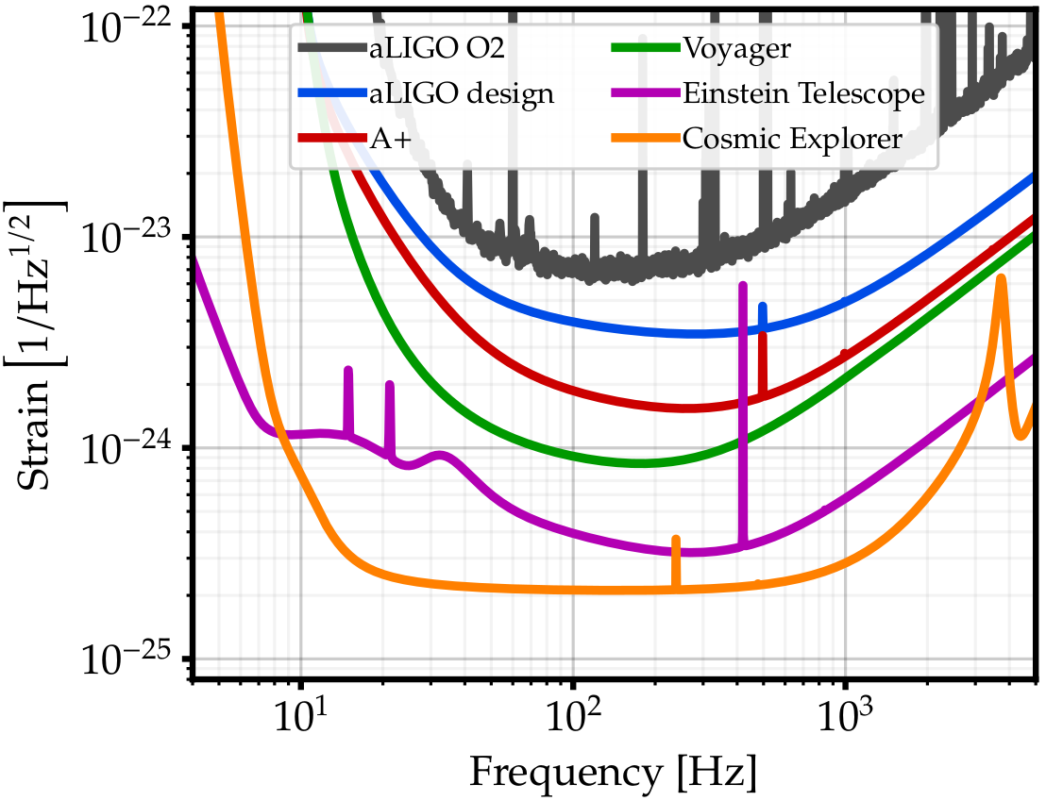
Upgrade possibilities
Exploring the sensitivity of next generation gravitational wave detectors (2017) CQG 34, 044001; www.et-gw.eu
Notes:
Adapted from Lisa Barsotti’s DAWN-IV presentation.

Slide 46
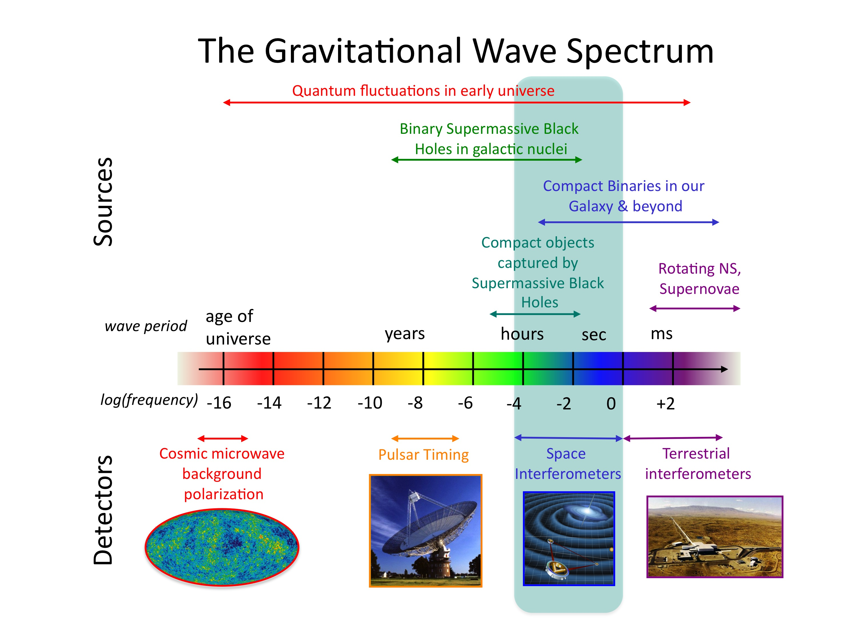
Credit: NASA

Slide 47
Summary
A new era of astrophysics has dawned with great fanfare, but it is poised to rapidly accelerate.
The rate of discovery over the next decades – your professional lifetimes – and the science that can be extracted from discoveries will be driven by an international community of experimental physicists and engineers developing better understanding of detector physics and new detector technologies.
India will be an important stage for these developments.
Will you ride the new wave in astronomy?

