Slide 1
Detectors and observations in O3
Lisa Barsotti, Nicolas Leroy,
Keita Kawabe, Brian O’Reilly, Alessio Rocchi
for the LIGO-VIRGO Joint Run Planning Committee

Slide 2
Instrument Status and Plans
Have seen better sensitivities from all instruments.
  So far, L1 up to 135Mpc with SQZ, H1 up to 90Mpc, V1 up to 55Mpc with SQZ
  (In O2, L1~100, H1~80/70, V1~27 Mpc)
  We’re still working hard on reliability and SQZ of H1. This will continue in the first half of ER14.
ER14 planned from Mar 04, 2019
  Finalize instruments’ configuration, calibration etc.
  End-to-end test of instruments/software.
O3 planned from Apr 01, 2019
  24/7 operation is the goal, except planned downtime.
  Past experience suggest ~50-60% triple observation availability
  Planning to be flexible about H1 commissioning for reliable operation if necessary.
  Open Public Alert

Slide 3
Detector Performance So Far:
L1 135 Mpc, ~3dB SQZ

Slide 4
Detector Performance So Far:
H1 up to 90 Mpc, no SQZ

Slide 5
But we observed 0.9dB squeezing last week.

Slide 6
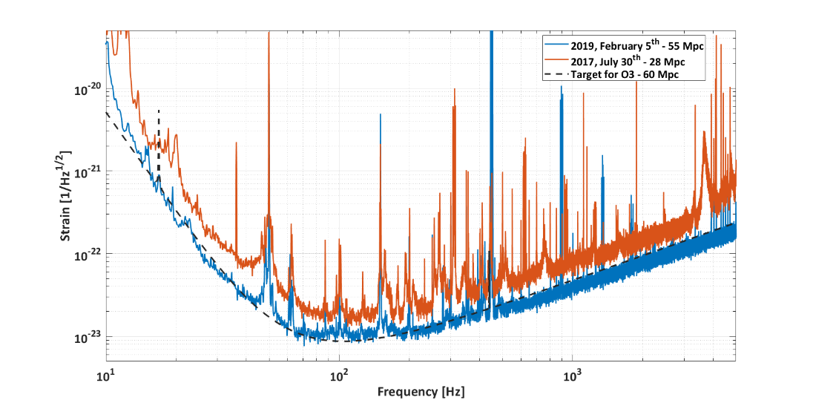
Detector Performance So Far: V1 up to 55 Mpc with SQZ
ORANGE: Sensitivity in O2
BLUE: Best current status
Best range observed so far close to 55 Mpc for BNS, 650 Mpc for BBH (30 M☉)
Squeezing is routinely injected

Slide 7
LIGO-G1801056

Slide 8
ER14 Observing strategy
Planned Mar 04,2019 – Mar 31, 2019
Part of the time will be used to stabilize and make some last improvements on the interferometers
We will shift to 24/7 operation, with planned downtime for maintenance and commissioning
  Hanford and Livingston maintenance, Tuesday 15:00 – 20:00 UTC
  Virgo maintenance, Tuesday 07:00 – 11:00 UTC
No automatic alert is expected, we will transmit highly interesting triggers after human vetting

Slide 9
O3 Observing strategy
“Good” single IFO duty factor meant >80% in the past, expect no significant change.
  Planned down time = maintenance and short commissioning, about 6%. (We ended up using ~10% for this under the same plan in O2.)
  Short commissioning often improves reliability and/or noise, and informs post-run interventions.
  We have unplanned down time (EQ, high wind, relocking etc.).
Coordination between the sites to maximize triple coincidence. https://dcc.ligo.org/L1800079
We hope H1 operates reliably with SQZ by then, but we’ll be flexible to spend more time if necessary.
Planned engineering: We WILL spend time on problems that need immediate attention, or if we think we can make significant improvement in short period.
  Ex) H1 vacuum incursion in O2 to diagnose and remove a point absorber from ITMX.

Slide 10
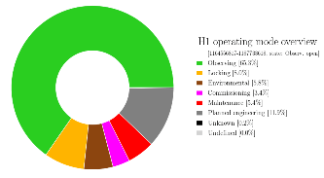
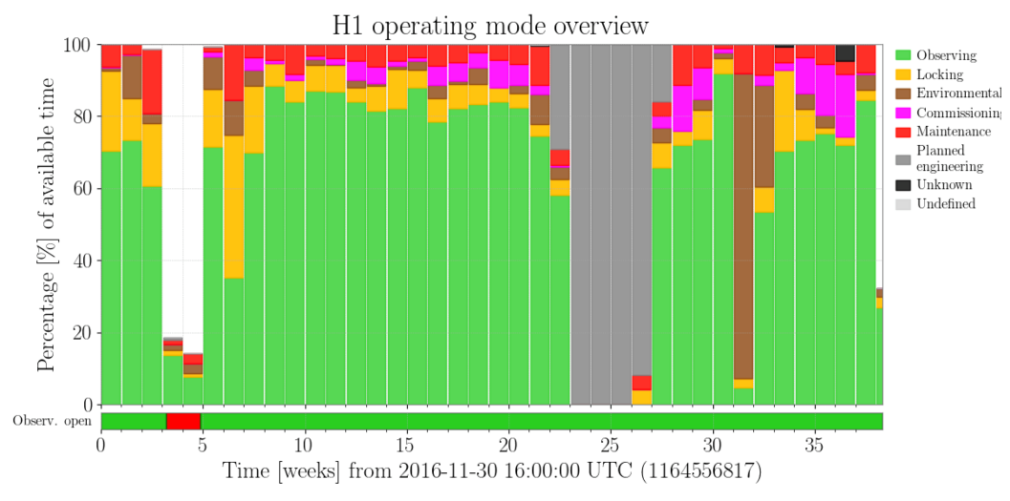
O2 Single IFO Duty Factor for H1
Planned engineering: Vacuum incursion to inspect/remove high absorption spot on one of the mirrors
Environment: Recovery from Montana EQ

Slide 11
OPA
Sarah/Patrick/Erik’s talk

Slide 12
Bonus Slides

Slide 13
Main upgrades since O2: LIGO
H1 ITMX replaced (high absorption spot)
All ETMs replaced (better coating)
All End Reaction Masses replaced (smaller gas film damping)
New monolithic Signal Recycling Mirror
New 70W laser (smaller acoustic noise)
  Higher power for L1 (40-50W)
Squeezing
Stray light control improvement
Tuned mass damper (parametric instability control improvement)

Slide 14
Main upgrades since O2: Virgo
All TMs suspended with fused silica fibers
New 100W laser amplifier
Squeezing
Stray light control improvement
Injection optical bench seismically isolated
Thermally tuned RoCs of ETMs (increased darkness of interferometer output port)

