Slide 1
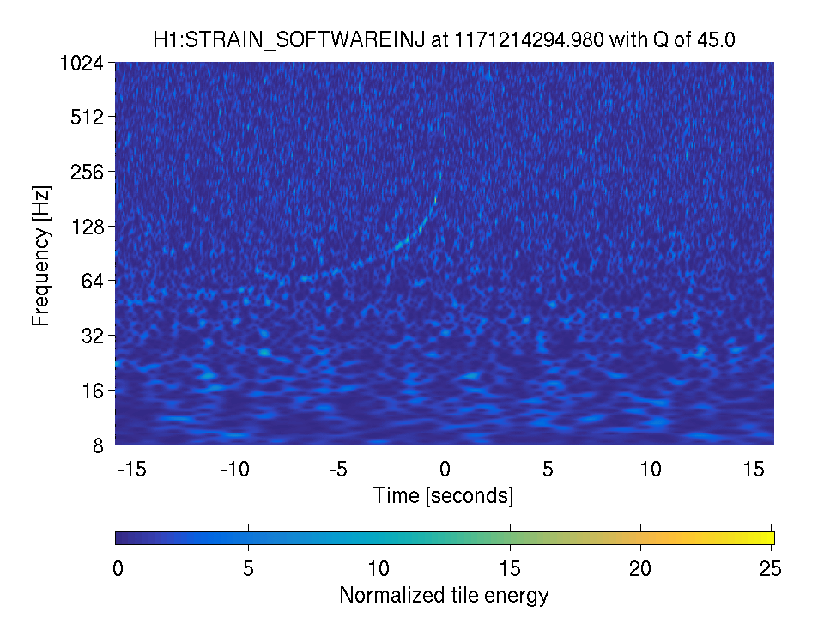
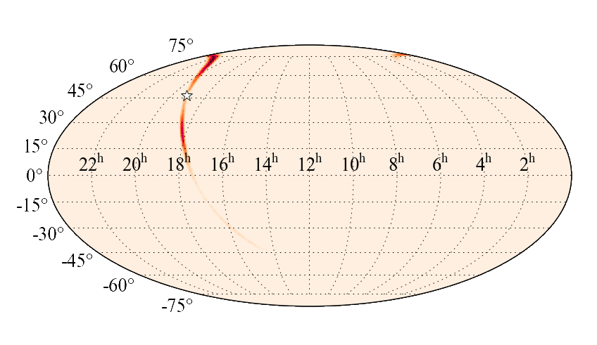
The impact of LIGO noise transients on accurate gravitational-wave event skymaps
J. McIver¹, T.J. Massinger¹, D. Davis², L. Nuttall³, V. Raymond⁴, R. Smith⁵
¹ LIGO Laboratory, Caltech; ²Syracuse University; ³University of Portsmouth; ⁴Cardiff University; ⁵Monash University
APS April Meeting 2019 in Denver, Colorado
LIGO DCC G1802340

Slide 2
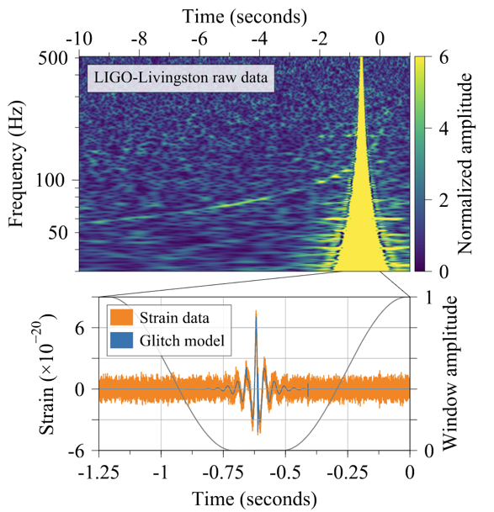
Motivation
What happens to our ability to estimate the properties of an astrophysical GW source that overlaps with a glitch?
Pankow et al. 2018 (arXiv 1808.03619)
explored the impact of glitch mitigation methods.
Powell 2018 (arXiv 1803.11346) studied glitch amplitude relative to injected signal for glitches directly overlapping merger times.
See also Sumeet Kulkarni’s NNETFIX talk.
B.P. Abbott et al (LIGO-Virgo) PRL. (2017)

Slide 3
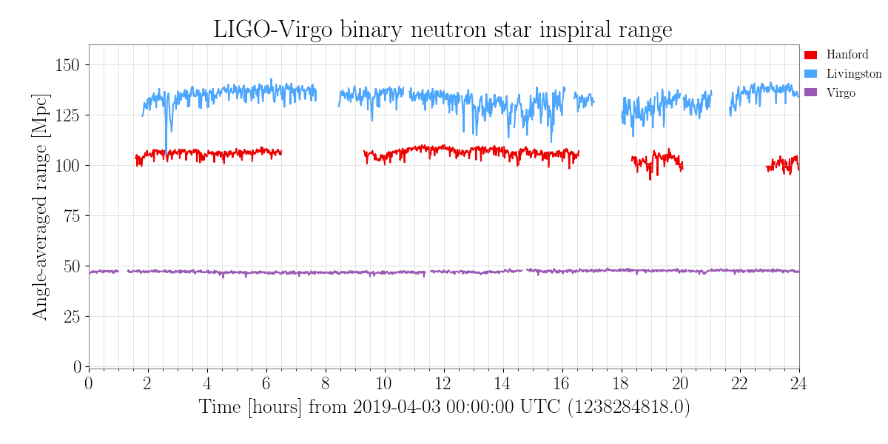
Motivation
Public detector status pages for a day of O3 on the Gravitational Wave Open Science Center (GWOSC):
https://www.gw-openscience.org/detector_status/

Slide 4
Motivation
Light scattering in LIGO-Livingston
Public detector status pages for a day of O3 on the Gravitational Wave Open Science Center (GWOSC):
https://www.gw-openscience.org/detector_status/

Slide 5
Motivation
Light scattering in LIGO-Livingston
Light scattering in LIGO-Hanford
Public detector status pages for a day of O3 on the Gravitational Wave Open Science Center (GWOSC):
https://www.gw-openscience.org/detector_status/

Slide 6
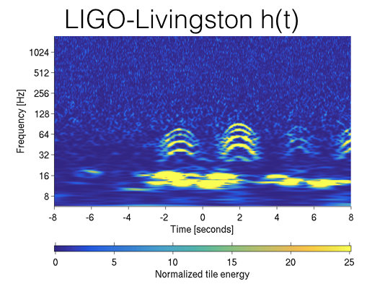
Motivation
Light scattering in LIGO-Livingston
O2 LIGO-Livingston example
Light scattering in LIGO-Hanford
Public detector status pages for a day of O3 on the Gravitational Wave Open Science Center (GWOSC):
https://www.gw-openscience.org/detector_status/

Slide 7
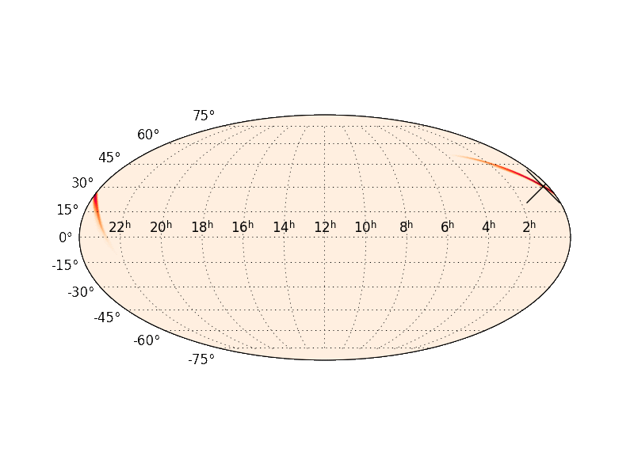
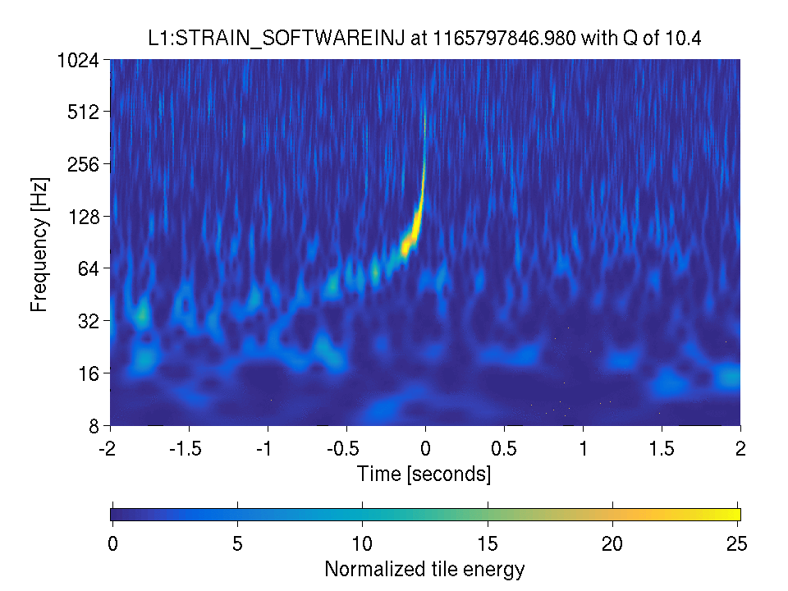
Approach
Method: slide simulated signals over examples of common/problematic LIGO glitches to assess how glitches impact parameter estimation for CBC signals.
Targeted source properties: masses (m₁, m₂, and m_{chirp}), spins (a_{z1}, a_{z2}), and sky localization (RA, dec, and 90% skymap area).

Slide 8
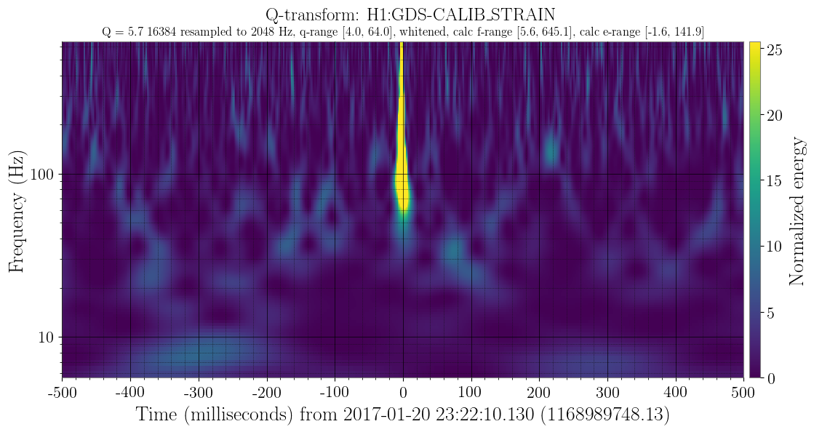
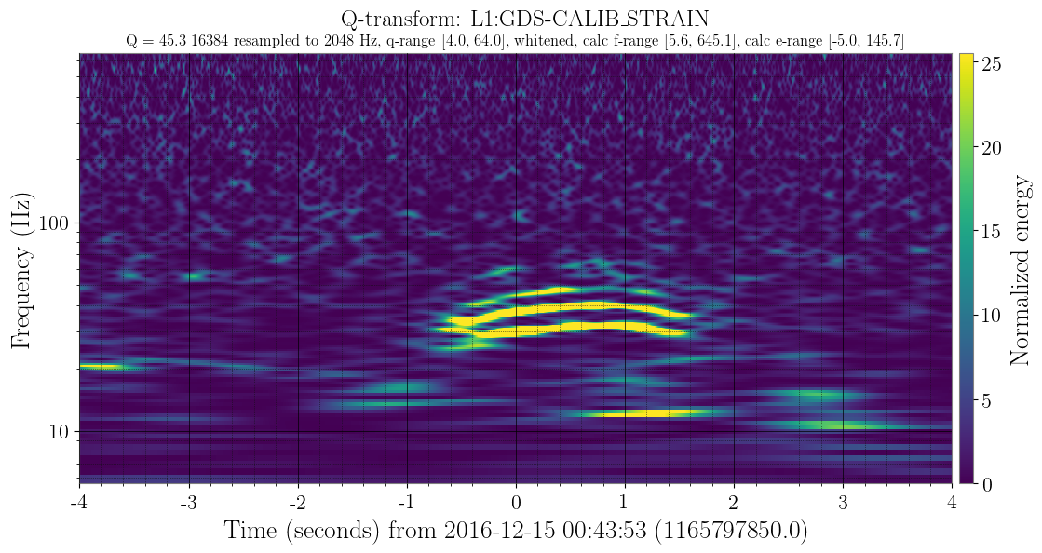
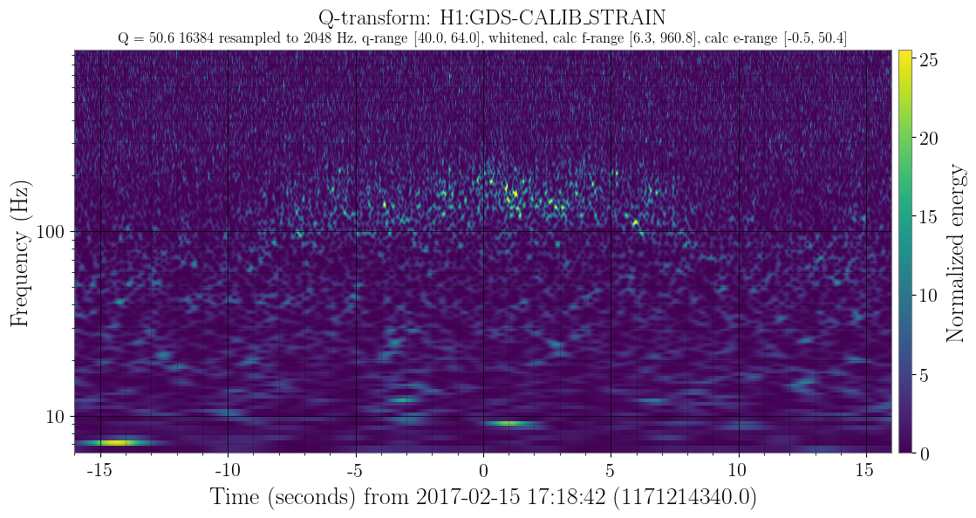
Approach: O2 LIGO glitch set
Targeted glitches: 3 examples each of blips, scattering, “blue mountains” (9 total)
All are known to affect CBC signals, all are difficult to veto with aux channels
B.P. Abbott et al. (LIGO-Virgo) CQG (2017) arXiv /1710.02185
light scattering
blip
“blue mountain”
All glitch examples have clean data in the other LIGO detector for the same time interval.

Slide 9
Approach: O2 LIGO glitch set
Targeted glitches: 3 examples each of blips, scattering, “blue mountains” (9 total)
All are known to affect CBC signals, all are difficult to veto with aux channels
B.P. Abbott et al. (LIGO-Virgo) CQG (2017) arXiv /1710.02185
light scattering
blip
“blue mountain”
All glitch examples have clean data in the other LIGO detector for the same time interval.

Slide 10
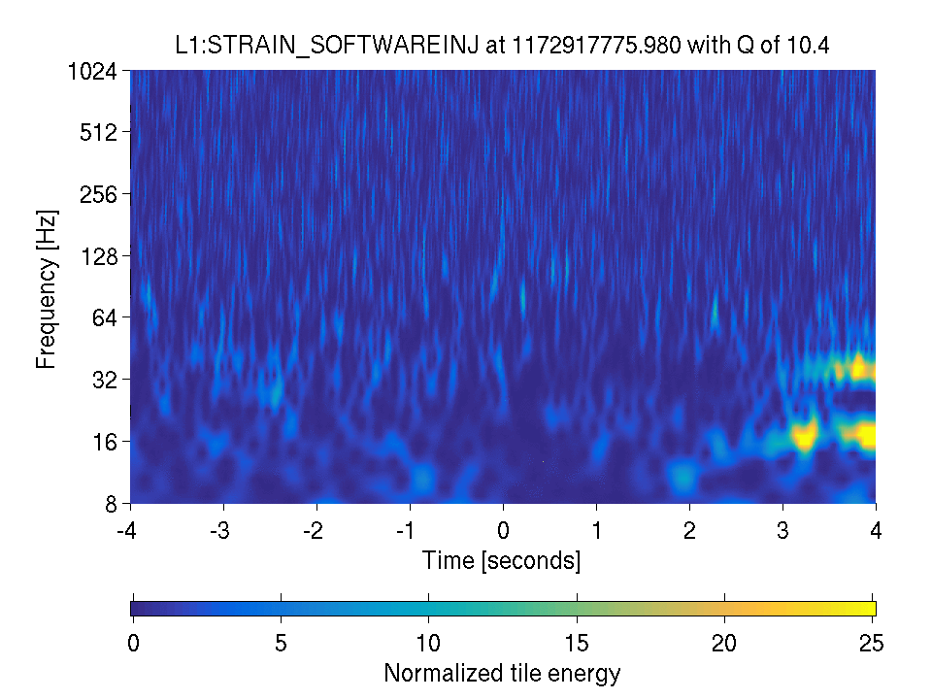
Results: scattering example
Light scattering in LIGO Livingston h(t) during O2 (clean time in LIGO Hanford)
Injected signal: BBH with component masses 7 M⨀ and 12 M⨀
_{(“GW170608-like”)}
‘Omega’ time-frequency projection: S. Chatterji et al. CQG 21(20), 2010

Slide 11
Recovery by a matched filter search
LIGO Livingston h(t)
Recovered for L1 data with PyCBC:
S. Usman et al. CQG 33(21), 2016

Slide 12
Recovery of mass posteriors
Recovered for H1L1 network with lalinference:
J. Veitch et al. Phys. Rev. D 91, 042003 (2015)
LIGO Livingston h(t)
Injected values overlaid
LIGO Livingston h(t)
m₁
Chirp mass
m₂

Slide 13
Recovery of component spins
Recovered for H1L1 network with lalinference:
J. Veitch et al. Phys. Rev. D 91, 042003 (2015)
LIGO Livingston h(t)
Injected values overlaid
LIGO Livingston h(t)
a_{2z}
m₁
a_{1z}
Chirp mass
m₂

Slide 14
Recovery of source sky location
Recovered for H1L1 network with lalinference:
J. Veitch et al. Phys. Rev. D 91, 042003 (2015)
LIGO Livingston h(t)
Injected values overlaid
m₁
LIGO Livingston h(t)
RA
90% sky map area
Dec
Chirp mass
m₂

Slide 15
Jensen-Shannon (JS) divergence of posteriors
LIGO Livingston h(t)
JS divergence, calculated relative to a clean reference time:
D.M. Endres et al. IEEE ToIT 49(7), 2003
JS divergence in quadrature for m₁, m₂, m_{c}, ra, dec, a_{z1}, a_{z2}

Slide 16
Future studies
Paper in prep. that builds statistics for the three targeted aLIGO glitch classes.
How far away from merger time does a well-localized glitch need to be for the skymap to be unaffected, and how does this vary by template length?
What types of noise introduce bias to skymap estimates for BNS or NSBH signals?
Would we mis-characterize a signal as high mass instead of EM bright due to a nearby glitch?
Future targets:
● 3-detector scenarios ● Expanding to target other models/glitches
● Incorporating spin effects

Slide 17
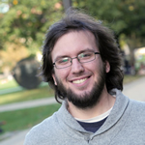
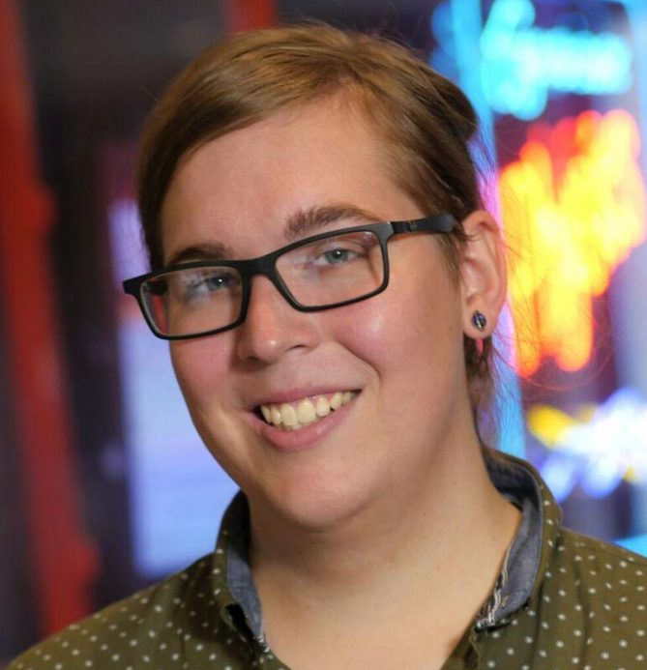
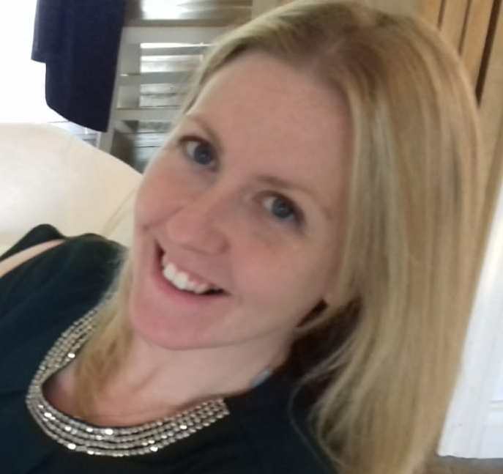
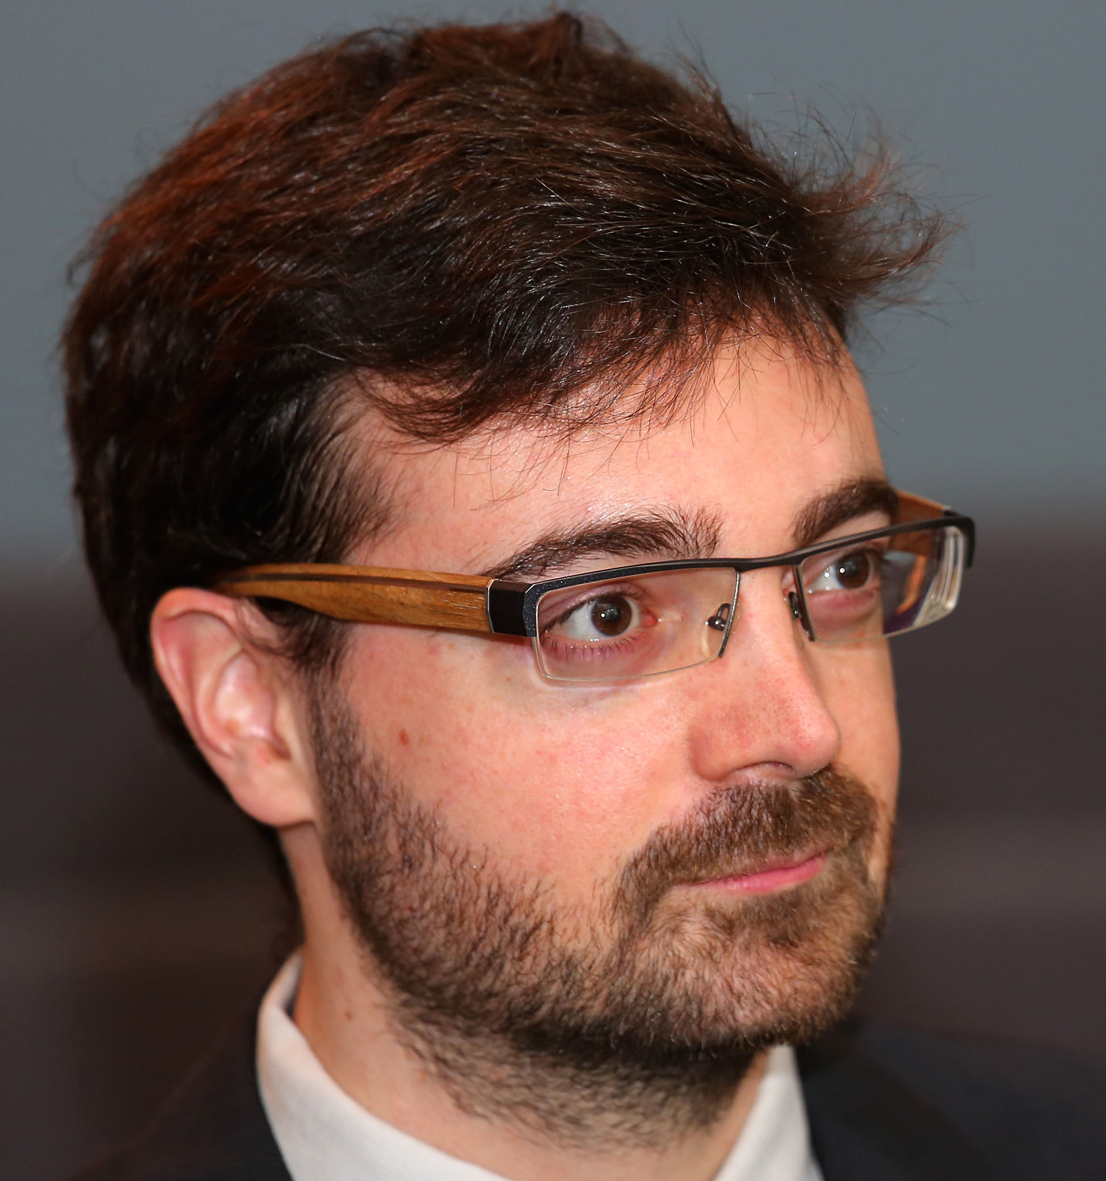
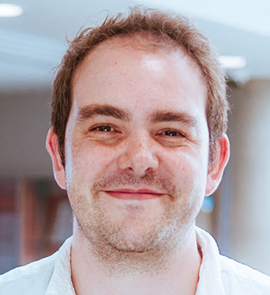
Thank you!
Questions are welcome!
Dr. TJ Massinger
LIGO Lab - Caltech
(Future Dr.) Derek Davis
Syracuse University
Dr. Laura Nuttall
University of Portsmouth
Dr. Vivien Raymond
Cardiff University
Dr. Rory Smith
Monash University

Slide 18
Extra slides

Slide 19
Approach
Inject simulated signals into real LIGO data and use ‘vanilla’ parameter estimation to recover properties.
Detector network: H1, L1
Four model templates chosen to sample different template lengths:
GW170817-like: 1.4 and 1.4 solar masses
NSBH: 30 and 1.4 solar masses
GW170608-like: 12 and 7 solar masses
GW150914-like: 36 and 29 solar masses
Injected coherently with network SNR=15 and zero spin.

Slide 20
Results: a guide
For each example, all results are shown on the same time axis.
Omegascan¹ of ifo with the glitch example
Example posteriogram for one of the targeted parameters
Jensen-Shannon (JS) divergence²
PyCBC single template newSNR³ (single detector)
For two distributions, P_1 and P_2, the JS divergence is:
We can add the JS divergence in quadrature for multiple parameters (i.e. RA and dec; or chirp mass and component masses, or all parameters of interest) for a single-value summary of the divergence of the PE posteriors relative to a clean reference time
¹ S. Chatterji et al. CQG 21(20), 2010
² D.M. Endres et al. IEEE ToIT 49(7), 2003
³ S. Usman et al. CQG 33(21), 2016

Slide 21
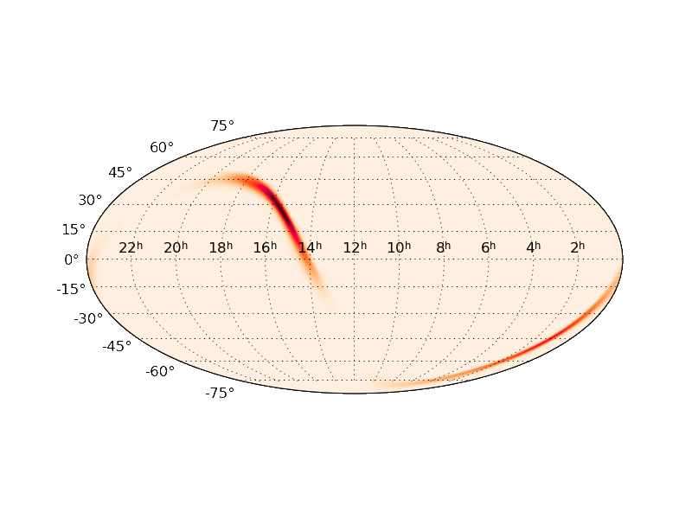
Results: scattering example
Light scattering in LIGO Livingston h(t) during O2 (clean time in LIGO Hanford)

Slide 22
Results: scattering example
Light scattering in LIGO Livingston h(t) during O2 (clean time in LIGO Hanford)
‘Omega’ time-frequency projection: S. Chatterji et al. CQG 21(20), 2010

