Slide 1
LSC and Virgo plans for data sharing
David Shoemaker
For Virgo and LSC
1 December 2018
G1802254

Slide 2
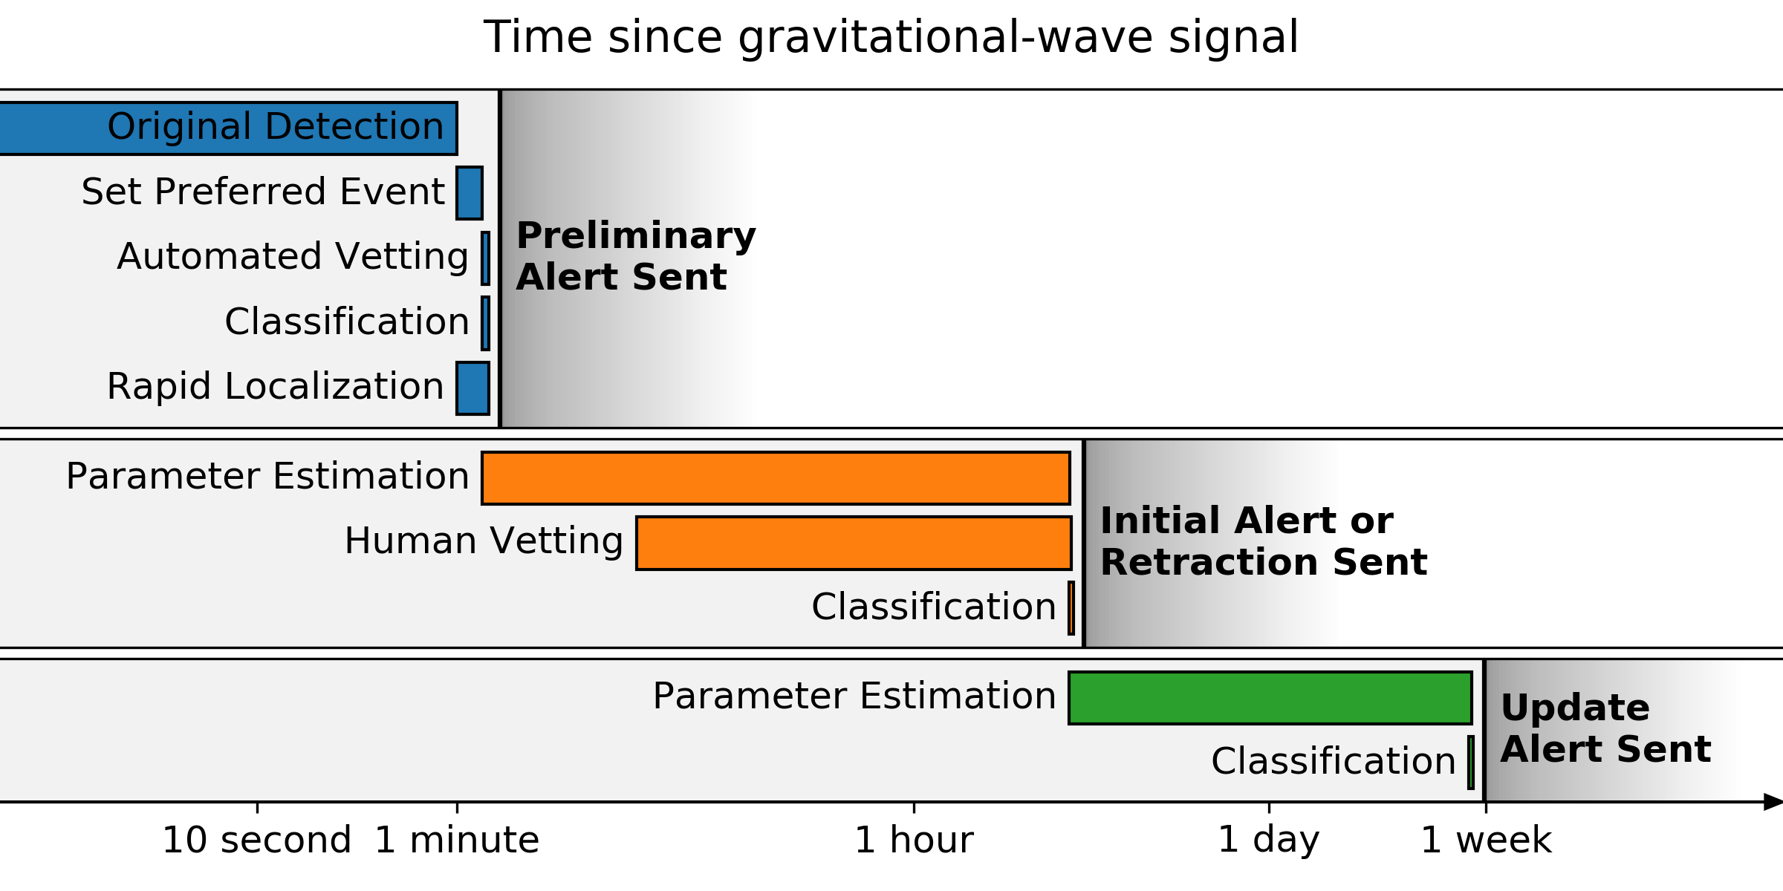
Alert timeline for O3

Slide 3
Alert timeline for O3
Within 1–10 minutes after GW trigger time, a preliminary notice will be sent autonomously, with a skymap as soon as it is available

Slide 4
Alert timeline for O3
Within 24 hours after the GW trigger time (goal: within 4 hours for BNS or NSBH sources), the Initial notices and circulars will be distributed with an update for the sky localization area and the source classification.
They are vetted by human instrument scientists and analysts.
The initial circular will be labeled as retracted or confirmed.
Note that the initial circular is considered the first LIGO/Virgo publication of a GW candidate, appropriate to cite in publications.

Slide 5
Alert timeline for O3
Update notice and circulars are sent whenever the sky localization area or significance accuracy improves (e.g. as a result of improved calibration, de-glitching, or computationally deeper parameter estimation).

Slide 6
Notice Contents
Date, Author, Where/When
FAR - Estimated false alarm rate in Hz
SkyMap - URL of HEALPix FITS localization file
Group -- CBC or Burst; Pipeline
If Burst: Central Frequency, Duration, Fluence
If CBC:
Probability that the source is a BNS, NSBH, BBH merger, or noise
Probability of a neutron star, and ejection of neutron star matter
The objective is to provide the information needed to find a host
The circular update available within 24 hours will include text with an expert evaluation of the impact of any data quality issues

Slide 7
Engineering Runs
ER13: 08:00 PT 14 Dec → 06:00 PT 18 Dec
ER14: Earliest start 1 March, up to 4 weeks in duration; O3 follows directly
We see ERs as a way to fully exercise our instruments, data quality, calibration, pipelines
During Engineering Runs and other times of stable instruments before the start of O3, no automatic alerts will be sent except as non-astrophysical tests.
If triggers of interest during the ERs, we will otherwise follow through as planned for the Observing run for all aspects that are ready
GCNs will be distributed with the lowest feasible latency, and (as usual) should be cited by other papers
As in O3, retraction will be made if we learn a trigger was not astrophysical
If of sufficient interest, LVC will publish as quickly as feasible papers on ER events, releasing (as usual) data around the event and data packages

Slide 8
Significance
Target estimated contamination (non-astrophysical triggers): ~10% of public alerts across all categories together
BNS, NSBH & other transients may individually have higher contamination
The final significance of the candidate will be estimated in the offline analysis
False Alarm Rates are currently anticipated to be 1/month for cbc and 1/yr for burst
These thresholds will change as the sensitivity of the instruments improves if we hold the contamination fixed

Slide 9
Expected Detection rates in O3
Binary neutron stars (BNS)
1/month to 1/year
Median 90% credible localization 120-180 deg²; 12-21% localized < 20 deg²
Binary black holes (BBH)
few/week to few/month
Neutron-star black-hole binaries (NSBH)
Uncertain, estimates include zero
Other transients
Unknown

Slide 10
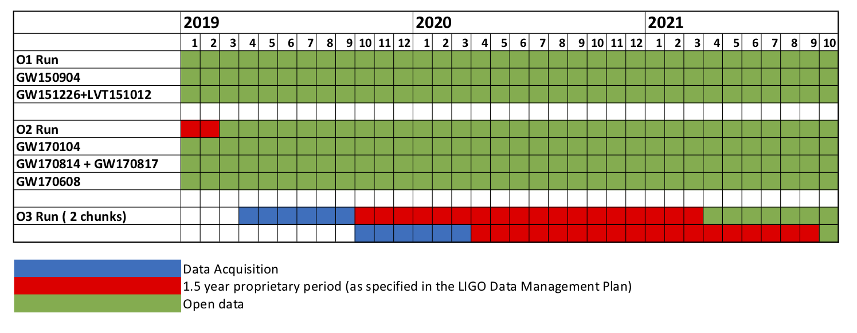
Bulk Data Releases for O3
Bulk Releases are planned to be (no later than) 18 months after the end of a 6-month data acquisition period
E.g., if O3 starts in April 2019, the first planned bulk data release would be April 2021
(O2 data will be public at end-February 2019)

Slide 11
Bulk Data Releases for O3
Release will take the same format as previous releases
The 18-month proprietary period serves to enable preparation of the data for analysis (re-calibration, subtraction of linearly-related auxiliary channels, data quality assessment and flagging) and internal processing by the Collaborations
As laid out in the LIGO Laboratory-NSF Data Management Plan
We will strive to complete these steps as quickly as possible, which could enable an earlier bulk release of data

Slide 12
Gravitational-Wave Open Science Center
GWOSC -- https://www.gw-openscience.org
LIGO and Virgo’s portal for
Bulk data
Event 1-hour time-series data, etc.
Pointers to papers, data behind figures, posterior samples
Pointers to analysis codes
Pointers to Workshop materials
The nominal scope is determined by the LIGO Laboratory-NSF Data Management Plan
Some postings beyond the DMP scope
Community requests to GWOSC on other elements of interest welcome

Slide 13
The Network, the Future
LIGO and Virgo coordinating closely on O3 planning
Observing, Analysis and publication, Data releases
KAGRA hoping to join toward the end of O3
Working toward joint analysis
O4 Currently foreseen for early-2021 to mid-2022, at design sensitivity
Hoping it will be the 4-detector network of 2xLIGO, Virgo, KAGRA
LSC, Lab, NSF considering shorter periods before release of data
Decisions will depend on ability to shorten preparation and analysis times, scope of key core collaboration analysis goals
A+ Upgrade follows for LIGO, AdV+ for Virgo
LIGO-India comes into play
Network planning to be done

Slide 14
In closing,
Alerts: Please see Public Alerts User Guide for additional information -- that site will continue to be updated
https://emfollow.docs.ligo.org/userguide/index.html
Questions/comments for Public Alerts welcomed at page above
Presentation on Alerts for Observers: LIGO-G1802186-v3
More general Observer/Data access questions/comments to Spokespersons
lsc-spokesperson@ligo.org - virgo-spokesperson@ego-gw.it
Hope to nourish a flourishing community doing science with GW data

