Slide 1
LIGO and Virgo instrument status and timeline of ER13, ER14 and O3
Lisa Barsotti, Nicolas Leroy,
Keita Kawabe, Brian O’Reilly, Alessio Rocchi
for the LIGO-VIRGO
Joint Run Planning Committee
LIGO-G1802174

Slide 2
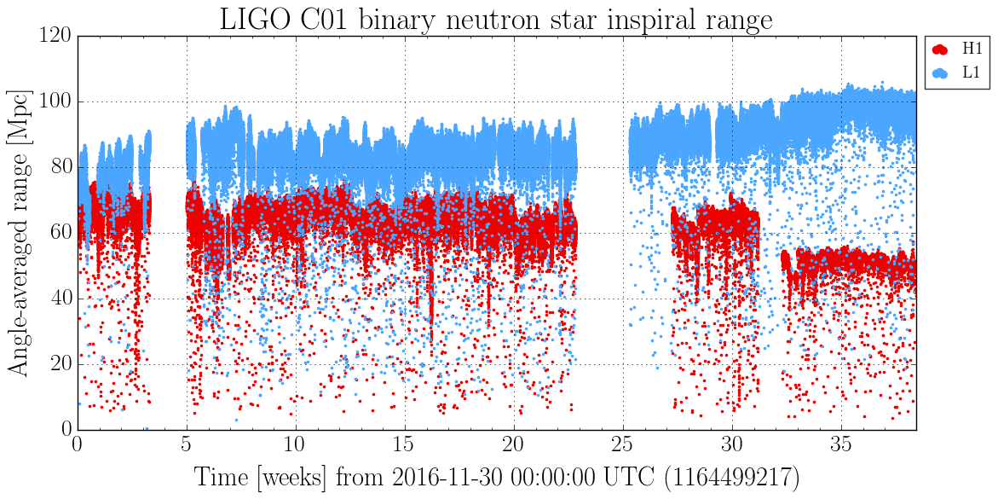
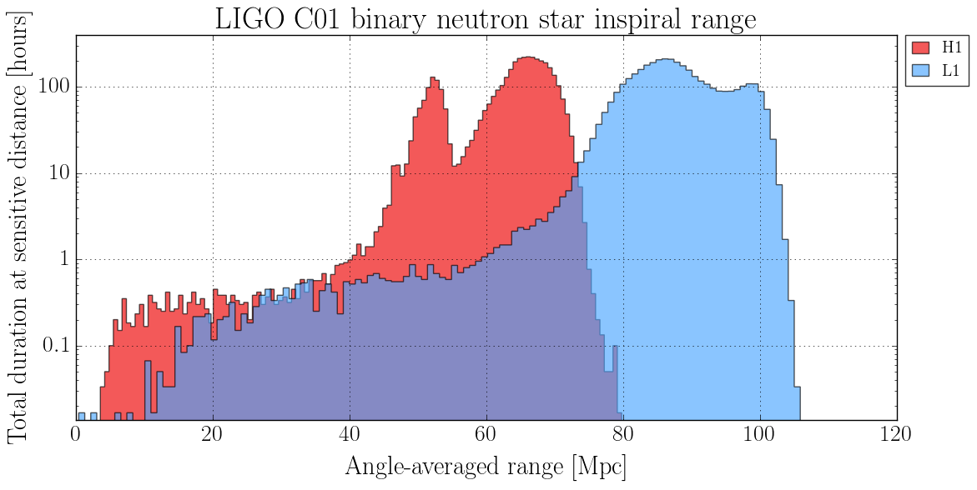
BNS Range in O2: LIGO L1 and H1
LIGO-LIVINGSTON:
100 Mpc towards the end of O2, best sensitivity ever
LIGO-HANFORD:
noise performance degraded during O2, some instrumental noise
removed offline
(“data cleaning”)

Slide 3
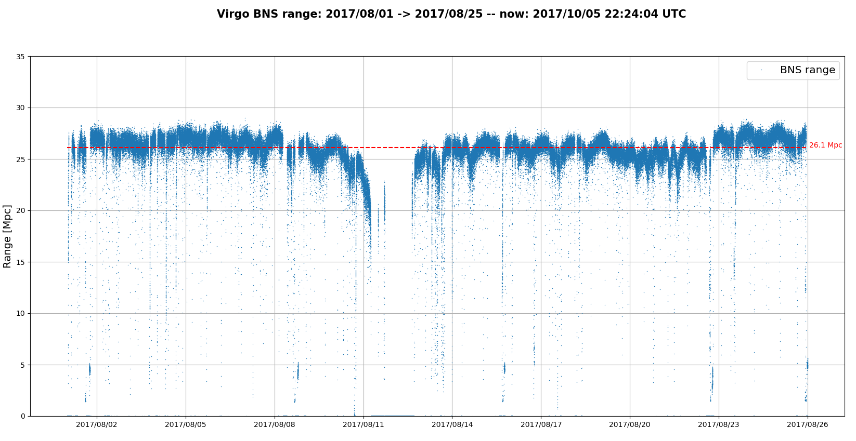
BNS Range in O2: VIRGO
First lock in March 2017, joined O2 in August with 25-30 Mpc BNS (only 3 months of “noise hunting”!)
30 Mpc
25 Mpc

Slide 4
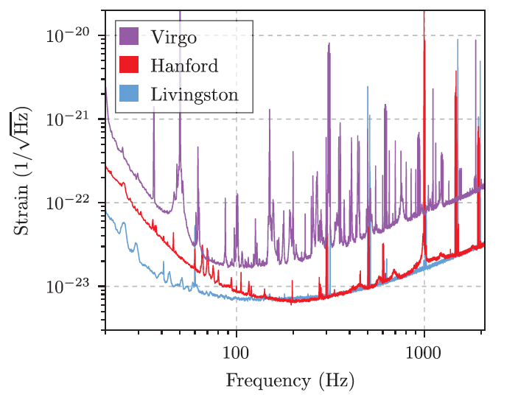
Instrument work after O2
(O3 goals: 120+Mpc LIGO, 60+ Mpc Virgo)
Noise performance in August 2017
Basic plan at all sites:
Improve the high frequency performance by increasing the amount of circulating laser power + squeezed light injection
Mitigate back scattered light
Identify and reduce other technical noises at low frequency
Some specific interventions:
Virgo: replace mirror suspension steel wires with fibers
Hanford: track the origin of excess noise at both high and low frequency

Slide 5
Current Status: L1 (Nov 2018)
Best range observed so far close to 115 Mpc
Modest increase in laser power so far, plus 25% shot-noise reduction with squeezed light injection
Some successful mitigation of technical noises
Work still in progress on all fronts (more power, higher levels of squeezing, noise hunting)
In parallel: data quality improvements and interferometer robustness

Slide 6
Current Status: H1 (Nov 2018)
Recovered from late O2 noise excess, improved over best O1 performance
Best range observed so far close to 90 Mpc
Modest increase in laser power so far, squeezing not yet injected
Work still in progress on all fronts (more power, squeezing, noise hunting)
In parallel: data quality improvements and interferometer robustness

Slide 7
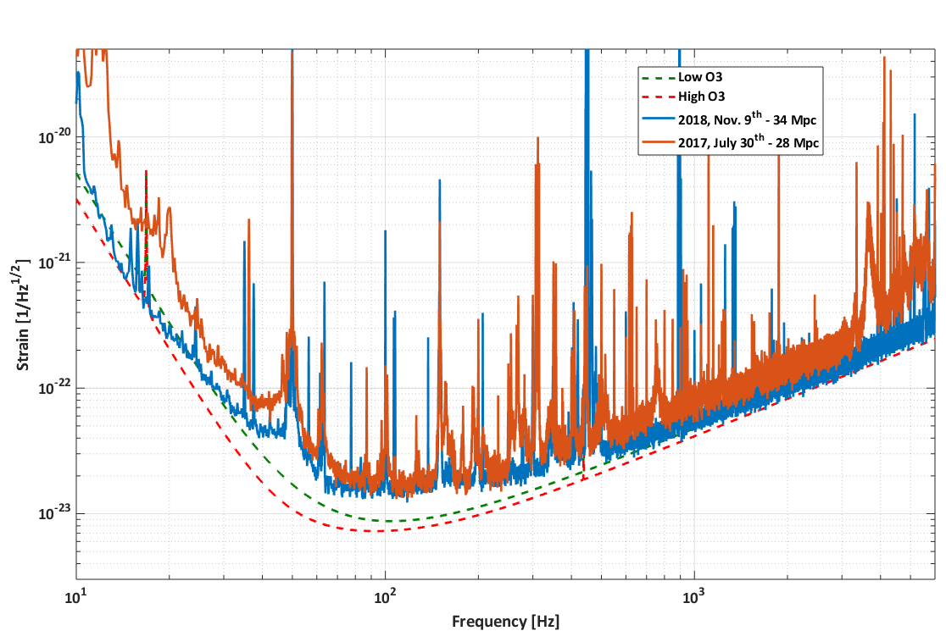
Current Status: VIRGO
Successfully replaced steel fibers with fused silica fibers
Exposed low frequency noise, some fixed
Power doubled wrt O2, squeezing not yet injected
Best range observed so far close to 35 Mpc
In parallel: data quality improvements and interferometer robustness
ORANGE: Sensitivity in O2
BLU: Best current status

Slide 8
LIGO-G1801056

Slide 9
O3 Observing Strategy
24/7 operation, with planned downtime for maintenance and (minimal) commissioning:
  of the weekly 168h, loss up to 21h (12%) of triple coincidence (21h → 12h double coincidence, 9h Virgo only)
Unplanned downtime: environmental disturbances, some of which are simultaneous (large earthquakes), some are local (storms, power outage) → up to 10% downtime in O2 for single interferometer
Extraordinary downtime: if major problem is observed during the run and need immediate fix, or major noise/data quality problem is identified and we think we can quickly fix it (example in O2: cleaning of one of the input arm mirrors in H1)

Slide 10
Conclusions
Intense hardware changes at all of the three sites after O2
  some delays, but good progress
  all of the instruments have now surpassed previous best noise performance
  Target is: 120Mpc+ for LIGO, 60+ Mpc for VIRGO
ER13 schedule established:
  8amPT Dec 14, 2018 – 6amPT Dec 18, 2018
ER14+O3 schedule shifted by 6 weeks:
  ER14 (up to 4 weeks) starting around March 1st, then transitioning into O3 late March/early April
  Change necessary to further improve noise, data quality, robustness

