Slide 1
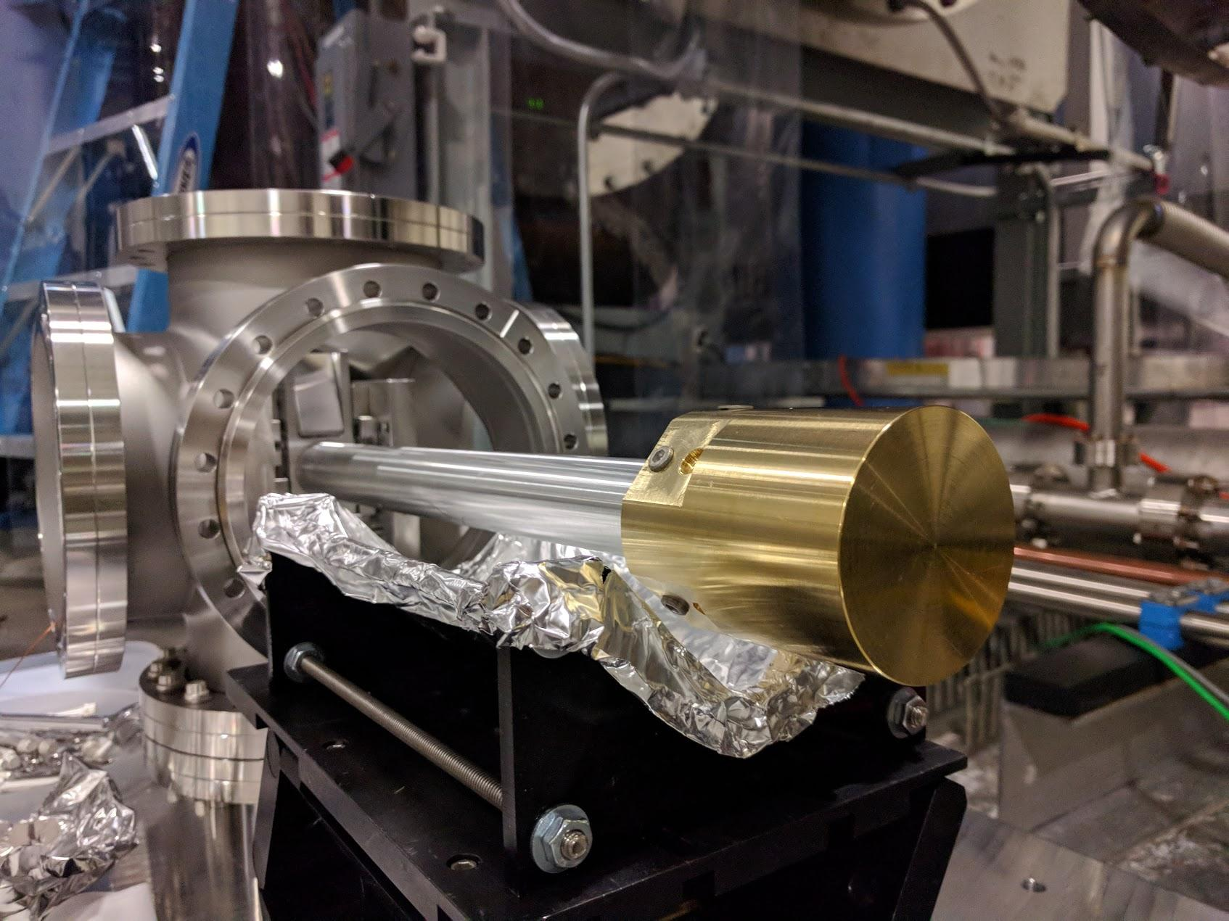
Integration of
Beam Rotation Sensors
to seismic isolation
Arnaud Pele
Michael Ross
Low frequency workshop
Birmingham, Aug 30th 2018

Slide 2
Overview
Introduction on seismic isolation at LIGO
BRS installation and challenges
BRS integration to ISI, some projections
What limits us at low-f ?

Slide 3
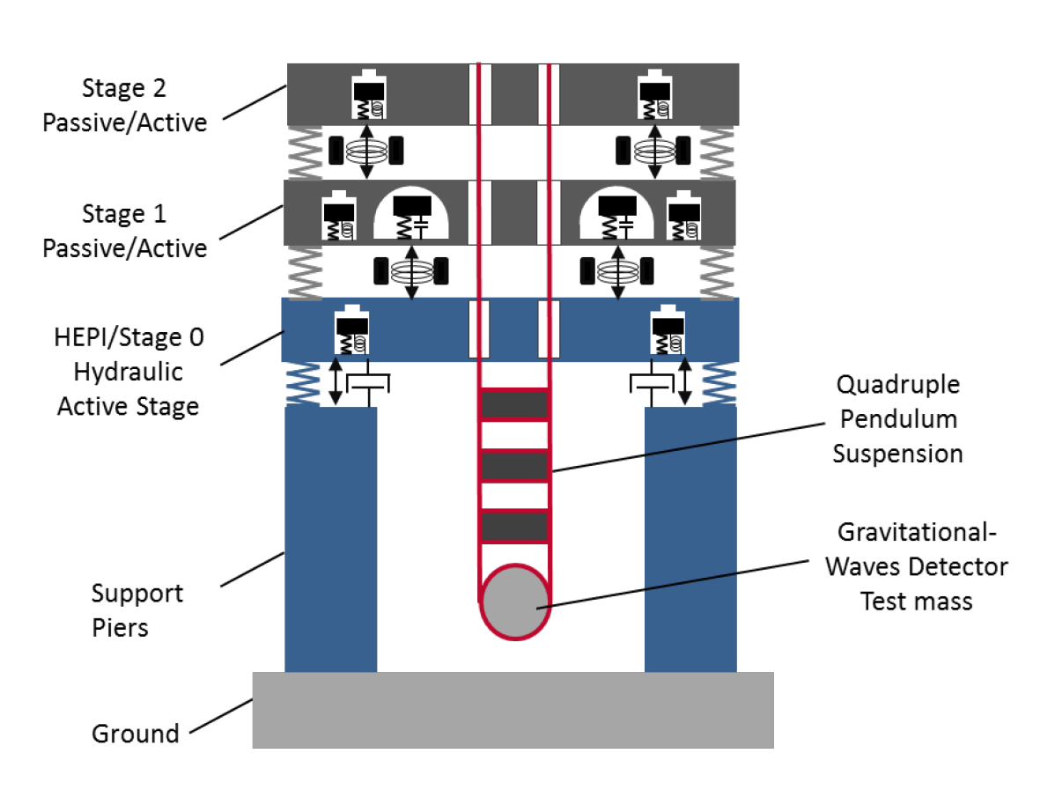
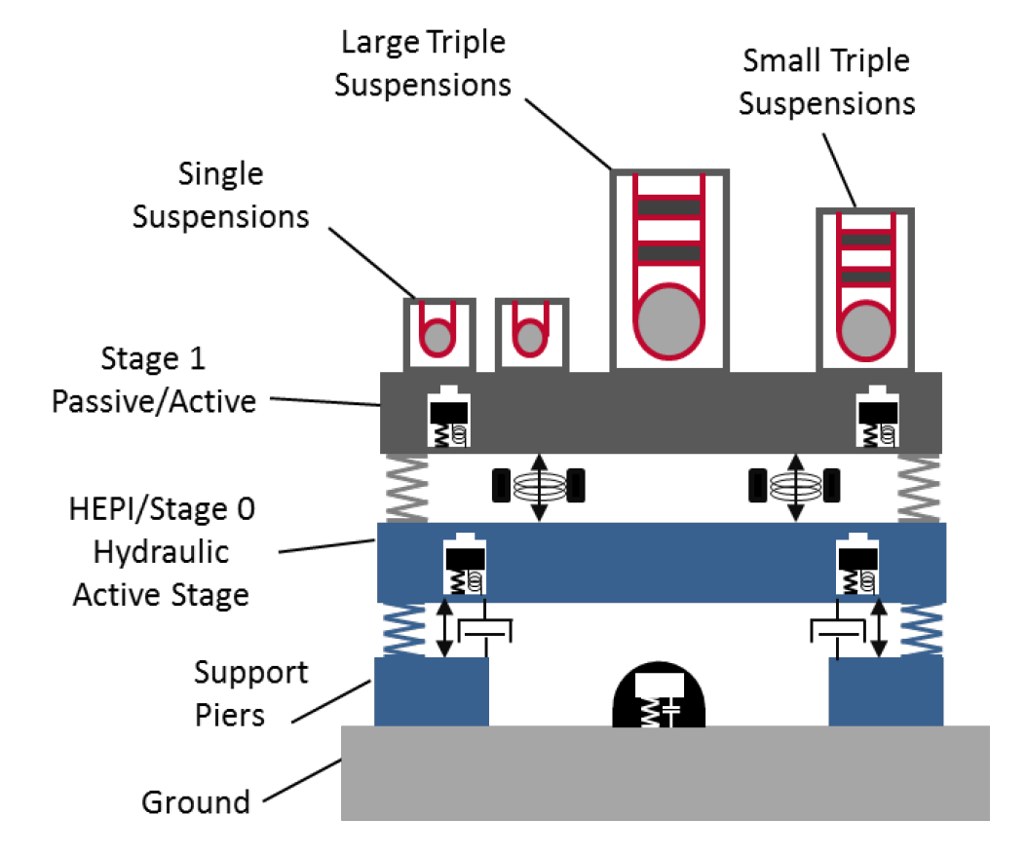
ISI (Internal Seismic Isolation) : Introduction
Provide vibration isolated support for the suspended optics
Help maintain and acquire resonance conditions for the optical cavities
Distinguish between mirror vibrations and gravitational wave signals
F. Matichard [4]

Slide 4
ISI (Internal Seismic Isolation) : Introduction
With single or double mass-spring systems, combination of passive and active isolation to cancel ground motion
Steel blades and flexure rods between the ISI stages for vertical and horizontal passive isolation
Actively limits the input ground motion from 0.1Hz to ~30Hz with combination of magnetic actuators, position and inertial sensors
Maximum total of 7 isolation stages for the core optics (HEPI + BSC-ISI + QUAD)

Slide 5
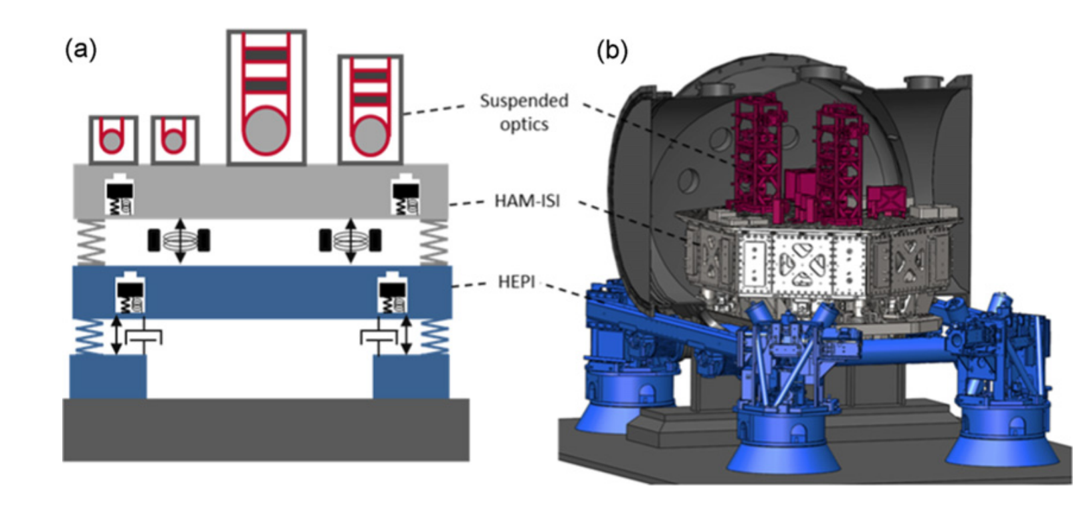
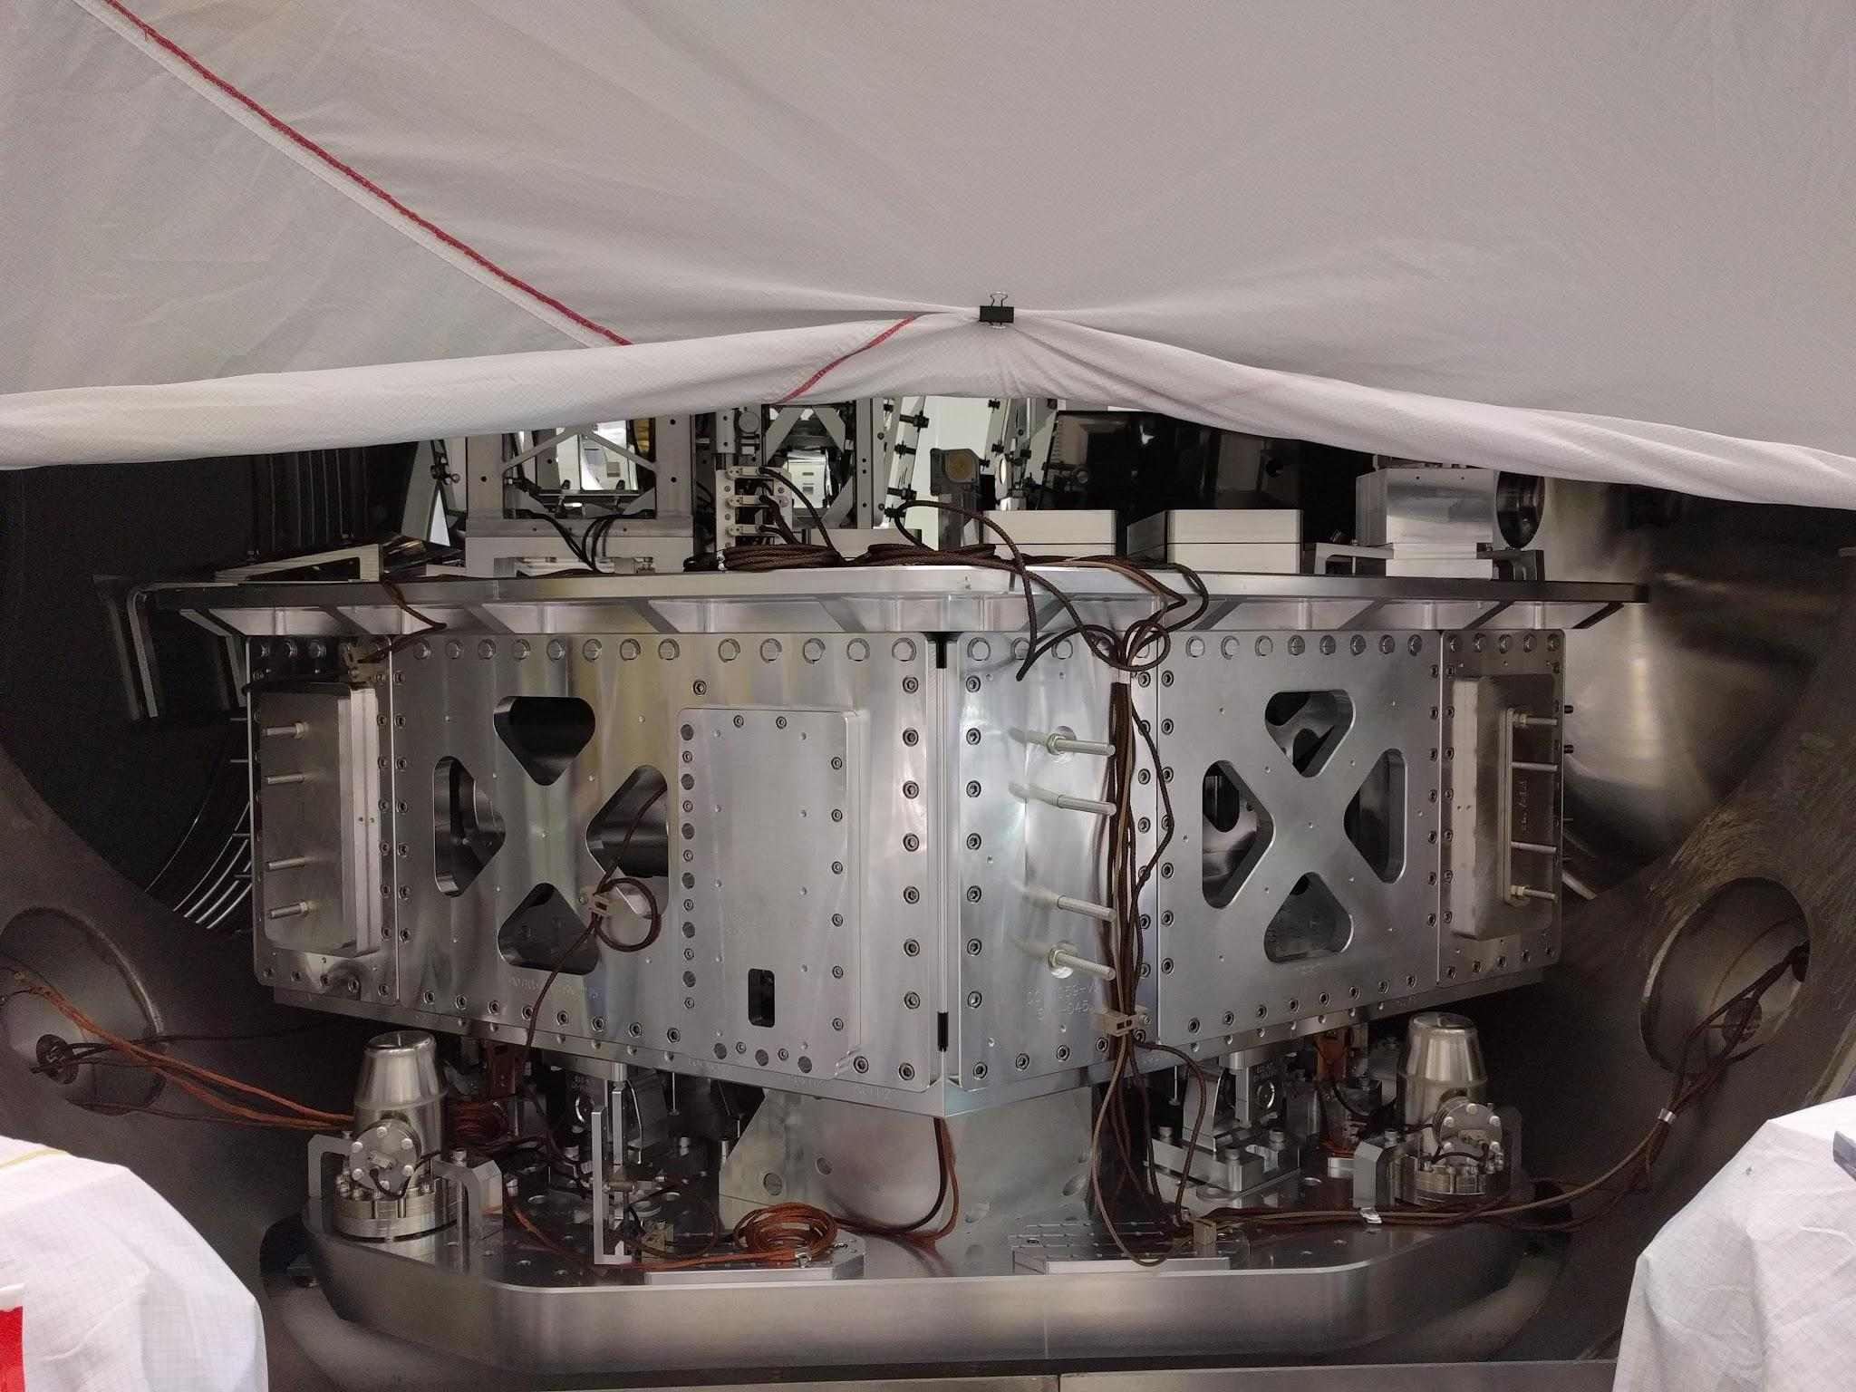
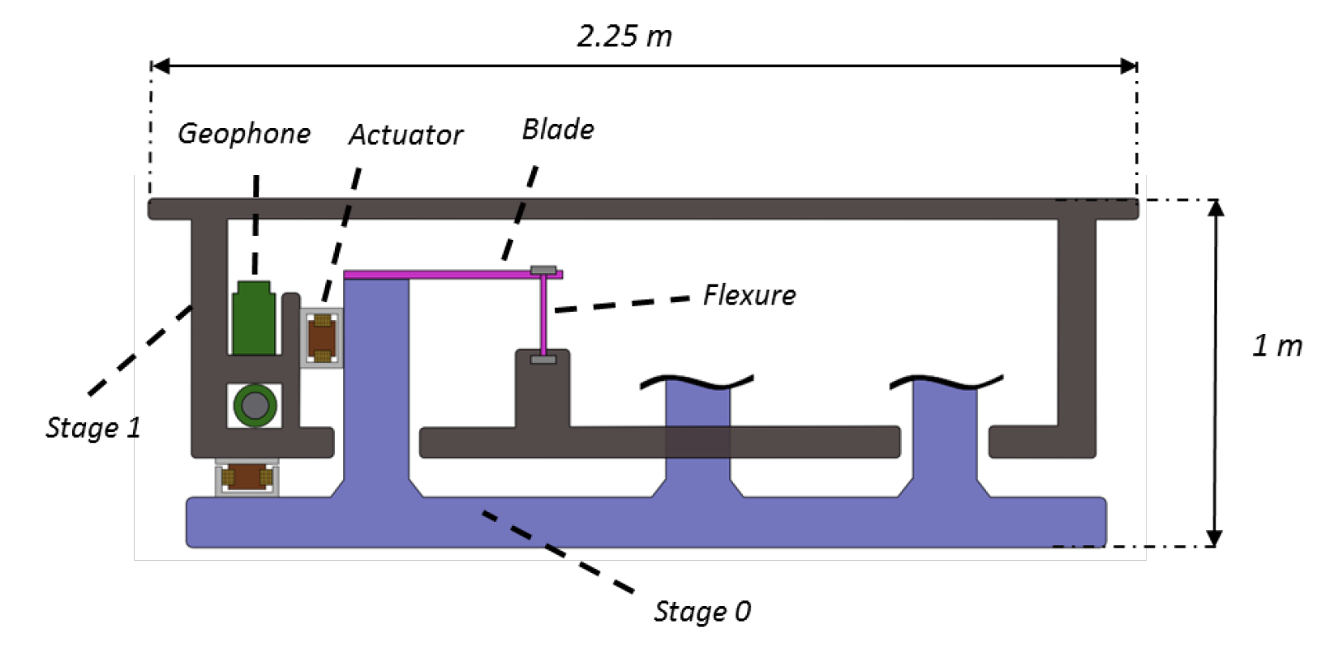
HAM-ISI

Slide 6
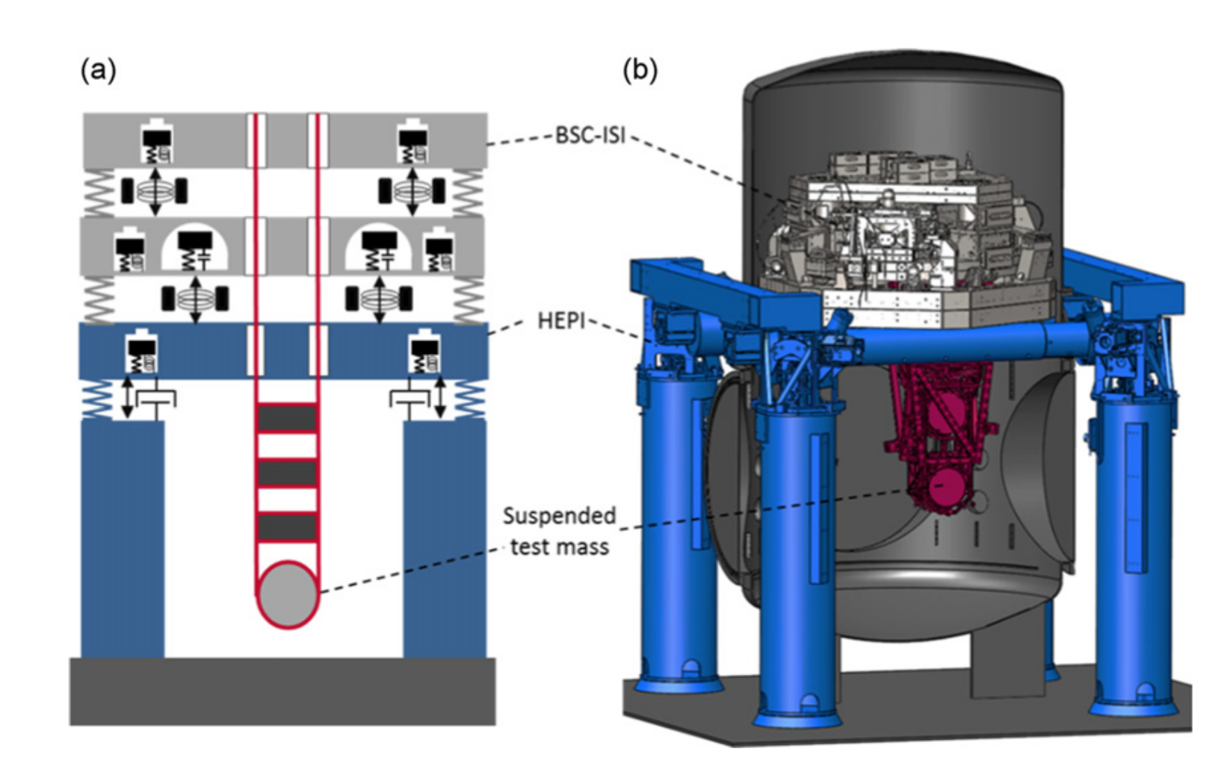
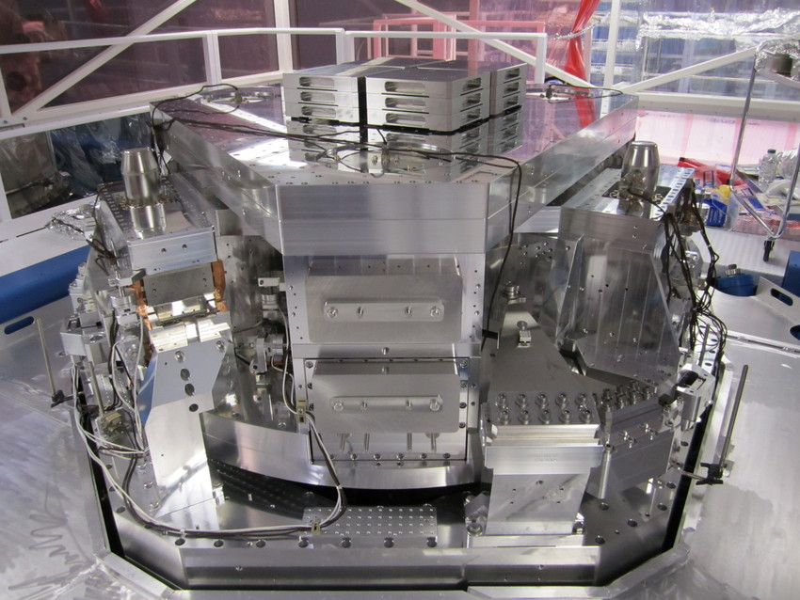
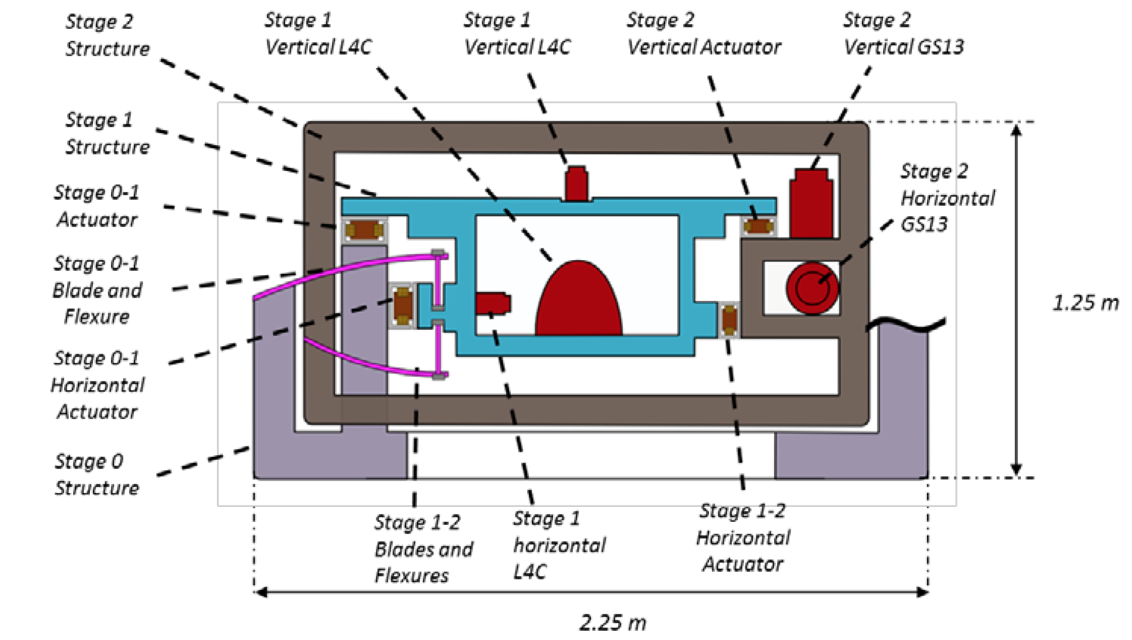
BSC-ISI
5.5 m

Slide 7
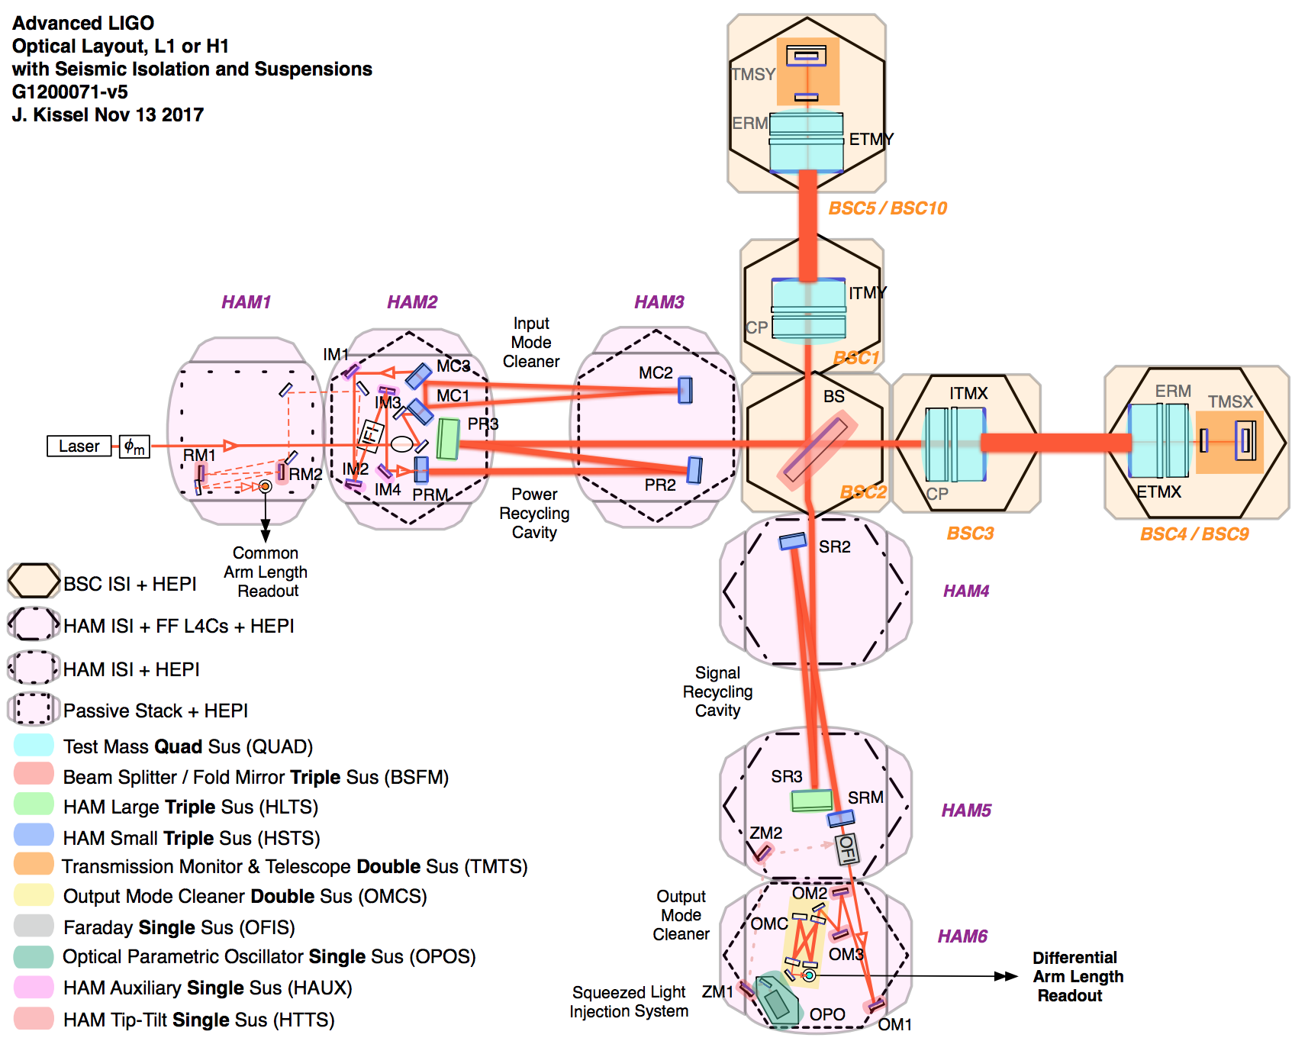
Kissel, G1200071

Slide 8
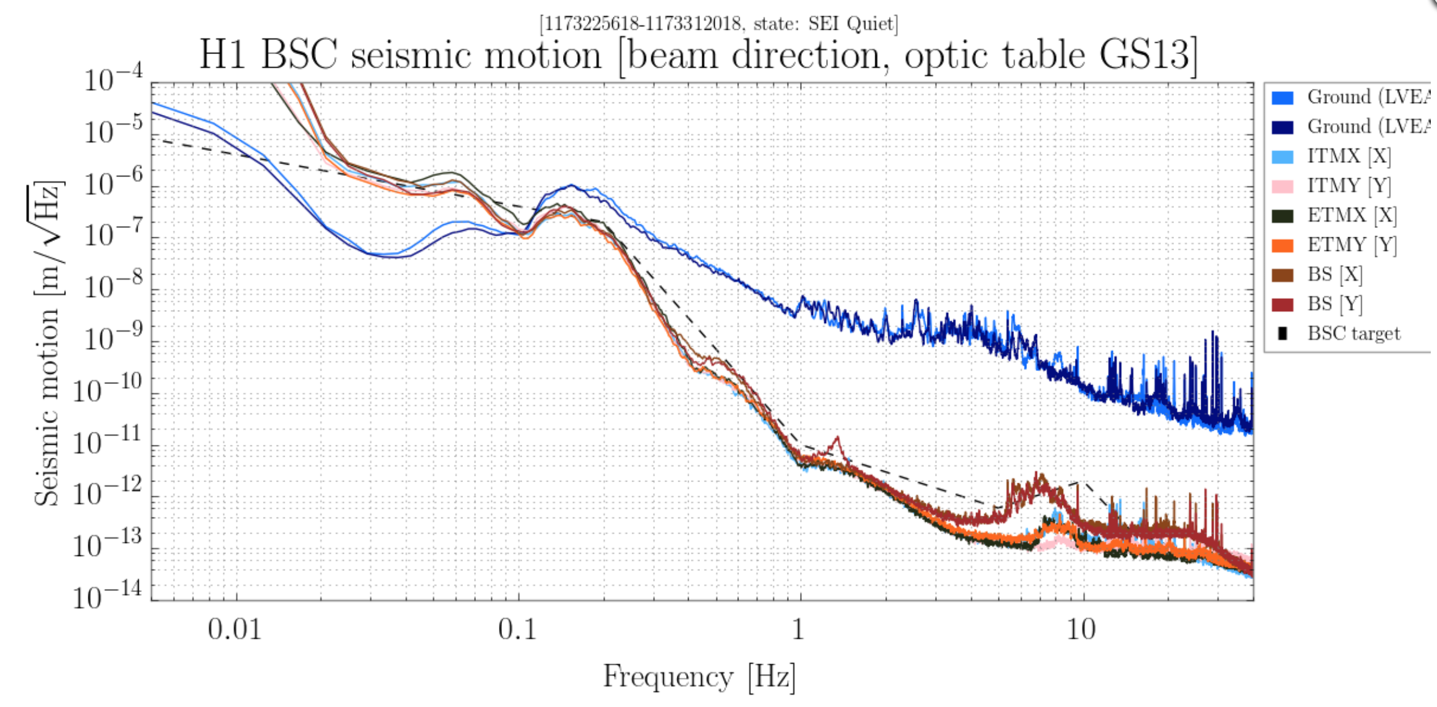
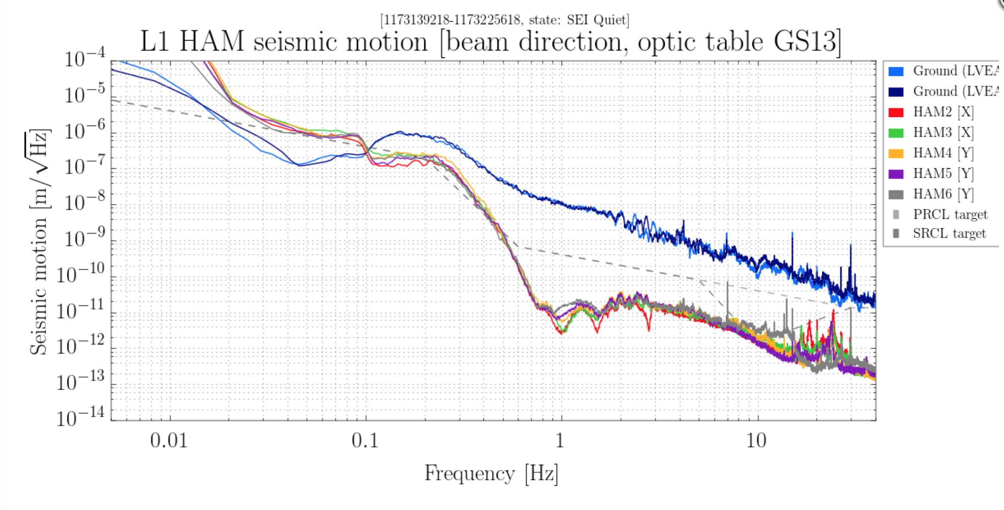
Requirements for seismic isolation : >1Hz
At 10Hz BSC-ISI < 2e-12m/sqrt(Hz) in all horizontal dofs [1]
At 10Hz HAM-ISI < 4e-11m/sqrt(Hz) for PRCL and 4e-12m/sqrt(Hz) for SRCL [3]
>x100
x100

Slide 9
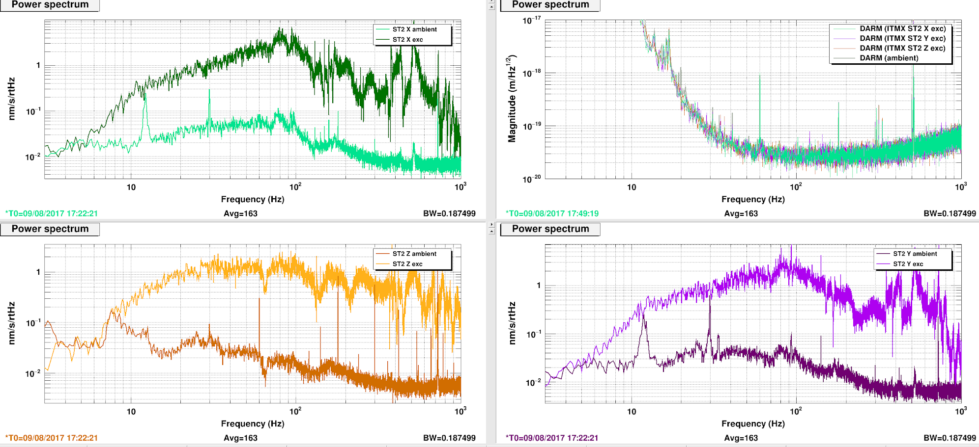
Requirements for seismic isolation : >1Hz
Certainly good enough : Large injections (x10 ambient noise) from BSC-ISI are not showing in the DARM sensitivity.
llo alog 35314

Slide 10
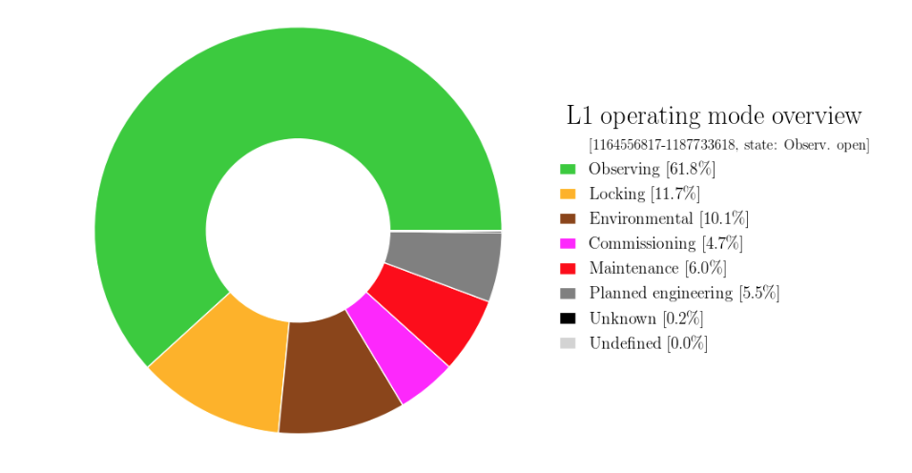
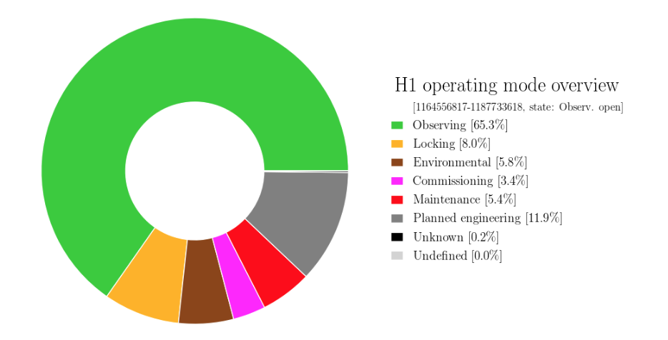
Requirements for seismic isolation : <1Hz
1-2 µm-rms typical microseismic amplitude suppressed by a factor of 5-10 [2]
Below 0.1Hz, less clearly defined requirements, hard to measure motion at those frequencies with seismometers
In reality: hard to lock with>2-3um rms microseism motion (100mHz-400mHz) >1um rms earthquake motion ( 30mHz-100mHz)
Down time from low-frequency input motion (wind/microseism/earthquakes) : 5-10% at both sites + 10% locking
Detchar summary pages

Slide 11
Active isolation, general control scheme
Feedback: Blending of sensors, one or two inertial sensors > 0.1Hz with position sensors < 0.1Hz, (similar scheme in all 6 dofs)
nL4C
1 Hz
nT240
CTRL
0.1 Hz
1 Hz
L4C
T240
nCPS
X1
F1
CPS
0.1 Hz

Slide 12
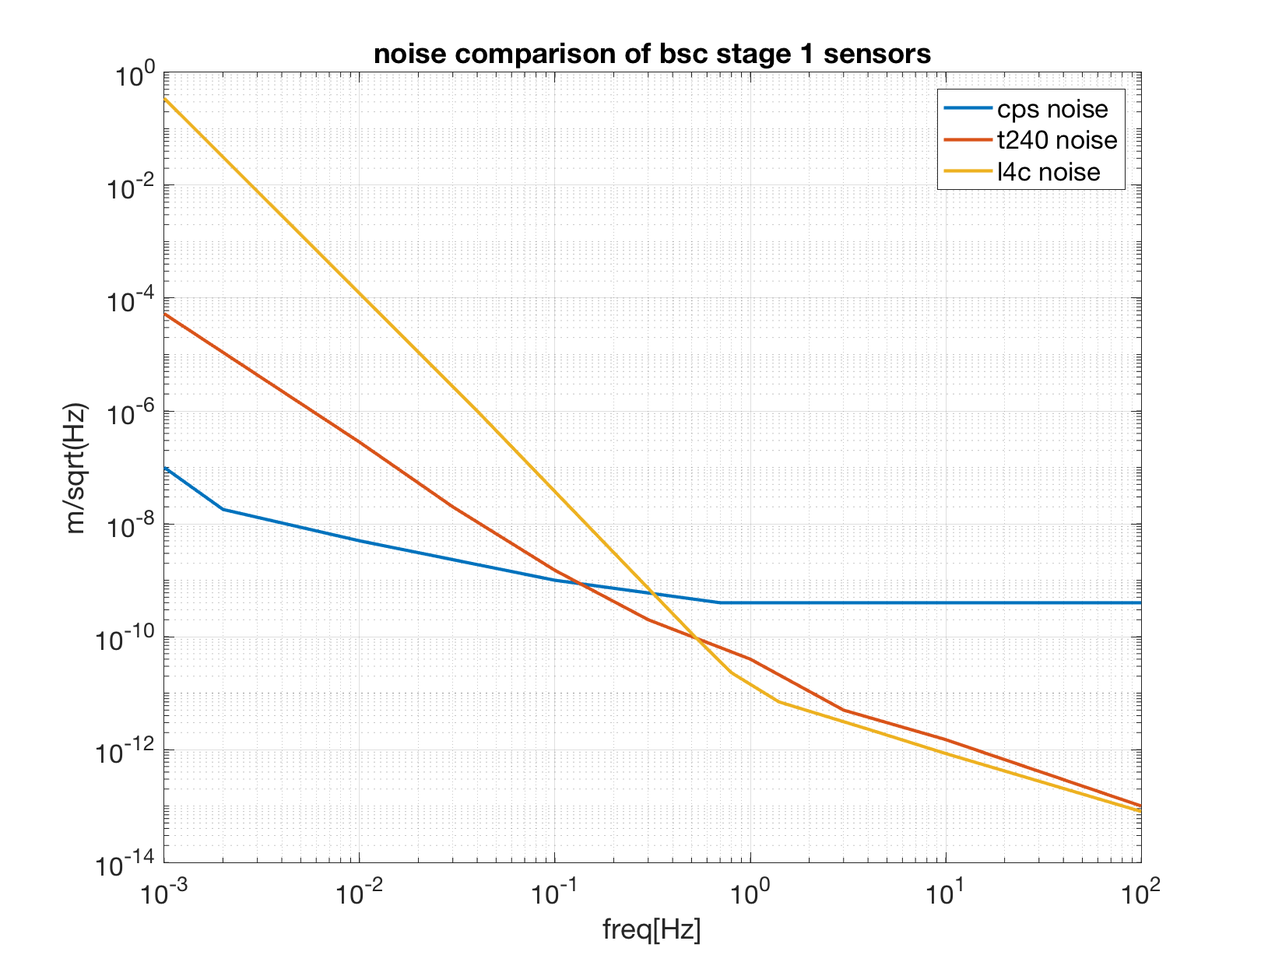
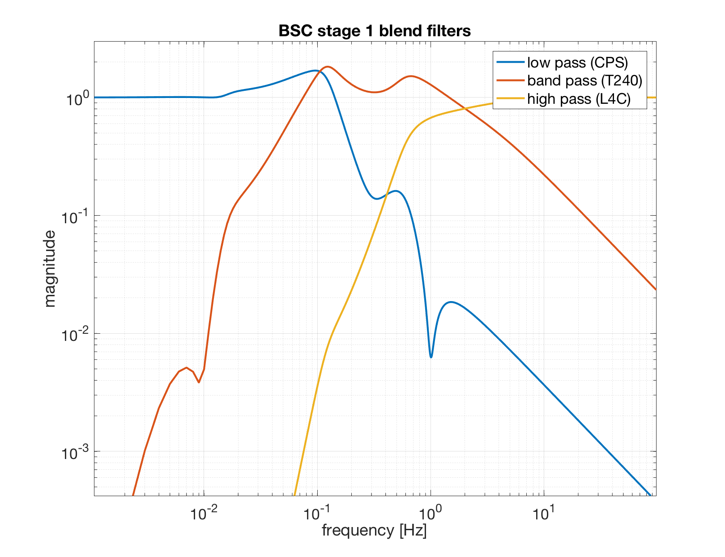
Sensor noise and blend filters

Slide 13
Active isolation, general control scheme
Feedforward: Ground seismometer feeds to CPS path to make it "inertial"
nL4C
nT240
1 Hz
CTRL
nCPS
0.1 Hz
1 Hz
L4C
T240
X1
0.1 Hz
F1
CPS
STS
0.1 Hz
10 Hz

Slide 14
Active isolation, general control scheme
In the corner station, same seismometer signal fed to all platform:
Advantage of moving all platforms in common (llo 34878), even w tilt
If relying on T240 at low-f, large relative motion (B.Lantz, G1700331)
nL4C
nT240
1 Hz
npt_tilt
CTRL
nCPS
0.1 Hz
1 Hz
npt_tilt
L4C
T240
X1
0.1 Hz
F1
CPS
STS
0.1 Hz
10 Hz
ntilt

Slide 15
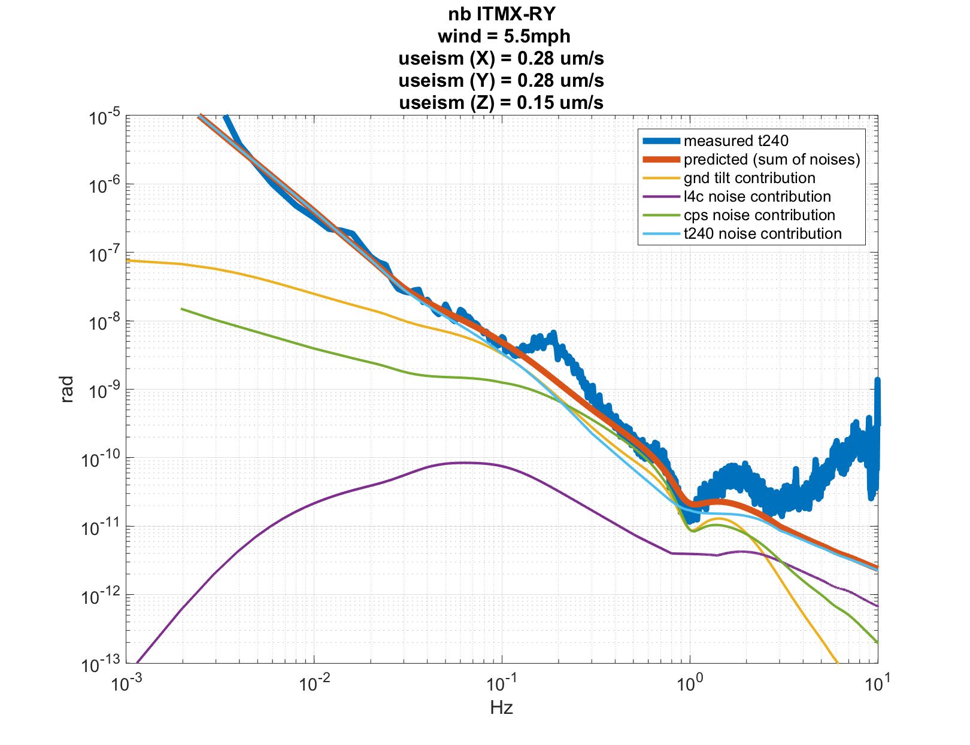
NB BSC-ISI stage 1 rotation dof, windy
Tilt measured by differential vertical T240
Limited by :
T240 noise < 100mHz
cps noise 0.5Hz-1Hz
Not well understood between 0.1Hz-0.5Hz
Varies with useism, not with ground tilt

Slide 16
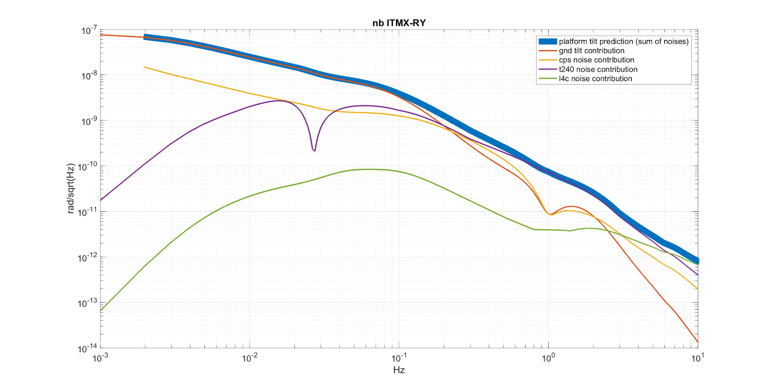
NB BSC-ISI stage 1 rotation dof, windy

Slide 17
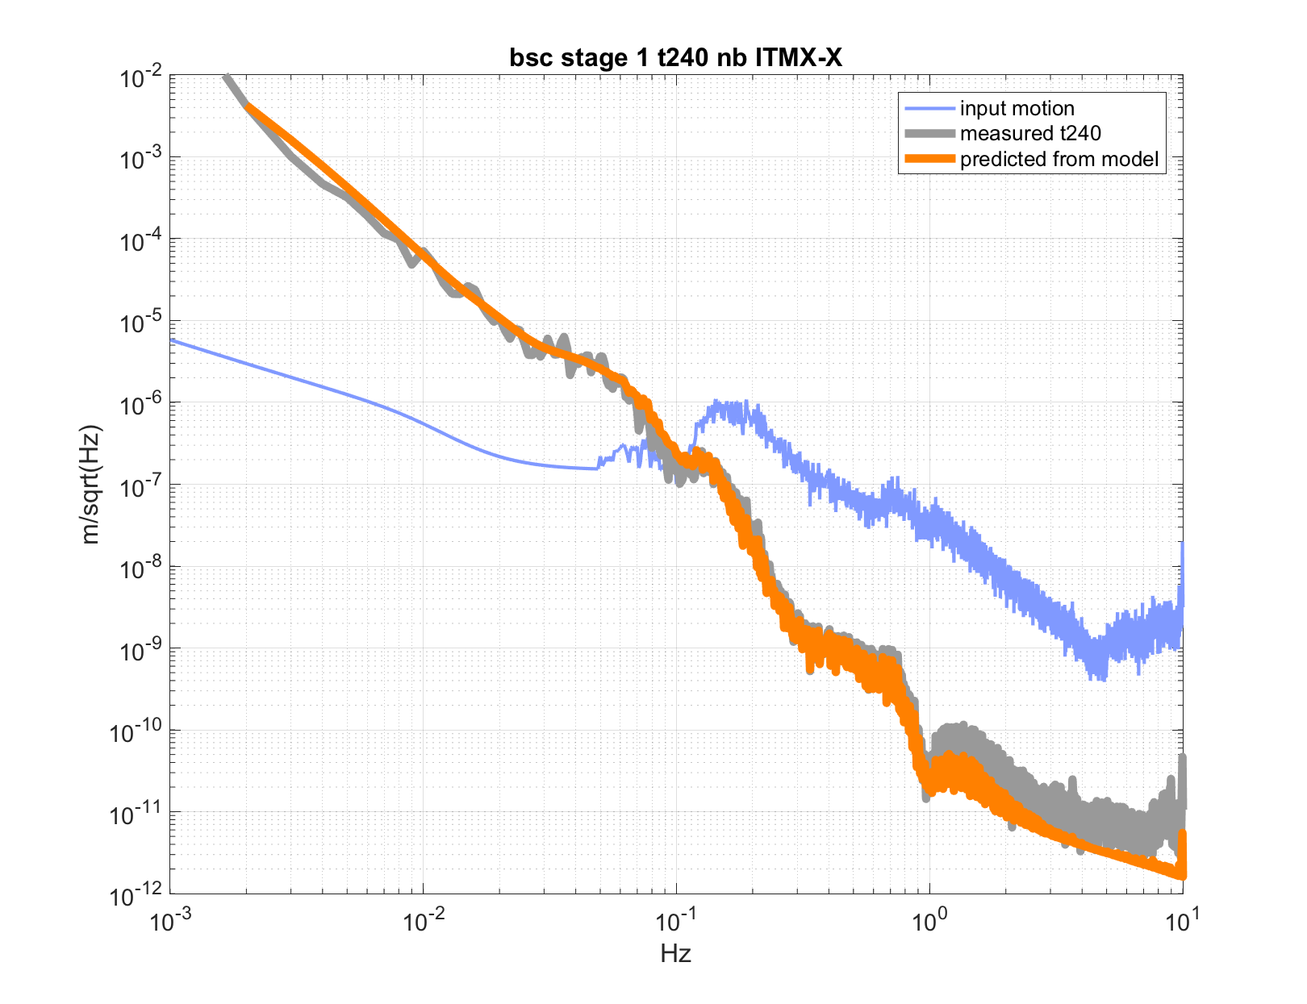
NB BSC-ISI stage 1 horizontal dof, windy
Model matches T240 signal

Slide 18
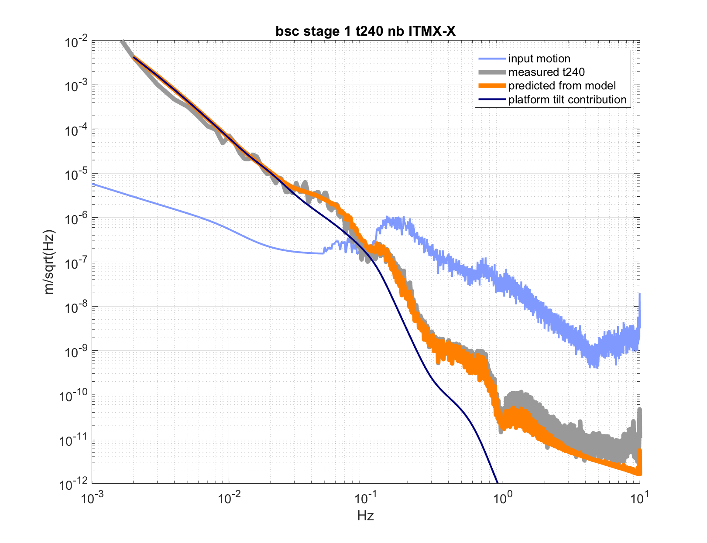
NB BSC-ISI stage 1 horizontal dof, windy
Model matches T240 signal
T240 dominated by platform tilt below 50mHz

Slide 19
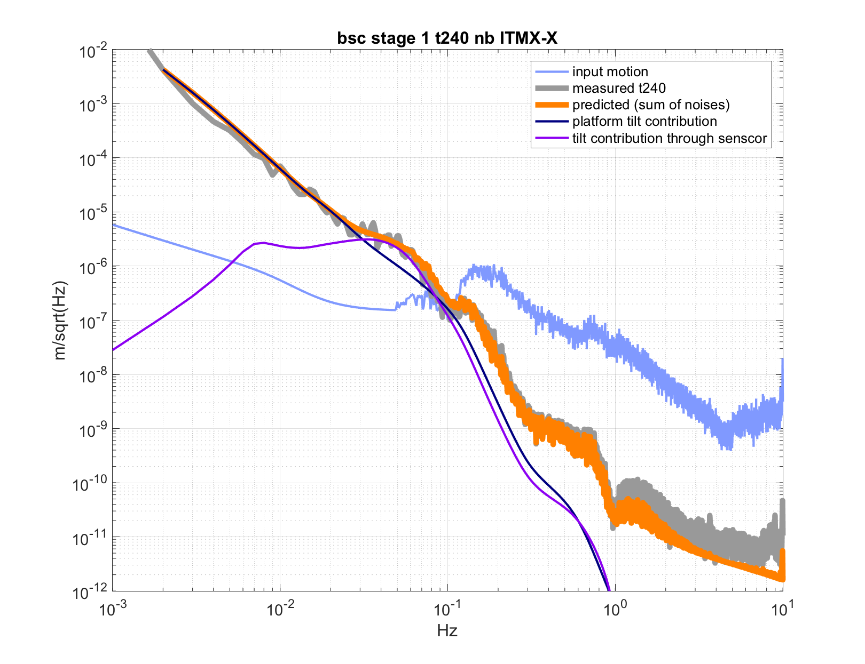
NB BSC-ISI stage 1 horizontal dof, windy
Model matches T240 signal
T240 dominated by platform tilt below 50mHz
T240 dominated by tilt from feedforward (STS) between 50-100mHz

Slide 20
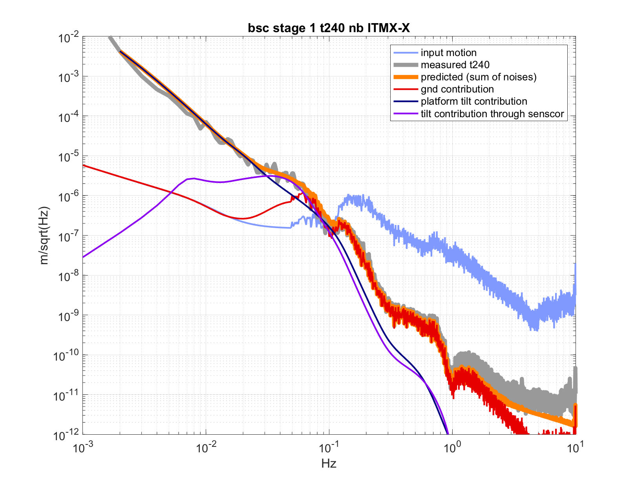
NB BSC-ISI stage 1 horizontal dof, windy
Model matches T240 signal
T240 dominated by platform tilt below 50mHz
T240 dominated by tilt from feedforward (STS) between 50-100mHz
Ground motion via CPS path

Slide 21
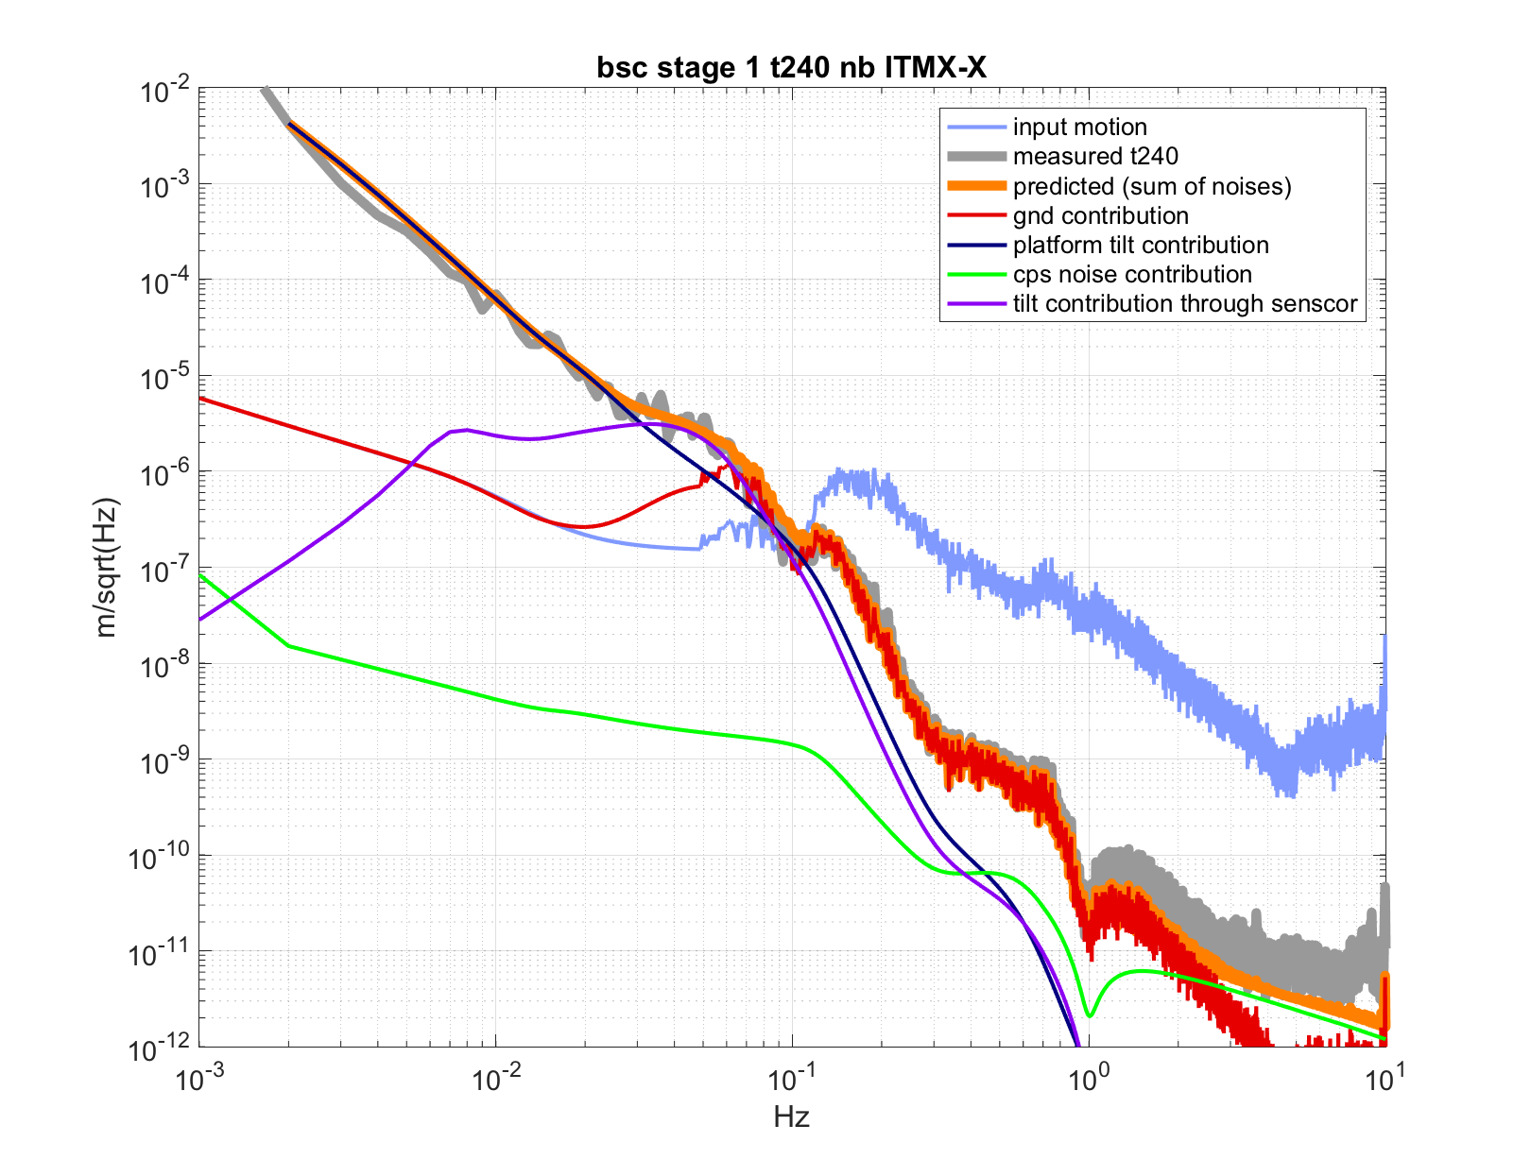
NB BSC-ISI stage 1 horizontal dof, windy
Model matches T240 signal
T240 dominated by platform tilt below 50mHz
T240 dominated by tilt from feedforward (STS) between 50-100mHz
Ground motion via CPS path
CPS noise above 2Hz

Slide 22
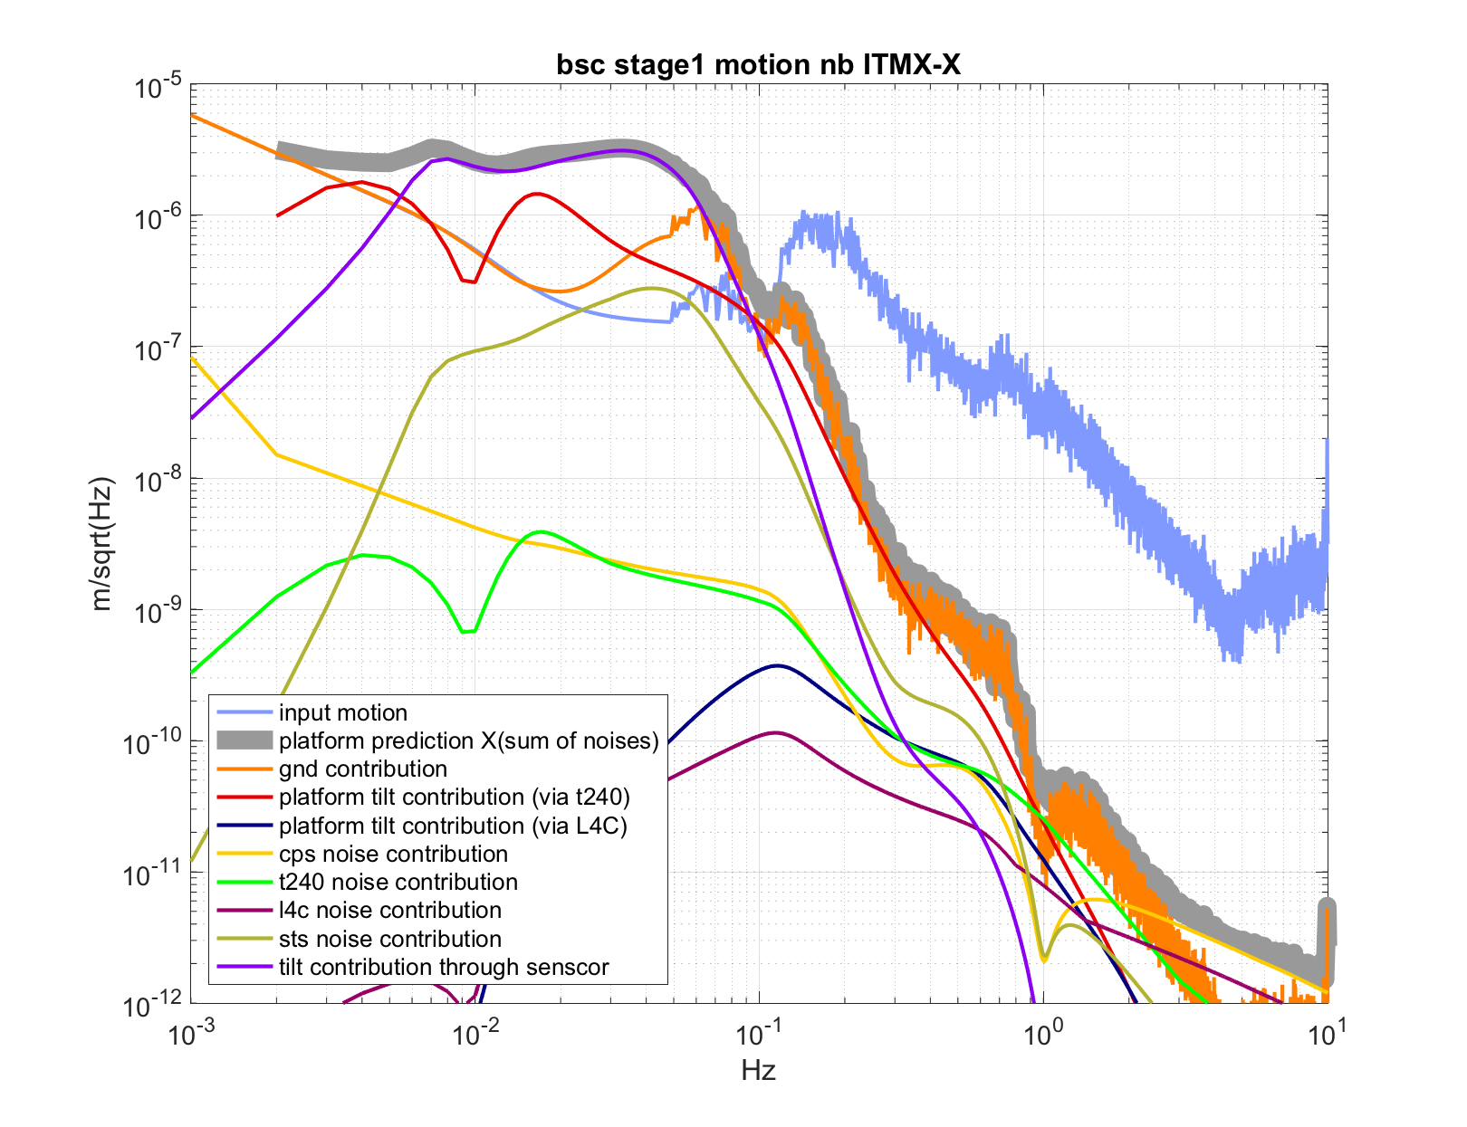
NB BSC-ISI stage 1 horizontal dof, windy
Estimated platform motion
Ground tilt via STS feedforward limits performance between 30-80mHz (earthquake band)
BRS can help reducing this noise

Slide 23
BRS Basics
Beam:
~1 m long
4.5 kg
10-15 μm thick flexures
3-8 mHz resonance
Autocollimator Readout
~0.1 nrad/√Hz
Capacitive Active Dampers

Slide 24
4 BRS installed
2 corner station
1 per end station

Slide 25
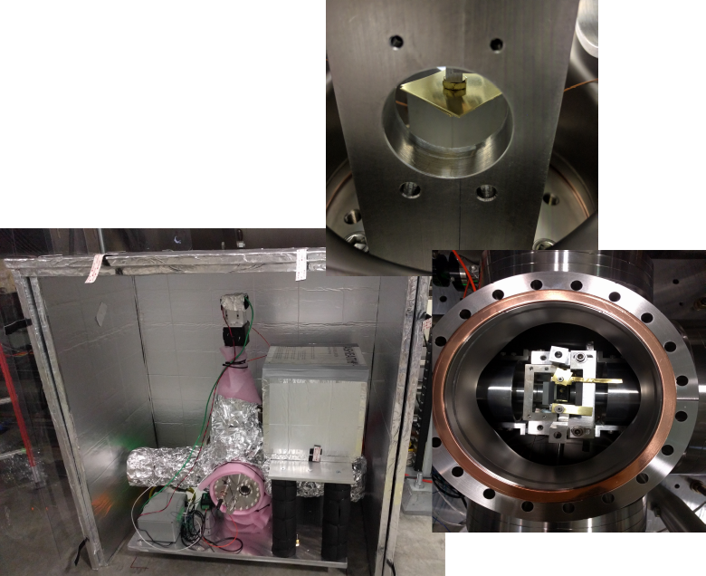
Practical Challenges and Lessons
Machinists make mistakes
Mass adjustments
Temperature variations become more important at lower frequencies
Tilts lose coherence over short distances (~meters)

Slide 26
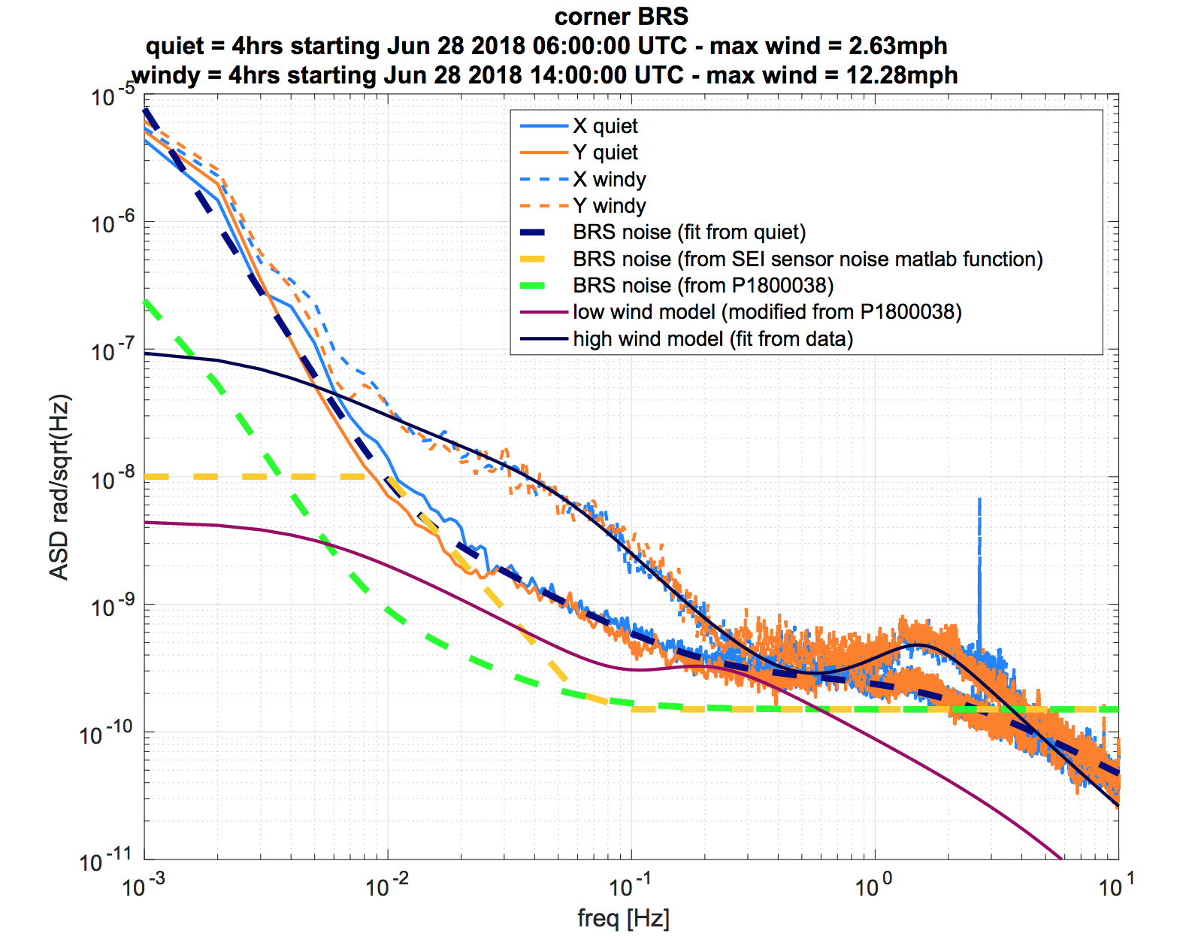
First LLO BRS spectrum (LLO corner station)
Both BRS see same level of tilt
Quiet spectra assumed to be instrument noise (not coherent with STS)

Slide 27
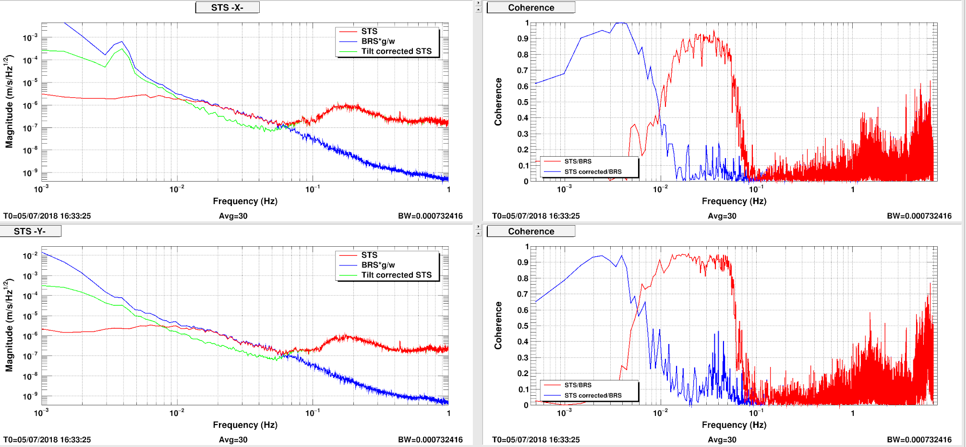
BRS : First subtraction (LLO corner)

Slide 28
Active isolation, general control scheme
Feedforward: Ground seismometer signal feeds to CPS path to make it "inertial"
nL4C
nT240
1 Hz
CTRL
nCPS
0.1 Hz
1 Hz
0.1 Hz
L4C
T240
ntilt
F1
X1
0.1 Hz
10 Hz
-ntilt
CPS
STS
BRS

Slide 29
NB BSC-ISI stage 1 horizontal dof, windy, no BRS

Slide 30
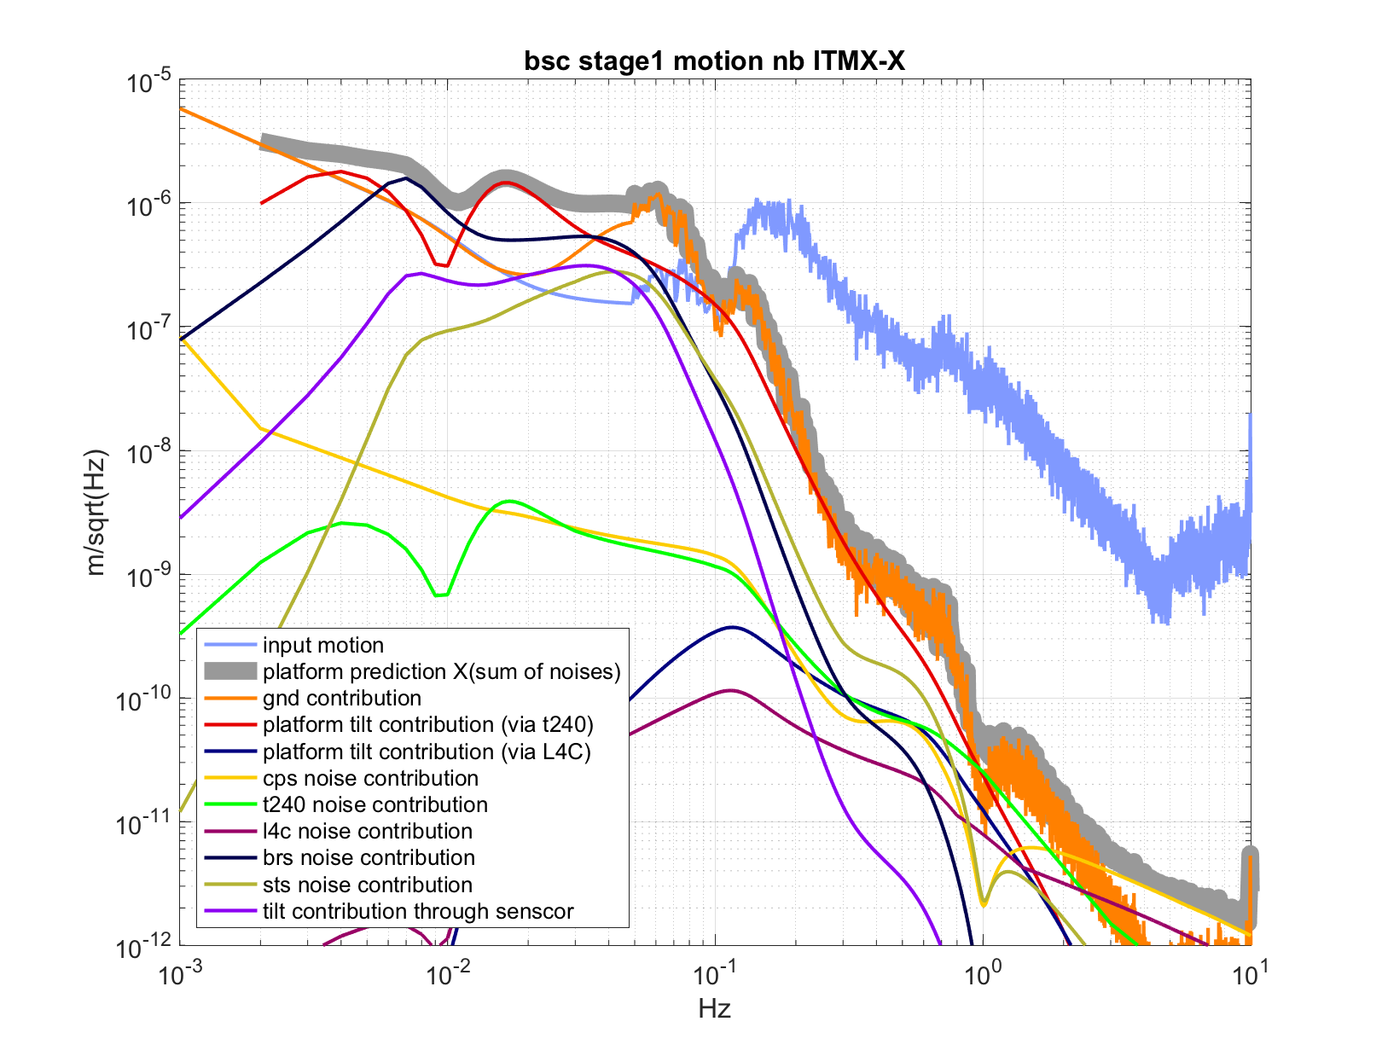
NB BSC-ISI stage 1 horizontal dof, windy, w BRS
Assuming tilt in the ground seismometer is reduced by a factor of ~10

Slide 31
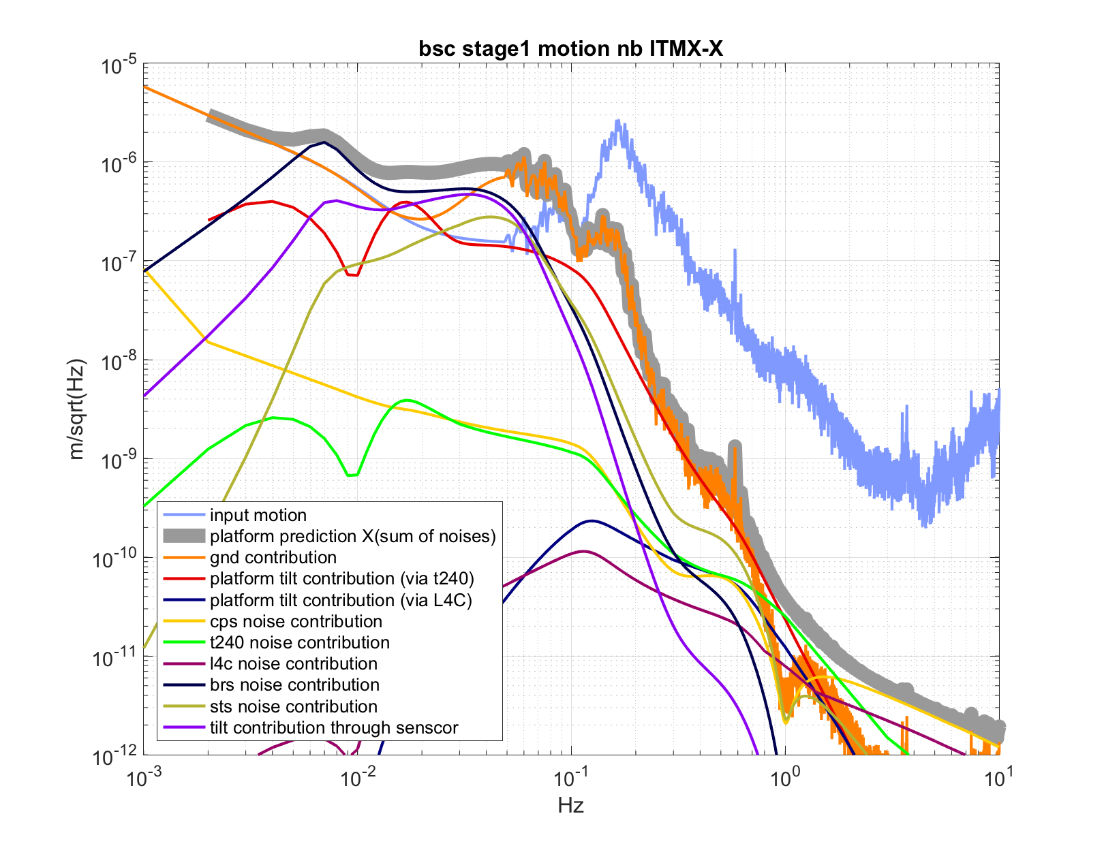
NB not windy (what's next limit at useism ?)

Slide 32
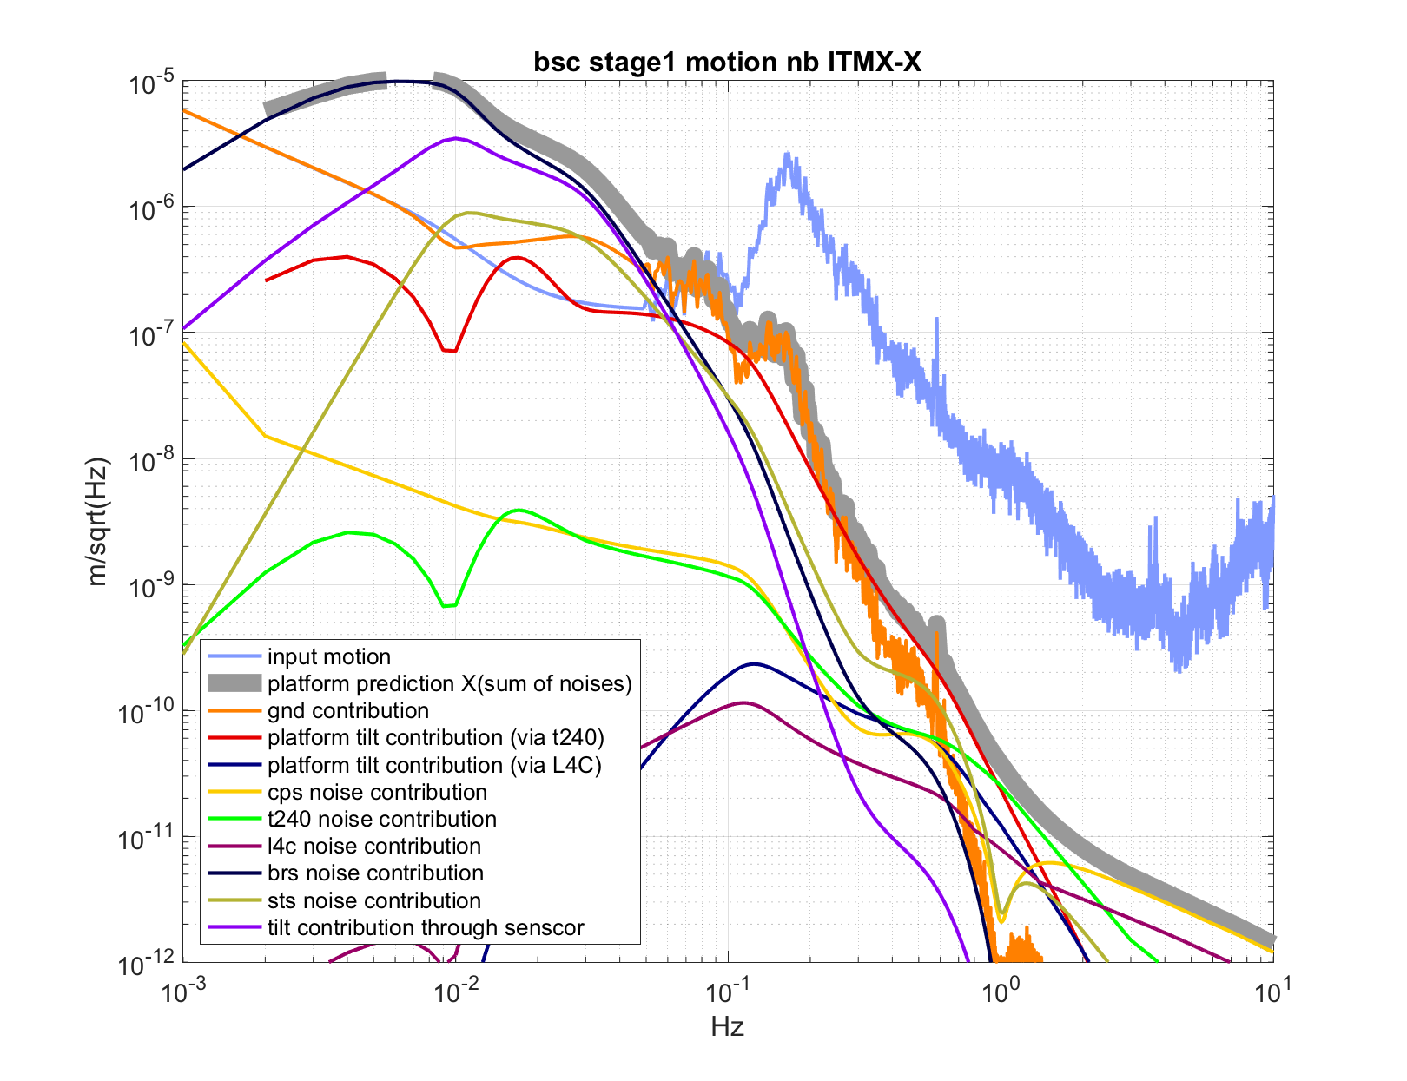
NB not windy (what's next limit at useism ?)
Changing the cut off frequency for the sensor correction
Large injection < 50mHz
x2 improvment at 0.15Hz

Slide 33
Conclusions
Noise requirements are met at 10Hz, could be relaxed, if necessary
Tilt limits platform horizontal motion
Ground BRS reduces tilt injected to platform in 30mHz-100mHz band
How much injection < 100mHz allowed to improve useism motion ?

Slide 34
[1] T1500122 Revised BSC-ISI requirement at 10Hz [2] E990303 Seismic Isolation Subsystem Design Requirements Document [3] T1000216 Revised BSC-ISI requirement at 10Hz [4] P1200040 Seismic isolation of Advanced LIGO gravitational waves detectors: Review of strategy, instrumentation, and performance.

Slide 35
Extra slides

Slide 36
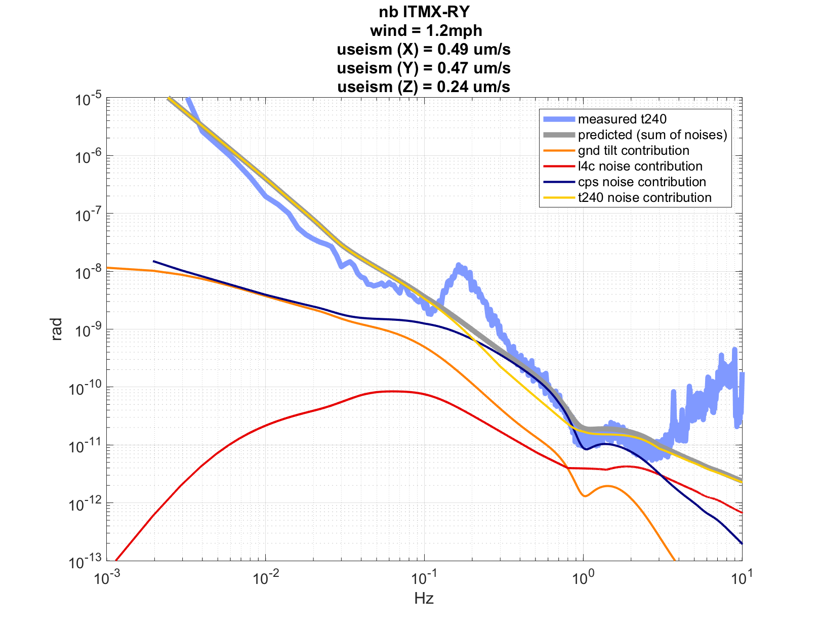
NB not windy rotation

Slide 37
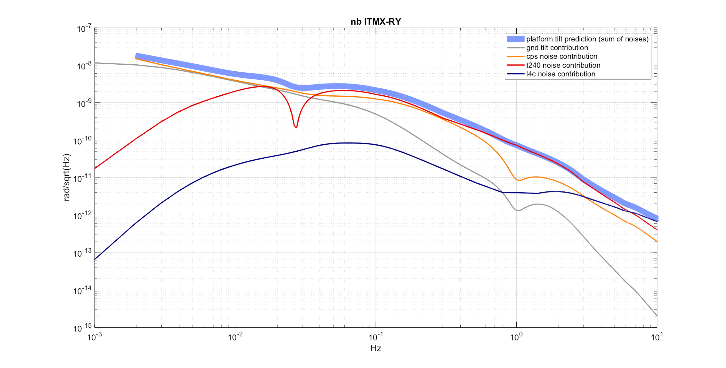
NB not windy rotation

Slide 38
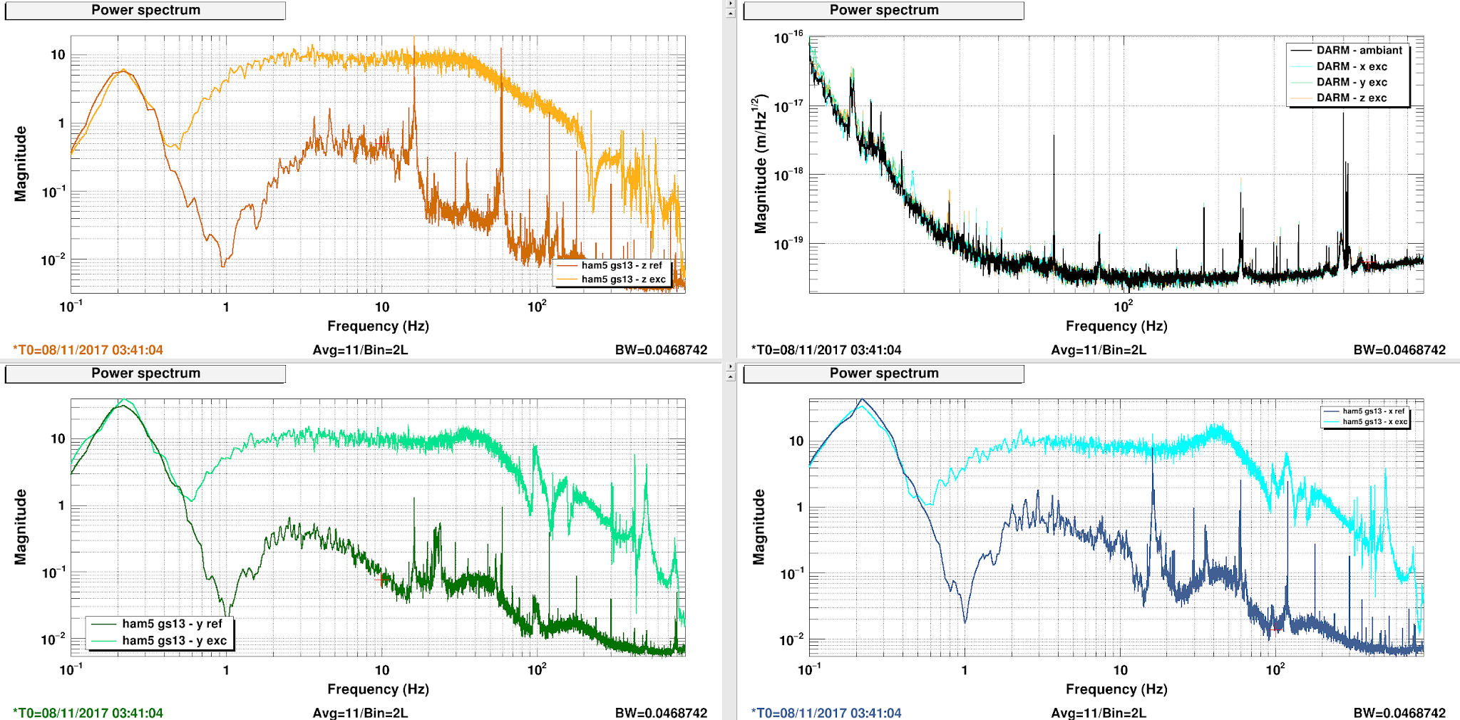
Requirements for seismic isolation : >1Hz
Similar for HAM-ISI
llo alog 36624

Slide 39
Make CPS "inertial"
CPS = X1 - Xg CPSinertial = X1 - Xg + (Xg+nsts)*SC CPSinertial = X1 - Xg*(1-SC) + nsts*SC
With X1, the platform motion Xg, the ground motion nsts, the STS noise including tilt noise SC, the band pass filter

Slide 40
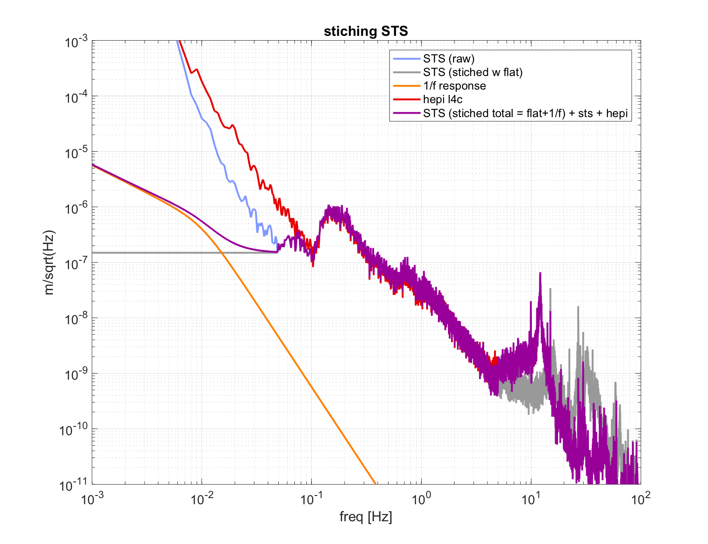
Ground stitching

Slide 41
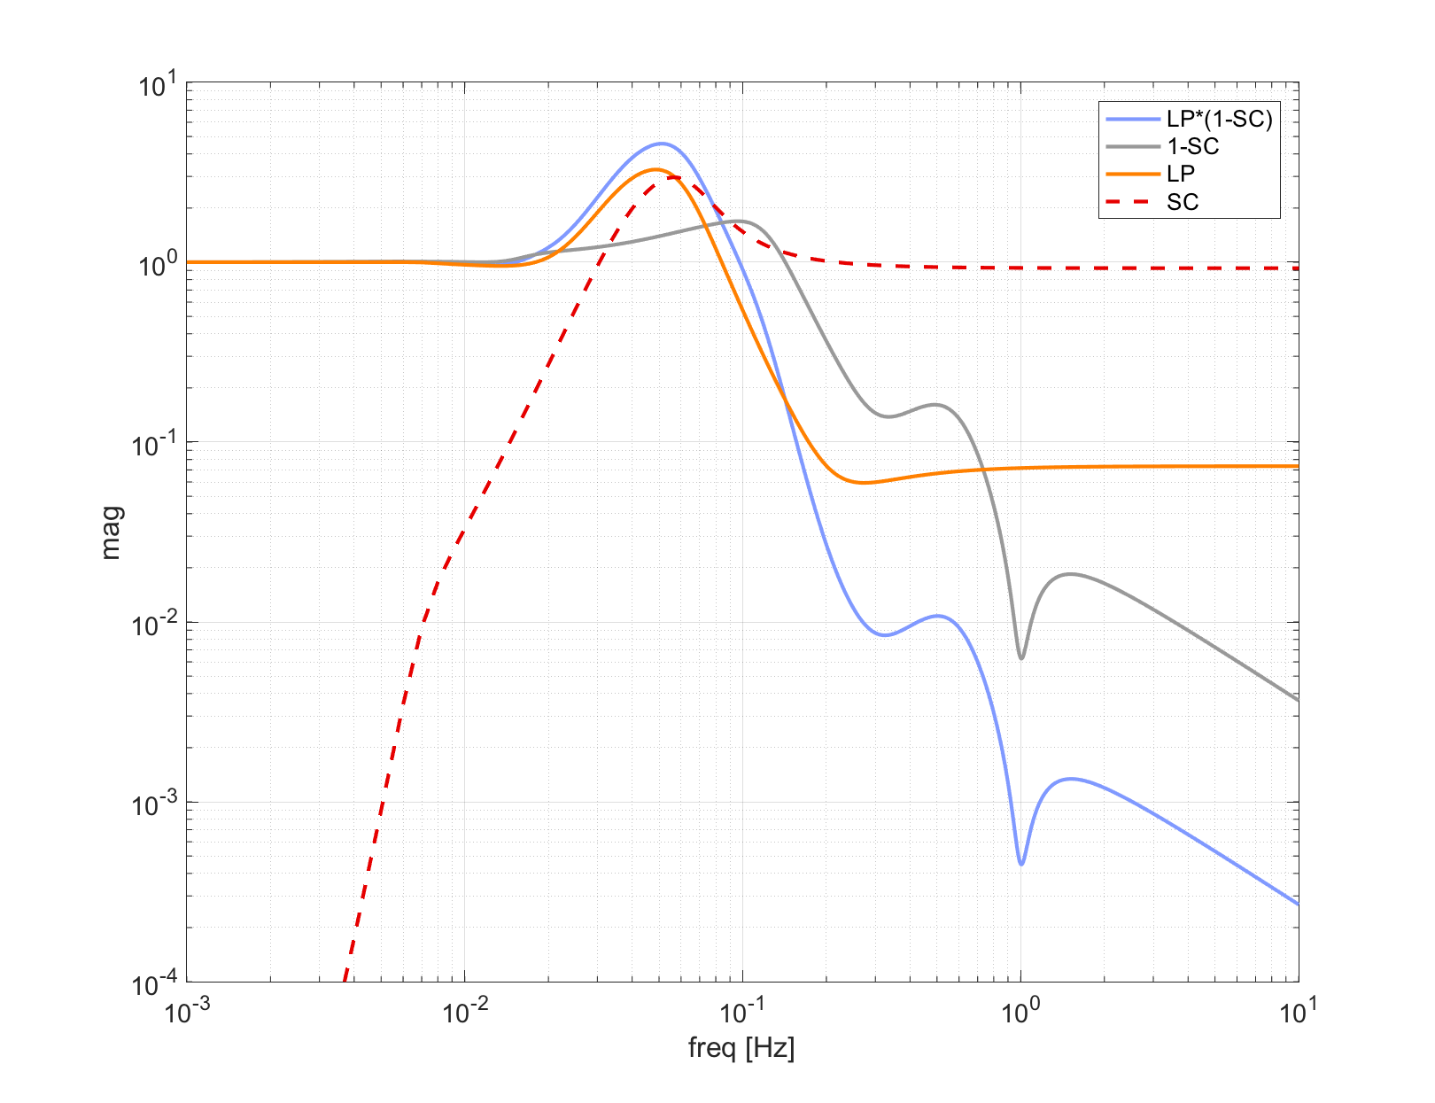
100mHz LP + broadband SC

Slide 42
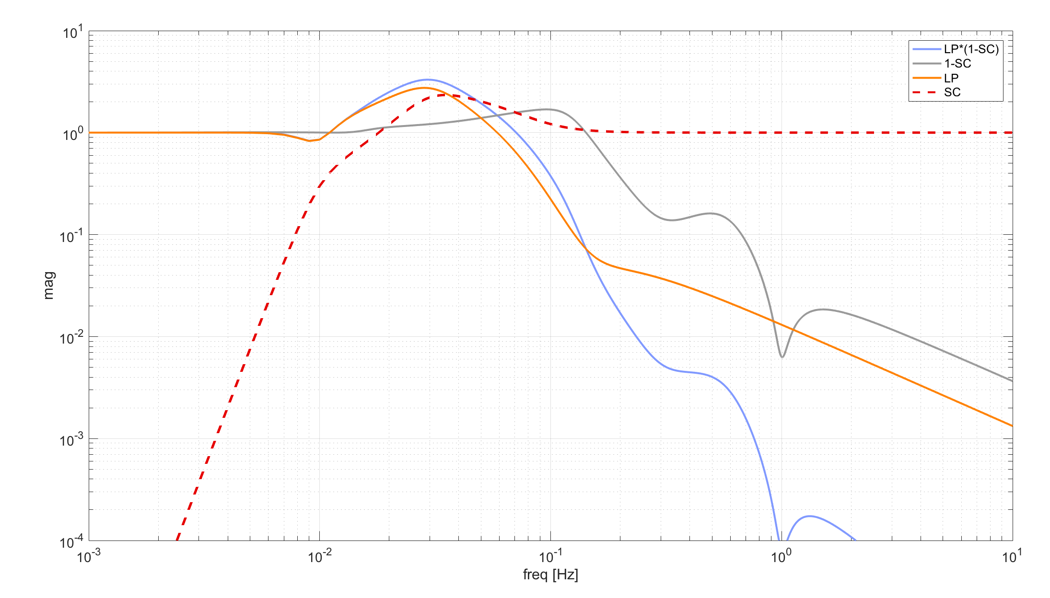
100mHz LP + broadband SC

Slide 43
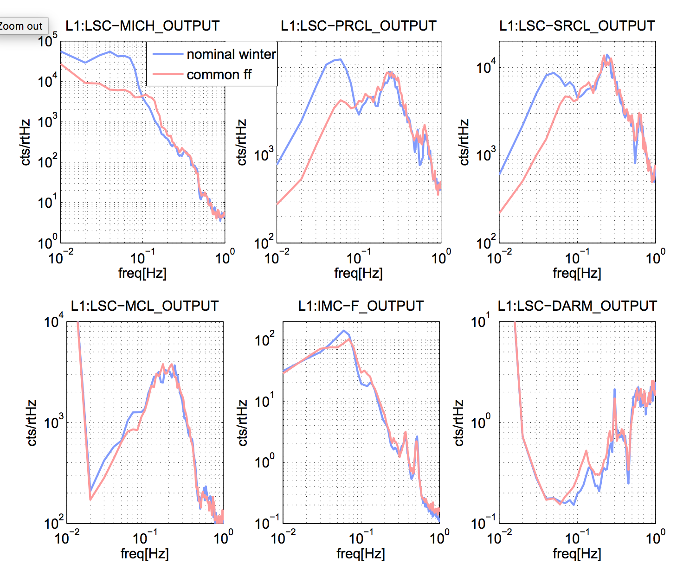
T240 50mHz blend vs common FF

Slide 44
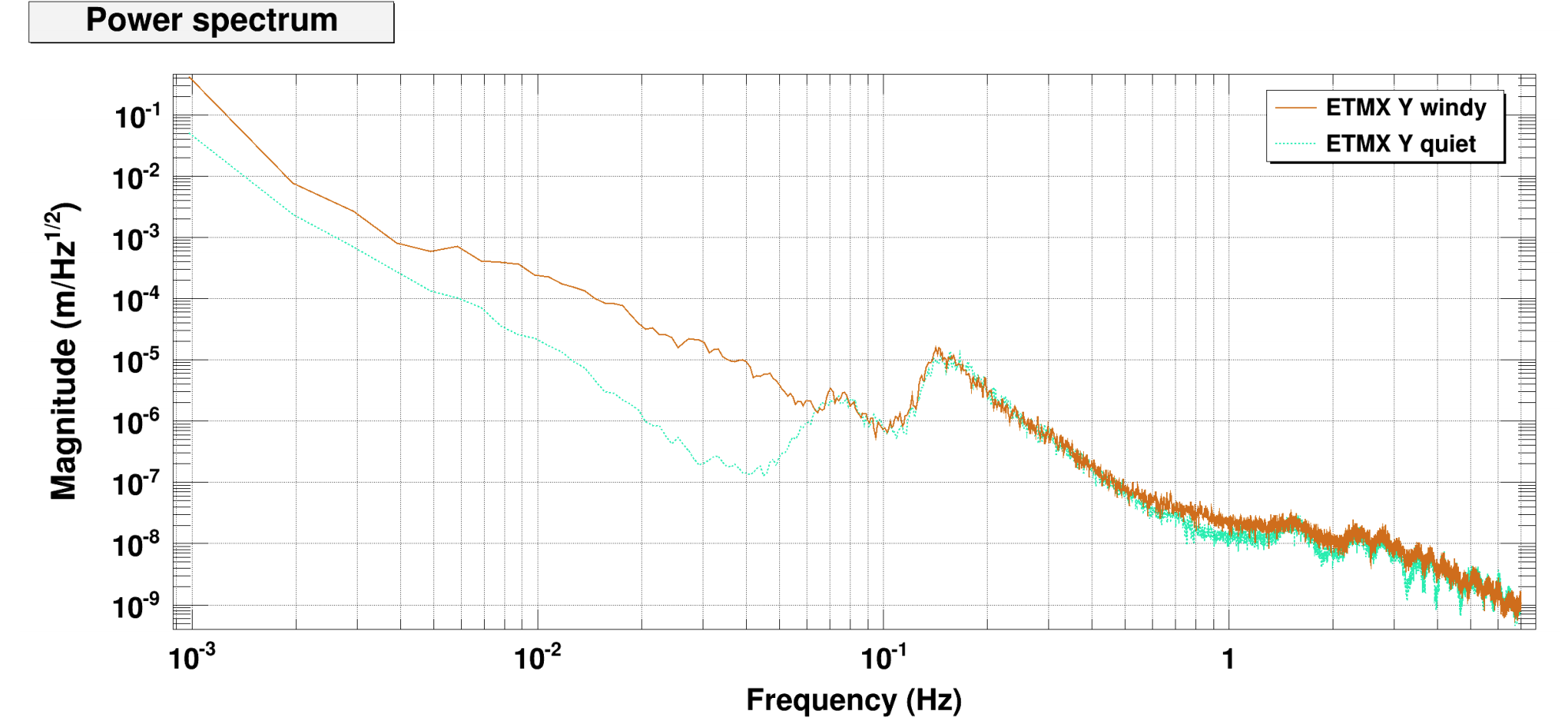
STS noise difference windy vs quiet

Slide 45
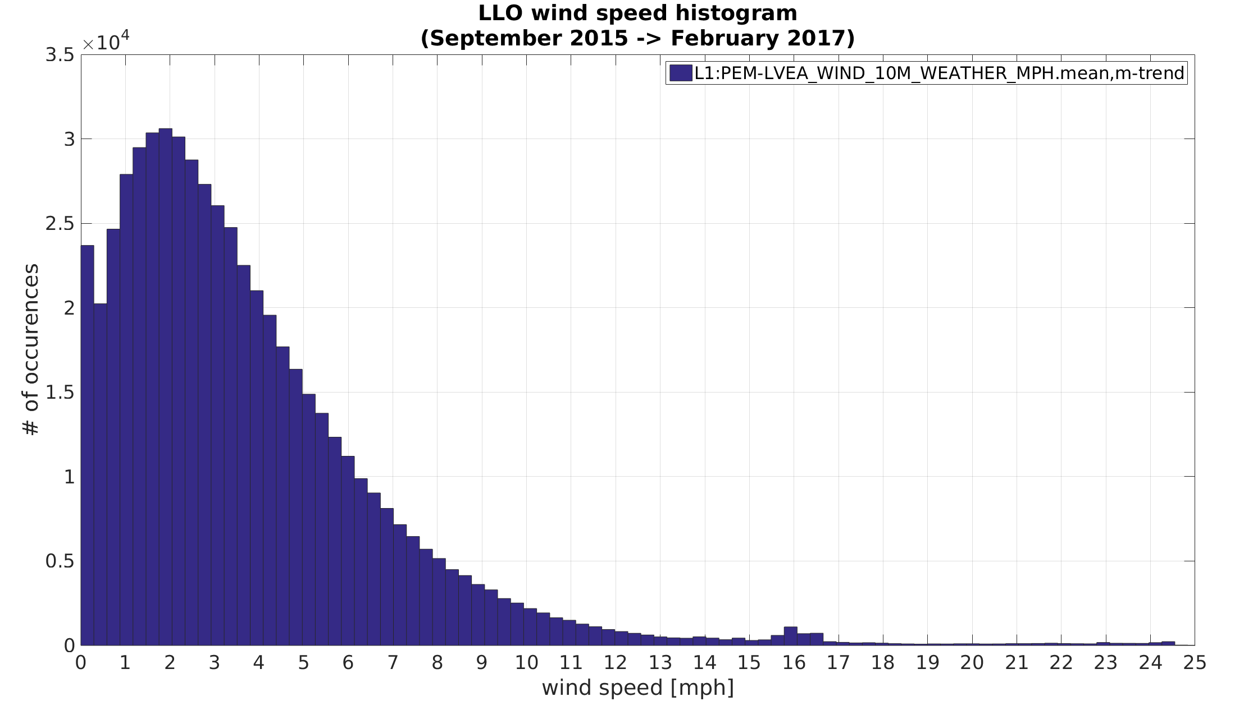
99th percentile is 16mph
95th percentile is 9mph

Slide 46
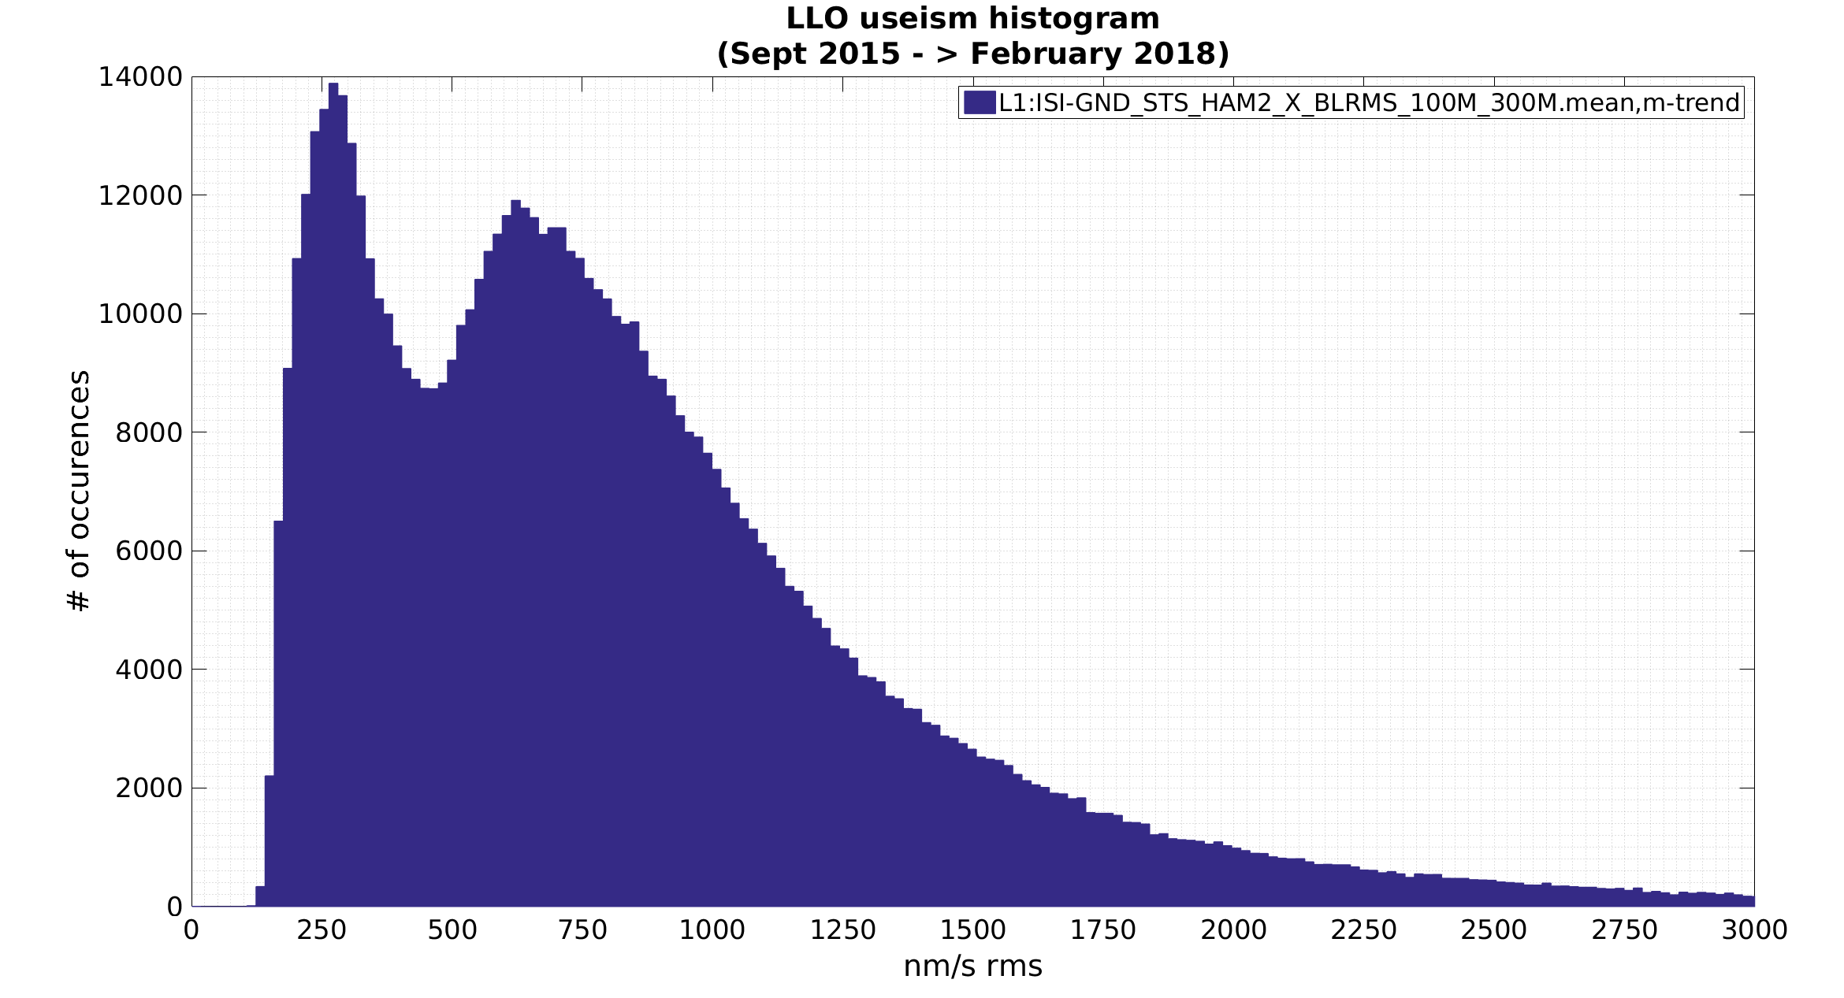
LLO useism histogram
September 2015 -> Feb 2017
99th percentile is 3.1 um/s rms
95th percentile is 2 um/s rms

Slide 47
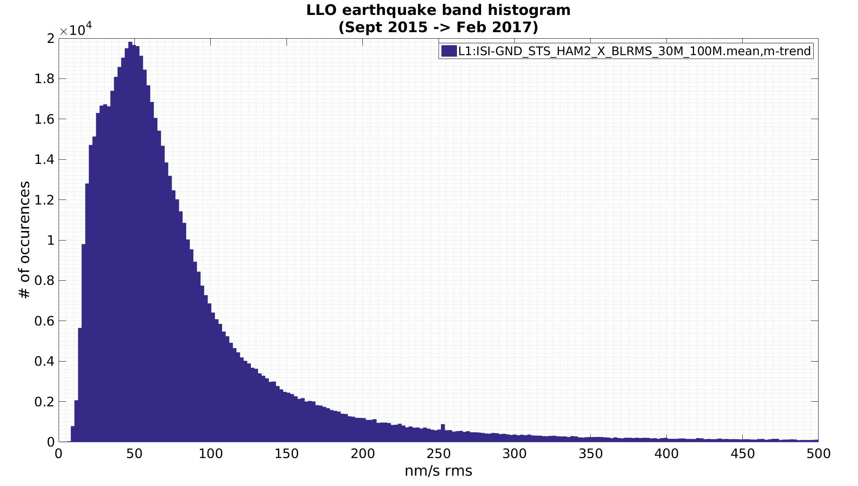
99th percentile is 1500 nm/s rms
95th percentile is 290 nm/s rms

