Slide 1

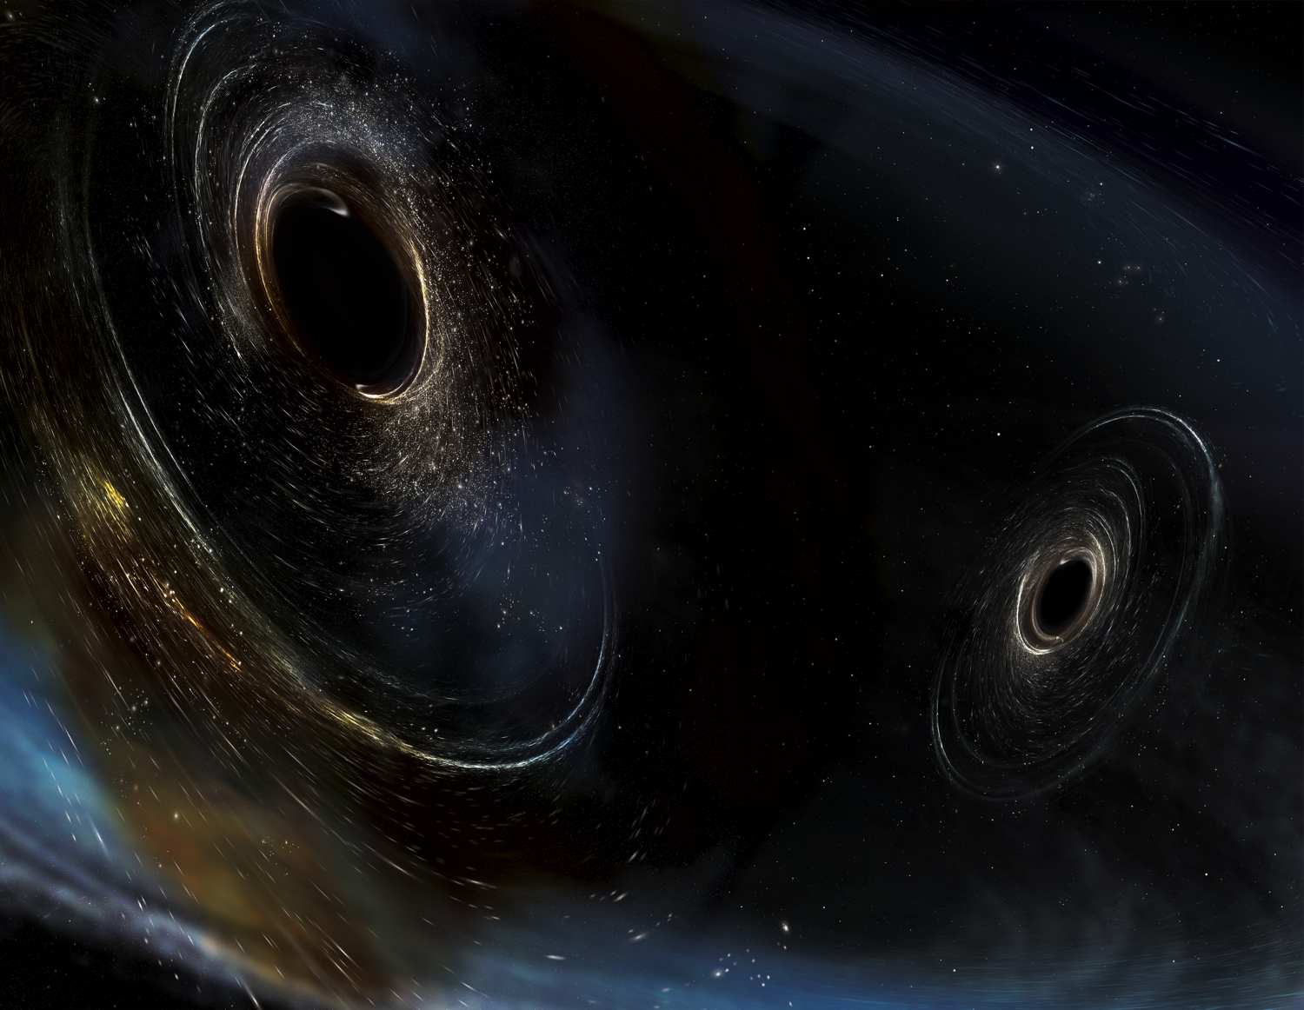




Can you get there from here?
Thinking about paths from AdV+/A+ to 3 G
M. Zucker
with minor additions from McClelland and Shoemaker
Dawn IV
30-31 August 2018
LIGO-G1801680

Slide 2
Outline
Perspective on A+
    Can someone offer symmetrical view for AdV+? Sorry, was planning to do more homework.
Constraints: real vs. imagined
“Baby steps” vs. “Giant Leaps”
Some ideas

Slide 3
A+ ‘elevator pitch’
(we’ll come back to this later)
An incremental upgrade to aLIGO that leverages existing technology and infrastructure, with minimal new investment, and moderate risk
Target: factor of 1.7* increase in range over aLIGO
About a factor of 4-7 greater CBC event rate
Bridge to future 3G GW astrophysics, cosmology, and nuclear physics
Stepping stone to 3G detector technology
Can be observing within 6 years (mid- 2024)
“Scientific breakeven” within 1/2 year of operation
Incremental cost: a small increment on aLIGO
Joint international effort: ~ 35% UK and Australia funding
*BBH 30/30 M: 1.6x
*BNS 1.4/1.4 M: 1.9x

Slide 4
A+: a mid-scale upgrade to
Advanced LIGO
Reduced quantum noise
  Improved optical losses
  Improved readout
  Frequency-Dependent Squeezing
Reduced thermal noise
  Improved mirror coatings
Observing by mid-2024
O2
aLIGO design
A+
BNS: 173 Mpc
BBH: 1607 Mpc
BNS: 325 Mpc
BBH: 2563 Mpc

Slide 5
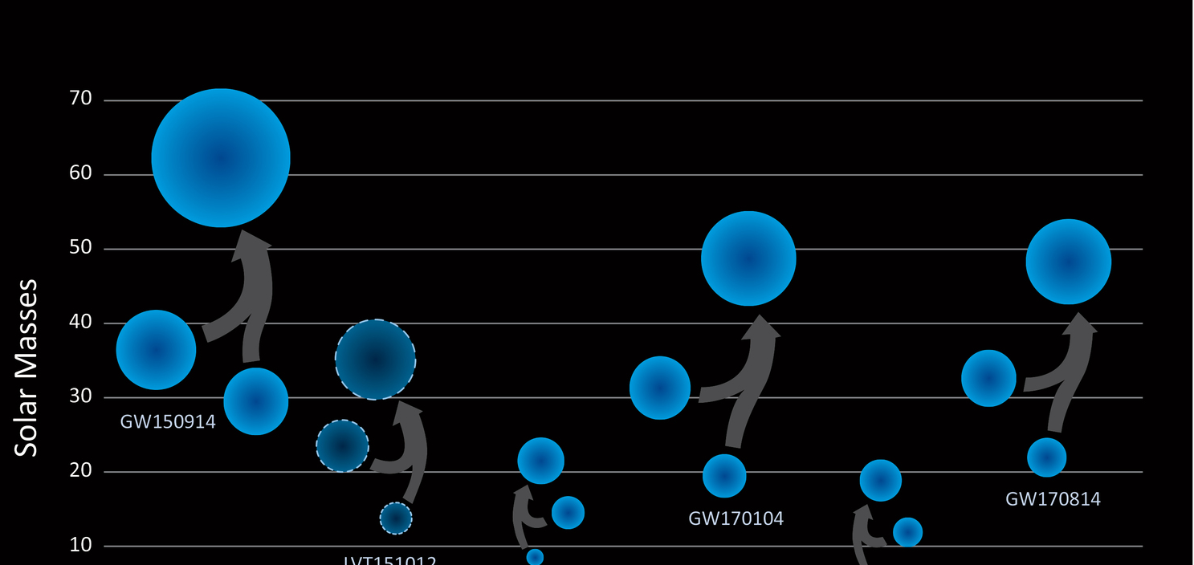
Selected A+ Discovery Targets
Based on P170608 and P170817 rate density estimates:
BBH rate 4.1x aLIGO ➔ 17-300 BBH/month
Off-axis observations ➔ BH component spins
BH Spins ➔ Origins of stellar-mass BH
Z_{max} ~ 1.5 ➔ BBH cosmological evolution
SNR ~ 100 ➔ Ultra-precision tests of GR
BNS rate 6.7x aLIGO ➔ 1-13 BNS/month
(2-11 BNS x SGRB coincidences/year)*
Multimessenger coincidences ➔ precision H₀ measurement, kilonovae, etc.
High inspiral SNR ➔ BNS tidal deformation
BNS remnant “ringdown” ➔ NS matter equation of state
*(or more, if GW170817 represents hidden sub-threshold SGRB population)

Slide 6
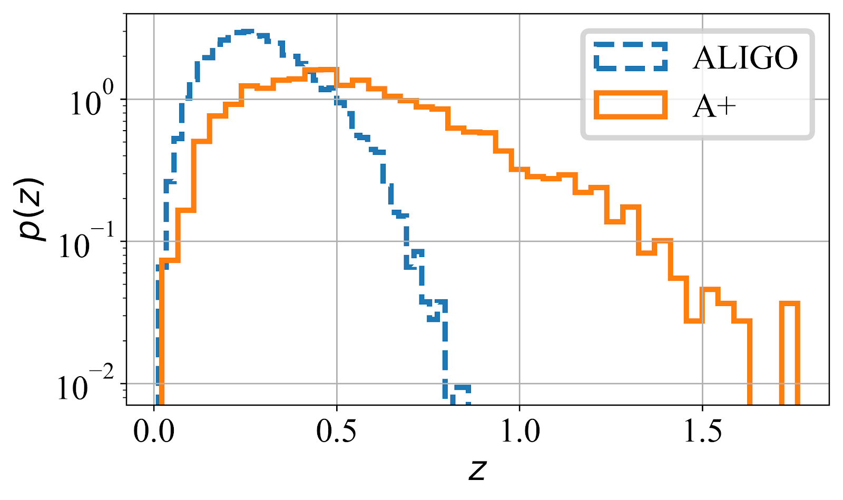
S. Vitale, M1800040
Figure 7: Redshift distribution of binary black hole sources detectable with SNR > 10 in a single A+ detector, as compared to baseline aLIGO at design sensitivity.

Slide 7
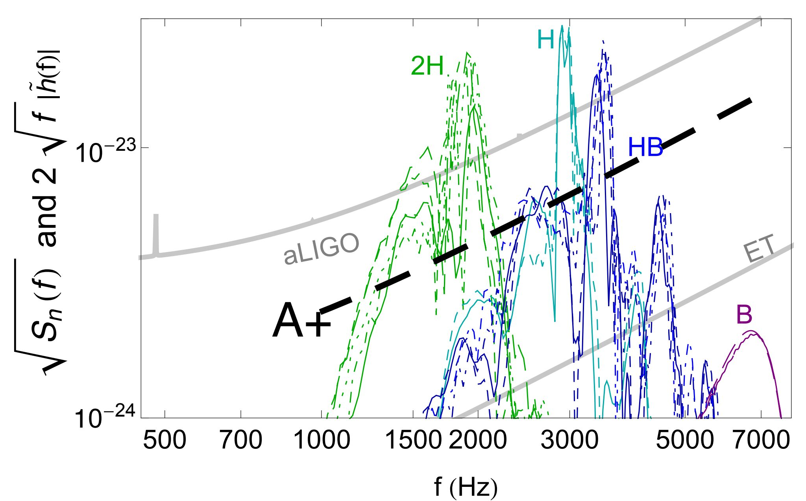
BNS post-merger “ringing” vs. NS EOS
Figure 6: BNS post-merger signal models vs. aLIGO and A+ detector noise for a range of speculated neutron-star equations of state (labeled 2H - B). A+ will have significantly improved capacity to detect post-merger "ringing" modes, whose characteristic frequencies are determined by the equation of state of super-nuclear matter. The low-frequency inspiral waveform component, which can also bear signatures of tidal deformability in the progenitor stars, is not shown. Simulations presume a reference BNS coalescence at 100 Mpc. (courtesy J. Veitch and S. Vitale, adapted from Read et al. [31])

Slide 8
A+ Upgrade Status
NSF awarded US funds, 18 months earlier than original request
  Same end date (4QFY2023, limited by COC coatings) but much faster start
  Acceleration may allow facility and vacuum upgrades between O3 and O4
  Retires risk, may well accelerate commissioning and O5 (no promises!)
  LIGO Lab team has formed and mobilized; formal start in 1 month, 10/1/2018
Australian ARC funding has already been awarded
Companion UK proposal is now under UKRI/STFC review
  We are cautiously optimistic for a similar accelerated UK start
  This would relieve schedule pressure on core optics polishing (sequential fabrication) and suspension design pipelines
Big picture: we expect LIGO will be observing with A+ sensitivity by late 2024

Slide 9
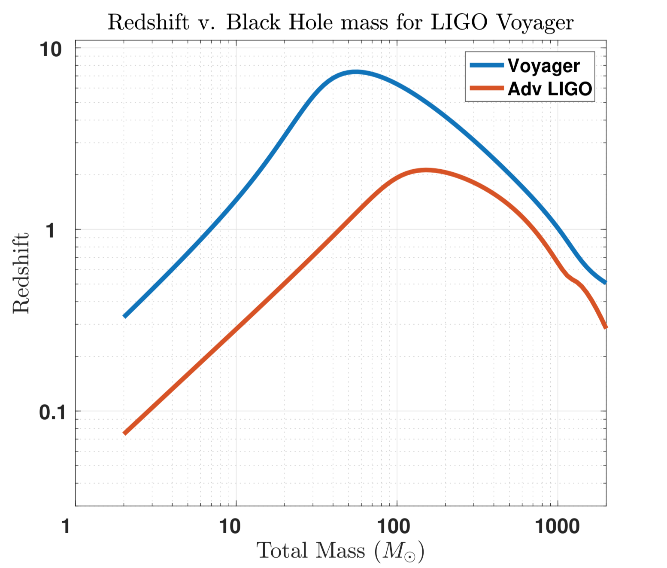
Beyond A+

Slide 10
A+ elevator pitch constraints
An incremental upgrade to aLIGO that leverages existing technology and infrastructure, with minimal new investment, and moderate risk
Target: factor of 1.7* increase in range over aLIGO
About a factor of 4-7 greater CBC event rate
Bridge to future 3G GW astrophysics, cosmology, and nuclear physics
Stepping stone to 3G detector technology
Can be observing within 6 years (mid- 2024)
“Scientific breakeven” within 1/2 year of operation
Incremental cost: a small increment on aLIGO
*BBH 30/30 M: 1.6x
*BNS 1.4/1.4 M: 1.9x

Slide 11
Look at all the constraints:
“Your next investment should…
  …be incremental in cost
  …minimize loss of observing for existing instruments
  …provide immediate scientific return
    e.g., improved rate*time integral should ‘quickly’ wipe out observing hiatus due to upgrade
  …build upon and fully exploit prior investment
    “we already invested 10⁹ $/€/£…”
  …simultaneously support following investments, e.g.,
    test technology for “(n+1)G”
    probe future astro source landscape

Slide 12
…all the constraints (2):
All good and wholesome, but taken together, recipe for a holding pattern
Nothing big happens that way
  (certainly not Initial or Advanced LIGO)
Which constraints to challenge here?
  (really asking, I don’t know).

Slide 13
Are there other constraints we should be considering?
For example:
  We naturally fret about seismic, quantum and thermal noise
  Our reviewers (perhaps the more influential ones?) may fret about 15% cost growth in steel, earthmoving, or concrete
    Even “routine” roads and tunnels see 100% overruns
  Are we investing responsibly to bound and manage large, “conventional” risks, or are we only looking after the novel “interesting” ones?

Slide 14
Suggestion: diversify
Increments like A+, AdV+ and Voyager are necessary, but too overconstrained to put us in the strike zone
Always the possibility of a visionary patron and a leap of faith; hope for this, but can’t plan on it
3G technology demonstration investments can retire investment risks
  Without interfering with 2/2.1/2.5G observations
  Without forcing ‘profitable’ integration on an existing (obsolete) instrument
LIGO and Virgo invested millions and decades to pre-qualify
  beamtube construction;
  phase noise at the MIT 5m;
  displacement noise at the CIT 40m;
  optic polishing, metrology & coating pathfinders;
  etc.
What are the analogs for 3G?

Slide 15
Possible “Large-scale” 3G technology demonstration investments
3G Value-Engineered Beamtube Demo
  LIGO is planning a water vapor desorption test on a spare 7m tube section at LLO
  NSF just funded a LIGO workshop for early ‘19 on Very Large Scale Vacuum Systems
  What about a 500m scale 3G beamtube fabrication and degassing test?
3G Tunnel/Earthwork Demonstration
3G Very Large Optic Polishing & Coating Pathfinder
…?...(ideas welcome)

Slide 16
Discussion points
Nobody wants to wait
Nobody wants to invest 10-100M $/€/£ in engineering demo projects that don’t detect GW’s
BUT
Moving directly to full scale design without some proofs of concept may meet resistance
We can’t demonstrate all of what we need on H1/L1/V1/K1/I1
We probably need to break all the risky problems (not just the interferometry) into pieces and show what we can do in each domain separately.
What impact do increments like A+, AdV+, A+ HF and Voyager have on the 3G case and network planning?

Slide 17
A few questions for the ‘Voyager Epoch’
how long will A+/AdV+ be interesting for observing
what cost scales are involved in making another 1.5-2x improvement in the instruments
when do those costs fall on funding agencies wrt to the CE/ET costs
what roles do these 2.5-2.75 generation play for CE/ET in terms of risk-reduction prototypes
what level of constructive and destructive interference will these projects have on parallel demands to get ET/CE designed/fabbed
do we want to deploy one of the world network instruments as a 2.75G system as a test, or multiple ones to increase the network sensitivity

Slide 18
THANKS
(and sincere apologies from MZ)

