Slide 1

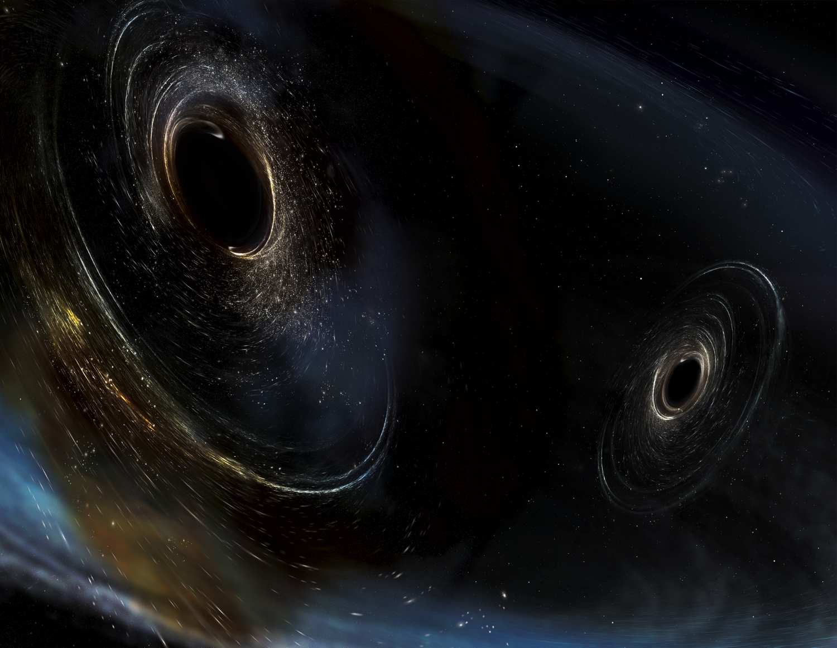




Can you get there from here?
Thinking about paths from AdV+/A+ to 3 G
D. McClelland, M. Zucker
Dawn IV
30-31 August 2018
LIGO-G1801680

Slide 2
Outline
Perspective on A+
    Can someone offer symmetrical view for AdV+? Sorry, was planning to do more homework.
Constraints: real vs. imagined
“Baby steps” vs. “Giant Leaps”
Some ideas

Slide 3
A+ ‘elevator pitch’
(we’ll come back to this later)
An incremental upgrade to aLIGO that leverages existing technology and infrastructure, with minimal new investment, and moderate risk
Target: factor of 1.7* increase in range over aLIGO
About a factor of 4-7 greater CBC event rate
Bridge to future 3G GW astrophysics, cosmology, and nuclear physics
Stepping stone to 3G detector technology
Can be observing within 6 years (mid- 2024)
“Scientific breakeven” within 1/2 year of operation
Incremental cost: a small increment on aLIGO
Joint international effort: ~ 35% UK and Australia funding
*BBH 30/30 M: 1.6x
*BNS 1.4/1.4 M: 1.9x

Slide 4
A+: a mid-scale upgrade to
Advanced LIGO
Reduced quantum noise
  Improved optical losses
  Improved readout
  Frequency-Dependent Squeezing
Reduced thermal noise
  Improved mirror coatings
Observing by mid-2024
O2
aLIGO design
A+
BNS: 173 Mpc
BBH: 1607 Mpc
BNS: 325 Mpc
BBH: 2563 Mpc

Slide 5
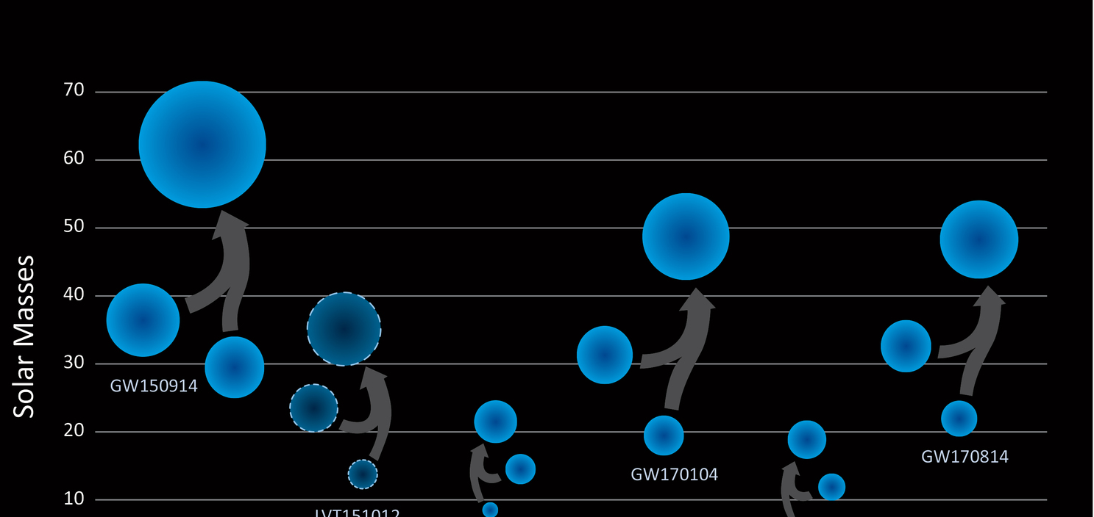
Selected A+ Discovery Targets
Based on P170608 and P170817 rate density estimates:
BBH rate 4.1x aLIGO ➔ 17-300 BBH/month
Off-axis observations ➔ BH component spins
BH Spins ➔ Origins of stellar-mass BH
Z_{max} ~ 1.5 ➔ BBH cosmological evolution
SNR ~ 100 ➔ Ultra-precision tests of GR
BNS rate 6.7x aLIGO ➔ 1-13 BNS/month
(2-11 BNS x SGRB coincidences/year)*
Multimessenger coincidences ➔ precision H₀ measurement, kilonovae, etc.
High inspiral SNR ➔ BNS tidal deformation
BNS remnant “ringdown” ➔ NS matter equation of state
*(or more, if GW170817 represents hidden sub-threshold SGRB population)

Slide 6
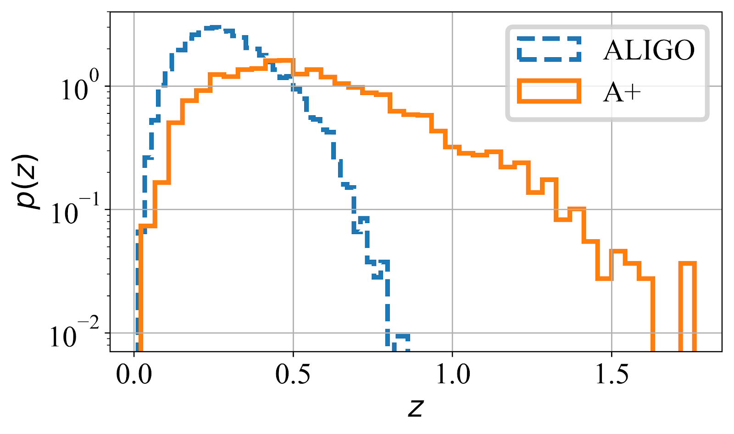
S. Vitale, M1800040
Figure 7: Redshift distribution of binary black hole sources detectable with SNR > 10 in a single A+ detector, as compared to baseline aLIGO at design sensitivity.

Slide 7
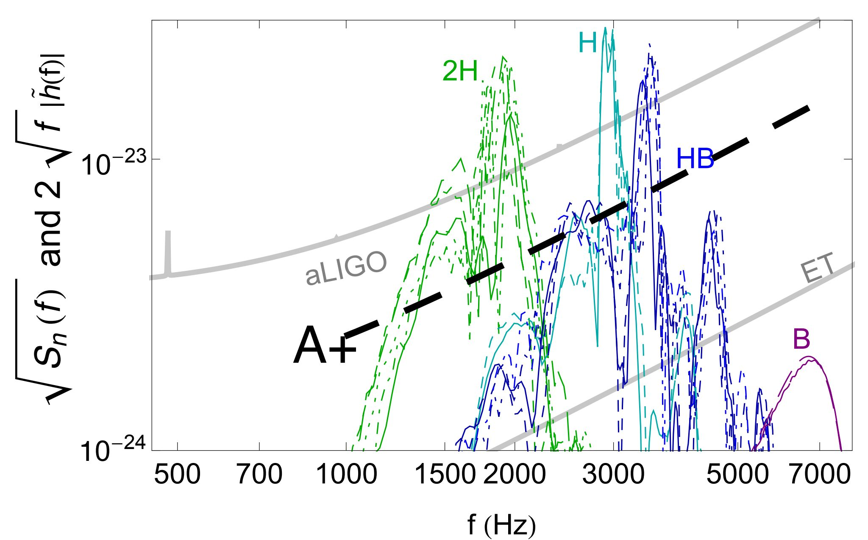
BNS post-merger “ringing” vs. NS EOS
Figure 6: BNS post-merger signal models vs. aLIGO and A+ detector noise for a range of speculated neutron-star equations of state (labeled 2H - B). A+ will have significantly improved capacity to detect post-merger "ringing" modes, whose characteristic frequencies are determined by the equation of state of super-nuclear matter. The low-frequency inspiral waveform component, which can also bear signatures of tidal deformability in the progenitor stars, is not shown. Simulations presume a reference BNS coalescence at 100 Mpc. (courtesy J. Veitch and S. Vitale, adapted from Read et al. [31])

Slide 8
A+ Upgrade Status
NSF awarded US funds, 18 months earlier than original request
  Same end date (4QFY2023, limited by COC coatings) but much faster start
  Acceleration may allow facility and vacuum upgrades between O3 and O4
  Retires risk, may well accelerate commissioning and O5 (no promises!)
  LIGO Lab team has formed and mobilized; formal start in 1 month, 10/1/2018
Australian ARC funding has already been awarded
Companion UK proposal is now under UKRI/STFC review
  We are cautiously optimistic for a similar accelerated UK start
  This would relieve schedule pressure on core optics polishing (sequential fabrication) and suspension design pipelines
Big picture: we expect LIGO will be observing with A+ sensitivity by late 2024

Slide 9
A+ elevator pitch constraints
An incremental upgrade to aLIGO that leverages existing technology and infrastructure, with minimal new investment, and moderate risk
Target: factor of 1.7* increase in range over aLIGO
About a factor of 4-7 greater CBC event rate
Bridge to future 3G GW astrophysics, cosmology, and nuclear physics
Stepping stone to 3G detector technology
Can be observing within 6 years (mid- 2024)
“Scientific breakeven” within 1/2 year of operation
Incremental cost: a small increment on aLIGO
*BBH 30/30 M: 1.6x
*BNS 1.4/1.4 M: 1.9x

Slide 10
Look at all the constraints:
“Your next investment should…
  …be incremental in cost
  …minimize loss of observing for existing instruments
  …provide immediate scientific return
    e.g., improved rate*time integral should ‘quickly’ wipe out observing hiatus due to upgrade
  …build upon and fully exploit prior investment
    “we already invested 10⁹ $/€/£…”
  …simultaneously support following investments, e.g.,
    test technology for “(n+1)G”
    probe future astro source landscape

Slide 11
…all the constraints (2):
All good and wholesome, but taken together, recipe for a holding pattern
Nothing big happens that way
  (certainly not Initial or Advanced LIGO)
Which constraints to challenge here?
  (really asking, I don’t know).

Slide 12
Are there other constraints we should be considering?
For example:
  We naturally fret about seismic, quantum and thermal noise
  Our reviewers (perhaps the more influential ones?) may fret about 15% cost growth in steel, earthmoving, or concrete
    Even “routine” roads and tunnels see 100% overruns
  Are we investing responsibly to bound and manage large, “conventional” risks, or are we only looking after the novel “interesting” ones?

Slide 13
Suggestion: diversify
Increments like A+, AdV+ and Voyager are necessary, but too overconstrained to put us in the strike zone
Always the possibility of a visionary patron and a leap of faith; hope for this, but can’t plan on it
3G technology demonstration investments can retire investment risks
  Without interfering with 2/2.1/2.5G observations
  Without forcing ‘profitable’ integration on an existing (obsolete) instrument
LIGO and Virgo invested millions and decades to pre-qualify
  beamtube construction;
  phase noise at the MIT 5m;
  displacement noise at the CIT 40m;
  optic polishing, metrology & coating pathfinders;
  etc.
What are the analogs for 3G?

Slide 14
Possible “Large-scale” 3G technology demonstration investments
3G Value-Engineered Beamtube Demo
  LIGO is planning a water vapor desorption test on a spare 7m tube section at LLO
  NSF just funded a LIGO workshop for early ‘19 on Very Large Scale Vacuum Systems
  What about a 500m scale 3G beamtube fabrication and degassing test?
3G Tunnel/Earthwork Demonstration
3G Very Large Optic Polishing & Coating Pathfinder
…?...(ideas welcome)

Slide 15
Discussion points
Nobody wants to wait
Nobody wants to invest 10-100M $/€/£ in engineering demo projects that don’t detect GW’s
BUT
Moving directly to full scale design without some proofs of concept may meet resistance
We can’t demonstrate all of what we need on H1/L1/V1/K1/I1
We probably need to break all the risky problems (not just the interferometry) into pieces and show what we can do in each domain separately.
We hope that increments like A+, AdV+, and Voyager will buy us time and let us hold our place at the forefront of modern astrophysics

Slide 16
THANKS
(and sincere apologies from MZ)

Slide 17
Spare Slides

Slide 18
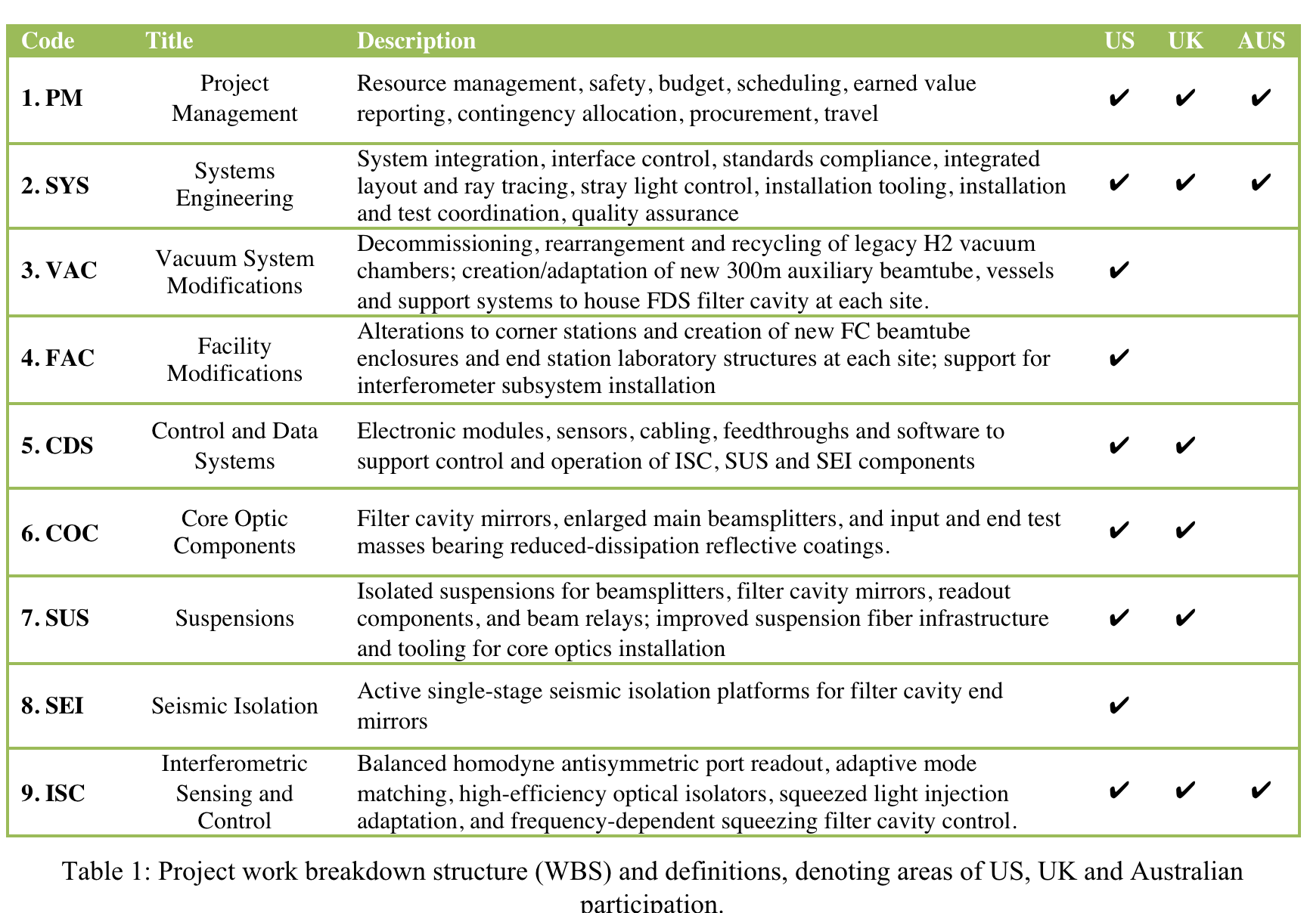
A+ WBS & foreign effort
UK ISC
  BHD readout
UK COC
  Large beamsplitter
  COC substrates, polish, coatings
UK SUS
  BOSEMs
  BHD SUS
  Large BS SUS
UK CDS
  Coil drivers (partial)
AUS ISC
  SQZ optics (partial)
  Adaptive mode match (partial)

Slide 19
A+ Proposal Team
LCCL- Zucker
  Science targets- Vitale
Lead Engineer- Billingsley
Project Manager- Hansen
  Schedule & resources- Toon
Subsystem Leads:
  Systems- Torrie
  Core Optics- Billingsley
  Seismic- Mason
  Suspensions- Robertson
  Facilities- Oram
  Vacuum- Romel
  CDS- Abbott
  ISC- Barsotti
UK
  Lead- Strain
  Science Case- J. Veitch
  ISC (BHD)- Hild
  SUS- O’Dell
  COC- Hammond
Australia
  Lead- McClelland
  ISC- McClelland, P. Veitch
(CIT and MIT departments covered US proposal prep costs ☺)

Slide 20
A+ NSF Proposal Review: Panel Summary
“Over the last several years LIGO has made tremendous discoveries which have inspired people around the world and demonstrated the value of gravitational-wave observation as a new tool for astronomy. The proposed effort promises to make a major advance in that effort for even better science. The proposed technical improvements take careful aim at the dominant noise sources remaining at the aLIGO design sensitivity, with a very carefully thought through approach, deploying cutting-edge technological innovations with careful thought to mitigating risks of delay and/or lost science opportunity. While some minor concerns are described in the section notes these are far outweighed by the overwhelming strengths of the proposal. The panel strongly recommends funding the proposed upgrade.”

Slide 21
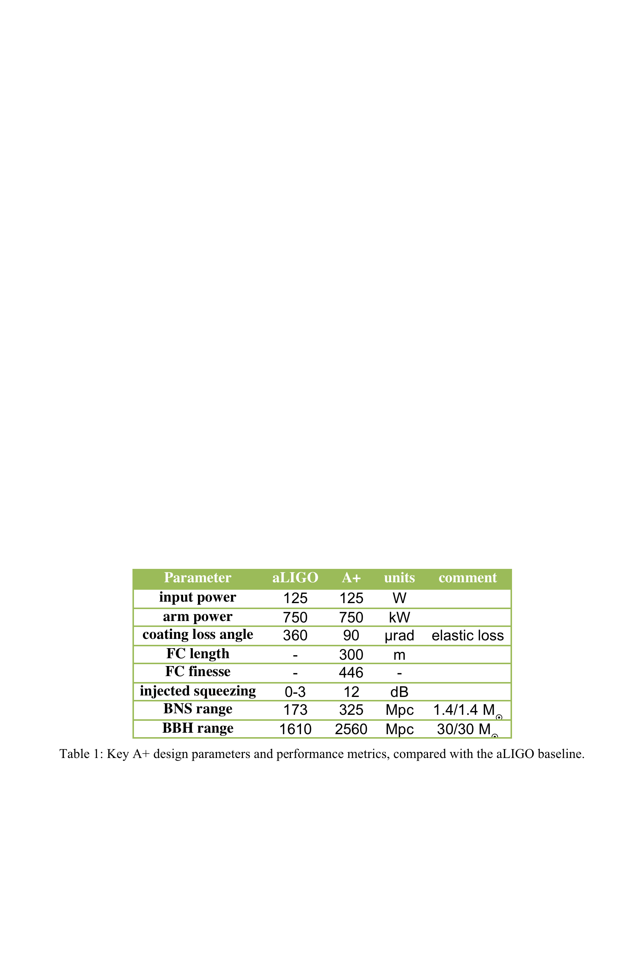
A+ parameters vs. aLIGO

Slide 22
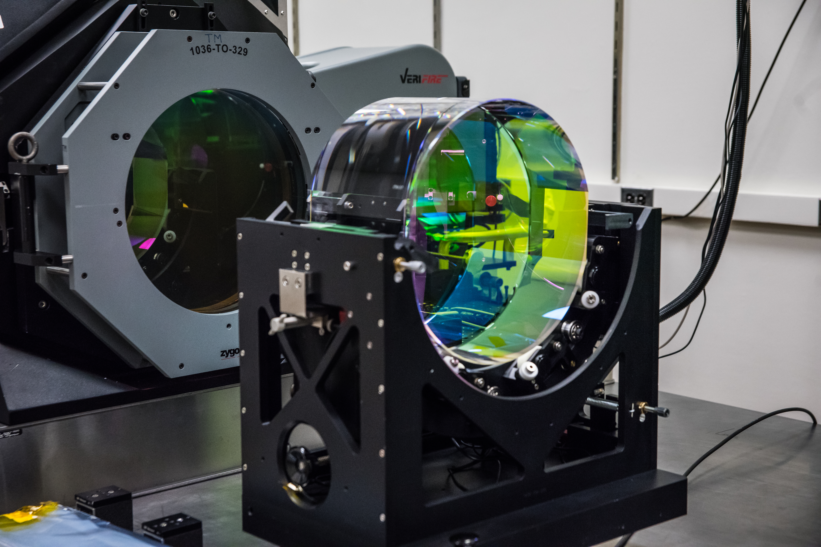
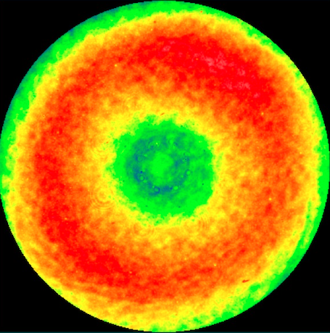
Improved Mirror Coatings for A+
400mm LIGO Fizeau
interferometer at CIT
TARGET: Elastic loss angle φ < 9 x 10⁻⁵
  (aLIGO φ = 3.6 x 10⁻⁴⁾
Current R&D on small samples
UK, Europe and US Center for Coatings Research initiative to select best low-loss coating design in about 2 years
A+ Coating Pathfinder program will spin up industrial vendor(s) and qualify full-aperture coatings for production
In parallel, new and existing spare aLIGO optics will be polished
Metrology, QA, lab infrastructure, tooling, procedures all same as aLIGO & reused
Replacement core optics delivered for final phase of A+ installation (mid-FY23)
aLIGO ETM figure map
6.5 Å_{RMS} over central 160 mm Φ
(LIGO Lab/G. Billingsley)

Slide 23
A+ Coatings
Gras & Evans, P1700448
A+ goal

Slide 24
Quantum Noise Reduction for A+:
Frequency-Dependent Squeezing
Expect squeezed light injection to be operating soon
Effective substitute or assist for high laser power
  Phase squeezing at HF causes amplitude anti-squeezing (radiation pressure) at LF
  Added radiation pressure bothersome as other LF noise is improved
Solution: Frequency-dependent squeezing (FDS)
  NOTE: FDS is also key for planned future detectors (Voyager, ET, CE, etc.)

Slide 25
Frequency-Dependent Squeezing
Optical “filter cavity” (FC)
Rotates squeezing phase to both improve radiation pressure at LF and phase noise at HF
Low-loss, high finesse cavity with bandwidth ~100 Hz
Sensitive to optical losses, scattering and mirror motion
Requires seismic isolation and quiet mirror suspension
Requires high-quality FC mirrors
Requires L_{FC} ~ 300 m

Slide 26
FDS demonstration w/ 2m filter cavity
Oelker et al, LIGO-P1500062
LIGO demonstration of audio-band frequency dependent squeezing
(A+ Proposal figure 3)

Slide 27
Filter cavity vacuum system and facility modifications
C. Torrie & E. Sanchez
Corner station (Hanford)
50 m
300 m
(TO LLO)
50 m

Slide 28
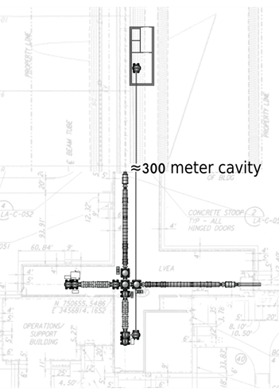
A+ FILTER CAVITY
BEAMLINE
New station
building
New HAM
Chamber
New 20cm
Beamtube &
Enclosure
New HAM
Chamber
View from future LLO FC end station back to corner
C. Torrie, E. Sanchez , G. Billingsley
M1800040

Slide 29
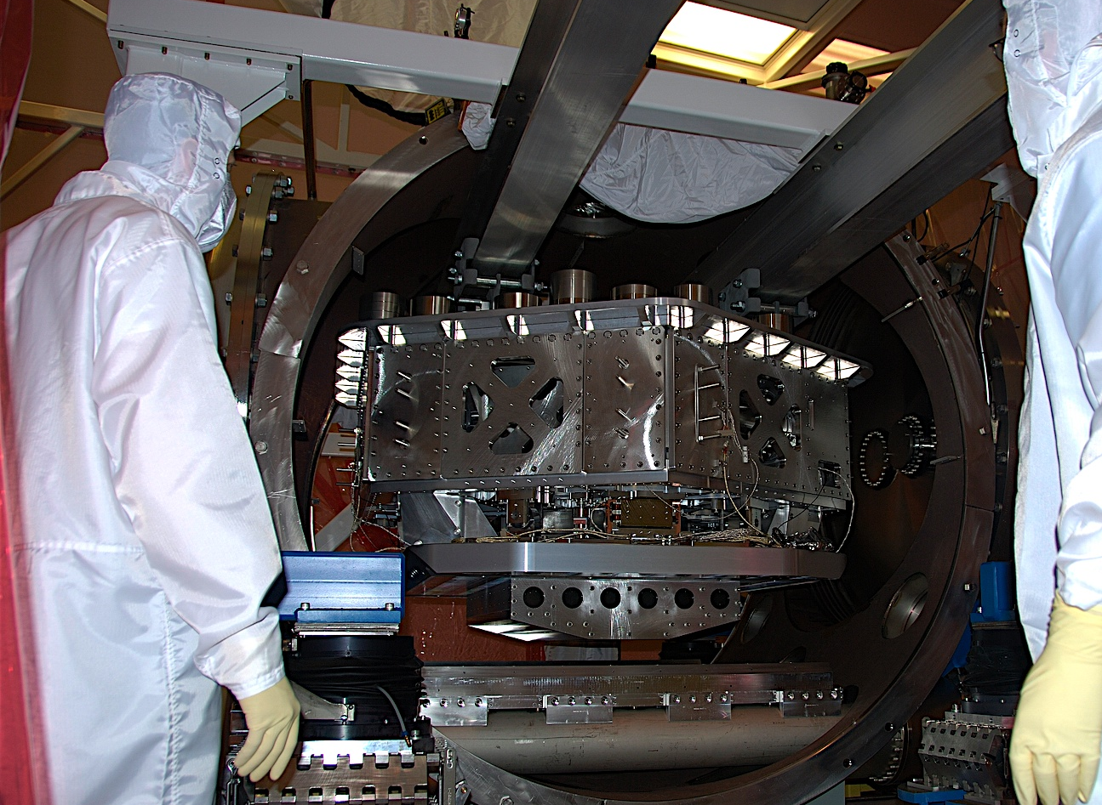
A+ filter cavity:
mirror suspension & seismic isolation
aLIGO HAM Small Triple Suspension (HSTS)
aLIGO HAM Internal Seismic Isolator (HAM-ISI)
Notes:
HAM ISI insertion in HAM6 at Livingston with guidance from Jeff Kissel (LSU, left) and Brian O’Reilly (LLO, right). March 2008.

Slide 30
Balanced Homodyne Readout (UK)
Reduced dark-port loss
Improved backscatter immunity
Improved phase tuning flexibility
Enhanced readout dynamic range
LIGO-P1300184

Slide 31
Balanced homodyne readout
Revised: LO DIFFERENTIAL PHASE NOISE IS CRITICAL!
Need low-noise beam relay mirrors
OMC’s now after LO/AS interference
LIGO-P1300184

Slide 32
A+ BHR
LO beam relay
(work in progress)
POP pickoff beam used for homodyne local oscillator
LO phase noise critical
Requires sub 10⁻¹⁸ m/Hz^{1/2} mirror noise at 100 Hz
Triple-stage suspension for relay optics
Space constraints → new compact triple suspension design is required

Slide 33
A+ Technical Updates
Filter cavity length → 300m
    Model showed insufficient backscatter margin at 100m
    Modest hit in civil & vacuum cost
Low-noise relay optics for BHD local oscillator
    Models revealed enhanced phase noise susceptibiity
    Now baselining ~ 11 triple-pendulum suspended small optics to deliver low-noise LO beam (new design)
    US to do design, UK to fund production
BHD topology changed
    AS and LO beams to be interfered before mode cleaners
    Modified OMC suspensions needed
Anticipating coating progress…
    Looking closely at zirconia-doped tantala

Slide 34
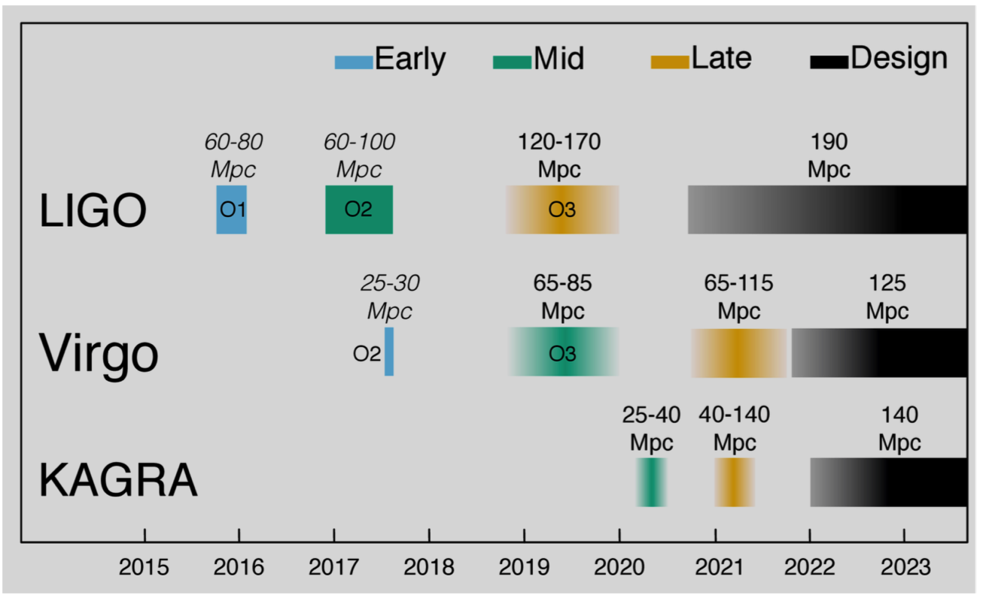
Observing scenario
From P1200087-v47

Slide 35
Original simplified schedule
From ‘19-23 LIGO ops renewal proposal

Slide 36
Sample revised schedule (schematic)
Advance civil & vacuum construction to O3-O4 break
Start optics integration immediately at end of O4
A+ award
Installation A
Installation B

Slide 37

Context: Bridging the Gap
(adapted from G1401081)
It may take a decade for “next-generation” GW instrument technology to come online.
Is extended observation at aLIGO performance limits the best we can do?
Ultimate Detector R&D
ET, CE--New Facility
Si, Cryo, 2 µm R&D
LIGO Voyager – Current Facility
Advanced LIGO
?
time
2017
2027?
2037?
aL Design Target (±)

Slide 38
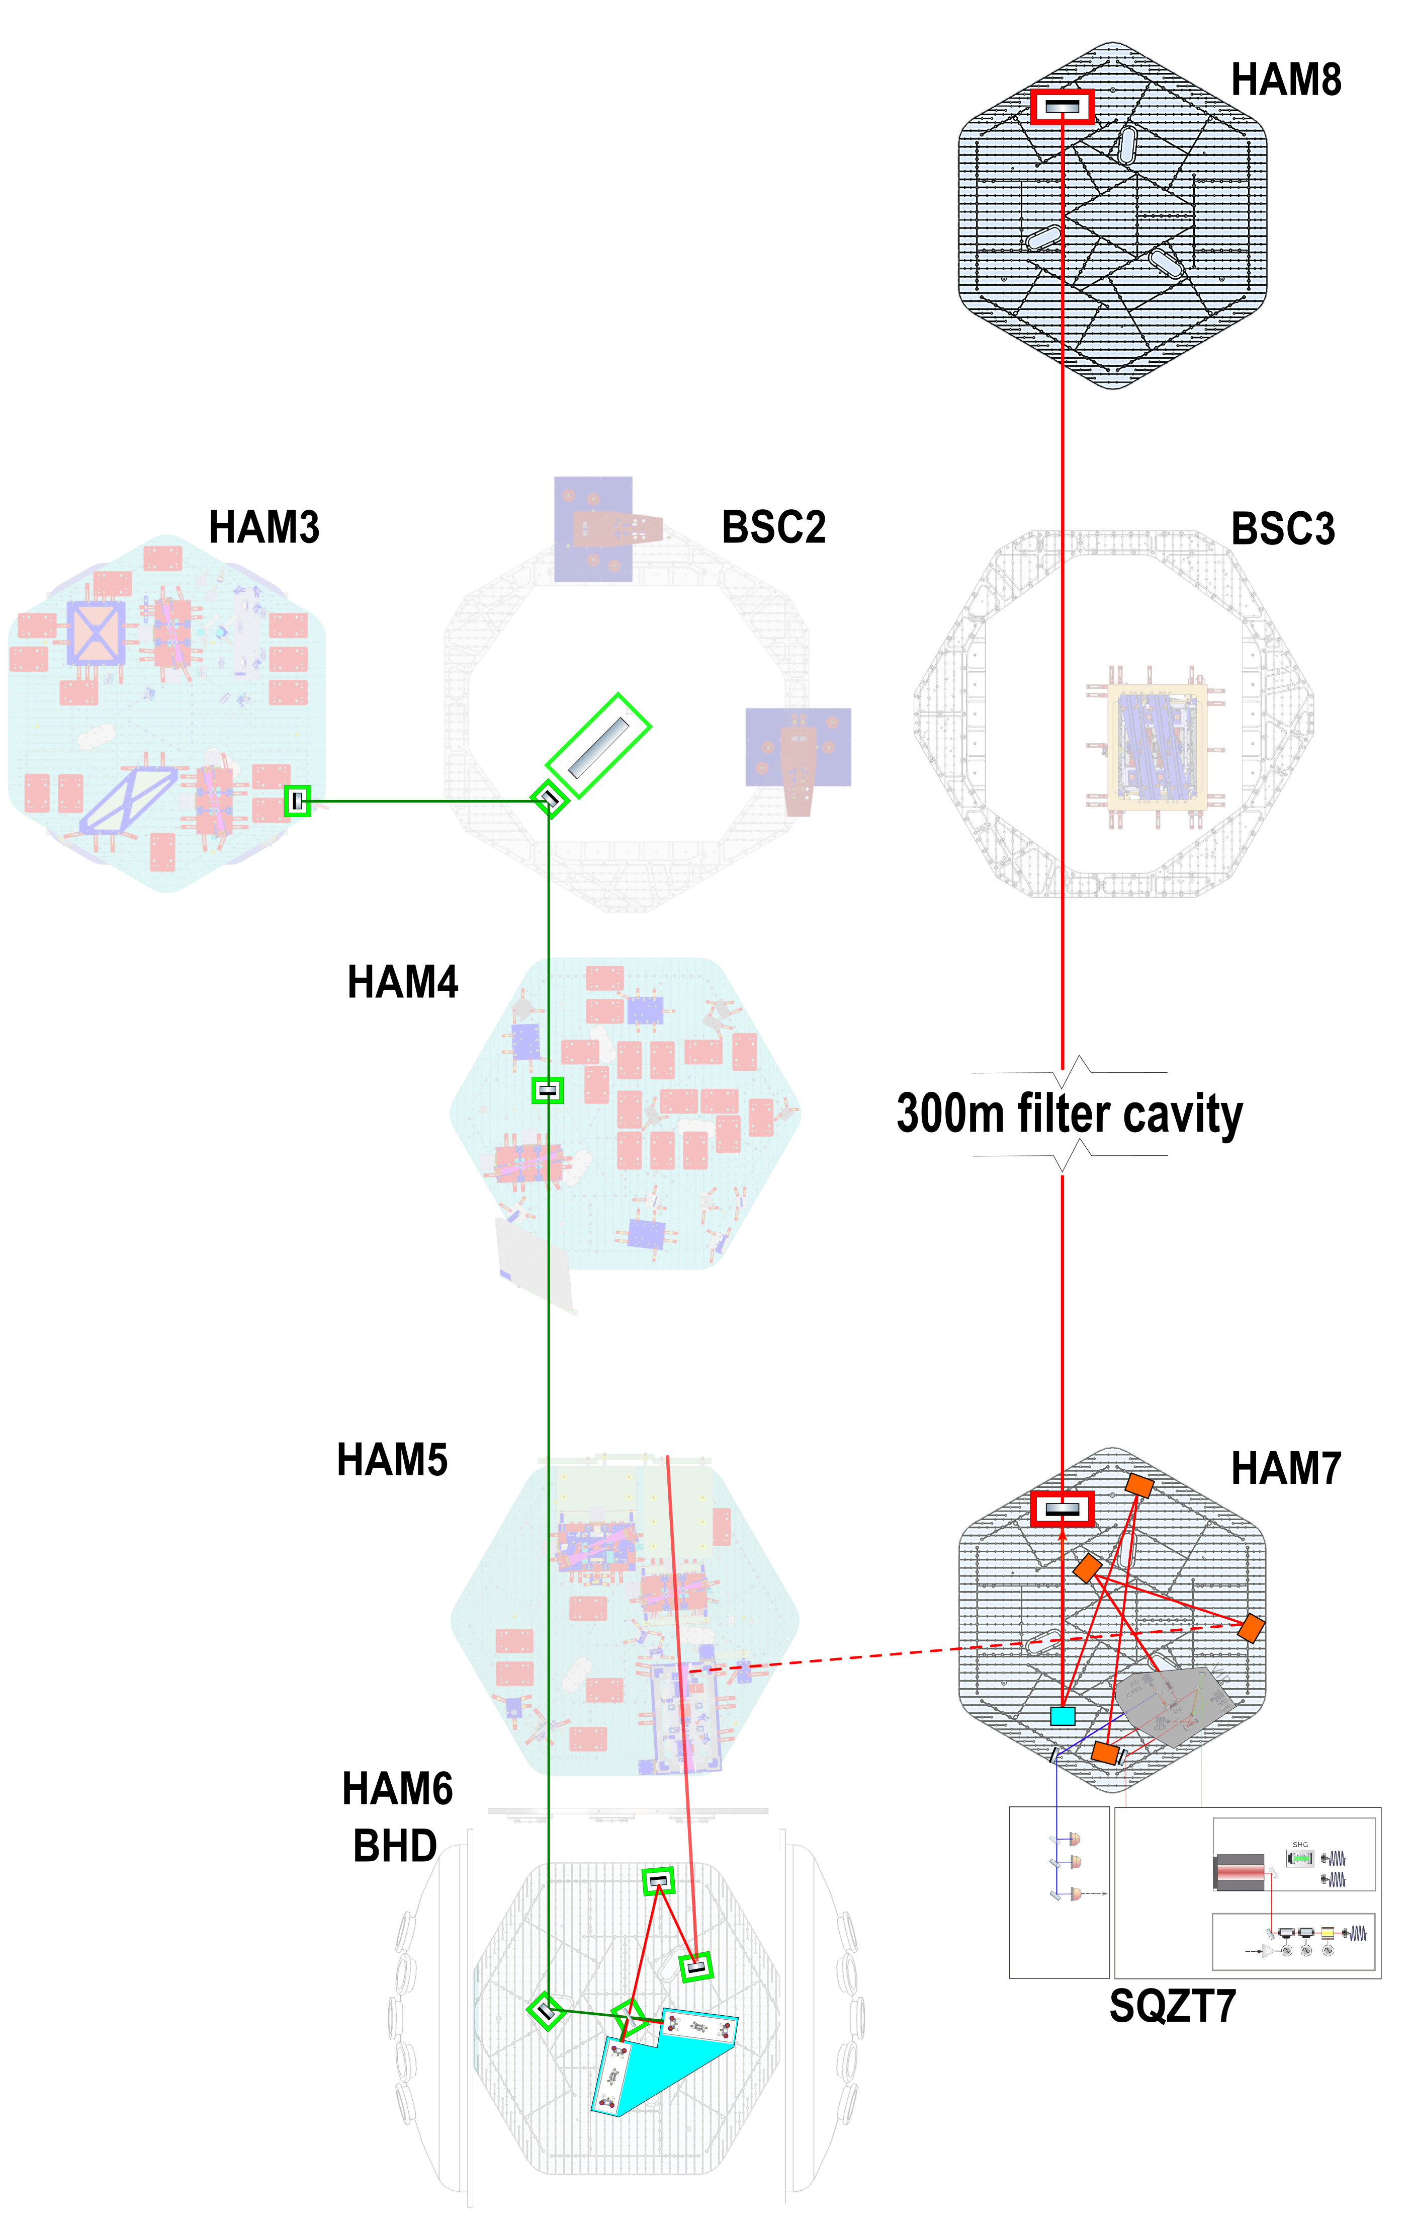
C. Torrie & E. Sanchez
“New” FC HAM chambers (HAM7,8) salvaged from H2
New HAM ISI and HSTS for FC mirrors
LO beam relay to use new “HRTS” triple suspension for low phase noise
BHD OMC’s may use a common suspended platform (based on VPI)
FC pipe penetrates BSC3 (beam passes behind ITMX)

Slide 39
A+ target noise budget
Barsotti et al, T1800043

Slide 40
aLIGO Design Target

Slide 41
A+ Design Target

Slide 42
A+ FDS with no CTN improvement

