Slide 1

The View from Europe
S. Katsanevas
30 August 2018

Slide 2
Gravitational Wave Physics in Europe
GW: GEO, Virgo , LIGO , LISA
Other Large Infrastructures in the field : LOFAR/SKA, CTA, KM3NET/ICECUBE
I will concentrate here on EGO/Virgo developments with large impact of GEO colleagues on technology (squeezing) and 3G leadership

Slide 3
30 years of EGO/Virgo History
Virgo
1989 Virgo proposal
1993-1994 CNRS and INFN approve VIRGO (+5y)
1997 Construction starts near Pisa (+7y)
2000 Foundation of EGO (CNRS, INFN) (+11y)
2003 Inauguration of VIRGO (+14y)
2004-2006 Commissioning of VIRGO
2006 Netherlands joins EGO as an Observer
2007 Start of Virgo science runs (+18y)
2007 LIGO-VIRGO “a single machine”
AdVirgo
2009 EGO Council approves AdVIRGO (+20y)
2010 Polish, Hungarian and Spanish groups join AdVirgo
2017 Enters in operation (+8y, +28y)
2019 O3 RUN BNS each 60-85 Mpc (+10y,+30y)
  Total cost (US costing, including HR) near 0.5 BE
Patrick Fleury

Slide 4
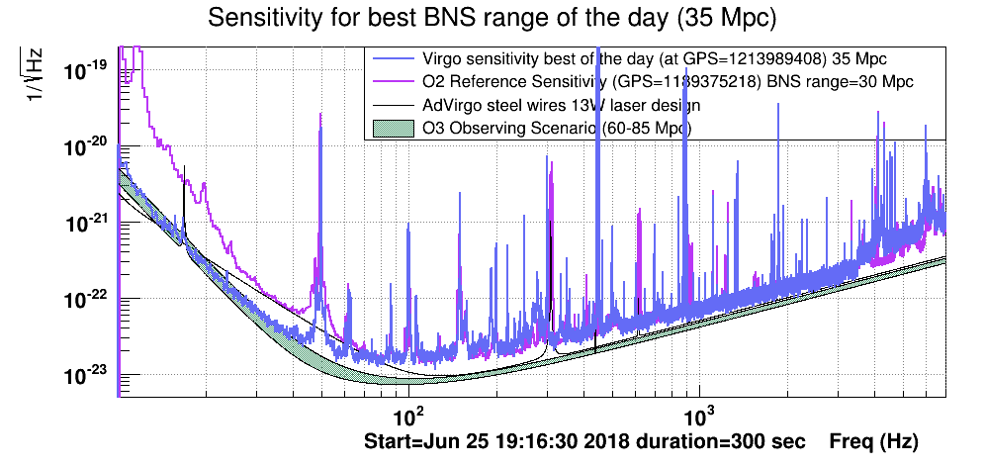
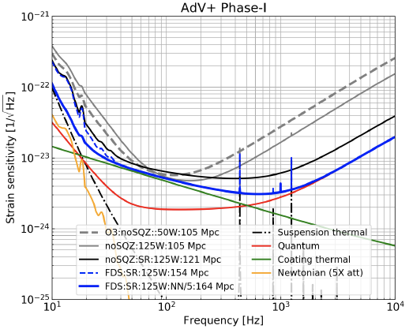
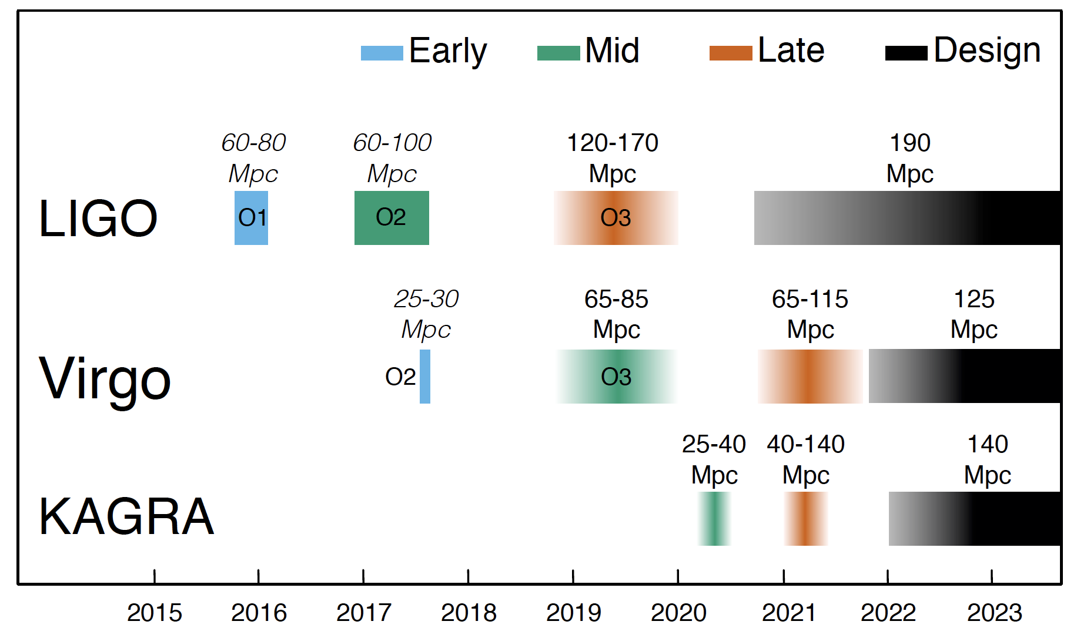
The next 5 years
  2019 O3 Run
  Range BNS >60 Mpc (BBH x10)
  Events BNS 0(9) , BH-BH 0(35)
  (Uncertainly factors of 3-5 )
  Monolithic suspensions, 70 to 100 W
  Frequency Independent Squeezing (AEI)
Adv+ Phase I
2024 O4 Run Range BNS >120 Mpc
  Complete AdV: Signal recycling
  Frequency Dependent Sqeezing (➔ 150 Mpc)
  Newtonian Noise Cancellation (➔ 160 Mpc)
  Events x 10
  Cost 0(10 M€)
Patrick Fleury

Slide 5
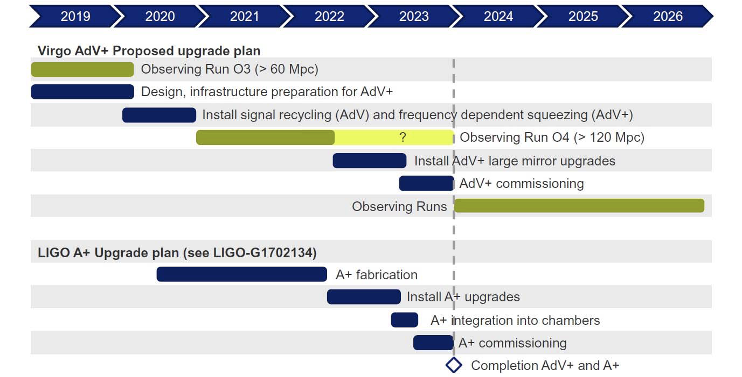
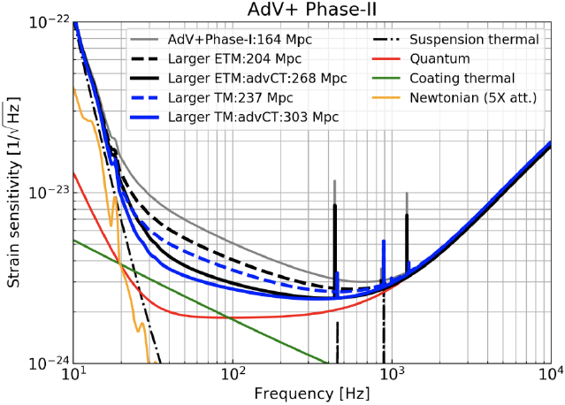
The next 10 years (ca 2030)
  AdV+ Phase II
  O4 duration not determined yet
  Towards the end of decade O5 Run
  Larger beam, increase test masses
    Range 200-230 Mpc
  Better coating (x3)
    Range 260-300 Mpc
  Sensitivity increase x10 w.r.t. today
  Cost 0(20-30 M€)
  Challenges:
    Grand Coater upgrade
    Vacuum infrastructure
    Payloads and attenuators
    Aberration control
Patrick Fleury

Slide 6
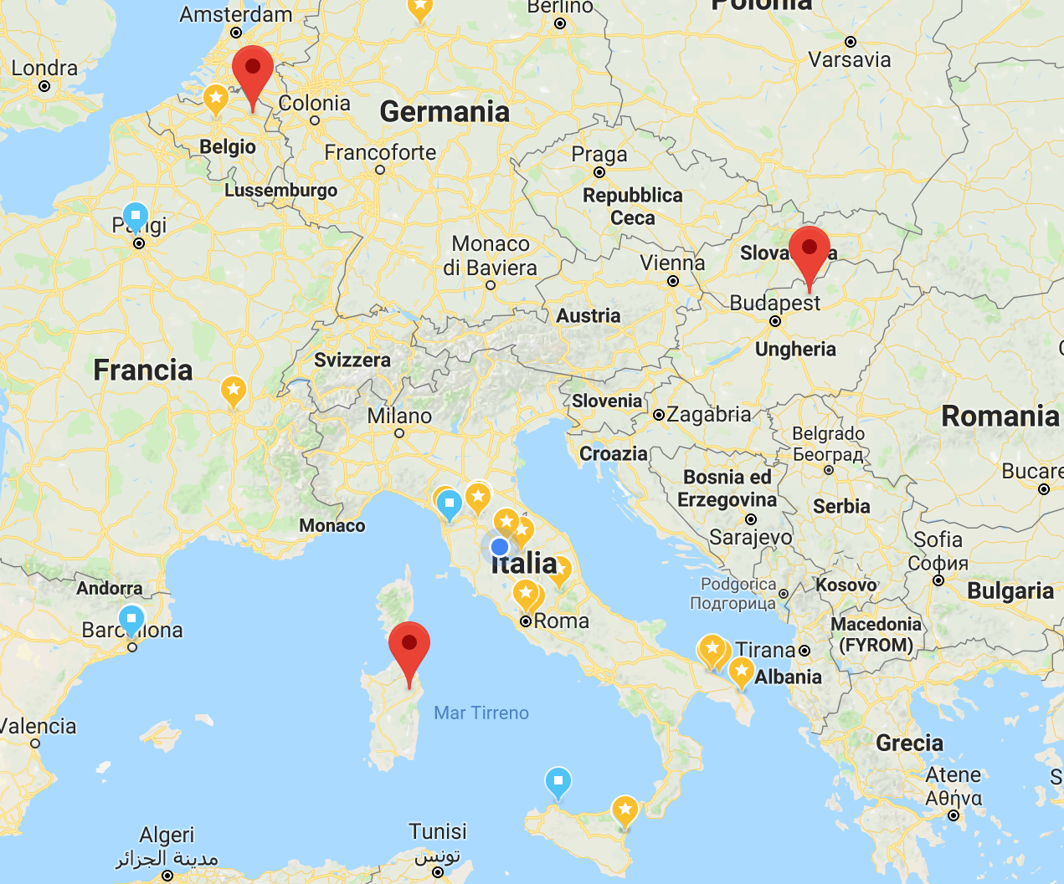
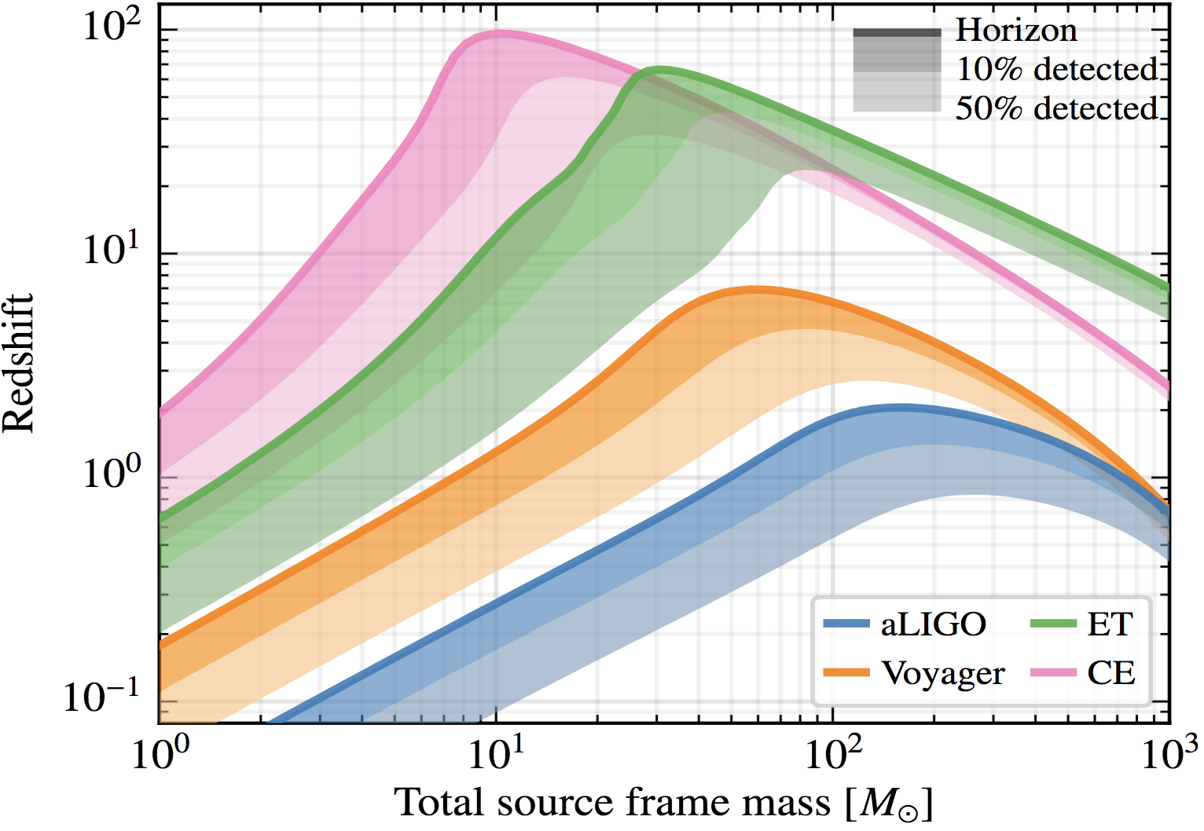
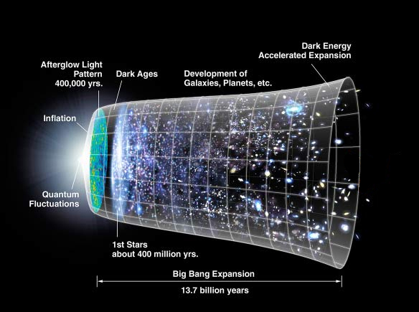
The next 25 years
3G : Einstein Telescope
  ET History
  2004 Idea(FP6-Ilias project, EU)
  2008-2011 Design Study (FP7, EU) Fr, De,, It, NL, UK coordinated by EGO
  2012-2018 Further studies: Elite, Grawiton (FP8 or H2020, APPEC)
  2018 Founding workshop: Formation of ET Collaboration
  3 sites (North, South, East of Europe)
  Proposed scenario:
  2021-2022 Site selection`
  2023 TDR
    2G➔ 3G Sensitivity x10 , Cost 0(1-2 B€)
  2025 Start excavation
  2030-2031 End of civil infrastructure
  2032+ Installation, Comissioning, Operation (2034 Lisa launch)
  Full coverage
  of the visible Universe
Patrick Fleury

Slide 7
Institutional markers in the next 5 years
Before the end of 2018
  AdV+ hopefully phase I approval (Sep 29, Dec 15)
  Participation of GW to the CERN European Strategy document
Before the end of 2019
  September: submission of a proposal that the path AdV+ Phase II ➔ ET is included in the ESFRI Roadmap (publication date 2020). Crucial for European country acceptance.
  Extension of the EGO consortium: in time (2020-2025) and in space (Netherlands +)
Before the end of 2021
  Approval of AdV+ phase II
Before the end of 2023
  Approval of ET construction

Slide 8
Strengths and opportunities of the process
( a personal view I )
Science
  It is a field where there is rare continuity between observation, upgrade and design of a new infrastructure
  The global network enhances the science potential. ET and CE are embedded in a global process and the GW community up to now has shown an exceptional unity in these matters.
  GW address many fields of fundamental science: from Astrophysics and Cosmology to Particle and Nuclear Physics but also and photonic/optomechanics challenges.
Technology, Industry and Society
  AdV+ Phase II will permit to tackle the technological risks of ET (de-risking)
  The interlinked sensor network monitoring and mitigating noise of the interferometers is at the avant-garde of the technological front of “smart infrastructures”
  The environmental studies can become a source of innovation in geological and atmospheric matters (early warnings, earth, cloud and sea monitoring). Synergies.
  The 3G civil-infrastructure is a large part (>90%) of the cost, there are technological, innovation synergies to be developed with other fields (HEP , ν) with the same concerns of civil infrastructure
  GW Computing is also at the forefont of recent developments (big data analytics, machine learning,..)
  There is a huge potential of outreach and education accompanying the GW revolution

Slide 9
Possible threats and a list of actions
( a personal view II)
There is always the danger to mix time and space scales.
In time, when the present (2G and 2G+) harms the potentialities of the future (3G) or ‘sin of rémanence’ , but also vice-versa where a precipitation of the future (3G) harms the rich potential of the current upgrades “sin of impatience”
In space, if the regional initiatives advance without coordination with the global effort. Here GWIC, GWAC, DAWN but also APPEC, ASTRONET etc play a crucial role
Possible actions increasing the possibilities of success
Strengthen the ties with the Multi-messenger community worldwide and increase the links with the Cosmology, HEP and and Nuclear ones as well as the interdisciplinary ties with Geoscience community at a regional and global level.
Launch common R&D and Computing initiatives
Develop the synergies on the issues of smart and innovative civil infrastructures
Exchange on the designs and governance schemes (GWIC-3G) and collaborate on roadmapping exercises
Develop a common outreach and education plan ?

Slide 10
Thanks

