Slide 1
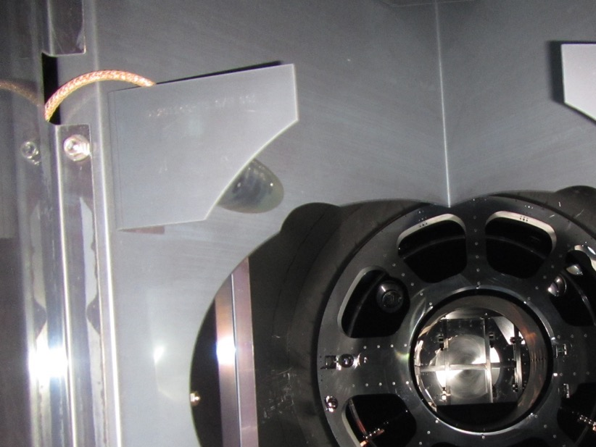
PEM update
DetChar F2F, August, 2018
I. Restoration of PEM system following install
II. More sensors near coupling sites
III. Improved PEM coupling functions
IV. Plans for BBH vetting in O3
V. Most important PEM-related commissioning
VI. Other support for astrophysical search groups
Robert Schofield, Philippe Nguyen, Kara Merfeld, Ray Frey, Jordan Palamos, UO, Anamaria Effler, Corey Austin, Terra Hardwick, Valery Frolov, LLO, and many others

Slide 2
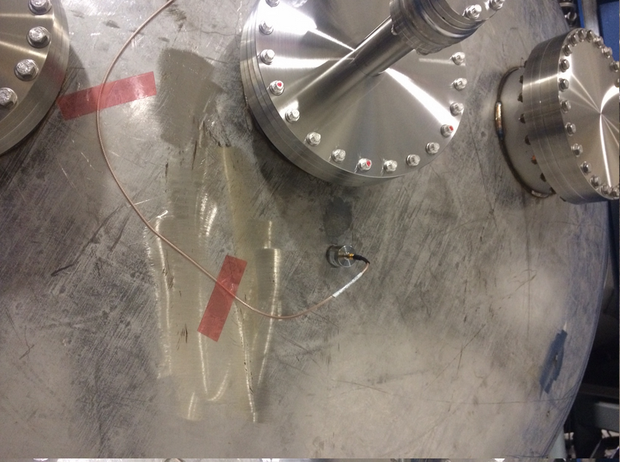
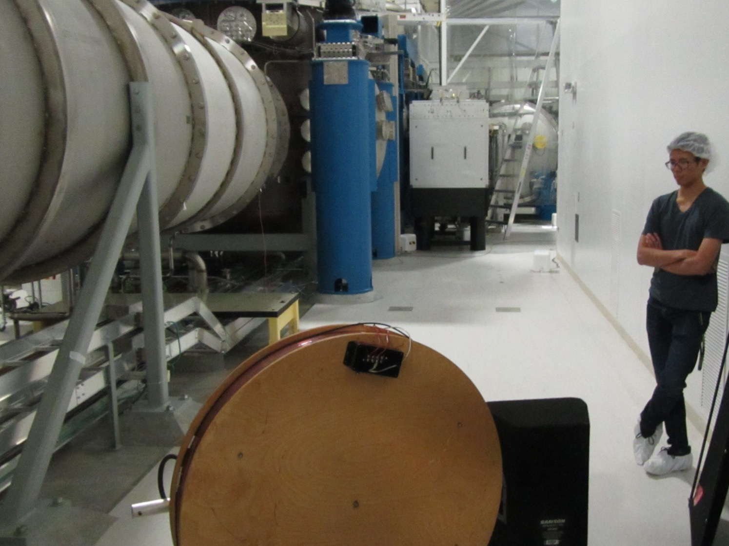
I. Restore PEM system
  1. Sensors
  a. Make sure accelerometers, magnetometers, microphones, narrow band radio, broad band radio, and weather stations are connected, properly oriented and working. Trouble-shoot bad channels alng with EE shop.
  b. Get cosmic ray system working.
  2. LIGOCAM Diponkar’s channel monitoring system
  a. Get software running
  b. Add new channels
  c. Establish nominal good spectra where possible
  d. Turn over maintenance to CDS (Niko at LHO)
  3. Jordan’s RF scanner at LHO
  a. Get it going again, solve storage problems
  b. Test for robustness
  c. Upgrade?

Slide 3
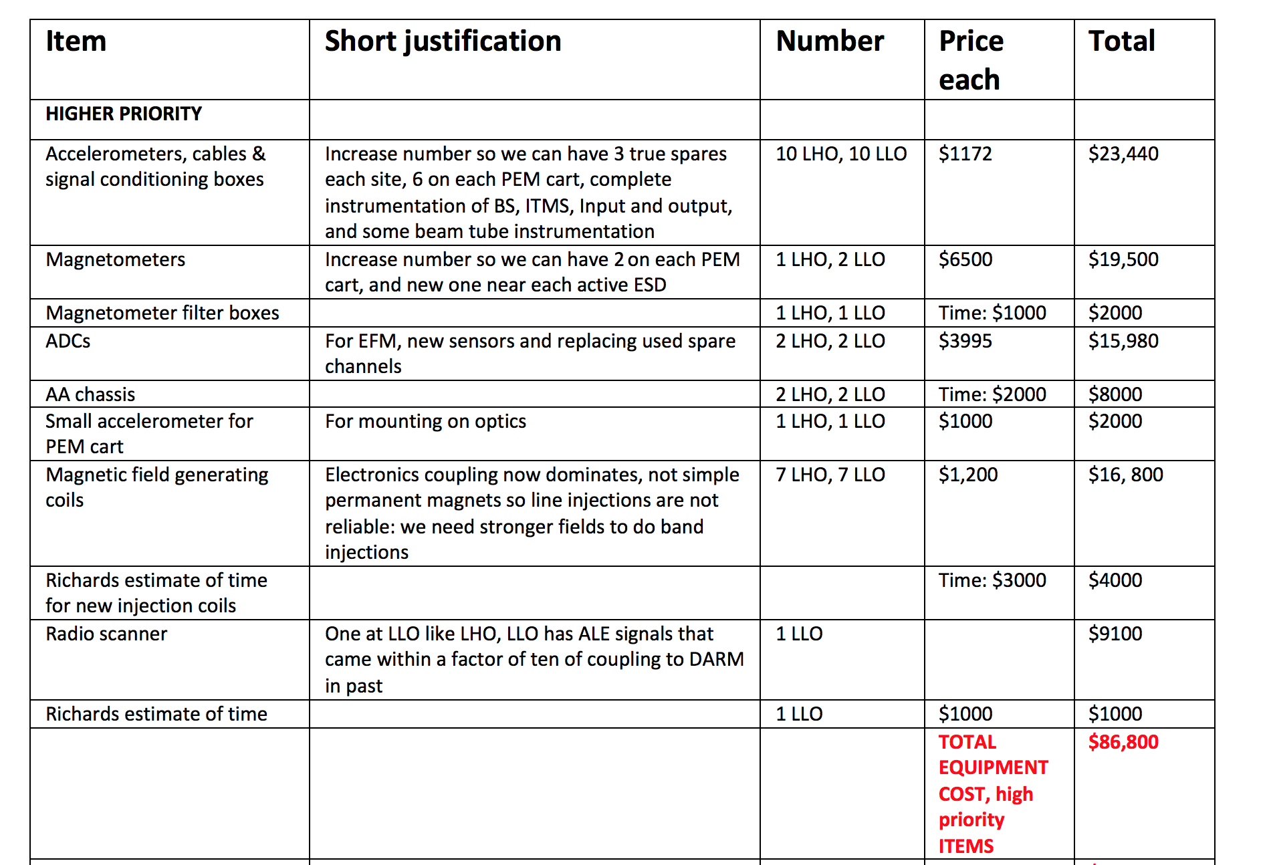
II. More sensors near coupling sites
  $90K of proposal granted for new sensors and other PEM equipment

Slide 4
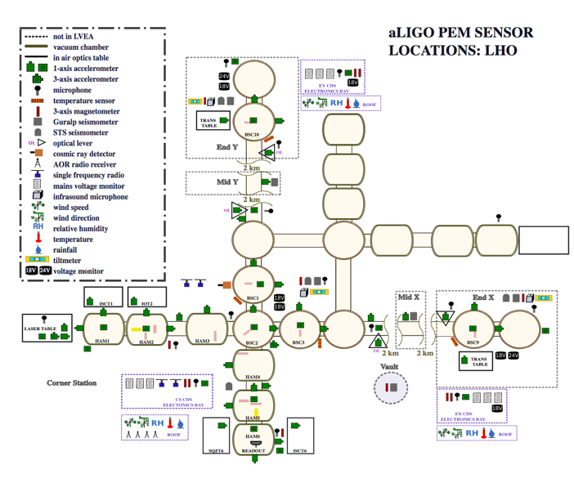
II. More sensors near coupling sites

Slide 5
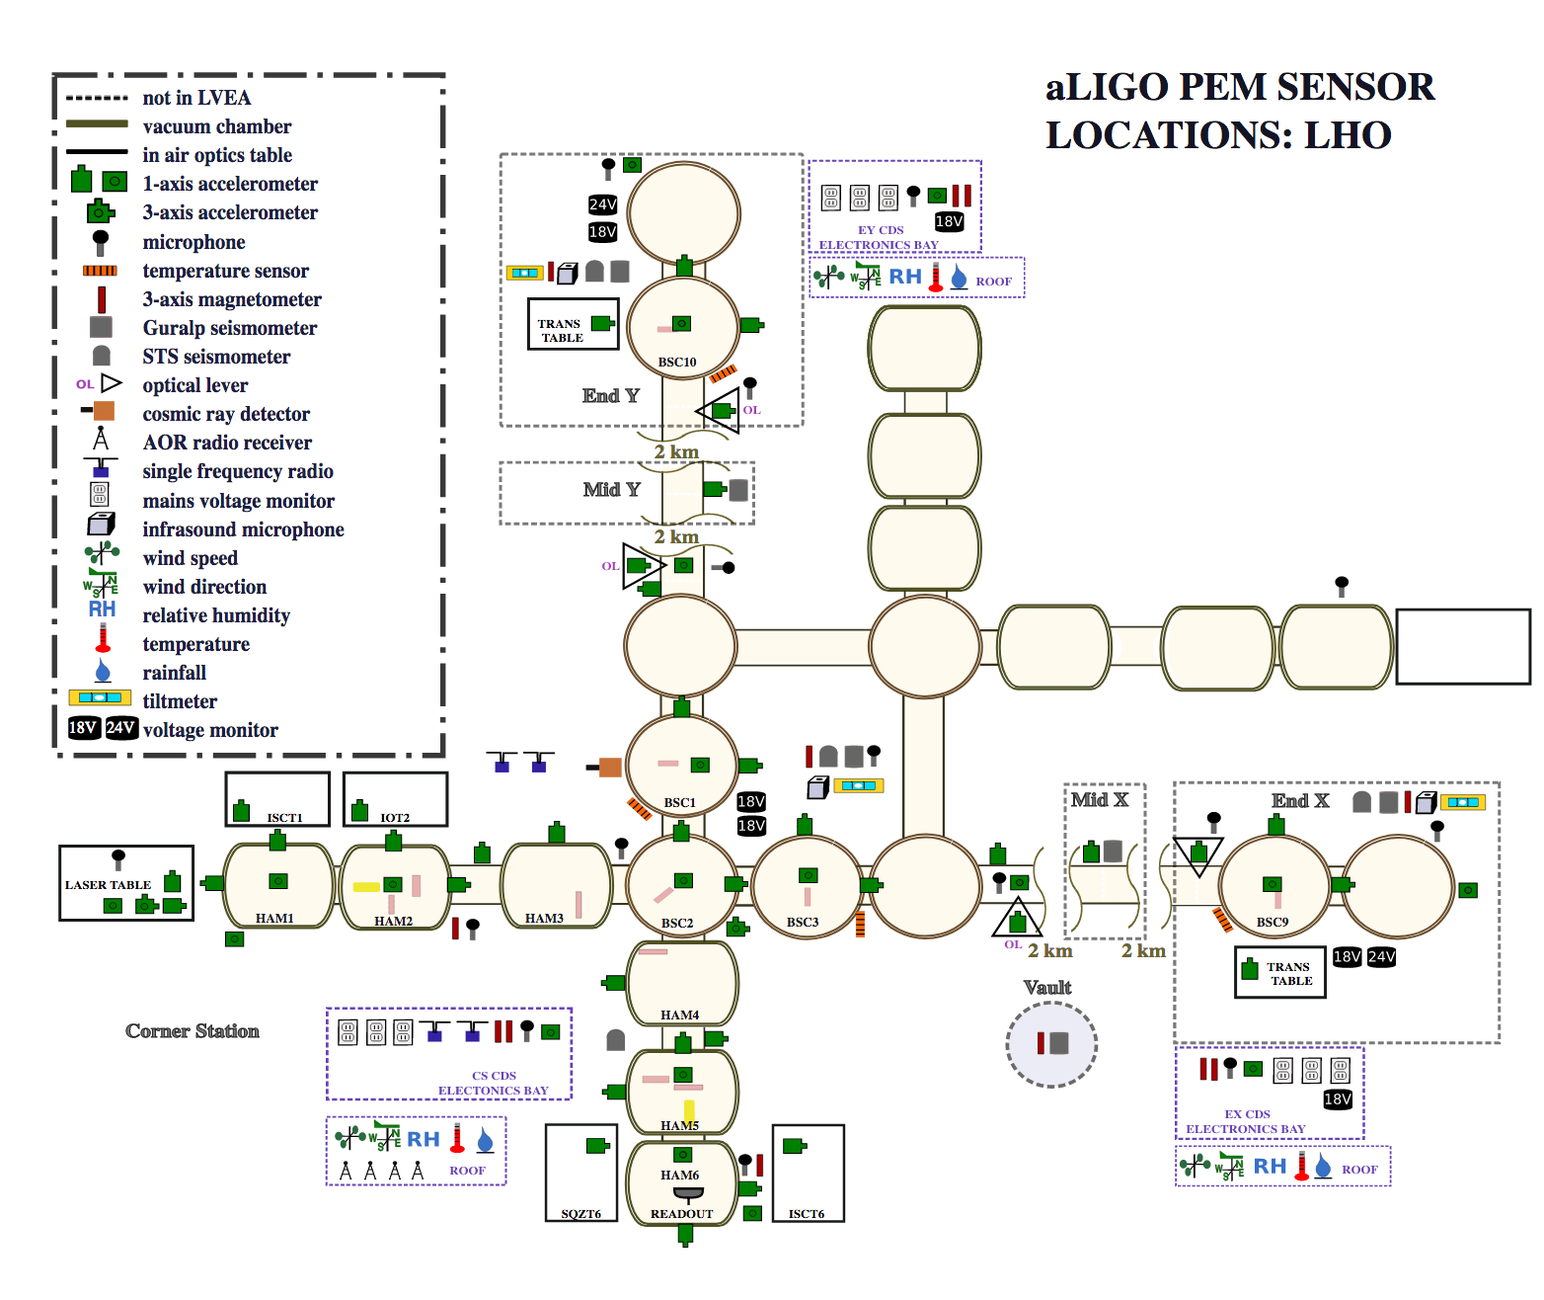
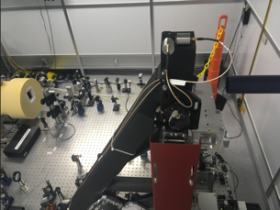
  A. Redistribution/addition of accelerometers based on O2 coupling measurements
= 16k, other accels: 4k sample rate

Slide 6
  B. New voltage monitoring channels for sensitive power supplies
= 16k, other accels: 4k sample rate

Slide 7
  C. New magnetometer to monitor Electrostatic Drive site
= 16k, other accels: 4k sample rate

Slide 8
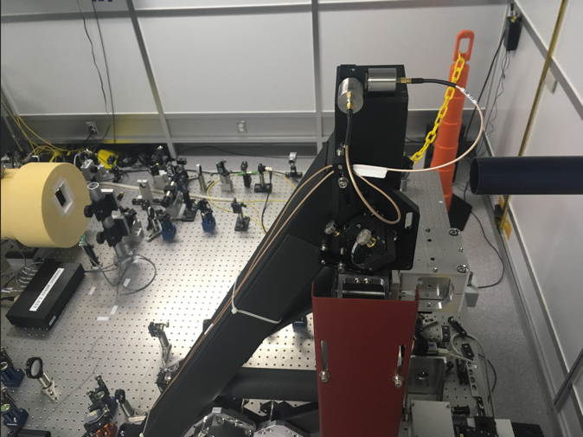
II. More sensors near coupling sites
Related system improvements
  D. Higher sample rates on accelerometers: at least 4k (vs 2k) and additional 16k channels; note that resonances make calibrations inaccurate above 3000 Hz
  E. 16 additional temporary 2k channels at the LHO corner station
  F. ADCs and other CDS hardware as needed for new permanent and temporary channels
  G. Quadrature sum channels for magnetometers
  H. New 10KHz-2GHz radio scanner at LLO, upgrade for faster scan at LHO
  I. Mid station microphones and accelerometers at LLO

Slide 9
III. Improved PEM coupling functions
  A. Philippe Nguyen and Julia Kruck’s coupling function code and current further development
  B. Large low-frequency shaker
  C. Development of higher-field magnetic injections so we can do more than line injections.

Slide 10
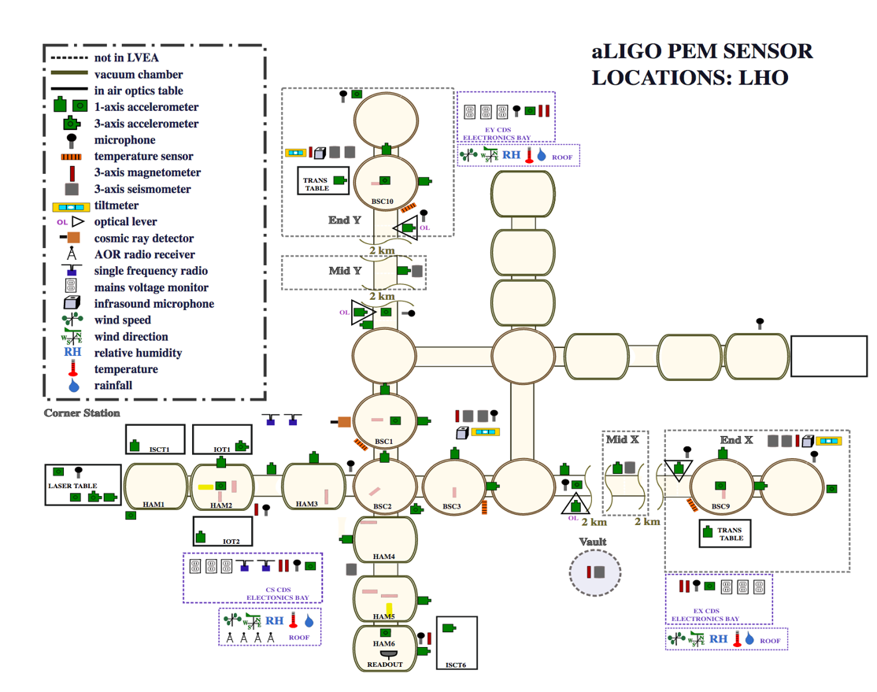
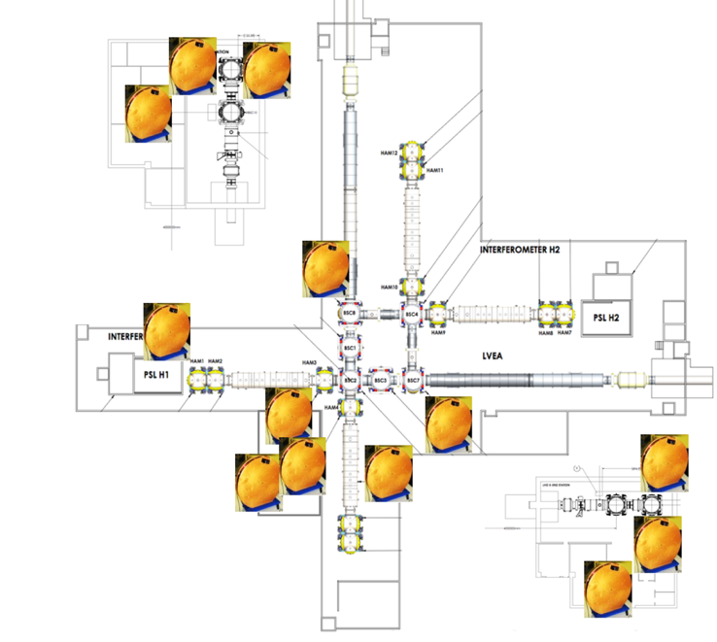


A. Philippe Nguyen and Julia Kruck’s code produces a single coupling function for every sensor from multiple injections
Acoustic
Magnetic

Slide 11
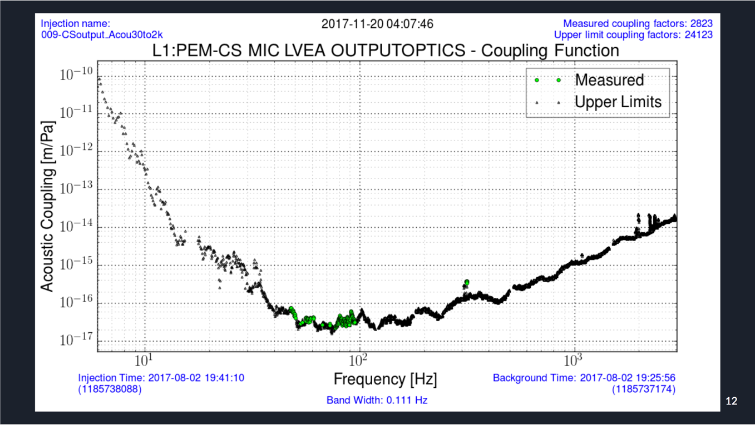
Code first produces a coupling function (CF) for every relevant sensor for every injection

Slide 12
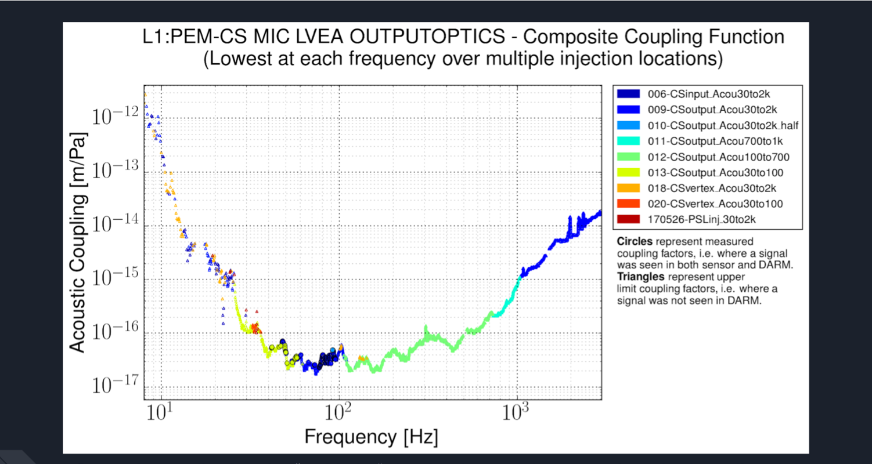
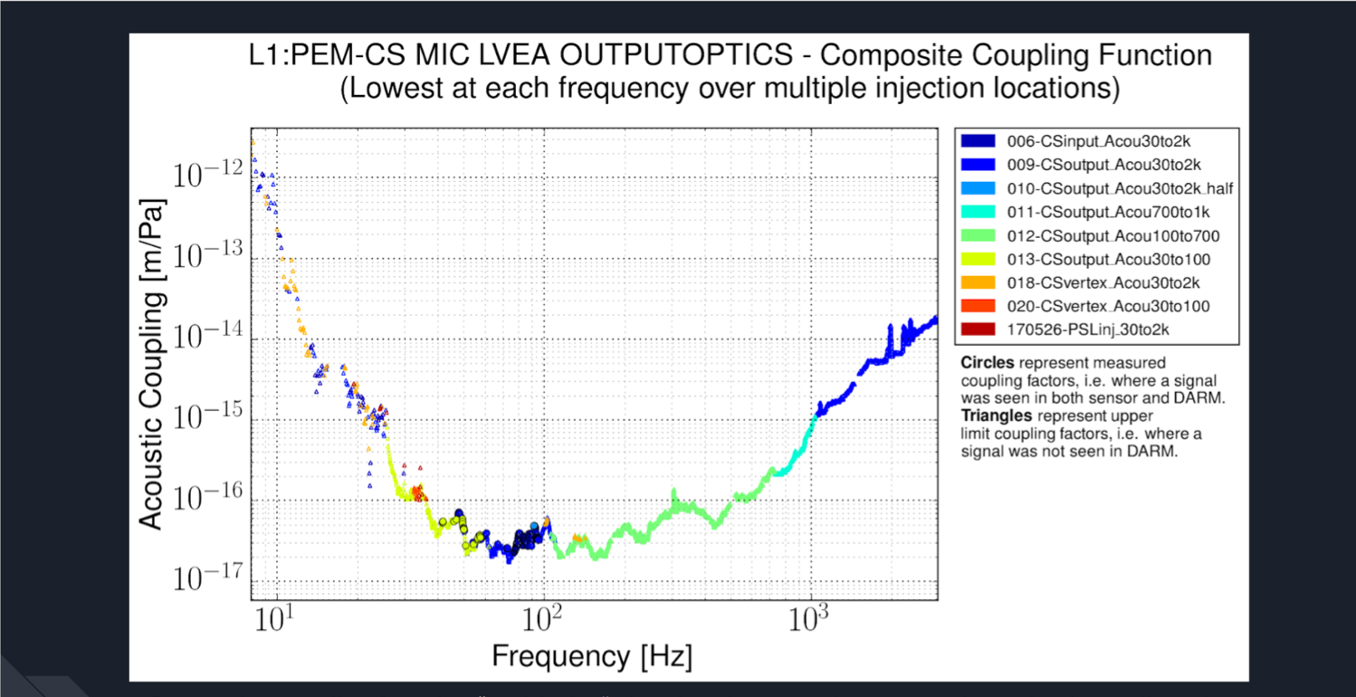
These injection CFs are combined into a single CF for each channel by taking the lowest coupling factor at each frequency over multiple injection locations

Slide 13
We are currently developing more sophisticated combination methods than simply taking the lowest coupling factor

Slide 14
Multiple versions of each coupling function: this version has
physics units and injection locations

Slide 15
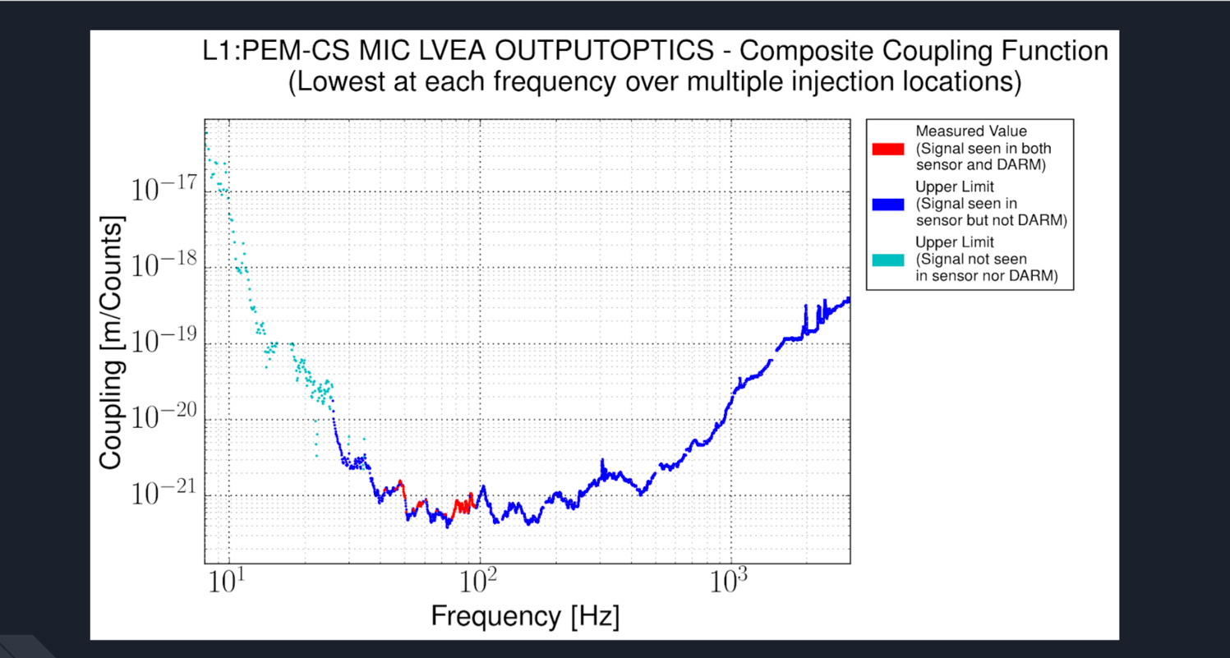
Multiple versions of each coupling function: this version has m/count for easy/automated calculation

Slide 16
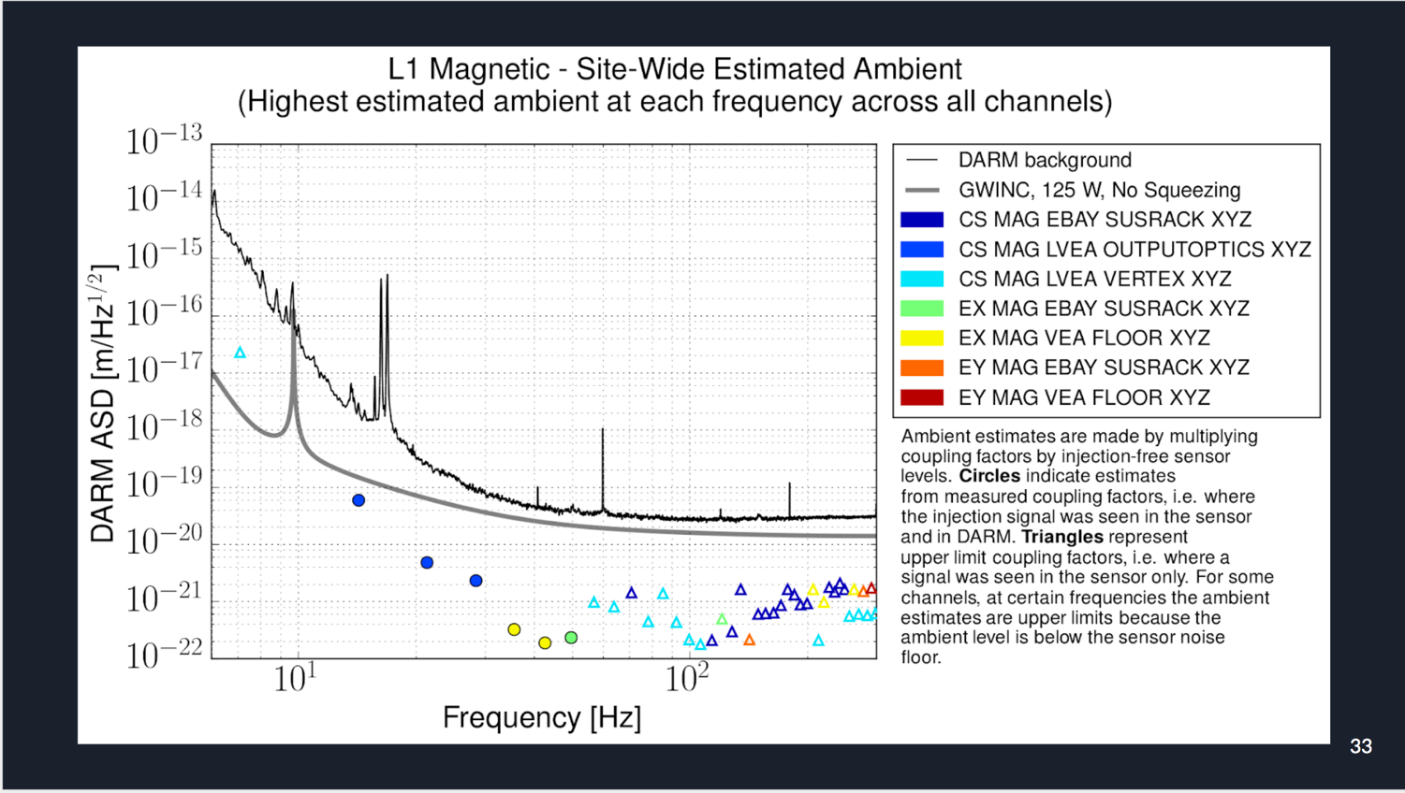
And summary plots are made from all sensor channels showing highest coupling

Slide 17
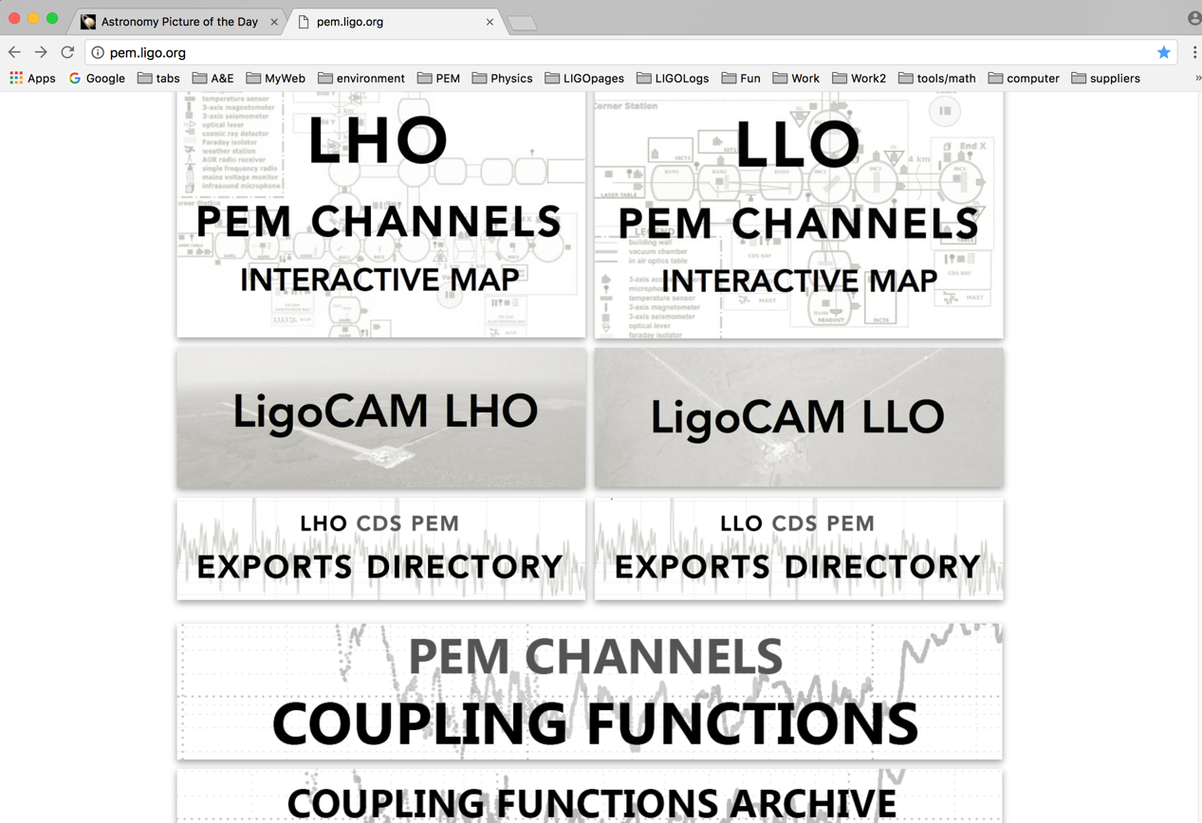
The data and plots are all located at PEM.LIGO.ORG

Slide 18
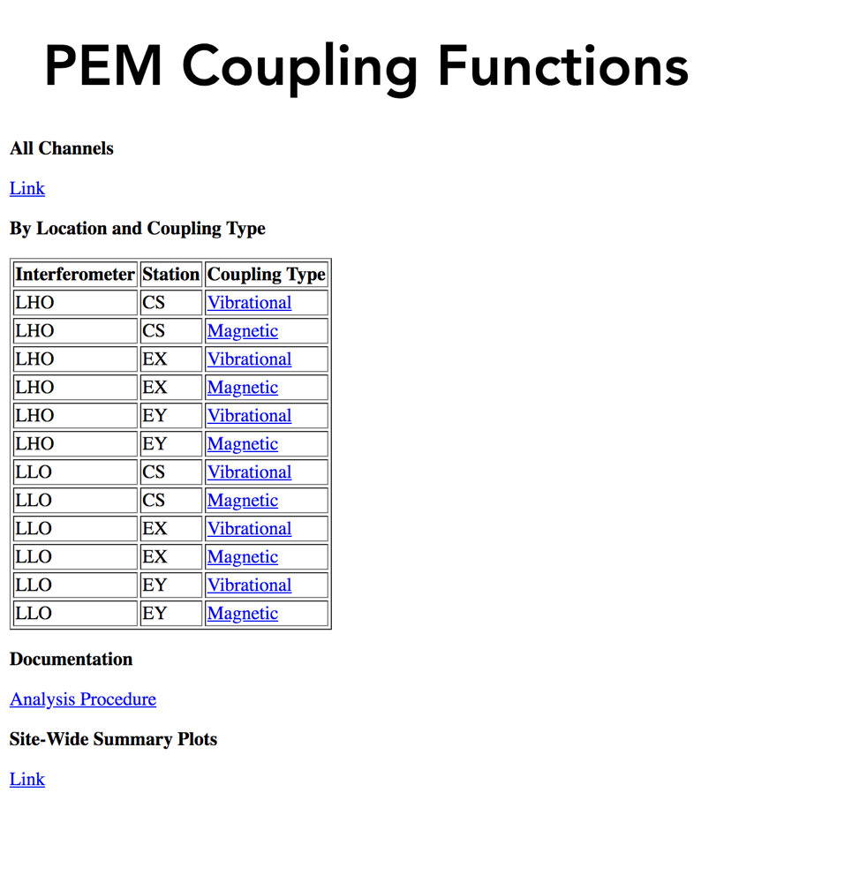

Slide 19
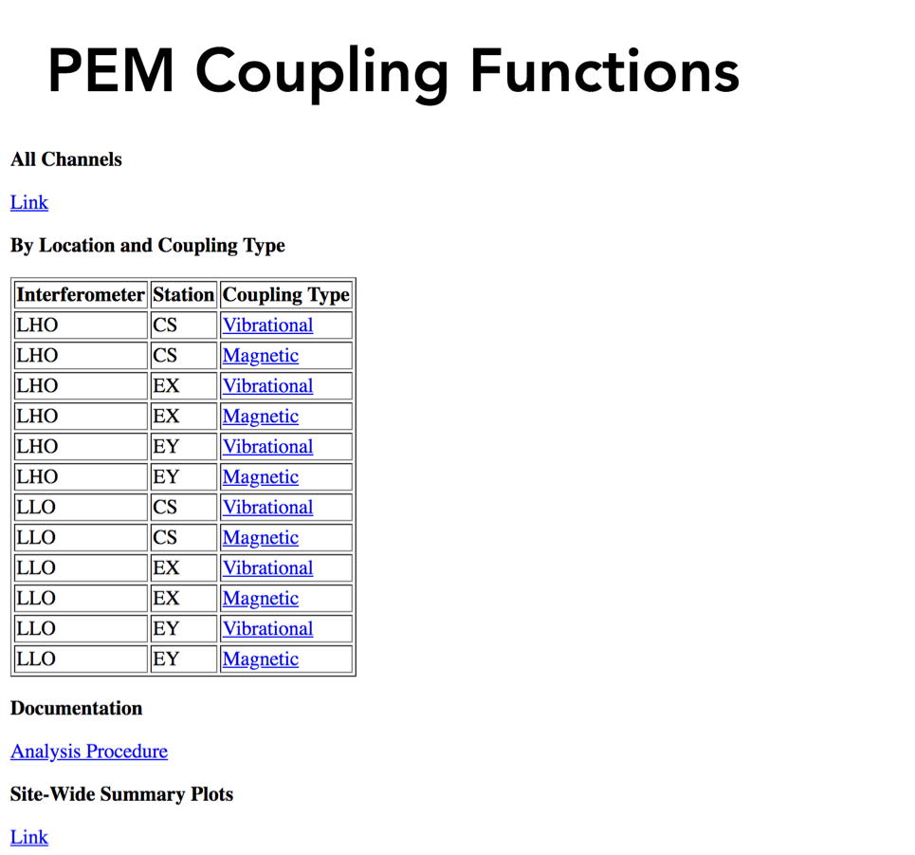
Count coupling functions for easy/automated estimation of DARM contribution

Slide 20
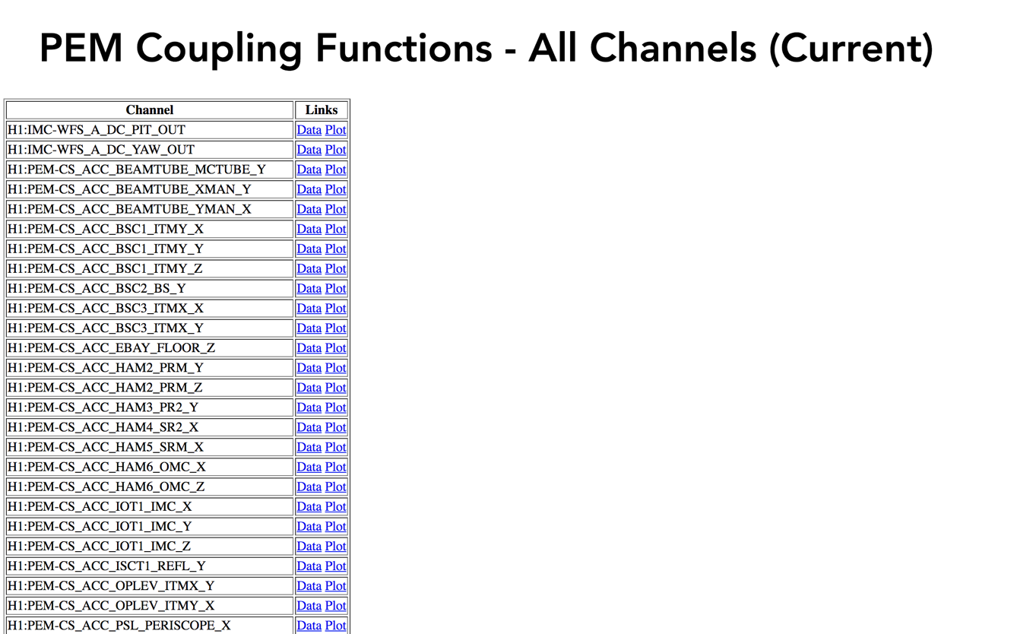

Slide 21
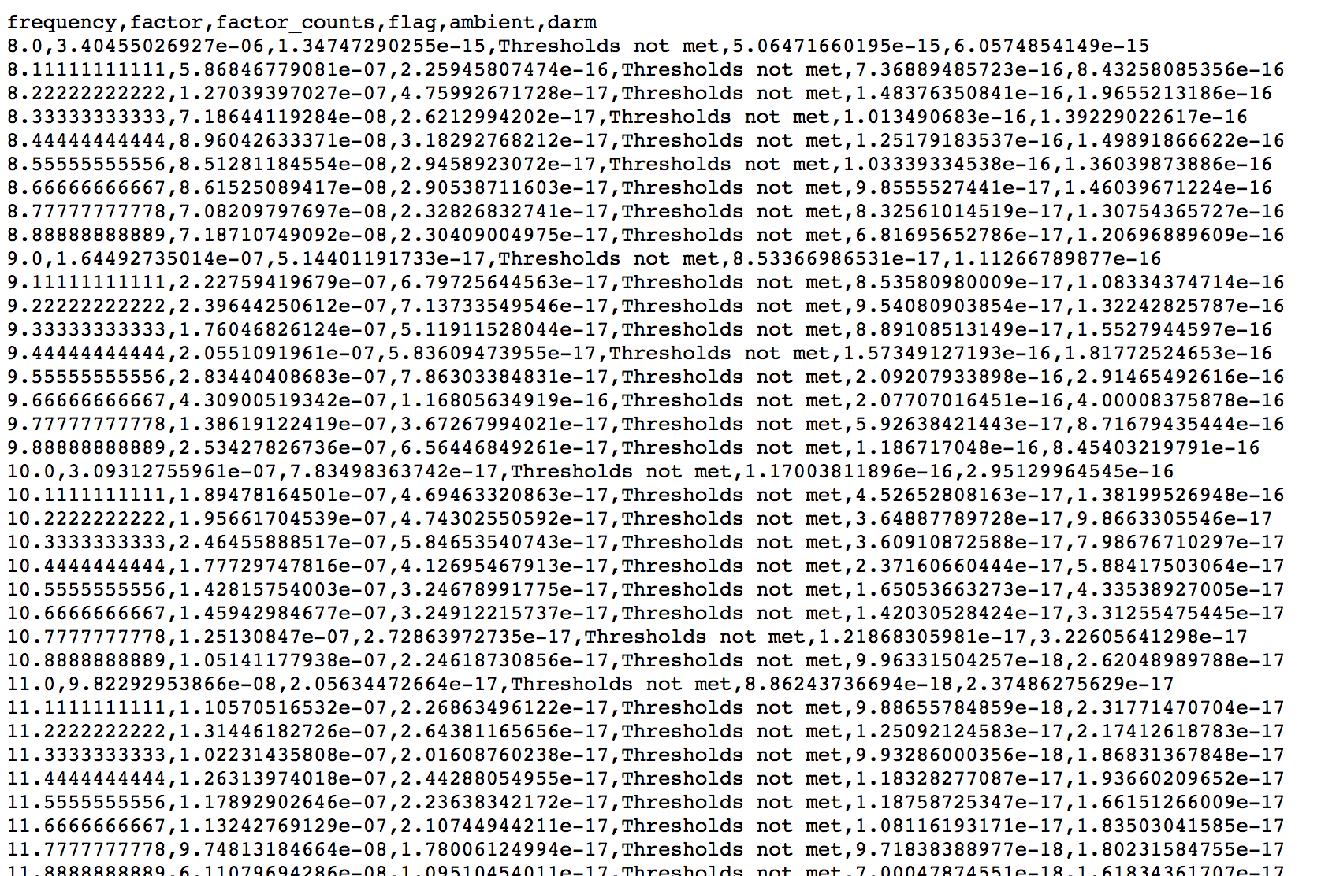

Slide 22


Slide 23
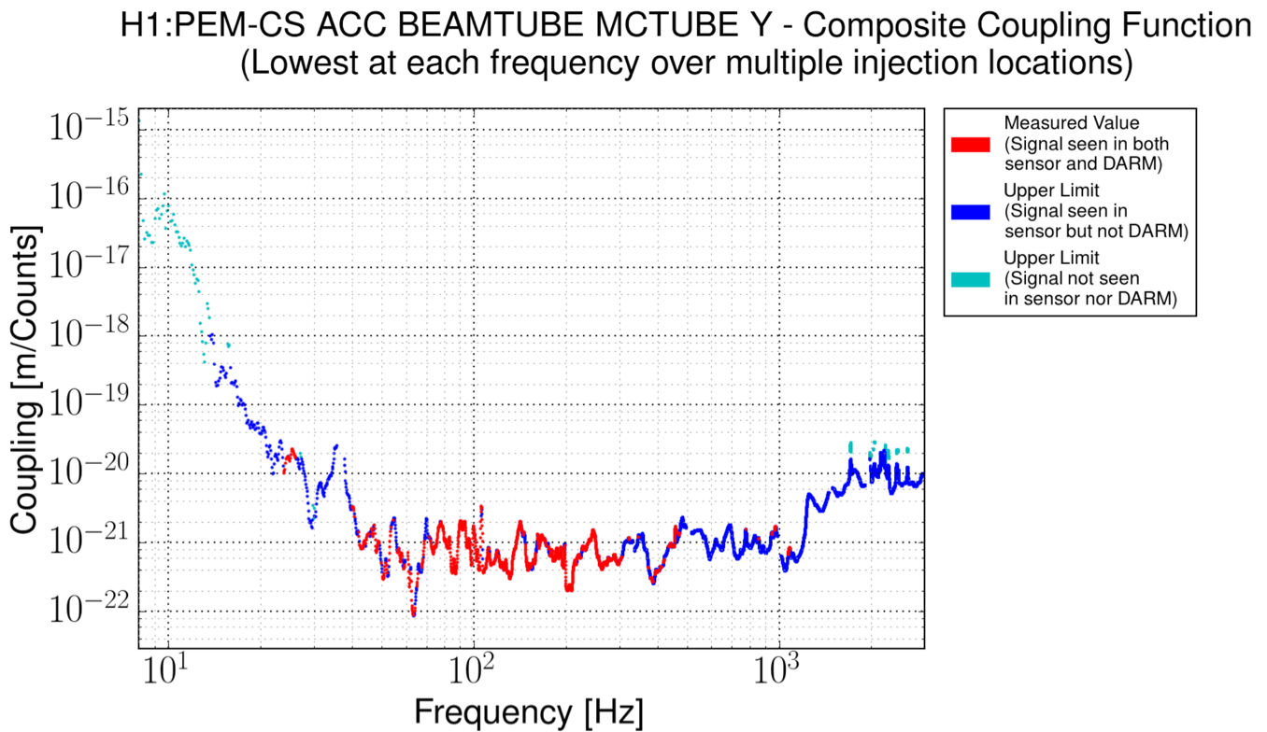

Slide 24
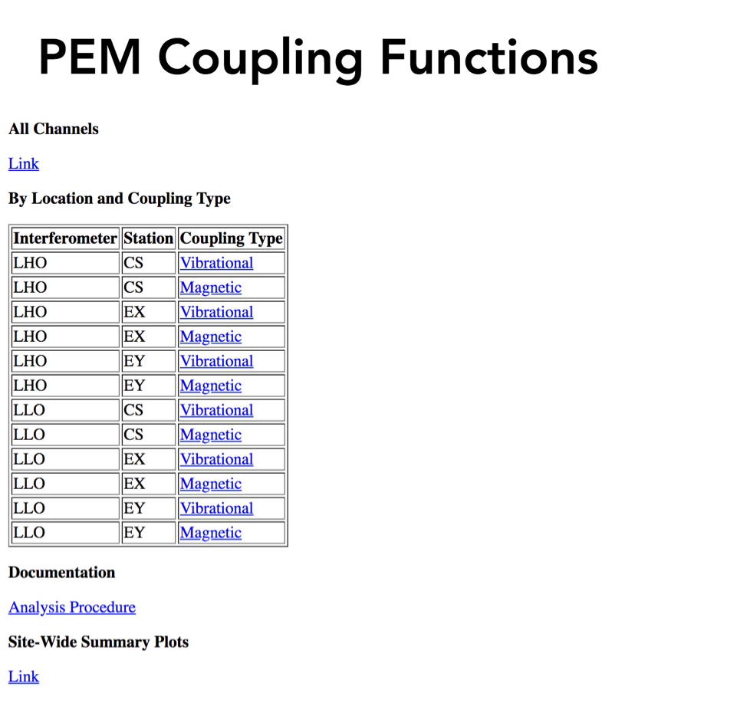
Summary plots

Slide 25
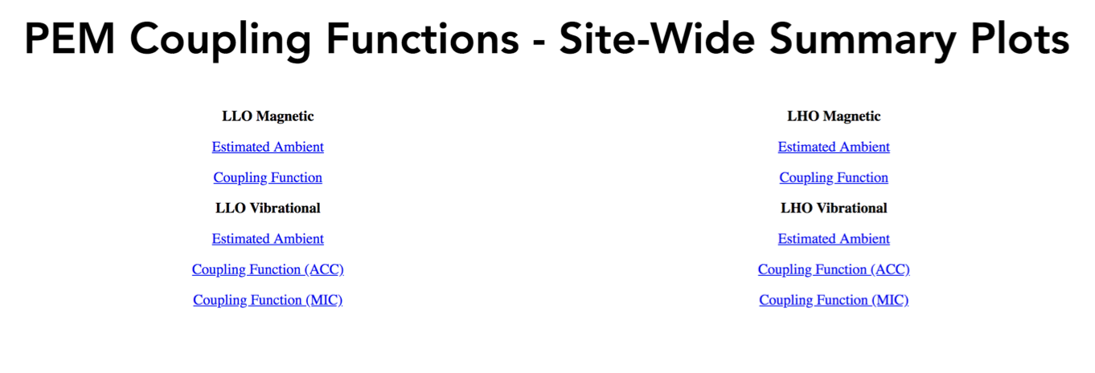
Summary plots

Slide 26
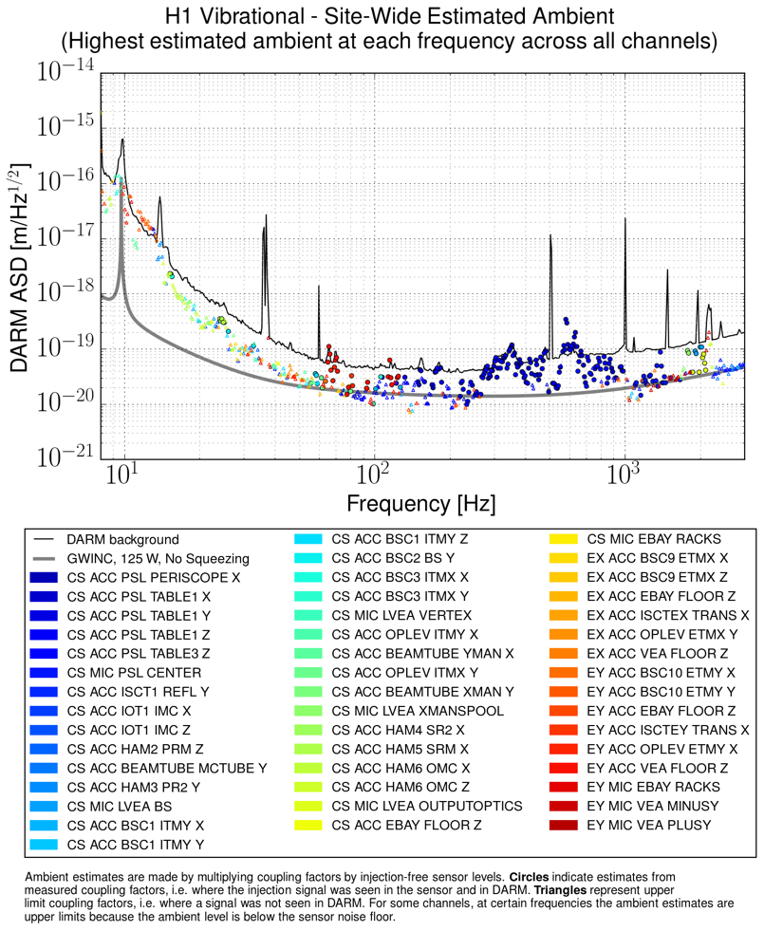
Hanford input beam jitter coupling

Slide 27
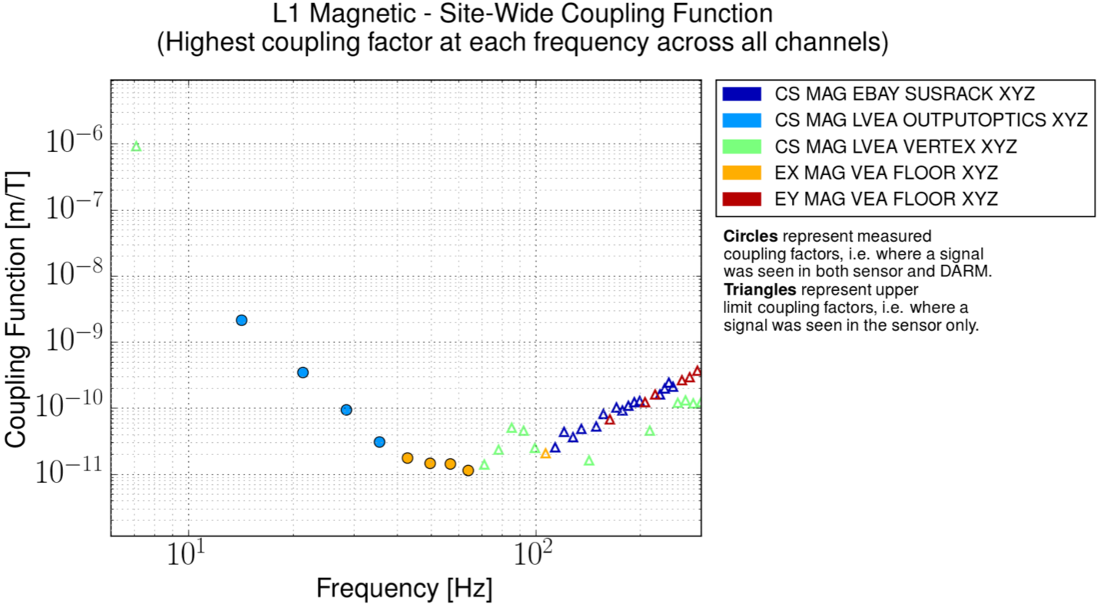

Slide 28
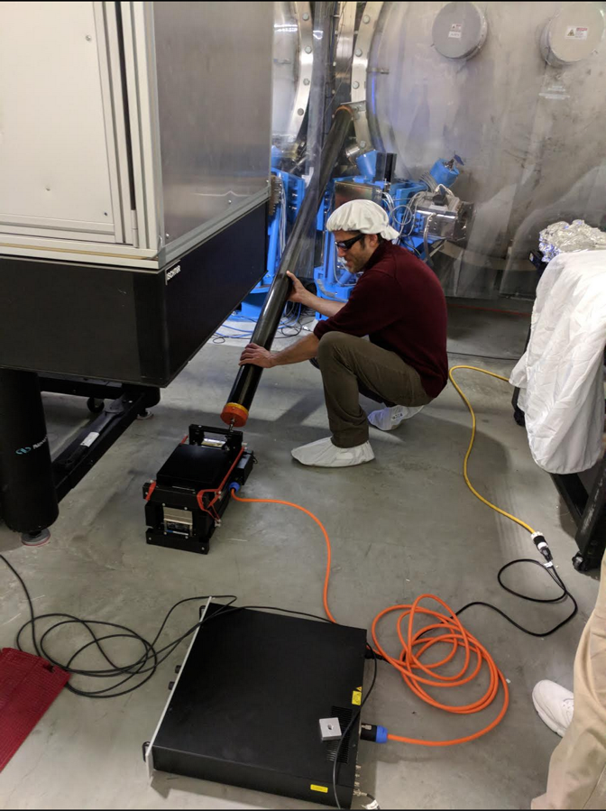
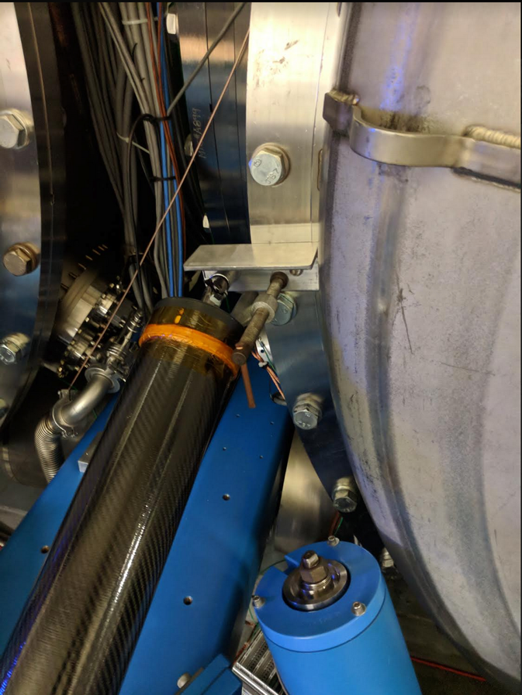
B. New low-f shaking system at LLO, with stiff connecting rod

Slide 29
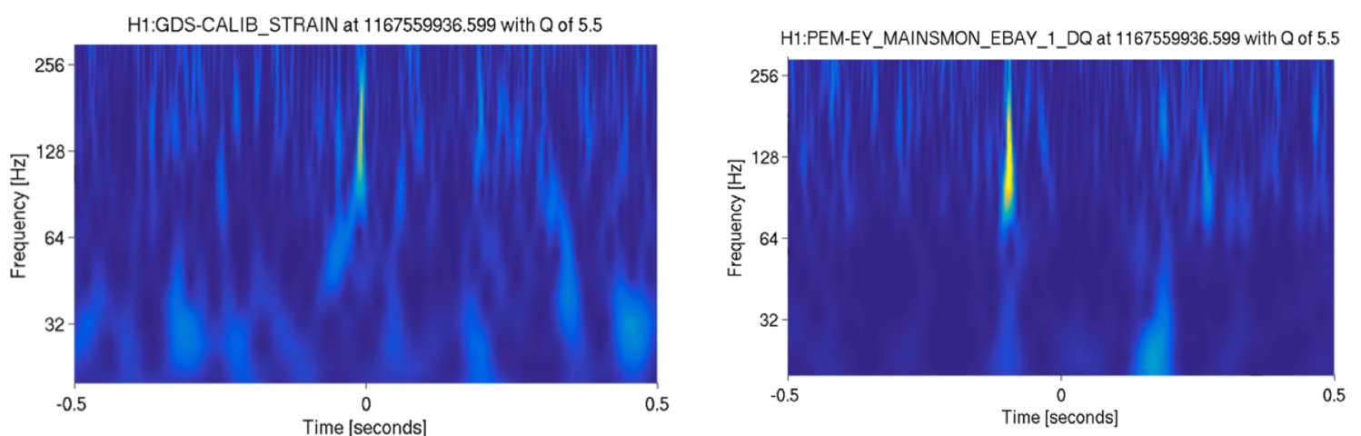
III. Plans for BBH vetting in O3
  A. LigoCAM-based PEM coverage assessment by expert
  B. Expert review of DetChar-supplied links to triggered channel spectrograms using PEM configuration files.
  C. Rarely, coupling calculations for any PEM TF paths that are similar to inspiral, using coupling functions on PEM.LIGO.ORG
Mainsmon event similar to GW170104, 0.1s before

Slide 30
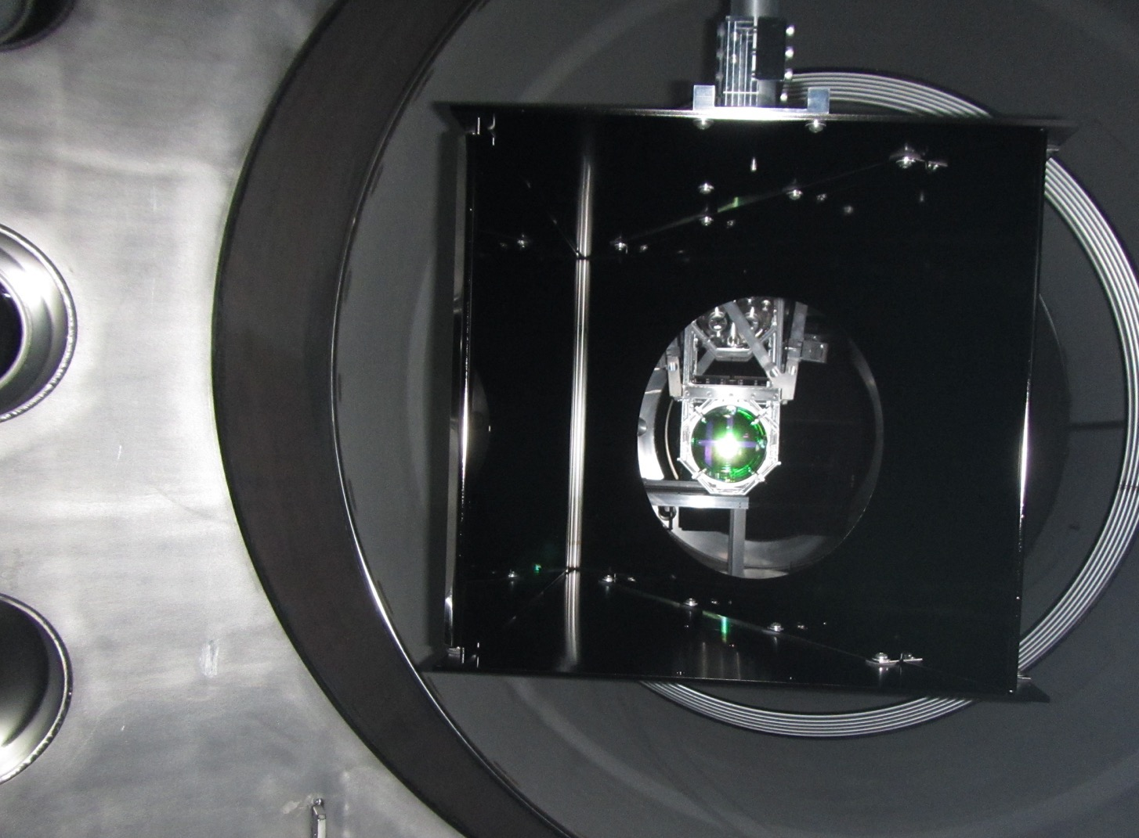
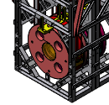

Most important PEM-related commissioning for O3
BSC2 wall
A. Beam jitter investigation/minimization especially at LHO
B. Scattering investigations - feedback to Stray Light Control project
C. New squeezer couplings
D. Blip-glitches, other glitches and lines
ITMY cage
BSC1-BSC8 flange
ITMY elliptical baffle
Beam spot view

Slide 31
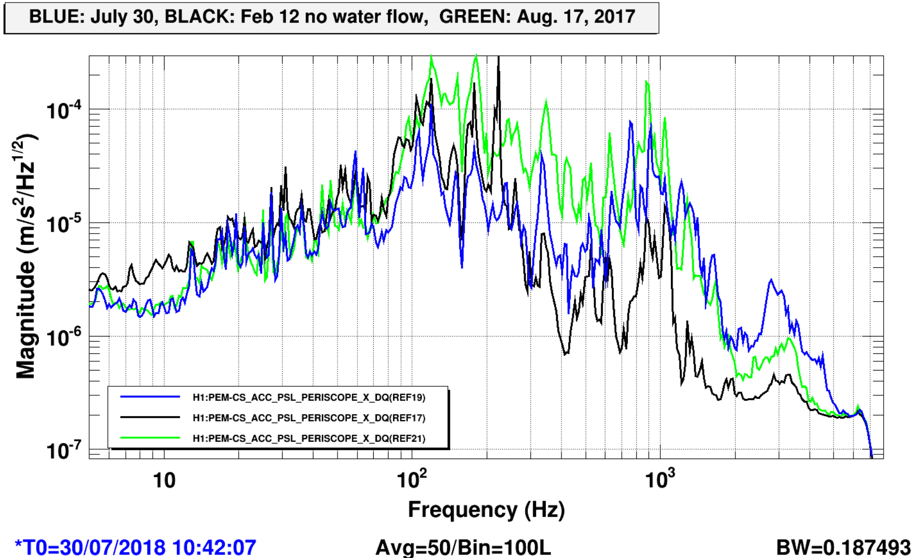
A. Status of LHO PSL table motion
BLUE: July 30, 2018, BLACK: no water flow Feb. 12, GREEN: Aug. 17, 2017

Slide 32
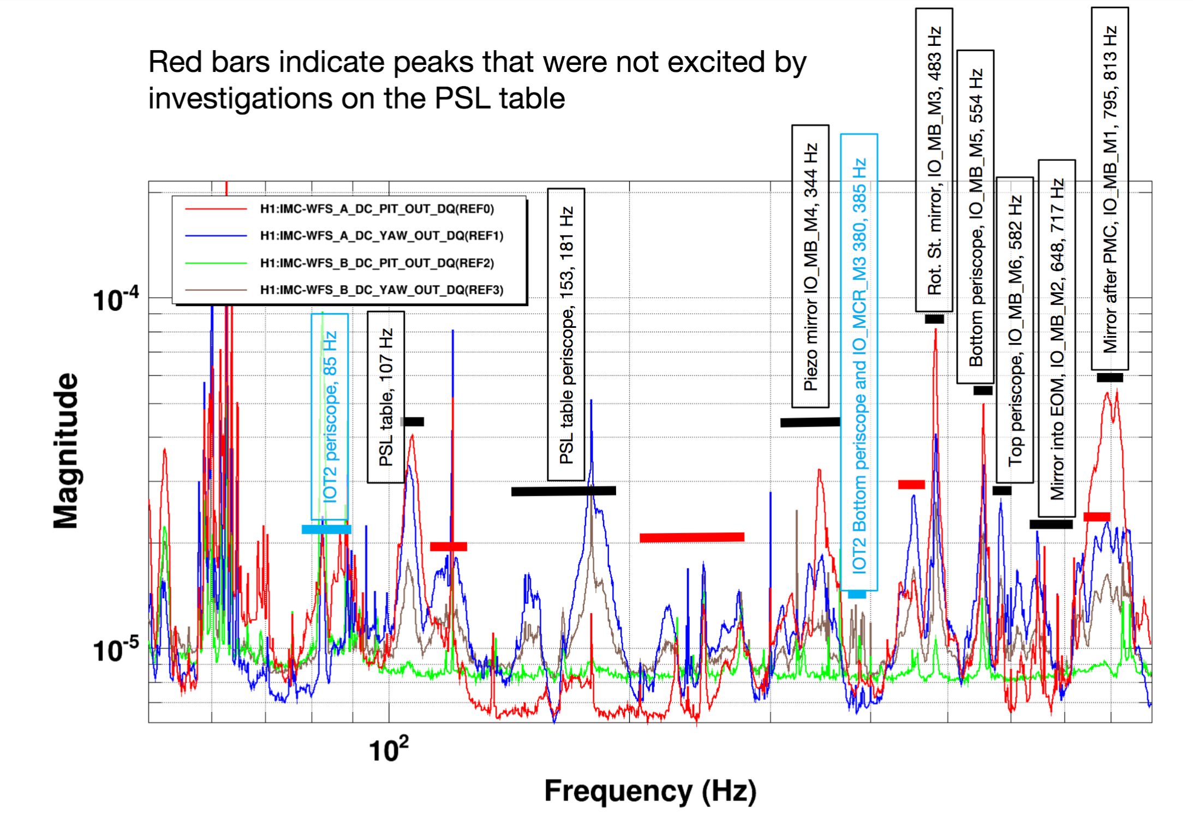
A. Identification of peaks in LHO jitter spectrum

Slide 34
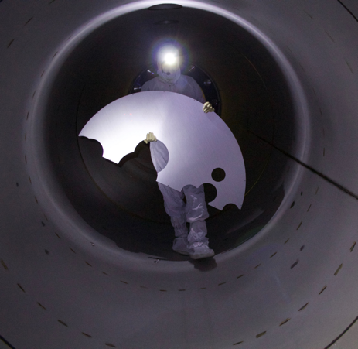
B. Scattering investigations and feedback to SLiC
  1. Low-f shaker coupling measurements LLO/LHO
  2. Some mitigation photos
  3. Beam spot photos at LHO
  4. Glint ranking for wide angle scattering at LHO

Slide 35
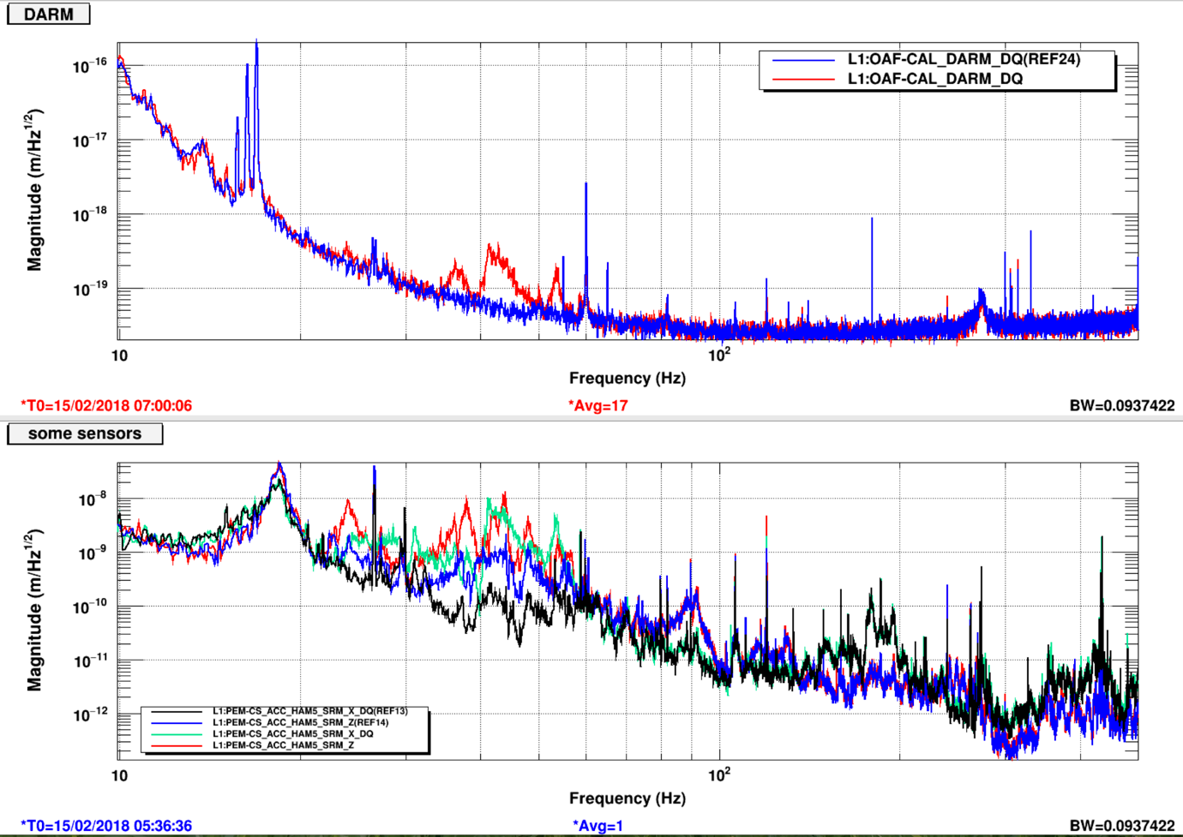
1. Factor of ~10 increase in LLO HAM5,6 motion in 40 Hz region produces ~10 increase in DARM

Slide 36
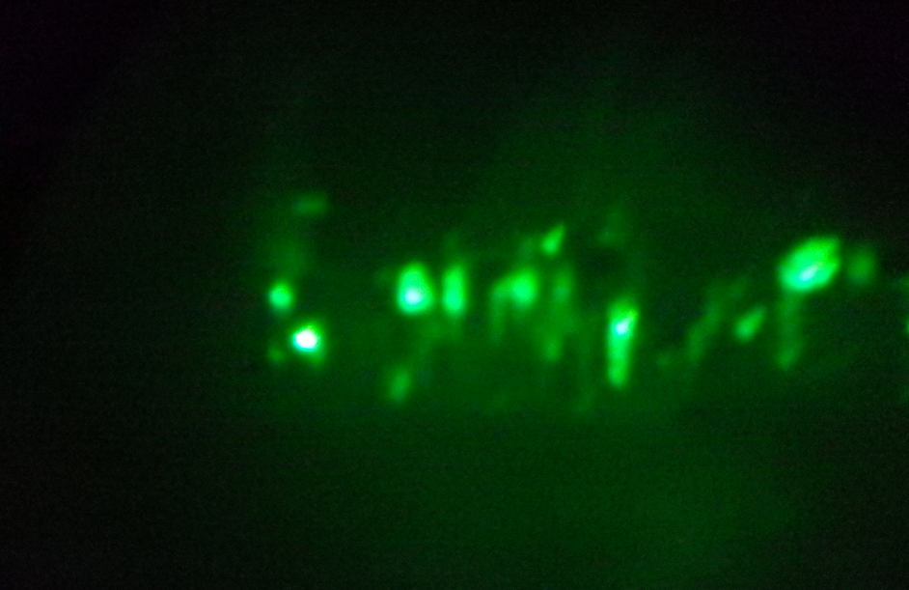
1. Possible scattering path: OFI to vacuum enclosure and back
  1) Shaking produces DARM noise at vacuum enclosure resonances
  2) Moving OFI, using new actuators, strong scattering, modulates chamber peak
  3) OFI is greatest source of scattered light visible at view ports.
Block paths from OFI to vacuum enclosure?

Slide 37
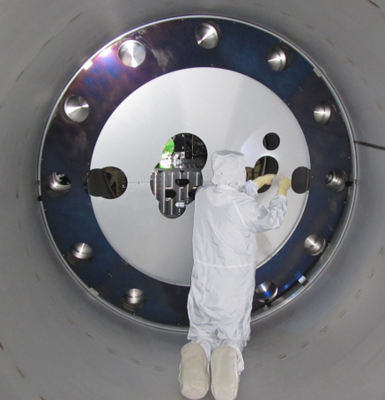
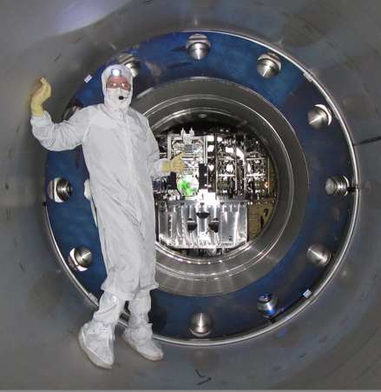
2. Removal of Swiss-cheese baffle

Slide 38
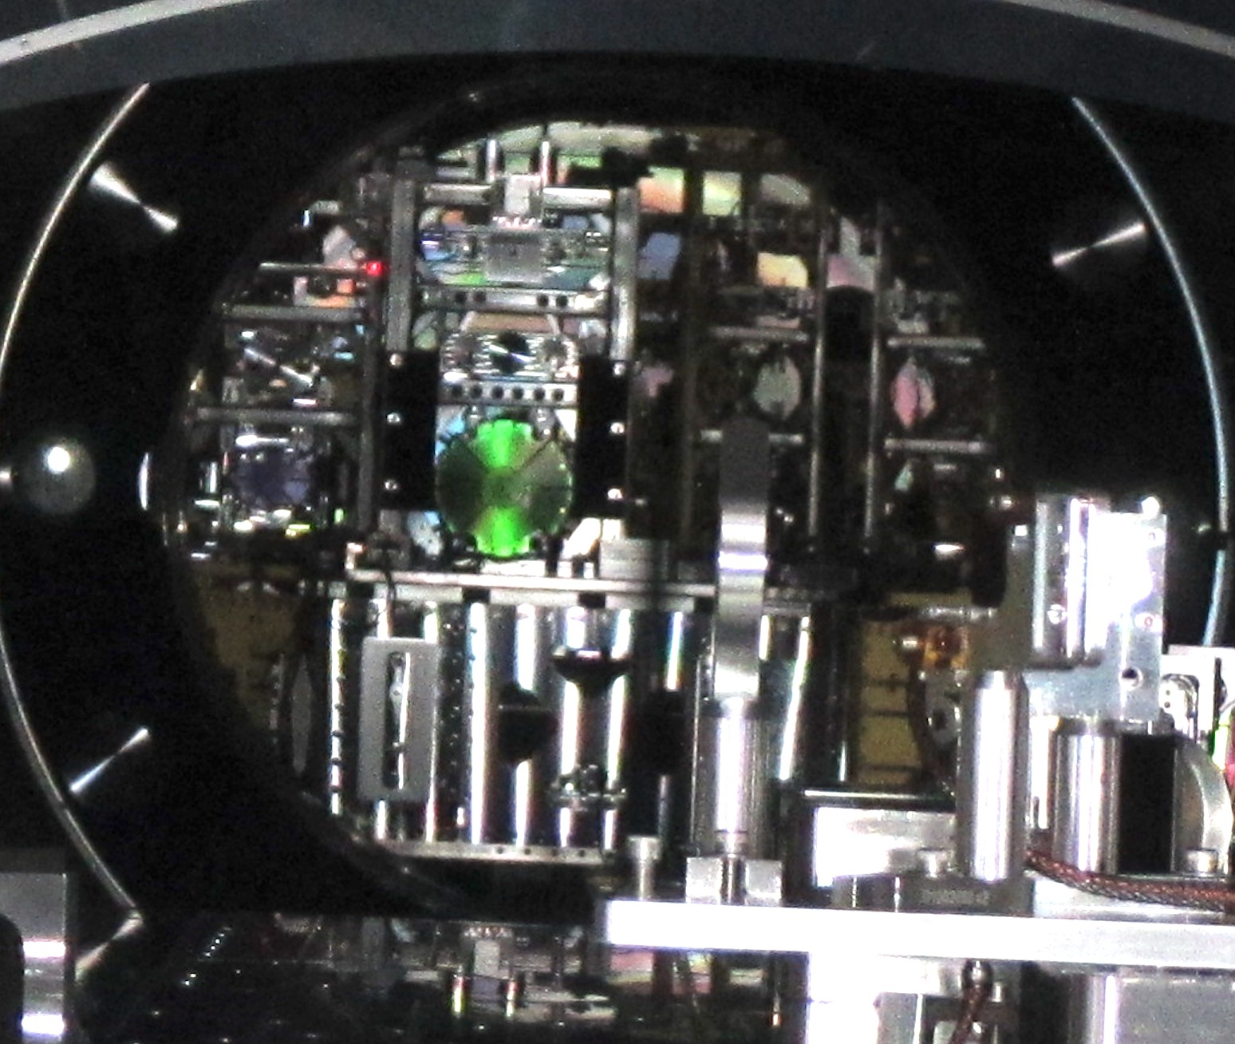
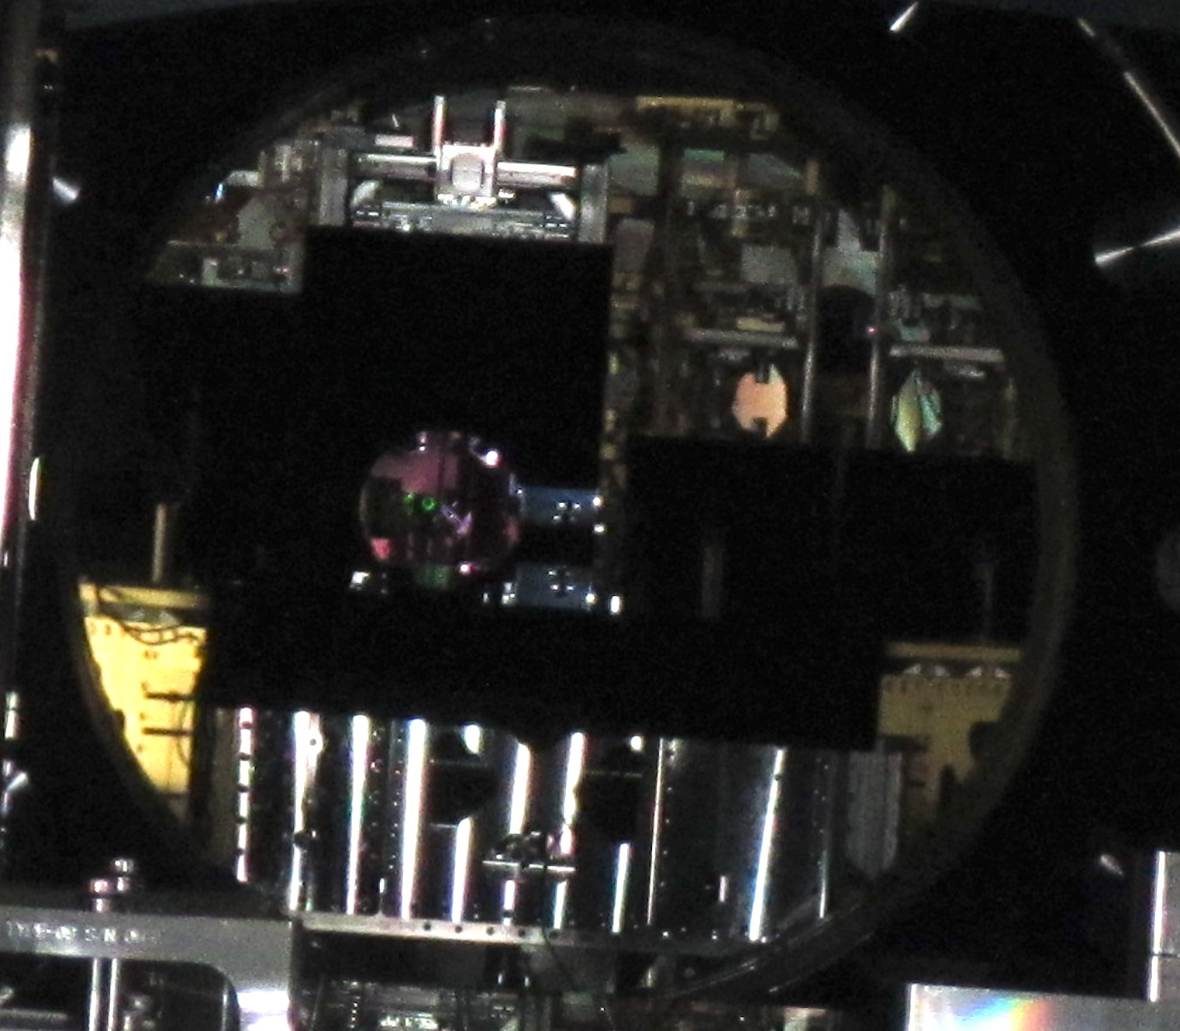
2. Before and after baffling at HAM2

Slide 39
2. P-Cal periscope baffling

Slide 40
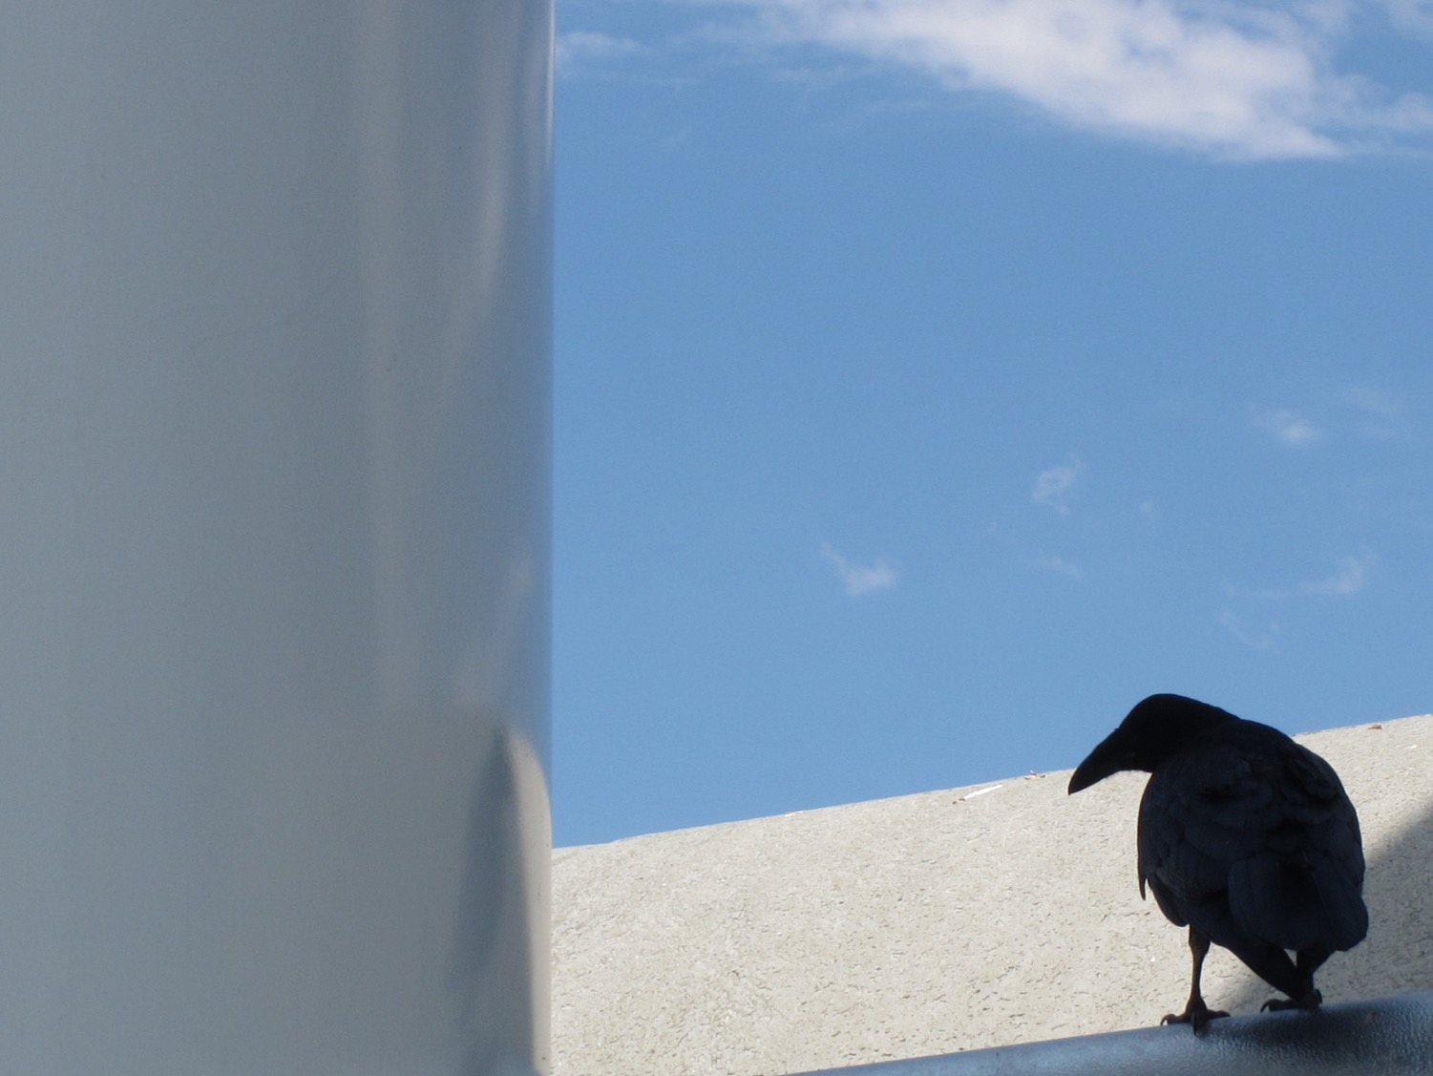
Raven pecks likely couple at P-Cal periscope
Ravens peck at ice accumulating on nitrogen discharge line from cryopump

Slide 42
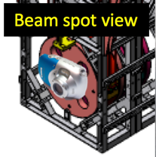
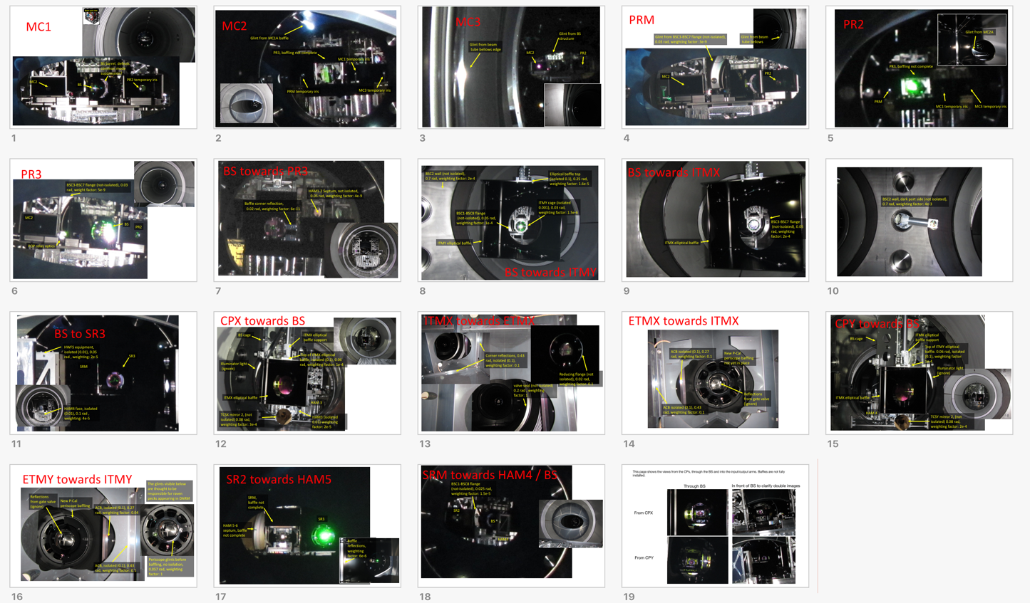
3. Views from beam spots at LHO
https://alog.ligo-wa.caltech.edu/aLOG/index.php?callRep=41142

Slide 43
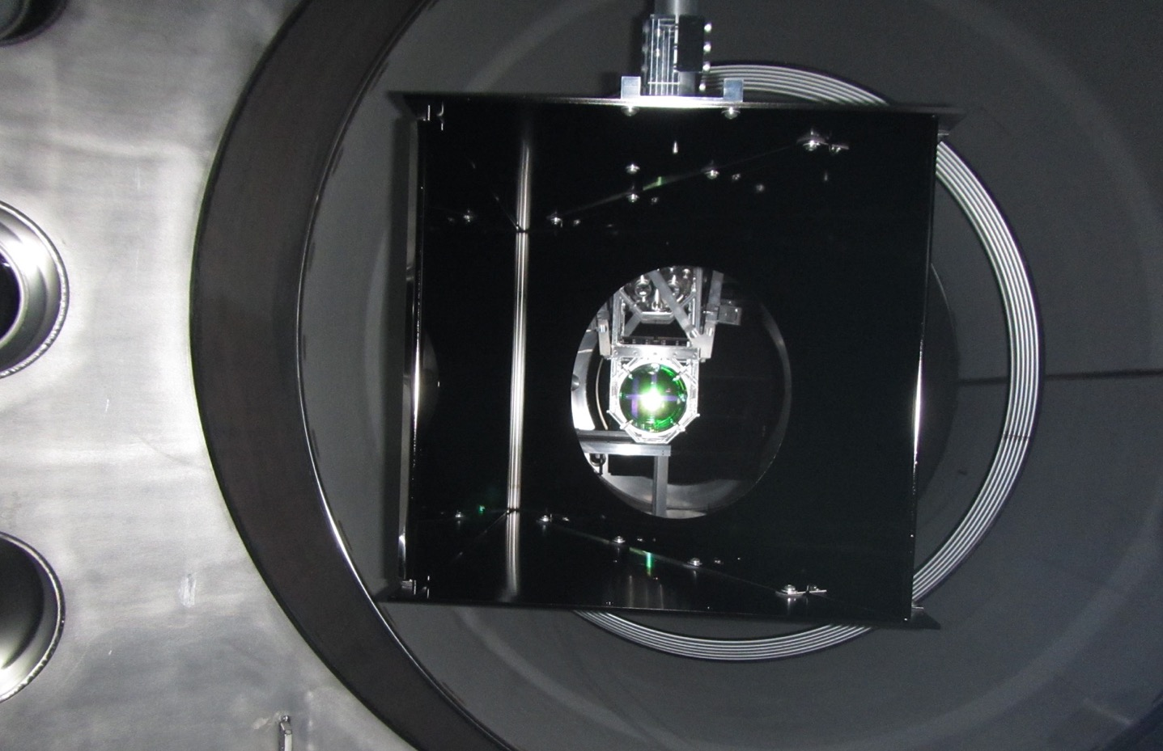
4. Assessing the importance of glints in beam-spot view photographs
BSC2 wall
Elliptical baffle top
ITMY cage
BSC1-BSC8 flange
ITMY elliptical baffle
Beam spot view
BS towards ITMY

Slide 44
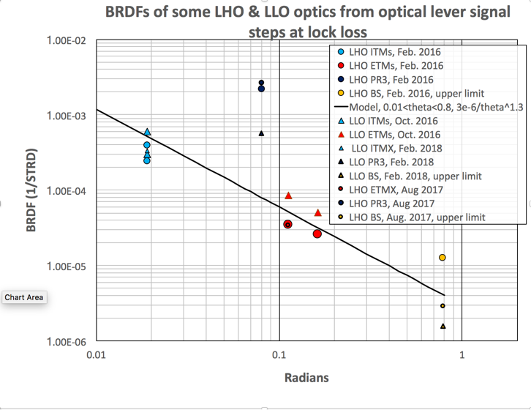
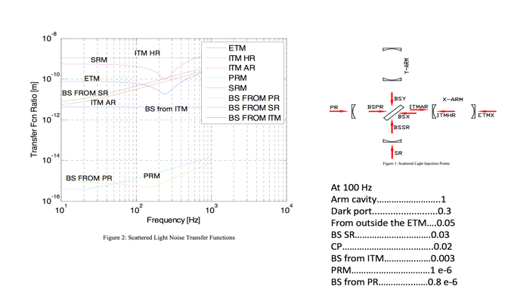
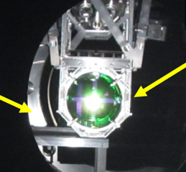
4. Glint ranking method
https://alog.ligo-wa.caltech.edu/aLOG/index.php?callRep=41142
  Weight = BRDF^2 * transfer-to-DARM * relative-power-on-optic * steradians-of-glint * reflector-motion * normalization-factor / distance-optic-to-reflector^2
  BRDF
  Transfer-to-DARM
  Steradians-of-glint: photo approx. calibrated to steradians per pixel using known angles, multiplied by pixels in glint. Simplified by assuming all pixels in glints have same value.

Slide 45
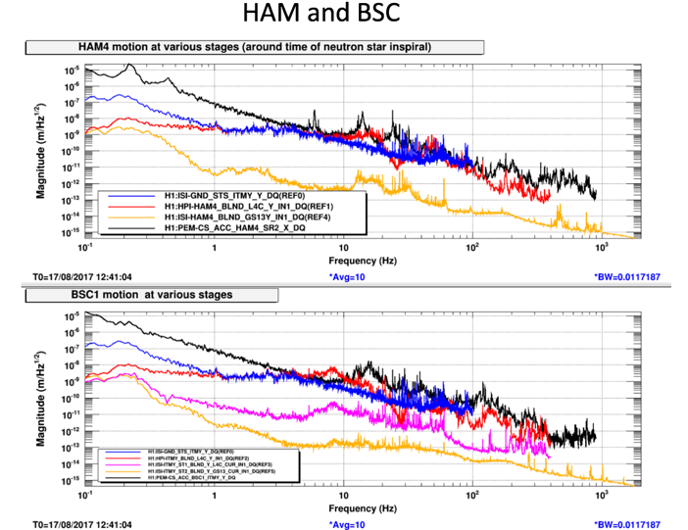
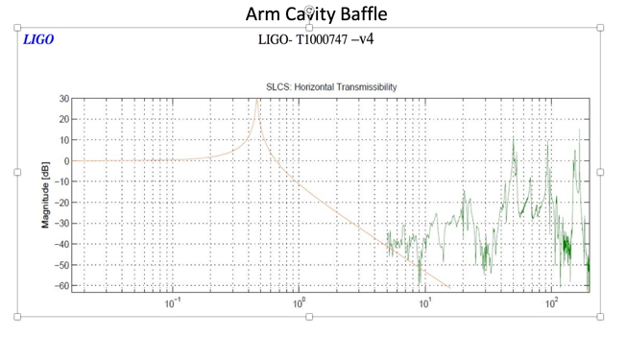
4. Glint ranking method
  Weight = BRDF^2 * transfer-to-DARM * relative-power-on-optic * steradians-of-glint * reflector-motion * normalization-factor / distance-optic-to-reflector^2
  Reflector motion estimate from transfer function at 100 Hz
Some caveats: photo is wide-band, doesn’t account for recombination at different optic, doesn’t account for stray beams (but pictures show reflectors).

Slide 46
Table of weighting factors for wide-angle scattering
optic from which beam is scattered and recombined, dash gives the direction of the beam being scattered if there are multiple possibilities | retro-reflecting site | weighting | Rough seismic isolation at 100 Hz | sqrt( weighting) x seismic isolation (rough amplitude)
BRDF model: 3e-6/theta^1.3 with distance^2 and isolation weighting
ETMY-ITMY | P-Cal periscope glint | 1.00E+00 | 1 | 1.00E+00
ITMX-ETMX | valve seat | 9.48E-01 | 1 | 9.73E-01
ITMX-ETMX | ACB line reflections in near corner of ACB | 3.10E+00 | 0.1 | 1.76E-01
ETMY-ITMY | ACB line reflection near corner | 2.24E+00 | 0.1 | 1.50E-01
ITMX-ETMX | reducing flange by op lev | 1.32E-02 | 1 | 1.15E-01
ETMX-ITMX | ACB line reflection near corner | 1.31E+00 | 0.1 | 1.14E-01
ETMX-ITMX | ACB line reflection far corner | 8.46E-01 | 0.1 | 9.20E-02
ETMY-ITMY | ACB line reflection far corner | 2.52E-01 | 0.1 | 5.02E-02
BS--XY wall | wall with op lev | 1.47E-03 | 1 | 3.83E-02
BS-ITMY | chamber wall | 2.70E-05 | 1 | 5.20E-03
BS-ITMX | BSC3-7-Flange | 1.03E-05 | 1 | 3.21E-03
BS-ITMY | Flange BSC1-8 | 6.50E-06 | 1 | 2.55E-03
ITMX-ETMX | bellows | 6.07E-06 | 1 | 2.46E-03
CPX-BS | TCS mirror | 4.28E-06 | 1 | 2.07E-03
CPY-BS | TCS mirror holder | 3.01E-06 | 1 | 1.73E-03
CPY-BS | ITM elliptical baffle top | 4.91E-05 | 0.1 | 7.01E-04
CPX-BS | ITM elliptical baffle top | 3.06E-05 | 0.1 | 5.53E-04
BS-ITMY | elliptical baffle top | 1.48E-05 | 0.1 | 3.85E-04
BS-SR3 | HAM4 table edge | 7.95E-04 | 0.01 | 2.82E-04
BS-SR3 | HWFS equipment | 1.72E-04 | 0.01 | 1.31E-04
SRM-BS | BSC1-8 flange | 5.39E-09 | 1 | 7.34E-05
CPX-BS | front side of HAM4, lower part visible under elliptical baffle | 4.41E-05 | 0.01 | 6.64E-05
SR2-SRM | baffle reflection | 2.52E-05 | 0.01 | 5.02E-05
CPX-BS | HAM4 table edge visible through elliptical baffle | 2.49E-05 | 0.01 | 4.99E-05
BS-ITMY | cage around test mass | 6.28E-05 | 0.003 | 2.38E-05
High rankings of P-Cal periscope, reduction flange and BS chamber walls agree with shaking results

Slide 47
Glints with weighting of 1
ETMY towards ITMY, showing P-Cal periscope before upgrade
Periscope glints before baffling, no isolation, about 0.06 rad, weighting factor: 1, glints thought to be responsible for raven pecks appearing in DARM. Reflection from gate valve has been blacked out.

Slide 48
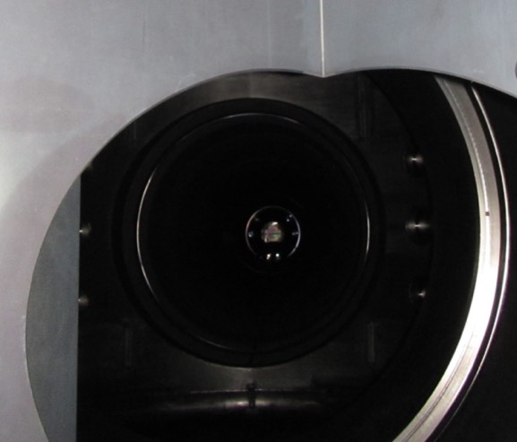
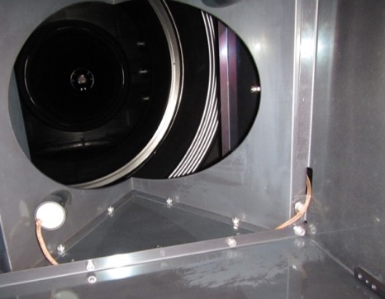

Next highest weighting factors
ITMX looking towards ETMX, similar on other arm
Reducing flange (not isolated), 0.02 rad, weighting factor: 0.1
valve seat (not isolated) 0.2 rad , weighting factor: 1
ACB linear structure reflections, 0.43 rad, isolated (0.1), weighting factor: 0.2

Slide 49

ETMX towards ITMX
ACB isolated (0.1), 0.27 rad, weighting factor: 0.1
New P-Cal periscope baffling not yet in place
Reflections from gate valve (ignore)
ACB isolated (0.1), 0.43 rad, weighting factor: 0.1

Slide 50

BSC2 wall, dark port side (not isolated),
0.7 rad, weighting factor: 0.04

Slide 51
Suggested priorities for SLiC
Stray light mitigation | Comments | Further studies
1) OFI shroud for HAM5-6 coupling | 1) OFI actuator injection: lots of DARM noise 2) Shaking indicates path that involves HAM5-6 vacuum enclosure (including septum) 3) Lots of light seen from port with viewer | Investigate possible role of ZM path (LHO/LLO difference in O2)
2) Improve SQZ beam diverter | Will help with diagnosis of other squeezer stray light, etc.
3) Nozzle baffle for P-Cal port, blank reduction flange ports, blank BS ports. | 1) Shaking of P-Cal beam nozzle 2) Moderate glint rankings
4) Baffle ring around baffle at reduction flange by ITM optical levers | 1) Moderate glint ranking 2) Shaking produces moderate coupling
5) Baffle BSC2 walls | 1) Moderate glint ranking 2) DARM noise from shaking of VE around BSC2 at both sites | Further shaking studies to test wall hypothesis
6) Improve Arm Cavity Baffles, baffle corner reflections and block gate valve seat | 1) High glint ranking 2) But no evidence in HEPI shaking tests or noise from shaking gate valve | X and Y HEPI injections at test masses
7) Baffle BS-side faces of HAM3,4 | 1) Glint ranking fairly low, 2) No evidence from shaking
8) Angle P-cal beam windows
Opportunistically: ghost beam on balance mass in front of PR2, Dog clamps / table masses, SR2 Baffle Aperture to HWC, etc.

Slide 52
Summary from shaking and glint ranking
I. We are doing pretty well for O3, glint ranking and shaking did not uncover any limiting scattering except at LLO HAM5-6 (OFI?).
II. However, glints from ACBs and valve seat were ranked almost as high as the P-Cal periscope and we need to double check that shaking stage zero of TMs doesn’t produce noise, and that we are moving the gate valve enough when we shake it.
III. Many of the places of concern, e.g. exposed HAM1-2 septum, are probably not significant concerns.
IV. We suggest focus on output port scattering (OFI?) and any new scattering associated with the squeezers. And continue checking stray beams.

Slide 53

VI. Other support for astrophysical search groups
  A. Continuous (like a calibration line) or Tuesday magnetic injection to determine coupling, for Stochastic estimates of correlated magnetic noise in DARM
  B. Likely need new site for LLO LEMI, also for Stochastic
  C. Beam tube currents and transients at LLO
  D. Line finding for CW and Stochastic
  E. Blip glitches from environmental sources
  F. PEM at KAGRA workshop

Slide 54


A. Ratio of O2 33-53 Hz magnentic coupling, Aug/Nov
Consistent with reduced coupling in path from ebay to vertex and remaining high coupling in output arm.
1/13
1/25
ebay
1/3
1/25
1/2
A possible explanation: HV supplies on ITM ESDs were replaced…
R. McCarthy F. Clara
Do we need to continuously inject (like a calibration line) to monitor coupling when we subtract correlated noise from Schumann resonances?

Slide 55


B. Investigation of LEMI site along entry road: 20 Hz still present
Should we be planning off-site location?

Slide 56

C. DEMCO found and corrected neutral-to-ground break,
but no reduction seen in glitches on magnetometer - recheck beam tube currents
Paul Corban, Anamaria

Slide 57


D. Contributions to Paper on O1-O2 line finding
https://dcc.ligo.org/DocDB/0148/P1700440/005/ALIGO_LinesCombsPaper.pdf

Slide 58

E. O2 high blip-glitch rate with low humidity
Derek Davis, Laurel White, Miriam Cabero

Slide 60

F. PEM at KAGRA workshop

Slide 61

Outline of results
A. SUGGESTED ACTIONS
1) For PEM channels, use BNC interfaces with a gain of at least 10, and a gain of 100 for the seismometers.
2) Check for clipping at likely sites (EOM/AOM) on PSL table.
3) Improve the PSL table periscope and make table connections more rigid at other optic structures with mass far above the surface (high moment of inertia around the attachment point).
4) Grout the PSL table legs to the floor.
5) Place the power supply racks on vibration isolating feet and also consider isolation for other electronics racks.
6) Improve seismometer mounting and monitor differential motion of the stations.
7) Testing equipment suggestions.
B. AMBIENT VIBRATION AND MAGNETIC LEVELS IN THE KAGRA CORNER STATION, AND A COMPARISON TO LIGO
1) The sound level at KAGRA, with temporary equipment shut down, was measured to be a factor of 2 or 3 below LHO at low (10-100) and high (>1000) frequencies.
2) The seismic signal should be amplified by about 100. The microseismic peak levels appear to be high at KAGRA.
3) Magnetic levels from the mains were significantly larger at KAGRA than LIGO.
C. COUPLING OF ENVIRONMENTAL SIGNALS TO THE IMC
4) The dominant vibration coupling site for the IMC is in the PSL.
5) A Table resonance is responsible for the largest peak in the IMC spectrum, the 80 Hz peak.

Slide 62
PEM update
DetChar F2F, August, 2018
I. Restoration of PEM system following install
II. More sensors near coupling sites
III. Improved PEM coupling functions
IV. Plans for BBH vetting in O3
V. Most important PEM-related commissioning
VI. Other support for astrophysical search groups
Robert Schofield, Philippe Nguyen, Kara Merfeld, Ray Frey, Jordan Palamos, UO, Anamaria Effler, Corey Austin, Terra Hardwick, Valery Frolov, LLO, and many others

